Slide 1
Welcome Back to School
August 2025
Bailey Tennesen, Compliance Consultant, KC RPDC
Dawn Lichtenberg, Compliance Consultant, NE RPDC
Notes:
Dawn- To Say: Good Morning and welcome back to school!! My name is Dawn Lichtenberg and I am the Northeast City-Regional Professional Development Center Compliance Consultant and my partner today is Bailey Tennesen from the Kansas City Regional Professional Development Center.

Slide 2
Back to School Hot Topics
Policy and Procedures
Standard and Indicators, State Plan and Local Compliance Plan
Senate Bill 68
Nonpublic Consultation
Transition from Part C to B
Administrator Checklist Duties
Missouri School for the Severely Disabled
Resources
Notes:
To Say: Today we are going to discuss the following hot topics
Policy and Procedures
Standards & Indicators and State Plan Changes
What this means for local compliance plan
Senate Bill 68
Nonpublic Consultation
C to B transition
Administrator Checklist Duties
Missouri School for the Severely Disabled
And Resources available at your fingertips!

Slide 3
Missouri Standards and Indicators for Special Education

Slide 4
Standards and Indicators
No changes are currently being made to the Missouri Standards and Indicators for Special Education.
Notes:
To Say: As of now, no changes to the Missouri Standards and Indicators have been made for the 2025-2026 school year.

Slide 5
Missouri State Plan Updates
Notes:
To Say: Let’s discuss the Missouri State Plan Updates.

Slide 6
Hang Tight
Changes are Coming to the Missouri State Plan due to SB 68
Notes:
To say: As of now, there are no changes to the Missouri State Plan. However, DESE is currently in process of getting the Emergency State Plan signed by our governor due to legislation passing Senate Bill 68. As soon as the Emergency State Plan gets signed, a SELs message will be released via email to notify districts about updating their local compliance plan.

Slide 7
Local Compliance Plan
http://dese.mo.gov/local-compliance-plan
Notes:
To Say: The next question you are probably thinking is, what do we need to do with our local compliance plan since there are no current changes?

Slide 8
Local Compliance Plan
No changes have been made YET to the Missouri State Plan for Special Education. At this time, LEAs do not need to adopt a new Local Compliance Plan. Stay tuned on SELs for further guidance.
Notes:
To Say: Districts do NOT need to adopt a new Local Compliance Plan for the 25-26 school year, at this time. We have had many districts contacting us asking if they would need to go in front of their school boards to get a new local compliance plan approved. This process only needs to happen when updates are made to the Missouri State Plan.
Recap: Districts DO NOT need to adopt a new Local Compliance Plan :) Wait for the SELs message from the state on guidance of the impact from Senate Bill 68 on Local Compliance Plans.

Slide 9
Young Child with a Developmental Delay (YCDD)
Notes:
To Say: Lets dive into Senate Bill 68 and discuss the changes that our legislation approved regarding special education.

Slide 10
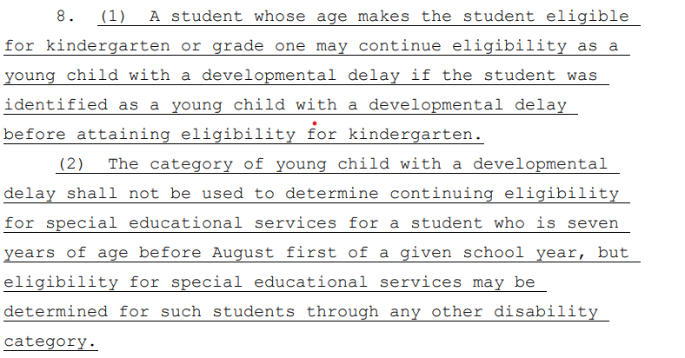
RSMo 162.700 YCDD
https://revisor.mo.gov/main/OneSection.aspx?section=162.700
Notes:
To Say: Senate Bill 68 has now changed the continued eligibility for Young Child with a Developmental Delay. In summary, this act provides that a child identified as a young child with a developmental delay before attaining the age of eligibility for kindergarten may continue such eligibility as a young child with a developmental delay. The category of young child with a developmental delay shall not be used to determine continuing eligibility for special educational services for a student who is seven years of age before August first of a given school year, but eligibility for special educational services may be determined for such students through any other disability category.

Slide 11
Steps to Consider for YCDD
Step 1:
Is the student eligible for kindergarten or grade one?
If the student PASSES first grade, YCDD is OVER PERIOD.
Students in kindergarten, grade one, or repeating either of these grades proceed to step 2.
Step 2:
When does the child turn 7?
Age 7 before August 1 of this school year, YCDD will NOT continue.
August 1 or later, YCDD can continue until the end of grade one.
Notes:
To Say: To better understand the YCDD changes, DESE has created these steps to assist our districts. The first question to ask is "is the student eligible for kindergarten or first grade? If the student has passed first grade, YCDD is over and a new eligibility must be determined. If the student is in kindergarten, first grade or repeating either of these, you would proceed to step 2. The next question you would ask is " when does the child turn 7?". If the student is age 7 before August 1st of the school year, YCDD will not continue. If the student turns 7 August 1st or later, YCDD can continue until the end of grade one.

Slide 12
Cell Phone Policy
Notes:
To Say: The other big hot topic we have been fielding a lot of questions on is the cell phone policy in Senate Bill 68.

Slide 13
RSMo 162.207 Cell Phone
Mandates that all public and charter schools in Missouri implement a policy restricting student use of personal electronic communication devices during the school day.
This includes cell phones, tablets, and smartwatches, with exceptions for emergencies and students with documented needs.
https://revisor.mo.gov/main/OneSection.aspx?section=162.207&bid=57281&hl=%20to%20167.%u2044167.625&hlr=y
Notes:
To Say: On July 9th Senate Bill 68 was signed into law. Within this law it mandates that all public and charter schools in Missouri implement a policy restricting student use of personal electronic communication during the school day. This includes cell phones, tablets and smart watches, with exceptions for emergencies and students with documented needs. Devices must be powered off and stored out of sight during the school day, including in classrooms, hallways, and during passing periods and lunch.
The law aims to minimize distractions, prioritize student engagement, and create a more conducive learning environment. Districts have the ability to create their own cell phone policies. We encourage our special education administrators to be apart of that development process. This law is in effect for the 2025-2026 school year and beyond.

Slide 14
What does this mean for students in SPED?
This needs to be clearly documented within the IEP (possible places we would see the use of a communication device- present level, potentially assistive technology device, health plan, accommodation/modification page)
***GOLDEN THREAD***
Remember, teams need to determine and document that the cell phone is a need not a benefit.
Notes:
To Say: Exceptions may be made for students with IEPs or 504 plans requiring device use for instructional, medical, or behavioral support. However, teams need to ask themselves, was this on the IEP prior? Why do they need it now? What can the specific communication device do that would cause it to be within the IEP that maybe their class Ipad or Laptop cannot?
Teams also need to be specific on where, when and how long they can utilize the communication device. Teams need to ask, is this a need or a benefit. A need may be for medical purposes, a benefit would be that they parent wants to be in contact with them at all times.
For example, if a student uses their phone to check their blood sugar levels, they may only need to use it before/after breakfast at school and before/after lunch or for emergency purposes based upon their health needs only. They most likely would be using this either in the nurse's office, or within the first 5 minutes of that morning or lunch class. This would not be a student that gets to have their cell phone out during class.
If an exception is granted, share with those staff members who need to be aware of the exception in accordance with FERPA's "legitimate educational interest" standard. The obligation is on us to share with those who need to know.

Slide 15
AT and Cell Phones
5 outcomes for Assisted Technology (AT) and least restrictive environment (LRE).
Enhance accessibility to curriculum and learning materials
Promote independence and active participation
Support differentiated instruction and universal design for learning
Facilitate communication and social interaction
Maximize academic and behavioral support
Notes:
To Say: Remember there are five outcomes for assisted technology and least restrictive environment. If the team determines that a cell phone is necessary, they would need to justify one of these five reasons. Once again, we should see alignment throughout the entire IEP that documents with data why this is a need.

Slide 16
Parentally Placed Private School Students
Notes:
To Say: Now let’s switch gears and discuss Parentally Placed Private School Students

Slide 17
Nonpublic Child Find
Districts must identify, locate and evaluate parentally placed private school children with disabilities attending schools located in their jurisdiction.
*This includes homeschooled students.
Parentally Placed Private School Children
Notes:
To Say: District have child find requirements for all students.

Slide 18
Nonpublic Consultation
LEA’s must consult with each nonpublic school located within the school district boundaries including homeschooled students.
At least annually, IDEA requires a timely and meaningful consultation among the public school district, officials of private schools, and representatives of parents of parentally placed school children in private, parochial, and homeschools with disabilities within the jurisdiction of the public school district.
Notes:
To Say: LEA’s must consult with each nonpublic school located within the school district boundaries including homeschooled students. This must happen at least annually, IDEA requires a timely and meaningful consultation among the public school district, officials of private schools, and representatives of parents of parentally placed school children in private, parochial, and homeschools with disabilities within the jurisdiction of the public school district.

Slide 19
Nonpublic Consultation Cont.
Districts should document decisions made during the consultation process and share the completed plan with nonpublic representatives involved in the consultation.
The district must maintain a copy of the affirmation of nonpublic consultation and participation
DESE Consultation/Affirmation Forms
Consultation Participation Guidance Document
Nonpublic Affirmation
Notes:
To Say: When holding your consultation meeting, remember to document any decisions that are made during that process. It is important that you share the completed plan with your nonpublic representative involved in the consultation. The nonpublic affirmation document that is linked on this slide will help you with documenting any decisions that are made. Keep a copy of this affirmation in case anyone asks for it!
*Also utilize the consultation participation guidance document. This provides specific questions that you should include at your consultation meeting.

Slide 20
If consultation and affirmation was completed in the spring of the year, the beginning of the school year is a good time to reach out to nonpublic schools and reaffirm understanding of the decisions made during that consultation.
Nonpublic Consultation/Affirmation
Notes:
To Say: Some school districts like to hold their consultation in the spring. If your consultation and affirmation was completed in the spring, it is still important to reach out to those nonpublic schools at the beginning of the school year and reaffirm your understanding of the decisions that were made with the nonpublic schools.
Document that you reached out.

Slide 21
Individual Service Plan
Children with disabilities placed in private schools by their parents would receive an Individual Service Plan (ISP) not a IEP.
The consultation process determines how, where, and by whom equitable services will be provided to parentally placed private school students.
Notes:
To Say: Remember , children who are parentally placed in a private school or homeschool are not entitled to FAPE and would not receive an Individualized Education Plan or IEP. Students would receive an ISP or an Individualized Service Plan. The consultation will determine how, where and by whom services will be provided.

Slide 22
Individual Service Plan
The ISP is not intended to meet FAPE for the student but rather provide equitable services and related services that the district will provide to the child in light of the decisions made in the consultation process.
ISP must be reviewed and revised annually.
Questions & Answers on Serving Children with Disabilities Placed by Their Parents in Private Schools (OSEP, Updated Feb 2022)
Notes:
To Say:
The Individual Service Plan (ISP) is not the same as an Individual Education Program (IEP).The ISP is not intended to meet FAPE for the student but rather provide equitable services and related services that the district will provide to the child in light of the decisions made in the consultation process. ISP must be reviewed and revised annually. OSEP Question & Answers on Serving Children with Disabilities Placed by their Parents in Private Schools is a great resource to utilize if you have further questions.

Slide 23
Early Childhood Reminders
Notes:
Bailey- Next let's discuss some early childhood reminders

Slide 24
Transition Part C to B Directory Info
GOOD FAITH EFFORT
2 attempts with 2 different forms of communication (mimicking the Notice of Meeting). Phone and registered mail. If you do not have an address or phone number make sure districts document that.
Put "Do not forward. Address correction requested.” on mail (need to ask your local post office about the process). The post office would send the mail back to the district and state where the family moved and then the district could mail to the new address.
Notes:
To Say: It is important to make a good faith effort when making contact once directory information is received for students transitioning from First Steps. This process should mimic the Notice of Meeting Requirements. Be mindful of barriers within the home.
Document what information you know. If families have potentially moved and the district has an incorrect address, there is an option to work with the post office to obtain the new mail address. You would need to inquire at your local post office to determine the local process for having the corrected address returned to the school, so then the district can make contact at the new address.

Slide 25
LEAD-K Act
Language Equality and Acquisition for Deaf Kid (LEAD-K) is a national campaign to promote language acquisition and kindergarten-readiness for children aged 0-5 who are deaf and hard of hearing. Missouri passed House Bill 447 in August 2023.
https://earlyconnections.mo.gov/language-equality-and-acquisition-deaf-kids-lead-k-act
Notes:
To Say: LEAD-K is a national campaign to promote language acquisition and kindergarten-readiness for children aged 0-5 who are deaf and hard of hearing. Missouri passed House Bill 447 in August 2023. This campaign aims to ensure deaf and hard-of-hearing children have strong language foundations, specifically American Sign Language (ASL) and English, for kindergarten readiness and future success.

Slide 26
Early Childhood Special Education
Remember to always make decisions based on the child’s Least Restrictive Environment
Notes:
To Say: Another important reminder is to have discussion on how to service our early childhood students. Keep in mind the least restrictive environment that is needed to provide FAPE to the student. Even if we have a full time ECSE program the student may not need to attend the full day ECSE program to meet FAPE in their IEP, they may be able to attend a general education preschool program as well. Make sure each decision is individualized.

Slide 27
Administrators Checklist Reminder
Notes:
To Say: The standards and indicators 100’s section has the administrator checklist. This is a list of required activities that districts must complete, that includes timeframe expectations. Now is the perfect time to review the 100’s document.

Slide 28
Administrators Checklist
Review your Local Education Agency (LEA) procedures and practices to ensure alignment with the Administrator’s Checklist – Standards and Indicators 100s Section
View the September 5th, 2024 Virtual Support Meeting on the Administrators Checklist for further details.
Notes:
To Say: This is a friendly reminder that all special education administrators need to become familiar with the Administrators Checklist (section 100 of the standards and indicators). We ask that you review your practices and procedures and ensure full alignment and are within compliance. If this is your first year as a director and are unsure what to do, we have you covered! Last year, Compliance Consultants Julie Harris and Leasa Day, walked us through the ins and outs! If you visit the special education director resource page and click on the 2024-2025 Topic Resource Tab and scroll down to September 5th, you will find a one hour quick hit on the administrators checklist.
This training includes discussions surrounding: public awareness activities, confidentiality training, access to records, hearing aids/devices, related service billing, RTI, paraprofessional requirements, parentally placed private school students with disabilities, contractual services, state board operated programs, destruction of records, release of information, transfer of rights, accessible materials, and Independent Educational Evaluations!

Slide 29
Missouri Schools for the Severely Disabled (MSSD) Update
Notes:
To Say:
In May, DESE leaders presented possible solutions to the Board to improve services at MSSD. Those solutions were designed to strengthen educational opportunities for both students currently enrolled within MSSD along with all students with extensive support needs (ESN) throughout Missouri

Slide 30
State Board Approval
The State Board of Education (Board) approved to permanently close 12 DESE-operated Missouri Schools for the Severely Disabled (MSSD) by next year.
https://dese.mo.gov/state-board-education-approves-reorganize-locations-missouri-schools-severely-disabled
Notes:
To Say: On August 12th, the Missouri State Board of Education met. The State Board of Education approved the recommendation by the Missouri Department of Elementary and Secondary Education (DESE) to permanently close 12 DESE-Operated Missouri Schools for the Severely Disabled by next year.

Slide 31
Six Schools will Close Immediately
Briarwood (Harrisonville)
Lakeview Woods (Lee’s Summit)
Gateway/Hubert Wheeler (St. Louis)
Rolling Meadow (Higginsville)
Delmar Cobble (Columbia)
Ozark Hills (Salem)
https://dese.mo.gov/state-board-education-approves-reorganize-locations-missouri-schools-severely-disabled
Notes:
To Say: Six of the twelve schools will close permanently effective immediately. These schools had already been temporarily consolidated due to staff vacancies. The following schools are affected: Briarwood, Lakeview Woods, Gateway/Hubert Wheeler, Rolling Meadow, Delmar Cobble and Ozark Hills.

Slide 32
Six Schools will Close at the End of 25-26
Citadel (Potosi)
College View (Joplin)
Crowley Ridge (Dexter)
Dogwood Hills (Eldon)
Lillian Schaper (Bowling Green)
Prairie View (Marshall).
https://dese.mo.gov/state-board-education-approves-reorganize-locations-missouri-schools-severely-disabled
Notes:
To Say: The other six schools will close at the end of the 25-26 school year. The following schools affected are:
Citadel, College View, Crowley Ridge, Dogwood Hills, Lillian Schaper and Prairie View.

Slide 33
MSSD Challenges
Enrollment: MSSD has experienced a 36 percent enrollment decline during the last 16 years (1,033 to 660 students statewide).
Staff recruitment and retention: There is currently a 23 percent vacancy rate among MSSD staff (115 vacant positions), along with a high turnover rate in MSSD leadership roles.
https://dese.mo.gov/state-board-education-approves-reorganize-locations-missouri-schools-severely-disabled
Notes:
To Say: Throughout the last two years, DESE worked with Public Consulting Group LLC (PCG) and Capital Asset Engineering to independently evaluate the operational and educational programming of MSSD to ensure students within the program receive the highest quality educational opportunities. In September 2024, a Long-Range Planning Advisory Committee (LRPAC), made up of more than 50 stakeholders, was established to review the findings of the PCG study and make recommendations to the Board.
During this extensive project, the LRPAC identified many strengths among MSSD’s work, including staff and leadership who are supportive and knowledgeable and team members who provide a caring environment for students. The LRPAC also recognized several unique challenges MSSD face.
Enrollment: MSSD has experienced a 36 percent enrollment decline during the last 16 years (1,033 to 660 students statewide).
Staff recruitment and retention: There is currently a 23 percent vacancy rate among MSSD staff (115 vacant positions), along with a high turnover rate in MSSD leadership roles.

Slide 34
Resources at Your Fingertips:
Special Education Data Q&A Sessions
Notes:
Next let's talk about some resources that all directors have at their finger tips~

Slide 35

August Data Q&A
What: How to Read Your End of Year Summary Report
When: August 27, 2025
What Time: 2:00 PM CST
Join ZoomGov Meeting
https://www.zoomgov.com/j/1612868189
Notes:
To Say: DESE data will be conducting zoom meetings to assist our districts. Their first meeting will be on learning how to read your end of year summary report. This meeting will be held August 28th at 2:00 PM.

Slide 36

September Data Q&A
What: October Cycle Data – Educator Collection and Educator Assignments
When: September 18, 2025
What Time: 2:00 PM CST
Join ZoomGov Meeting
https://www.zoomgov.com/j/1605701384
Notes:
To say: In September, DESE Data will discuss the October Cycle Data.

Slide 37
October Data Q&A
What: Answering Your Data Questions
When: October 16, 2025
What Time: 2:00 PM CST
Join ZoomGov Meeting
https://www.zoomgov.com/j/1605701384
Notes:
To Say: Finally DESE Data will have a Q&A session on October 16th at 2:00 PM to cater to the specific needs of our districts. Please take advantage of these zoom meetings.

Slide 38
Resources at Your Fingertips:
Special Education Finance Trainings
Notes:
To Say: The next resource we would like to share with you is our DESE Special Education Finance Trainings.

Slide 39
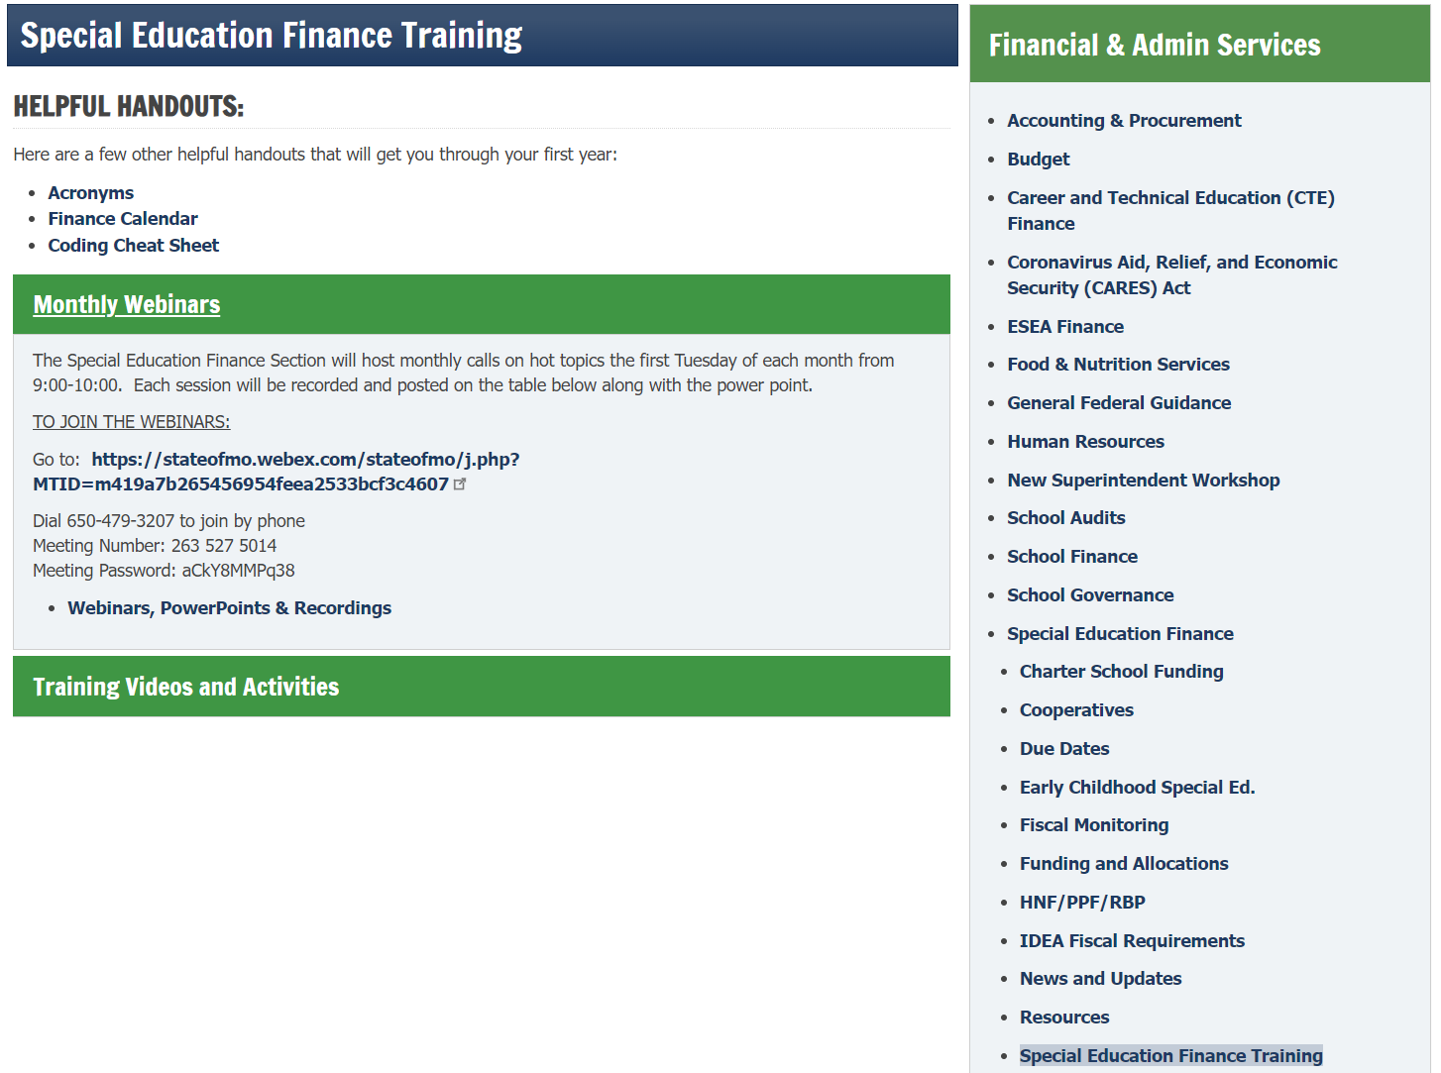
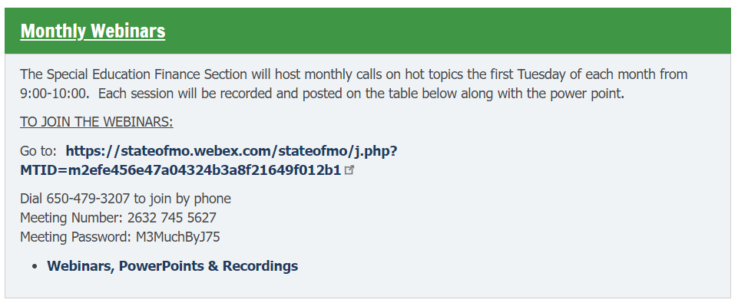
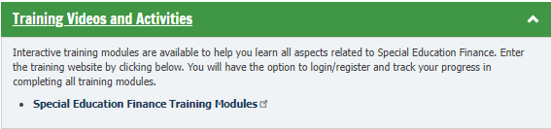
Finance Webinars
https://dese.mo.gov/financial-admin-services/special-education-finance/special-education-finance-training ​
Notes:
To Say: The special education finance training webinars can be found on the DESE special education webpage. Go to the green tab that says finance in the center. Once on the finance webpage, on the left hand side in the grey box, at the bottom click on Special Education Finance Trainings. From there you will find monthly webinars as well as 14 training modules and activities that have already been created that you can watch on-demand!

Slide 40
SPED Finance Webinars
FIRST TUESDAY OF THE MONTH, 9-10am
DATES
September 3
October 1
November 5
December 3
https://dese.mo.gov/financial-admin-services/special-education-finance/special-education-finance-training
Notes:
To Say: The special education finance live webinars will be held the first Tuesday of the month from 9-10 AM.

Slide 41
Resources at Your Fingertips: SPED Effective Practices
Notes:
Bailey: Next we have some amazing special education effective practice resources that we want to make sure you are familiar with.

Slide 42
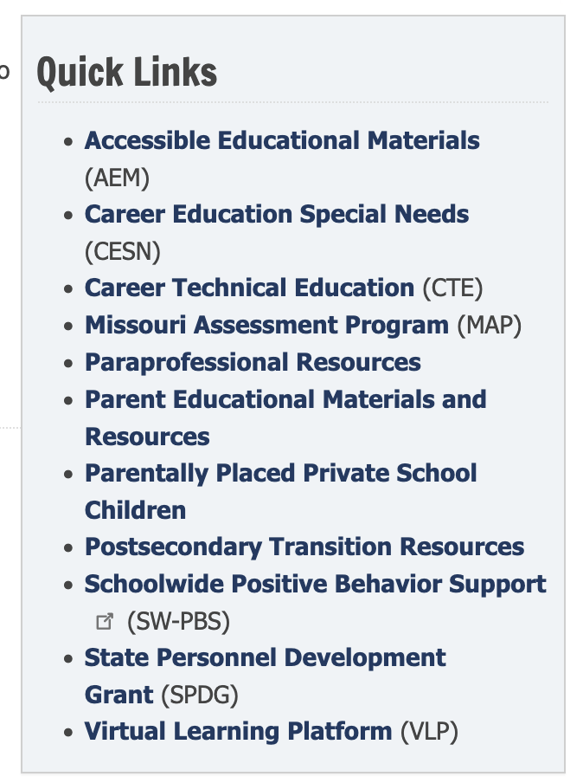
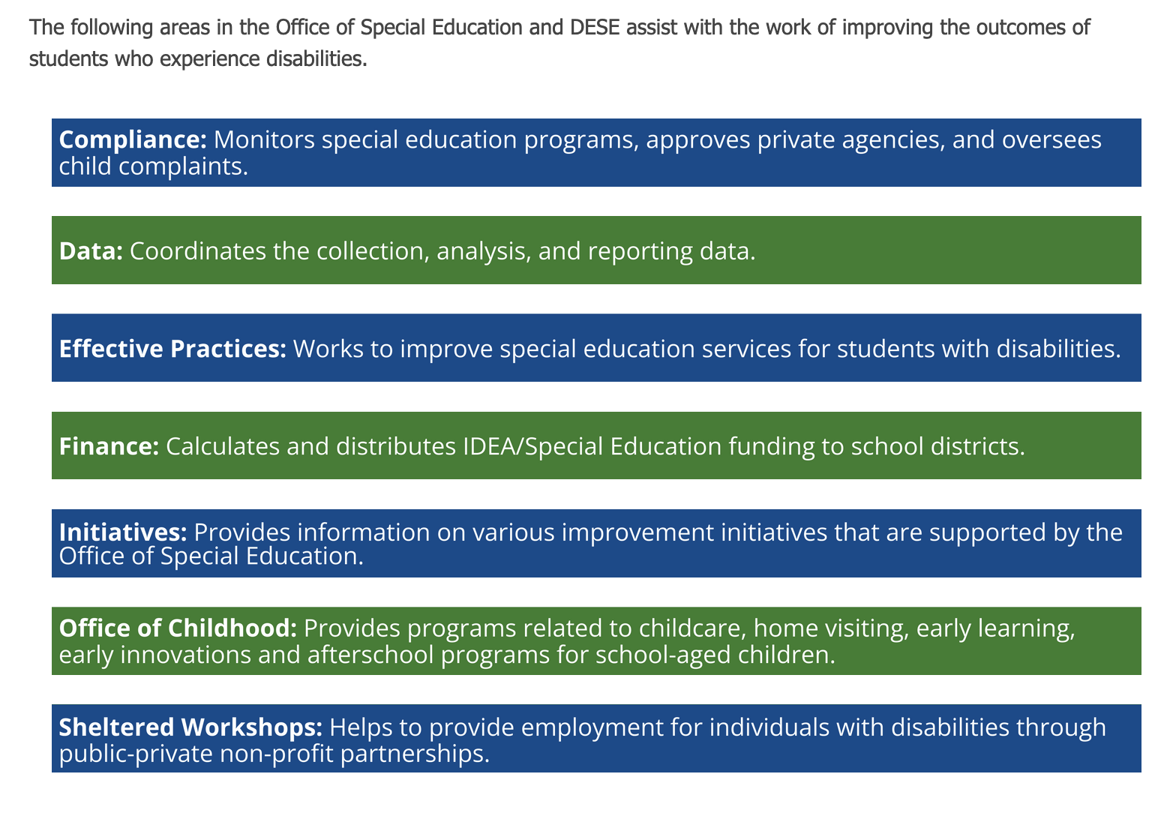
Check Out the Quick Links
Notes:
To Say: When you go to the DESE special education webpage and click on the blue tab that says effective practices, you will notice that there is a variety of resources at your fingertips. A couple we would like to highlight is paraprofessional resources. This will populate national and state resources as well as a paraprofessional webinar series.
On the effective practice page, we also have post-secondary transition resources for all! This includes all the transition training institute handouts and resources as well as the Missouri Transition Planning resource locator, information on our postsecondary transition liaisons, pre-ets & vocational rehabilitation information.
The last resource on our effective practice webpage that we would like to highlight is the Virtual Learning Platform. This can be located on the left side in the grey bar under quick links. (Go to next slide)

Slide 43
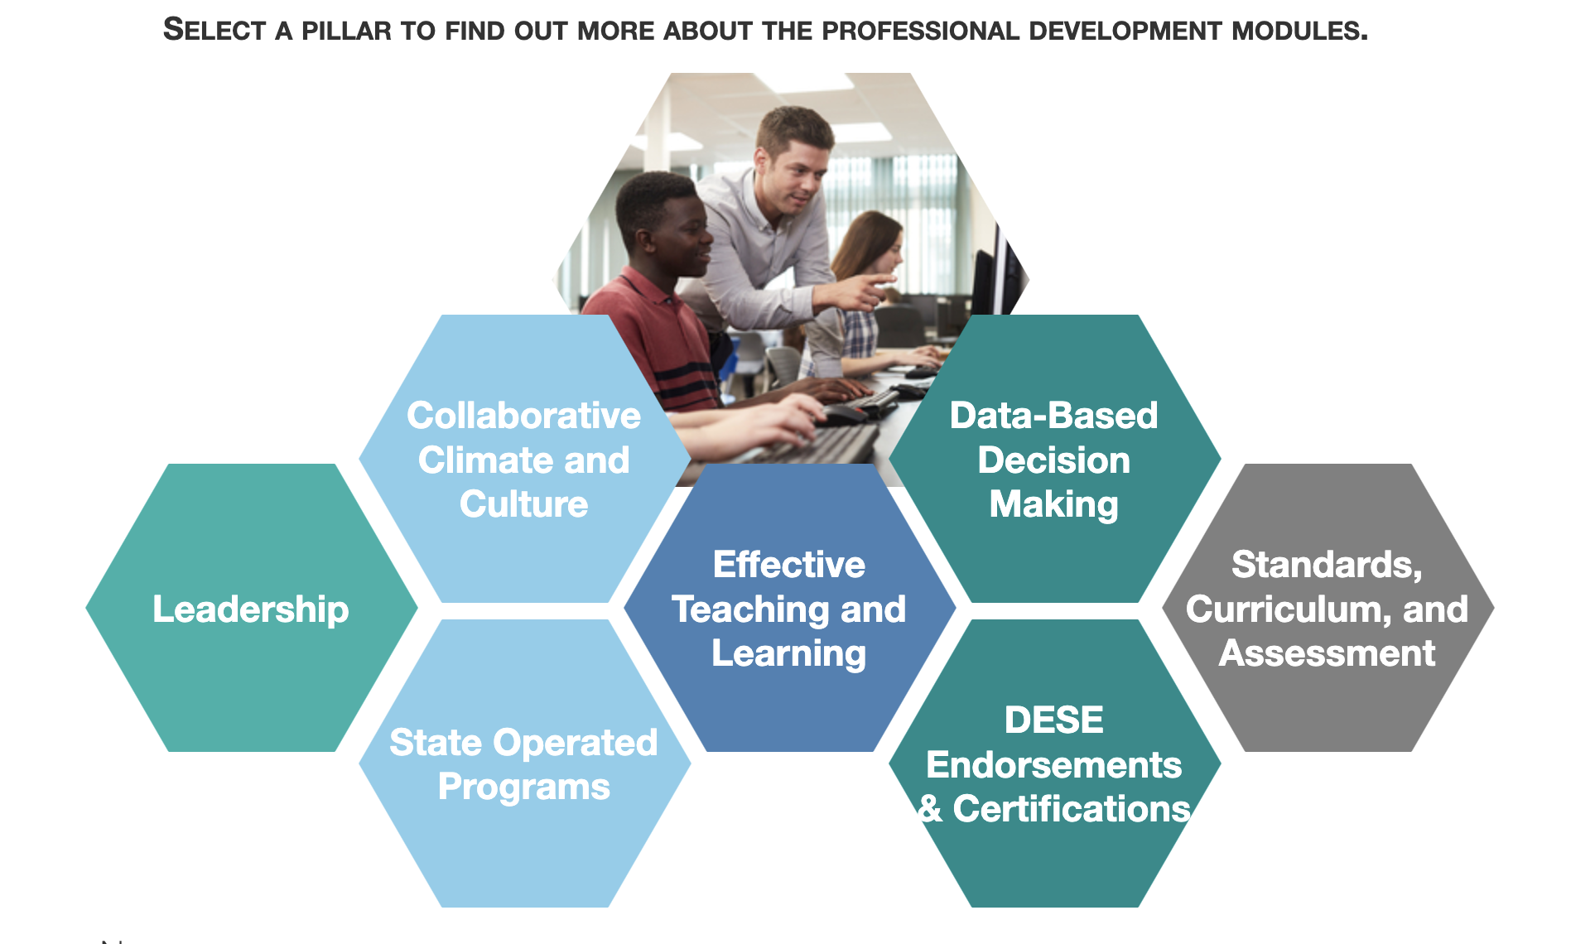
Virtual Learning Platform
Notes:
To Say: The VLP is a collection of evidence-based professional development, practice profiles, and needs assessments that is available to educators in Missouri public schools through DESE’s Web Application system. Special education compliance, effective practice and behavior consultants have been working hard on creating and updating our professional development modules to assist districts.
Professional learning modules include the following topics:
Collaborative Climate and Culture
Effective Teaching and Learning, including Academic, Behavioral, and Science of Reading
Data-based Decision Making
Standards, Curriculum, and Assessment
Leadership
DESE Endorsements & Certifications

Slide 44
Resources at Your Fingertips: SPED Compliance
Notes:
To say: Last but not least, we want to direct you to resources on the DESE Special Education Compliance website.

Slide 45
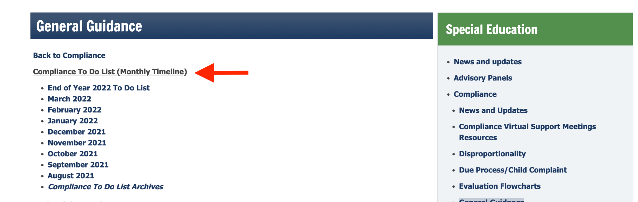
To-Do List
The Office of Special Education shares a monthly To Do List to remind LEAs of deadlines and requirements throughout the school year.
https://dese.mo.gov/special-education/compliance/general-guidance
Notes:
To Say :Right side menu under compliance is the General Guidance link this will take you to the Compliance To Do List that are posted monthly.

Slide 46
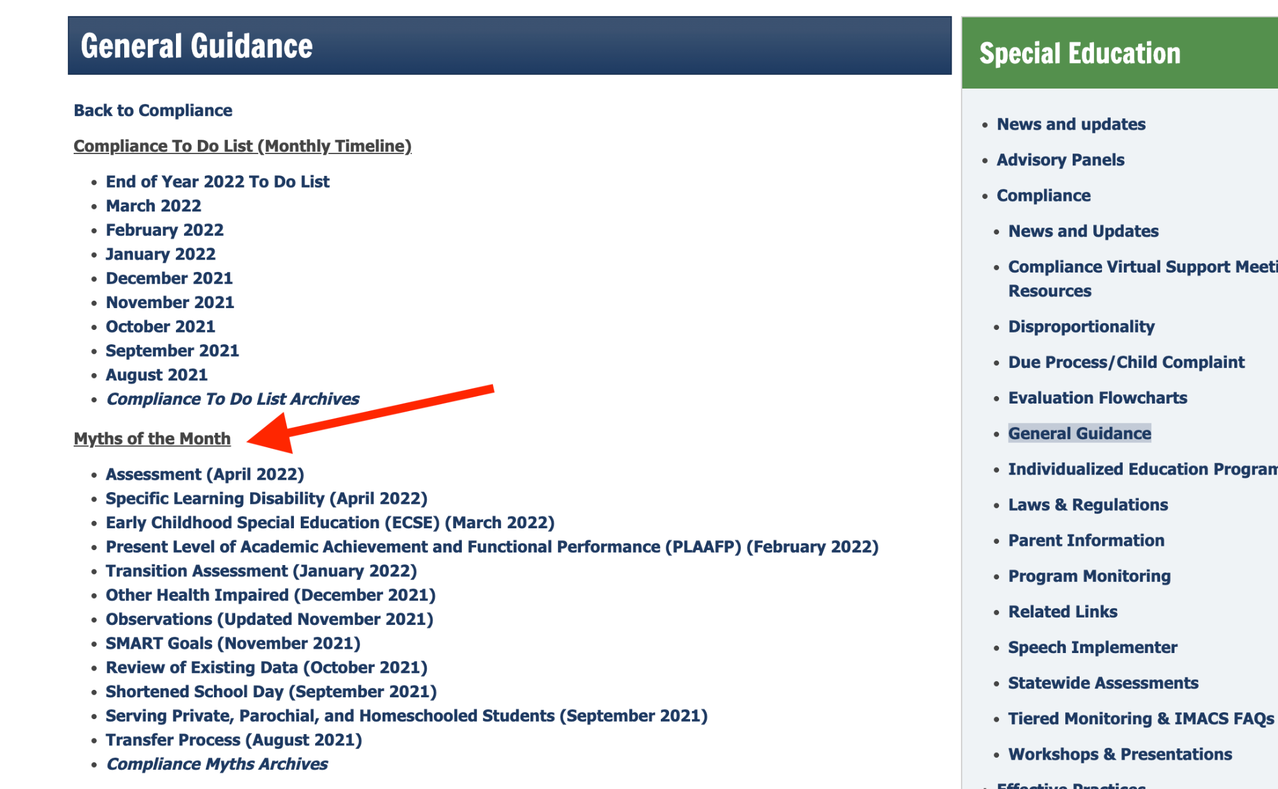
Myths of the Month
Each month DESE rolls out new information on a particular special education hot topic.
Myths of the Month provides guidance on misconceptions that surrounds topics
https://dese.mo.gov/special/education/compliance/general-guidance
Notes:
To Say: Also under general guidance are Myths of the Month this is information on a particular special education hot topic. These myths provide guidance and misconceptions that surround the topics.

Slide 47
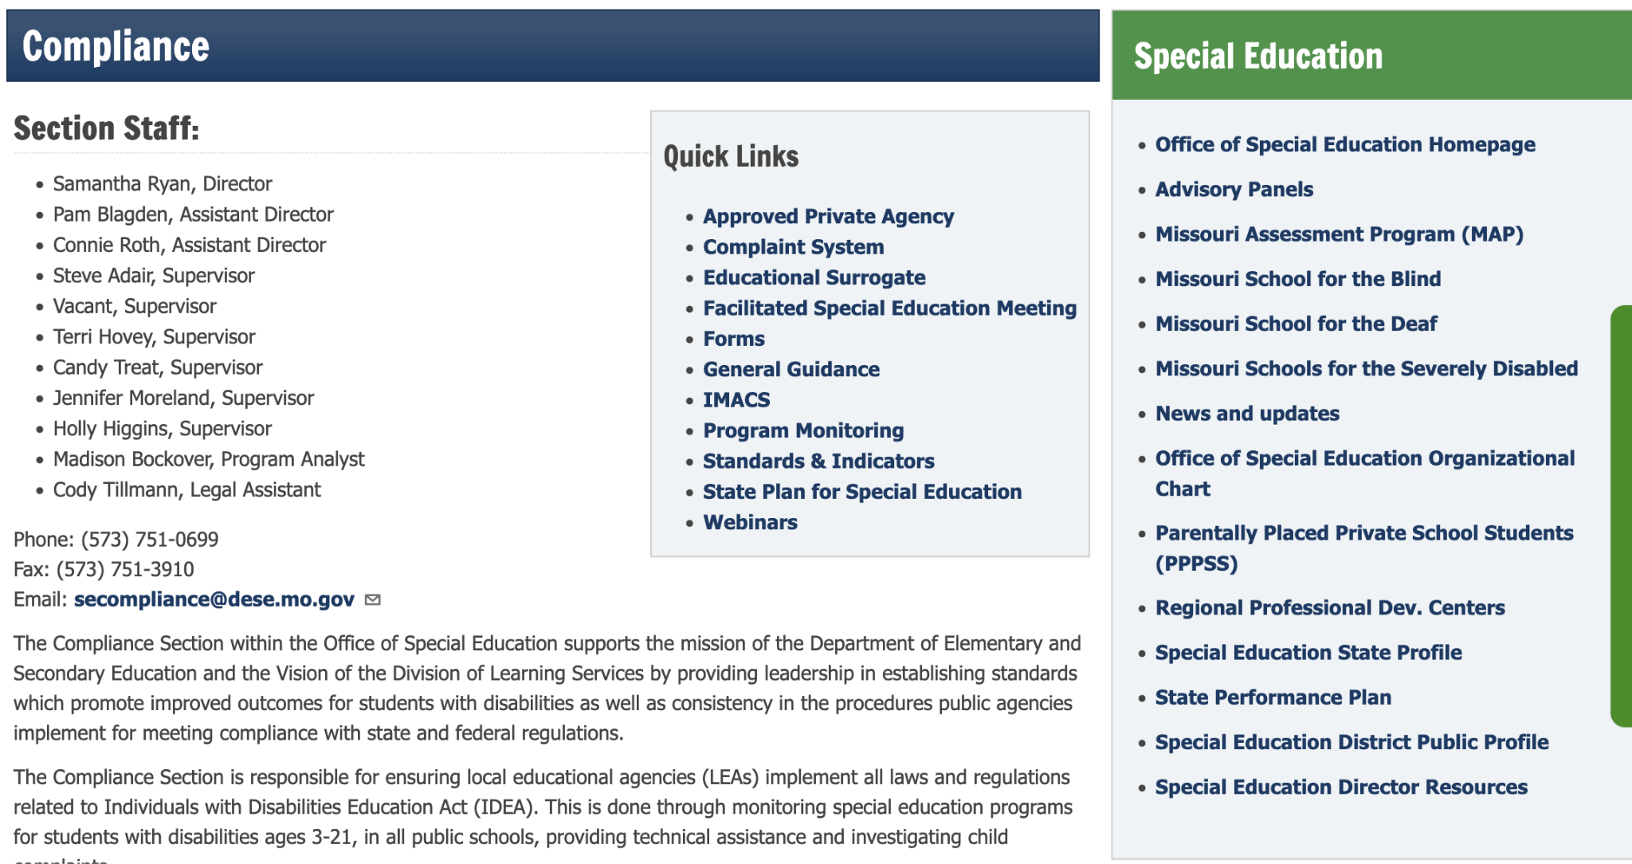
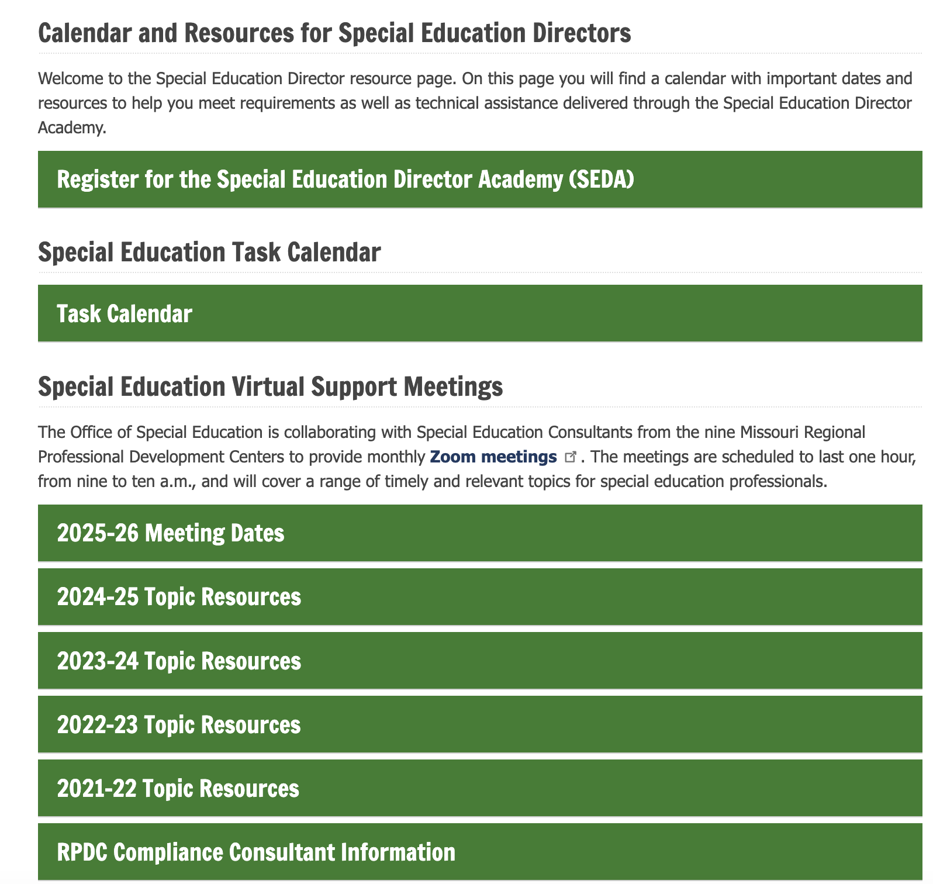
Virtual Support
https://dese.mo.gov/special-education/effective-practices/special-education-directors
Notes:
To Say: On this page you will find a calendar with important dates and resources to help you meet requirements as well as technical assistance delivered through the Special Education Director Academy.

Slide 48
Utilize Your Special Education Compliance Consultants
Notes:
To Say: Your special education compliance consultants are key to having a successful school year.

Slide 49
Contact Us
Region | Compliance Consultant | Phone | Email
Southeast | vacant | 573-651-5161
Heart of Missouri | Lynn Lynch | 573-424-7847 | lynchly@missouri.edu
Kansas City | Bailey Tennesen | 816-235-5957 | tennesenb@umkc.edu
Northeast | Dawn Lichtenberg | 660-785-4310 | dlichtenberg@truman.edu
Northwest | Julia Schmitz | 660-562-1909 | julia@nwmissouri.edu
South Central | Leasa Day | 573-341-6821 | ldnd3@mst.edu
Southwest | Melynda VanNote | 417-836-4083 | melyndavannote@missouristate.edu
St. Louis | Cheryl Garbs | 314-692-1200 | cgarbs@aplus.org
Central | Julie Harris | 660-232-0387 | jlharris@ucmo.edu
Notes:
To Say: If you are in need of assistance, please reach out to your region's consultant. We are happy to help provide technical assistance as well as professional development in the areas of special education compliance.

Slide 50

Thank You for Your Time
Notes:
To Say: Thank you so much for spending this hour with us. We appreciate your time and look forward to having a great 24-25 school year!

