Slide 1
SPECIAL EDUCATION COMPLIANCE TIERED FEDERAL MONITORING SELF-ASSESSMENT TRAINING COHORT 2
2024

Slide 2
2
Learning Objectives
Participants will Learn
1. the steps in the special education monitoring process for local agency self-assessment,
2. the required activities for the self-assessment and their due dates, and
3. how to find resources for assistance with questions.
Notes:
I am going to talk about
1. the steps in the special education monitoring process for local agency self-assessment,
2. the required activities for the self-assessment and their due dates, and
3. how to find resources for assistance with questions.

Slide 3
Program Monitoring of Districts
Missouri uses a 3-year cyclical monitoring process. Cohort 2 is beginning their self-assessment year.
The cyclical monitoring process includes:
Self-Assessment (Year 1)
Corrective Action (Year 2)
Maintain & Retrain (Year 3)
Notes:
Missouri uses a 3-year cyclical monitoring process. Cohort 2 is beginning their self-assessment year. The cyclical monitoring process includes Self-Assessment (Year 1), Corrective Action (Year 2), and Maintain & Retrain (Year 3). Today we will explain processes for monitoring in Year 1, the Self-Assessment year with file reviews.

Slide 4
Special Education Tiered Monitoring
Notes:
Here you can see a flow chart of the Tiered Monitoring Process. Cohort 1 is beginning Year 1. You can fine this chart on our website. It is easiest to find if you Google “Department of Elementary and Secondary Education Tiered Monitoring Flowchart.”

Slide 5
Self-Assessment Year 1
Notes:
Here you can see the steps in the Self-Assessment process and the due dates. Today we are conducting the training for self-assessment and will cover each of the other steps in detail. From November to January, you will conduct self-assessments. In February, you will use IMACS 2.0 to submit files. In April compliance supervisors will start conducting desk reviews using the documentation districts have uploaded into IMACS 2.0 to determine whether each indicator being reviewed is in or out of compliance. On May 15, you will submit initial and C to B timelines to Department of Elementary and Secondary Education .

Slide 6
Five Components of the Self-Assessment
Parent Surveys
File Review
Initial Evaluation Timelines
C to B Transition Timelines
Upload requested documents in IMACS 2.0
Notes:
There are five components in the Self-Assessment process.
Facilitating Parent Surveys (opens in the fall)
Completing the Self-Assessment File Review
Collecting and submitting initial evaluation timelines
Collecting and submitting C to B transition timelines
Uploading documents for the desk review verification
The self-assessment and desk review are tailored to the district based on data collection by Department of Elementary and Secondary Education on several factors.

Slide 7
Parent Surveys
Purpose is to increase parent engagement and provide data for State Performance Plan (SPP) Indicator 8 which states:
Percent of parents with a child receiving special education services, who report school facilitated parent involvement as a means of improving services and results for children with disabilities.
All parents of students with disabilities served by the Local Education Agency should participate in the Parent Survey.
During first semester of the 2024-25 school year,
University of Missouri Institute of Public Policy (IPP) will send out the survey,
Local Education Agency’s provide parent with the survey or a survey link, and
parents complete the survey and mail it back to the IPP or submit it electronically.
Local Education Agencies will receive the results of surveys to use in planning for increasing parent involvement.
Notes:
The purpose of the Parent Surveys is to improve parent engagement in the special education process and to provide data for SPP Indicator 8 which addresses parent involvement and is included in the district’s special education profile.
During fall the University of Missouri will send an email containing the survey information to each director. This email is copied to the superintendent, as well. It will contain instructions, timelines, and district specific surveys. The surveys are available online, but since some parents do not have access to the internet, paper copies are also distributed. The paper copies should be mailed by the parent, not the district, to IPP. It is important to note that each Local Education Agency will receive a copy of their Parent Survey results to assist the Local Education Agency to increase parent engagement and involvement. The results are not parent specific.

Slide 8
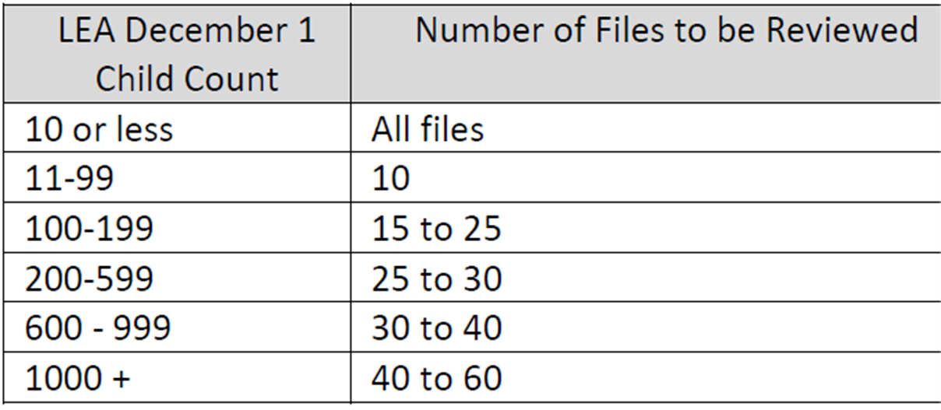
File Review: Number of Student Files Included
Based on the December 1, 2023, child count for the agency, the following number of files should be used as a guideline for determining the total number of files included in file review:
Notes:
This slide describes the number of files you will review based on the number of students with Individual education programs reported in your most recent December 1 child count. Files are then selected by your Department of Elementary and Secondary Education compliance supervisor for the desk review verification. Compliance supervisors will generally select files which serve multiple purposes for review. For example, files for a high-school student would be used to review reevaluation indicators, Individual education program indicators, and postsecondary transition indicators. This chart is posted on our website.

Slide 9
File Review: Selecting Student Files
Student files selected by the district for self-assessment should represent:
A cross section of ages, grade levels, and buildings within the district, including ECSE students and students with postsecondary transition plans, that have had an initial evaluation, a reevaluation, or have post-secondary transition Individual education program completed since January 2024
Provide a variety of disabilities and placements. Select districts will be asked for specific conditional areas such as: Intellectual Disabilities (ID), Other Health Impaired (OHI), and Specific learning Disability (SLD)
Students from your districts who are enrolled in an Approved Private Agency or virtual learning. (See next slide for more information.)
Select files for students who were evaluated or reevaluated in the current (24/25) and prior school year (23/24).
Notes:
Student selection for self-assessment file review should include
A cross-section of ages, grade levels, and buildings within the district, including ECSE students and students with postsecondary transition plans, that have had an initial evaluation, a reevaluation, or have post-secondary transition Individual education program completed since August 2023
Select districts will be asked for specific conditional areas such as: Intellectual Disabilities (ID), Other Health Impaired (OHI), and Specific Learning Disability (SLD)
Students from your districts who are enrolled in an Approved Private Agency or virtual learning. If you are a MOCAP Host district, you will be required to submit a few student files of those with Individual education programs attending their district’s virtual school.
Select files for students who were evaluated or reevaluated in the current (24/25) and prior school year (23/24).

Slide 10
File Review: Selecting Student Files
DO NOT submit files that used triennial waivers.
Avoid using transfer students, but if they must be used, contact your supervisor.
Notes:
DO NOT use files that used triennial waivers. Triennial waivers are not reevaluations.
Avoid using transfer students, but if they must be used, contact your supervisor.

Slide 11
Students Attending Approved Private Agencies or Enrolled in Virtual Learning
Districts who have full-time students placed in a Department of Elementary and Secondary Education Approved Private Agency (APA) must include one or more of those students in their self-assessment file review.
Resident districts who have full time students enrolled in virtual learning through a Memorandum of Understand (MOU) or enrolled with a non-hosted MOCAP provider must include one or more of those students in their self-assessment file review.
Host districts who have full time students enrolled with their hosted MOCAP provider must include one or more of those students in their self-assessment file review.
Notes:
Districts that have full-time students placed in a Department of Elementary and Secondary Education Approved Private Agency (APA) must include one or more of those students in their self-assessment file review.
Resident districts who have full-time students enrolled in virtual learning through a Memorandum of Understanding (MOU) or enrolled with a non-hosted MOCAP provider must include one or more of those students in their self-assessment file review. A resident district is the public school district or charter school the student would attend if receiving classes in person, and that would receive state aid for the student.
Host districts that have full-time students enrolled with their hosted MOCAP provider must include one or more of those students in their self-assessment file review. A Host District is the public school district, charter school, or higher education institution that enrolls the student in the online provider’s program.

Slide 12
Students Attending Approved Private Agencies or Enrolled in Virtual learning File Review
Number of students placed in an APA, enrolled in virtual Learning through their resident district, or enrolled in virtual Learning with a host district | Number of files to include in their self-assessment selection
Up to 5 students | 1 or 2 student files
6 to 10 students | 3 or 4 student files
11 to 19 students | 5 or 6 student files
20 or more students | 7 student files
The APA or virtual learning files selected must be an initial evaluation, a reevaluation, or have a post-secondary transition Individual education program completed, as described in the selection criteria on slide 8.
Notes:
The chart shows you the number of files you should include for your review.
APA or virtual learning files selected must meet the selection criteria outlined on slide 8, such as an initial evaluation, a reevaluation, or having a post-secondary transition Individual education program completed. There will be an expectation In the documentation for Year 2 that CAP statements will include how virtual providers will be trained and how needed corrections for them would be monitored.

Slide 13
Required/Conditional Indicators
Required Indicators
Referral (initial only)
Evaluation
Reevaluation
Individual education program
Present Level of Academic and Functional Performance
Annual Goals and Goal Progress Reports
Postsecondary Transition
Conditional Indicators
MAP-A
Eligibility (SLD, OHI, ID)
Long Term Suspensions
Notes:
Required indicators are those that every public agency must address through student file reviews.
For the required indicators, you and compliance supervisors will review the referral (initial evaluations only), the evaluation, and the Individualized Education Program (Individual education program), including the postsecondary transition planning and goal progress reports.
Conditional Indicators are those included in the file review only when district special education performance data reflects the need. Conditional indicators are included when districts do not meet performance targets for MAP-Alternate (MAP-A) participation, identification of students in the eligibility areas of Specific Learning Disability, Other Health Impairment and Intellectual Disability, and long-term suspensions of students with disabilities. For a review of students who have been long-term suspended, including records for three students meeting the description in the Special Education Program Review Indicators 300.30 through 300.80 in the self-assessment file review.
In the next part of this training that covers how to use IMACS 2.0, we will show you where to look to find out if conditional indicators apply for your district.

Slide 14
File Review: Selecting a Variety of Files
Initial Evaluations
When conditional indicators are triggered, include students eligible using criteria for SLD, ID, and/or OHI. Conditional indicators need initial evaluation for review.
Reevaluations (with and without assessment)
Individual education programs
A variety of grade levels and placements, including ECSE students as well as students enrolled in APAs and virtual learning
A minimum of five Individual education programs with postsecondary transition plans
Individual education programs for students enrolled in MAP-A when conditional indicators are included
Notes:
When selecting files for a file review select from a variety of files.
Include a variety Initial Evaluations so your practices for determining eligibility in several area can be reviewed. If you are required to review conditional indicators, initial evaluation must be used. IMACS 2.0 will not count reevaluations for the required conditional areas when you are submitting files. Initial evaluations must be used for conditional SLD, ID, and OHI files.
Include Reevaluations (with and without assessment).
Include Individual education programs from a variety of grade levels and placements including one or two ECSE students as well as students enrolled in APAs and virtual learning
Please make every effort to include at least five Individual education programs with postsecondary transition plans in the self-assessment. The self-assessment and desk review verification results for the indicators applied to postsecondary transition planning will be used to calculate your district’s Special Education Profile Indicator 13 performance data until the next monitoring cycle. Don’t put all your eggs in one basket. For example, if you only include two students with transition plans in your self-assessment and one of those students has one transition indicator that is out of compliance, the district’s score for Indicator 13 transition planning will be 50% because the score is based on the number of students who meet all of the postsecondary transition planning requirements included for indicator 13 reporting.

Slide 15
Enter Student Demographic Data In IMACS 2.0
There are now two ways to add data:
Type individual student demographic data in IMACS 2.0.
Upload bulk student demographic data to IMACS 2.0 via a CSV file.
Notes:
You can enter student demographic data in IMACS 2.0 in two different ways. You can enter data for each student individually by clicking on Add New Student File Review , or you can enter student data in a spreadsheet and import the spreadsheet by clicking on Import Student File Review Data from CSV file .

Slide 16
File Review: Assemble Documents
Be aware of double-sided pages which only scan one side
Files should be ordered in the order of the special education process
Double-check uploaded documents to make sure they are complete and readable
Notes:
In preparing files for scanning and then uploading, be aware of double-sided pages which only scan one side which causes missing documentation. The order in which the documentation is scanned into the pdf file needs to be according to the special education process with the referral, review of existing data, evaluation report and Individual education program with meeting notifications and Prior Written Notice in the correct order. Double-check uploaded documents to make sure they are complete and readable.
It is helpful to create a file folder on your desktop with the files you are going to upload so that files are easily accessible and all in one place.

Slide 17
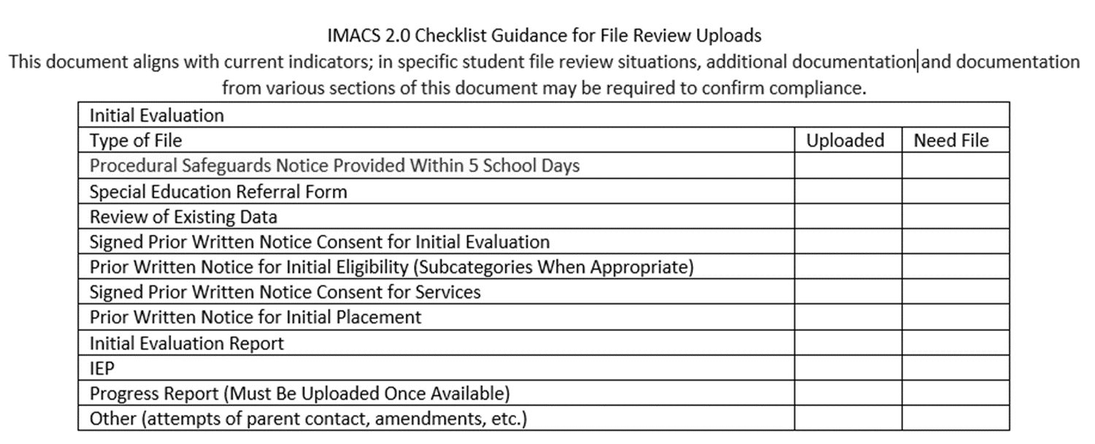
IMACS 2.0 Checklist Guidance for File Review Uploads
Below, you can see the documentation needed for an Initial Evaluation. The checklist includes the types of files and documentation.
Notes:
This checklist will be posted with other self-assessment guidance and training documents. It includes a general list for initial evaluations, re-evaluation with testing, re-evaluations without testing, files containing post-secondary transition, and Disciplinary files. Include the previous Individual education program date documentation if not on the front page of the Individual education program.

Slide 18
File Review: Conducting Self-Assessment
Read the entire indicator.
Refer often to the Special Education Compliance Program Standards and Indicators manual for guidance and clarification. Do not rely only on the IMACS 2.0 checklist language.
Determinations are
Yes = documentation is present/correct
No = documentation does not meet compliance
N/A = indicator doesn’t apply
Notes:
When Conducting self-assessment for the file review. Read the entire indicator.
Use the Special Education Program Review Standards and Indicators manual as you review files and are entering responses into IMACS. Do not rely only on the IMACS 2.0 checklist language.
As you review, you will select
Yes = YES means the documentation is present and meets the compliance requirement.
No = NO means the documentation does not meet compliance requirements.
N/A = NA means the indicator doesn’t apply to the special education process for this student.

Slide 19
Documentation Upload for the Desk Review Verification
Upon request by the Department of Elementary and Secondary Education compliance supervisor, upload documentation from the files of specific students chosen for the desk review.
Upload to IMACS 2.0 no later than April 1, 2025.
Notes:
Your Department of Elementary and Secondary Education compliance supervisor will request documents used to verify the self-assessment results through the IMACS 2.0 system. Upload documents described in the request for selected students. Make sure all documentation is included, which determines the decision for a particular indicator. For example, be sure to include all the supporting documents for each part of the process being reviewed. For an initial evaluation, you will need the referral form, any other documents such as a contact log that includes the date Procedural Safeguards were provided to the parent, Prior Written Notice for consent to evaluate, Notification of Meeting for the eligibility determination, and the evaluation report.
Upon request by the compliance supervisor, upload documentation into IMACS 2.0 by April 1, from the files of students chosen for the desk review.

Slide 20
Documentation for the Desk Review Verification
Department of Elementary and Secondary Education supervisors will review and verify each district’s self-assessment in IMACS 2.0 during desk monitoring conducted from April through August 2025.
Provide your supervisor with contact info (Phone #, email address)
Keep an electronic copy of the documents, including those with signatures, in a central, easy-to-access location.
Notes:
Compliance supervisors will review and verify each district’s self-assessment in IMACS 2.0 during desk monitoring conducted from April through August 2025.
It is important to provide your compliance supervisor with summer contact info such as your cell phone number or an email address you used in the summer, in case additional documentation is needed to complete the verification or questions arise.
Keep an electronic copy of the documents, including those that have signatures, in an easy-to-access, central location preferably one that can be accessed remotely.

Slide 21
Timelines: Submission
Timeline submissions are due May 15, 2025.
Initial Evaluations
Include all students with initial evaluations (ineligible and eligible).
For C to B transition students who were evaluated between these dates, they should be included in the initial evaluation timelines
Include initial evaluations that began after July 1, 2024, and are finished before April 30, 2025
Notes:
Timeline Submission are due May 15 . Since the timeline collection period ends April 30, do not submit timelines prior to April 30.
Initial evaluations include all students (ineligible and eligible). Include initial evaluation that began after July 1 and are finished before April 30.
For C to B transition students who were evaluated between these dates, they should be included in the initial evaluation timelines

Slide 22
Timelines: Submissions
Timeline submissions are due May 15, 2025.
Part C to Part B Transition
Include children who were referred from First Steps between
For C to B transition students who were evaluated between these dates, they should be included in the initial evaluation timelines
July 1, 2024, and April 30, 2025, and whose third birthday
occurs before April 30, 2025.
Notes:
Timeline Submissions are due May 15. Do not submit timelines prior to April 30, as the timeline collection period ends on that date.
Part C to Part B timelines include any children whose 3rd birthday falls within the data July 1 - April 30 data collection period.

Slide 23
The Individual Education Program is not in place by the 3rd birthday
Must provide specific, detailed reasoning in the “If NO, give reason” box.
Reasons may include:
Child referral to Part C less than 90 days before the third birthday
The parents opted out of providing directory information to part B and then changed their minds less than 90 days before the third birthday
Delay in providing consent or parents refusing to provide consent
Children with summer birthdays whose parents chose to continue early intervention services

Slide 24
Copies of both PowerPoints presented today
List of Things to Remember for Self-Assessment
Self-Assessment Procedures for Monitoring
Local Education Agency Special Education Compliance Monitoring Checklist
Tiered Monitoring Flowchart
IMACS 2.0 Checklist Guidance for File Review Uploads
Department of Elementary and Secondary Education ’s Self-Assessment (Year 1) Guidance and Resources
Notes:
The Department of Elementary and Secondary Education has the following resources posted on their website. The easiest way to locate them is to Google “Department of Elementary and Secondary Education Self-Assessment (Year 1) Guidance and Resources”. Also, remember to reference the Missouri Special Education Standards and Indicators and the Missouri State Plan for Special Education.

Slide 25
Compliance Consultants
Region | Compliance Consultant | Phone Number | Email
Southeast | Tiffiney Smith | 573-651-2621 | tdsmith@semo.edu
2. Heart of Missouri | Lynn Lynch | 573-424-7847 | lynchly@missouri.edu
3. Kansas City | Bailey Tennesen | 816-235-5957 | tennesenb@umkc.edu
4. Northeast | Dawn Lichtenberg | 660-785-6080 | dlichtenberg@truman.edu
5. Northwest | Julia Schmitz | 660-562-1995 | julia@nwmissouri.edu
6. South Central | Leasa Day | 573-341-6821 | ldnd3@mst.edu
7. Southwest | Amy Phipps | 417-836-4082 | amyphipps@missouristate.edu
8. St. Louis | Jeanne Rothermel | 314-724-6736 | jrothermel@edplus.org
9. Central | Julie Harris | 660-232-0387 | jlharris@ucmo.edu

Slide 26
Questions?
Office of Special Education
Special Education Compliance (Part B)
P.O. Box 480, Jefferson City, MO 65102-0480
Phone: 573-751-0699
Email: secompliance@dese.mo.gov

Slide 27
27
Missouri Department of Elementary and Secondary Education
It is the policy of the Missouri Department of Elementary and Secondary Education not to discriminate on the basis of race, color, religion, gender, gender identity, sexual orientation, national origin, age, veteran status, mental or physical disability, or any other basis prohibited by statute in its programs or employment practices as required by Title VI and VII of the Civil Rights Act of 1964, Title IX of the Education Amendments of 1972, Section 504 of the Rehabilitation Act of 1973, the Age Discrimination Act of 1975 and Title II of the Americans with Disabilities Act of 1990, and the Americans with Disabilities Act of 2008 (ADAAA), the Genetic Information Non-Discrimination Act (GINA), or USDA Title VI.

