Slide 1
SPECIAL EDUCATION COMPLIANCE
TIERED MONITORING
SELF-ASSESSMENT YEAR
IMACS TRAINING & GUIDANCE
Cohort 2
2024

Slide 2
2
Questions to Be Answered
What is the Parent Special Education Survey?
Why do I have to use IMACS?
Where did the Correspondence go?
Where do I go in IMACS for each step?
Which student do I pick for the Student file review?
When do I turn in Timelines? What is the collection period?
Why is it not uploading my file?
Notes:
I am going to talk about
1. the steps in the special education monitoring process for local agency self-assessment,
2. the required activities for the self-assessment and their due dates, and
3. how to find resources for assistance with questions.

Slide 3
Parent Special Education Survey
The Missouri Department of Elementary and Secondary Education has partnered with the University of Missouri’s Institute of Public Policy (IPP) to conduct the 2024-2025 Parent Special Education Survey. This survey is mandatory for federal reporting purposes and part of the self-assessment process. We appreciate your cooperation in administering this important survey to parents in your district.
Notes:
The Missouri Department of Elementary and Secondary Education (DESE) has partnered with the University of Missouri’s Institute of Public Policy (IPP) to conduct the 2024-2025 Parent Special Education Survey. This survey is mandatory for federal reporting purposes. We appreciate your cooperation in administering this important survey to parents in your district. The survey are sent out in the fall of the self-assessment year.

Slide 4
Parent Survey Helpful Hints
Some helpful hints and ways to increase response rates:
Provide a translated survey
Complete the district name and district code sections
Provide a pre-addressed return envelope with a paper copy of the survey and postage
Provide a survey for each child who has an Individualized Education Program
Use school-wide communication systems and narrow the communication to students with Individualized Education Program
Ask parents to fill it out during conferences and meetings
Notes:
Please read through the helpful hints and implement these to increase response rates.

Slide 5
Special Education Survey Questions
If you have any problems accessing the site, receiving your response rate information, or have any other questions or concerns, please contact the University of Missouri’s Institute of Public Policy (IPP).

Slide 6
Features in IMACS 2.0
All communication between the Department of Elementary and Secondary Education and LEAs regarding compliance monitoring or containing student Personally Identifiable Information (PII) will be housed in IMACS 2.0.
Districts will receive email notifications from IMACS 2.0 when information from the Department of Elementary and Secondary Education is available in IMACS 2.0 (and vice versa).
IMACS 2.0 automatically saves each answer in the file review as it is entered.
Notes:
Please use IMACS 2.0 for all correspondence regarding any issue so that we have a collection of all communications in one safe, secure place.
You will receive notifications via the email address entered by the Local Education Agency in IMACS 2.0. Pay attention to the notification messages so that you are looking in the right place when you open IMACS 2.0. You will get notifications when uploads are requested as well as when there is a communication from the Department of Elementary and Secondary Education to read. If multiple people work within IMACS 2.0 at the district level, the first person who opens new communication needs to make sure the intended receiver knows about it because it will be marked as Read after it has been opened on the district side.
Now IMACS 2.0 automatically saves the information. A box on the indicators page indicates when an auto-save was done.

Slide 7
Features in IMACS 2.0
Districts will be able to upload requested documentation at any time in IMACS 2.0.
The Department of Elementary and Secondary Education tailors file reviews according to each Local Education Agency’s Special Education Performance Data. Districts meeting performance targets have fewer indicators in their self-assessment file reviews.
Notes:
If a Supervisor is missing something, they can request a document upload at any time. Use the links provided to upload the requested documents.
The Department of Elementary and Secondary Education tailors file reviews according to each Local Education Agency’s Special Education Performance Data. Districts meeting performance targets have fewer indicators in their self-assessment file reviews.

Slide 8
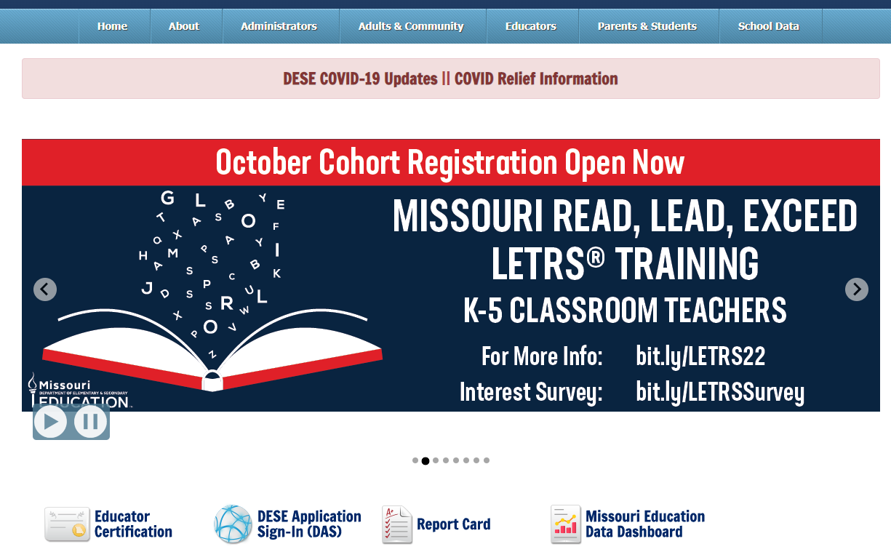
How to Find IMACS 2.0

Slide 9
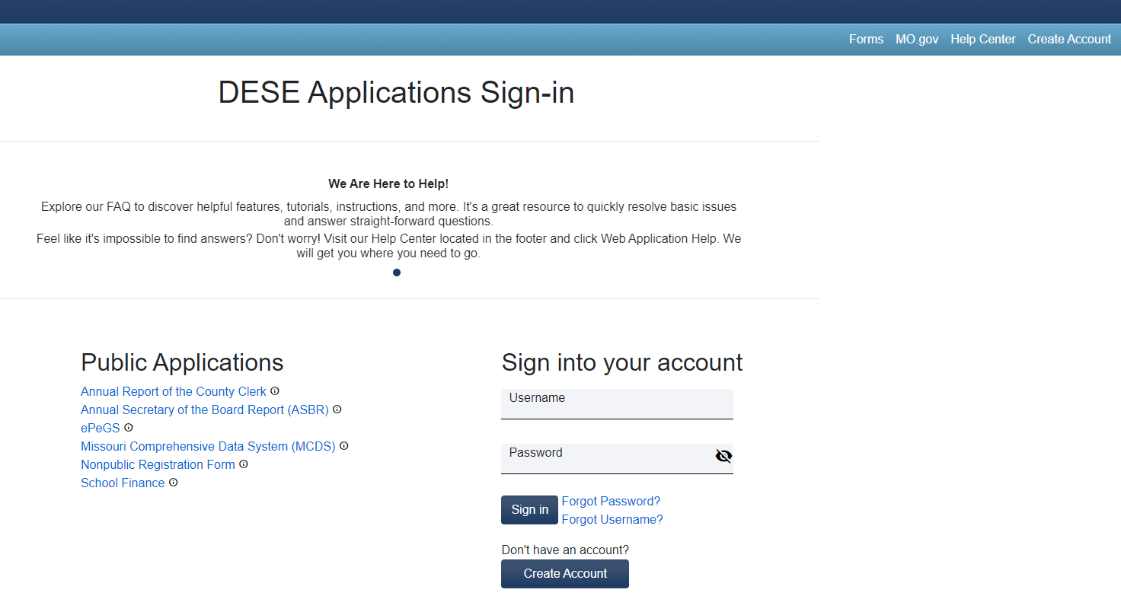
Gaining DESE Applications Access
you have not had previous access to DESE Applications, you will need to request it before you can use IMACS 2.0. Your district’s User Manager grants this access.

Slide 10
Access to IMACS 2.0
There are two access levels for IMACS 2.0:
User Manager
User
User Manager access includes permissions to all functionality in IMACS 2.0, including the ability to grant access to Users
User access includes permission to view only or update specific modules in IMACS 2.0

Slide 11
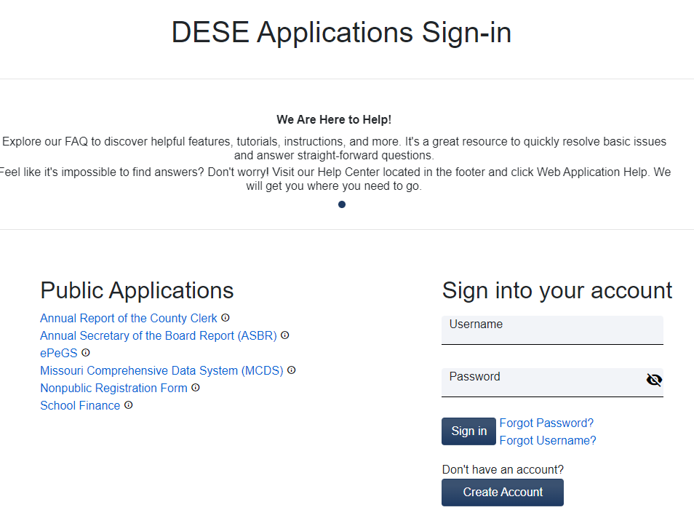
Logging into IMACS 2.0
Once you have been granted user access, you can log into IMACS 2.0.

Slide 12
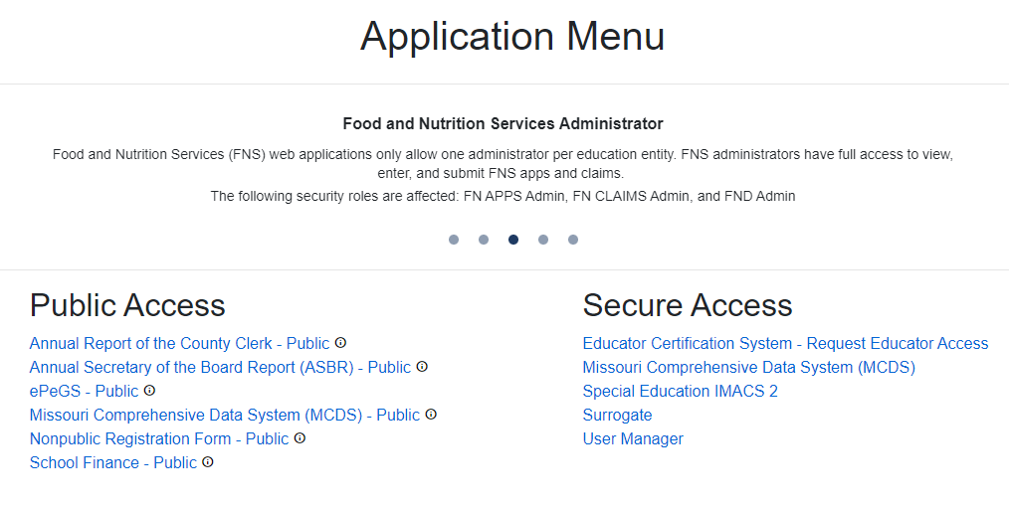
After Logging In: Menu
Local Education Agency will be taken to the DESE Applications menu page. Click on Special Education IMACS 2.0.
Notes:
The list of applications is dependent upon what User Access level you have been granted. Contact your User Manager if you do not see Special Education IMACS 2.0 on your screen.

Slide 13
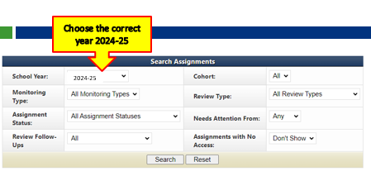
IMACS Monitoring School Year

Slide 14
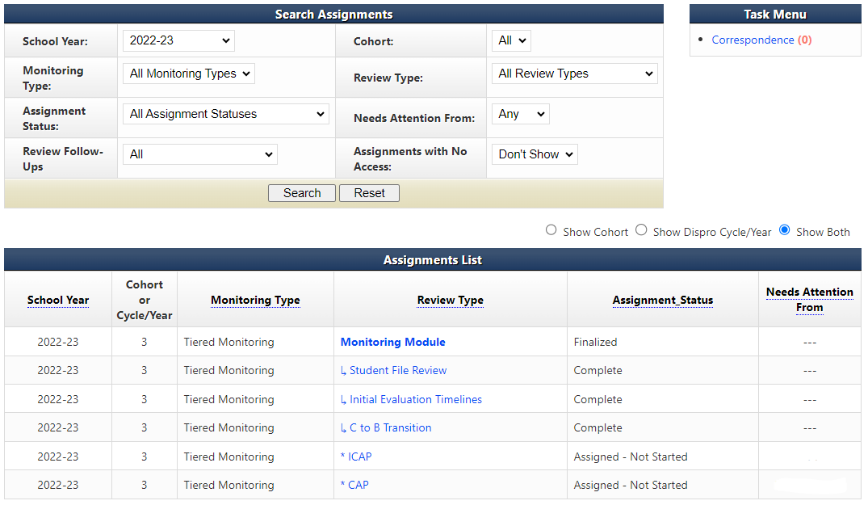
Local Education Agency Home Page in IMACS 2.0
Choose the correct year 2024-25

Slide 15


Monitoring Process
Monitoring Module
Student File Review
Initial Evaluation Timelines
C to B Transition Timelines
Notes:
The Monitoring Module includes:
Student File Review,
Initial Evaluation Timelines, and
C to B Transition Timelines.

Slide 16
Assignments List
The Assignments List gives links to each part of the process.
Monitoring Module | This is the overarching layer of the tiered monitoring process, which encompasses the Student File review, Initial Evaluation timelines, and the C to B Transition Timelines. All communication and uploads can be viewed here, but nothing should be uploaded here.
Notes:
The Assignments List gives links to each part of the process. Monitoring Module: The over-arching layer of the tiered monitoring process that encompasses the Student File review, Initial Evaluation timelines, and the C to B Transition Timelines. All communication and uploads can be viewed here. Nothing should be uploaded here.

Slide 17
Assignments List, Continued
Student File Review | Contains student files selected for monitoring by the Local Education Agency and the student file documentation uploaded by the district. Any communication and uploads regarding student files can be viewed here. Upload documentation related to student files here.
Notes:
Student File Review: Contains student files selected for monitoring by the Local Education Agency and the student file documentation uploaded by the district. Any communication and uploads regarding student files can be viewed here. Upload documentation related to student files here.

Slide 18
Assignments List, Continued 2
Student File Review | Contains student files selected for monitoring by the Local Education Agency and the student file documentation uploaded by the district. Any communication and uploads regarding student files can be viewed here. Upload documentation related to student files here.

Slide 19
Assignments List, Continued 3
Initial Evaluation Timelines | Contains student demographics & important dates for all initial evaluations completed between July 1, 2024, and April 30, 2025. Any communication and uploads regarding initial evaluation timelines files can be viewed here.

Slide 20
Assignments List, Continued 4
C to B Transition Timelines | Contains student demographics & important dates for all C to B Transitions completed between July 1, 2024, and April 30, 2025. Any communication and uploads regarding C to B transitions timelines files can be viewed here.
Notes:
C to B transition timelines: Contains student demographics & important dates for all C to B Transitions done between July 1, 2024, and April 30, 2025. Any communication and uploads regarding C to B transitions timelines files can be viewed here.

Slide 21
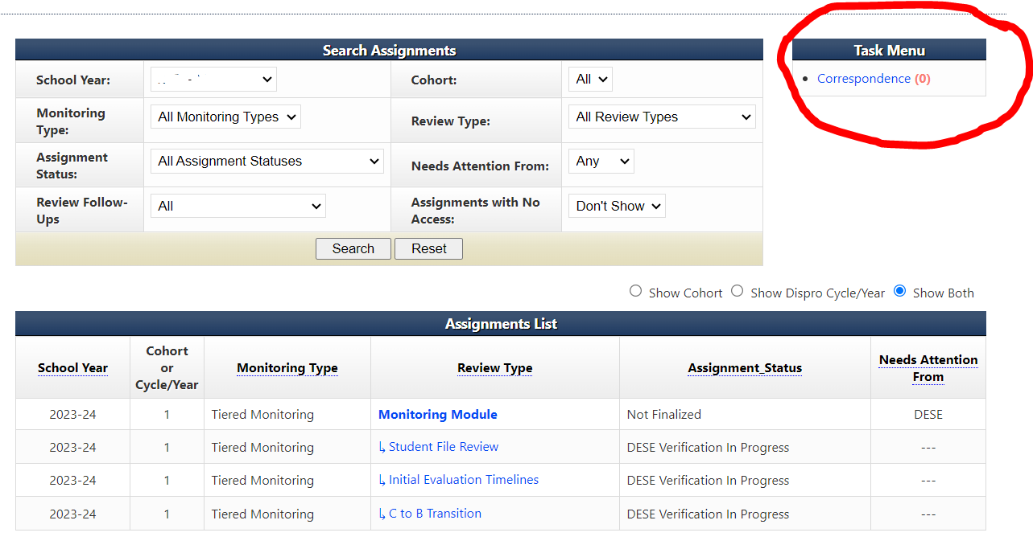
Locating Correspondence
To locate letters, from the Local Education Agency home page click on Correspondence under Task Menu.

Slide 22
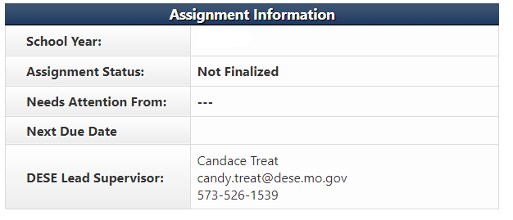
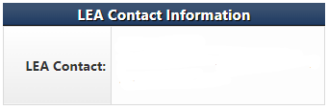
Local Education Agency Contact Information
Notes:
When you are the person responsible for self-assessment monitoring, make sure you are listed as the Local Education Agency contact in IMACS so you receive email notifications when correspondence is waiting for your review. Be sure to enter Local Education Agency contact information on the Monitoring Module page. Contact information should be copied to the other assignments in IMACS (student file review, initial evaluations, and C to B). You can also find contact information for your supervisor at the top of each assignment.

Slide 23
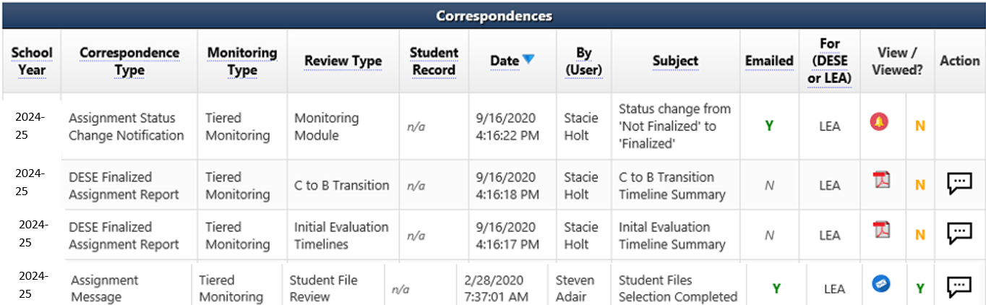
Locating Individual Correspondence
Notes:
Under Correspondence Type you will be able to tell if it is a message, a notification about a change in status, a document request, or a report.
Review Type will let you know if the original communication was sent from main Monitoring module or one of the sub-reviews such as Student File Review, Initial Evaluation, or C to B Transition.
The Date and By (User) columns will list time, date, and from whom the correspondence originated.
The For (DESE or LEA) column will let you know at a glance whether a compliance supervisor at Department of Elementary and Secondary Education or an agency representative needs to pay attention to the message.
The View / Viewed? column displays icons that distinguish what kind of message it was and the Y/N help to determine if the message has been viewed.
The last column, Action, allows you to respond to that message if the conservation balloon icon is available.

Slide 24
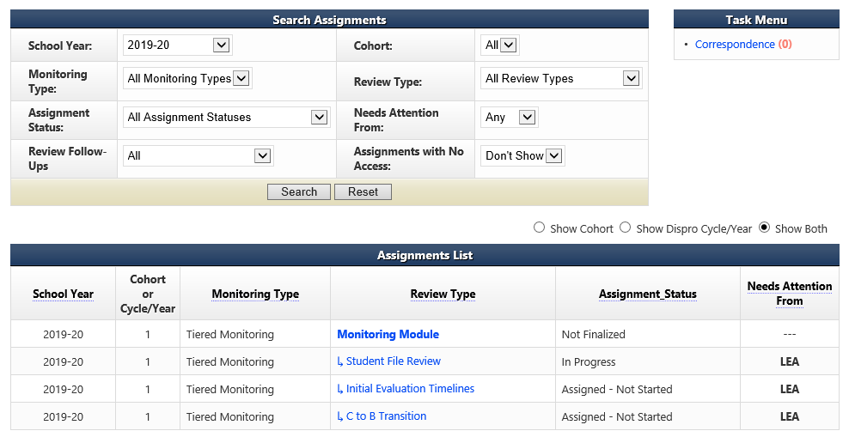
Student File Review Summary Page
Add the names of students whose files are being selected by the Local Education Agency for review by going to the Local Education Agency home page and clicking on Student File Review.
Notes:
Add the names of students whose files are being selected by the Local Education Agency for review by going to the Local Education Agency home page and clicking on Student File Review.

Slide 25
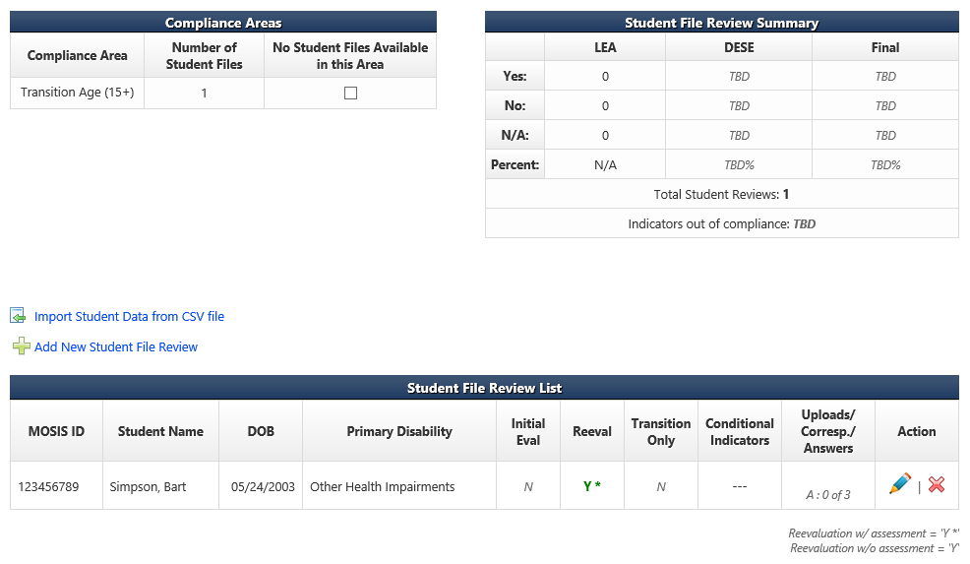
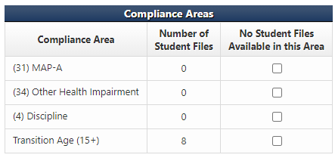
Student File Review Summary Page
The Student File Review Summary page is where LEAs add student names and demographic information.
Notes:
Conditional areas listed on the main monitoring page in IMACS are generated by the district’s data. The eligibility areas listed are there because the district is over the state incident rate in those particular areas. The Department of Elementary and Secondary Education needs to review initial evaluations to see the district’s eligibility determination process.
In this district’s sample we were looking for Other Health Impairment. The district must go through their files and see if there are any students who have been determined initially eligible as Other Health Impairment since Spring 2024. If there are NO students who meet this criteria and the district has not determined anyone eligible in that category since Spring 2024 then they need to mark the check box on their side of IMACS attesting to that fact.

Slide 26


Student File Review Summary Page Continued
The Student File Review Summary page is where LEAs add student names and demographic information.
Notes:
There are two ways to enter students on the Student File Review Summary page. You can either import student demographic data using a comma-separated values (CSV) file or you can enter student demographic data one by one. If you want to import a CSV file you will need to click on Import Student Data from CSV file and if you want to go one by one then click Add New Student File Review for each student record.
The Local Education Agency can also see their Compliance Areas dashboard on this page. The dashboard has information such as how many of the students they are entering are included in compliance areas such as Postsecondary Transition, MAP-A, Discipline, or various areas of eligibility. If the Local Education Agency is required to include students to meet certain conditional areas it will show up on this dashboard.

Slide 27
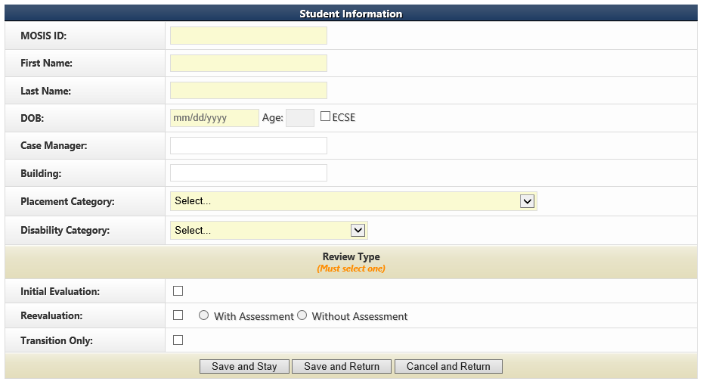
Adding New Student Reviews Individually
If you decide to enter your student demographics for the reviews one student at a time in IMACS 2.0 then you will do so by clicking on Add New Student File Review. It will bring up the familiar student demographic screen below.
After the Local Education Agency has completed filling in the boxes, they need to select either the Save and Stay or Save and Return button. The Cancel and Return button does not save.
Notes:
Save and Stay will keep you on this page, Save and Return will return you to the Student File Review Summary, and Cancel and Return will erase what you have typed and return you to the Student File Summary.
Make sure you are reporting your files correctly and ask if you are unsure.
Initial files: The student has never had special education services prior to this Individual education program.
Re-evaluation with Assessments: Any re-evaluation in which the district conducted any new assessments.
Re-evaluation without Assessment: Any re-evaluation in which the district determined no new additional data or information is needed and no new assessments were given. This includes when parents bring in new data to consider.

Slide 28
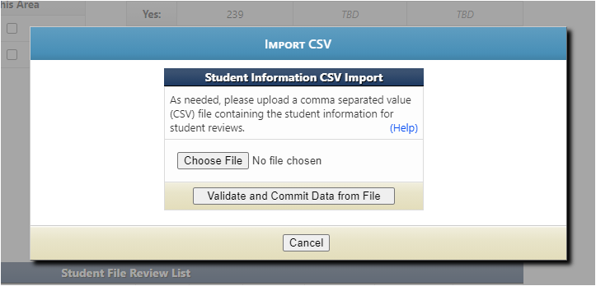
Importing Data from CSV file
Click on (Help) to read the directions for preparing the CSV/TXT upload.
Click on Choose File to locate the CSV/TXT document and to upload from your computer.
Click on Validate and Commit Data from File once you are done with everything.
Notes:
Click on (Help) to read the directions for preparing the CSV/TXT upload.
Click on Choose File to locate the CSV/TXT document and to upload from your computer.
Click on Validate and Commit Data from File once you are done with everything.

Slide 29
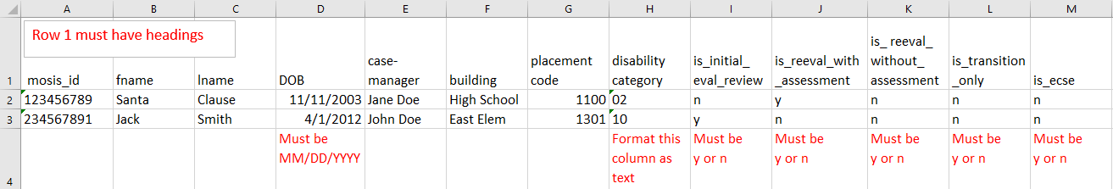
IMACS 2.0 Student Information Upload for Student File Review
The file can have an extension of .csv or .txt.
Upon submitting a file, the website will first validate the file, and if valid will then prompt the user to commit the data.
The spreadsheet should look like this:
Use the codes listed on the next slide for columns G and H.
Notes:
CSV stands for comma separated values. This type of record uses commas to separate data. If commas are used within a column (for example in the “reason over 60” column) the file will be corrupted.

Slide 30
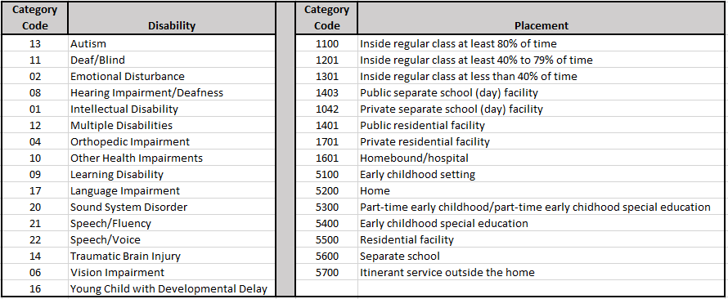
Importing Student Data for Student File Review

Slide 31
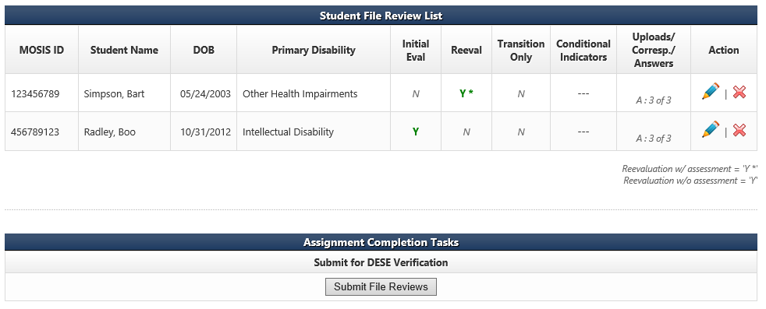
After the district has answered the individual indicators under each individual student on the Student File Review List, the district will need to submit the file reviews. Complete the review and submit no later than February 1, 2025.
Student File Review Screen, cont.
Notes:
The Uploads/Corresp/Answers column shows if all the indicator questions have been answered. (yellow circle)
Once the Local Education Agency is sure that it has entered all the required students and answered all the indicator questions, it needs to click on the Submit File Reviews (red circle) button.
It is important to remember that only the Student File Review Assignment is completed and submitted by February 1, 2025. Do not upload any student records. Department of Elementary and Secondary Education compliance supervisors will request specific student records after March 1, 2025.
Do NOT complete the self-assessment on any file that has not been completed. If the Individual education program is not in place, don’t use the file for self-assessment.

Slide 32
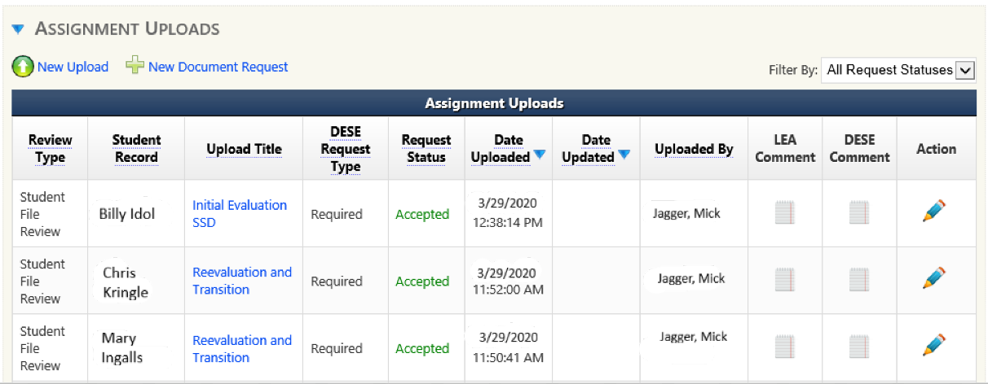
Uploading Documentation for the Desk Review
During late February/early March 2025 time period, districts will be notified via IMACS 2.0 correspondence of the student files chosen for desk review verification and what documents must be uploaded.
Most individual education program systems allow users to “print to PDF” rather than print and scan documents.
Student documents should be uploaded under the individual student file review page.
This documentation is due in IMACS 2.0 no later than April 1, 2025.
Notes:
MAKE SURE TO SEND ALL DOCUMENTS USED TO MARK INDICATORS!!
At the bottom of the Student File Review Summary page is the Assignment Uploads area. When you click on the blue arrow next to the words Assignment Uploads the document requests from Department of Elementary and Secondary Education will be listed.
To open each individual request click on the pencil at the end of the row (green arrow). This will open the Assignment Upload window for that student.
ONLY UPLOAD IN THE STUDENT REVIEW, INITIAL EVALUATION TIMELINES, AND C TO B TRANSITION TIMELINES

Slide 33
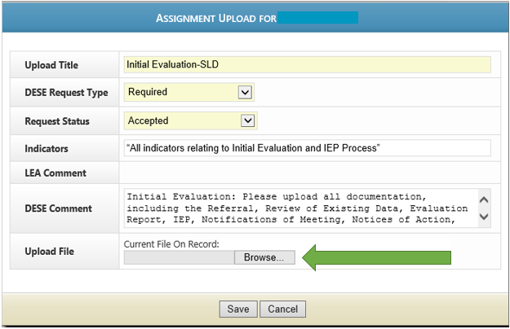
Uploading Documentation
Once the Assignment Upload window has opened, the Local Education Agency may upload the requested student documents. You will receive one document request per student. It is preferred that all documents needed for verification are merged and uploaded as one file.
Notes:
Once the Assignment Upload window has opened, the Local Education Agency may upload the requested student documents. You will receive one document request per student. It is preferred that all documents needed for verification are merged and uploaded as one file, in the order of the special education process, for each requested student. An automated email will be generated to the Supervisor overseeing your district to let them know it is uploaded.
The DESE comment, as seen in this window, includes a list of things that need to be uploaded for that file. We have also created a checklist.

Slide 34
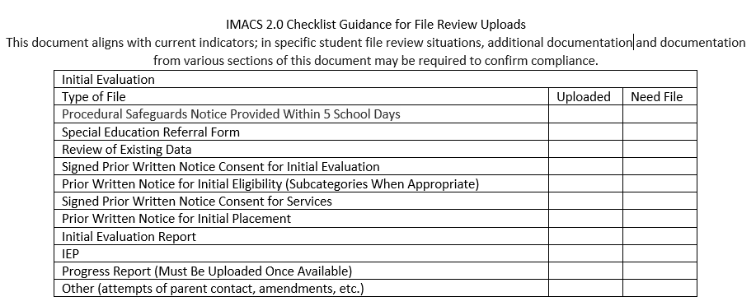
IMACS 2.0 Checklist Guidance for File Review Uploads
Below, you can see the documentation needed for an Initial Evaluation. The checklist includes the types of files and documentation.
Notes:
This checklist will be posted with other self-assessment guidance and training documents. It includes a general list for initial evaluations, re-evaluation with testing, re-evaluations without testing, files containing post-secondary transition, and Disciplinary files. Please include the previous Individual education program date documentation if not on the front page of the Individual education program.

Slide 35
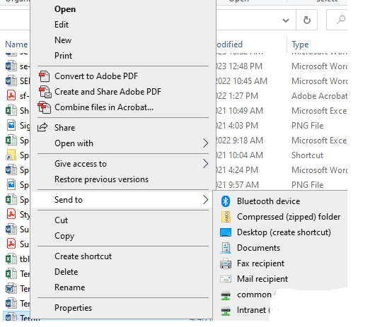
Creating a zip file
Right click on the file or folder. (To select multiple files, hold down the Ctrl key on your keyboard and click on each file you wish to zip. Then right click.)
Select Send to
Select Compressed (zipped) folder
To rename the file, right click on the file and select Rename
You can now drag and drop additional files into the folder
Notes:
Right click on the file or folder. (To select multiple files, hold down the Ctrl key on your keyboard and click on each file you wish to zip. Then right click.)
Select Send to
Select Compressed (zipped) folder
To rename the file, right click on the file and select Rename
You can now drag and drop additional files into the folder
Do not use a TIF file. This uses Windows Photo Viewer, and files will be returned.

Slide 36
Helpful Hints for Uploading of Documents
Merge all documents into one file for that student’s Document Request.
Send all documents that were used to mark indicators in IMACS.
Provide meeting notices only if used to answer an indicator
Place documents in the order of the special education process.
Check to make sure each student’s file is 20 MB or less in size. Merging options impact file size.
Make sure each file’s path name is less than fifty characters.
Only upload files under the individual student and NOT the monitoring module or student file review summary page.
Notes:
Merge all documents for a specific student into one file for that student’s Document Request.
BE SURE to send all documents that were used to mark indicators in IMACS.
We only need meeting notices if you use it to answer an indicator. Usually only needed for transition-aged students.
Before merging all of one student’s files together, place them in the order of the special education process.
Check to make sure each student’s file is 20 MB or less in size. Merging options impact file size.
Make sure each file’s path name is less than fifty characters. The location for saving your file prior to upload can lengthen the path name.
Only upload files under the individual student and NOT the monitoring module or student file review summary page.
You might need to speak to your district’s IT manager or administrative staff to find out which program with merge capability is available. Documents may be uploaded as WORD, PDF, or zip files.

Slide 37
Upload Quality
Check the quality of your upload. If you can’t read it, neither can we.
Make sure no part of the page is cut off.
Make sure both sides of double-sided copies are scanned.
Make sure there are no missing pages.
Notes:
Check the quality of your upload. If you can’t read it, neither can we.

Slide 38
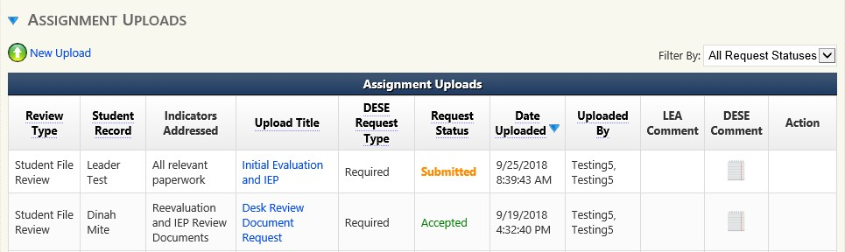
Documentation Request Status
The document status can be found in the Request Status box.
Submitted - Uploaded, but not yet looked at by Department of Elementary and Secondary Education
Accepted – Department of Elementary and Secondary Education has looked over the file and it seems like everything needed is there.
Rejected – Department of Elementary and Secondary Education has looked over the file and something is not right.
If your file is rejected and you need to upload new information be aware that you will need to either:
1) merge new information into your file and re-upload the entire thing, or
2) upload the missing information under the student’s record using “New Upload” link.
Notes:
The document status can be found in the Request Status box.
Submitted - Uploaded, but not yet looked at by the Department of Elementary and Secondary Education
Accepted—The Department of Elementary and Secondary Education has reviewed the file, and it seems that everything needed is there.
Rejected – The Department of Elementary and Secondary Education has looked over the file and something is not right
When a file is rejected, the assigned Department of Elementary and Secondary Education Supervisor will contact you by phone or email to help you understand what to do next.
If additional documents are needed you will get an email/phone call from your supervisor and a message will be sent through IMACS2.0 as well.

Slide 39
Initial Evaluations Timelines Submission
Timeline submissions due May 15, 2025.
  Initial Evaluations
    Include all students (ineligible and eligible)
    For C to B transition students who were evaluated between these dates they should be included in the initial evaluation timelines
Data collection for timelines will cover the period beginning July 1, 2024 and ending April 30, 2025.

Slide 40
Patterns of instruction do not extend a timeline. For example:
Virtual Schooling—Students attending school virtually are counted as in attendance for reporting and funding purposes. So, it is paradoxical to say a child is attending school but is unavailable for testing.
4-day School Week – weekends are longer, but still count in the 60 calendar day timeline.
Timeline Exceptions

Slide 41
Timeline Exceptions
Timelines may be extended for just cause:
school breaks for summer or holidays,
student absences due to illness, and
repeated failure by the parent to make the child available for testing
Districts must document good faith efforts to work with parents to complete assessments. Consider alternative settings or virtual assessments, if necessary, to access the student.

Slide 42
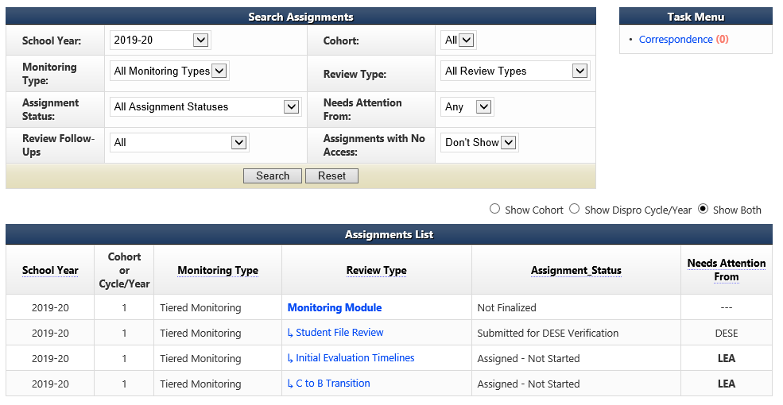
Initial Evaluation Timelines Summary Page
Add the Initial Evaluation Timelines information by going to the Local Education Agency home page and clicking on the Initial Evaluation Timelines review type.
Notes:
Add the Initial Evaluation Timelines information by going to the Local Education Agency home page and clicking on the Initial Evaluation Timelines review type.

Slide 43
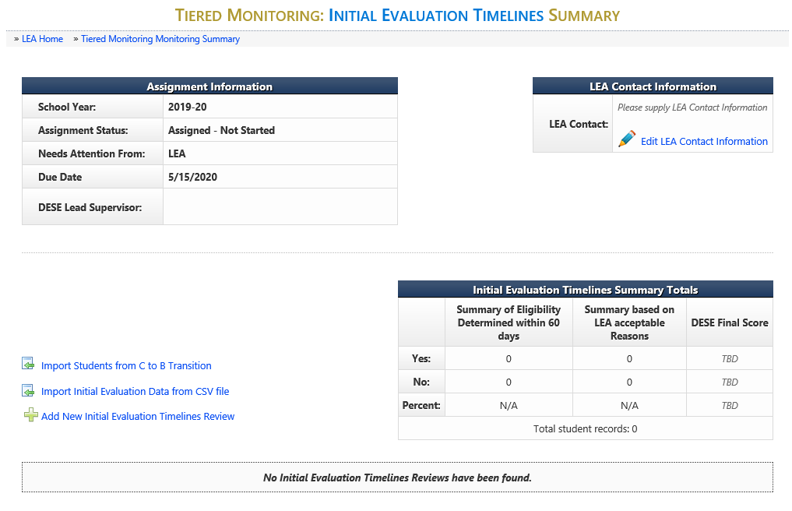
Initial Evaluation Timelines Summary
Notes:
There are two options for entering the Initial Evaluation Timeline information now in IMACS 2.0.
You can either compile the data collection on a spreadsheet and import that by clicking on Import Initial Evaluation Data from CSV file (green arrow) or you can enter each student individually by clicking on Add New Initial Evaluation Timelines Review (blue arrow).

Slide 44
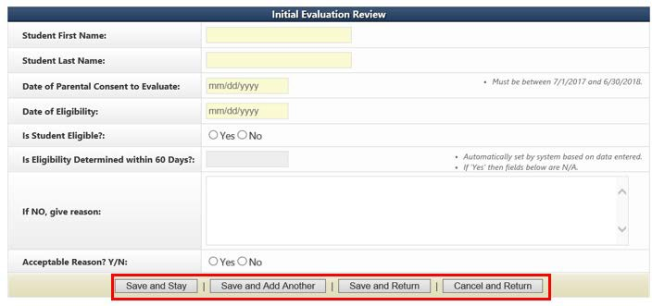
Adding New Student Timeline Data Individually
If you decide to enter your timeline data one student at a time in IMACS 2.0 by clicking on Add New Initial Evaluation Timelines Review then you will see the familiar student demographic screen below.
BAD EXAMPLE 21 vacation days
GOOD EXAMPLE 12/19/24-01/02/25: Christmas Break, 01/16/25: No School, 01/25/25: Snow Day, 01/31/25-02/03/25: student absence, 02/17/25: Professional Development Day, 02/20/25: President's Day
**BE SPECIFIC!
Notes:
When the timeline is not met (exceeded 60 calendar days) the Local Education Agency will need to make sure that specific dates that the student was absent or school was not in session are put into the “If NO, give reasons:” box. The compliance supervisor is NOT responsible for reviewing school calendars. Be specific by identifying the days as snow/weather related, student absence, district scheduled out (holiday/PD)
At the bottom of the screen there are many save options. Save and Stay will keep you on the same page after saving. Save and Add Another will save the student you just finished working on and give you a new student demographic screen to begin the next student. Save and Return will save the student you just finished working on and then take you back out to the main timeline page.
As you enter students you do have the option to edit (pencil icon) or delete (red cross) your entry on the right hand side of the main Initial Evaluation Timeline Summary page.
Remember the only weekends that are counted as an exception are the weekends included in the scheduled winter break.

Slide 45
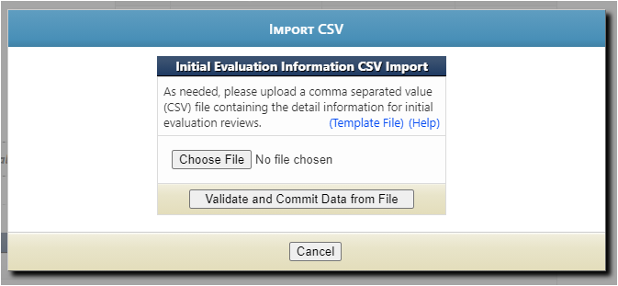
Importing Data from CSV file
Click on the (yellow arrow) Template File to use the blank Excel template that the Department of Elementary and Secondary Education created.
Click on the (green arrow) blue Help to read the directions for preparing the CSV/TXT upload.
Click on (blue arrow) Choose File to locate the CSV/TXT document and to upload from your computer.
Click on (red arrow) Validate and Commit Data from File once you are done with everything.

Slide 46
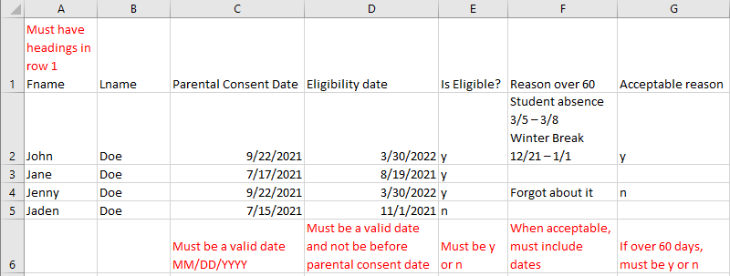
Importing Student Data for Initial Evaluation Timelines
The file can have an extension of .csv or .txt.
Upon submitting a file, the website will first validate and, if valid, will then prompt the user to commit the data.
Data rows should contain only information intended for Initial Evaluation Reviews.
If 'Is Eligible' is 'N' the remaining fields are not required
'Reason 60 Days' column is only required if student eligibility was not determined within 60 days.
When you list an acceptable reason in the ‘Reason 60 Days’ column, you also need to list the applicable dates.
Notes:
CSV stands for comma separated values. This type of record uses commas to separate data. If commas are used within a column (for example in the “reason over 60” column) the file will be corrupted.
When the timeline is not met (exceeded 60 days) the Local Education Agency will need to make sure that specific dates that the student was absent or dates school was not in session are put into the “If NO, give reasons:” field. Do NOT use any commas within dates. Do not use any commas or hard returns within the description of the reason why the evaluation exceeded 60 days. Using commas and hard returns will result in data corruption in your upload because the system uses commas to separate the data being reported.
The system will allow as many CSV/TXT imports as needed. It will take the file and add the data to the existing records with no overwriting of previous information. Please review records in IMACS to make sure that there are no duplicates before submitting the Timelines for review.
After student timelines have been uploaded, you do have the option to edit (pencil icon) or delete (red cross) your entry on the right hand side of the main Initial Evaluation Timeline page.

Slide 47
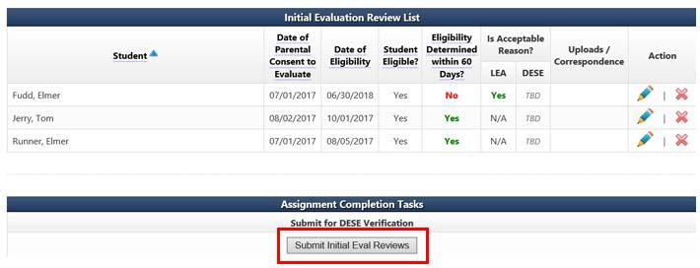
Submitting Initial Evaluation Reviews
After the district has entered the individual student information, the district will submit the initial evaluation review.
Notes:
After the district has entered the individual student information, the district will submit the initial evaluation review.

Slide 48
Timeline submissions due May 15, 2025.
  Part C to Part B Transition
    Include all students referred from Part C whose referral date falls within the data collection period and whose 3rd birthday is prior to April 30, 2024.
    For C to B transition students who were evaluated between these dates they should be included in the initial evaluation timelines
Data collection for timelines will cover the period beginning July 1, 2024 and ending April 30, 2025
Part C to Part B Timelines Submission

Slide 49
C to B Transition Summary Page
Add the C to B Transition Timelines information by going to the Local Education Agency home page and clicking on the C to B Transition review type.
Notes:
Add the C to B Transition Timelines information by going to the Local Education Agency home page and clicking on the C to B Transition review type. Add the C to B Transition Timelines information by going to the Local Education Agency home page and clicking on the C to B Transition review type.

Slide 50
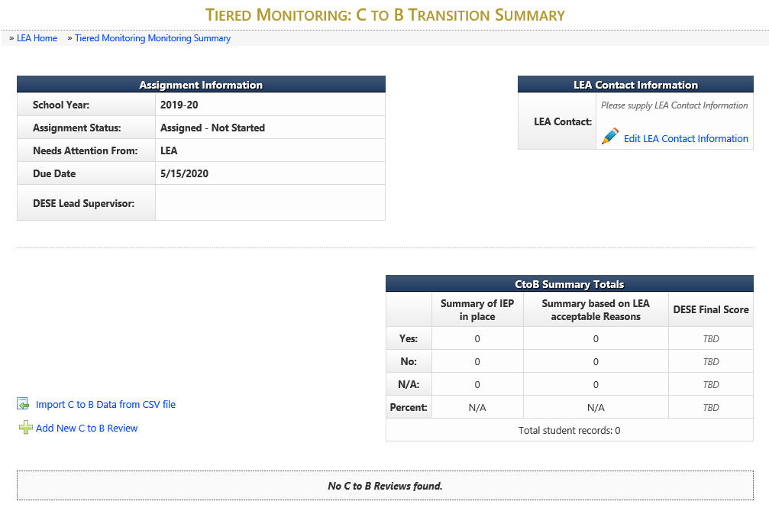
C to B Transition Summary
Notes:
There are two options for entering the C to B Transition information now in IMACS 2.0.
You can either compile the data collection on a spreadsheet and import that by clicking on Import C to B Data from CSV file (green arrow) or you can enter each student individually by clicking on Add New C to B Review (blue arrow).

Slide 51
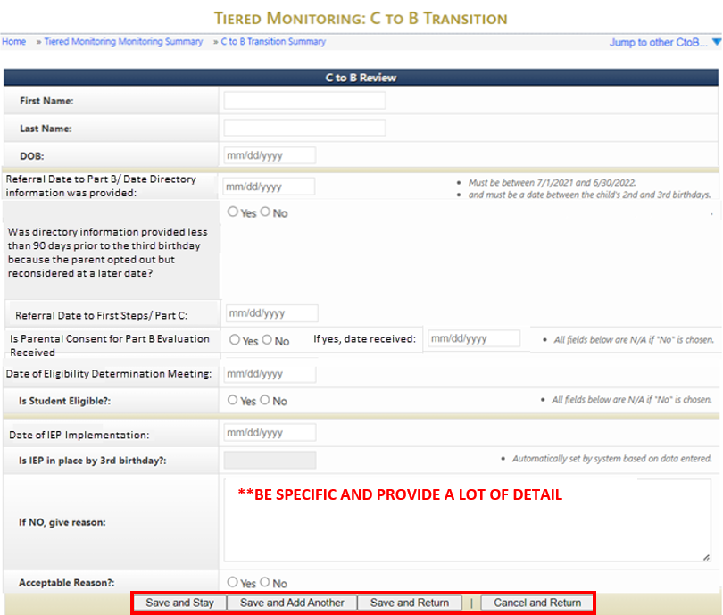
C to B Transition Review
Once completed, select the “Save and Stay,” “Save and Add Another,” or “Save and Return” button.
Notes:
Special Ed Referral Date and First Steps Referral Date are two different dates!
Special Ed Referral Date is the date the Local Education Agency received the directory information from First Step.
First Steps Referral Date is the date that the child was first referred for First Steps services.
When the Individual education program is not in place by the 3rd birthday, the Local Education Agency must provide specific, detailed reasoning in the “If NO, give reason” box.

Slide 52
The Individual education program is not in place by the 3rd birthday
Must provide specific, detailed reasoning in the “If NO, give reason” box.
Reasons may include:
Child referral to Part C less than 90 days before the third birthday
The parents opted out of providing directory information to part B and then changed their minds less than 90 days before the third birthday
Delay in providing consent or parents refusing to provide consent
Children with summer birthdays whose parents chose to continue early intervention services

Slide 53
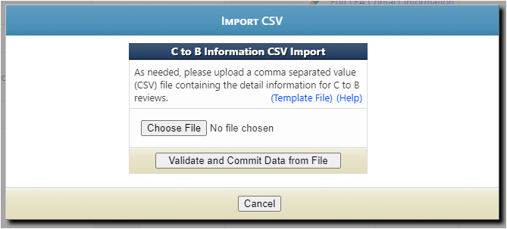
Importing Data from CSV File
Click on the blue Template File to use the blank Excel template that Department of Elementary and Secondary Education created.
Click on the blue Help to read the directions for preparing the CSV/TXT upload.
Click on Choose File to locate the CSV/TXT document and to upload from your computer.
Click on Validate and Commit Data from File once you are done with everything.
Notes:
Click on the blue Template File to use the blank Excel template that Department of Elementary and Secondary Education created.
Click on the blue Help to read the directions for preparing the CSV/TXT upload.
Click on Choose File to locate the CSV/TXT document and to upload from your computer.
Click on Validate and Commit Data from File once you are done with everything.

Slide 54
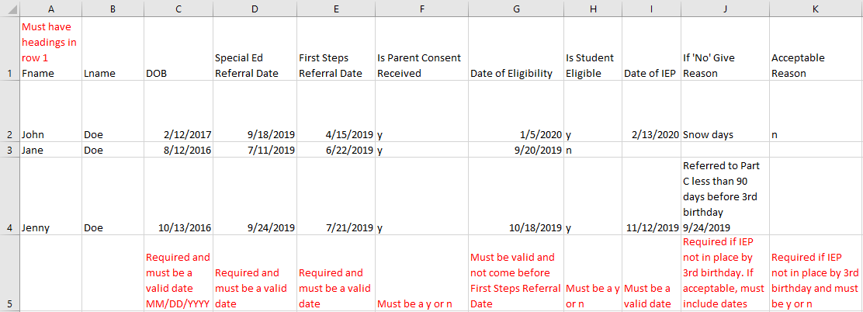
Importing Student Data for C to B Transition Timelines
The file can have an extension of .csv or .txt.
Upon submitting a file, website will first validate and if valid will then prompt the user to commit the data.
Data rows should contain only information intended for C to B Reviews.
If 'Is Parental Consent Received' is 'N' the remaining fields are not required.
If 'Is Student Eligible' is 'N' the remaining fields are not required.
Notes:
CSV stands for comma separated values. This type of record uses commas to separate data. If commas are used within a column the file will be corrupted.
When Individual education program is not in place by the 3rd birthday, the Local Education Agency will need to make sure that specific dates that the student was absent or school was not in session are put into the “If NO, give reasons:” box. Do NOT use any commas within dates or when describing reasons. Do not use hard returns.
Please review records in IMACS to make sure that there are no duplicate records before submitting the Timelines for review.
After student C to B transition timelines have been uploaded, you do have the option to edit (pencil icon) or delete (red cross) your entry on the right hand side of the main C to B Transition Timeline page.

Slide 55
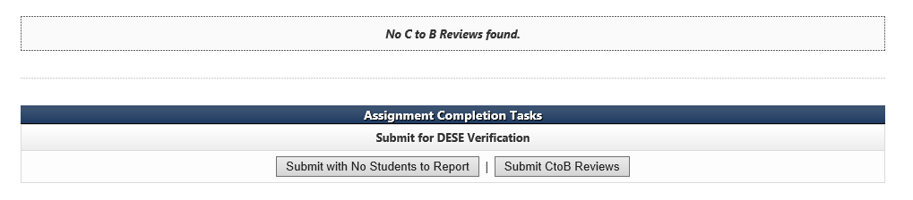
Submitting the C to B Transition Review
After the district has entered the individual student information, the district will need to submit the C to B Transition reviews.
If there are no C to B students, then the Local Education Agency with select the Submit with No Students to Report button.

Slide 56
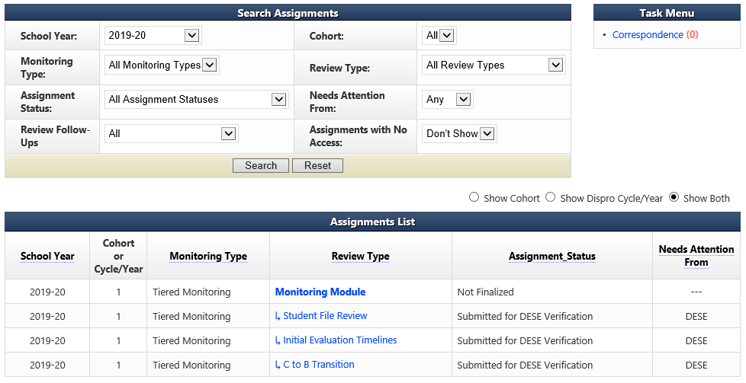
Self-Assessment Completed
Notes:
The CAP Year Training & Guidance can be found at https://dese.mo.gov/special-education/compliance/tiered-monitoring-imacs-faqs and is updated for each cohort. You will receive a notification when it is ready, or you can view the date posted next to the documents to ensure it has been updated.

Slide 57
Reminders
All communication between the Department of Elementary and Secondary Education and the Local Education Agency regarding compliance monitoring or containing Personally Identifiable Information (PII) will be housed in IMACS 2.0.
The system will send an email notification to the Special Education contact and Department of Elementary and Secondary Education each time information has been submitted or returned.
Districts will be able to upload requested documentation to the individual student record at any time in IMACS 2.0.

Slide 58
Common Issues
When submitting prior written notices, if the signature line is blank because they were sent electronically, you must also submit a copy of the email in which they were received.
Be sure to submit a document that states the previous Individual education program date.
Be sure to submit progress reporting for EVERY Individual education program, even if it is submitted later.
Make sure that the correct contact information for the Local Education Agency is included on every page in IMACS.
Fill out ALL demographic information for student files.
Notes:
Read the Slide
Remember to review your files before entering the student demographics. Documentation submitted and opened by Department of Elementary and Secondary Education may be reviewed for compliance.

Slide 59
Compliance Consultants
Region | Compliance Consultant | Phone Number | Email
Southeast | Tiffiney Smith | 573-651-2621 | tdsmith@semo.edu
2. Heart of Missouri | Lynn Lynch | 573-424-7847 | lynchly@missouri.edu
3. Kansas City | Bailey Tennesen | 816-235-5957 | tennesenb@umkc.edu
4. Northeast | Dawn Lichtenberg | 660-785-6080 | dlichtenberg@truman.edu
5. Northwest | Julia Schmitz | 660-562-1995 | julia@nwmissouri.edu
6. South Central | Leasa Day | 573-341-6821 | ldnd3@mst.edu
7. Southwest | Amy Phipps | 417-836-4082 | amyphipps@missouristate.edu
8. St. Louis | Jeanne Rothermel | 314-724-6736 | jrothermel@edplus.org
9. Central | Julie Harris | 660-232-0387 | jlharris@ucmo.edu

Slide 60
Helpful links for Tiered Monitoring and IMACS
Self-Assessment (Year 1) Guidance and Resources
Self-Assessments IMACS Training PowerPoint
Self-Assessment Tiered Monitoring Process PowerPoint
Top Indicators Out of Compliance
Top Indicators Out of Compliance PowerPoint
List of Things to Remember for Self-Assessment
Self-Assessment Procedures for Monitoring
Local Education Agency Special Education Compliance Monitoring Checklist
Tiered Monitoring Flowchart

Slide 61
Resources
Office of Special Education
Special Education Compliance (Part B)
P.O. Box 480, Jefferson City, MO 65102-0480
Phone: 573-751-0699
Email: secompliance@DESE.mo.gov

Slide 62
62
Missouri Department of Elementary and Secondary Education
It is the policy of the Missouri Department of Elementary and Secondary Education not to discriminate on the basis of race, color, religion, gender, gender identity, sexual orientation, national origin, age, veteran status, mental or physical disability, or any other basis prohibited by statute in its programs or employment practices as required by Title VI and VII of the Civil Rights Act of 1964, Title IX of the Education Amendments of 1972, Section 504 of the Rehabilitation Act of 1973, the Age Discrimination Act of 1975 and Title II of the Americans with Disabilities Act of 1990, and the Americans with Disabilities Act of 2008 (ADAAA), the Genetic Information Non-Discrimination Act (GINA), or USDA Title VI.

