Slide 1

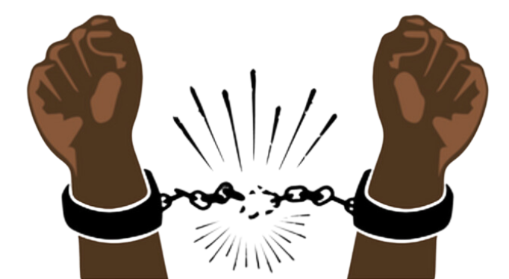
Juneteenth: A Celebration of the Process of Emancipation
Juneteenth:
A Celebration of the Process of Emancipation
Notes:
The following slides are designed to accompany the lesson over Juneteenth: The lessons of this holiday are still unfolding in today’s classrooms, as many are just hearing about this celebration for the first time. To begin, teachers might discuss what students have of this holiday and what they know about it as well.

Slide 2
January 1, 1863
What do you already know about Emancipation Proclamation
CC BY-NC-ND 3.0 DEED
Notes:
Discuss the following:
What did the Emancipation Proclamation accomplish?
Rather than correct students on specifics as to the details of the 1863 Emancipation Proclamation, allow them to discover some misconceptions and additional learning as they proceed through the remainder of the lesson.

Slide 3
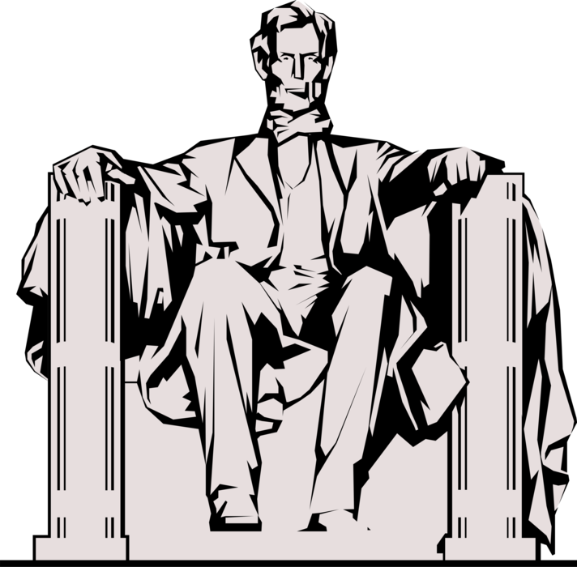
Emancipation
Emancipation
"That on the first day of January, in the year of our Lord one thousand eight hundred and sixty-three, all persons held as slaves within any State or designated part of a State, the people whereof shall then be in rebellion against the United States, shall be then, thenceforward, and forever free.”
Proclamation
CC BY 3.0 DEED
Notes:
PRIMARY SOURCE ANALYSIS:
This is a quote from the Emancipation Proclamation:
Who is the author of this document?
What kind source is this “proclamation”?
To which states did this apply?
To which states did this NOT apply?
Why did this only apply to rebellious states?
So, did this apply to Missouri?

Slide 4
Use the note sheet to construct a timeline to help you determine the answer to our
Essential Question:
How is emancipation a historical process more than a historical event?
Notes:
Emancipation Timeline

Slide 5
President Lincoln freed enslaved peoples even before January 1863…
Do you know when & where?

Slide 6
April 16, 1862
DC Emancipation Act
On April 16, 1862, President Abraham Lincoln signed a bill ending slavery in the District of Columbia. Passage of this law came nearly nine months before President Lincoln issued his Emancipation Proclamation.
It provided for immediate emancipation, compensation to former owners who were loyal to the Union of up to $300 for each freed slave, voluntary colonization of former slaves to locations outside the United States, and payments of up to $100 for each person choosing emigration.
Source: National Archives Foundation
CC BY-NC-ND 3.0 DEED
Notes:
Ask students why Lincoln may have emancipated the enslaved people in Washington DC so much earlier than in the rebelling states?

Slide 7
The Emancipation Proclamation did not create immediate freedom for all enslaved peoples.
So, why not? And, what did ?

Slide 8

It is recommended that the instructor utilize complementary videos to help students understand the meaning and importance of Juneteenth.
One such video can be searched via YouTube: “Henry Louis Gates Jr. on the significance and history of Juneteenth.”
Run time is approximately 6.5 minutes.
PxHere CC0 1.0 DEED
Notes:
Here are some discussion questions that accompany the interview with historian, Henry Louis Gates, Jr.:
What are the “big three” holidays/commemorations for Blacks? (Emancipation Proclamation, Juneteenth, and the 13th Amendment)
Why are those important to remember for all Americans?
What fictional ideas/myths have been attached to the holiday over time?
Look at the Emancipation Proclamation in context:
Who did the Proclamation apply to in 1863?
Who did it not apply to in 1863?
What does this do to complicate our understanding of Lincoln as well as this famous Proclamation?
Why didn’t the Civil War actually end at Appomattox?
What technically led to the delayed emancipation of enslaved people in Texas?
How would enslaved people in Galveston have heard about emancipation before General Granger’s General Orders, No. 3?
Why might these ideas have evolved inaccurately?
What are the most important things that followed emancipation? (discuss the meanings and power of the 13th, 14th, and 15th Amendments)
How does the idea of justice emerge from Juneteenth and all that it celebrates?

Slide 9
June 19, 1865
General Orders, No. 3
CC BY-NC-ND 3.0 DEED
Notes:
Ask students what they know about this time period. To prime their responses, teachers might ask what major event came to a close to this same date in American history. Inquire as to what students know about “General Orders”--where might these come from?

Slide 10
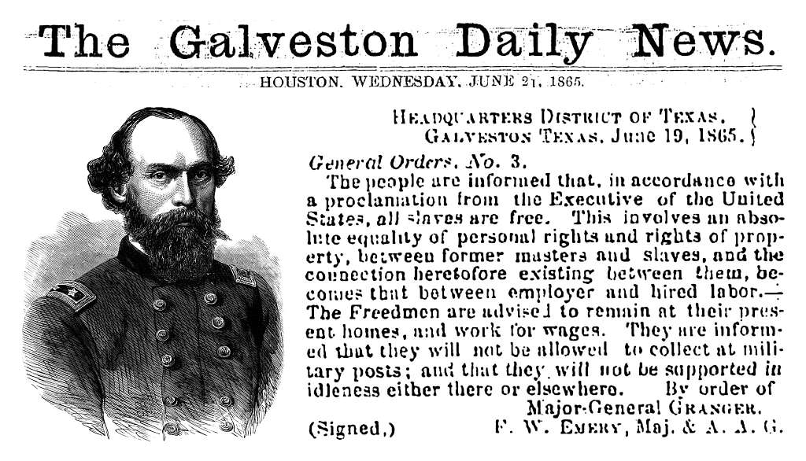
Galveston Daily News Article
PDM 1.0 DEED
Notes:
PRIMARY SOURCE ANALYSIS:
This Houston, Texas reprint of the original Galveston, Texas article details General Orders, No. 3. Break down the following components of this order:
Who is the author of this document?
What kind or “order” is this, and why might it come from an army officer?
How does this relate to what you from the video (if you watched the one with Henry Louis Gates, Jr.)
Who is the intended audience?
What different types of reactions might arise from different groups of people?
Discuss the phrase “all slaves are free.” What kind of impact might this have on Galveston, Texas?
How did the relationship between “masters and slaves” change according to the order?

Slide 11
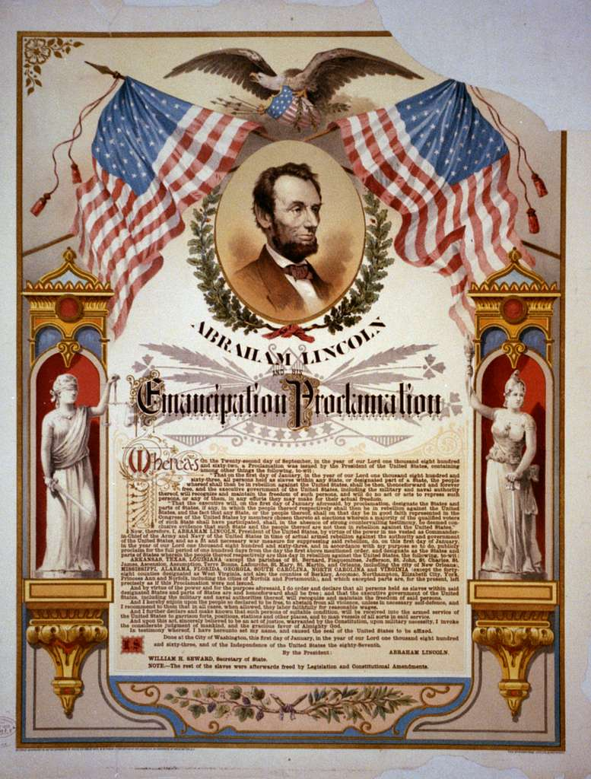
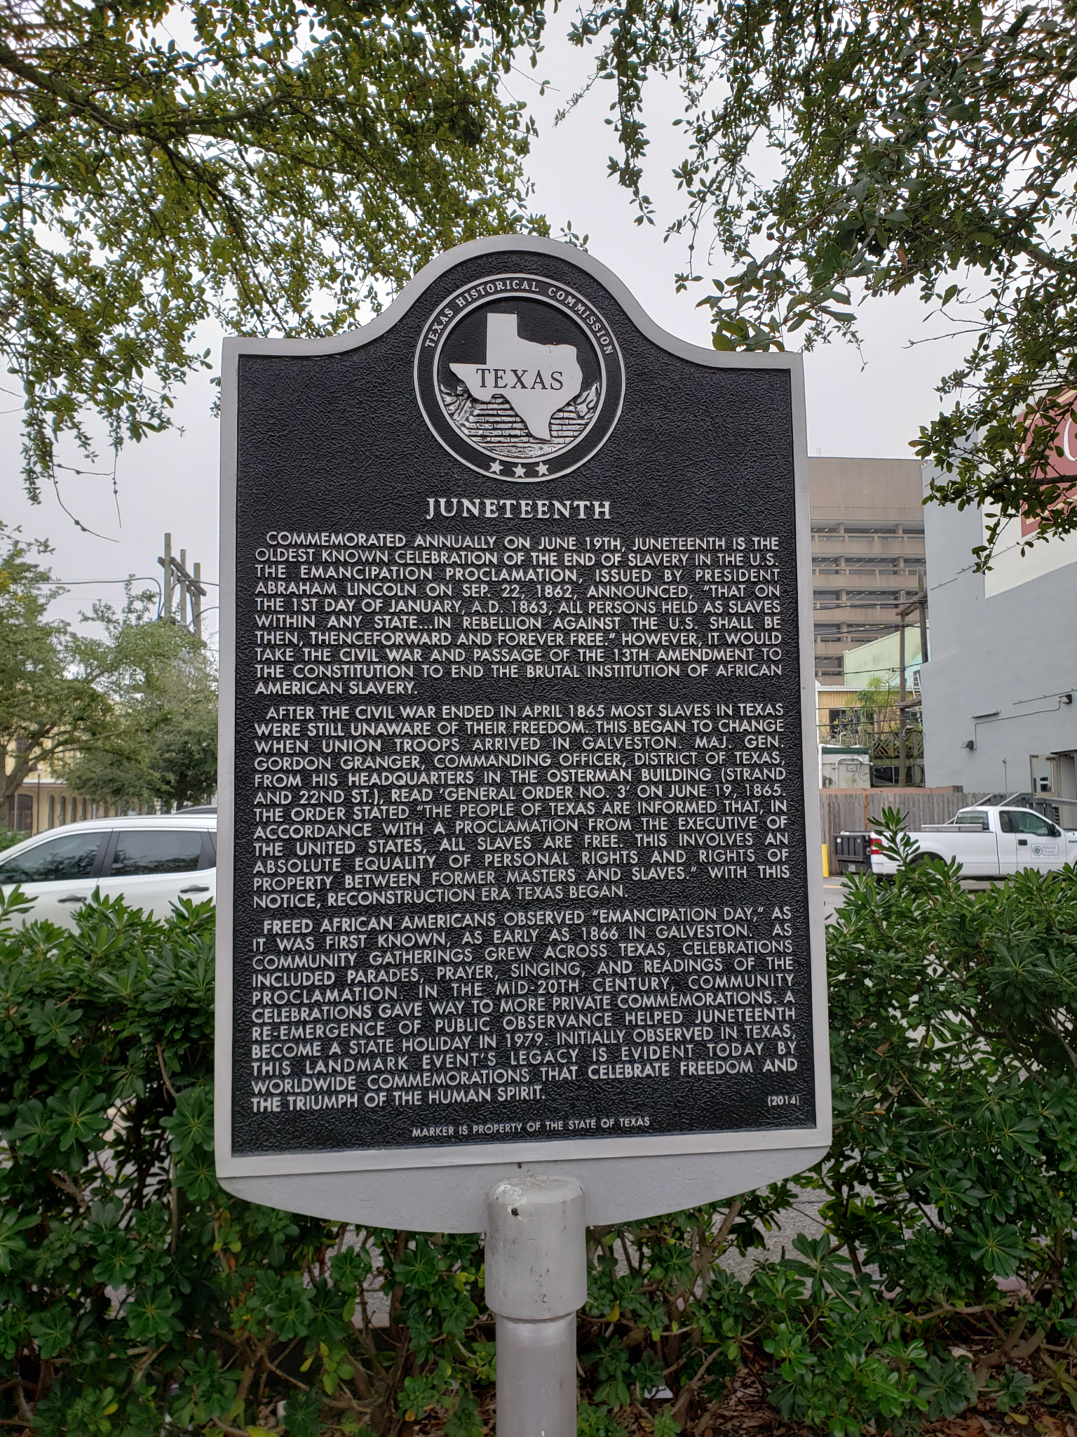
Delayed News is Still Good News!
What role did these things play in causing a delay?
Which caused the biggest delay?
Distance
Methods of Communication
Warfare
Geography and infrastructure
Despite those roadblocks to think the enslaved people of Texas really hadn’t heard about Emancipation before June 19, 1865?
If this is your first time hearing about your freedom, what kind of reactions might you have had?
June 19, 1865
January 1, 1963

Slide 12
December 6, 1865
Ratification of the 13th Amendment
CC BY-NC-ND 3.0 DEED
Notes:
Discuss the following:
If the 13th Amendment was passed in on January 31, 1865, why did it not take effect until December 6, 1865?
What changed as a result of the ratification of the 13th Amendment?
What didn’t change as a result of the ratification of the 13th Amendment?

Slide 13
June 19, 2021
Juneteenth--A National Holiday
CC BY-NC-ND 3.0 DEED
Notes:
Now that students have some background knowledge, it is time to examine the essential question for application to today’s world:
How is emancipation a historical process more than a historical event?

Slide 14
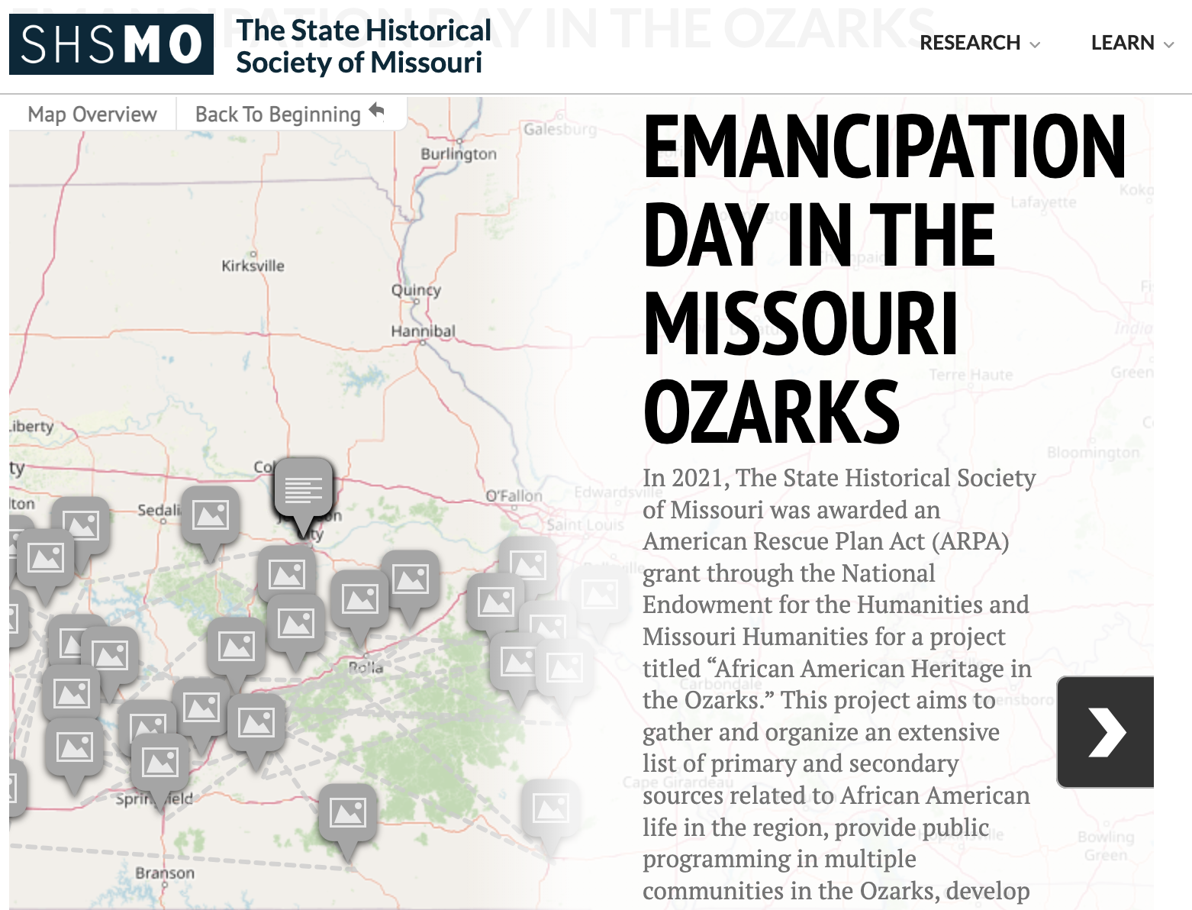
Activity:
Explore the origins of Juneteenth in Missouri by visiting: https://shsmo.org/learn/emancipation-day-ozarks
Choose 5 places in Missouri to investigate how and when emancipation was celebrated there.
Notes:
What can we learn about when and how emancipation has been celebrated in Missouri over time?
The State Historical Society of Missouri released an interactive guide to “Emancipation Day in the Ozarks” with an accompanying map to help students find local connections, as well as both primary and secondary sources to enrich their learning. This is a fairly new and fantastic resource!

Slide 15
Did you know?
Facts about Juneteenth and celebrations
throughout our history
It’s now time to teach others about what you have learned about Juneteenth.
Consider including information:
that was new to you
about which you had misconceptions
linked to pieces of Missouri history
Your purpose is to educate others so that they too may understand the history of emancipation acknowledged with the celebration of Juneteenth.
Use the “Did you know?” note sheet to sketch out a draft of the flyer or poster you’ll make

