Slide 1
Zoom Support Meeting Norms
Mute unless you are speaking to the group
Use the chat to ask questions
Be professional and helpful
Be mindful when asking questions about specific situations - don't give out any information that could reveal the identity of a person with a disability

Slide 2
Back to School
August 2024
Bailey Tennesen, Compliance Consultant, KC RPDC
Dawn Lichtenberg, Compliance Consultant, NE RPDC
Leslie Porter, Special Education Finance
Notes:
Good Morning and welcome back to school!! My name is Bailey Tennesen and I am the Kansas City-Regional Professional Development Center Compliance Consultant and I have with me co-presenting Dawn Lichtenberg who is the Northeast City-Regional Professional Development Center Compliance Consultant.

Slide 3
Back to School Hot Topics
Policy and Procedures
State Plans and Local Compliance Plans
Standard and Indicators Changes
Prior Written Notice Reminders
Nonpublic Consultation
Use of Substitutes
Transition from Part C to B
Artificial Intelligence
Finance Overview with Leslie Porter
Notes:
Today we are going to discuss the following hot topics
Policy and Procedures
Standard and Indicators Changes
Prior Written Notice Reminders
Nonpublic Consultation
Use of Substitutes
Transition from Part C to B
Artificial Intelligence
Finance Overview with Leslie Porter

Slide 4
Missouri State Plan Updates
Notes:
We are going to get things started with the Missouri State Plan Updates.

Slide 5
SURPRISE!
NO
Missouri State Plan Changes
https://dese.mo.gov/governmental-affairs/dese-administrative-rules/incorporated-reference-materials/IDEAPartB-2014
Notes:
There are no new changes for the 24-25 school year!!! Weehoo!! One suggestion that I would have is that you print off a Missouri State Plan and Standards and Indicators and place them in a binder and have them readily available. They will come in handy as the school year kicks off

Slide 6
Local Compliance Plan
http://dese.mo.gov/local-compliance-plan
Notes:
There are no new Missouri State Plan Updates

Slide 7
No changes were made to the Missouri State Plan for Special Education so districts do not need to adopt a new Local Compliance Plan.
Notes:
Districts do NOT need to adopt a new Local Compliance Plan for the 24-25 school year. We have had many districts contacting us asking if they would need to go in front of their school boards to get a new local compliance plan approved. This process only needs to happen when updates are made to the Missouri State Plan.
Recap: Districts DO NOT need to adopt a new Local Compliance Plan :)

Slide 8
Standards & Indicator Changes
Notes:
Proposed Changes to the Missouri State Standards and Indicators are being addressed with local special education directors and stakeholders from across the state as we speak.

Slide 9
Proposed Areas of Change
Specific Learning Disability
Language Impairment
All Three Areas of Speech
Voice
Fluency
Sound-System Disorder
Prior Written Notice for Initial Eligibility
Prior Written Notice for Consent for Initial Services
Notes:
Here are the proposed areas of change:
*As I mentioned earlier, we are currently gathering stakeholder input on changes and as soon as they are approved, they will be published on the Department of Elementary And Secondary Education (DESE) website and a SELs message will be sent. Stay tuned!

Slide 10
Prior Written Notice Reminder

Slide 11
Prior Written Notice (PWN) for Initial Eligibility/Provision of Initial Services
DESE revised initial evaluation flow charts for parent and agency referrals
LEAs are required provide PWN requesting parent written consent for provision of initial special education and related services but are not required to convene the IEP team until the parent has provided written consent.
C.F.R 300.300.b
Notes:
When researching federal law 34 CFR 300.300 (b), DESE Compliance found that if a student is eligible for special education, they are eligible for the initial provision of special education and related services, and this should be determined at the eligibility determination meeting. During the eligibility determination meeting, the team would not predetermine the amount, frequency or location of services being provided (that would be discussed at the IEP meeting). We are simply stating that they require special education services (and potentially related services depending on the needs of the student). An analogy that was shared with me is the doctor office analogy. When you check in at doctors' office, you’re required to consent to doctor providing services prior to even being seen by the doctor. When you see the doctor, they will fine tune a treatment plan similar to an IEP team and IEP development.
*During the IEP meeting, the IEP team will determine the amount, location, and frequency of services required. Parental consent is not required for this determination . This would be considered the details of the initial placement on your PWN.
LEAs are encouraged to set a tentative IEP meeting date in anticipation of receiving parent consent for provision of initial services. LEAs should expedite the IEP meeting process as much as possible after receiving consent when a parent has delayed providing consent. In no case should the IEP meeting be held more than 30 days after the date the parent provided consent for provision of services.
A recap: The provision of initial special education and related services is determined at time of eligibility, that’s what the initial services PWN is focused on, “the general need” not the specific details of services.

Slide 12
Two Ways to Fill Out PWN for Initial Eligibility and Provision of Initial Special Education and Related Services
1st Way: 2 Separate PWNs Describing Each Action:
PWN 1 : Initial Eligibility ( box for initial eligibility would be checked, but parental consent is not required)
PWN 2: Initial Services (box for initial service would be checked and consent required)
DESE Example showcases provision of services on March 2024 To-Do List (PWN 2 above)
2nd Way: One PWN Describing Both Actions:
PWN1: Initial eligibility & initial service box would be checked and discussed. Parental consent would be required for initial services
*Suggestion: Separate out each action by including one paragraph for initial eligibility and a second paragraph for provision of initial special education and related services on each section of PWN.
Notes:
There are two ways you can complete Prior Written Notices (PWN) for initial eligibility and provision of initial special education and related services during the Eligibility Determination Meeting
1st way: The PWN example that was provided in DESE sample was to show how you could describe the provision of initial special education and related services at the eligibility determination meeting (PWN 2). In the example, the team chose to have two separate PWN documents describing each action that was agreed at the eligibility determination meeting (initial eligibility – PWN 1 and PWN 2 for the provision of initial special education and related services).
2nd way: Districts could choose to put both actions on one PWN. If you do this, I suggest writing one paragraph on initial eligibility and a second paragraph on provision of initial special education and related services for each section of the PWN. In this situation both boxes would be checked, initial eligibility, and initial services. Parental consent would be required for this PWN because you combined initial services and initial eligibility.

Slide 13
Substitutes in Special Education
Notes:
Let’s talk about substitutes in special education for a quick second. One of the earliest challenges we are facing right now is finding fully certified staff in special education.

Slide 14
Can substitutes provide sped services?
The IDEA requires special education teachers be properly certified according to their state requirements. IDEA does not address substitute teachers specifically.
The Missouri State Board of Education approved new changes in June 2022 that allow different paths to becoming a substitute teacher in Missouri. With continuing teacher shortages many districts are turning to the use of long-term substitutes.
It is legal to use long-term substitutes to fulfill shortages in the special education classroom, but special attention needs to be paid to the compliance requirements of IDEA regarding FAPE and IDEA required paperwork
Notes:
The biggest question is can substitutes provide special education services? Here is what IDEA as well as the Missouri State Board of Education have to say about this: READ SLIDE

Slide 15
Can a substitute teacher case manage, write IEPs to students with disabilities?
There is currently nothing in Federal Law or Missouri Law that prohibits a substitute for a special education teacher from doing any of these things.
Substitutes should be supervised and be provided with support from a certified special education teacher, process coordinator, or administrator. Positions filled by long-term substitutes will need to be monitored more closely to ensure compliance.
It would be BEST PRACTICE to have a properly certified special education teacher perform as many of those duties as possible.

Slide 16
Helpful Tips When Using Long Term Subs Substitutes
Involve them in any Special Education Professional Development (SPED PD) training you conduct in the district or that are offered by the RPDC.
Show them all of DESE’s compliance resources (including recorded Zooms, Myths, forms etc.).
Conduct a “boot camp” in which you give them an overview of the SPED process, IEP implementation, how to collect IEP goal data on their specific IEPs, and any specific instructional strategies they may need to fully implement their students’ IEPs.
Keep detailed records of all the training you have provided them.
Assign a mentor to each long-term substitute teacher - someone who can check in with them on a frequent basis to provide support and answer questions.
Consider having a mentor to assist them with IEP development and have the mentor attend their IEP meetings.
Notes:
Positions filled by long-term substitutes will need to be monitored more closely to ensure compliance. Here are some helpful tips when using a long-term substitute in a special education classroom.

Slide 17
Parentally Placed Private School Students
Notes:
Dawn:

Slide 18
Nonpublic Child Find
Districts must identify, locate and evaluate parentally placed private school children with disabilities attending schools located in their jurisdiction.
*This includes homeschooled students.
Parentally Placed Private School Children
Notes:
District have child find requirements for all students.

Slide 19
Nonpublic Consultation
LEA’s must consult with each nonpublic school located within the school district boundaries including homeschooled students.
At least annually, IDEA requires a timely and meaningful consultation among the public school district, officials of private schools, and representatives of parents of parentally placed school children in private, parochial, and homeschools with disabilities within the jurisdiction of the public school district.

Slide 20
Nonpublic Consultation (continued)
Districts should document decisions made during the consultation process and share the completed plan with nonpublic representatives involved in the consultation.
The district must maintain a copy of the affirmation of nonpublic consultation and participation
DESE Consultation/Affirmation Forms
Consultation Participation Guidance Document
Nonpublic Affirmation

Slide 21
If consultation and affirmation was completed in the spring of the year, the beginning of the school year is a good time to reach out to nonpublic schools and reaffirm understanding of the decisions made during that consultation.
Nonpublic Consultation/Affirmation

Slide 22
Individual Service Plan
Children with disabilities placed in private schools by their parents where Free Appropriate Public Education (FAPE) is not at issue do not have an individual entitlement to the special education and related services they would receive if they were enrolled in a public school.
The consultation process determines how, where, and by whom equitable services will be provided to parentally placed private school students.

Slide 23
Individual Service Plan
The Individual Service Plan (ISP) is not the same as an Individual Education Program (IEP).
The ISP is not intended to meet FAPE for the student but rather provide equitable services and related services that the district will provide to the child in light of the decisions made in the consultation process.
ISP must be reviewed and revised annually.
Questions & Answers on Serving Children with Disabilities Placed by Their Parents in Private Schools (OSEP, Updated Feb 2022)

Slide 24
Transition from Part C to B Directory Information
GOOD FAITH EFFORT
2 attempts with 2 different forms of communication (mimicking the Notice of Meeting). Phone and registered mail.
*If you do not have an address or phone number make sure districts document that.
Put "Do not forward. Address correction requested.” on mail (need to ask your local post office about the process). The post office would send the mail back to the district and state where the family moved and then the district could mail to the new address.
Notes:
It is important to make a good faith effort when making contact once directory information is received for students transitioning from First Steps. This process should mimic the Notice of Meeting Requirements. Document what information you know. If families have potentially moved and the district has an incorrect address, there is an option to work with the post office to obtain the new mail address. You would need to inquire at your local post office to determine the local process for having the corrected address returned to the school, so then the district can make contact at the new address. Be mindful of barriers within the home.

Slide 25
Language Equality and Acquisition for Deaf Kids (LEAD-K) Act
•LEAD-K is a national campaign to promote language acquisition and kindergarten-readiness for children aged 0-5 who are deaf and hard of hearing. Missouri passed House Bill 447 in August 2023.
Notes:
Read the slide.

Slide 26
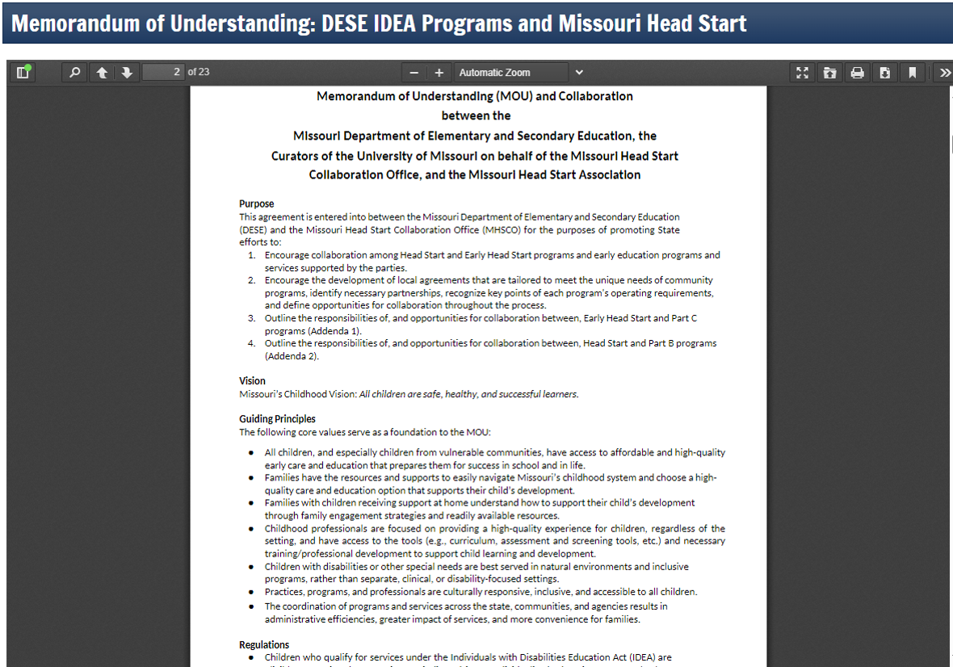
Updated MOU with Head Start
Memorandum of Understanding: DESE IDEA Programs and Missouri Head Start | Missouri Department of Elementary and Secondary Education
Notes:
This document can be a supportive tool for Head Start Programs and LEA’s to build an individualized local Memorandum of Understanding (MOU) to encourage delivery of services to children with disabilities in inclusive settings in the natural/least restrictive environment. The tables within the MOU include suggested discussion topics to support collaboration at the local level.

Slide 27
Early Childhood Special Education
Remember to always make decisions based on the child’s Least Restrictive Environment
Notes:
It is important when discussion how to service our early childhood students that we keep in mind the least restrictive environment that is needed to provide FAPE to the student. Even if we have a full time ECSE program the student may not need to attend the full day ECSE program to meet FAPE in their IEP, they may be able to attend a general education preschool program as well. Make sure each decision is individualized.

Slide 28
Artificial Intelligence

Slide 29
Artificial Intelligence (AI)
Districts should be proactive
Policies and expectations for staff and students regarding the use of AI
Refer to your District Board Policy
Make sure IEPs are individualized not in a generic format
Be mindful of personally identifiable information that is being shared on AI platforms
Remember: Chat Boxes are not educational experts!
Notes:
Districts should be proactive and have district policies regarding the use of artificial intelligence. It is important to remember that IEP’s must be individualized, never put personally identifiable information into an AI platform. Then we must keep in mind that chat boxes are not educational or special education experts.

Slide 30
Special Ed. Connections Resources
US Dept. of Education- Artificial Intelligence & the Future of Teaching and Learning - Insights and Recommendations
https://www.specialedconnection.com/LrpSecStoryTool/index.jsp?contentId=10001&chunkid=1000015262
Download Why Using AI Chatbot can Help, Interfere with Crafting IEPs
https://www.specialedconnection.com/LrpSecStoryTool/index.jsp?contentId=22746811&query=((%7bAI%7d))&listnum=0&offset=1&topic=Main&chunknum=1
Upload Knowledge to Special Educators on AI tools
https://www.specialedconnection.com/LrpSecStoryTool/index.jsp?contentId=22747764&query=(({AI}))&listnum=1&offset=2&topic=Main&chunknum=1
Notes:
There are resources available that address AI in special education connections, that each district has a membership to.

Slide 31
Special Education Finance

Slide 32
Agenda
RESOURCES
Website
SELs Messages
Calendar/Payment Request Due Dates
Fiscal Monitoring Guides
ePeGS Guides
Special Education Finance Training:
Coding Cheat Sheet
Webinars
Training Modules
FISCAL CYCLE
Federal and State Funding
Special Purpose Funds
Proportionate Share
Budget Revisions
Tiered Monitoring
ASBR
Analysis
Impact of Revisions
SPECIAL EDUCATION FINANCE CONTACTS

Slide 33
Resources

Slide 34
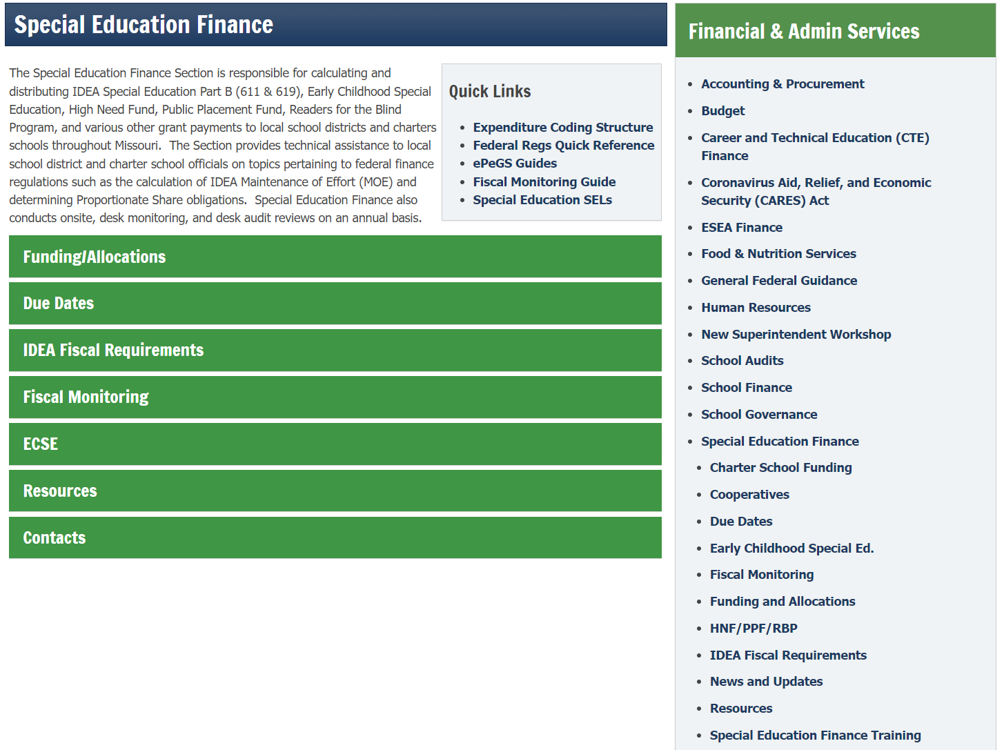
Website
Notes:
https://dese.mo.gov/financial-admin-services/special-education-finance

Slide 35
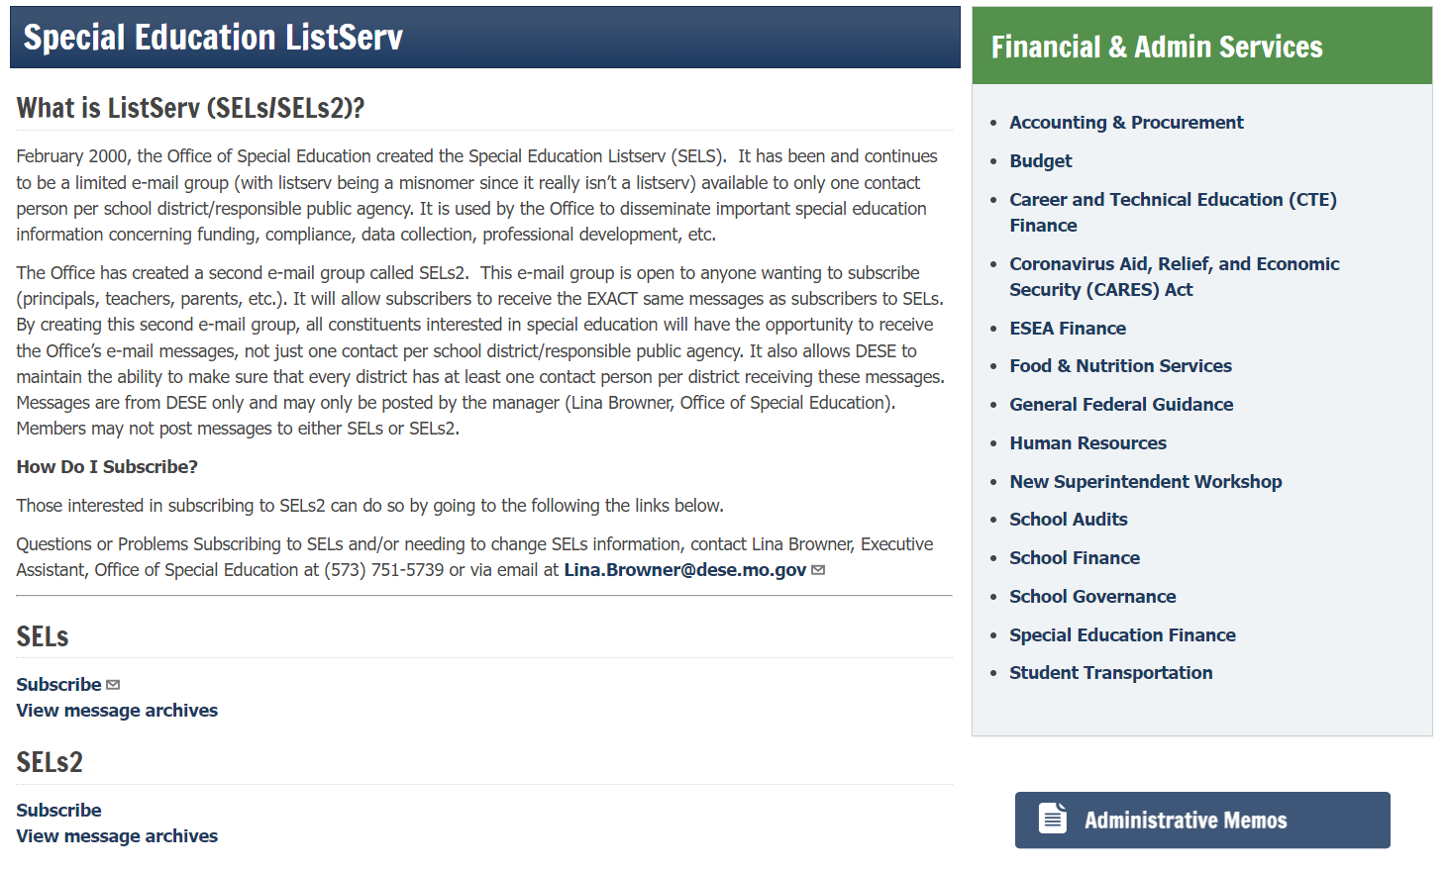
SELs Messages
Notes:
https://dese.mo.gov/financial-admin-services/special-education-finance/special-education-listserv

Slide 36
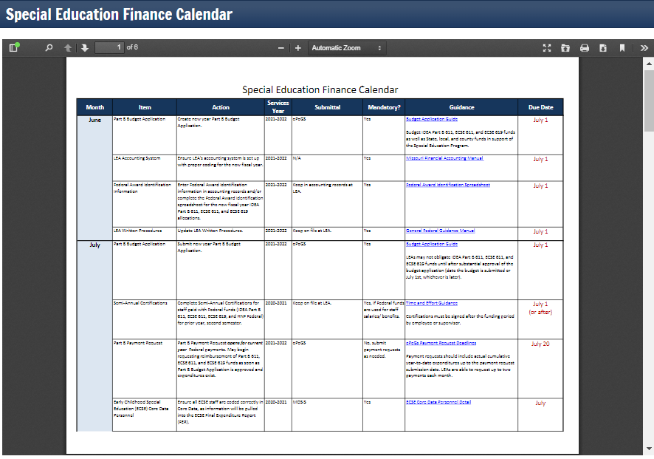
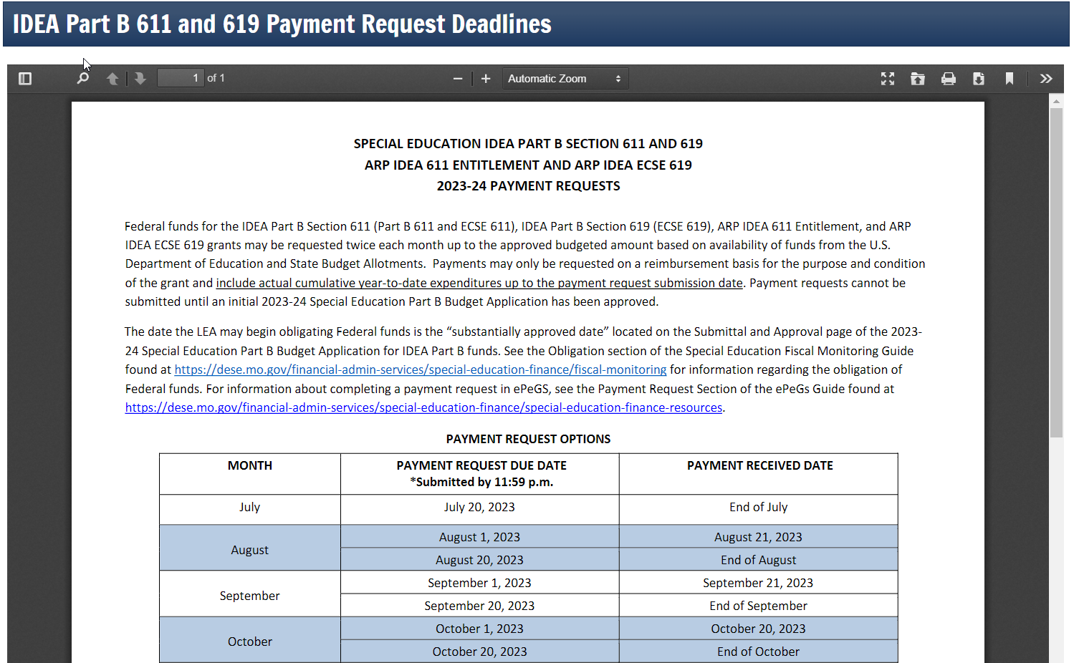
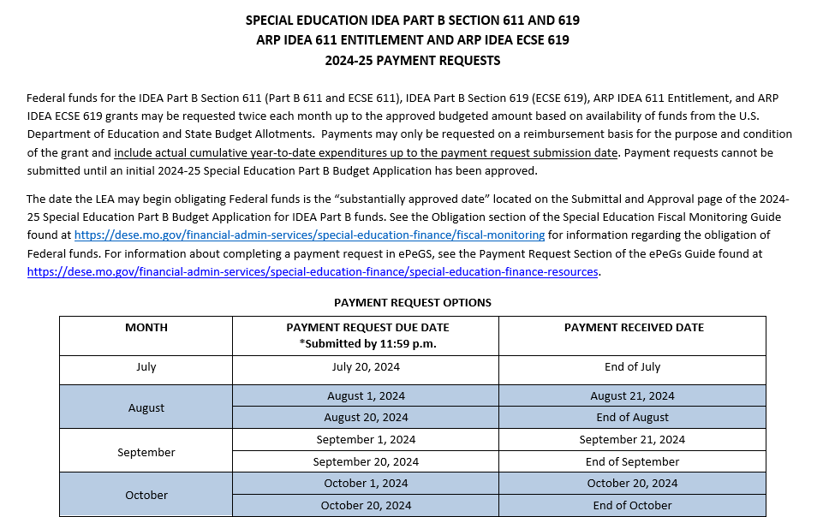
Due Dates
Notes:
https://dese.mo.gov/financial-admin-services/special-education-finance/special-education-finance-due-dates

Slide 37
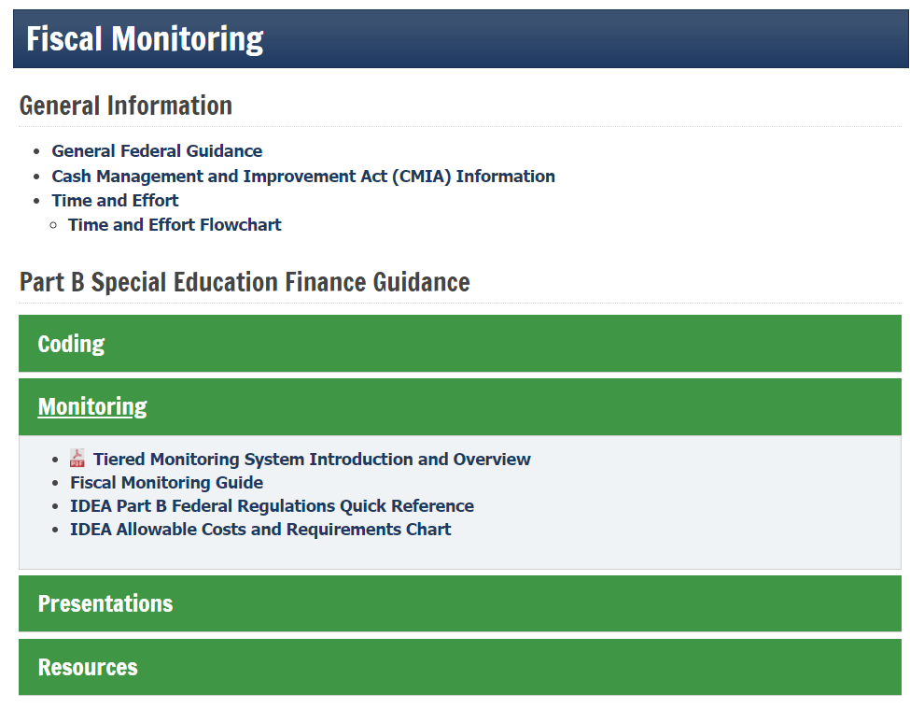
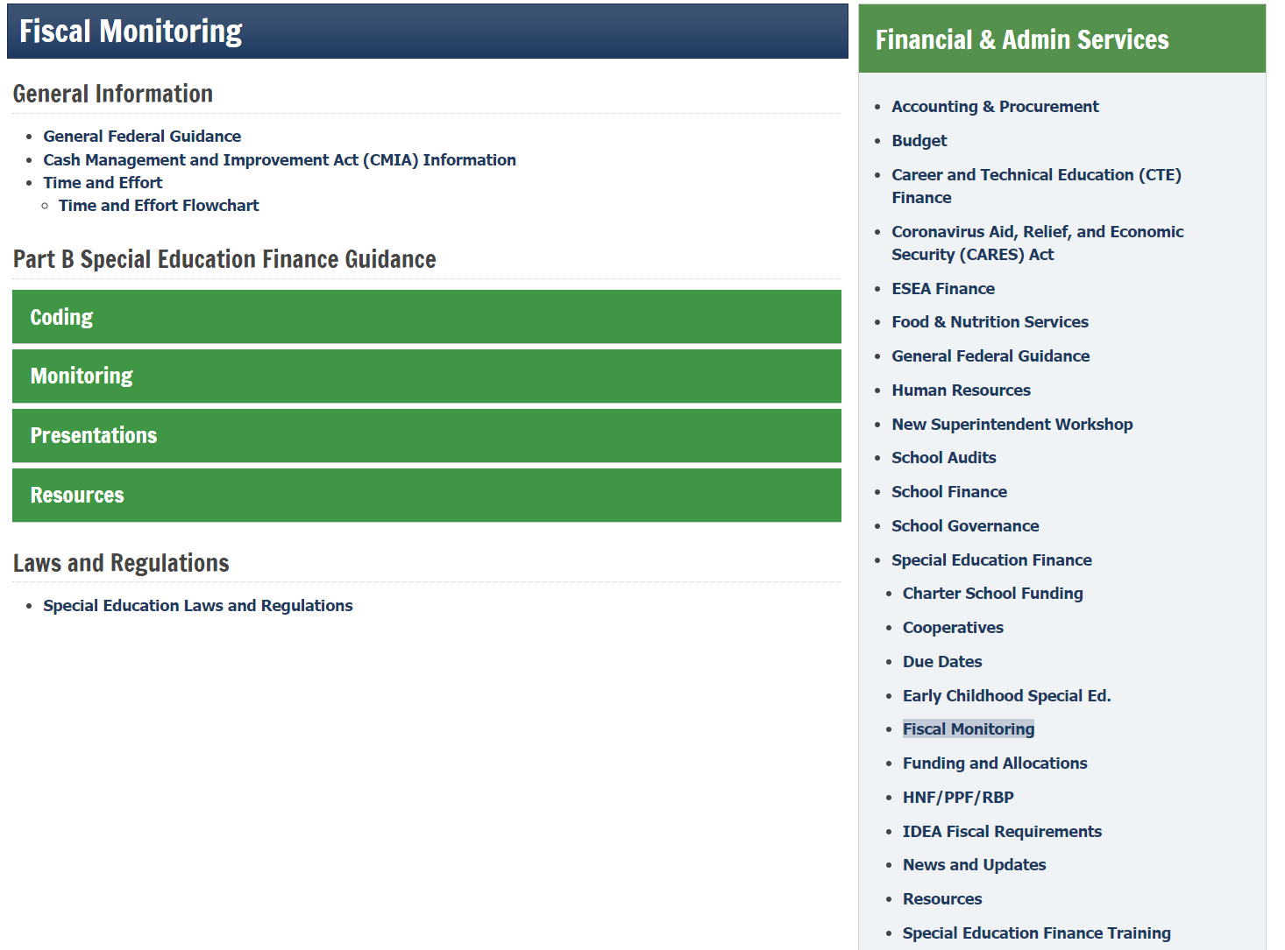
Fiscal Monitoring
Notes:
https://dese.mo.gov/financial-admin-services/special-education-finance/fiscal-monitoring

Slide 38
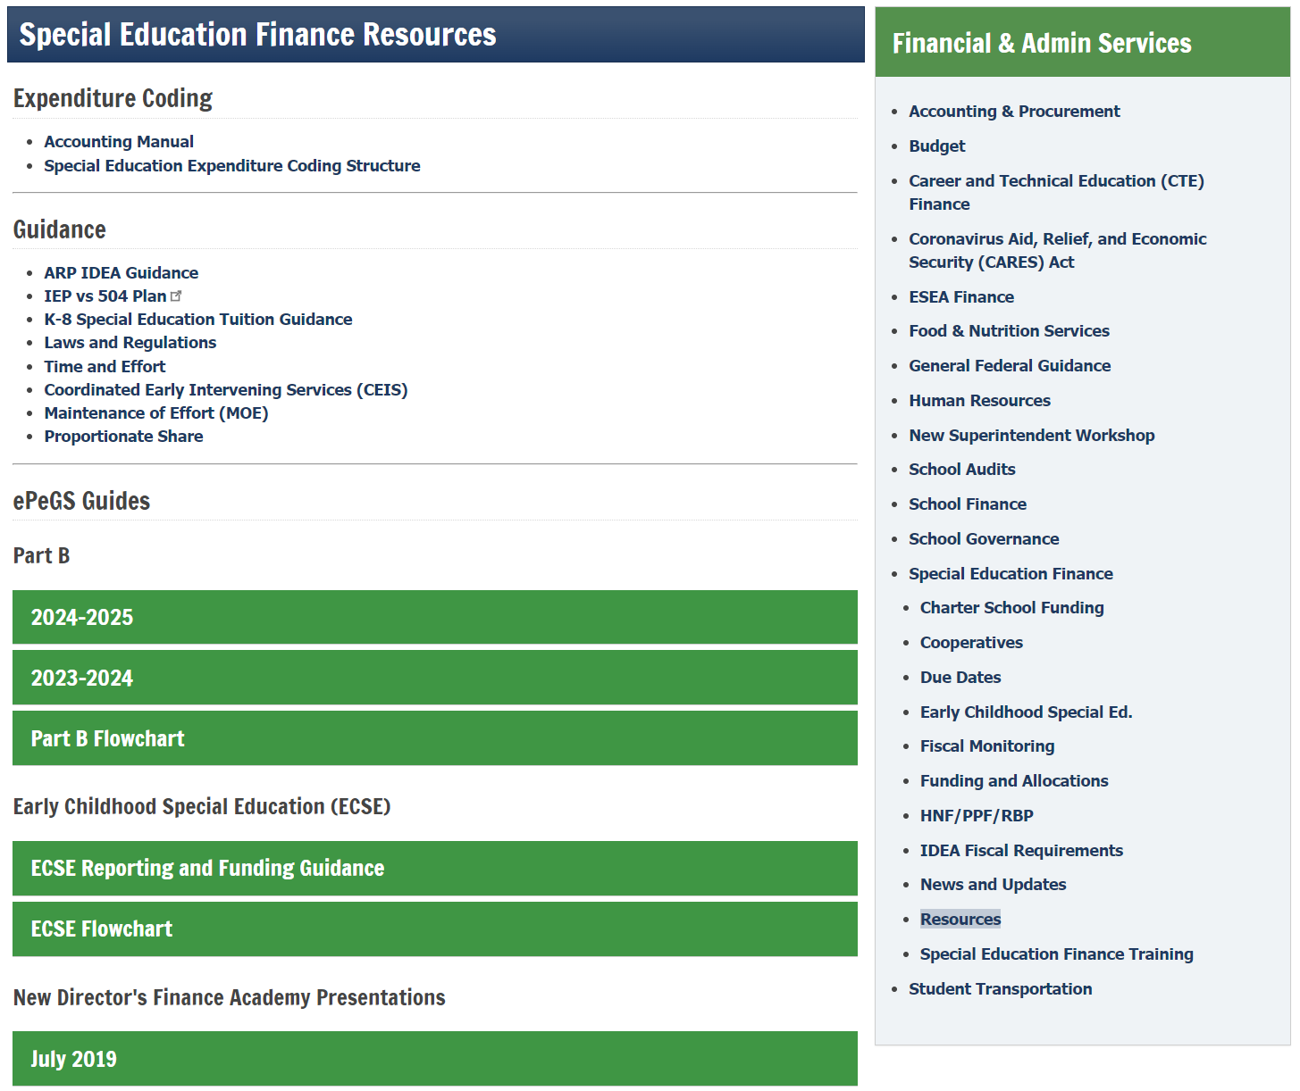
ePeGS Guides
Notes:
https://dese.mo.gov/financial-admin-services/special-education-finance/special-education-finance-resources

Slide 39
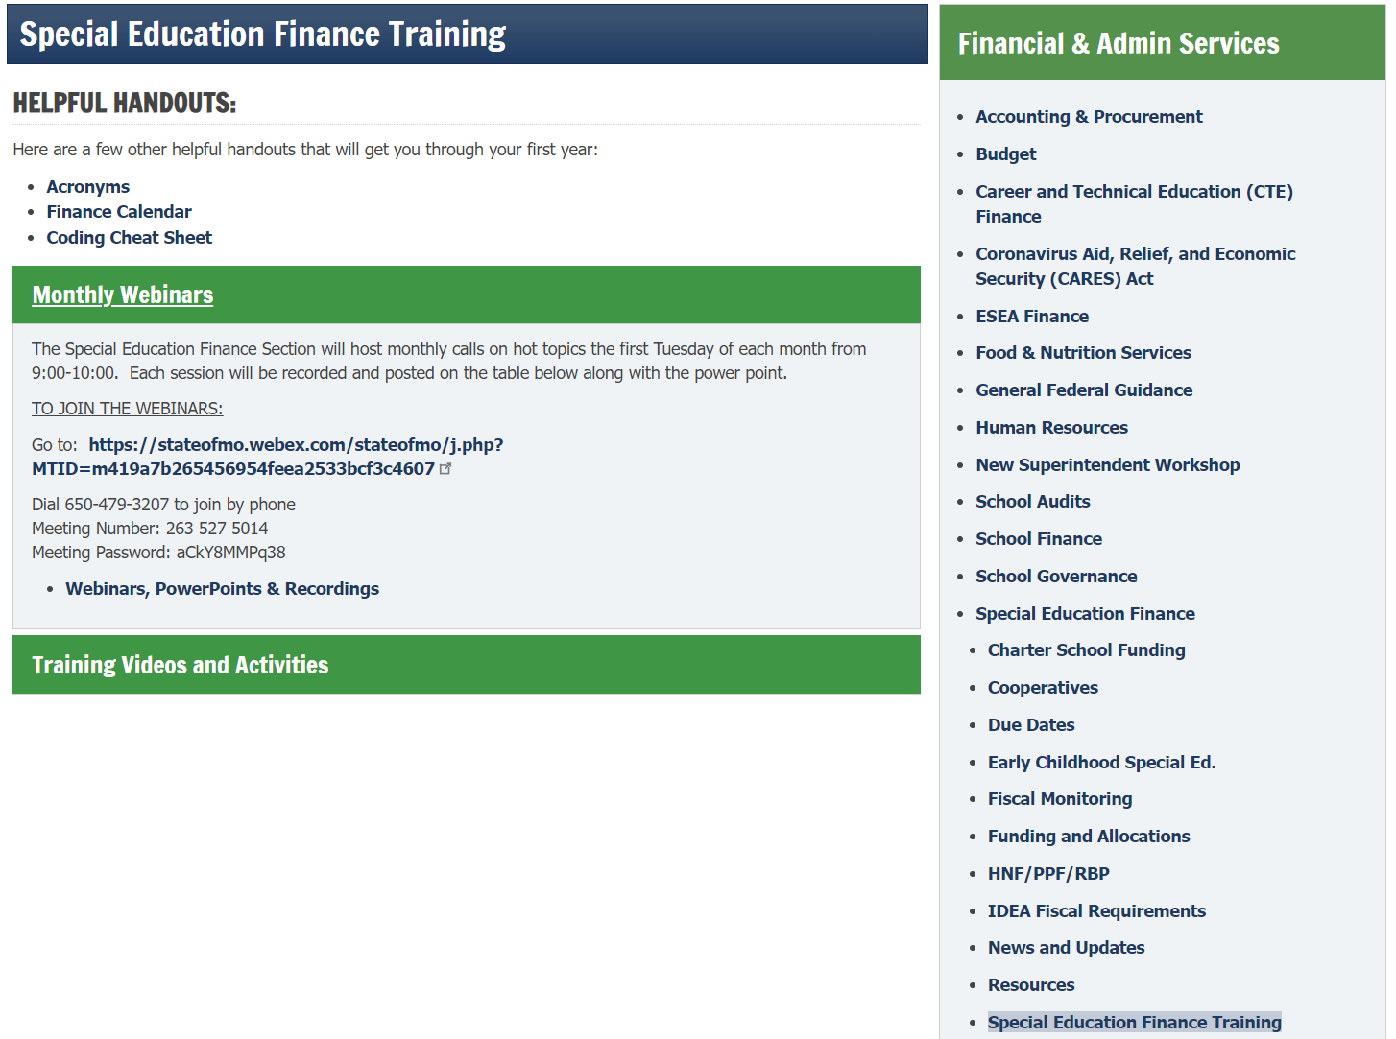
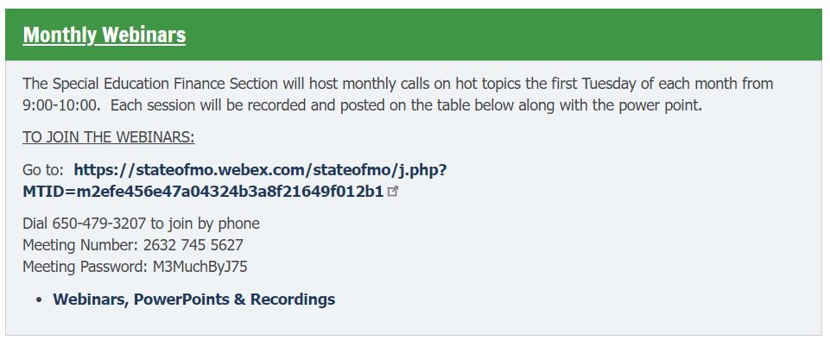
SPED Finance Training
Notes:
https://dese.mo.gov/financial-admin-services/special-education-finance/special-education-finance-training

Slide 40
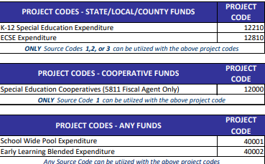
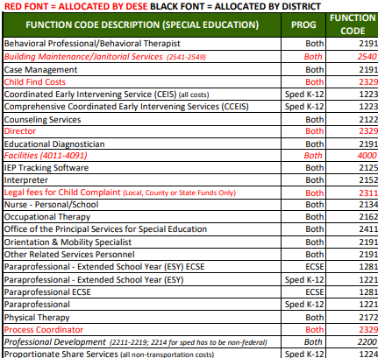
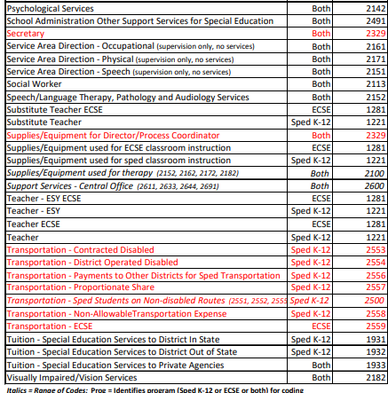
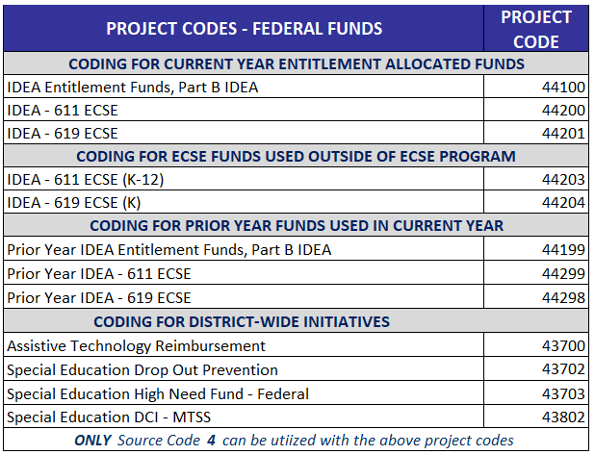
Coding Cheat Sheet
Notes:
https://dese.mo.gov/media/pdf/special-education-expenditure-coding

Slide 41
Webinars
Notes:
https://dese.mo.gov/financial-admin-services/special-education-finance/special-education-finance-training

Slide 42
SPED Finance Webinars
FIRST TUESDAY OF THE MONTH, 9-10am
DATES
September 3
October 1
November 5
December 3
Notes:
https://dese.mo.gov/financial-admin-services/special-education-finance/special-education-finance-training

Slide 43
Training Modules
Notes:
https://dese.mo.gov/financial-admin-services/special-education-finance/special-education-finance-training

Slide 44
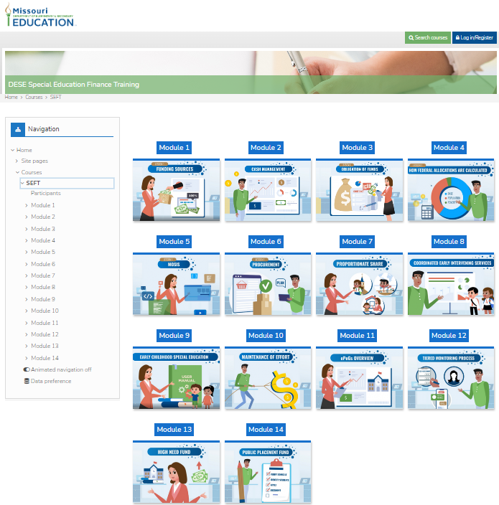
DESE SpecialEducationFinance.com
Funding Sources
Cash Management
Obligation of Funds
How Federal Funds Are Calculated
MOSIS
Procurement
Proportionate Share
CEIS
ECSE
MOE
ePeGS Overview
Tiered Monitoring Process
High Need Funds
Public Placement Funds
Notes:
DESESpecialEducationFinance.com

Slide 45
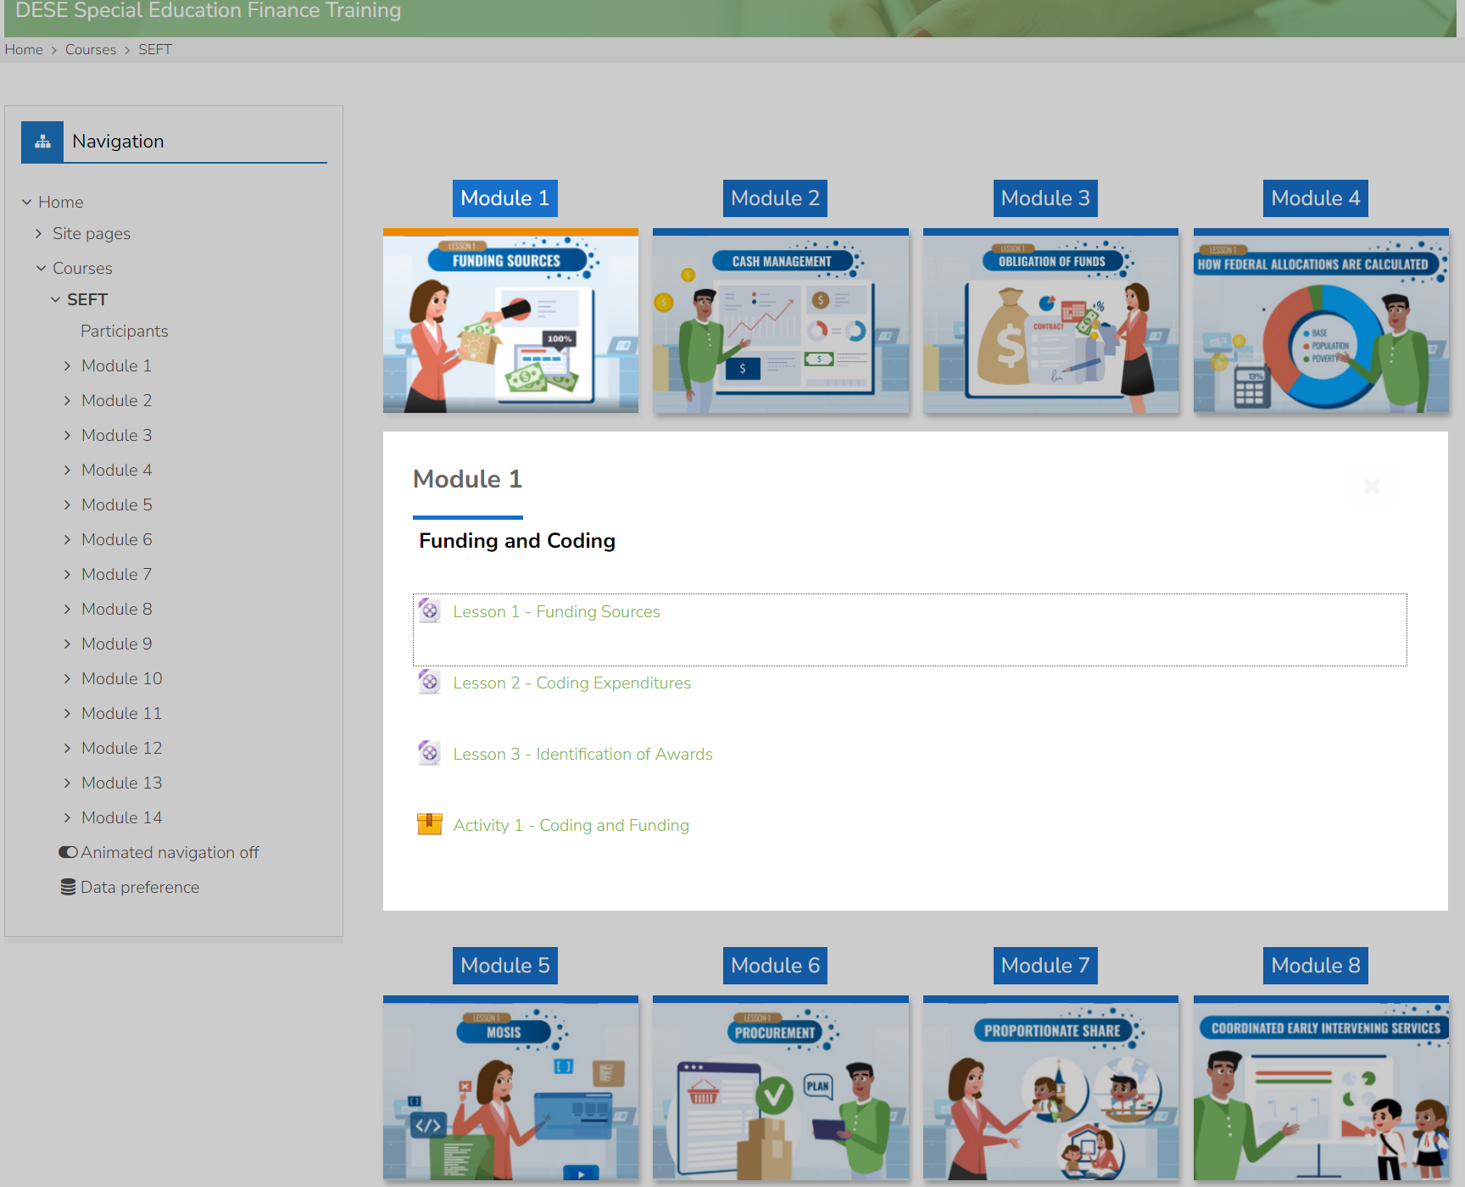
Finance Learning Modules
Notes:
DESESpecialEducationFinance.com

Slide 46
Fiscal Cycle

Slide 47
Fiscal Cycle – Federal & State Funding
IDEA Part B | ECSE State
▪ IDEA Part B 611 federal funds ▪ ECSE 611 federal funds ▪ ECSE 619 federal funds | ▪ Non-federal funds (state, county, local)
Budget Applications: Due July 1 | Budgeted on the MOE Grid pages of the IDEA Part B Budget Application
Payment Requests: Open July 15 | ECSE FER acts as ECSE State Payment Requests
Final Expenditure Report: Due September 30 for Prior Year Expenditures | Final Expenditure Report: Due October 31 for Prior Year Expenditures

Slide 48
Fiscal Cycle – Special Purpose Funds
High Need Fund | Public Placement Fund | Readers for the Blind
July – October 15 Update June MOSIS Student Core Data file and mark students that correspond to the High Need Fund. | October – Create a PPF application. | November – Create a RBP application.
Applications are due in ePeGS on October 15 for reimbursement of prior year expenditures. | Applications are due by email on October 31 for reimbursement of prior year expenditures. | Applications are due by email on November 30 for current year reader expenditures.
Reimbursements are dispersed in January/February. | Reimbursements are dispersed in February. | Reimbursements are dispersed in May.

Slide 49
Fiscal Cycle – PROP Share
Date | Proportionate Share
May | Prop Share estimates for the current year are calculated from prior year Dec 1 child counts of 2100 placement code students.
July 1 | All Prop Share funds must be budgeted in the initial Budget Application.
Sept | Final Prop Share obligation is calculated on the FER. Once the FER is approved, district must create a Budget Application Revision to budget current year Prop Share and any Prop Share Carryover.
March | Unspent Prop Share Carryover funds may qualify for release.
April 30 | Prop Share Carryover Release Requests are due April 30. After this date, DESE will need to create a release for the district.
April 30 | Budget Application Revisions are necessary to budget the released Prop Share Carryover funds. After this date, DESE will need to open Budget Application Revisions.

Slide 50
Fiscal Cycle - Budget Revisions
Month | Budget Application Revisions
July | Districts can create Budget Application Revisions when there has been a change in the planned federal expenditures for the year.
October | Complete a Budget Application Revision once the Part B FER has been approved.
February | Complete a Budget Application Revision after the reallocation of funds.
April 30 | After this date, DESE must create Budget Application Revision for the district.

Slide 51
Fiscal Cycle - Tiered Monitoring
Month | Tiered Monitoring
November | Districts are notified of selection for Self-Assessment/Desk Monitoring. DESE opens for applicable districts in the Tiered Monitoring System within DESE Web Application.
December – January | Districts are notified of selection for On-Site Monitoring.
January 31 | Self-Assessments/Desk Monitorings are due.
January – June | On-Site Monitoring visits are completed.

Slide 52
Annual Secretary Of The Board Report (ASBR)
DUE BY AUGUST 15TH EVERY YEAR
Notes:
https://dese.mo.gov/financial-admin-services/school-finance/annual-secretary-board-report-asbr-0

Slide 53
ASBR Analysis
ASBR analysis consists of reviewing ASBR Part III-B Detailed Report for:
Negative amounts
Missing project codes
Missing source codes
Incorrect coding combinations
Function codes that won’t pull into ePeGS
Incorrect project codes tied to incorrect function codes
Expenditures coded with HNF federal if received HNF federal revenue
DESE will email all districts with issues; corrections must be made prior to submitting the FER.

Slide 54
ASBR Analysis – Part III-B Detailed Report

Slide 55
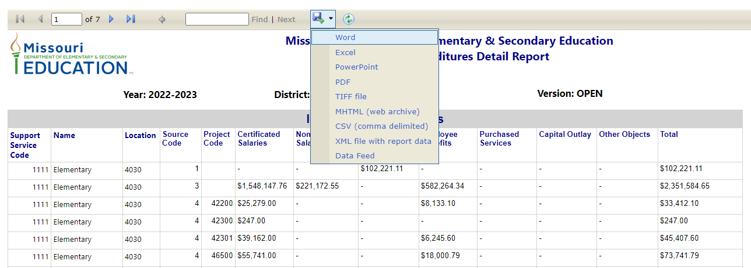
ASBR Analysis Part III-B Detailed Report
2023-2024

Slide 56
Enter Project Codes Correctly
No ePeGS Code
Incorrect Project Code with Function Code
Missing Project Codes
Incorrect Coding Combinations

Slide 57
Corrections Needed?
DESE does NOT recommend the district manually amend the ASBR to correct any coding issues/errors.
REASON:
G/L ≠ ASBR ≠ FER
Manual amending opens district up for errors.
INSTEAD:
1. Journal entry corrections should be completed within the 2023-24 general ledger.
2. The district will then re-upload and submit the 2023-24 ASBR.
3. The district can then resave each of the pages of the FERs to pull in the revised amounts.
REASON:
G/L = ASBR = FER
All three must match!

Slide 58
Impact Of ASBR Revision

Slide 59
ASBR Submission and Revision Cycle
ASBR SUBMISSION
PART B FER & ECSE FER REVISION
IDEA PART B FER SUBMISSION
ASBR REVISON
ECSE FER SUBMISSION

Slide 60
Revising ASBR
SUBMIT ASBR
ECSE FER REVISION
ASBR REVISION
ECSE FER REVISION
PART B FER
PART B FER REVISION
PART B FER REVISION
PART B FER REVISION
ECSE FER
ASBR REVISON
ECSE FER REVISION
ASBR REVISION

Slide 61
ASBR Revision Completed?
Districts should contact Special Education Finance following ASBR Revisions if Special Education Program expenditures are impacted.
DESE will determine if it is necessary to complete an IDEA Part B FER or ECSE FER Revision.
Changes to federal expenditures impact FER Grid reporting
Changes to state, county, or local expenditures impact MOE calculation

Slide 62
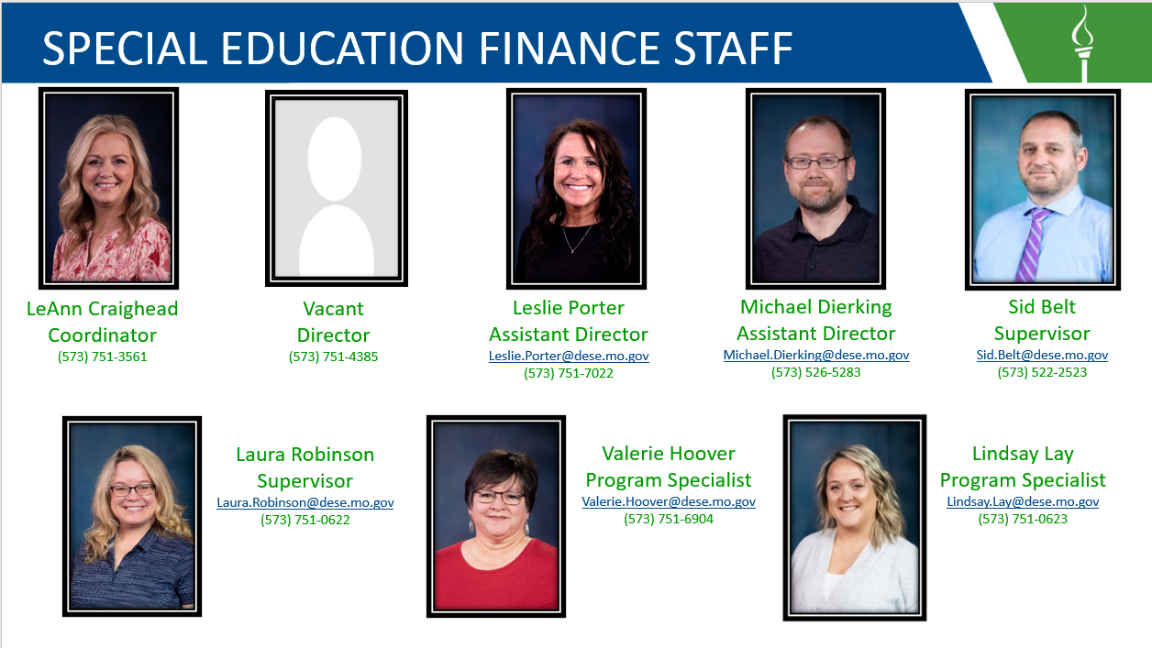
Special Education Finance Staff

Slide 63
Resources at Your Fingertips!
Notes:
Dawn: Last but not least, we want to direct you to resources on the DESE website.

Slide 64
Utilize the To-Do List
The Office of Special Education shares a monthly To Do List to remind LEAs of deadlines and requirements throughout the school year.
https://dese.mo.gov/special-education/compliance/general-guidance
Notes:
Right side menu under compliance is the General Guidance link this will take you to the Compliance To Do List that are posted monthly.

Slide 65
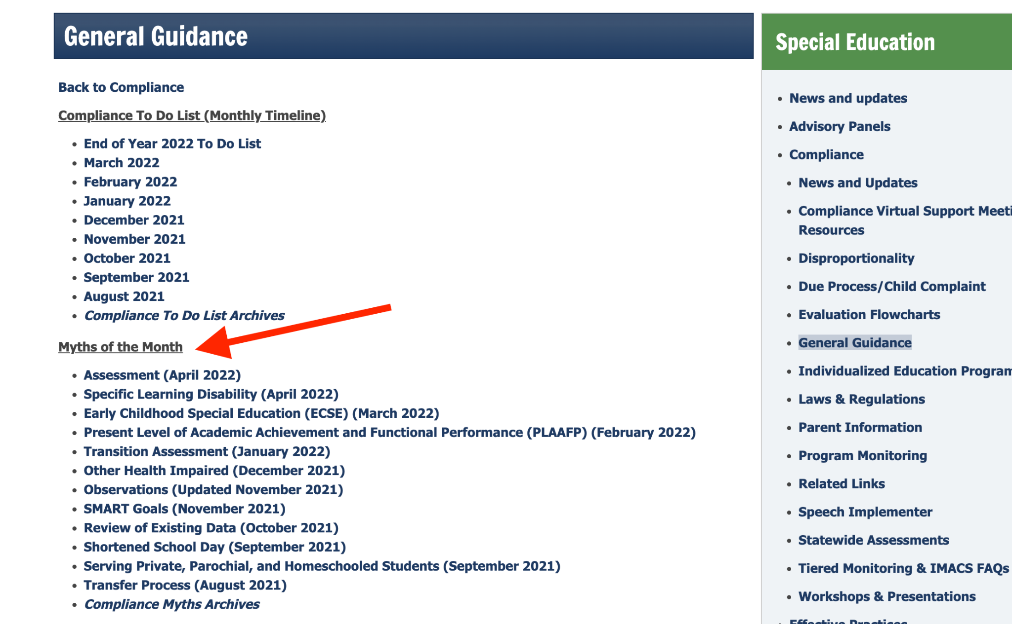
Myths of the Month
Each month DESE rolls out new information on a particular special education hot topic.
Myths of the Month provides guidance on misconceptions that surrounds topics
You can access all the myths of the month by visiting: https://dese.mo.gov/special/education/compliance/general-guidance
Notes:
Also under general guidance are Myths of the Month this is information on a particular special education hot topic. These myths provide guidance and misconceptions that surround the topics.

Slide 66
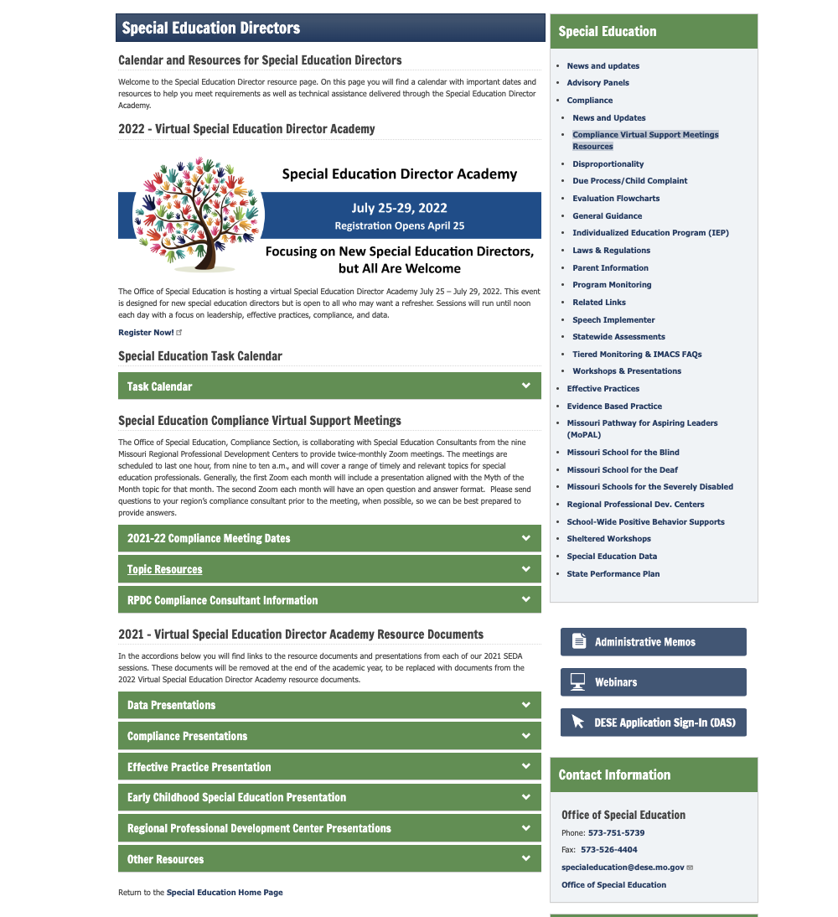
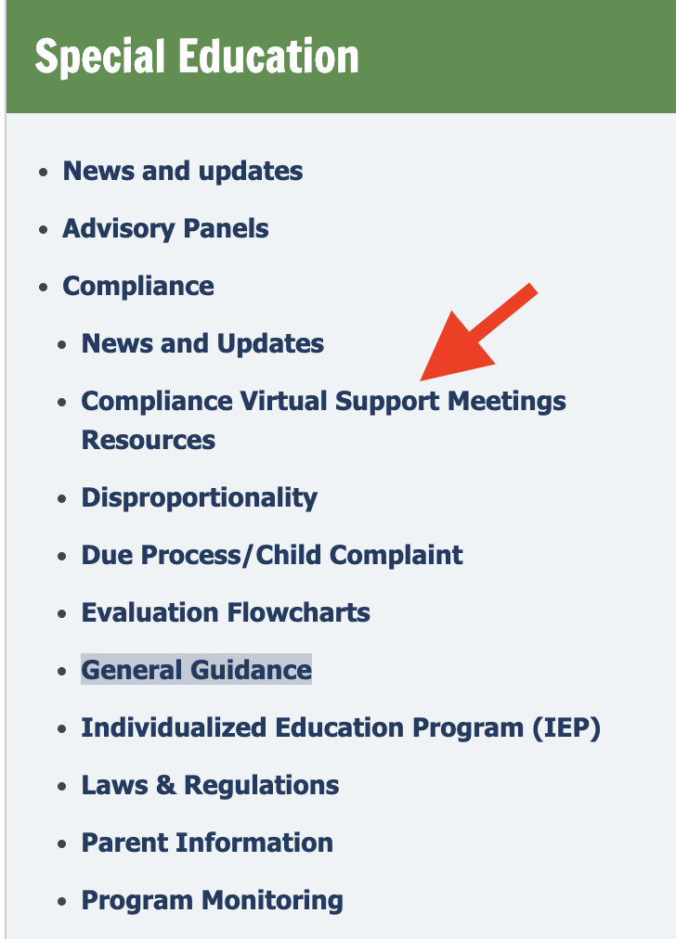
Compliance Virtual Support Resources
https://dese.mo.gov/special-education/effective-practices/special-education-directors
Notes:
On this page you will find a calendar with important dates and resources to help you meet requirements as well as technical assistance delivered through the Special Education Director Academy.

Slide 67
Utilize Your Special Education Compliance Consultants

Slide 68
Office of Special Education Compliance Contacts
Notes:
Your compliance consultants are here ready to help you all make this year a success, please feel free to contact any of us when a question arises.

Slide 69
Thank you for your time!
Notes:
Thank you so much for spending this hour with us. We appreciate your time and look forward to having a great 24-25 school year!

