Slide 1
Zoom Support Meeting Norms
Mute unless you are speaking to the group
Use the chat to ask questions
Be professional and helpful
Be mindful when asking questions about specific situations - don't give out any information that could reveal the identity of a person with a disability

Slide 2
Administrator Checklist
Presented by Julie Harris and Leasa Day, RPDC Compliance Consultants
September 2024
Notes:
Good morning and welcome. This morning, we will be discussing the 100s section of the Missouri Standards and Indicators Manual This section is composed of your administrative responsibility and duties in several areas. This morning, we will break down those areas in detail.

Slide 3
Administrator Checklist: Learning Outcomes
After today’s training, you will:
Be able to review your Local Education Agency (LEA) procedures and practices to ensure alignment with the Administrator’s Checklist – Standards and Indicators 100s Section
Become familiar with additional resources for support
Notes:
Read the slide

Slide 4
Administrator’s Checklist
Throughout this presentation we will answer:
What are we supposed to do?
When do we do it?
How do we do it?
How do we document that we’ve done it?
Notes:
There are the five burning questions we hear all the time in Compliance. They are . . .
First, why do we do what we do?
Second, what are we supposed to do?
Third, when do we do it?
Fourth, how do we do it?
And finally, prove that we’ve done it?

Slide 5
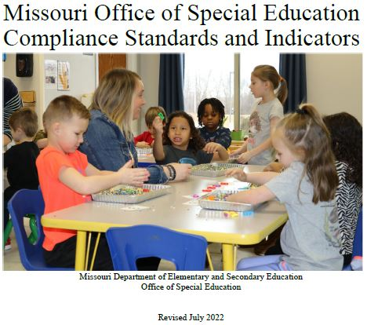
Missouri Special Education Guidance
MO Standards and Indicators
Notes:
This slide shows the current Missouri Standards and Indicators Manual dated July 2022.
Remember those burning questions from the beginning of the presentation – the why, the what, the when, and the how of special education? Contained within this manual is the answers for ALL of those questions!!

Slide 6
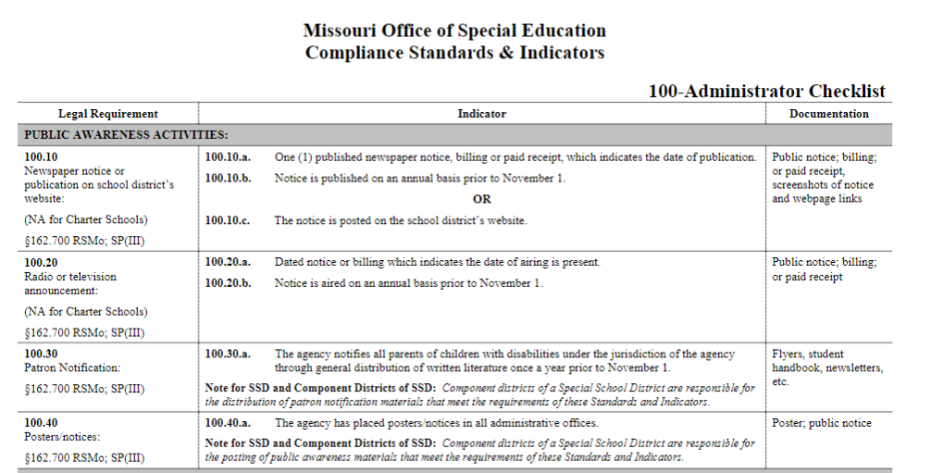
Missouri Special Education Guidance
Section 100 Administrator Checklist
Notes:
The Standards and Indicators Manual is organized into sections:
The 100s is the Administrator Checklist
The 200s is the Special Education Process
The 300s is the Discipline Process
The 500s & 550s are the Transfer process for in-state and out-of-state transfers
Finally, the 600s through 2100s are the eligibility criteria for Autism through YCDD.

Slide 7
Understanding the Standards and Indicators Manual
LEGAL REQUIREMENT –
Federal & State Laws citations
Missouri State Plan for Special Education sections
INDICATOR –
A description of what is required
Additional notes to provide clarification
DOCUMENTATION –
The evidence to prove that the requirement has been met
Notes:
When you look through the Standards and Indicator Manual you might notice how each special education requirement, called an indicator, is divided into three columns. The first column shows the legal basis for the requirement. The second column lists the specifics of the requirement and describes it in detail. Third column shows how districts would be expected to document or show as evidence of compliance with the indicator.

Slide 8
Standards and Indicators Manual – the 100s
The 100s section of the Standards & Indicators Manual is a
“Laundry List” of SPED Administrative Requirements.
Public Awareness Activities
100.10 – 100.130
Notes:
We refer to the 100s as the Laundry List of Requirements for SPED Admin. The required activities include:
Public Awareness Activities - LEAs have an obligation to find potentially eligible students through public awareness activities. Each LEA is required to publish a notice in either the newspaper or post a notice on the district website AND air a radio and/or television announcement by November 1. In addition, patrons of the school district must be notified by flier, handbook, or newsletters. Poster and/or notices should also be posted in all administrative offices. The Child Find notice must include the agency’s responsibility to identify, locate, and evaluate children with disabilities who are under the jurisdiction of the agency regardless of the severity of the disability including those children that may be attending private or parochial school or who are home schooled and must state the agency’s intent to service all children with disabilities from 3 to 21. DESE has a model form available.

Slide 9
Standards and Indicators Manual – the 100s
The 100s section of the Standards & Indicators Manual is a
“Laundry List” of SPED Administrative Requirements.
Educational Surrogates
100.140 – 100.210
Notes:
:Educational Surrogates – each LEA is responsible to have written procedures to determine which children need educational surrogates and to recruit educational surrogates for their area.

Slide 10
Standards and Indicators Manual – the 100s
The 100s section of the Standards & Indicators Manual is a
“Laundry List” of SPED Administrative Requirements.
Confidentiality Training
100.220
Notes:
Confidentiality training - The Family Educational Rights and Privacy Act (FERPA) requires confidentiality training be provided to all staff. The IDEA requires confidentiality training for ALL persons collecting or using personally identifiable data and that you have written documentation for when and who attended your confidentiality training. The requirement is that all staff receive the training at least once and that all new hires are trained in confidentiality as well. Many districts chose to include an annual confidentiality training in the beginning of school trainings/workshops for all school staff prior to school starting to meet this requirement.

Slide 11
Standards and Indicators Manual – the 100s
The 100s section of the Standards & Indicators Manual is a
“Laundry List” of SPED Administrative Requirements.
Access to records
100.230
Notes:
Access to Records - The district is required to have a listing of employees’ positions having access to student records posted at student file location or other central location.

Slide 12
Standards and Indicators Manual – the 100s
The 100s section of the Standards & Indicators Manual is a
“Laundry List” of SPED Administrative Requirements.
Hearing Aids/Hearing Devices
100.310
Notes:
Hearing Aids/Hearing Devices - One of the most overlooked administrative responsibility is the monitoring of hearing aids and hearing devices. The requirement is that these devices be monitored on a daily basis by staff to ensure proper functioning. It is important to keep documentation of this daily monitoring for hearing aids, external components of cochlear implants, auditory trainers, etc. Remember that if these devices are not working properly, the student will not be able to effectively hear instruction during the school day and receive FAPE.

Slide 13
Standards and Indicators Manual – the 100s
The 100s section of the Standards & Indicators Manual is a
“Laundry List” of SPED Administrative Requirements.
Related Services Billing
100.295
Notes:
.
Medicaid Funding for Services - LEAs can chose to seek reimbursement from Medicaid for therapies provided to students who are eligible for an IEP. However, the LEA must follow the required process to notify parents as described in the Administrator’s Checklist.

Slide 14
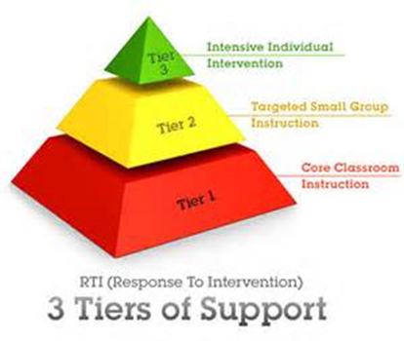
Standards and Indicators Manual – the 100s
The 100s section of the Standards & Indicators Manual is a
“Laundry List” of SPED Administrative Requirements.
Response to Intervention (RTI)
100.320
Notes:
Response to Intervention - The general education use of Response to Intervention (RTI) or, as it is sometimes referred to as, the Multi Tiered Systems of Supports (MTSS) is very common in school districts these days. Use of these models of intervention is to provide targeted services to students who are “at risk” academically. However, in the special education world, RTI is one specific method of determining eligibility for Learning Disabilities. If your LEA choses to use this method to determine eligibility for learning disabilities, there must be written procedures that follow the DESE guidelines. It is VERY important to know if your LEA uses the RTI model for identifying Learning Disabilities because this method CANNOT be used unless the written procedure is in place and followed when making these eligibility determinations.

Slide 15
Standards and Indicators Manual – the 100s
Paraprofessionals credential requirements (100.240 – 100.270):
Paraprofessionals engaged in any instructional support activities in a building designated as Title I School-wide Projects must have one of the following:
sixty (60) college hours
an Associate Degree
have passed the State approved paraprofessional assessment with an established minimum score
completed the DESE 20 hour online training for substitute teachers
Notes:
Paraprofessional Credentials and Training –It is important to know the educational level of each paraprofessional and their building assignment. When looking at paraprofessional credentials, it is very important to know the Title I status of the assigned building and the type of work the paraprofessional will be doing with students. This is because (ESSA) Every Student Succeeds Act requires that any paraprofessionals providing instructional support, including special education paraprofessionals, working in school-wide, not target assist Title I buildings, have 60 credit hours or an associate degree or have passed the State approved paraprofessional assessment with an established minimum score or completed the DESE 20 hour online training for substitute teachers.. This does not include personal assistants unless they perform instructional support activities..

Slide 16
Standards and Indicators Manual – the 100s
Paraprofessionals credential requirements (100.240 – 100.270):
Paraprofessionals assigned to buildings engaged solely in personal assistance (i.e., feeding, mobility, toileting, etc.) activities; in a building designated as Title I School-wide Projects must have:
High School Diploma or General Educational Development (GED)
Paraprofessionals assigned to buildings not designated as Title I School-wide (Building) Projects can have:
High School Diploma or GED
Notes:
Paraprofessionals who work in non-Title I school-wide buildings are only required to have a high school diploma or GED. Please note that your local school board policy may have a higher standard than this minimum requirement.

Slide 17
Standards and Indicators Manual – the 100s
Paraprofessional training requirements (100.280):
Paraprofessionals, including those who hold teaching certificates, are required to have received 15 clock hours of training within 6 months of hire, including orientation and initial training prior to working with the student. A minimum of 10 clock hours each school year thereafter is also required.
Verification documentation for both orientation training and the on-going training must include:
dates, content agenda, number of clock hours, and participants
Notes:
Training requirements vary by the number of years of employment as a paraprofessional. Paraprofessionals must have 15 professional development hours during the first year of employment, even those paras holding a teaching certificate, plus orientation and a minimum of 10 hours thereafter. It is very important that this training be related to the paraprofessional’s assignment. Note that assisting the teacher in the classroom, attending IEP meetings, or orientation training CANNOT be counted towards the required training. ALL paraprofessionals are required to meet orientation and initial training requirements during their first year with a district. If you are interested in exploring online paraprofessional training videos through DESE Effective Practices Division, contact your RPDC consultant. Don’t forget that even paras that are hired mid-year must complete the required training. We recommend you adopt a record-keeping system to maintain your para training hours.
The 100s in the Standards & Indicators Manual lists these specific requirements for paraprofessional training and is a wonderful resource when questions arise. It is important to keep the credential and training requirements in mind when making paraprofessional assignments.

Slide 18
Standards and Indicators Manual – the 100s
Parentally Placed Homeschool/ Private/ Parochial Students with Disabilities(100.300):
LEAs are required to hold a meeting annually with representatives to determine proportionate share services.
Notes:
Thank you Julie – now we will continue on with the 100s and
Parentally Placed Private School Student: Students with disabilities who attend private or parochial schools do NOT have an individual right to receive FAPE and have an IEP. Instead, these students have the right to access proportionate share funded services through an individual service plan (ISP). The Administrator’s Checklist describes the required procedures for conducting a consultation meeting with representatives of private/parochial school and parent representatives of parentally-placed private/parochial school students in order to determine what services will be offered by an LEA.
Remember that in Missouri, homeschooled children are considered to be attending a private school. Please note that charter schools are EXEMPT from this requirement because the LEA in which the charter school is located is responsible for child find and providing the proportionate share services to these students.

Slide 19
Standards and Indicators Manual – the 100s
Contractual Services(100.330):
If a LEA is unable to provide the required special education or related services to a student with a disability, they may decide to contract with an approved private agency for special education services.
Notes:
Next on the administrator checklist is
Contractual Services/Approved Private Agency - If your LEA is unable to provide the required special education or related services for one of your students with a disability, you may decide to contract for services. It is important to remember that the contract MUST be with an approved private agency for special education services. The department maintains a current list of approved private agencies on the website.
It is important to remember the LEA continues to have the responsibility of providing FAPE in contract situations – not the contracted agency. This means the LEA is still responsible for developing the IEP, providing needed reevaluations and providing FAPE to the student. Consider the approved private agency as a “satellite” classroom. It is very important the LEA ensures the services are being provided by the contractor in accordance with the child’s IEP in these situations and has procedures in place to monitor the provision of services for compliance. If there is an allegation in a child complaint or due process, the LEA is ultimately responsible – NOT the approved private agency.

Slide 20
Standards and Indicators Manual – the 100s
State Board Operated Programs (100.340 – 100.360)
Missouri School for the Blind (MSB) Missouri School for the Deaf (MSD) Missouri Schools for the Severely Disabled (MSSD)
Notes:
On to
State Board Operated Programs - In some specific situations, your LEA may not be able to provide the necessary services to provide FAPE and would need to make a referral to one of the State Board Operated Program Schools as the most appropriate least restrictive environment for the student. Each of the State Board Operated Programs has a website that describes their programs and referral process.
The LEA is required to maintain a current evaluation report and a current IEP for each student placed in one of these state board operated programs. The LEA is responsible for conducting reevaluations and IEP meetings for students placed at state board operated programs. The IEP team, including LEA representatives from both the local school district in which the child resides and the state board operated program, is responsible for determining placement in the least restrictive environment at each annual IEP meeting and any additional meetings called for that purpose.
Also note that each of the State Board Operated Programs has an outreach office and can serve as a valuable resource to districts in the identification and provision of services to children with multiple/severe disabilities or hearing or visual impairments.

Slide 21
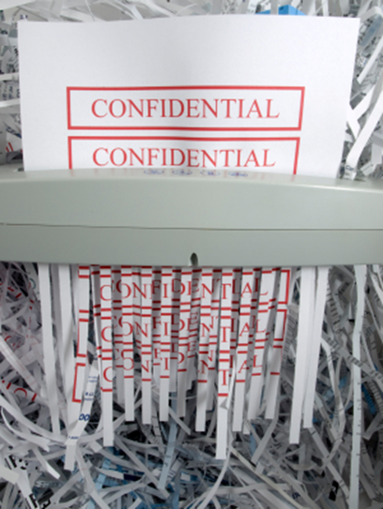
Standards and Indicators Manual – the 100s
Destruction of Records (100.370 – 100.380):
The LEA must follow a process for the destruction of records that are out-of-date and no longer necessary to provide education for the student.
MO Secretary of State Public School Records Retention Schedule
Notes:
Now we are up to Destruction of Records on the checklist.
In the past, records had to be maintained for a period of 3 years from the time they were no longer educationally relevant, and after that, the district could destroy after sending a letter to the last known address. However, Senate Bill 106 which went into effect for the 2023-24 school year, stated that a student’s special education record shall be deemed a permanent record and shall be maintained as part of the child’s cumulative scholastic record (cumulative records are retained 75 years). This law defined a special education record as “an IEP, an IFSP, or a 504 Plan” and it said the district must maintain ‘the most recent’ special education record.” As you can well imagine, this caused more confusion because most districts were saying things like “what about the most recent evaluation?” and . . . “a 504 isn’t a special education record” . . . and so on.
Fast forward the story, the Secretary of State’s Office issued guidance November 2023 which gives a specific list of all we are to keep with the school year beginning 2023-24 forward. It also seems to indicate the most recent special education records prior to the 23-24 school year must be maintained permanently. There is specific guidance found on page 19 of the document at the Secretary of State link on this slide.
Districts can always consult legal counsel if you need specific information.
As far as whether you keep an electronic or hard copy, that is up to the district, but if you keep records electronically, the district must make sure it is securely maintained. If it is your district policy to give students a copy of their special education records minus testing protocols, you would still need to maintain a copy (or the original) for students’ permanent records.

Slide 22
Standards and Indicators Manual – the 100s
Release of Information (100.390 – 100.400):
The LEA must obtain consent for release of information prior to release of records.
Notes:
Now let’s discuss
Release of information - these procedures must be in place before you can share confidential information. The district’s Release of Information form should document the specific records to be disclosed, why the records are being disclosed, to whom the records are being disclosed, as well as a dated signature of the parent or eligible student. Know the exceptions for release of information without written consent outlined in FERPA such as to school officials where the student plans to enroll, or audits, or college loans, and so on.
It is important to remember that a Release of Information is required for any persons other than the parent/guardian to attend an IEP meeting – that means grandparents, boyfriends, outside agencies, advocates, etc. NOTE: Release of Information is also needed for inviting an outside person into the meeting.

Slide 23
Standards and Indicators Manual – the 100s
Transfer of Rights (100.410):
The LEA must follow a process notifying the student and the parent about the change in who is the legal decision maker.
Notes:
Moving on to
Transfer of Rights: The LEA needs to notify both student and the parent that the student will become his/her own educational decision maker upon reaching the age of majority. This notification is provided to the parent no later than the student’s 18th birthday.
Additionally, in Standards and Indicators 200.790, it directs that no later than the student’s 17th birthday, the IEP must include a statement that the student has been informed of the rights under IDEA that will transfer to the student upon his/her 18th birthday.
So essentially, you are providing this notice two times:
Once to the student by the 17th birthday
And then again to the parent by the 18th birthday

Slide 24
Standards and Indicators Manual – the 100s
National Instructional Materials Accessibility Standard/National Instructional Materials Access Center (NIMAS/NIMAC) (100.450 – 100.460):
The LEA must acknowledge with an assurance statement in their Local Compliance Plans how they plan to adopt NIMAS and coordinate with NIMAC.
Notes:
Now let’s address National Instructional Materials Accessibility Standard and National Instruction Materials Access Center which we commonly refer to as
NIMAS/NIMAC: IDEA requires that public agencies adopt the National Instructional Materials Accessibility Standards (NIMAS) for the purposes of providing instructional materials to blind children and youth or other children and youth with print disabilities. The LEA then has the option of coordinating its efforts with the National Instructional Materials Center (NIMAC) to achieve these standards OR the LEA can indicate that it will not coordinate with NIMAC but assures that it will provide instructional materials to these identified students in a timely manner. This requirement is accomplished through the local compliance plan which is approved by each LEA’s board of education. More information on NIMAS/NIMAC can be found on the Department’s website.

Slide 25
Standards and Indicators Manual – the 100s
Independent Educational Evaluation (100.420 – 100.440):
An Independent Educational Evaluation (IEE) can be requested by the parent/guardian when they disagree with the evaluation that was conducted by the LEA. It is a second opinion gotten outside of the LEA.
Important things to remember:
It must be provided at public expense
LEA must consider the results of the IEE and keep documentation of the IEE & its consideration in the student’s file.
LEA should have an IEE school board policy addressing geographic area, cost, and the qualifications of the examiners.
When a parent requests an IEE; LEAs have two options – Provide the IEE or file for Due Process.
Notes:
Next . . . Independent Educational Evaluations or IEEs
An IEE must be provided at public expense and the LEA must consider the results of the IEE. Documentation of this IEE and its consideration should be maintained in the student’s file. Meeting notes would be an excellent data source to use as documentation of consideration of the IEE.
Each LEA should have a school board policy to address IEEs. The agency’s board policy can limit geographic area, cost, and the qualifications of the examiners. This criteria must be spelled out in that board policy.
When a parent requests an IEE, the district only has two options.
Provide the IEE.
File for due process to explain why the district’s evaluation is correct.

Slide 26
Standards and Indicators Manual – the 100s
Remember these are just the highlights of the 100s section. You will need to take a thorough look later.
Notes:
This has just been a quick run through of the 100s section of the Standards and Indicators, but we would encourage you to spend a little time looking through them on your own. And of course if you have questions, contact your RPDC Compliance Consultants for clarification and explanation.

Slide 27
Resources For Additional Support
SPED Data Reporting Table
Notes:
Here are additional resources to access for support and training over the topics covered in this section. This slide includes a link to the special education data reporting table with the various due dates and the items collected during each MOSIS cycle. If you have questions about special education data reporting, reach out to the Data section of DESE.

Slide 28
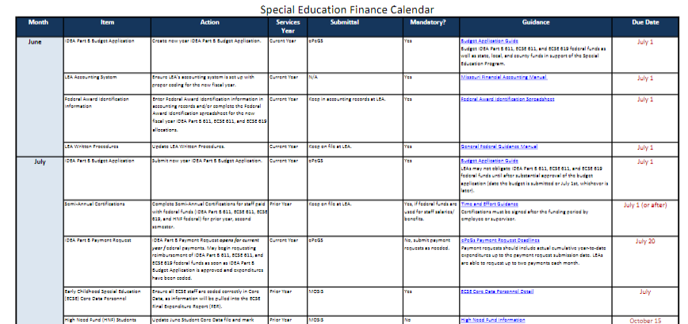
Resources For Additional Support
SPED Finance Calendar
Notes:
And this slide includes a link to the special education finance calendar with the various due dates. Once you access the calendar, additional links are embedded that provide further explanation. For questions about special education finance, contact the finance section. Finance conducts regular webinars and provides additional support to districts based upon need. They will work with your district proactively to help your LEA meet requirements and deadlines. Please don’t hesitate to contact them for assistance.

Slide 29
Contacts
Special Education Compliance:
573-751-0699, secompliance@dese.mo.gov
Regional Professional Development Centers (RPDCs):
Region | Compliance Consultant | Phone Number | Email
Southeast | Tiffiney Smith | 573-651-2621 | tdsmith@semo.edu
2. Heart of Missouri | Lynn Lynch | 573-424-7847 | lynchly@missouri.edu
3. Kansas City | Bailey Tennesen | 816-235-5957 | tennesenb@umkc.edu
4. Northeast | Dawn Lichtenberg | 660-785-6080 | dlichtenberg@Truman.edu
5. Northwest | Julia Schmitz | 660-562-1995 | Julia@nwmissouri.edu
6. South Central | Leasa Day | 573-341-6821 | ldnd3@mst.edu
7. Southwest | Amy Phipps | 417-836-4082 | amyphipps@missouristate.edu
8. St. Louis | Jeanne Rothermel | 314-692-1239 | jrothermel@edplus.org
9. Central | Julie Harris | 660-232-0387 | jlharris@ucmo.edu
Notes:
Finally, here is contact information for your Regional Professional Development Compliance Consultants. Please don’t hesitate to reach out for support.
Julie and I want to say a great big thank you to Bailey for providing technical support and Connie for acting as our facilitator.
Hope you all are having a good beginning to your school year; we will see you soon.

