Slide 1
Alternate Assessment
August 2024
MAPA Training Introduction
Caryn Giarratano, Ph.D.
DESE Assistant Director of Assessment
Slide 1

Slide 2
Part One: Overview
August 2024
Caryn Giarratano, Ph.D.
DESE Assistant Director of Assessment
Slide 2

Slide 3
DLM Kite Programs
Kite Suite
Educator Portal
Student Portal
State Education Agency
DLM Required Training Courses

Slide 4
Educator Portal Tasks
Enter information
Retrieve information
Complete tasks

Slide 5
Parameters of MAP-A
A student eligible for MAP-A does not participate in any other statewide standardized assessments.
  English Learners in grades 1-12 may take the WIDA Alternate ACCESS English test.
  MAP-A students are not included in national or international assessments.

Slide 6
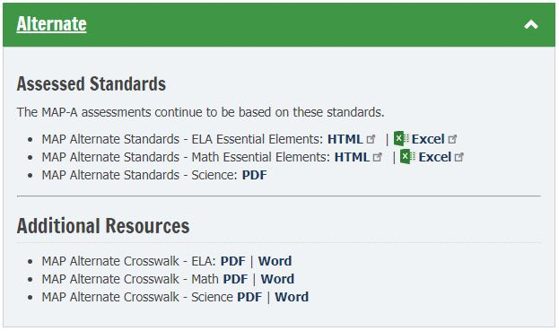
Standards and Crosswalks

Slide 7
Instructionally Embedded
Instruction and assessment forms a teach/test pattern throughout the year.
Fall window is September through December.
Spring window is February through May.
EEs are embedded in day-to-day instruction.

Slide 8
Missouri Uses Two Models
Instructionally Embedded is used for ELA and math with grades 3-8, and 11 required to test in both windows.
Year End is used for science with grades 5, 8, and 11 required to test in the spring.

Slide 9
Integrate Goals and EEs
Use the information from the Linkage Levels and Mini-Maps to plan instruction and create IEP goals
Create goals with short-term objectives or benchmarks.
Begin the teaching/testing pattern in September and February.

Slide 10
Part 2: Tour of DESE MAPA
August 2024
Caryn Giarratano, Ph.D.
DESE Assistant Director of Assessment
Slide 10

Slide 11
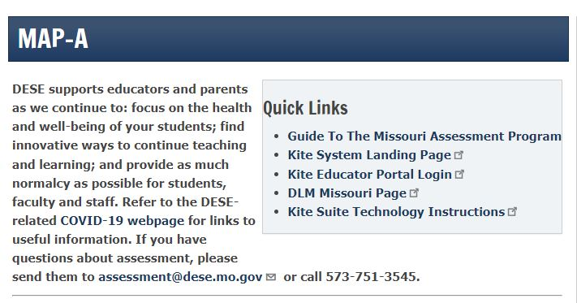
DESE Quick Links

Slide 12
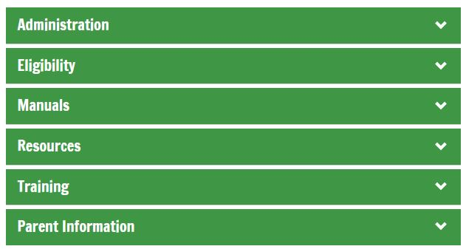
DESE MAPA Tabs
  There are six tabs on the DESE MAPA webpage to organize alternate assessment guidance documents.

Slide 13
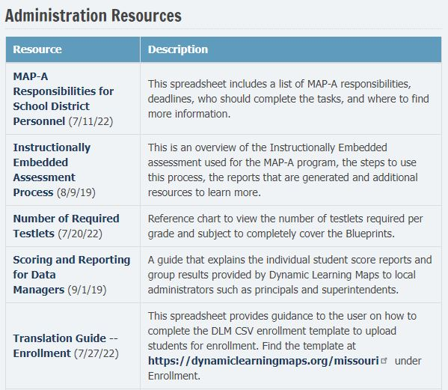
Administration Tab
Please view this guidance document for DTCs, MDTCs, data managers, and teachers, to learn MAP-A responsibilities for each.

Slide 14
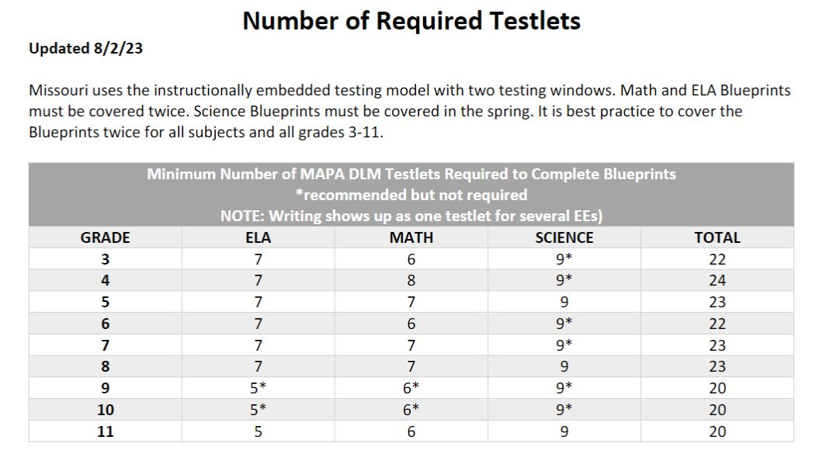
Testlets To Cover Blueprint

Slide 15
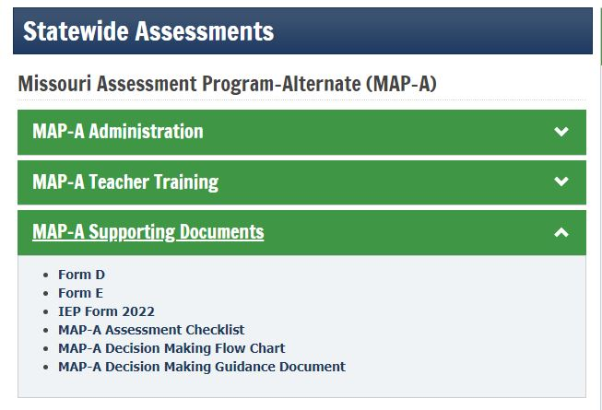
Eligibility Tab
The Eligibility tab links to the Compliance page for eligibility guidance.

Slide 16
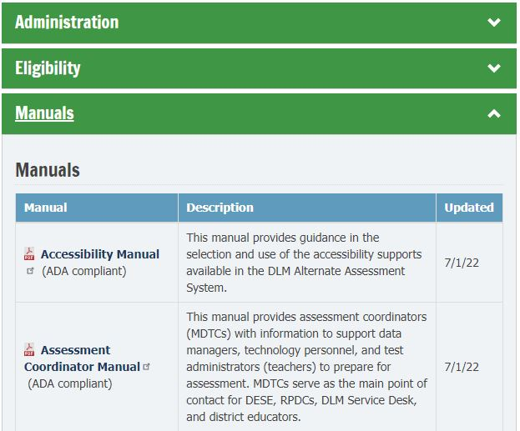
Manuals Tab

Slide 17
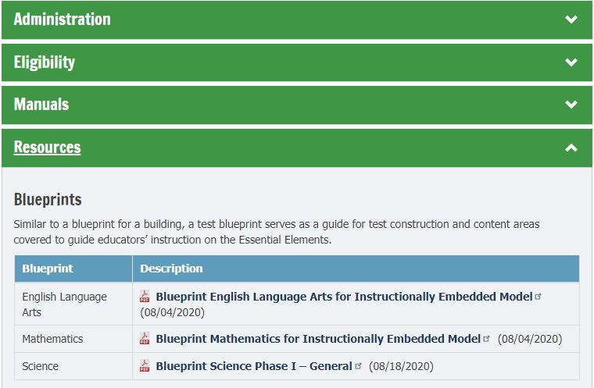
Resources Tab

Slide 18
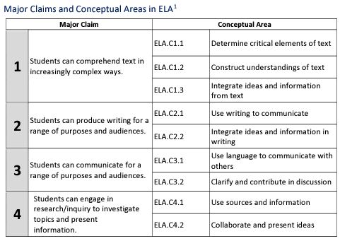
Blueprint Claims and EEs

Slide 19
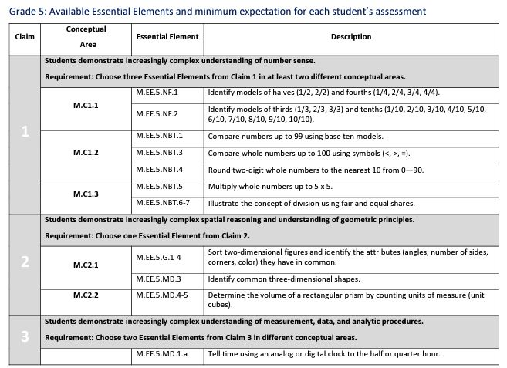
Math Blueprint Example
19

Slide 20
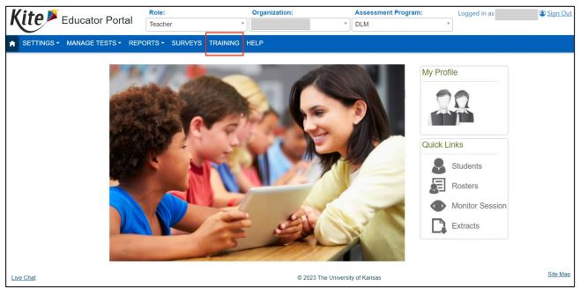
Training Tab

Slide 21
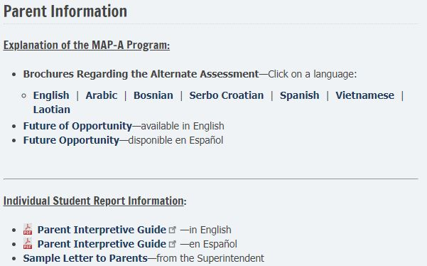
Parent Information Tab

Slide 22
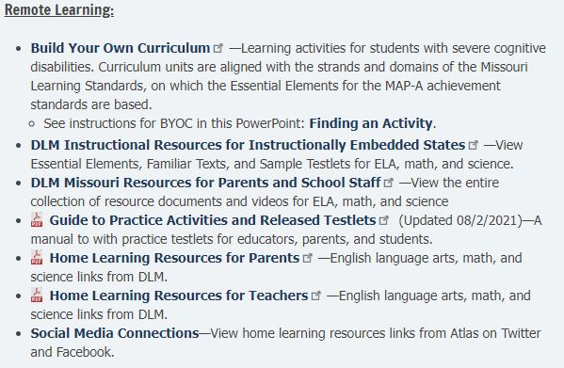
Finding an Activity

Slide 23
Part 3: Tour of DLM
August 2024
Caryn Giarratano, Ph.D.
DESE Assistant Director of Assessment
Slide 23

Slide 24
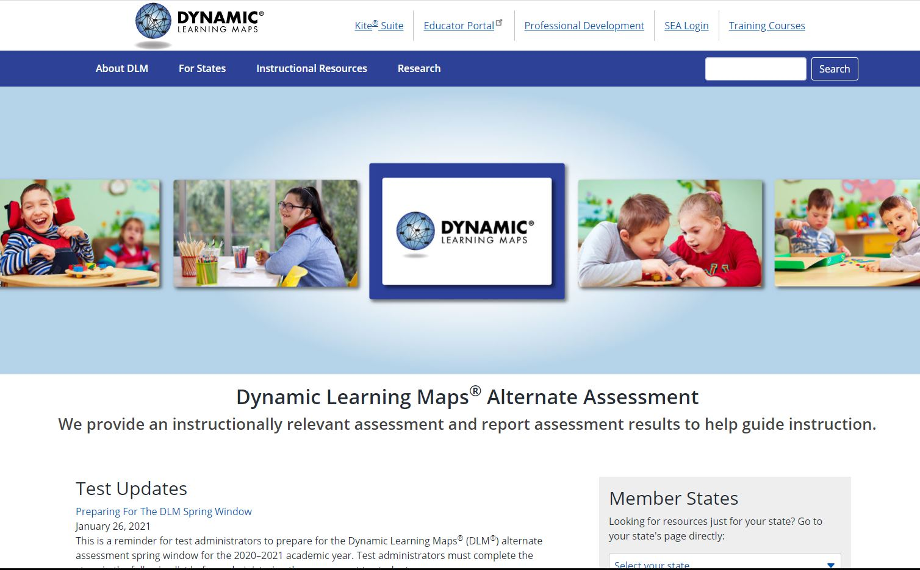
View DLM Missouri Page

Slide 25
Professional Development

Slide 26
Required Training Courses

Slide 27
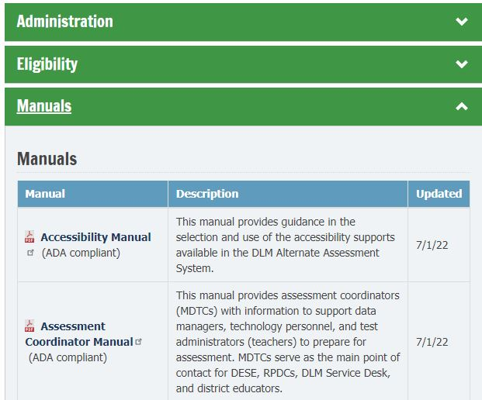
Manuals for Teachers
Five manuals for teachers:
Accessibility Manual
Educator Portal User Guide
Guide to Required Test Administrator Training
Guide to Practice Activities & Released Testlets IM
Test Administration Manual

Slide 28
Find Assistance with MAPA
An experienced MAPA coworker
The MAPA district test coordinator (MDTC)
A Regional Professional Development Center Consultant (RPDC)
(View the link in the script for information about the Facilitated Training for teachers provided by the Missouri Regional Professional Development Center personnel)
The DLM Service Desk (1-844-675-4479, DLM-support@ku.edu)
The DESE Assistant Director of Assessment for MAPA

Slide 29
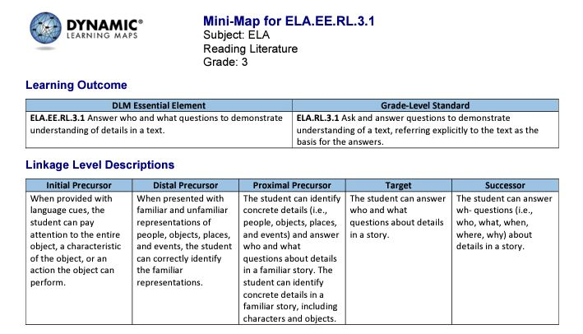
Mini-Map: EEs, GLSs, LLs

Slide 30
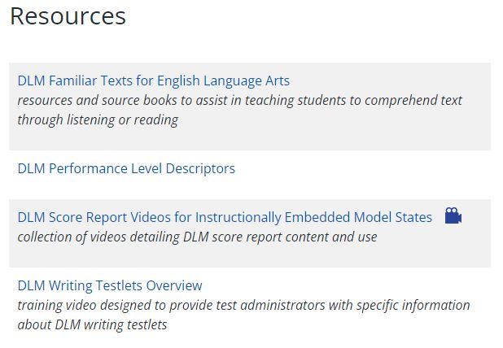
Writing Overview

Slide 31
Part 4: Tasks for Teachers
August 2024
Caryn Giarratano, Ph.D.
DESE Assistant Director of Assessment
Slide 31

Slide 32
DLM Landing Page

Slide 33
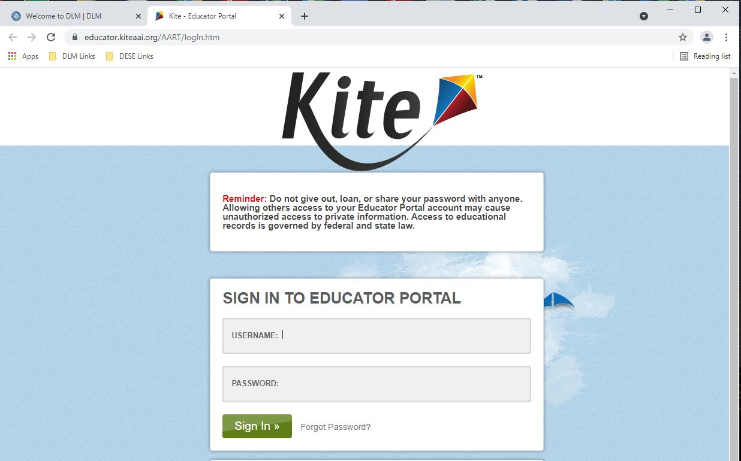
Login for Educator Portal

Slide 34
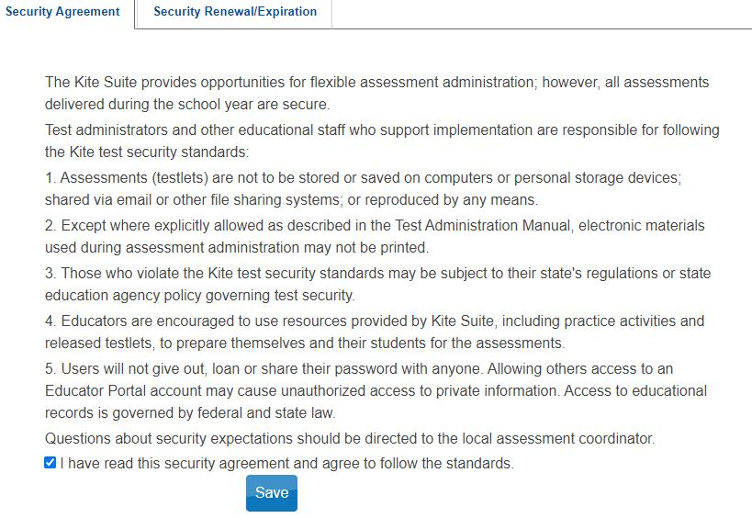
Click Security Agreement

Slide 35
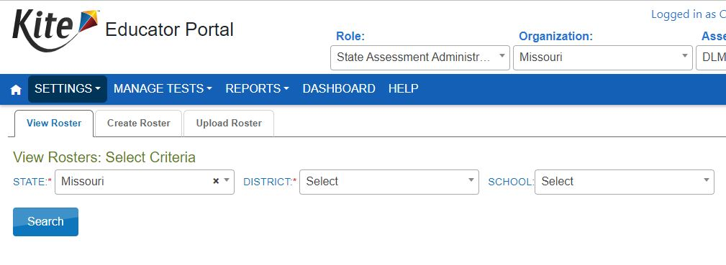
View Student Roster

Slide 36
Teacher Duty Highlights
Complete First Contact Survey.
Update Personal Needs Profile.
Create instructional plans in the Instruction and Assessment Planner.
Instruct students.
Test students in Student Portal.
Read each DESE MAP-A Update to keep up with guidance and deadlines.

Slide 37
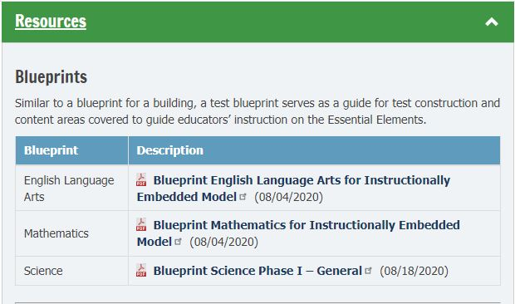
Use Blueprints to Plan

Slide 38
Clean Data in EP
Verify the email address and educator identifier match.
Submit all First Contact Surveys, even if not testing.
Complete Personal Needs Profiles, even if not testing.
Check for accuracy in student profiles, especially MOSIS numbers.
Keep grades 3-11 MAP-A students enrolled in Educator Portal, even if not testing.
Grade 12 may be exited from EP(use code 98).

Slide 39
Part 5: DESE Eligibility Criteria
August 2024
Caryn Giarratano, Ph.D.
DESE Assistant Director of Assessment
Slide 39

Slide 40
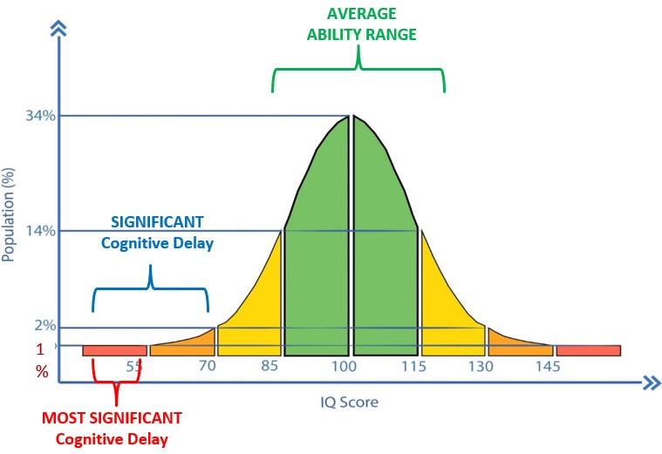
Student Eligibility

Slide 41
IDEA Guidance
Students must be assessed in the form most likely to yield accurate information on what the child knows and can do academically, developmentally, and functionally.
See Section 300.304(3)(c)(1) in the script for the full text of this section.

Slide 42
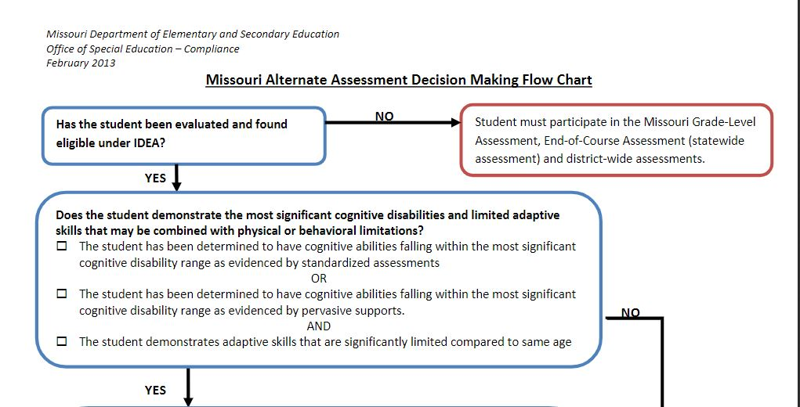
Decision Making Flow Chart

Slide 43
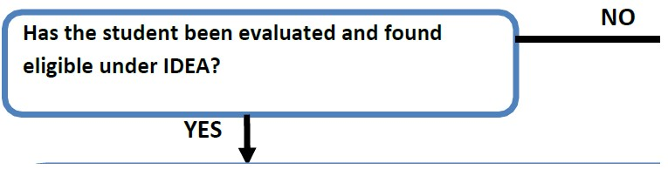
Flow Chart Step 1

Slide 44
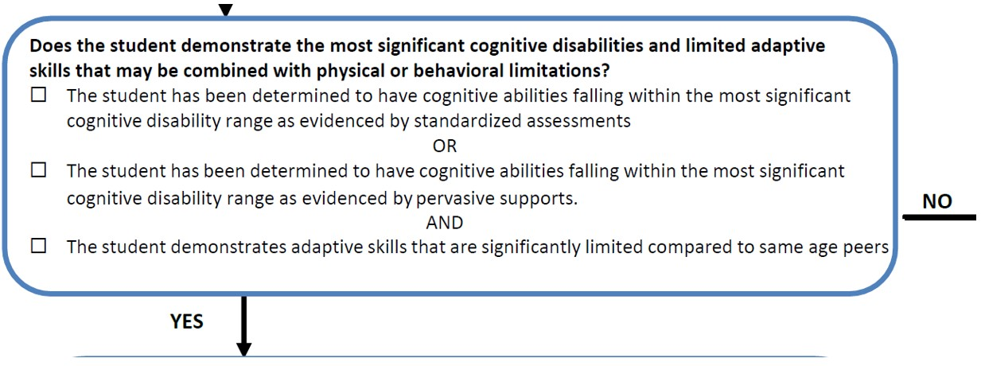
Flow Chart Step 2

Slide 45
IQ Only Part of Decision
The IQ score is not the sole criterion.
Students are expected to score lower than peers.
A valid score on a general education test is unachievable.
Documentation shows a level of support required.
Skills the student can perform are identified.
Skills the student has not mastered are identified.

Slide 46
Student Review Areas
communication
self-care
daily living
social skills
access to community
self-direction
health and safety
functional academics
leisure
work

Slide 47
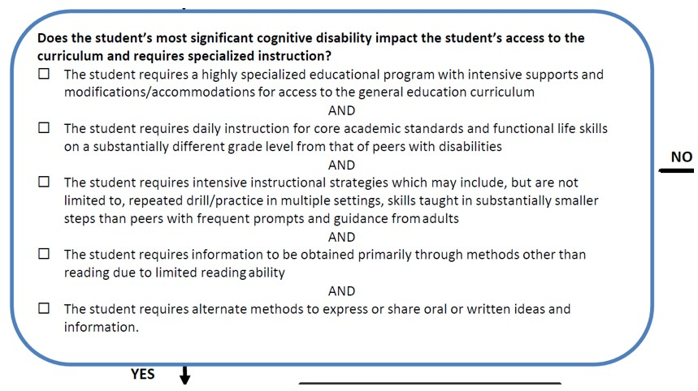
Flow Chart Step 3

Slide 48
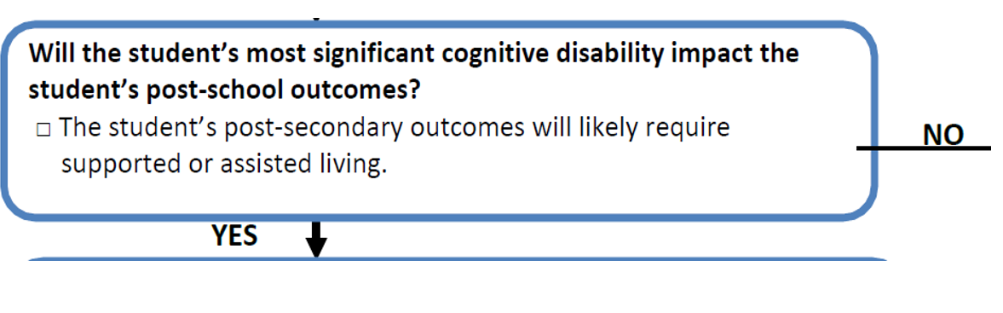
Flow Chart Step 4

Slide 49
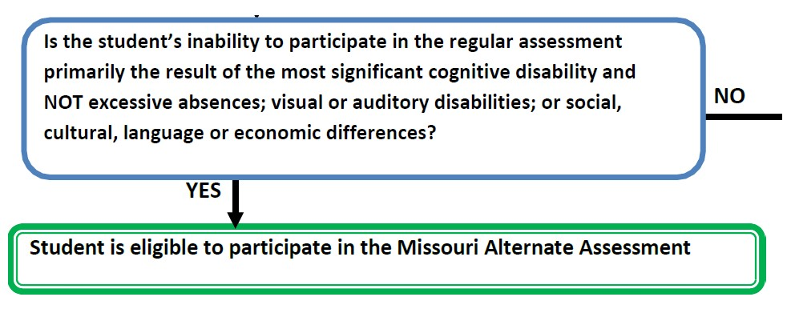
Flow Chart: Step 5

Slide 50
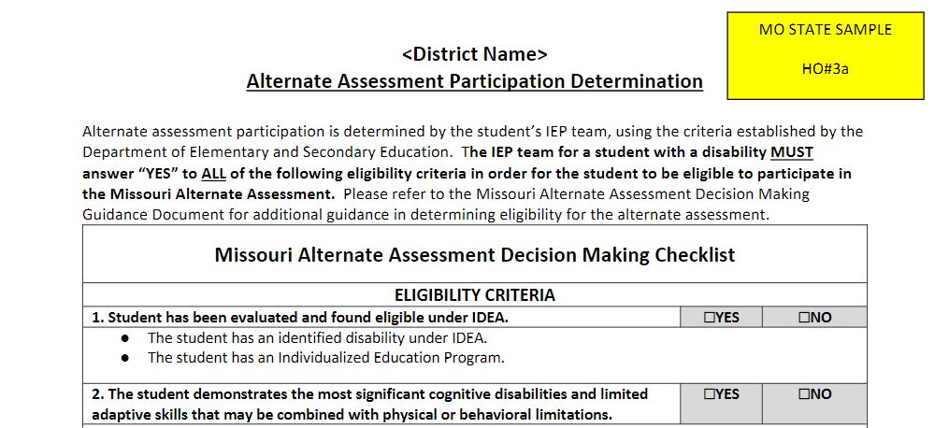
Eligibility Criteria Checklist

Slide 51
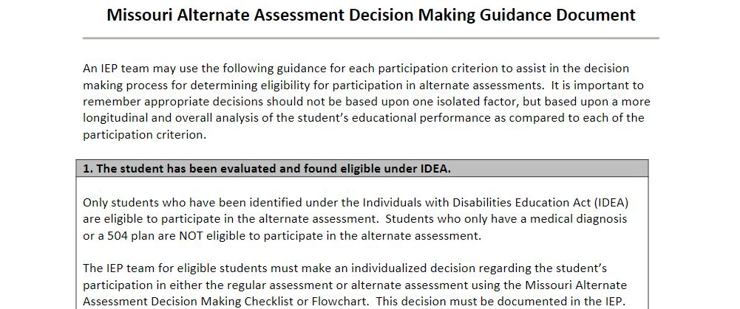
Guidance Document

Slide 52
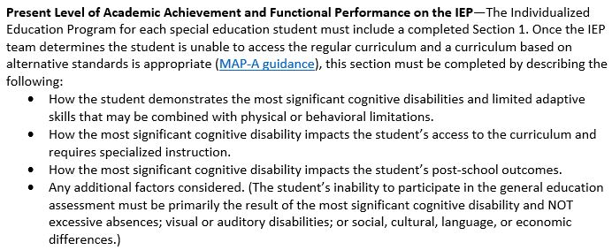
Present Levels

Slide 53
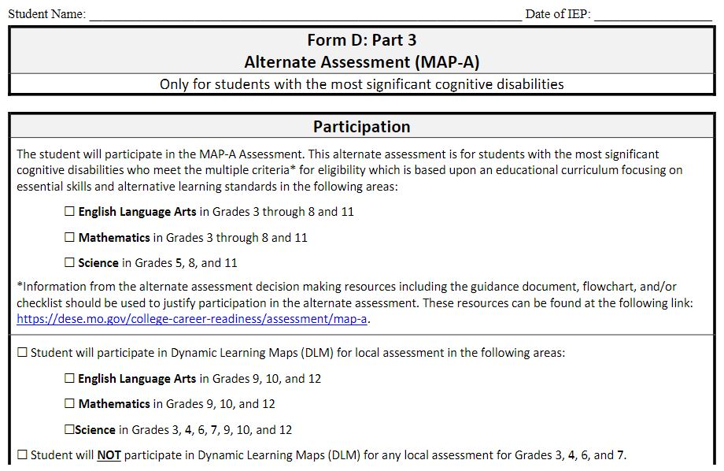
Form D, Part 3

Slide 54
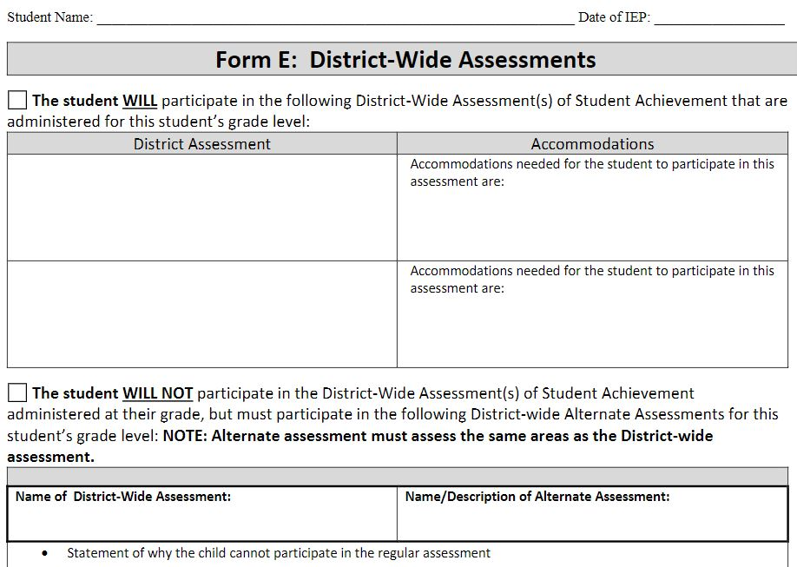
Form E

Slide 55
Part 6: Student Testing
August 2024
Caryn Giarratano, Ph.D.
DESE Assistant Director of Assessment
Slide 55

Slide 56
Testing Procedures
Use the Planner to track ELA and math EEs.
Must teach / test science in spring window for grades 5, 8 and 11.
Complete First Contact survey 24 and Personal Needs and Preferences (PNP) profile 24 hours before testing.
Testlets may take 15 minutes to release.
Close out of Student Portal when finished!

Slide 57
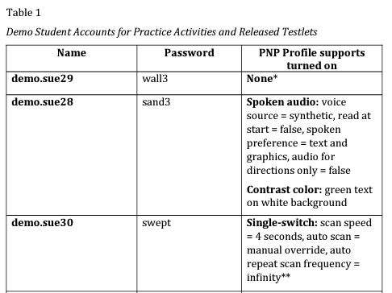
Take Practice Testlets First

Slide 58
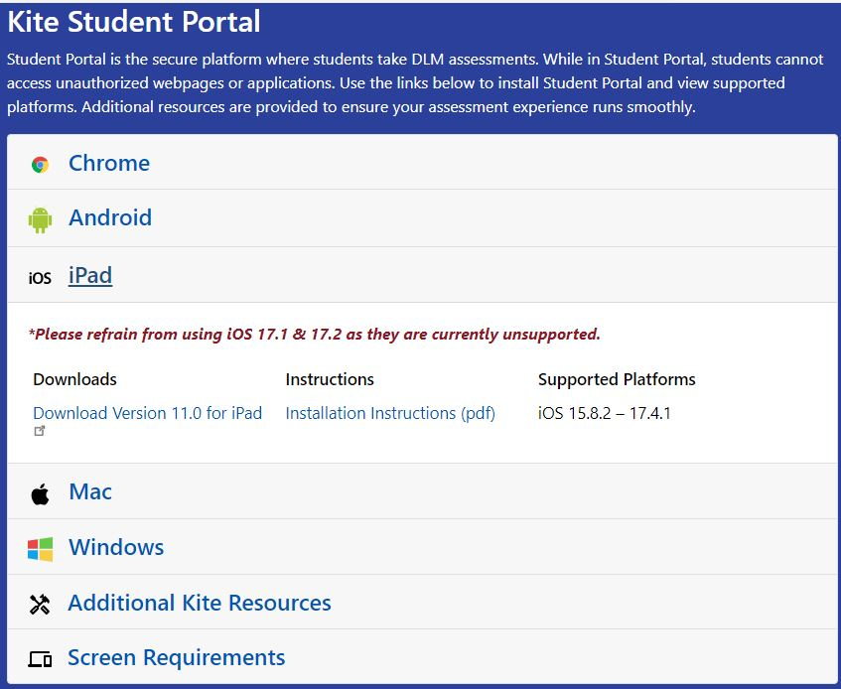
Update Student Portal

Slide 59
Best Practice for Testing
Why teach/test students all three subjects in grades 3-11:
Provide continuity of instruction.
Remind students of test format.
Non-required testing does not cost the district, does not count against the 1% cap, and is not used for accountability.

Slide 60
Complete First Contact
The First Contact Survey must be completed prior to testlets being generated.
Linkage Levels are determined by the system from the FCS information, so it is recommended to use them.

Slide 61
Test Information Page
  Must view the TIP before giving each testlet.
  See the Test Administration Manual for more information.
  Destroy TIP materials when finished.
  Find the TIP for ELA and math in the same location.
  Find the TIP for science in a different location for fall than spring.

Slide 62
Test Information for Fall
  Go to Instruction and Assessment Planner
  Complete boxes and click Search
  Find student’s table
  Click Blue Arrow
  Click stack of three dots (kebab)
  Click ready to test
  Click on TIP and download or print

Slide 63
Science TIP for Spring
  Go to Manage Tests
  Select Test Management
  Complete boxes and click Search
  Select Summative for Testing Program
  Click Search
  Select the Test Information PDF
  Download or print
  Destroy the TIP when finished.

Slide 64
Use Familiar Texts
Download and use familiar texts to read in classroom daily to enhance ELA assessments.

Slide 65
Review Resources
DLM provides materials collections, familiar texts, math glossaries, and science instructional activities:
Instructional Resources for IE Model States | Dynamic Learning Maps
Instructional Resources for IE Model States | Dynamic Learning Maps
Instructional Resources for IE Model States | Dynamic Learning Maps
Project Core – A Stepping-Up Technology Implementation Grant Directed by the Center for Literacy and Disability Studies (project-core.com)

Slide 66
Science Requirements
Fall Window
EEs are chosen by teachers
Testing is optional, but strongly encouraged
Testlets are NOT used for accountability purposes
Spring Window
EEs are NOT chosen by teachers
Testing is required
Testlets ARE used for accountability purposes

Slide 67
Testing Practices
Teachers use best judgment:
May provide additional supports.
Read the “Practices Allowed” section of the Test Administration Manual.
Read “Learn about the Accessibility Supports” in the Accessibility Manual.
Read the instructions in the Test Information Page.
Teachers may NOT view the testlet before giving it.

Slide 68
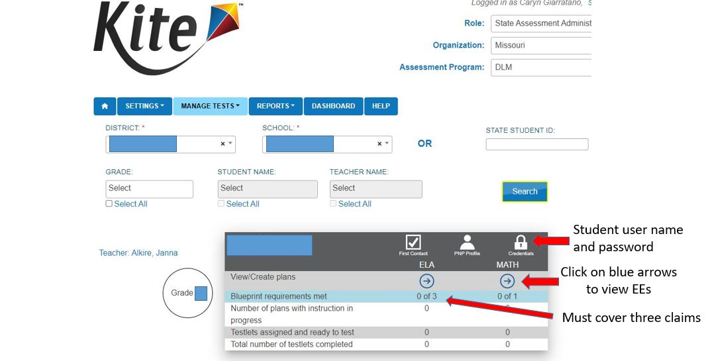
The Planner

Slide 69
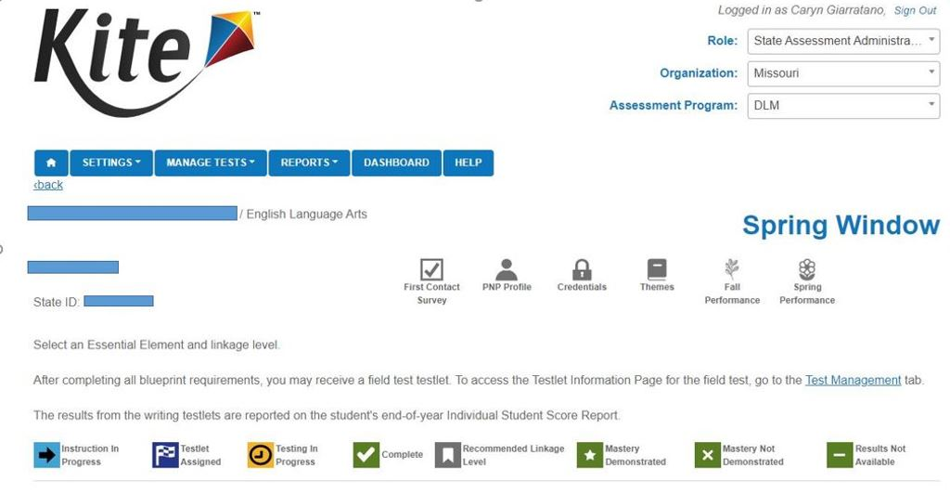
Top of Planner Page

Slide 70
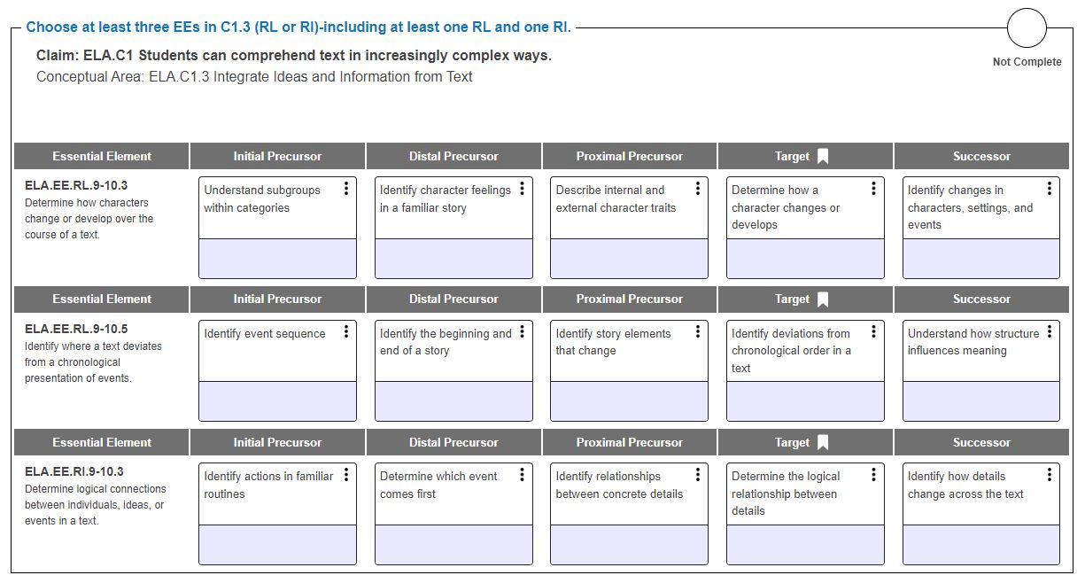
EEs and Linkage Levels
Instructions for this claim
This claim is not covered
Click stack of three dots
Bookmark to indicate correct linkage level

Slide 71
Linkage Level Comparison
ELA & Math Linkage Levels | Science Linkage Levels
Initial Precursor | Initial
Distal Precursor
Proximal Precursor | Precursor
Target | Target
Successor

Slide 72
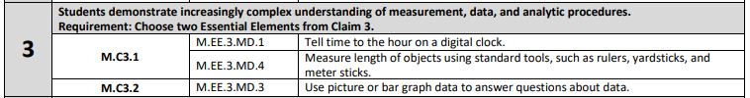
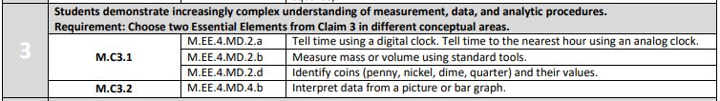
Teaching across Grades
Grade 3 Mathematics
Grade 4 Mathematics

Slide 73
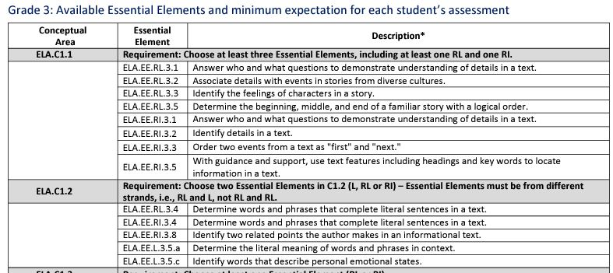
Teaching in Grade Level

Slide 74
Student Skill Mastery
Skill mastery is based on a probability, using Bayesian Statistics, that the student mastered a skill given the student’s answers to the items about that skill.
If a student has mastered one linkage level, it is likely the student mastered the skills in all the lower linkage levels for that Essential Element.

Slide 75
Part 7: MDTC Responsibilities
August 2024
Caryn Giarratano, Ph.D.
DESE Assistant Director of Assessment
Slide 75

Slide 76
Manuals for District Staff
MDTCs, data managers, and BTCs are encouraged to read the following five of the eleven manuals:
Assessment Coordinator Manual
Data Management Manual
Educator Portal User Guide
Facilitator Guide to Required Test Administrator Training
Parent Portal User Guide for District Staff

Slide 77
PD for District Staff
Learn how to enroll teachers and students, roster students, and pull reports:
https://kusurvey.ca1.qualtrics.com/jfe/form/SV_1BojBFybHhwPSfA
Dynamic Learning Maps Professional Development (dlmpd.com)
District Staff Video Resources for IE States | Dynamic Learning Maps

Slide 78
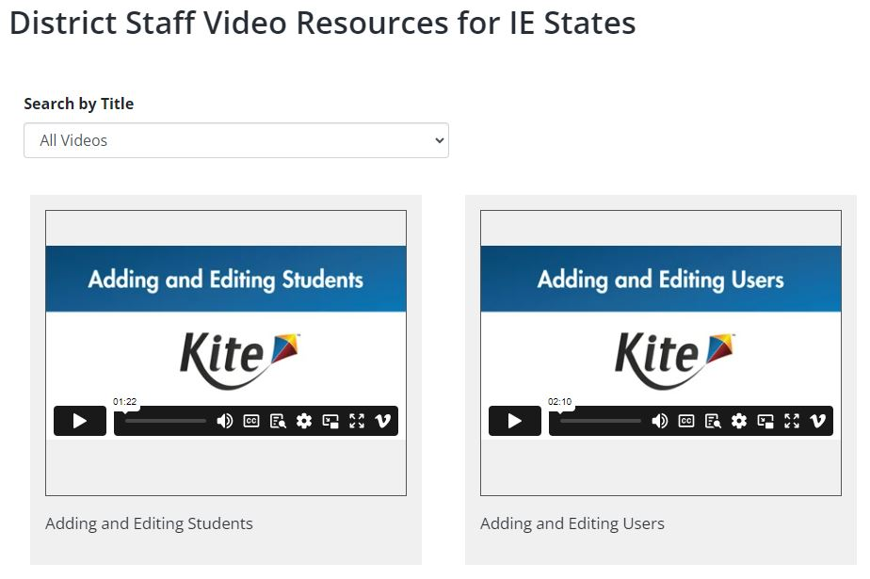
Videos for District Staff

Slide 79
Request EP Account
Contact Caryn at DESE Assessment to:
Create an Educator Portal account for MDTCs, or transfer last year’s account to the current district.
Teachers contact their district level staff to request an account.

Slide 80
District Staff Duties
Pull reports, such as Individual Student Reports.
Enroll users and maintain user list.
Enroll students and maintain student list.
Roster students in ELA, math, and science.
Share the MAPA Update email newsletter.

Slide 81
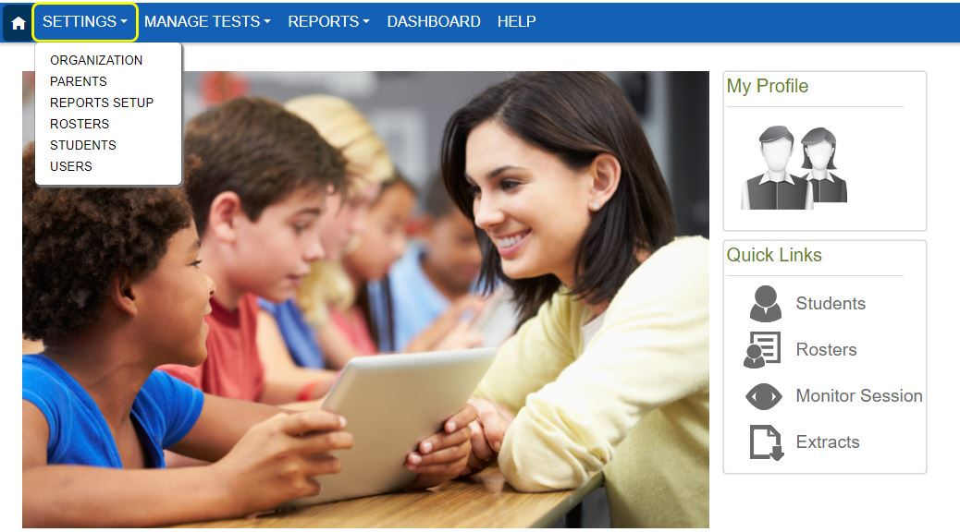
Enroll Users

Slide 82
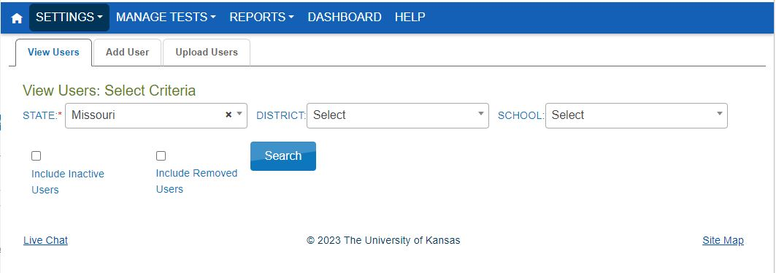
Enroll User Tabs

Slide 83
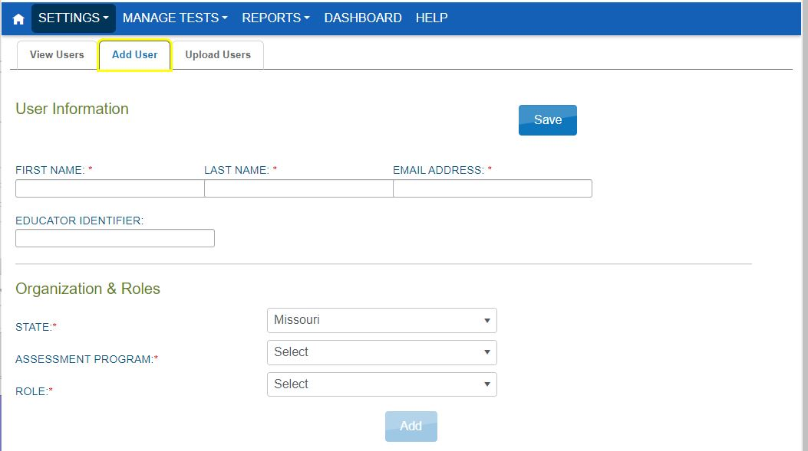
Add a User Tab

Slide 84
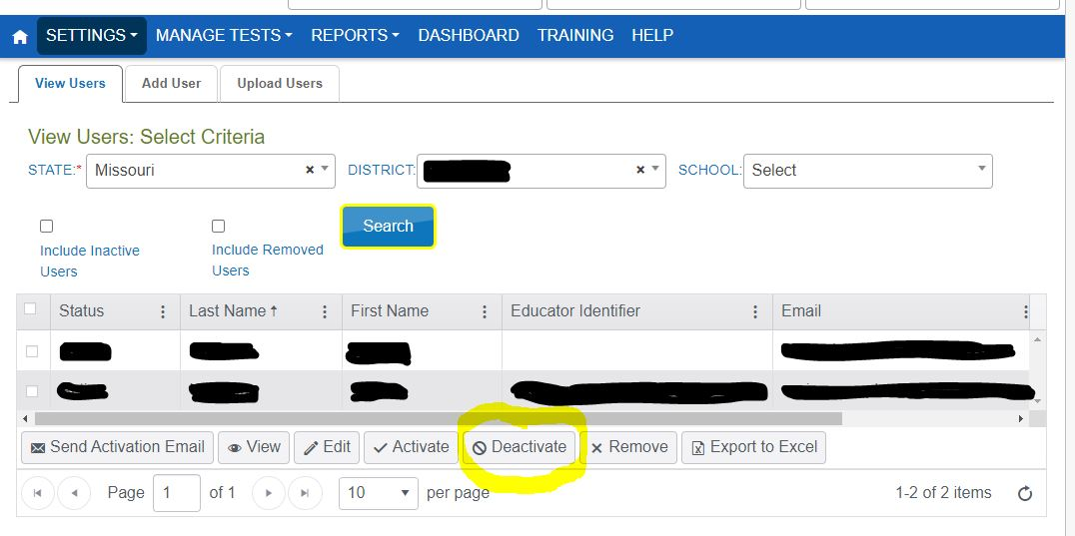
Deactivating Users

Slide 85
Role Assignment in EP
Teachers = test administrators
DTC or sped director = district test coordinator
Data managers = district users
Principals = building test coordinators Superintendents = superintendents
Technology directors = no role in EP
Regional directors = building users

Slide 86
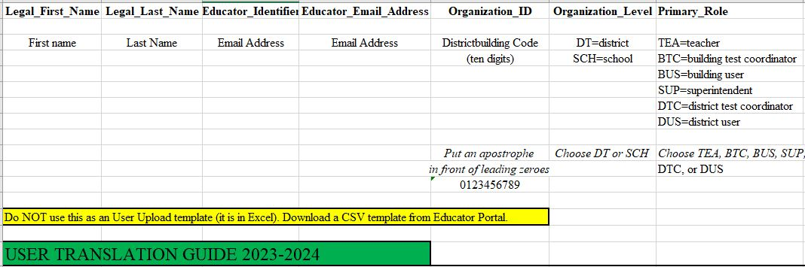
Translation Guide—Users

Slide 87
Enroll Students
There are three methods to enroll students in Educator Portal for the MAP-A assessment:
Find Student
Add Student
Upload Enrollment

Slide 88
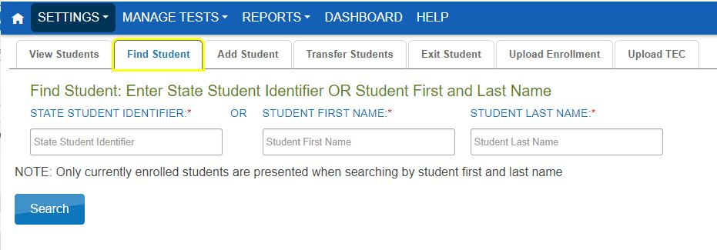
Find Student Enrollment

Slide 89
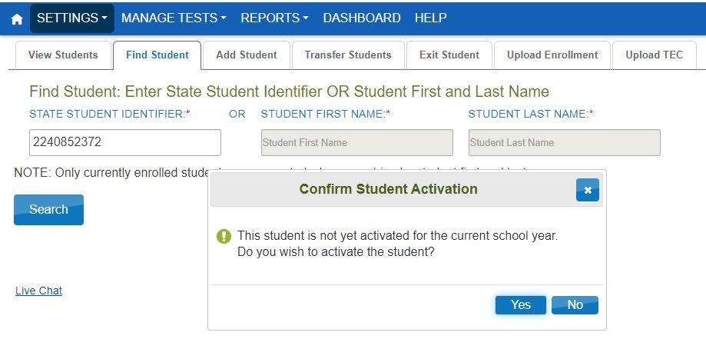
Activate Student in EP

Slide 90
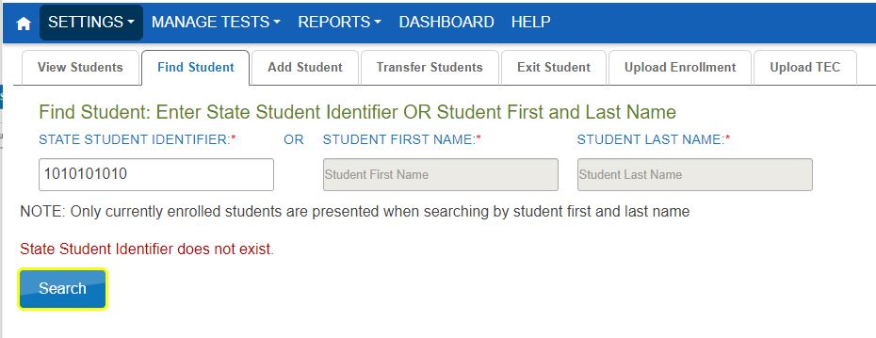
Add Student Enrollment

Slide 91

Add Student Form

Slide 92

Uploading Enrollment

Slide 93

Translation Guide—Enroll

Slide 94

Student Roster Methods

Slide 95

Translation Guide--Roster

Slide 96

Upload Roster Template

Slide 97
Steps to Cancel a Testlet
Only MDTCs can cancel a testlet.
Find the Essential Element that needs to be canceled.
Click on the stack of three dots.
When the new dialogue box opens, click on cancel testlet.

Slide 98
Student Transfer
MAP-A District Test Coordinators may transfer students within the district in Educator Portal.
Only DESE may transfer students from one district to another.

Slide 99
Part 8: Pull Reports
August 2024
Caryn Giarratano, Ph.D.
DESE Assistant Director of Assessment
Slide 99

Slide 100

Individual Student Reports

Slide 101

How to Use ISRs

Slide 102

Find ISRs on End of Year Tab

Slide 103

Find Performance Report

Slide 104

Fall Performance Report

Slide 105

District Staff Reports

Slide 106

Find Data Extracts

Slide 107

Data Extract Instructions

Slide 108

Create the Extract

Slide 109

Create Extract Confirmation

Slide 110

Data Extract in Queue

Slide 111

Test Monitoring Extract
Goal is 100%
Goal is 100%
Goal is 9

Slide 112

Student Report Archive

Slide 113

Alternate Reports

Slide 114

Alternate Reports Details

Slide 115

General Reports

Slide 116
Kite Collector
District staff are asked to complete test observation forms and submit them to DLM.
Kite Collector is submitted electronically.
Instructions are posted on the DESE MAP-A page under the Resources tab.
Links are in the script.

Slide 117
Part 9: DESE Connections
August 2024
Caryn Giarratano, Ph.D.
DESE Assistant Director of Assessment
Slide 117

Slide 118

MAPA Update

Slide 119

Contact for Questions
Caryn Giarratano, Ph.D.
Assistant Director of Assessment
Alternate Assessment
573-751-6731
caryn.giarratano@dese.mo.gov

