Slide 1
High Leverage Practices
Special Education Improvement Consultants
Jennifer Statler
Tonya Grant
2024

Slide 2
Learning Objectives
Participants will have a basic understanding of what High Leverage Practices are.
Participants will understand the need to embed High Leverage Practices in their daily instruction.
Participants will know where to find information on High Leverage Practices and additional training.
Notes:
State the intentions or have participants read them on their own.

Slide 3
High Leverage Practices (HLPs)
High-Leverage Practices
for Students
with Disabilities
Notes:
What they are: The fundamental purpose of CEC’s HLP project was to identify improved methods for supporting special education teacher candidates as they learn to use effective practices in their classrooms. The HLPs are organized around four aspects of practice—collaboration, assessment, social/emotional/behavioral practices, and instruction—because special education teachers institute combined and related practices in these areas. The HLPs for instruction can be used to teach both academic content and emotional, behavioral, and social skills. Special education teachers bring their knowledge of HLPs in these areas when collaborating with other professionals and parents. HLPs, and their inclusion of culturally responsive approaches, are also considered effective practice for general education teachers.
From the four aspects, there are 22 practices intended to address the most critical practices that every K–12 special education teacher should master and be able to demonstrate. The selected practices are used frequently in classrooms and have been shown to improve student outcomes if successfully implemented.
Just a resource: https://highleveragepractices.org/sites/default/files/2020-10/Preface.Intro1_.pdf?_gl=1*5gia58*_ga*MTcxMzM0NzY0Ni4xNzA3MzU2OTQ3*_ga_L4ZFTNESGT*MTcwODQ0MzQxOS44LjEuMTcwODQ0MzQzNS40NC4wLjA.

Slide 4
Notes:
As with everything else, the HLPs got a makeover on their structuring. Here are the High Leverage Practices Restructured. The top level holds the Four Areas of Practice, note we now have new titles following Collaboration, Data Driven Planning, Instruction in Behavior and Academics, Intensify and Intervene as Needed. Underneath this layer we have the HLP Pillars. These pillars are the HLPs that create the foundation for and encompass other HLPs. The 3rd level holds the Embedded HLPs- those that are encompassed within the Pillars.
Today for our purposes and time limit we are going to focus on the Pillars of High Leverage Practices.

Slide 5
Why Use
High Leverage Practices?
Understanding Cognitive Load
Notes:
To Know: This is a transition slide.

Slide 6
Teachers Are Tasked With…
Notes:
As teachers we are given the responsibility to instruct and make sure our students meet the expectations of the Missouri Learning Standards. Yet we have classrooms with a variety of learners- high achieving, average, basic, and our below basic learners; not to mention the variances of disabilities/disorders, “home” life, social status, etc.
Logically the first question is how am I going to teach this, but actually an important first step is…

Slide 7
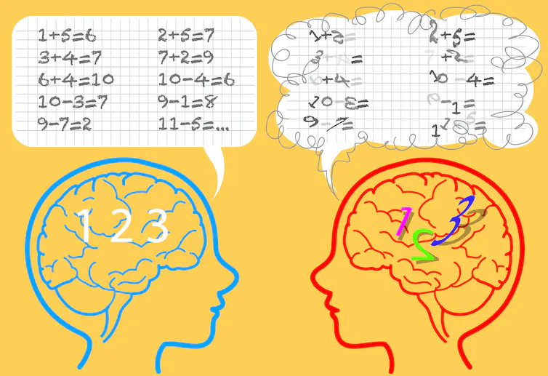
Consider the Individual Needs of Students
Notes:
Considering the individual needs of all students. In this next section we are going to look at something called cognitive overload and how it affects the needs of each individual student. Then as we go through the rest of the presentation you will be able to see how using High Leverage Practices can reduce this overload so that the precious time that we have to teach our students will be maximized.

Slide 8
What’s In Your Wallet?
Notes:
We all have at least one of these in our wallet. We constantly draw from checking/banking accounts. Most of the time, we don’t even think about how much money is coming out of the account. When buying most items, there is no worry at all, because you have a vague idea of how much you have in the account versus what the item cost

Slide 9
Funds Are Plentiful the Costs are Low
Notes:
When the funds are plentiful the costs are low. When you are having a good day, not overloaded, your brain can quickly processes information that everything is fine, and the daily “purchases” can be successfully made. In this pristine cognitive load-we can perform multiple (highly impressive) tasks at once.

Slide 10
“Your Card Was Declined”
Notes:
With that in mind, what happens to you when you hear the dreaded words:“Your card was declined”. You may go into a panic or your anxiety shoots through the roof. When someone’s brain becomes overloaded, when it has reached its maximum limit, there is nothing left for that person to give. Simple tasks, requests, comments can quickly send that person over the edge, especially those who lack emotional regulation.

Slide 11
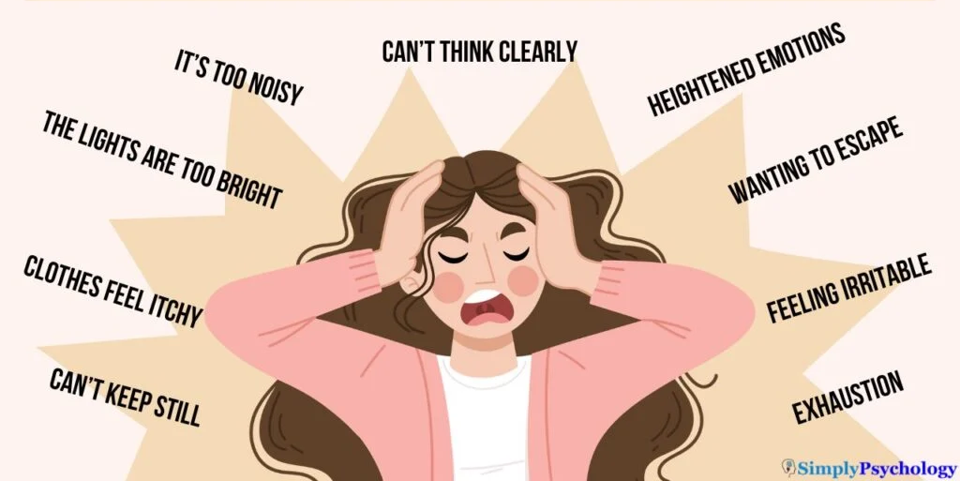
Cognitive Overload for Students Looks Like This…

Slide 12
Cognitive Overload for Educators?

Slide 13
Life’s Potholes
Notes:
As adults, we have skills to avoid many of life’s potholes. We check our account before we make a big purchase. Make sure we set our alarm to get to work on time. Fill up our tank before we hit the road for a long trip.

Slide 14
“Processing Declined”
When available working memory resources are expended, learning or performance cannot occur.
Notes:
Students in school, however, have less (or no) capacity to avoid unwanted feelings embarrassment, failure, and dread. Think about that for a moment… what we “ask” of students each day. Cognitive load theory is based on the idea that all humans are limited at any given moment in terms of how much information they can process. When available working memory resources are expended or spent, learning and performance cannot occur.
However, the brain is resilient - even if overwhelmed in the moment, it can quickly snapback, but for many students, the damage has been done by missing key content in that overwhelmed moment, or by becoming further disengaged.

Slide 15
This is me on the golf course. I’m on cognitive overload.

Slide 16
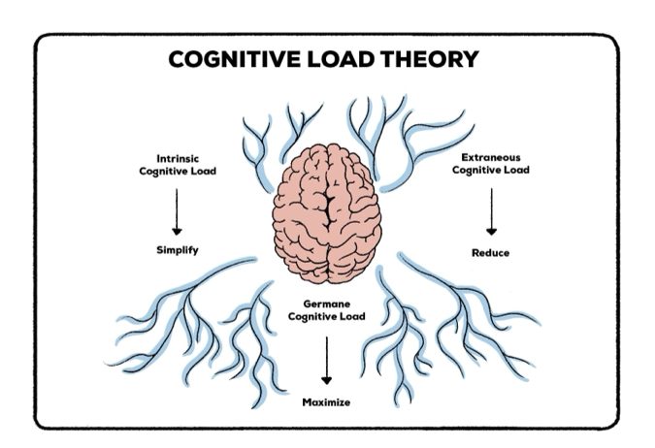
Notes:
Under the cognitive load theory, as teachers we want to simplify the intrinsic (cost of learning new information), reduce- to the best of our ability- the extraneous (cost of dealing with environment and intrapersonal issues), and with that the germane portion(what amount of cognitive processing is available) should increase.
We do not live in a perfect world where we can manage everyone’s cognitive load. There are times and situations for some that overload can’t be avoided. But if we offer instruction in different ways, provide a positive environment, and apply a proactive approach, we can help control how much cognitive processing ability is being taken out of the account.

Slide 17
Intrinsic load
Even if the content doesn’t charge much by itself, if a lot of content is bundled and taught at the same time and/or quickly OVERLOAD can occur
“cost of learning new information”
Notes:
Many students with disabilities/disorders have some level of dysfunction in terms of cognitive functionality. Intrinsic load is almost always higher for these students.
But even if the content doesn’t charge much intrinsic load by itself, if a lot of content is bundled and taught at the same time and/or quickly, overload can occur.
Which is what we are going to do to you today (LOL)!

Slide 18
Extraneous Load
I haven’t really slept in days, haven’t eaten a decent meal in weeks, I don’t feel safe at home or school, but please, tell me about the French Revolution…
“cost of dealing with environment and intrapersonal issues”
Notes:
Extraneous Load: Costs inflicted by how content is taught, or other distractors in learning/teaching environment. Think about the 5 senses. Slides or worksheets are too busy, the light is buzzing, the lawn mower outside is distracting. Someone has too much Axe body spray on, the expo marker the teacher is using stinks. The tag on shirt is scratchy, my feet are too hot. Something happened in the hallway on the way to class/ lunch. Do I need to stay at Tommy’s house again tonight?
Do you have any you would like to add?

Slide 19
High Leverage Practice Pillars
Notes:
We know that students can get overwhelmed in any number of ways. However, there are ways to reduce their load. One way to do that is by using high leverage practices. This will just be a brief overview of the HLPs.

Slide 20
Notes:
HLP 1 - Collaborate with professionals to increase student achievement.

Slide 21
Notes:
HLP 3 - Collaborate with families to support student learning and secure needed services.

Slide 22
Notes:
Nested under HLP 1 and 3 is an embedded HLP, HLP #2. This one is “ organizes and facilitates effective meetings with professionals and families.” Now let’s break those down a little.

Slide 23
Collaboration
The effective special educator who works well with families to learn all they can about the student will:

Slide 24
Collaboration
The effective special educator who works well with families to learn all they can about the student will:
be in a strong position to run effective meetings (HLP 2),

Slide 25
Collaboration
The effective special educator who works well with families to learn all they can about the student will:
be in a strong position to run effective meetings (HLP 2),
and work with their colleagues to implement an effective IEP (HLP 1).

Slide 26
Collaboration
The effective special educator who works well with families to learn all they can about the student will:
be in a strong position to run effective meetings,
work with their colleagues to implement an effective IEP.
collaborate with families to inform the development of long- and short-term goals, and other needed supports and practices noted within the social/behavioral and instruction HLP domains.

Slide 27
Use Effective Practices for Communicating with Families
Communicate in a language and format accessible to the family.

Slide 28
Use Effective Practices for Communicating with Families
Use face-to-face interactions in planned, formal, and informal meetings (e.g., open house, community/school events, IEP meetings) to communicate with families.

Slide 29
Use Effective Practices for Communicating with Families
Use written and digital communication to share formal and informal information about school activities, parent and student rights and responsibilities, and student educational progress.

Slide 30
Use Effective Practices for Communicating with Families
Make phone calls to families as needed to build on students’ strengths and discuss supports or resources.

Slide 31
Use Effective Practices for Communicating with Families
Share information and/or resources with families via course management systems, school websites, and classroom webpages/ blogs.

Slide 32
Notes:
HLP 6 falls under data-driven planning. Specifically, “use student assessment data, analyze instructional practices, and make necessary adjustments that improve student outcomes.

Slide 33
Notes:
The embedded HLPs nested under HLP 6 are:
-HLP 4: Use multiple sources of information to develop a comprehensive understanding of a student’s strengths and needs
-HLP 5: Interpret and communicate assessment information to collaboratively design and implement educational programs.
-HLP 11: Identify and prioritize long and short-term learning goals
-HLP 12: Systematically design instruction toward a specific learning goal
As you hear these note the similarities between the HLPs and IEPs.

Slide 34
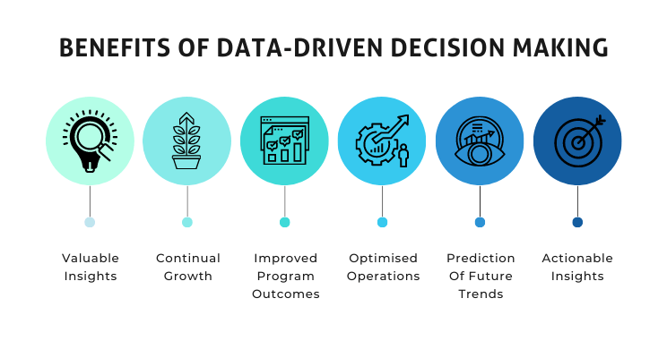

Slide 35
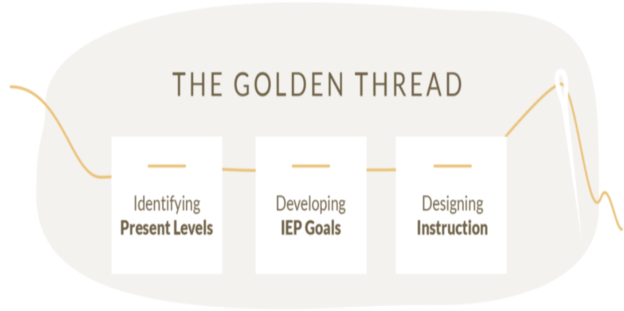
Evaluation Report: Eligibility Determination Data
Notes:
This was created by our very own, Tiffany Smith. With the golden thread, there is common thread beginning with the evaluation, moving on to the present level, developing IEP goals, and then designing instruction. This golden thread ties into HLP 6 and those HLPs that are embedded underneath it. By using student data, we can use that information to guide the needs of our students.

Slide 36
Golden thread refers to the fundamental principle of providing inclusive and equitable opportunities for individuals with disabilities to access a quality education.

Slide 37
This thread weaves through the entire tapestry of special education, guiding the development of individualized plans and support systems that cater to each student's unique needs.

Slide 38
This thread connects teachers, parents, specialists, and students where each student can reach their full potential.

Slide 39
It serves as a reminder that every child is unique and deserves tailored interventions and accommodations to thrive academically, socially, and emotionally.

Slide 40
This golden thread should be what guides your goals and in turn those goals will help you plan your instruction.
Notes:
This golden thread ties into HLP 6 and those HLPs that are embedded underneath it. By using student data, we can use that information to guide the needs of our students.

Slide 41
Notes:
Next are the HLPs related to instruction in behavior and academics. HLP 7 states - Establish consistent, organized and responsive learning environments. The focus of HLP 7 and 16 is not only what we teach, but how we teach it.
Nested directly below HLP 7 is “what to teach”. There we find:
-HLP 9: Teach social behaviors
-HLP 14: Teach cognitive and metacognitive strategies to support learning and independence
-HLP 21: Teach students to maintain and generalize new learning across time and settings.

Slide 42
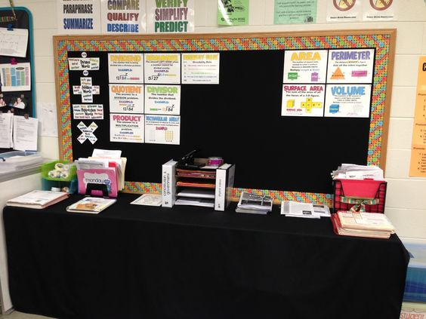
Establish Consistent, Organized and Responsive Learning Environments
If this isn’t in place the rest of educators’ efforts are likely going to be wasted…

Slide 43
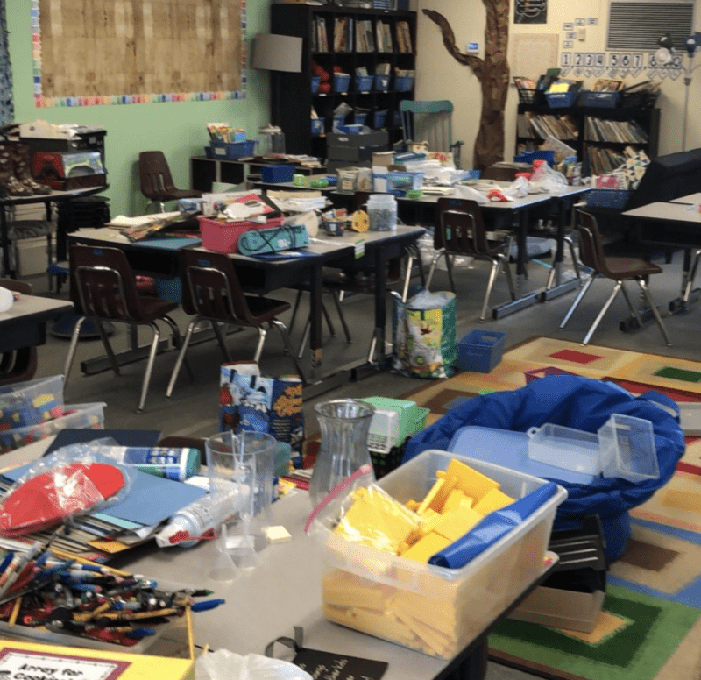
Establish Consistent, Organized and Responsive Learning Environments
If the classroom is chaos, the learning will be chaos.

Slide 44
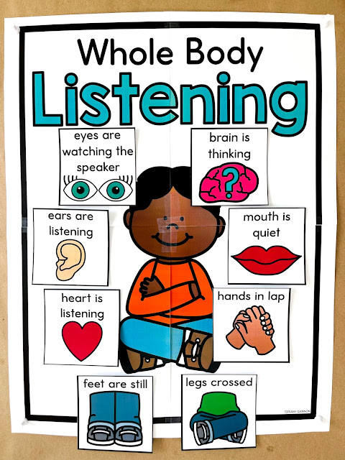
Establish Consistent, Organized and Responsive Learning Environments
Be planful and deliberate in how you set up your classroom space to provide students with clear directions, procedures, and expectations to support their learning and behavioral success.
Notes:
*NOTE: The next 4 slides go along with HLP 7 definition
Citation: Kennedy, M. J., Hirsch, S.E., Peeples K. N., Romig, J. E., Mathews, H. M., Rodgers, W. J. (2018). High-leverage practice #7: Establish a consistent, organized, and respectful learning environment. https://highleveragepractices.org/hlp-7-establish-consistent-organized-….
Establishing a consistent, organized, and respectful learning environment means the teacher is planful and deliberate in how they set up their classroom space to provide students with clear directions, procedures, and expectations to support their learning and behavioral success.
Putting these elements into place… (click each of the next 3 slides for the benefits of HLP7)

Slide 45
Establish Consistent, Organized and Responsive Learning Environments
Be planful and deliberate in how you set up your classroom space to provide students with clear directions, procedures, and expectations to support their learning and behavioral success.
increases the likelihood of student academic and social behavior success

Slide 46
Establish Consistent, Organized and Responsive Learning Environments
Be planful and deliberate in how you set up your classroom space to provide students with clear directions, procedures, and expectations to support their learning and behavioral success.
increases the likelihood of student academic and social behavior success
increases educator opportunities to engage in effective instructional practices

Slide 47
Establish Consistent, Organized and Responsive Learning Environments
Be planful and deliberate in how you set up your classroom space to provide students with clear directions, procedures, and expectations to support their learning and behavioral success.
increases the likelihood of student academic and social behavior success
increases educator opportunities to engage in effective instructional practices
fosters caring and respectful interactions between educators and students.

Slide 48
Classroom expectations and rules should be defined and taught
Acknowledge appropriate behavior with high frequency
Actively engage using a high rate of OTRs
Respect
Notes:
1.Classroom expectations and rules should be defined and taught. To do so requires time be taken at the beginning of the year, and at regular intervals throughout the year. Teachers should not assume students arrive at school knowing how to behave. Instead, providing clear expectations, and explaining or modeling what those expectations look like in specific settings is essential. If an expectation is not met, use this as a learning opportunity instead of a punishment opportunity. What do we do if a student makes an error on an assignment, we take time to reteach that concept. “Treat behavioral issues as learning errors – which are remediated by re-teaching”
2. Use a continuum of strategies to acknowledge appropriate behavior with high frequency. Teachers who are deliberate in setting up an environment where students have clear and ongoing information about what is expected and how well they are meeting expectations often achieve tremendous success in terms of students’ academic and behavioral performance. Face it we all as humans want to know how we measure up, even if we don’t say so, we really do want to know what our administrators think of our teaching. “Students are human beings too, they have that same want. If we want them to make a change, we need to be on our game to notice when they actually do the thing we want them to do, otherwise we will never see it.”
3. Effective teachers also actively engage their students by delivering high rates of opportunities to respond (or OTRs). OTRs are teacher behaviors that solicit a response from a student. These include individual and choral responding as well gestures and response cards.
4. A teacher who demonstrates respect towards all students at all times is in a position to expect her/his students to do the same. When paired with clear expectations and an organized learning environment, a positive, respectful teacher is well positioned to help all students succeed.

Slide 49
Establish Consistent, Organized and Responsive Learning Environments
Special and general educators cannot “make” students learn or behave; they can however proactively create environments to increase the likelihood they do both (Lewis, 2009).

Slide 50
Notes:
HLP 16 is the use of explicit instruction - again, this focus is on “how to teach”.
HLP 13- requires us to adapt curriculum tasks and materials for specific learning goals
HLP 15 - Provide scaffolded supports
HLP 17 - Use flexible grouping
HLP 18 - Use strategies to promote active student engagement
HLP 19 - Use assistive and instructional technologies
HLP 8/22 - Provide positive and constructive feedback to guide students’ learning (HLP 22) and behavior (HLP 8)

Slide 51
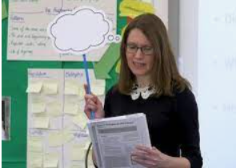
Use Explicit Instruction
Make content, skills, and concepts explicit by showing and telling students what to do or think while solving problems, enacting strategies, completing tasks, and classifying concepts
Notes:
*NOTE: The next 6 slides go along with HLP 16 definition
Teachers who use explicit instruction bring a laser like focus on selecting only the most critical content students need to know… Sequencing skills logically… And breaking complex skills and strategies into smaller instructional units.

Slide 52
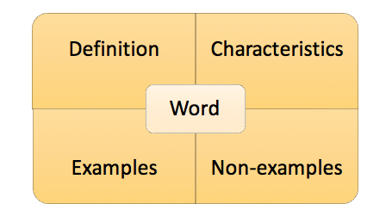
Use Explicit Instruction
Make content, skills, and concepts explicit by showing and telling students what to do or think while solving problems, enacting strategies, completing tasks, and classifying concepts
strategically choose examples and non-examples and language to facilitate student understanding
Notes:
Teachers also highlight critical examples and nonexamples. Think about professional development we attend about writing a quality IEP, what is it that everyone wants…a good example; what do you also need…a poor example.

Slide 53
Use Explicit Instruction
Make content, skills, and concepts explicit by showing and telling students what to do or think while solving problems, enacting strategies, completing tasks, and classifying concepts
strategically choose examples and non-examples and language to facilitate student understanding
anticipate common misconceptions
Notes:
A hallmark of explicit instruction is that the teacher provide lots of opportunities for students to respond to keep instruction moving at a brisk pace, and provide immediate feedback on student performance.

Slide 54
Use Explicit Instruction
Make content, skills, and concepts explicit by showing and telling students what to do or think while solving problems, enacting strategies, completing tasks, and classifying concepts
strategically choose examples and non-examples and language to facilitate student understanding
anticipate common misconceptions
highlight essential content and remove distracting information
Notes:
Language used within an explicit lesson is crystal clear.

Slide 55
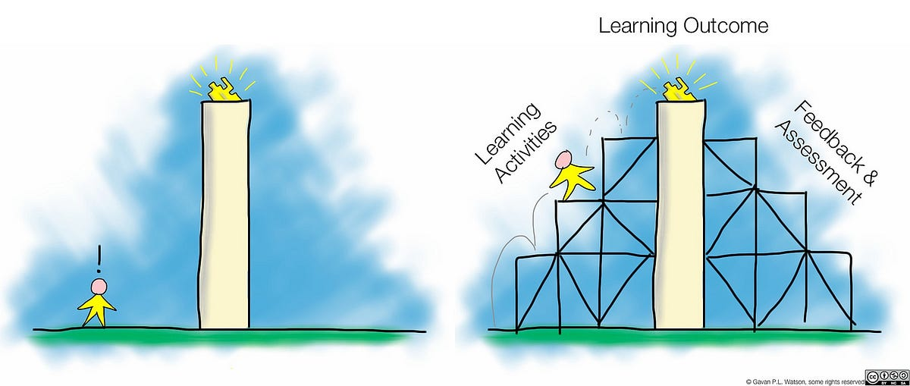
Use Explicit Instruction
Make content, skills, and concepts explicit by showing and telling students what to do or think while solving problems, enacting strategies, completing tasks, and classifying concepts
strategically choose examples and non-examples and language to facilitate student understanding
anticipate common misconceptions
highlight essential content and remove distracting information
model and scaffold steps or processes
Notes:
Explicit lessons are also known for the I do, we do, you do instructional sequence. Meaning the teacher first models how to solve a problem or complete a task by thinking aloud. Then, guides students through a scaffolded application of the skill or concept and provides feedback. Finally, students are provided opportunities for independent practice to ensure mastery. Students receive meaningful feedback at every step.

Slide 56
Use Explicit Instruction
Explicit instruction helps teachers design and deliver effective instruction for a range of student learning needs.
Notes:
Explicit instruction is effective for most students, not only those with disabilities. This approach can be used across grade levels and content areas. Although explicit instruction can be provided by any teacher, the unique setting and needs of students being taught determines the level of intensity with which the teacher uses this practice. The difference in intensity is not merely the number of students in each class, but that instruction should be appropriately intense, matched to the unique needs of students. A effective educator is responsible for ensuring data that is carefully collected and monitored drives instructional decision-making. This ensures the explicit instruction being delivered is appropriately intense and changes can be made as needed.

Slide 58
Key Elements of Explicit Instruction
Use clear language
Use cues
Break complicated content into chunks
Make connections to prior learning
Highlight relevant and varied examples (and non-examples)
Use an engaging, deliberate, and predictable pace
Provide lots of (varied) opportunities to respond (OTRs)
Deliver high-quality feedback
Model (I do) regularly
Provide guided practice (we do) regularly
Utilize independent practice (you do) when students are ready
Notes:
The key elements of explicit instruction are listed here. The elements that are highlighted are the elements that should be seen a daily basis in your instruction.

Slide 59
Notes:
Our last section focuses on intensifying instruction and intervening as needed. HLP 20-state that we should “provide intensive intervention for academics and behavior.” Though many students make adequate progress with evidence-based practices, a number of students do not make sufficient progress with these interventions and require a more intense and individualized approach. Intensive intervention is often provided within the evidence-based systematic framework of Data Based Individualization. Four decades of research indicates that students with disabilities who do not make sufficient progress in general education or with supplemental interventions require instruction that is more intense along a number of dimensions in order to make significant gains. The DBI process includes the use of an evidence-based curriculum in the specific area of need, ongoing progress monitoring, specific diagnostic testing, team-based decision making, and adjusting instruction (to curriculum, group size, both, etc.) based on the results of student data.
The embedded HLP nested under #20 is HLP is HLP 10 - Conduct functional behavioral assessments to develop individual student behavior plans.

Slide 60
Students with Disabilities
Students with intensive needs require as much as 10-30 times more practice to master a skill as opposed to their non-disabled peers.
All Students
504
IEP
Notes:
Research indicates that it may take students with intensive needs, including those with disabilities, as much as 10 – 30 times more practice to master a skill, compared to peers without disabilities. This means that the dosage and pace of general education classroom instruction and even some Tier 2 intervention programs may be a mismatch for the individualized needs of many students with disabilities. Even when evidence-based practices and intervention programs are used, some students still do not make adequate progress. They require something more.
There is a need for intensive intervention due to the large number of students who need more than standard remediation to succeed. The need for intensive intervention is determined when teachers, using progress monitoring data, note that a student is not making progress towards IEP goals, or has not responded or improved with additional supports in general education and when also receiving supplemental, Tier 2 instruction.

Slide 61
Provide Intensive Intervention for Academics and Behavior
Match the intensity of instruction to the intensity of the student’s learning and behavioral challenges
Notes:
*NOTE: Following 3 slides go with defining HLP 20
Intensive intervention is not a specific product or tool, but rather a process educators use to identify and provide evidence-based instruction for students with disabilities who demonstrate severe and persistent learning needs. Teachers match the intensity of instruction to the intensity of the student’s learning and behavioral challenges.

Slide 62
Provide Intensive Intervention for Academics and Behavior
Match the intensity of instruction to the intensity of the student’s learning and behavioral challenges
Group students with similar needs on a small number of high priority, clearly defined skills or concepts that are critical to academic success
Notes:
Intensive instruction involves working with students with similar needs on a small number of high priority, clearly defined skills or concepts critical to academic success.

Slide 63
Provide Intensive Intervention for Academics and Behavior
Match the intensity of instruction to the intensity of the student’s learning and behavioral challenges
Group students with similar needs on a small number of high priority, clearly defined skills or concepts that are critical to academic success
Student groups should be based on common learning needs; clearly define learning goals; and use systematic, explicit, and well-paced instruction
Notes:
Students are also grouped based on common learning needs; clearly define learning goals; and use systematic, explicit, and well-paced instruction.

Slide 64
HLP 20: Provide Intensive Intervention for Academics and Behavior
Match the intensity of instruction to the intensity of the student’s learning and behavioral challenges
Group students with similar needs on a small number of high priority, clearly defined skills or concepts that are critical to academic success
Student groups should be based on common learning needs; clearly define learning goals; and use systematic, explicit, and well-paced instruction
Frequently monitor students’ progress and adjust their instruction accordingly.
Notes:
Teachers are able to frequently monitor students’ progress and adjust their instruction accordingly. Within intensive instruction, students have many opportunities to respond and receive immediate, corrective feedback with teachers and peers to practice what they are learning.

Slide 65
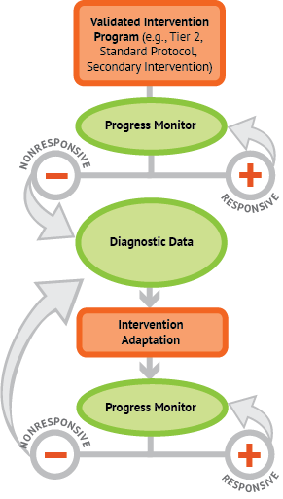
Data-Based Individualization Process
Using a standard protocol intervention program with fidelity
Regularly monitoring student progress with reliable data
Collecting diagnostic data in areas of concern
Making data-driven adaptations to intervention offerings
Notes:
These steps often occur concurrently and also recur as needed, and are always implemented by a team of professionals.
Teachers utilize a validated intervention package, which functions as the platform where high quality supplemental intervention is provided with fidelity. The intervention package can be for academics or behavior. Teachers may need access to multiple programs based on students’ unique needs. In instances where a validated program is not available, teachers should ensure they are providing a steady course of explicit instruction and other evidence-based practices in the domain where they are providing student support.
Progress monitoring data allows professionals to assess the extent to which the intervention is having the intended impact.
Teachers use additional diagnostic information to try and figure out the root cause of the academic or behavioral challenges when students are not making gains toward their goal. The intervention teams uses this data to develop a hypothesis about the student’s unique needs and then plans instructional changes accordingly. The team wants to focus on the area of student struggle most likely to result in performance gains in priority areas.
Teachers make instructional adjustments based on results of the diagnostic data, and then they continue to monitor student progress on a regular basis. The team meets on a regular basis to evaluate how things are going and consider additional changes

Slide 66
Notes:
This information comes from the Progress Center at the American Institutes for Research

Slide 67
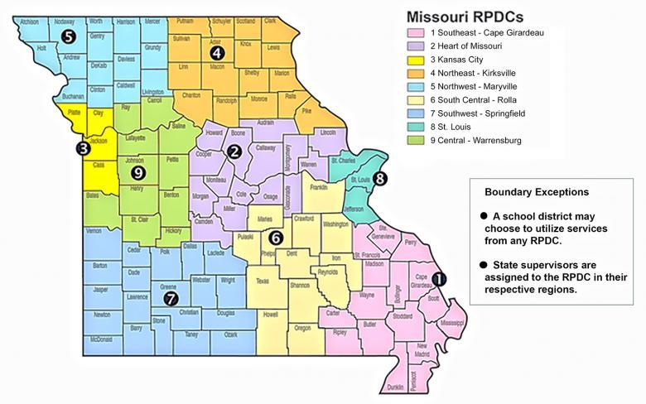
High Leverage Practice Trainings
If you would like to dive deeper into High Leverage Practices, contact your local RPDC Behavior and Special Education Improvement consultants.
Region Professional Development Centers
Notes:
As mentioned previously, this area of practice is Intensify and Intervene as Needed, this could be academic or behavioral. The embedded HLP 10 covers conducting Functional Behavior Assessments (FBA) and developing Individualized Behavior Support Plans (BPS). For further information regarding HLP 10, we encourage you to reach out to your region’s Behavior Consultant.

Slide 68
Resources
https://highleveragepractices.org/
https://iris.peabody.vanderbilt.edu/resources/high-leverage-practices/

