Slide 1
Specially Designed Instruction (SDI)
DESE 1 Hour Zoom Session
2024
Notes:
Zoom Session
Federal and State Regulations
Focus on Content, Methodology, and Delivery of instruction
SDI = Special Education
Structure of the Planning Steps
Structure - circle image
Resources - Ann B and Marilyn Friend Books
Other state departments with resources on SDI - maybe TX with documents
Don’t focus on accommodations - focus on the steps for planning
Resources on the CEC website
GA has a literacy document on SDI

Slide 2
What is SDI (Specially Designed Instruction)?
Anne Beninghof has a multi-step guide to help us develop a systematic plan for SDI implementation. Let’s take a look.
Beninghof, Anne M. Specially Designed Instruction: Increasing Success for Students with Disabilities. Routledge, 2022.

Slide 3
Legal Foundation
SDI is included in both state and federal law.
We have a legal mandate to provide specially designed instruction for our special education students.

Slide 4
Regulations for SDI at the Federal Level
IDEA - Special Education
“The term ‘special education’ means specially designed instruction, at no cost to parents, to meet the unique needs of a child with a disability, including
Instruction conducted in the classroom, in the home, in hospitals, and institutions, and in other settings, and
Instruction in physical education
Last modified on November 7, 2019 https://sites.ed.gov/idea/statute-chapter-33/subchapter-i/1401/29

Slide 5
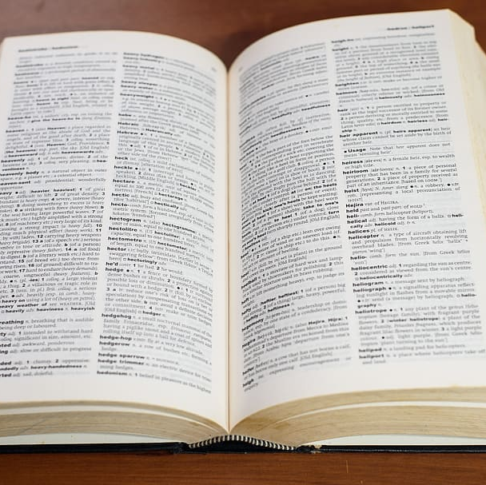
MO Regulation and SDI Defined…
…adapting, as appropriate, the content, methodology, or delivery of instruction to address the unique needs of a child with a disability to ensure access of the child to the general curriculum, so that he or she can meet the educational standards of the public agency that apply to all children.
…adapting to the needs of an eligible student relative to content, methodology, or delivery of instruction
To meet unique needs
Ensure access to the general education curriculum (in LRE)

Slide 6
Meet the diverse needs of all learners
Essentials for SDI implementation to meet unique student needs
Adapt Teaching Methods | Promote Engagement | Prevent Achievement Gaps
Notes:
Adapt Teaching Methods:
Adapt both teaching methods and materials
Learners vary in their readiness, interests, and learning profiles
Differentiation is one way to ensure each student receives the support they need to succeed
Promote Engagement:
Instruction methods tailored to diverse learning options so students are more likely to be engaged in the learning process.
Engagement enhances
Motivation and interest
Leads to a positive attitude toward learning
Increased participation in class
Prevent Achievement Gaps:
By addressing diverse learning needs:
educators work to close achievement gaps that may be due to difference in
socioeconomic status
language proficiency
other factors

Slide 7
What is SDI?

Slide 8
Back to the Definition:
Adapting Instruction As Appropriate
Content | Methodology | Delivery
Based on State Standards (priority standards) Relates to stated purpose and learning goals Encourages higher levels of thinking; working toward generalization | The instructional design of content and approach to instruction | How instruction is provided based on needs of the student Instructional strategies the teacher implements to support learning and engagement
Often intertwined

Slide 9
Adapt Instruction As Appropriate…
How does the student access the general education curriculum (i.e., accommodations, modifications, or pre-requisite skills)? | Is there a practice or method that proves to be more productive for this student when acquiring knowledge/skills? | How is this applied to the content that the student is learning? Is the instruction more explicit or systematic?
Examples: Decodable test on the same content Reading passages shortened *NOTE: content should be adapted for only a small percentage of students. | Examples: Chunking Multi-sensory phonics Math manipulatives that are additional to what is already being used with the class Scaffolded writing process with increased emphasis on planning and organizing. | Examples: Pre-teaching/re-teaching specific skills, content, or vocabulary Explicit step-by-step instruction for more comprehensive skills or tasks Speech to text software to support written idea development or evidence of comprehension
Notes:
Ashley

Slide 10
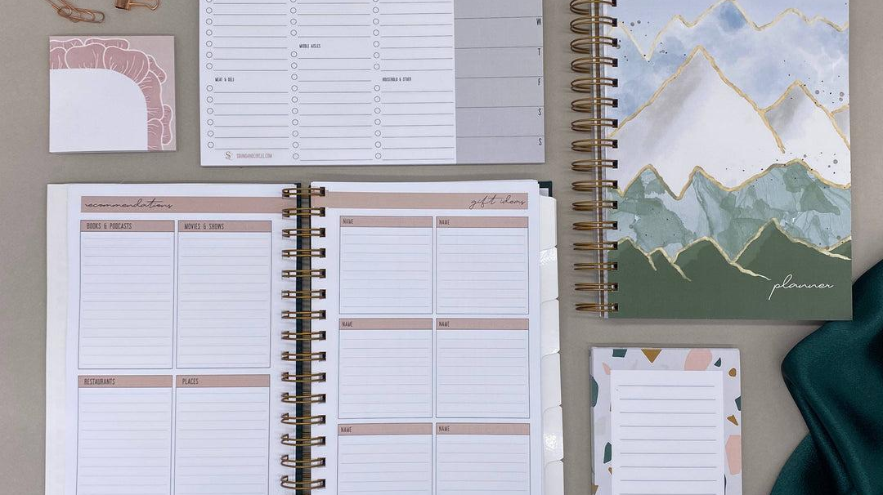
What makes it SDI?
Planned
Intentional
Organized
Systematic, structured process
Specifically addresses student needs as outline in the goals and objectives
What the teacher does, not what the student does
Frequently progress monitored
Notes:
Very Important

Slide 11
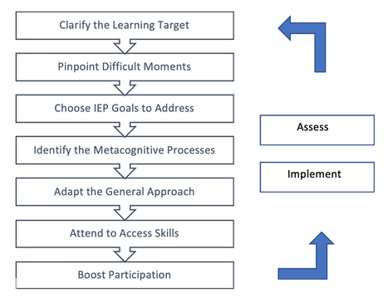
7 Steps
to consider as part of the planning process for SDI

Slide 12
Step 1
Clarify the Learning Target

Slide 13
Planning for Step 1: Learning Target
Always focus on the destination marker that help students on their learning journey.
Describe in student-friendly language:
the lesson-sized chunk of information, skills and reasoning process
Students should have this information at the start of the lesson.
Notes:
Students can see the lesson destination clearly and be able to answer the question: What will we accomplish today?
pg. 53

Slide 14
Considerations
Foundational | Reflect on Missing skills Prior Knowledge (or lack of) Incomplete processes that may interfere with success Language barriers, poor attendance
Learning Goal | Reflect on grade-level expectations of the curricula; priority standards
Cognitive Complexity | Plan for Rich content Deep thinking that extends their experiences Keep them engaged (decrease boredom
Notes:
Students may need targets on more than one level. Teachers need to be plan for multiple levels without overwhelming students with too many learning targets. One or two will bring about focus, three or more will blur the view.
pg. 53

Slide 15
Achievement Feels Good!
All stakeholders work together with clarity of purpose in actionable chunks
Improves student’s ability to self-regulate, monitor progress and redirect efforts to a task
Students see micro-progress
Achieving even a small goal releases dopamine. This neurotransmitter makes us feel good, but also boosts memory, attention span, ability to sustain effort, perseverance and motivation.

Slide 16
Learning Targets should be written with flexible verbs
Students should be able to answer the question: What will we accomplish today?
Flexible Verbs | Constrictive Verbs
Produce Show Compute Share Communicate Select Judge | Diagram Draw Add/Subtract State Pronounce Outline Diagram
Notes:
Remember learning targets are actionable chunks in student-friendly language. Students should be able to answer the question: What will we accomplish today?
Clarity of learning targets is critical, especially when co-planning or co-implementing with others. When learning targets are interpreted differently, instruction may go in several directions leaving students confused, frustrated and disengaged.
Co-teachers
Paras

Slide 17
Planning for Step 2
Pinpoint the difficult moment students may experience

Slide 18
Guiding Questions to identify difficult moments
By asking the right questions early in the process, we will be able to prioritize and focus.
Guiding questions can elicit valuable thought and discussion
Notes:
Teachers may rely upon past experience when they’ve taught the lesson or concept before. However, there are many case where a teacher is brand new to a content or grade-level, there is a new co-teaching team assigned, or a new special education teacher has started a role and trying to incorporate SDI.
The handout is a series of guiding questions to try to pinpoint the difficult moments.
pgs. 61-62

Slide 19
Guiding Questions
What has been a challenge for students when this lesson was taught in the past?
What might be the root cause of any difficulties?
Are there foundational vocabulary terms that are necessary?
Are there prerequisite skills some students are missing?
Is there a lesson component where students might get bogged down?
Are there accessibility concerns for our students with disabilities?
Are there lesson components that require skills such as fine-motor, visual processing or sustained attention?
Is there anything that might be confusing?
What does our student data tell us might be challenging?
Are there moments when some students will need intensive adult intervention?
Is there any other data we should look at before proceeding with our planning?
What other questions does this raise?

Slide 20
Formative Data
Classwork
Pre-tests
Surveys
Exit Tickets
Observations
Homework
Self-assessments
Parent input
Student interviews
Short quizzes
Show of hands
Project work
Progress-monitoring data
Standardized assessments
DATA
Notes:
These formatives must connect with instruction. Little will improve if we don’t adjust based on the data

Slide 21
Planning for Step 3
Choose IEP Goals to address during the lesson or lesson series

Slide 22
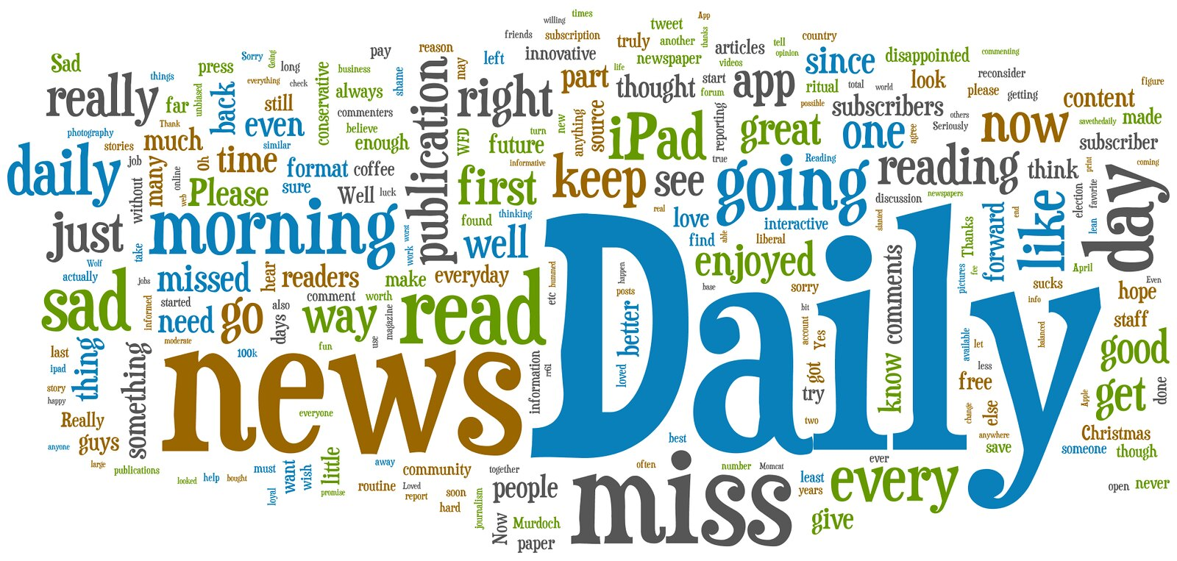
Daily Mantra
A daily mantra for a special educator should be:
What IEP goals am I working on?
What am I doing that is special?
Notes:
The role of a special education teacher is complex and incorporates dozens of tasks. The most important of those tasks is to provide specially designed instruction to help students meet their IEP goals.
If general education practices were 100% effective for students with disabilities, they would not have an IEP. Therefore, whether services are provided in separate or integrated settings, those services should look different than what you would see from a general educator. “The common misconception-that good to-teachers become clones of each other-often results in poor outcomes for students.” (Beninghof 2015, p.10).

Slide 23
Planning for Step 4
Identify Metacognitive Processes that Successful Learners Use

Slide 24
What is Metacognition?
“Thinking about our thinking…”
This is a broad term that refers to a person’s awareness of how they think and learn.
Notes:
Starts on page 73 of the SDI book
Researcher, John Hattie, says “metacognitive skills are one of the ultimate goals of all learning”. Adults with strong metacognitive skills can think through a problem, consider and choose from alternative strategies and reflectively evaluate the outcome. This is a perfect match for what specialists need to do in order to implement SDI!

Slide 25
Adaptive Metacognition
…being able to change thinking in response to a wide range of variables.
Routine classroom activities have numerous variables because teaching is such a social interaction.
Therefore, teachers use adaptive metacognition on a regular basis.

Slide 26
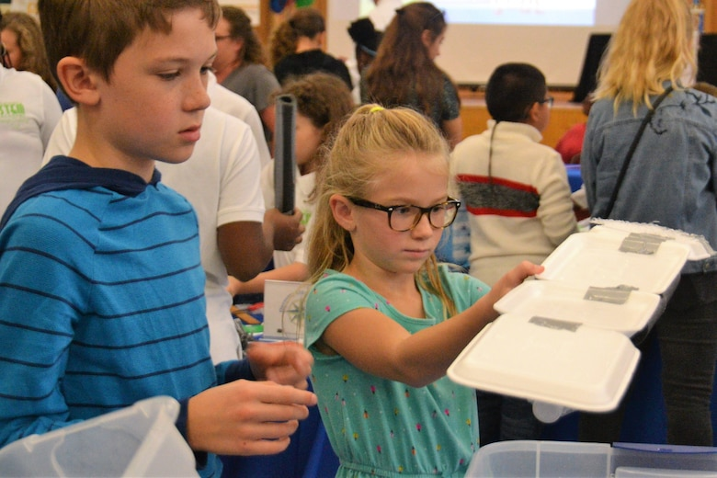
Inclusive Setting
In an inclusive setting, teachers may need to think about many various situations for individual students within a given classroom.
Examples:
Perceived germs
Vision supports
Mobility issues
Distractibility
Perceptions or misperceptions of control
Notes:
Samuel’s need to distance himself from perceived germs on furniture or peers.
John’s preferences for furniture that remains unmoved due to his low vision and mobility issues.
Annie’s visual distractibility as she enters an overwhelmingly busy room.
Joey’s perception that directions are always a negative, authoritarian control of his freedoms.
Susie’s social circle, viewed by her as a protective, life-saving group of friends that cannot be ignored.
These are just a fraction of the individual student variable teachers address throughout each day of school.

Slide 27
Growth Mindset
Regardless of the current metacognition functioning level, both students and teachers can improve their performance through:
Observation | Awareness | Strategy Training
Observe other teachers’ think alouds with students and compare them with your own metacognitive process. | Ask team members to share their thinking with you. Respond with questions to dive deeper into the thinking process rather than the outcome. Practice taking on the perspective of a specific student. How might they think about this? Then switch to another student’s perspective. | For Example: Summarizing Delay your processing of a just-read text before summarizing the information.

Slide 28
Planning for Step 5
Adapt the General
Approach

Slide 29
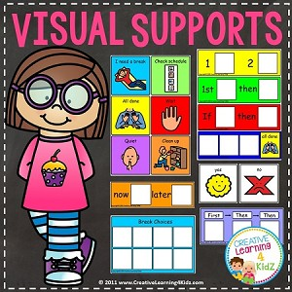
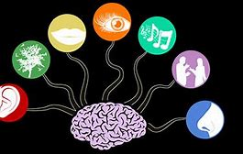
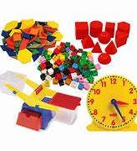
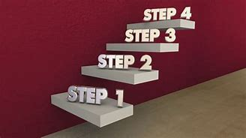
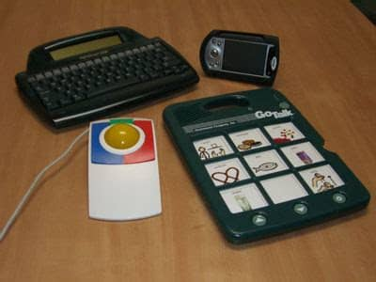
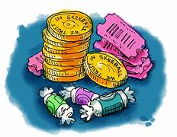
SDI Might Involve:
Other Ideas?
Notes:
To Say:
SDI may include any of these supports, but these are only examples. Have participants share additional examples.
Multi-sensory engagement
Manipulatives
Assistive technology
Visual supports
Task analysis
Scaffolding to gradual release
Explicit teaching
Anger management training
Positive reinforcers
SDI is certainly not limited to these supports. The IEP team should consider all of the unique educational needs of the student and design an individual plan to meet these unique needs.

Slide 30
Planning for Step 6
Attend to necessary access and executive function skills

Slide 31
Access Skill refers to…
…the skills we need to access the curriculum, but which are not explicitly represented by the academic standards.
Things that make you go hmmmm…
Notes:
Starts on page 73 of the SDI book
Researcher, John Hattie, says “metacognitive skills are one of the ultimate goals of all learning”. Adults with strong metacognitive skills can think through a problem, consider and choose from alternative strategies and reflectively evaluate the outcome. This is a perfect match for what specialists need to do in order to implement SDI!

Slide 32
Access Skill Examples
Scanning the departure board at the airport for information
Raising your hand in the classroom
Taking turns
Sitting up in your seat
Communication skills
Problem-Solving Skills
Gross/Fine Motor skills
Inter/Intra personal skills
Organization
Technology
Work Readiness
Also includes:
Missing pre-requisite academic skills needed for success
Struggling reader will have difficulty accessing the high school biology textbook (reading fluency will not be stated in the HS science standards but it is a challenge for students who do not have the skill)
Notes:
Starts on page 73 of the SDI book
Researcher, John Hattie, says “metacognitive skills are one of the ultimate goals of all learning”. Adults with strong metacognitive skills can think through a problem, consider and choose from alternative strategies and reflectively evaluate the outcome. This is a perfect match for what specialists need to do in order to implement SDI!

Slide 33
Executive Function = Umbrella Term
…Set of cognitive processes used to successfully navigate a complex situation
Notes:
Starts on page 73 of the SDI book
Researcher, John Hattie, says “metacognitive skills are one of the ultimate goals of all learning”. Adults with strong metacognitive skills can think through a problem, consider and choose from alternative strategies and reflectively evaluate the outcome. This is a perfect match for what specialists need to do in order to implement SDI!

Slide 34
Executive Function
The Center on the Developing Child has grouped these processes into three dimensions.
Planning Step 6
A. Beninghof,
pg. 100
Notes:
https://developingchild.harvard.edu/
Say:
All of these executive functions are necessary to be a successful students, yet they develop at various ages for students. The development of these skills is affected by our experiences and background opportunities from infancy through adolescence.
Our students with disabilities may be at a disadvantage due to situations that occurred prior to birth in their development. Thus, we have to create situations to help them learn these skills.

Slide 35
Planning for Access and EF Skills

Slide 36
Case Study: David
David was a thirteen year old, eighth grade student who has reading and math skills one to two years below grade level. He is failing every subject and seemed destined to repeat the eighth grade. His teachers described him as disruptive and oppositional in class and state that he had difficulty paying attention during structured and unstructured activities.
What might be some of the access or executive function challenges that exist for David?
Respond in the chat box
Notes:
Karla

Slide 37
Planning for Step 7
Build in specific methods to boost participation

Slide 38
Participation and Engagement
To help build a culture of participation and engagement, consider the following:
All stakeholders work together with clarity of purpose in actionable chunks
Improves student’s ability to self-regulate, monitor progress and redirect efforts to a task
Students see micro-progress
Questions to consider:
Why is the student not participating in the group?
What strategies or tools will lead to successful participation and engagement?
Is there a grouping that works best?

Slide 39
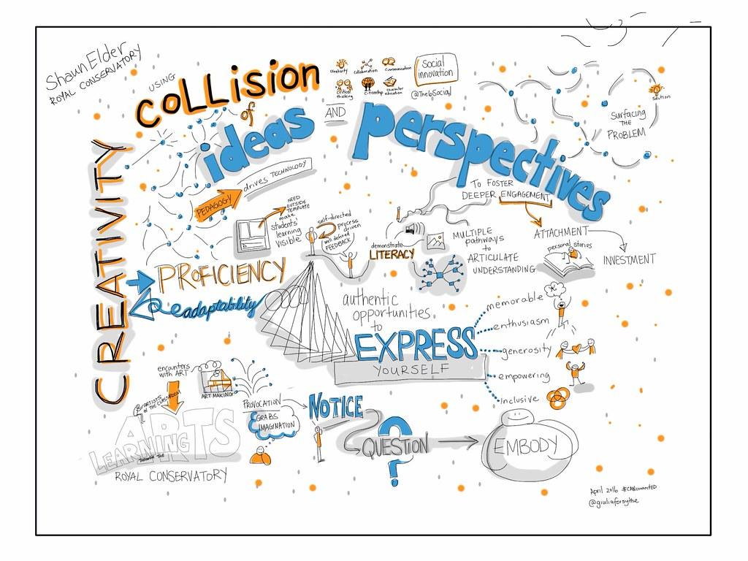
Engagement Boosters
Engagement Booster | Reflective Questions
Emotion | How will the student feel during the lesson? Do students feel accepted in the classroom? Does the environment feel safe for risk-taking?
Interest | Does this tap into student interest? Have I built in choices for students? Is the learning task “game-like” or fun? How can I use questioning techniques to pique interest?
Importance | Have I conveyed the importance of the learning target? Do students see it as important? Is there a way to tap into pop culture or contemporary issues? Is there a way to make it more authentic?
Efficacy | Does the student feel they can accomplish the task? Have I built in scaffolding and supports? How are students monitoring their growth?

Slide 40
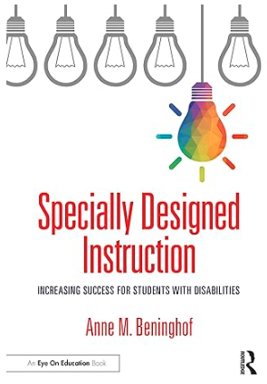
Resource Books
Notes:
Carrie

Slide 41
Thank you for participating today!
Carrie Turner, KC-RPDC
Berkley Rosenquist, SE-RPDC

