Slide 1
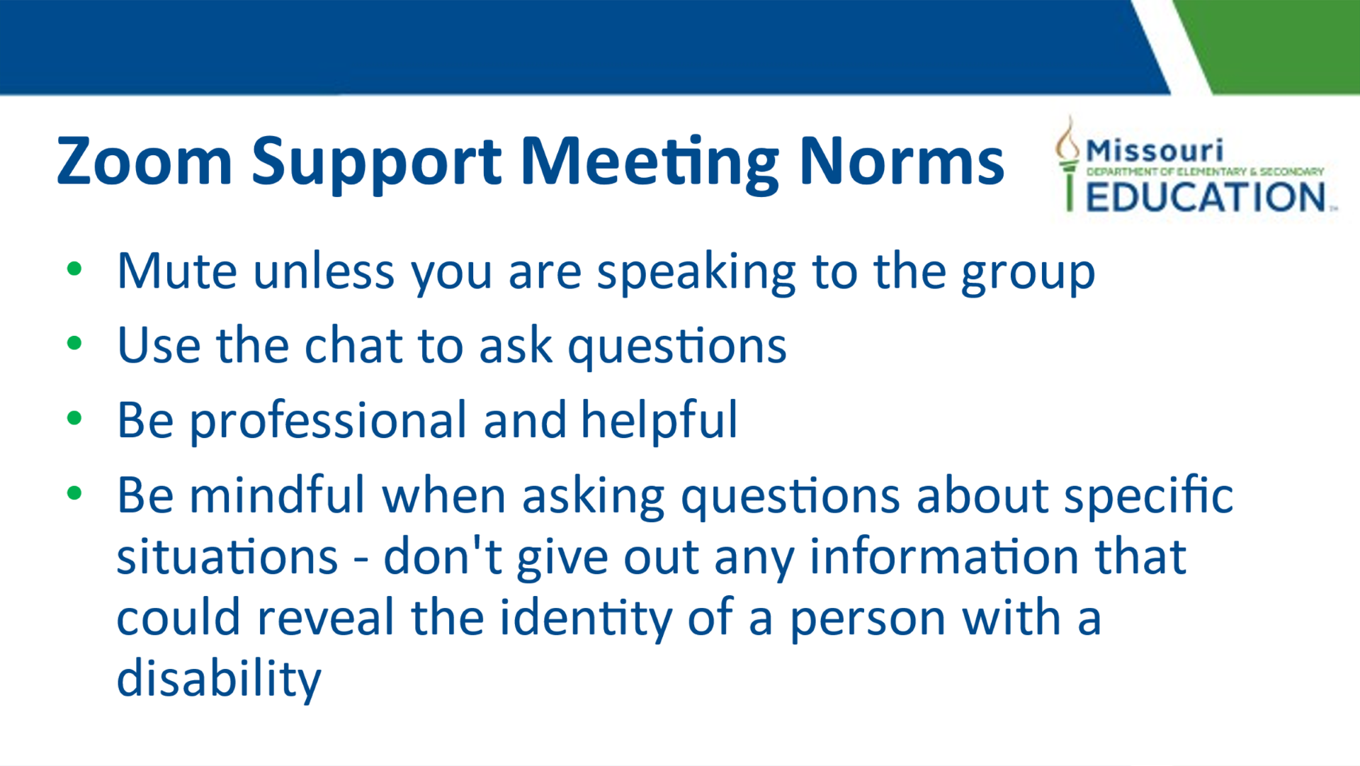

Slide 2

Introducing the Role of: Behavior Consultant
Supporting your behavior needs
January 2024

Slide 3

Supporting Educators
Put very simply,
we are here to support the educators in our regions.
Assisting in improving academic and behavioral outcomes for all students, with the development and implementation of effective behavior management strategies.

Slide 4

Providing Technical Assistance on:
Defining and measuring behavior
Understanding principles of behavior change (including but not limited to: reinforcement, consequences, and environmental factors);
Methods and approaches for teaching appropriate replacement behaviors
Implementing strategies for weakening undesired behavior
Identifying antecedents and triggers; and maintaining consequences.

Slide 5

Functional Behavior Assessments and Behavior Intervention Plans
We can train your school-based team on best practices of conducting an effective Functional Behavior Assessment and designing and implementing successful Behavior Intervention Plans that address classroom organization, effective instruction, social skills instruction, executive function instruction, and behavior modification.

Slide 6

Effective Behavior Management Practices
We can train individuals or groups of teachers/district personnel on effective behavior management practices, such as determining the function of behaviors and developing, implementing and monitoring behavior interventions using efficient and effective data collection methods.

Slide 7

Research-Based Practices
We can provide professional development that targets research strategies and modeling of instructional practices to support teachers in providing behavior supports in their classrooms.

Slide 8

Data-Driven Decisions
Train district administrators to:
Review behavior referrals and reports to look for data trends.
Review discipline data including out-of-school and in-school suspension (OSS and ISS) reports to identify trends and alternatives to OSS and ISS for students.
Train staff to use individual students’ behavioral data to identify trends and develop specific behavior supports to include in IEPs.

Slide 9

Providing Professional Development on topics such as:
Classroom Management Practices
Addressing challenging student behaviors through behavior assessment and special education services
Conducting an effective Functional Behavior Assessment (FBA) and Behavior Intervention Plan (BIP)
Social-Emotional Learning Practices
  Assertiveness
  Self-efficacy
  Self-regulation
  Conflict management
High-Leverage Practices

Slide 10
We customize our training to address needs related to the specific behaviors occurring in your district.

Slide 11
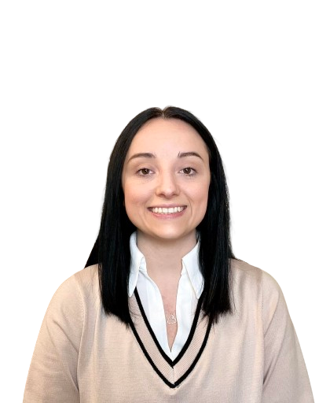
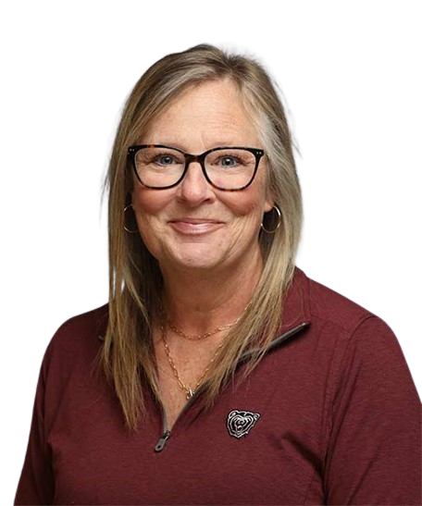
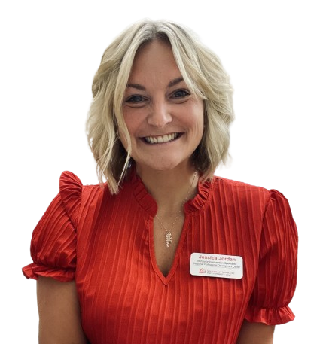
Meet Your Team
SE Region
SW Region
NW Region
Jessica Jordan
jjordan@semo.edu
573-521-8004
Mikelle O’Neal
mikelleoneal@missouristate.edu 417-836-6465
Emylee King
eking@nwmissouri.edu
660-562-1995

Slide 12
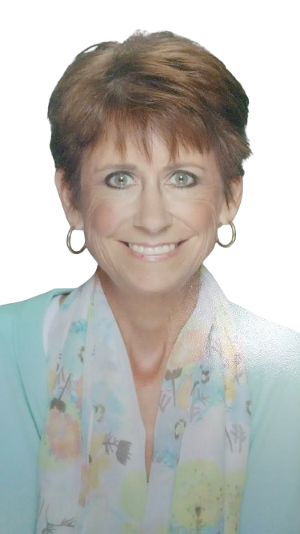
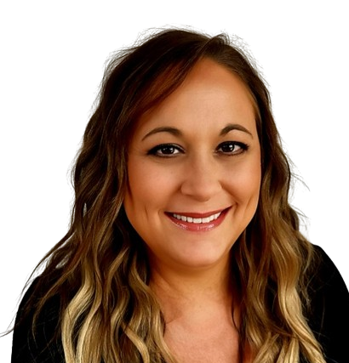
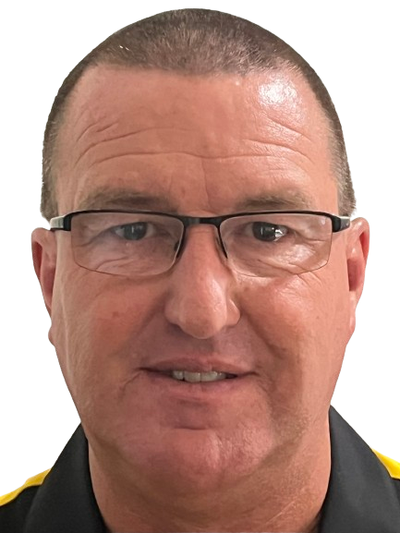
Meet Your Team
NE Region
UCMO Region
Heart of MO
Kelly O’Laughlin
kolaughlin@truman.edu
(660) 785-4310
Scott Schmitt
scottschmitt@ucmo.edu
(816) 335-5969
Jenessa Dodson
jenessadodson@missouri.edu
(573) 882-0859

Slide 13
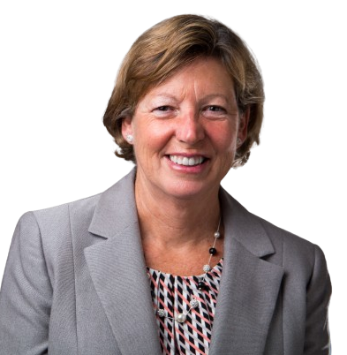
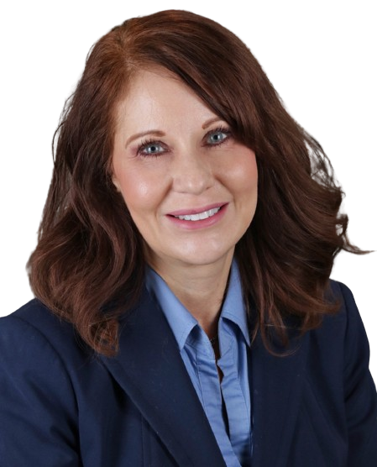
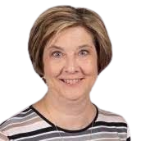
Meet Your Team
KC Region
St. Louis Region
South Central Region
Kathy Growney
growneyk@umkc.edu
913-449-4541
Nicole Conaway, Ed.D.
nconaway@edplus.org
(314) 629-1200
Susan Jadwin
sjadwin@mst.edu
(573) 341-6818

