Slide 1
Components of Effective Literacy: Introduction
Notes:
To Say: The purpose of this training is to introduce the components of literacy as anchored in the science or reading. There are 6 other modules that are designed to address the elements skilled readers possess as well as the instructional components necessary to produce success in reading. Each session is designed to be completed sequentially.

Slide 2
Learner Intentions
Participants will
Consider the research behind the “Simple View of Reading”
Understand the inter-related skills needed for developing skilled readers according to the “Reading Rope”
Explore the “Science of Reading” and the “Reading Brain”
Examine the use of the Diagnostic Decision Tree to determine where to begin instruction for struggling readers.
Prepare to gather information to align our instruction for reading with the evidence of ‘What Works’ in Reading instruction.
Notes:
MB
To Know: This module will be the first in a series of the research based modules that will address phonological and phonemic awareness, phonics/ spelling connections, assessment, vocabulary, comprehension, and writing.
To Do: Review the learning intentions for the day.
To Say: These are our learning intentions for this module. By the end of the module you will understand the importance of the Simple View of Reading int terms of how it impacts reading instruction. You will understand the inte-rrelated skills of the reading rope and how it related to the Simple View of Reading. You will see how our brain processes reading, understand where we need to begin instruction for struggling readers and find out what the research says in necessary to teach reading.

Slide 3
Missouri Teaching Standards
The following Missouri Teacher Standards will be addressed today:
Standard #1 Content knowledge aligned with appropriate instruction
Standard #2: Student Learning, Growth and Development
Standard #3: Curriculum Implementation
Standard #7: Student Assessment and Data Analysis
Notes:
MB
To Know: These are the teaching standards we will address today.
To Do: Direct participants to the slide.
To Say: If you need to document for your professional development reference, here are the Missouri Teaching Standards that we will be addressing today. I will pause a moment while you note these if needed. We will address Standards #1, 2, 3, and 7

Slide 4
Norms
●Be Present
●Mute your Mics
●Questions in chat box
●Have open heart and open minds
Notes:
To Know: There are norms for virtual or face to face but please place the norms that fit your group into the slides so that all attending are comfortable and ready to learn hitting the expectations needed for the building or district.
To Do: Use Norms and Expectation that fit the group and situation.
To Say: Today we are going to ask that you be present with us considering how this learning ‘fits’ into what you already do. It will either confirm some things you are already doing or it might push you to consider what might be different according to research on what works in the world of literacy development. Please mute your mics and put your questions in the chat box. They will be captured for a FAQ document
. As you open your mind up to confirm your practices or align your practices with research, we know it takes a stretch or patience and a heart for doing what is best for students. We deeply appreciate your professional passion and drive to share, learn and apply for student success.

Slide 5
How Hard Was Learning to Read for You?
Notes:
In the chat box share with a number how hard learning to read was for you. With 1 very easy you barely remember not reading and 5 being it was extremely difficult; you needed additional help through either a Title One reading program, remedial reading, special education services. Ther are many different journeys to learning to read, some of us had it easy and learned without a struggle it was a smooth journey and you felt like you were propelled by a motor while you sat in in the shade with a cool beverge, enjoying the experience, others the journey was more arduous, you were tossed around in a strong current, rowing with all your might while someone shrieked directions at you and the sun beat down on you relentlessly
According to the educator and author by Nancy Young, 5% learn to read with very little effort. For another 35% learning to read is relatively easy with broad instruction.
However 40-50% require code-based explicit, systematic and sequential instruction to read at proficiency.
and for the remaining 10-15% they require code-based explicit, systematic, sequential, diagnostic instruction with many repetitions to read at proficiency.
All these students can benefit from a structured literacy approach. But that lower 50-65% require it.
In special education we primarily deal with a student population that requires a very structured approach and that is what Science of Reading is about.

Slide 6
What Does This Mean to You?
“No Equity without Literacy.”
Notes:
I had an opportunity to hear Kareen Weaver give the keynote at the Reading Leqgue Virtual Conference is 2021. This is a quote from his keynote that really resonated with me. I want you to think about what this quote means to you. He went on to say If your literacy program is not getting the most number of kids to literacy, then it is you that needs to change your approach, not the students. There can be no equity, no social justice, without literacy.”
Consider the long-term implications of literacy; or the lack of literacy : according to Project Literacy, 43% of adults living in poverty have low literacy levels; even more startling are statistics from the U.S. Department of Justice linking incarceration and illiteracy, with an astonishing 70% of incarcerated adults unable to read above a fourth-grade level. Our children’s life outcomes literally depend on solving literacy instruction in our classrooms and allocating the right resources for early identification.

Slide 7
Reading Research
Notes:
To Know: This is the Section Header
To Do:
To Say: Let us start with the research foundation.

Slide 8
Simple View of Reading
D X LC = RC
Decoding Word Recognition
Language Comprehension
Reading Comprehension
Gough and Tunmer (1986)
Notes:
To Know :The Simple View of Reading is a formula demonstrating the widely accepted view that reading has two basic components: word recognition (decoding) and language comprehension.
To Say: The Simple view of Reading is a formula demonstrating the widely accepted view that reading has two basic components: word recognition (decoding) and language comprehension. The Simple View formula has been supported and validated by a number of research studies. Understanding the formula will help educators with assessing reading weaknesses and providing appropriate instruction.
In this model, D - Decoding which is defined a “efficient word recognition” and LC, listening comprehension or the ability to derive meaning for spoken words are multiplied together to get RC which is reading comprehension. Reading Comprehension is defined as the ability to perceive words and derive meaning from print.
Notice the formula is one involving multiplication not addition.That’s important because it means this: when one is weak, you can’t just compensate with a heavier dose of the other. A student needs both to be a successful reader. Reading comprehension scores will NOT be an average of decoding (D) skills and language comprehension (LC).
Intervention for struggling readers is effective only when it addresses the student’s specific weakness, which may be decoding, language comprehension, or both.
Intervention instruction focused on developing content knowledge or comprehension strategies will benefit struggling readers only if they have a weakness in language comprehension.
Struggling readers of all ages can have decoding weaknesses; explicit instruction in decoding will be necessary to improve their reading comprehension.

Slide 9
Examples of the Simple View
The snables tramped the mengs to the dwip. The dwip fropped. The mengs clambed a sib boogle. The snables gicked and gicked.
Notes:
To Say: Let’s see what the simple view of reading means. D or decoding is the first line at the top of the page. Can you decode and read that for me? It is a simple phrase, something you should recognize and know we say it every day. It is something that should be in your sight vocabulary. But this probably looks like Greek to you, precisely because it is Greek. It is not something that is familar to us. We can’t decode it because we do not have word recognition skills in Greek. If we saw this everyday for a long time and were told what it meant. We may get to the point that we could recognize it and remember it. But when your Decoding skills are low - it is almost like you are reading another language. The squiggles on the paper hold no meaning for you. This phrase is the Thank You in Greek. I might in a few days of looking at these Greek letters memorize the phrase and be able to “decode” it when I see it because it is in my visual memory. But it would not help me sound out anything else.
Now lets say you are able to decode words but have low language comprehension. I want you to read the bottom short paragraph about snables and I am going to ask you some comprehension questions. Use your reaction button to raise your hand and we will ask you to share out your answer.
What did the snables do to the mengs?
What di the dwip do?
What did the mengs clambed?
So then what did the snables do?
Because of your understanding of phonics, grammar and sentence structure, you were able to answer some low level comprehension questions. But did you have a clue what you were reading. Did any of those words carry meaning? Could you answer questions like this Is fropping dangerous? Would the mengs be upset about being tramped? No clue because you are not able to derive any meaning from that short paragraph, because you do not have the necessary language comprehension skills.

Slide 10
Simple View of Reading
D X LC = RC
Decoding
Word Recognition
Language
Comprehension
Reading Comprehension
.50
x
1
=
.50
Notes:
To Say: In the Simple View formula, the values of D and LC must be between 0 and 1 (or 0% and 100%). A score of 0 means no skill or ability at all and 1 indicates perfection. A student’s reading comprehension will always be significantly impacted by their lowest area An example of that is a student who has poor decoding skills. Let’s say they struggle with long vowels and consonant blends and would score at .50 in decoding/word recognition. But this same student comes from a family that has opportunities to visit zoos, museums and different locations. Their parents have always read to them and because of that they have many experiences to draw from and great language comprehension skills and score at 1 in Language Comprehension. When you multiply the .50 by 1 you will get an overall reading comprehension score of .50. They are going to struggle until we address the decoding/word recognition skills.
The Simple View formula makes clear that strong reading comprehension cannot occur unless both decoding skills and language comprehension abilities are strong.
We must teach students to decode expertly as early as possible. When students can decode expertly, their reading comprehension capabilities equal their language comprehension abilities.
We must provide students with strong content knowledge in many domains at all grade levels in order for them to develop adequate language comprehension abilities.

Slide 11
Reading Rope
Hand-out #1
Notes:
To Know: You will follow the DIrections for the Reading Rope to explain the elements of reading. (Estimated TIme: 8 minutes)
To Do: Provide the supplies for making the Reading Rope.
To Say: To really get more explicit with reading we get into Scarboroughs reading rope. It defines Word Recognition and Language Comprehension into specific skills.
Word Recognition is where most of the problems are in reading - most students who have difficulties in reading have difficulties in word recognition or decoding.
Phonological Awareness is the ability to recognize and manipulate the spoken parts of sentences and words. At the very lowest level it is understanding individual words make up a sentence. The Bear Ate My Lunch – hop to each word It includes such skills as Blending b/a/t makes bat Substitution Say Park now instead of /p/ use /m/ Mark
Decoding is the letter to sound symbol relationship – phonics knowing that the letter A makes the a and a sound, knowing that ch makes the “ch” sounds
Sight Recognition is the words that students already have in their word repertoire and it varies for each student, when the are young often fewer words– possibly their name, McDonalds and more as they get older. making reading more automatic
In Language Comprehension it involves the understanding of words and how we use words
Background Knowledge: What you bring to the reading. - Just think how hard It would be for you to understand a story about baseball if you did not know what a homerun was. Think of what you know about the word homerun – does it mean you run to your house? So in a story about a game, people are cheering when you left the game to run to your house.
Vocabulary is about the knowledge of words that you use, in listening, speaking, reading and writing
Language Structure: Is understanding how sentences are formulated is how you were qble to answer ? About snables
Verbal Reasoning: similes and metaphors
Literacy Knowledge: Reading from Left to Right up to down Reading a mystery different from reading a text book - hold

Slide 12
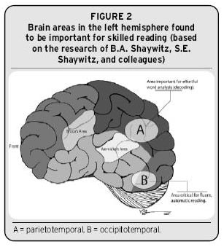
Brain Imaging and Reading
fMRI
Sally Shaywitz
Brain activation
Reading Rockets
Notes:
To Know: Current research has begun to reveal where the processing occurs inside the brain.(Papanicolaou, Pugh, Simos, and Mencl (2004) and Richards (2001) have great descriptions.
To Do:
To Say: Brain imaging provides us with the reality of what actually happens inside of a person’s brain as they read.
They way an MRI works is that it will light up to show regions of the brain where blood flow (activity processing) is happening. Advances in MRI have led to what we call fMRI which map which sections of the brain are active.
Sally Shaywitz was the first to find that you can actually look at the brain to find which areas are linked to reading. The portions of the brain that are activated during reading ‘light up’ when reading and will appear during an fMRI (Functional Magnetic Reasoning Image). Images of the brain taken during reading tasks with strong readers looks different than those who are struggling readers. This led to even more studies looking at brain activity.
More information below if needed:
Researchers have used (fMRI) Functional MRI which allows people to stay alert and perform tasks while under the magnet. The image can reveal which sections of the brain light up due to activity. The fMRI can document the different areas of the brain that is activated with different readers.
Several studies using functional imaging techniques that compared the brain activation patterns of readers with and without dyslexia show potentially important patterns of differences. We might expect that readers with Reading Disability would show underactivation in areas where they are weaker and overactivation in other areas in order to compensate, and that is exactly what many researchers have found (e.g., Shaywitz et al., 1998). Shaywitz found that the brain uses the same regions while reading sharing the same patterns. Poor readers do not show those necessary patterns. But those patterns can be formed with good instruction.

Slide 13
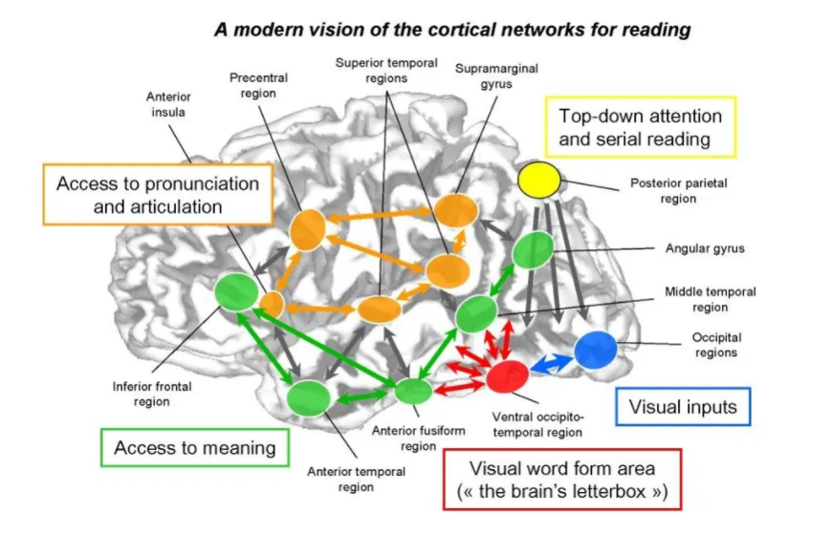
Dr. Stanislas Dehaene “Reading in the Brain”
Notes:
To Know: Dr. Stanislas Dehaene has completed multiple studies on the brain and published the book "Reading in the Brain". For more information: https://www.youtube.com/watch?v=25GI3-kiLdo&t=72s and https://www.youtube.com/watch?v=MSy685vNqYk&t=259s
To Say: Dr. Stanislas Dehaene has completed multiple studies on the brain and has found how several areas of the brain are used to read, speak, process letters, sounds and words. He also has found that the pathways needed for reading can be found in all readers of all cultures in the same locations. Poor readers do not have those same activation areas yet, those areas can be rewired to activate with intervention and instruction.

Slide 14
Notes:
To Know: Simos et al, 2005 documents how intervention can rewire the brain.
To Do:
To Say: In this photo, you can see the difference intervention makes with an at-risk reader. More parts of the brain are firing and in the appropriate areas needed for literacy. Take a moment to notice the difference in the left hemisphere, it now more closely resembles the activity seen in good readers.
https://www.commlearn.com/dyslexia-and-the-brain/

Slide 15
Looking at the Reader
Notes:
To Know: This is the Section Header
To Do:
To Say: We have talked about reading, so now we are going to switch and begin thinking about the reader.

Slide 16
Characteristics of Poor Readers
difficulties with accurate and/or fluent word recognition
poor spelling and decoding abilities.
can actively be a part of conversations understanding content well when text is read aloud and discussed
poor reading comprehension
reduced knowledge of vocabulary and background knowledge
Notes:
To Know: Begin thinking about the student characteristics.
To Do: If virtual have participants annotate the ones that are true for them or place in the “Chat” how many out of 5 characteristics do they see?
To Say: When we asked teachers to come up with characteristics of poor readers these are skills thye ofen came up with. Do they look familiar to you?
Definitions:
Fluent word recognition: the ability to recognize words automatically, accurately, and quickly
Decoding: Understanding the predictable relationship between the sounds of spoken language, and the letters and spellings that represent those sounds in written language.
Reading Comprehension: The ability to derive meaning from print
Background knowledge: What a student brings to the reading experience, their personal knowledge and experiences regarding the topic

Slide 17
More Characteristics
Slow, choppy, inaccurate reading
Guesses words based on shapes (house/horse, breakfast/basket)
Correct letters/incorrect sequence (from/form, stop/spot)
Inserts or omits letters
Skips or misread prepositions (of, at, to)
Poor decoding skills
Struggles to read the same word in multiple places on the page
Confuses vowel sounds (bat, bet, bit)
Notes:
To Know: Consider other common difficulties struggling students exhibit.`
To Do:
To Say: Do you recognize any of these? Are these reasons students are referred for testing in your district?
All of them are characteristics of poor reader, whether or not they have an IEP or a 504 plan, whether or not they have been identified as dyslexia. However, not all poor readers struggle with all of these characteristics. But, all of the ones we have shown on this slide and the one previous can be remediated with instruction, support and practice using routines and strategies from the science of reading.

Slide 18
..difficulties with accurate and/or fluent word recognition ... poor spelling and decoding abilities. These difficulties typically result from a deficit in the phonological component of language that is often unexpected in relation to other cognitive abilities and the provision of effective classroom instruction. Secondary consequences may include problems in reading comprehension and reduced reading experience that can impede growth of vocabulary and background knowledge.”
Notes:
To Know:
To Do: Allow time for participants to read the slide.
To Say: Now let’s compare what you marked as characteristics of struggling students to the characteristics on this screen. How many do you see here are on our list?
Pause for participants to read.
What we see here is the reality that students who struggle with reading carry the same characteristics.

Slide 19
“Dyslexia is a specific learning disability that is neurobiological in origin. It is characterized by difficulties with accurate and/or fluent word recognition and by poor spelling and decoding abilities. These difficulties typically result from a deficit in the phonological component of language that is often unexpected in relation to other cognitive abilities and the provision of effective classroom instruction. Secondary consequences may include problems in reading comprehension and reduced reading experience that can impede growth of vocabulary and background knowledge.” (IDA/NICHD, 2002)
Notes:
To Know: This is the official definition of dyslexia. (International Dyslexia Association, National Institute of Child Health and Human. Development, 2002)
To Do: Be intentional to pause for understanding and reading of the slide.
To Say: What do you notice? (Wait for reflection of participants)
This is the official definition of dyslexia. (International Dyslexia Association, National Institute of Child Health and Human Development, 2002)
Neurobiological means -- of the brain. The research has proven to us that there is a neurobiological signature for dyslexia that is found in the brain even before a child enters school.
The rest of the definition, stating the academic characteristics are in-line with the same characteristics we posted a few slides earlier.
Not all of the students who display these difficulties actually have dyslexia.
There are several factors that could impact these. Possibly lack of connection or attendance in school, limited opportunities to engage in the foundational instruction needed for reading, or lack of direct, explicit instruction. In some cases, the student was not taught with intentional instruction due to lack of training.
Research has proven that good reading instruction is good reading instruction and the use of targeted, direct, explicit instruction ‘rewired’ portions of the brain so they were being activated for successful reading. This in turn reduced and often removed most the characteristics found here in this definition.
These practices changed the progress and reading trajectory of students exponentially.
MORE INFORMATION FOR YOU if needed:
There are three other indicators that a person might have dyslexia according to clinical considerations.
others in the family have a history of difficulties learning to read or with literacy
assessments indicate limited short term memory
assessment indicate slower processing speed
The definition and the three factors above are very evident in many of our students with a reading disability. The way we support, instruct and intervene can change the learning for all these students. Many of our SLD students can show unexpectedly strong abilities in other areas of learning (music, building, painting, oral discussions, hands-on performance, etc.. )but struggle to read, write, spell or retain vocabulary without multi-modal instruction.

Slide 20
State Standards?
Notes:
To Say: One of the challenges we face with poor readers is how to address grade level standards?

Slide 21
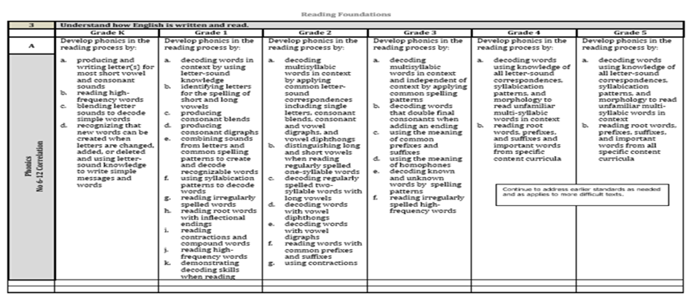
Reading Foundations
Notes:
To Know: This slide represents Reading Foundations in our Missouri Learning Standards.
To Do: Point to the little box.
To Say: Here is a snapshot of our Reading Foundations out of the Missouri Learning Standards. This comes straight from the DESE website and is what the MAP and EOc tests are based on. Have you noticed what that little box says to us? Let me show you on the next slide.

Slide 22
Continue to address earlier standards as needed and as applies to more difficult text.
Notes:
To Know: This is the little box highlighted on the previous slide but enlarged to read clearly. The words are directly off the Missouri Learning Standards.
To Do: Allow participants time to read the slide.
To Say: Here is what that little box says. (Pause) We are charged with this notice in the elementary standards. Phonemic awareness does not naturally develop in some readers and all readers need this to become a successful reader. As students move into more difficult text with longer sentences and multi-syllable words, we find students can not decode or apply the skills.
It is part of our curriculum to go back and ‘teach’ the skills as it applies to more difficult text.
Where are we carving out, devoting and ensuring this for our students?
What do you have in place?
Is it more difficult in upper grades to address?

Slide 23
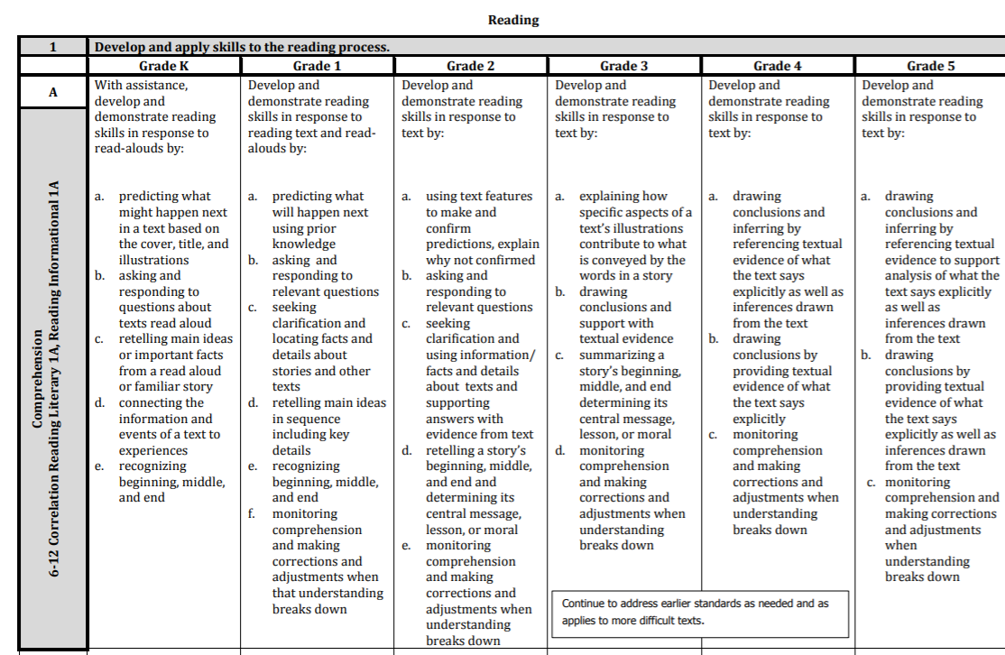
Notes:
To Know: This is the first section of the Missouri Learning Standards adopted in 2016.
To Do:
To Say: Do you notice that same little box on the Reading Standards? (advance slide)

Slide 24
Continue to address earlier standards as needed and as applies to more difficult text.
Notes:
To Know: This is the little box highlighted on the previous slide but enlarged to read clearly. The words are directly off the Missouri Learning Standards.
To Do: Allow participants time to read the slide.
To Say: Yes. This little box reminds us to ensure literacy development across different genre.
We must remind ourselves to be intentional with the lens of grade level vocabulary.
Students need to be able to access grade level text using quality grade level questions. As we provide an instructional level text, we still ask questions using grade level vocabulary even when using a lower level readability.
When we select a text for readability for a student or look to select an instructional level text, we are frequently accessing a text with questions for that level of a reader. We need to be intentional that the questions and vocabulary used in those questions reflect the grade level.
For example: A student in fifth grade reading on a third grade level needs to be asked questions using the vocabulary and items from the fifth grade standards skills such as comparing and contrasting the roles and functions of characters or explain the conflict and resolution in a story. Another caution here is that we must ensure that students can access the language of the standards as they move into different genre.
Skills might need more direct, explicit instruction as the text becomes more complex.

Slide 25
Reading is learned developmentally,
not by grade level.
Notes:
To Know:
To Do: Pause for participants to read and digest.
To Say: Reading is a developmental process. Students do not learn to read grade by grade as standards state. .
We won’t be able to make progress unless we take time to go back and fill in those holes and recognize what makes the difference for that reader. Every student can learn; not on the same day, not in the same order...We need to determine if they have deficits in decoding or language comprehension or both and target their specific deficits to make progress. Even students in middle school and high school may need work in phonemic awareness to fill in some of their reading gaps.

Slide 26
Research to Practice
Notes:
To Know and to Say: We must be intentional about how we connect our daily practice in meaningful steps for application. We must understand what the science of reading is telling us about how students learn to read and utlize those practices in our day-to-day instruction
To Do: Move to the next slide.

Slide 27
The Science of Reading is Not….
A boxed curriculum or program for sale.
The newest and latest fad.
Notes:
In Missouri you will hear over and over again in amy conversation about reading, “Does how you are teaching reading meet the Science of Reading Guidelines?” It is what the literacy consultants train on. It is what LETRS training is all about. It is also what our components of effective literacy module is based on. So let’s start with what the Science of Reading is not.
It is not a boxed set of materials or a specific type of reading program or a curriculum. We are not here to sell you on a new reading series or tell you that you can’t use what you are currently using. But we want you to consider if your current reading series and your reading curriculum includes the explicit instruction in the essential components of reading. Currently many reading series are jumping on the bandwagon and touting how they are based on the science of reading; but on further reflection you may find that it is more a marketing ploy than actual research.
Remember you will have some students that learn to read; no matter how you teach it. But other students will need that direct, explicit instruction that covers the research on the Science of Reading

Slide 28
The Science of Reading Is……
Research based
Contains specific components that must be taught: phonological awareness. phonics, fluency, vocabulary & reading comprehension
Notes:
The Science of Reading is a vast interdisciplinary body of scientifically based research about how students learn to read. This research has been conducted over the last five decades across the globe. The research making up Science of Reading is derived from thousands of studies conducted in multiple languages. It has culminated in a preponderance of evidence to inform educators how proficient reading and writing develop; why some students have difficulty and how we can most efficiently assess and teach literacy.
The research was first released by the National Reading Panel in 2000. Most universities did not pick up on it and therefore did not change their practices to reflect it and scores of teachers did not learn about it. But the research is empirical and has been validated time after time over the last 20+ years since the report was published. It is considered settled science. Missouri has determined as has many other states that this is the approach they want used to teach reading.
The science of reading requires specific, explicit instruction is phonological awareness, phonics, fluency, vodabualry and reading comprehension.

Slide 29
Define the Terms
Phonological Awareness
Phonics
Fluency
Vocabulary
Reading Comprehension
Notes:
It is important that we speak the same language, as the modules in this instructional series will focus on these areas. So we will define them so we have a common understanding of them
Phonological Awareness is the sound structure of speech. It includes the ability to manipulate sounds from whole words to syllable and then to the individual sounds known as phonemes. Within phonological awareness you will find phonemic awareness which is the ability to the individual sounds/phonemes in words and being able to manipulate those sounds. It is different from phonics in we are just talking about sounds not letters. It is said that you can teach phonemic awareness in the dark because we are talking about just sounds not the letters. Although, we do not recommend that because often times students need to see the shape of the mouth or the placement of the tongue to make a specific sound. For instance the sounds /C/ /A/ /T/ are the sounds that make up the word CAT we do not talk about the letters CAT. There are many skills within phonological awareness that students must be proficient in to decode words. Many reading series do not teach phonological awareness long enough and at the advanced levels. Many of our students’ struggles in reading relate back to phonological awareness.
Phonics is the knowledge of attaching letters to sounds and the ability to apply that knowledge to decode unfamiliar words. Often times we do not teach phonics long enough. Research indicates that some students will need phonics instruction through 5th or 6th grade. It helps students recognize the patterns in our language. When students can understand the patterns they can more easily decode words.
Fluency is the ability to read with speed and accuracy and proper expression. A fluent reader does not have to stop and decode every word - most words can be read with automaticity. This way students can focus on what the text means. It is the bridge between decoding words and understanding what has been read.
Vocabulary includes both oral and reading vocabulary and includes the words we use in speaking and comprehending text or what we hear. Reading vocabulary refers to the words we comprehend in text.
Reading comprehension is the ability to understand and interpret what we read, It is the ability to drive meaning from print.

Slide 30
Combining Research to Practice
A large percent of at risk readers and students with severe reading disabilities can develop and maintain average reading skills when provided with the right kind of intervention.
Torgesen et al., 2001; Lennon & Slesinski, 1999; Shapiro & Solity, 2008; Foorman & Al Otaiba, 2009; Torgesen, Wagner, Rashotte, Herron & Lindamood, 2010; Truck 1994, 2003, 2004; Vellutino et al.., 1996
Notes:
To Know: There are many studies to validate the ability to change the reading trajectory of at risk readers or students who have met eligibility for a reading disorder. This is only a small number of researchers who have proven this to be a true fact.
To Do: Stay current on research
To Say: Numerous studies over the past 30 plus years has proven we can change students reading ability when we target the skills needed for intervention.
A large proportion of students at risk for reading difficulties and students with severe reading disabilities can develop and maintain normalized reading skills. The key is to inform all teachers in what good instruction looks like and which elements to focus in on for intervention.
I want you to think for a minute how much power there is in that statement. When we accept this research, that a large percent of at-risk readers and students with severe reading disabilities can develop and maintain average reading skills, then we no longer just accept poor reading scores. We no longer assume it is the student’s fault. We can no longer say, “Bless, their hearts, they are doing the best they can.” We can no longer hide behind a label of SLD in basic reading skills, reading comprehension and reading fluency. We know all to well what the research indicates a student’s future will look like if they are not literate. It requires us to continue working until we find that right intervention. It puts the responsibility on our shoulders if our students can’t read.

Slide 31
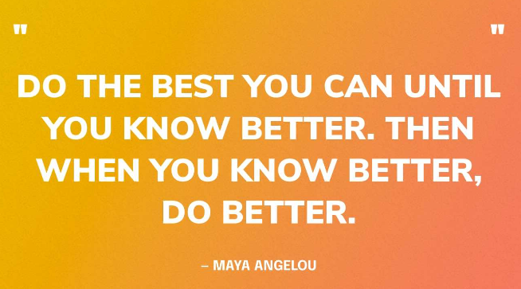
Research to Reality
3rd Grade: 58.6% EOC: 46.4%
4th Grade: 55.5%
5th Grade: 56%
6th Grade: 60.6%
7th Grade: 62.1%
8th Grade: 57.5%
Notes:
This is what our current reality is in Missouri. These are the spring 2022 MAP/EOC Scores in ELA. The spring 2023 MAP/EOC scores have not been released. These scores show the percent of students scoring at the below basic and basic levels. Lets reflect back on what the research told us.
“A large percent of at risk readers and students with severe reading disabilities can develop and maintain average reading skills when provided with the right kind of intervention.”
Right now a large percent of all or our students are not demonstrating an average reading ability as indicated by the MAP/EOC. We know that things have not been easy the past few years and they are still not easy. We are not here to berate or make anyone feel bad, just a reminder that research says that we can do better and if we accept the research; then we don’t stop trying to get better. Like the quote from Maya Angelou (Click) “Do the best you can until you know better, then when you know better, you do better.”

Slide 32
Poor comprehension
goes back to fluency
Poor fluency
goes back to word recognition
Poor word recognition
goes back to Phonics and Decoding
Poor Phonics & Decoding
goes back to Phonemic Awareness
Notes:
To Know and to Say: This is how we remediate deficits in reading, We do not start at the area of deficit, we start at the level below it. This is key to good reading intervention. ‘It also means we must really understand where the child’s reading deficit is found decoding or language comprehension, we need to know what specific skills to target, progress minintor the interventions and if they are not meeting with success do more assessing to see if their deficits go farther back than we initially realized. According to the Website Reading Rockets, which was used in the formulation of this powerpoint, “At least 80% of poor readers are estimated to demonstrate a weakness in phonological awareness and/or phonological memory. Phonological memory is the ability to hold information (sounds, words) in short term memory long enough to process it, use it and then transfer it into long-term memory.
Most of our reading curriculums do not teach phonemic awareness long enough. it generally trails off in second grade and they ofgen do not include the upper level skills of phonemic awareness; such as substitution and deletion. James Kilpatrick’s research indicates that phonemic awareness skills can improve with 5-7 minutes of phonemic awareness training a day. This chart is how we need to do intervention for all students, not just elementary students. We need to target starting at the level below where students are having trouble to ensure they have the necessary skills to build on.
Poor Comprehension - goes back to fluency
Poor Fluency - goes back to word recognition
Poor Word Recognition - goes back to phonics and decoding
Poor Phonics & Decoding - goes back to phonemic awareness
We just need to know ‘what works’, how to identify the student need and provide the appropriate instruction.

Slide 33
What Works in Reading Instruction
Students were trained in phonological awareness to the advanced levels
Phonics decoding skills were taught in explicit, systematic ways and reinforced within text
Lots of opportunities to read connected text
Kilpatrick, 2016
Notes:
To Know and To Say: All the trainings presented in the literacy modules will anchor to the framework of the “Five Components of Literacy” (phonemic awareness, phonics, fluency, vocabulary and comprehension) and linked to the connections of research about effective reading instruction through programs. The programs found most effective in reading had all three of the components listed on this slide. Teachers need to know how to use the five components in an effective program to develop strong readers and reduce the number of at-risk readers. This is ‘what works’ in reading instruction. We will define, explain and go through the developmental levels of these foundational skill needed for literacy in those modules.
To Do; (Pause for the slide to be read and considered)

Slide 34
The components of effective reading instruction are the same whether the focus is prevention or intervention…
Foorman and Torgesen (2001) Learning Disabilities Research & Practice
Notes:
To Know: Foorman, B.R., & Torgesen J.K. (2001) Critical elements of classroom and small group instruction promotes reading success in all children. Learning Disabilities Research & Practice, 16 (4) 201-212.
To Do:
To Say: Take a moment to read this quote. The components of effective reading instruction are the same whether for prevention or for intervention.
There is no better prevention or intervention than having a teacher that recognizes the elements needed for effective instruction. Perhaps if we can teach using the 5 necessary components and utilize the practices that are necessary in our reading instruction, we can do less intervention after the fact.

Slide 35
Components of Effective Literacy
1. Phonological and Phonemic Awareness
2. Phonics and Spelling
3. Assessment
4. Vocabulary
5. Comprehension
6. Writing
Notes:
To Know: This series will address the components listed on the slide.
To Do:
To Say: This is the series of modules in our Components of Effective Literacy training.
Each module will address a different element from the science of reading and from the Reading Rope we discussed earlier.
For students to be proficient readers they need to possess all these skills.
If they have a deficit in one it will impact their overall reading skills. Sessions will dive into ‘what works’ and provide hands-on application for preventing reading difficulties and intervening effectively to close the gap for struggling students. They are desgigned for all teachers and can benefit teachers at all grade levels that work with students in the reading process.
This series is designed be completed sequentially beginning with Phonological and Phonemic Awareness without skipping or randomly taking sessions apart from the whole. It was designed to be completed as a series to understand what makes effective literacy instruction. But we can work with you to present what you need in the time you have available,

Slide 36
Resources
https://www.readingrockets.org/topics/about-reading/articles/simple-view-reading
Simple View of Reading. Gough & Tunmer, 1986.
The Reading Rope. Scarborough, 2001.
Reading and the Brain. Deheane, 2010.
Reading Rockets. https://www.readingrockets.org/teaching/reading101-course/modules/course-modules
Instructional Resources | Missouri Department of Elementary and Secondary Education (mo.gov) dese.mo.gov/special-education/effective-practices-instructional-resources
Notes:
These are some resources that may be useful to you as you travel on your Science of Reading journey. The website Reading Rockets was used heavily in this set of modules. They have articles about the simple view of reading as well as a set of modules that a teacher can go through to understand all the 5 essential components of reading. The dese web page in special education has a link to many great resources for reading both research, practices and activities that meet the SOR guidelines.

Slide 37
Thank you for your professional attention.

