Slide 1
MAP-A
2023-24
Notes:
Click to add notes

Slide 2
Prerequisites and Preparations
Pre-read—explore the DESE MAP-A website
Check with the District Test Coordinator to ensure you are enrolled in the Kite Educator Portal of the DLM/MAP-A system
Pre-read Glossary from the Test Administration Manual (TAM)
Print or download the following manuals to use during training
  Test Administration Manual
  Educator Portal User Guide
  Guide to DLM Test Administrator Training
Bring District Calendar
Bring an Individualized Education Plan (IEP) or a list of Essential Elements (EEs) completed last year
Notes:
THIS SLIDE SHOULD BE HIDDEN PRIOR TO PRESENTING.
To Do: Send the following email to participants (consultants can adjust to include additional information and/or fit needs of RPDC) prior to training.
Thank you for registering for the New to MAP-A training. Before coming to our training on (DATE), please complete the following pre-requisites
Review the attached glossary from the Test Administration Manual (TAM).
Please review the DESE MAP-A website at
http://dese.mo.gov/college-career-readiness/assessment/map-a
Print or download the following manuals to use during training:
Accessibility Manual
Test Administration
Educator Portal User Guide
Guide to Dynamic Learning Maps (DLM) Test Administrator Training
All manuals can be found here:
https://dese.mo.gov/college-career-readiness/assessment/map-a#mini-panel-map-a3
Bring a copy of your district calendar.
We look forward to seeing you at (TIME) on (DATE) at (LOCATION)

Slide 3
Notes to Presenter
The intent of this module is to make sure that the MAP-A Test Administrator can pass the required Test Administrator test. The participants need to be in the Kite system to do this. In the handouts is a letter that can be sent one to two weeks prior to the training to ensure all participants are in the system and can get in and take the test and score 80 percent or higher following the training.

Slide 4

NORMS
Please
Start and end on time
Be an engaged participant
Use electronics respectfully
Come back from breaks on time
Ask questions for clarification
Notes:
To Know: Consultants may adjust slide as needed for situations.
To Do: Let participants read the slide to themselves.
To Say: Are there any additional norms that you would like to add?

Slide 5

Welcome and Introductions
Please Share
Your name
Your district
Using the chart paper at your table, finish this statement
“When I think of MAP-A testing I…”
Notes:
Consultant may adjust this slide to fit preferences.
To Know: Who the presenter is and his/her position and the same information for those in attendance.
To Do: Show slide.
To Say: “Good morning. Welcome to today’s training. Introduce yourself. At your table, please introduce yourself, share your district, and one unique thing about yourself.”

Slide 6

Essential Questions
What is the relationship between the MAP-A and DLM?
What is MAP-A Vocabulary?
Where are the MAP-A Resources on DESE and DLM?
How is eligibility determined for MAP-A?
What are the timelines for the MAP-A assessment?
Notes:
To Know: The intent of the training.
To Do: Briefly go over the questions with the participants.
To Say: Read slide.

Slide 7
Essential Questions
What are the similarities and differences for MAP-A, ELA, math, and science?
What are the responsibilities of Test Administrators and other school district roles?
How do you use the Instruction and Assessment Planner?
What is the Kite System?
Notes:
To Know: The intent of the training.
To Do: Briefly go over the questions with the participants.
To Say: Please discuss at your table the three top questions you are most excited about, or need to learn. Take one minute to share your number one question with a partner. As we go through today’s training, it is my intent for you to discover the answers to these questions.

Slide 8
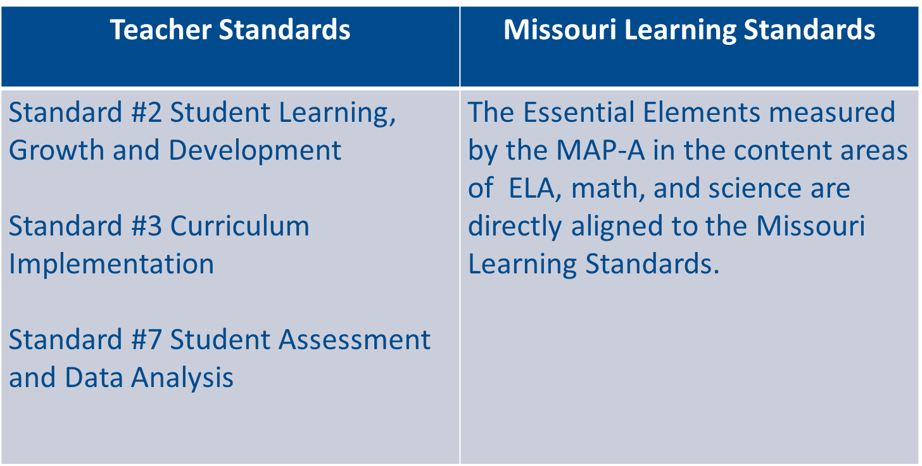
Connections
Notes:
To Know: The connections among the Missouri Teacher Standards, the Missouri Learning Standards and topic of training which is MAP-A Administration.
To Do: Display the slide.
To Say: MAP-A addresses three teacher standards (2, 3, and 7) as shown in the slide. Additionally, the Essential Elements (EEs) measured by the MAP-A in the content areas of ELA, math, and science are directly aligned to the Missouri Learning Standards.

Slide 9
AGENDA FOR THE DAY
HO #1
Section 1: How Do I Begin?
Section 2: MAP-A Vocabulary and Structure
Section 3: General Information MAP-A, DESE, and DLM
Section 4: Eligibility Criteria
Section 5: What are my First Steps?
Section 6: Instructionally Embedded Instruction Using the Linkage Levels
Section 7: Tasks for Teachers
Section 8: Resources for Success
Section 9: Deeper Look at Giving the MAP-A
Notes:
To Know: How the learning for the day will unfold.
To Say: For today’s training, when there is a handout associated with the slide, you will see a small yellow box with HO and then the number of the handout. Please take a look at handout #1, as indicated by the yellow box on this slide. This handout shows today’s agenda. This is how the training is lined out.

Slide 10
Planning Your Calendar
HO #2
As we progress through the training today, you will design your calendar for the Instructionally Embedded window and the Summative window
You may want to color-code your calendar
You are also encouraged to use the checklist in the TAM on page 10 to assist you with your calendar
Notes:
To Know: It is important to know that you must keep organized with the MAP-A. There are deadlines that will make it easier to assess students when followed.
To Do: Show handout #2
To Say: It is important to stay organized. In order to do this, you need to keep your own calendar as well as refer to the district calendar. Handout #2a is a Calendar Handout from August through July. As we progress through the training today, you will design your calendar for the Instructionally Embedded window and the Summative window. This will be used in conjunction with the school calendar you brought with you. Handout #2b is a list of items you will need to put on your calendar. If you don’t need to use this, don’t. It is an option.
As you work on your calendar, you may want to color-code your calendar. Do what works best for you. Please do not forget that the Test Administration Manual (TAM) has key steps you may want to use also. The key steps are not included in the handouts, however, you can find them in the TAM that you were asked to review prior to attending.

Slide 11
Section 1:
How Do I Begin?

Slide 12
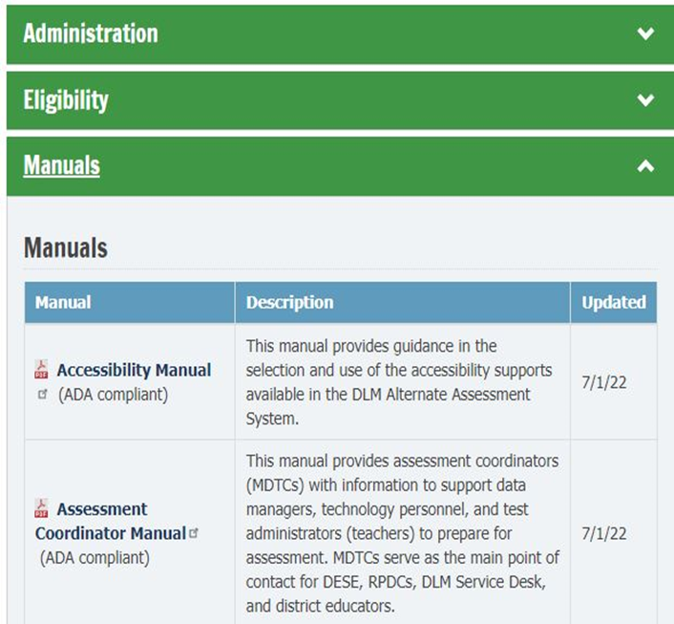
MAP-A/DLM Manuals
Teachers are encouraged to be familiar with five of the eleven manuals posted
Accessibility Manual
Educator Portal User Guide
Guide to Required Test Administrator Training
Guide to Practice Activities and Released Testlets IM
Test Administration Manual
Notes:
To Do: Hand out the Test Administrator page.
To Say: The five manuals listed will be the most helpful to you. We will talk about them throughout the training today. They can be accessed on the DESE MAP-A page under the “Manuals” section. We will go to the page and show you how to access them. We also will share with you a step-by-step guide on how to download and access them.
The TAM is generally the one to start with. That is why we have it in bold on the slide and asked you to download it. Because they are listed on the webpage in alphabetical order, it is the last one. But, it will be very important to you. Remember, if you give the test you are the Test Administrator.
If you have not downloaded it, this is how you will do it (you can walk them through the process using the link on this page.) I have the link live, but there is a handout that gives you the exact steps that I will also share with you so you can find it easily.
This has the information you will need to move forward in this process. We have a handout that lists the page numbers of the important sections of the TAM. We will refer to it as we move forward in our MAP-A discussion.

Slide 13

Where Do I Start?
Test Administrators first steps in the MAP-A Process
https://docs.google.com/document/d/1V8omn9CiUFwlywhuvCD5hZhVYrf3Dhf9mq5805fqQL4/edit
Notes:
To Say: Knowing where to start and what you need to do first is key, because preparing to give the MAP-A test is a multi-step process. The link is to the one-pager. It lists what you need to be doing in both testing windows to prepare for this process. There is also a copy with your handouts in the padelet.

Slide 14

It Takes a Village
Test Administrator
DTC-District Test Coordinator
Data Manager
Technology Manager
Notes:
To Say: You are not alone in the process of giving the MAP-A test. These are the MAP-A roles in your district. If you are responsible for giving the MAP-A you are the Test Administrator. Depending the size of your district, the other roles may be assigned to other people in your district. But, for you to do your job as Test Administrator, you will need to know who these people are because they will need to do their jobs so you can do your job of testing your students.
The District Test Coordinator (DTC) supports you as the Test Administrator. They oversee the assessment process and will check in to ensure the MAP-A testing is being completed. They are the main point of contact between the district and the state.
The Data Manager is the one that makes sure you are in the system and the correct students are assigned to you. They deal with educators, students, and roster data.
The Technology Manager ensures your devices are updated with the newest version of the MAP-A. They prepare the network and devices for assessment administration.
Raise your hand if you do not know if you are in the system and on our next break we will get with the MAP-A person at the state and see what we need to do to get you in the system.
There is a handout on the DESE website that outlines the responsibilities for each role, and we will call attention to it.

Slide 15

Calendar
Notes:
If you want to review your calendar and put the date you intend to have the Test Administrator Manual (TAM) reviewed, you can do that now.

Slide 16
Section 2:
MAP-A Vocabulary and Structure
Notes:
One of the reasons MAP-A training can be challenging is that you need to carry a great deal of vocabulary along with you to understand the topic. So, we are going to take a minute to review some of the terms and the structure of the MAP-A.
There is a glossary in the MAP-A Test Administrator Manual starting on page 126. We will cover some of the universal terms in this section.

Slide 17

What is MAP-A?
Missouri Assessment Program-Alternate
MAP-A is designed to promote enhanced capacities and integrated learning opportunities.
Notes:
To Do:
To Say: The MAP-A is the state-level exam that is administered only to students with the most significant cognitive disabilities. It stands for Missouri Assessment Program – Alternative. It is a federal requirement that all students who are enrolled in a grade where a state-required test is given, must take an equivalent type test. For our students with significant cognitive disabilities, that test is the MAP-A. The MAP-A is administered in testlets which are designed to integrate assessment into the instructional process.
The goal of MAP-A is to push students to perform at their highest level and assess them at the time they are best able to demonstrate their knowledge. Unlike the hours of testing with the MAP, each MAP-A testlet is designed to take between five to fifteen minutes to administer.

Slide 18

Academic Instruction
All students with disabilities are required to receive instruction linked to general education grade-level content standards.
Notes:
“As a part of the Individual with Disabilities Education Act (IDEA), all students with disabilities, even those with severe cognitive deficits, are required to receive access to general education grade-level content standards.”
The purpose of the IEP is to help students be involved and progress in the general education curriculum. The way we do that with students with severe cognitive deficits is by using the Essential Elements or EEs. The EEs are based on the Missouri Learning Standards (MLS), which is the grade-level content standard for our state.
That is why there are EEs for each grade level. Students need to be taught and assessed in the grade-level standards for the grade in which they are currently enrolled. There are standards for students in grades K-12. Students with severe cognitive deficits may have other goals on their IEP such as adaptive behavior goals or transition goals. But, the academic goals need to relate to the EE. It is your go-to place for writing academic goals.

Slide 19
Important Vocabulary
Instructionally Embedded (IE)
Essential Elements (EE)/Missouri Learning Standards (MLS)
Blueprints
Linkage Level (LL)
Testlet
Testing Windows
Notes:
For this section we have a vocabulary sheet that you need to fill out as we go along to make sure you understand the vocabulary. Research indicates that when you take notes (actual notes with pen-to-paper), you remember things better. You are
using more than one modality and that makes the learning stronger.
With the MAP-A, unlike the MAP test we integrate the assessment into the instructional process. This means we do not assess them at the end of the semester or the end of the year. The definition of Instructionally Embedded or IE is students are assessed after they have been taught the content and we believe they are ready to show mastery on that content. It is designed to help teachers integrate the assessment with their classroom instruction.
Essential Elements sometimes known as EEs are the academic content standards used for assessing students with severe cognitive deficits. There are EE in ELA, math and science. The essential elements are based on the Missouri Learning Standards but are reduced in terms of depth, breadth, and level of complexity. They are the bridge to grade-level content standards.
Academic goals for your students need to be based on these standards and we will show you later where you can access them.
The blueprints are the Essential Elements that have tests associated with them. Not all EE have tests associated with them. So it is important that you have these available as you develop academic IEP goals for your students with significant cognitive deficits. Within the blueprints there will be some specific areas you are required to teach and assess to meet state requirements We will get more into that later.
Each of the blueprints have levels. We know that some of the students we test may have profound disabilities and what they can achieve academically may be limited. Remember the goal is to maximize their performance, but there are different levels of the blueprints from the very basic to more advanced and closer to grade-level standards. These levels are called Linkage Levels.
Linkage Levels for an EE are always related directly to grade-level content standards but at different levels of cognitive complexity. There will be a Linkage Level that is appropriate for you to teach and assess your students.
Testlets are the short assessments that go along with each EE on the blueprint. All testlets will start with an engagement activity designed to tap into prior knowledge or introduce the content. All testlests have three to nine items and take the student five to fifteen minutes to complete. They are designed to provide evidence of the students knowledge, skills, and understanding of the concept being measured.
Testing windows are the time frames when the tests can be given. There are two testing windows in a school year. One is a fall and winter window and the other is a spring window. During this time, a required number of tests will be given. We will clearly delineate the number of required testlets as we move forward in the training.

Slide 20
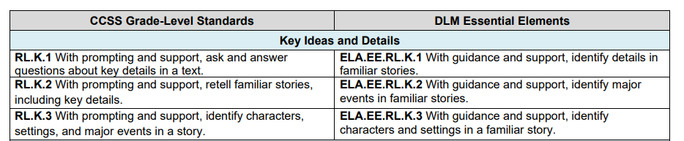
MAP-A and DLM
Dynamic Learning Maps (DLM) is a multi-state consortium that has developed a computer-delivered alternate assessment for students with most significant cognitive disabilities.
Notes:
To Say: “Dynamic Learning Maps (DLM) is a consortium of 22 states that has developed a computer-delivered alternate assessment for students with significant cognitive deficits. Missouri uses this DLM alternate assessment and refers to it as MAP-A. The MAP-A measures Essential Elements which are aligned to Missouri Learning Standards.”
The DLM EEs focus on academic instruction. You need to utilize the EE at the student’s grade level to develop or reference academic goals for the student.

Slide 21

Quick Draw
Notes:
This is an engagement strategy if you have time for it.
A study released by the University of Waterloo in 2019 demonstrated that drawing is superior to activities such as reading or writing because it forces the person to process information in multiple ways: visually, kinesthetically, and semantically. Across a series of experiments, researchers found drawing information to be a powerful way to boost memory, increasing recall by nearly double.
With that in mind, we are going to have you draw something that we went over that you would like to remember. It will be a quick draw. When I say go, you will have 90 seconds to draw something you want to remember. When I call time, put down your pencil and pass it to the person on your right to see if they can guess what you drew.
I will have a couple of you share your masterpieces, because the research went on to say, it is not the quality of the drawing that matters. Unlike listening to a lecture or viewing an image—activities in which students passively absorb information—drawing is active. It forces students to grapple with what they’re learning and reconstruct it in a way that makes sense to them.

Slide 22
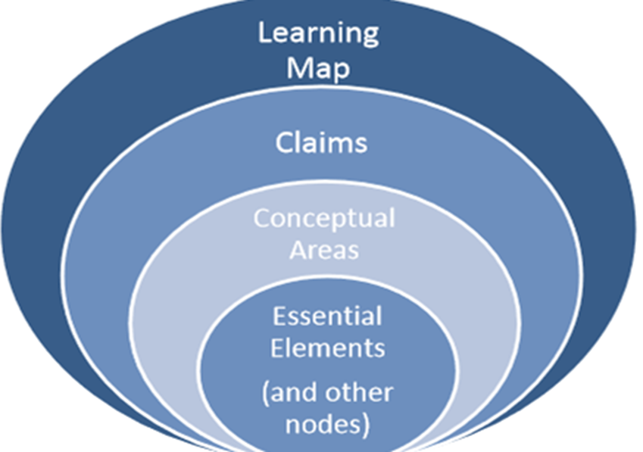
MAP-A Structure for ELA and Math
Notes:
To Say: “Please take a look at the graphic. Notice the terms on the graphic. They are the language of MAP-A for ELA and math. They explain the structure of how the MAP-A was designed.”
Starting at the outer ring is the Learning Map. The Learning Map is the learning progression students go through to learn a skill. That progression may vary from student to student. Assessment and instruction based on learning maps allows for multiple pathways to target a specific skill. It is where the process of developing EEs started.
Because there were so many skills, they were organized into claims and conceptual areas:
Claims are broad statements about what students are expected to learn and to do in relation to the content contained in the ELA and mathematics. For instance, in ELA comprehension is a claim area.
Conceptual areas are broad statements that tell what students should know and do in relation to a claim. For instance, in ELA, comprehension, m6 critical elements (plot, characters) is a conceptual area.
Essential Elements (EEs): We talked about EE on the vocabulary slide. Essential Elements describe what students should know and do in relation to a conceptual area and are aligned to Missouri Learning Standards. They are what we teach and assess. Again, the EEs are what the academic goals for students with severe cognitive deficits should be based on.
Nodes is a term they use to describe the discrete knowledge and skills and understanding in ELA or math. Some of the nodes are what we call foundational nodes, they are the basis of learning. For instance, a foundational node may be to “attend to the teacher.”
All EEs are nodes. ELA has more than 2,000 nodes and math has 2,300 nodes. They also share more than 150 foundational nodes.

Slide 23
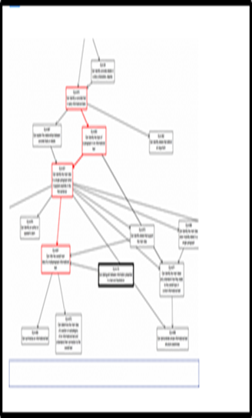
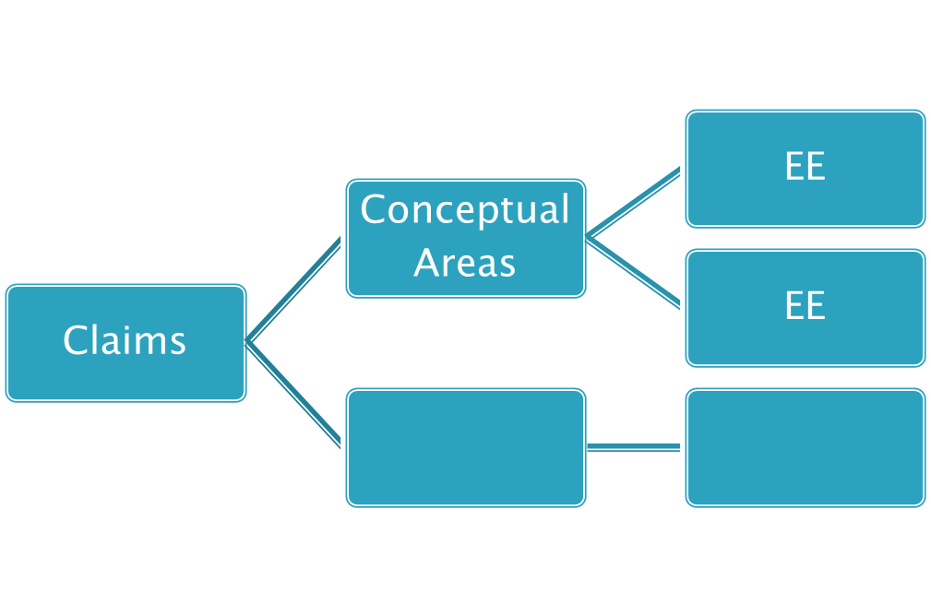

Science Structure
EEs
Topics
EEs
Core Areas
EEs
Domains
Topics
Notes:
To Say: ELA and math align in many ways. They have the same number or claims and conceptual areas and skills that are derived from the Learning Map. The science structure is different. It does not have a Learning MAP-A and the structure for science is different than ELA and math. Science does not use the terms “Claims or Conceptual Areas”. Instead, it uses “Domains, Core Areas, and Topics”. Domains are the major science content areas, such as life science. Within the domains are core areas. The core areas are the key organizing principles in the science content. For instance, in life science a core area is Ecosystems. Topics further narrow the content. A topic for Ecosystems is the interdependence of Ecosystems. Science does have EEs just like ELA and math that are aligned to grade-level standards – but they are in grade bands, not individual grade levels. There is an elementary, middle school, and high school band.
As we proceed, we will continue to highlight other differences between science and ELA/math.

Slide 24

Quizlet I
According to IDEA, ALL students with disabilities must receive instruction linked to general education grade-level content standards.
The DLM Essential Elements focus on functional life skills.
These instructionally embedded assessments are designed to integrate instruction with assessment
MAP testlets generally take 30 minutes or
more to complete
Notes:
We are doing some pop quiz questions throughout the training. To get into the system to give the MAP-A, you have to watch four modules and take and pass tests at 80 percent accuracy. We will provide time at the end of the session for you to take the four tests. Because we are going through the information, we are considering this the modules. You will take the test as if you have gone through the modules in a facilitated manner. These questions are based on the questions that will be on the tests you take as a part of your certification to give the MAP-A. Our plan is that you will be ready to take the test at the end of today, if you haven’t already.
True – must be based on grade-level standards – they are linked to MLS
False – linked to academic standards – IEP may contain functional goals, but all academic goals must be tied to the EEs – which are tied to the MLS
True – we teach then we test and we use how they did on the test to plan for teaching – we will go through what the cycle should look like
False - They generally take 5-15 minutes

Slide 25
Section 3:
General Information
MAP-A, DESE, and DLM

Slide 26
MAP-A
MAP-A measures student performance based on alternate achievement standards (referred to as Essential Elements) that are aligned with Missouri Learning Standards
A student who is eligible for the MAP-A does not participate in any other statewide (i.e., EOCs,
Grade-Level Assessments, Standardized Assessments)
Notes:
To Say: A student who is eligible for the MAP-A does NOT participate in any other statewide standardized assessments regardless of what classes they are attending. Therefore, the student will not take the End of Course (EOC) exams, grade-level assessments or other standardized state testing at their grade level. This does not apply to any assessments that are designated in the local assessment plan.
Any child who qualifies to take the MAP-A will take the MAP-A across the board. They cannot take the MAP-A in ELA but the MAP in math. MAP-A students who qualify as English Language Learners (ELA) may possibly take the WIDA Alternate ACCESS English Language Proficiency Test. MAP-A students are not included in national or international assessments such as the National Assessment of Educational Progress (NAEP).

Slide 27

District Assessment
Special education students need to participate in any district evaluations at their grade level.
Notes:
To Say: This slide is not necessarily related to the MAP-A, but needs to be mentioned. It is also important to understand that if your district gives a specific test at a grade level as outlined in their district assessment plan, then any special education students, regardless of their disability, in that grade level will need to take that test or an equivalent test.
For instance, if your district routinely gives the Armed Services Vocational Aptitude Battery (ASVAB), which is a career aptitude test, at a specific grade in high school, you need to ensure all your special education students in that grade either take that test or a different career aptitude test.
It can be a locally developed assessment for a student with a severe cognitive impairment. It can be something you get off the Zarrow Center website (https://www.ou.edu/education/zarrow). But, you need to ensure you meet all your local district assessment requirements. Each district is required to have an assessment plan. You can find out from your building counselor or principal what those testing requirements are and ensure your special education students are meeting those guidelines. The MAP-A only takes the place of the state assessments which are 3rd-8th MAP-And the required End of Course (EOC) exams in high school.
If you have questions about finding appropriate testing for your students with severe cognitive deficits, reach out to me after the training.

Slide 28

MAP-A
The MAP-A is required in three content areas
    ELA in grades 3-8 and 11
    Math in grades 3-8 and 11
    Science in grades 5, 8, and 11
NOTE: Districts may choose to administer the optional MAP-A ELA and math assessments and the science assessment for local assessment use. Please refer to Form D and E.
In Form D you are required to address whether or not you will utilize the MAP-A (listed as Dynamic Learning Maps (DLM)) for local assessments.
Notes:
To Say: Much like the MAP, the MAP-A is required at specific grade levels. On the slide are the grade levels and subject areas listed where it is required. The IEP, Form D, Part 3 is where you will fill out information if the student will be taking the MAP-A as their state assessment.
State academic achievement testing is a requirement. Because of the Every Student Succeeds Act (ESSA) passed in 2015, there are no exempt students. That means all students take a state test. Those enrolled in state schools, in district sponsored severely disabled programs, students on the autism spectrum, medically fragile students, and homebound students are all required to take a state assessment.
If a district chooses to administer the MAP-A as an optional assessments, in grades 9, 10, and 12, or the science assessment in grades 3, 4, 6, 7, 9, 10, and 12 as a local assessment use, then the MAP-A is considered a district-level assessments as opposed to state level. In this case, Form E is filled out. If you have questions about Form D or Form E, please contact your compliance consultant.
The compliance consultants updated Form D to include whether or not you intend to utilize the MAP-A (listed as the DLM test) as a local district assessment. There is a checkbox where you will address that question.
A teacher may chose to give the MAP-A in grades or content not required as a way to track IEP goal progress or to keep the students familiar with the testing process or to serve in place of locally required assessments for that grade level. It will not count against your annual performance report, if you are locally testing students using the MAP-A or if you do not give the required number of assessments.

Slide 29

MAP-A is Unique
Instruction and assessment occurs throughout the year.
There are two instructionally embedded testing windows
for ELA and math
  The fall window starts on September 11, 2023
  and ends on December 22, 2023.
  The spring window starts on February 5, 2024
  and ends on May 17, 2024.
Notes:
To Say: “There are two instructionally embedded testing windows for ELA and math MAP-A. The windows are when the tests must be given. The fall window starts on September 11, 2023 and ends on December 22 , 2023. The spring window starts on February 5, 2024 and ends on May 17, 2024. You will give the MAP-A during both of the windows.
This is different from traditional year-end testing in which a student’s knowledge is assessed for the core subjects during a few days in the spring. Remember, with embedded instruction, assessment items and tasks are embedded in your day-to-day instruction and inform what you are teaching. Which means, as you instruct the students you assess when you feel they can demonstrate they have learned the material anytime during that testing window. The primary intention of this model is to connect instruction and assessment to the students’ IEP goals.
You most likely will not start assessing via a testlet until late September or early October, after you get the year started and get into your teaching routine. It will depend on the student. However, this is not a race to complete all testlets within the first month of school or a mad dash at the end of the testing window to get all testlets completed in the last few days the window is open. We tell teachers to look strategically at your calendars and figure out tentative dates for testing and plan backwards from there. You can’t guarantee you will be there, but it helps spread the testing out over the entire window and helps you pace your instruction. It also helps you structure your time if you are assessing multiple students.
Assessment items and tasks are to be embedded in day-to-day instruction and inform teaching. The student takes the test when you have taught the content and you think they are ready, rather than an arbitrary date provided by the district or state.

Slide 30

Missouri Uses Two Models
Instructionally Embedded – ELA and math
Year-End - Science
Notes:
Although we talk about Missouri being an instructionally-embedded state, meaning we give the MAP-A all during the year, the reality is that we are both instructionally-embedded and year-end. ELA and math are instructionally-embedded. They are given during the fall and spring windows, whenever you feel the child is ready to demonstrate what they have learned.
Science is only required in the spring. But, it may be given whenever the spring window opens and the student is ready, not just near at the end of the school year like the MAP. As soon as the testing window opens, you can begin assessing your students. Teachers can give science MAP-A testlets in the fall window for practice or to progress-monitor IEP goals. The scores will not count on the districts Annual Performance Report (APR) and they will not count on the students individual year-end score report.

Slide 31
DESE MAP-A Web Page
HO #3
The Place for Resources
https://dese.mo.gov/quality-schools/assessment/map-a
How do I get to DESE’s MAP-A web page?
Go to: dese.mo.gov
Scroll to “Topics”
Choose “MAP”
On the right, choose “MAP-A”
NOTE: When you open the MAP-A page, be sure to scroll the length of the entire “MAP-A” webpage since it contains links to almost all needed information and/or materials.
Notes:
Refer to note page make sure we have step by step navigation guide
To Say: “DESE’s MAP-A webpage is the page to go for resources. It contains many resources, but is not always easy to navigate. We do have a handout that you can use to navigate the webpage and help you find what you need. We are now going to look at the DESE webpage for MAP-A. I will take you on a brief tour of the website, utilizing the handout I have for you. You can follow along with me and highlight items on the handout or if you have a computer, you can follow along.
Make sure you touch on
The Checklist for the Test Administrator found in the Test Administrator Manual
The Educator Portal User Guide as the manual that provides the best information to complete a task in the Educator Portal

Slide 32
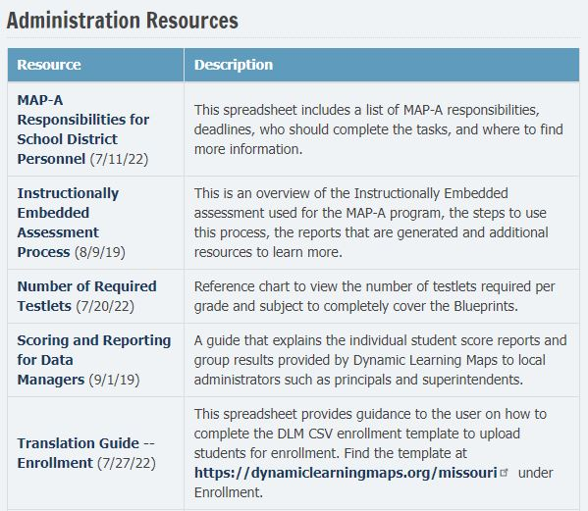
Administration Resources
Please view this guidance document for DTCs, MDTCs, data managers, and teachers to learn MAP-A responsibilities for each.
https://dese.mo.gov/media/file/map-responsibilities-school-district-personnel
Notes:
This is the information we mentioned earlier, it is the handout that outlines all the responsibilities for the different MAP-A roles in the district. MAP-A is one of those things where it truly takes a village. One person in your district may have more than one role. For instance, the District Test Coordinator and data manager could be the same person, even though they are two different roles. But you cannot do your job as the Test Administrator until they do their part. They may be new in their role also, so you can share th

Slide 33
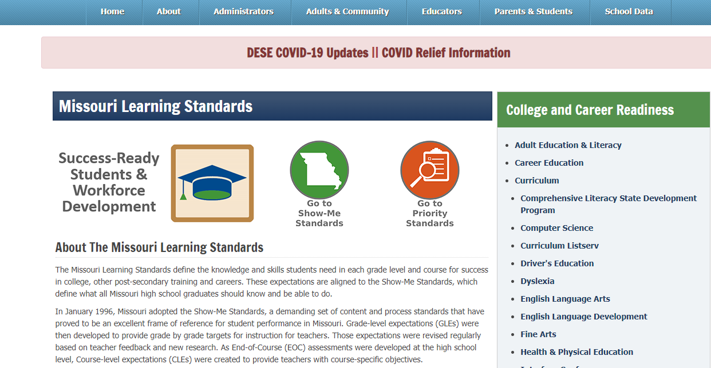
Alternate Standards
https://dese.mo.gov/college-career-readiness/curriculum/Missouri-learning-standards
Notes:
There are some important sites on the DESE webpage that may be helpful that are not in the MAP-A section. The Missouri Learning Standards for students with significant cognitive deficits aka the Essential Elements (EEs) can also be found at the bottom of this page in a tab marked “ALTERNATE”. As we have mentioned previously, any academic goals on IEPS need to relate the EEs for that students’ grade level. These are the skills you will be assessing; these are the skills you need to be teaching.
Another set of documents located on the DESE website that are very important are the crosswalk documents. The “MAP Alternate Crosswalk for ELA, math or science” describe how the Essential Elements align to the Missouri Learning Standards. It is available in PDF or Word format. There is a link to this on the MAP-A website also. But, on the DLM website the EE are aligned to the common core standards, not the Missouri Learning Standards. The crosswalk may be helpful in helping parents understand that even if the activities and lessons look different in your classroom, you are meeting the IDEA required mandate of providing access to the general education curriculum.

Slide 34
Find Help Learning MAP-A
An experienced coworker
MAP-A District Test Coordinator (MDTC)
RPDC consultant mbscherer@ucmo.edu
DLM Service Desk (1-844-675-4479)
DLM-support@ku.edu
DESE Assistant Director of Assessment, Caryn Giarratano (573-751-6731, caryn.Giarratano@dese.mo.gov)
Notes:
This is your village to help you with MAP-A. Experienced teachers in your district are a valuable resource. There is someone in your district, possibly a director or process coordinator, who is the MAP-A Test Coordinator. They will be able to help you. You are welcome to reach out to me. The DLM service desk has someone assigned to Missouri. However, they only want to talk to one person per district. So, you may need to go through your district chain of command to reach out to them. Caryn Giarratano is a great resource. She is MAP-A, 24/7, 365 days-a-week and is very quick to get back with you.
RPDC Consultant-change to your name

Slide 35
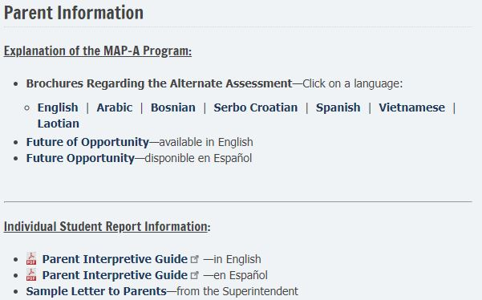
Parent Information Tab
Notes:
Communicating with parents about the MAP-A is vitally important and MAP-A results should go when the MAP goes home to the parents. The MAP-A results are called End-of-the-Year Individual Student Reports. There are some resources available for parents on understanding the MAP-A assessment and the MAP-A results. There are also documents available to help you, the Test Administrator, understand and use those results to check progress on goals and provide progress monitoring updates to the parents.
We will not go into much detail about the Student End-of-the-Year report during this module. But it does provide good information regarding student progress. It does have two parts; performance profile and learning profile. Together the two parts let parents know how the student did on each of the testlets they took and overall in the subject area. You will get a student report for each subject the student is tested.

Slide 36
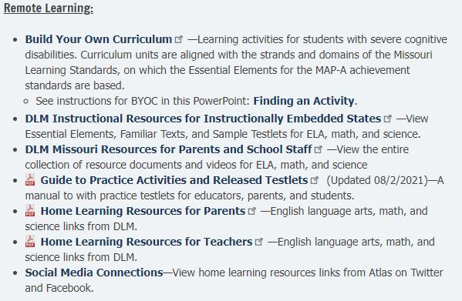
Finding an Activity-Parent Information
Notes:
To Say: There is a section in the MAP-A resources that is for parents. If you have parents that want ideas on what instruction looks like for students with severe cognitive impairments, this is a good place to send them. Also, this is a section that teachers can use. There are some good resources found here. In the Build Your Own Curriculum section, which is the state school curriculum, there are activities that may work for some of your students. You will find complete lessons designed on specific Missouri Learning Standards. The arrow points to a PowerPoint on how to access those instructional activities. You will access them from the Build Your Own Curriculum link, which is directly above it.
There are at-home resources for teachers if you have students who are medically fragile and miss a lot of school or are homebound and you provide education for the student at their home. There is also a similar document for parents.
The last section is new and contains links to social media connections to the MAP-A. It has a link to all the MAP-A Pinterest pages as well as some of the professional development modules.

Slide 37
Quizlet II
What are the two parts of the Student End-of-Year Report?
Where would you find the checklist for the Test Administrator?
Which manual would have the best information about how to complete a task in the Kite Educator Portal?
Notes:
As a reminder, these pop quizzes will be very useful when it comes time to take the tests to get into the system.
Performance Profile and Learning Profile
The checklist for the Test Administrator is in the Test Administrator manual
The Educator Portal User Guide is the manual that provides the best information on how to complete a task in the Educator Portal

Slide 38
Navigating the Dynamic Learning Maps (DLM) Website
Notes:
The following slides will discuss navigating the Dynamic Learning Maps (DLM) website.

Slide 39
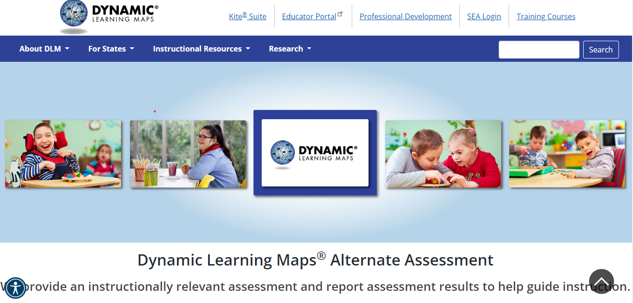
DLM Website
DLM Website
Notes:
This is the DLM landing page. When you go to this site, be sure to look for the “For States” tab, click on “MISSOURI” under the IE States. IE stands for Instructionally Embedded, which means we test all year; we embed the assessment with the instruction in ELA and math and even though we are end-of-the-year in science we still use the IE tab. The resources you find on this page can be search-filtered by state. Make sure you choose “MISSOURI”.
For Instructional Resources tab, click the “Instructionally Embedded” (IE) Model States. You will get many of the same resources that way, but not Missouri-specific information.
“Educator Portal” takes you to the sign in where you can access this section. As a Test Administrator the Educator Portal is where you will do a lot of the work to get ready to assess the students.
“Training Courses” is where you will complete the modules and assessments needed to allow you to administer the MAP-A to students. This year, it has been moved into the Educator Portal section. The “Training Courses” link will send you to the sign in page, where you will be taken straight to the Educator Portal section. You will have individual student records in the Educator Portal that you will utilize to assign testing for your students. You do your work in Educator Portal, but students take the testlets in the Student Portal. The two systems are linked together. The student portal is accessed through the Kite Suite Tab.
We always remind teachers, if you miss a year of doing the module and assessment to give the MAP-A because that year you have no MAP-A students, then the following year, you are treated like a brand new teacher and need to take the four modules and complete the test on each module. So, you may need to think about how you want to handle that year in and year out.

Slide 40
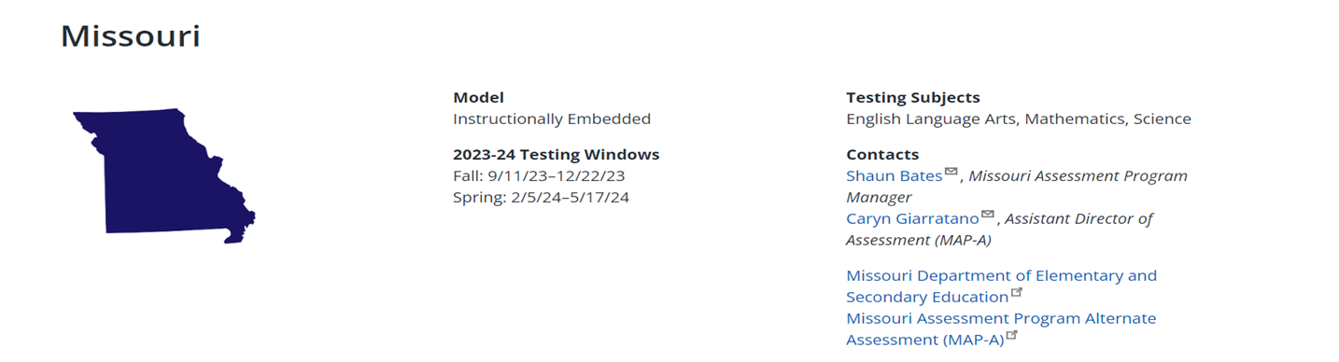
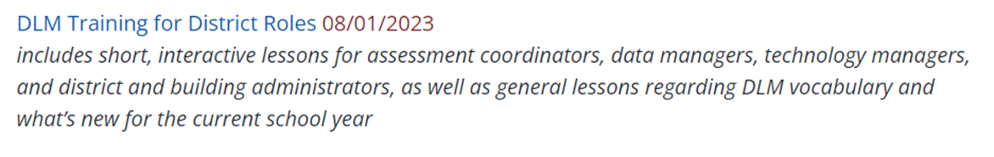
Missouri Webpage on Dynamic Learning Map (DLM)
HO #4
https://dynamiclearningmaps.org/missouri
Notes:
The Missouri webpage has several resources. We will quickly look at each of the tabs listed on the screen. We have an arrow pointed to Caryn Giarratano - she is your MAP-A friend at DESE. She is really good and quick about answering MAP-A questions. There is one new training for new District Test Coordinators, Process Coordinators, and Directors on what the individual roles are for preparing to administer the MAP-A test. We have highlighted it on the slide because it is new.
(Click on the link and go through the DLM handout with the participants)
Make sure you address that you can filter and search the DLM site by state and type of instructional model
Make sure you address the short helplet videos that are generally 2-20 minutes long.

Slide 41
Quizlet III
The resources on the DLM website can be searched and filtered by state.
The Educator portal is where the students take their assessments.
A helplet video is designed to take at least an hour to watch.
Notes:
True
False. They take their tests in the student portal.
False. Helplets are designed to be short videos of 2 to 20 minutes.

Slide 42
Section 4:
Eligibility Criteria
https://dese.mo.gov/special-education/compliance/statewide-assessments
Notes:
In this section we are going to cover eligibility and the fact that no more than one percent of the student population should be taking the MAP-A. It is possible that a district may not have any students taking the MAP-A some years. Do not go in with the premise that we have to find one percent of our student population to give the MAP-A. The idea is that we look at our identified population to see if any students qualify - knowing that we cannot go above one percent of the population. We are also looking at measuring our MAP-A students against the general population - not just the students in our district.

Slide 43
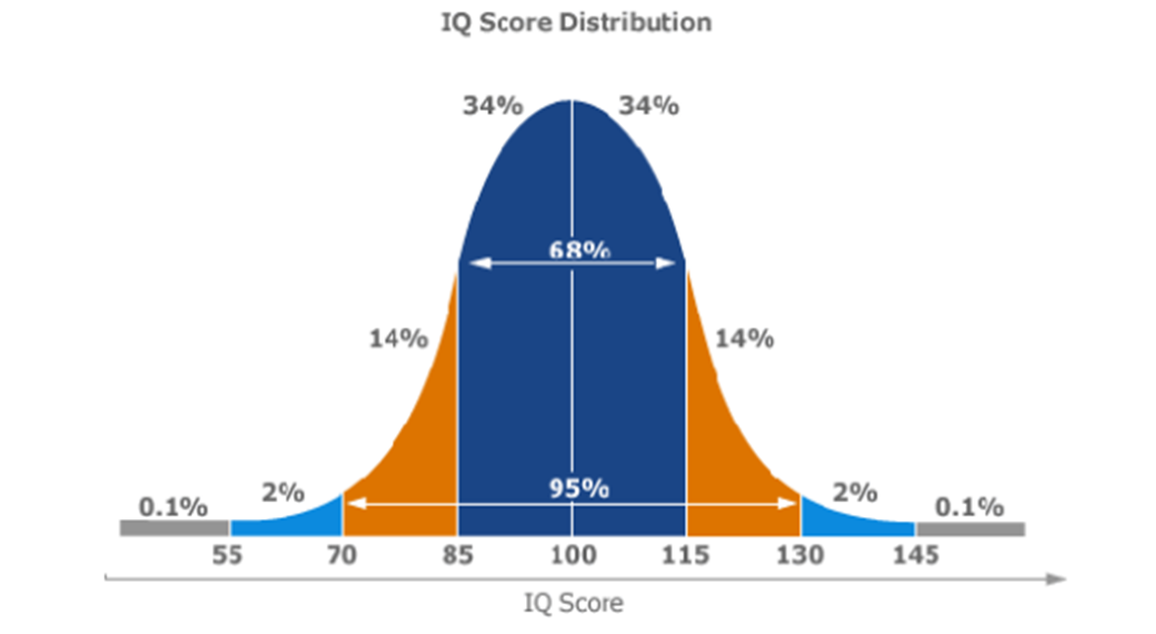
Student Eligibility
MOST SIGNIFICANT
Cognitive Delay
Notes:
To Say: Using the Bell Curve as a graphic, average ability scores fall between IQ scores of 85 and 115 and approximately 68 percent of the population falls within this range of scores. Another 28 percent of the population are within one standard deviation above and below the average ability. Another four percent is found two standard deviations from the average. The left side of the slide shows a significant cognitive delay which is found in approximately two percent of the population who have IQ scores that fall at 70 or below. Continuing on the left side is the most significant cognitive delay. It is considered to be the one percent of the population who have IQ scores that fall at or below 55.
IQ is not the only determining factor. Students with the most significant cognitive delay require supervision and assistance at all times. These students need a significant level of support in all areas including communication, self-care, daily living, social skills, access to community, self-direction, health and safety, functional academics, leisure, and work.

Slide 44
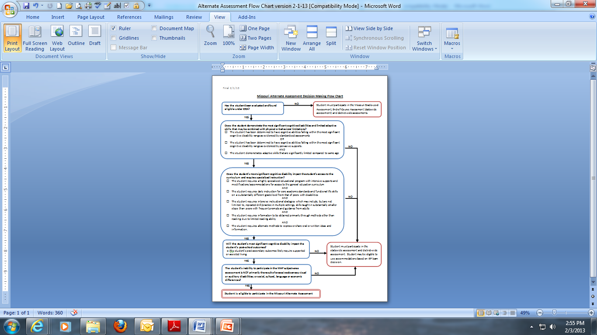
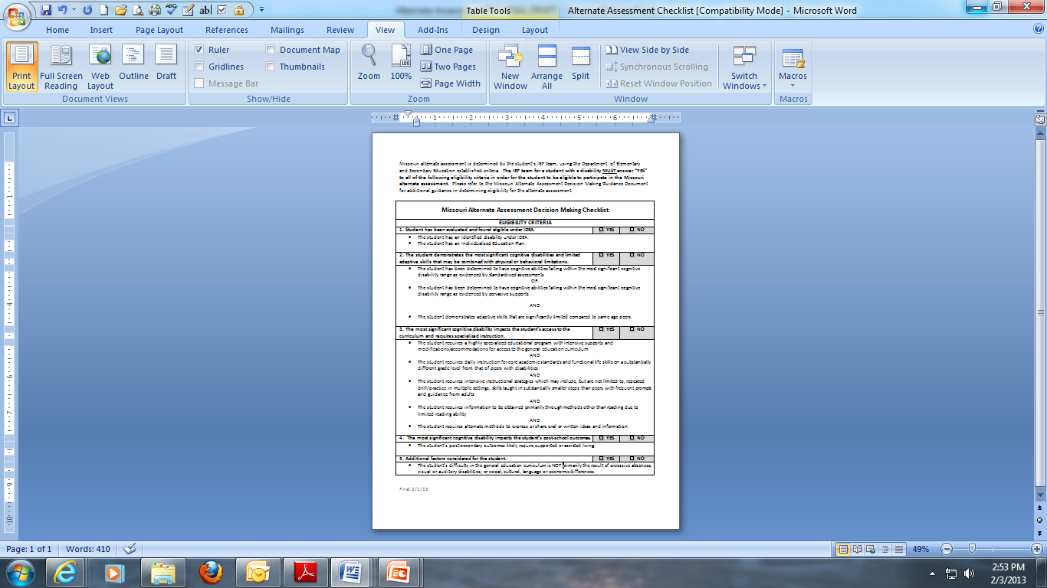
Flow Chart and Checklist
HO # 5a-5b
https://dese.mo.gov/special-education/compliance/statewide-assessments
Notes:
To Say: While an IQ score is not the sole criterion to determine if a student should participate in the Missouri Alternate Assessment, it is one of the factors that is looked at quite closely.
DESE has developed both a Flow Chart and a Checklist with the five criteria that must be met in order to determine a student eligible to participate in the alternate assessment. IEP teams can use either resource to guide the process of considering each of the five criteria. They are not required forms, but they are good documentation to have to prove that you reviewed the information annually to determine if you think the student still qualifies for the MAP-A. You will also document this information on the present level of academic achievement and functional performance section of the IEP.
These resources can be found on the DESE website on the Special Education Compliance section or under the eligibility tab on the MAP-A page
The student must meet ALL the criteria to be determined eligible for the MAP-A. Remember, this assessment is designed for the lowest one percent of the student population. Both districts and the state are required to stay within that one percent of students taking an Alternate Assessment. Only in rare instances, will districts have more than one percent of their students who qualify on all criteria on the eligibility checklist. Districts having more than one percent will be asked to show justification.
The compliance consultants will tell you it is best practice to file the checklists and documentation with the IEP.
You will address questions related to the students
1. Qualification for special education
2. Cognitive functioning level and limited adaptive skills
3. How their disability impacts access to the curriculum and requires specialized instruction
4. How their cognitive disability impacts the student’s post-school outcomes
5. The fact that their inability to participate is the result of a significant cognitive disability and not excessive absences, visual or auditory disabilities, or social, cultural, or economic difference.

Slide 45
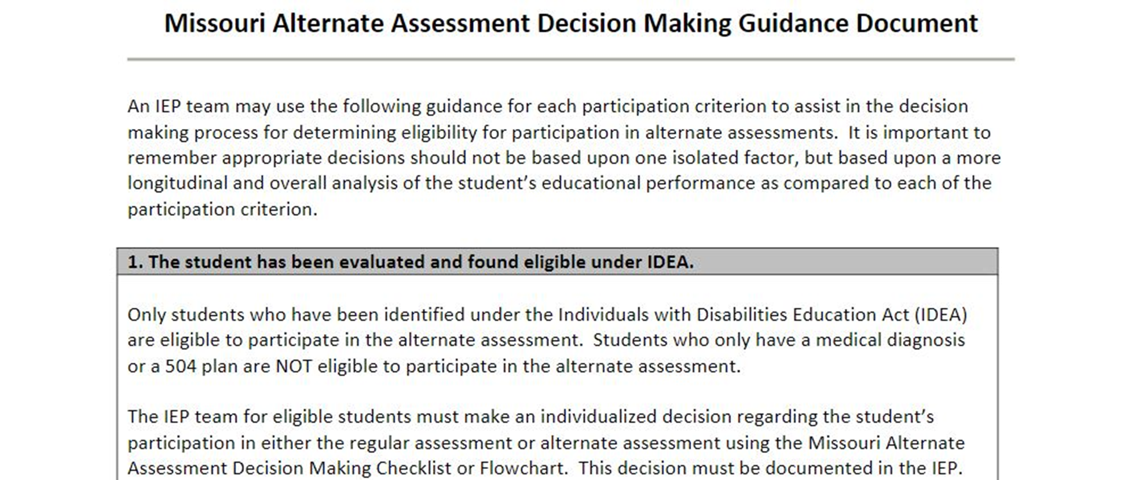
Guidance Document
Notes:
To Say: The checklist and the flowchart are designed to be used in conjunction with a Guidance Document which provides more detailed information to assist IEP teams as they carefully consider each of the criteria. The Guidance Document lists each of the criterion and provides additional guidance and clarification as well as examples of students who would and would not be eligible for participation in the alternate assessment.
It can be found under the eligibility tab on the DESE webpage.

Slide 46
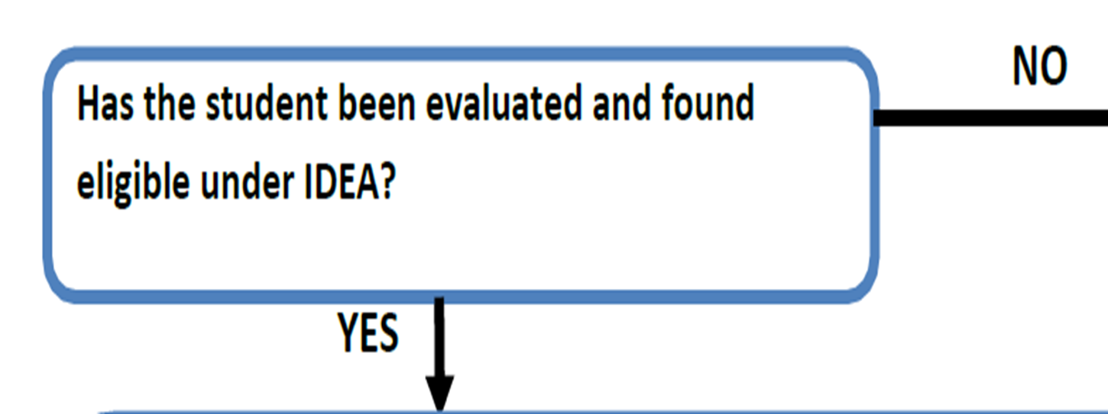
Flowchart: Step 1
Notes:
To Say: The first criteria requires that only students who have been identified under the Individuals with Disabilities Education Act (IDEA) are eligible to participate in the alternate assessment. Students who only have a medical diagnosis or a 504 plan are not eligible to participate in the alternate assessment.
The IEP team for eligible students must make an individualized decision regarding the student’s participation in either the regular assessment or alternate assessment using the information found in the Missouri Alternate Assessment Decision Making Checklist or Flowchart. This decision must be documented in the IEP. The decision on qualifying for the MAP-A must be made every year as a part of the IEP meeting by the IEP team. Only, the IEP team determines eligibility for the MAP-A.

Slide 47
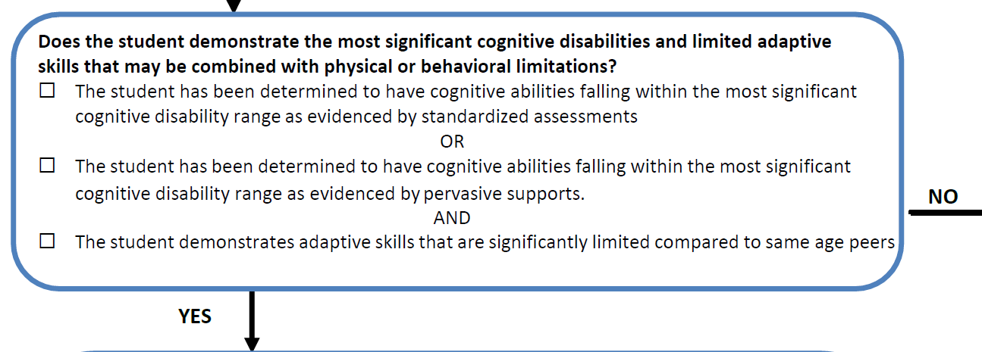
Flowchart: Step 2
Notes:
The second criteria reviews a student’s cognitive abilities. While there is no one method of determining if a student demonstrates the most significant cognitive disability, it is clear this decision must be made by comparing the student to the entire population of other students of the same age—not just other students within the district or school building. If you look at the form, there is an or and then an and. This means that two of the three boxes need to be checked.
On the first two there is an OR that means that you need one or the other. The most significant cognitive disability range can be evidenced by standardized assessments or pervasive supports. Remember the IQ distribution slide we showed you? We are looking at around the range of a 55 IQ. We know that for some students it may not be possible to get an IQ score. So, for these students we look at pervasive supports. Pervasive support refers to constant support across environments and life areas and may include life-sustaining measures. A person requiring pervasive support will need assistance on a daily basis across all life areas. Some examples of pervasive supports include: help with basic life functions including eating, toileting, and navigating between classes successfully.
The student must also demonstrate adaptive skills that are significantly limited as compared to same-age peers. Adaptive skills include activities of personal care or daily living, such as eating, dressing, mobility, and toileting. What are the expectations for their peer group and what are they capable of doing on their own? So it only makes sense that students with significantly limited adaptive skills will need pervasive supports.
(The following is additional information you can chose to add if needed).
While IDEA does not provide guidance on determining the most significant cognitive disabilities, it does state, under Section 300.304(3)(c)(1), “Assessments and other evaluation materials used to assess a child under this part—(i) are selected and administered so as not to be discriminatory on a racial or cultural basis; (ii) are provided and administered in the child’s native language or other mode of communication and in the form most likely to yield accurate information on what the child knows and can do academically, developmentally, and functionally, unless it is clearly not feasible to so provide or administer; (iii) are used for the purposes for which the assessments or measures are valid and reliable; (iv) are administered by trained and knowledgeable personnel; and, (v) are administered in accordance with any

Slide 48
IQ is a Part of Decision-Making
IQ score not the sole criterion
Students are expected to score lower than peers
Valid score on general education tests is unachievable
Documentation shows level of support required
Skills can perform are identified
Skills that have not been mastered are identified
Notes:
Remember IQ is not the only criteria. There are some students that may qualify due to multiple severe impairments. Often times with students with multiple disabilities you are unable to obtain an IQ score. There could be students who are on the profound range on the autism spectrum that may qualify that we could not get an IQ score on because of language, behavior, and academic impairments. It may be you have a student with a 56 IQ that you can document the need for pervasive supports.
Just make sure you can document what levels of support they need and that level of support is significant and how the skills they have are far below age level peers.

Slide 49
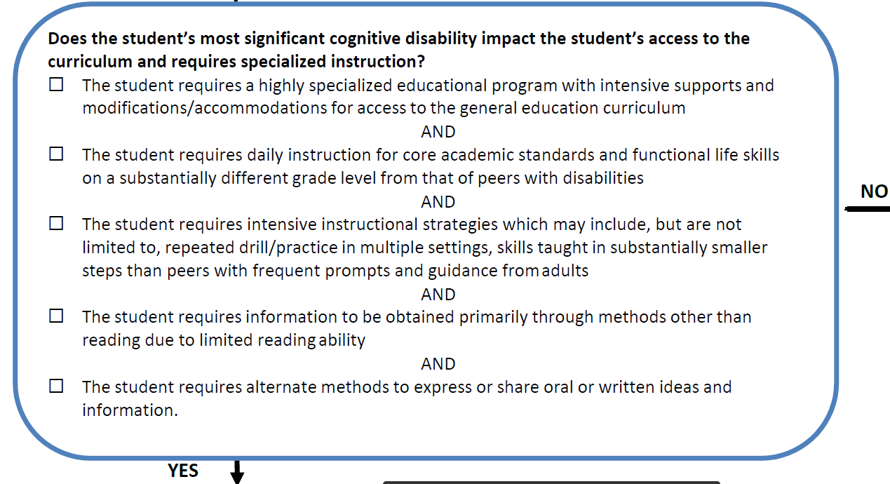
Flowchart: Step 3
Notes:
To Say: The third criteria requirement relates to the academic curriculum they utilize and the type of instruction they receive. You will notice that they all have “and” between them. This means they all need to be checked to continue to document eligibility. If even one is not checked, you have a “No” and they are not eligible for the MAP-A.
The first related to the student’s daily instruction on chronologically age-appropriate academic content standards and the grade level benchmarks is substantively different from that of peers with or without disabilities. There is a marked difference between the curriculum they are learning at what their age and grade level peers are learning.
The student requires intensive instructional strategies which may include, but are not limited to, repeated drill/practice in multiple settings, skills taught in substantially smaller steps than peers with frequent prompts and guidance from adults.
The student also requires intensive supports in the school setting as evidenced in the IEP by statements indicating the need for individualized instruction, adult supervision, and assistance throughout the school day.
The student’s modified curriculum may consist of functional life skills such as: pre-academics, communication, self-care, daily-living, and social skills.
The student requires information to be obtained primarily through methods other than reading due to limited reading ability and also utilizes alternate methods to express or share oral or written ideas and information with others. These are not the students that you are having read a chapter and answer the questions at the end in complete sentences. They are not writing paragraphs or giving speeches.
All five of these must be checked to keep moving down the flow chart toward MAP-A eligibility.

Slide 50
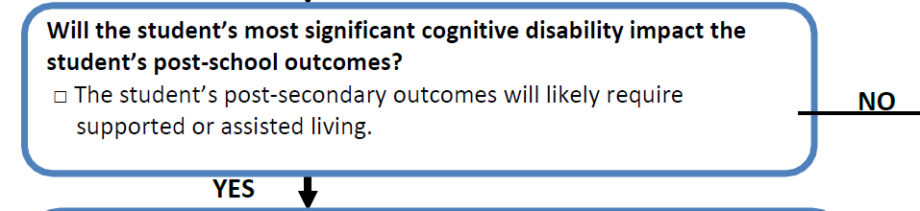
Flowchart: Step 4
Notes:
To Say: The fourth criteria is that the student’s postsecondary outcomes for independent living will likely require supported or assisted living. The student may have a guardian when he/she turns age 18. The student would require moderate to significant supervision in order to access the community for recreation, employment, training, and daily living.
The student’s postsecondary outcomes for education/training and will likely include on-the-job training for sheltered or supported employment, as well as, skill acquisition for social, communication, and/or behavior. The student’s postsecondary outcomes for employment will likely result in sheltered or supported employment, part-time employment, participation in day activity centers, or home.
Sometimes it can be difficult to feel like you can make these determinations at the elementary level. But realize that even with outstanding educational services, students with the most significant cognitive deficits will not be successful living and working without many supports.

Slide 51
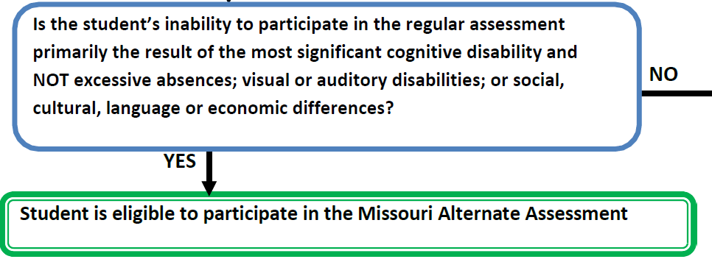
Flowchart: Step 5
Notes:
To Say: The fifth criteria requires that the student’s difficulty in the general education curriculum is not primarily the result of excessive absences; visual or auditory disabilities; or social, cultural, language, or economic differences. The student’s difficulty in the general education curriculum is due primarily to the impact of the student’s most significant cognitive disability and limited adaptive skills.
If YES has been answered to all five of the criteria, then the student is eligible to participate in the alternate assessment. It is worth repeating that this decision needs to be made every year by the IEP Team.

Slide 52
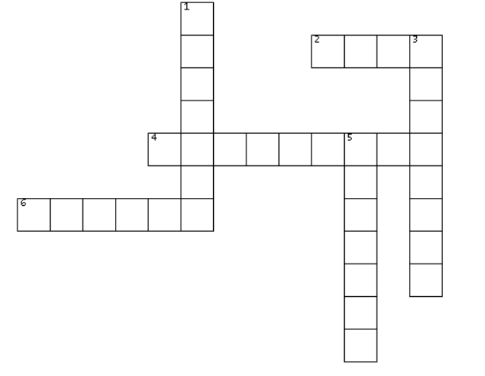
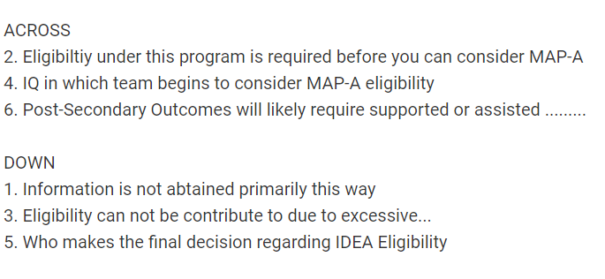
Review
Notes:
Because there is no questions related to eligibility in the required tests, you may need to put in an engagement activity here.

Slide 53
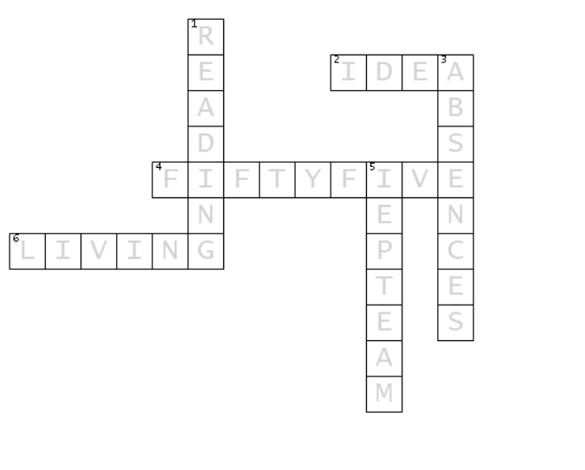
Answers

Slide 54
Section 5:
What Are My First Steps?

Slide 55
First Steps
Make sure you are in the system
Log in and sign the agreement
Complete training requirements
Take the required test(s) and score 80 percent on each
Check the students that are rostered to you
Notes:
These are some first steps to prepare you to be ready to give the MAP-A. Hopefully, most of them have been done or are being done today. As we mentioned before, your first step is to be in the system. Even if you are in the system, these are things that need to be done annually. Talk with your District Test Coordinator to make sure you are still in the system. Your login is generally your email address and your password is your email address up to the ampersand symbol. If your name has changed over the summer, you have a new email, or you have changed districts, make sure that it has been updated.
You will have to sign the agreement every year. It is the first thing you will do when you access the Educator Portal. You can’t move forward until you have successfully signed in. You will need to complete the training and take the required tests. Today, our training will help with that. You will be prepared to take the tests.
For a beginner, there are four modules and each module has a test. If you do not score at least 80 percent, you will need to retake the test. Again, this training will prepare you for all four tests and you can take the tests in the facilitated module section. This way you do not have to watch all the modules. You can go straight to the tests. As an experienced MAP-A Test Administrator, you still take tests, only shorter. If you do not score 80 percent on the tests, you will have to go back and retake the longer tests.
It is important to understand that if you skip a year of getting certified to take the MAP-A test, then you go back to the beginner status and have to take the longer tests. It is also important to understand that if you have a new student that the IEP team determines is eligible for the MAP-A or one that moves into your district/classroom and qualifies anytime during the year, you are not certified and you will have to go back and get certified to give the MAP-A. We encourage teachers to go ahead and get qualified each year to keep from having to go back and start from the beginning, or scrambling to get qualified in the middle of the year.
When you go into the system, you will see a list of student(s) that have been rostered to you. This means they have been assigned to you for testing. Make sure those students are familiar to you. It may be possible they did not get moved to another teacher or that student has graduated and moved and have not been taken out of the system. You should only see on your roster of students you are required to test.

Slide 56
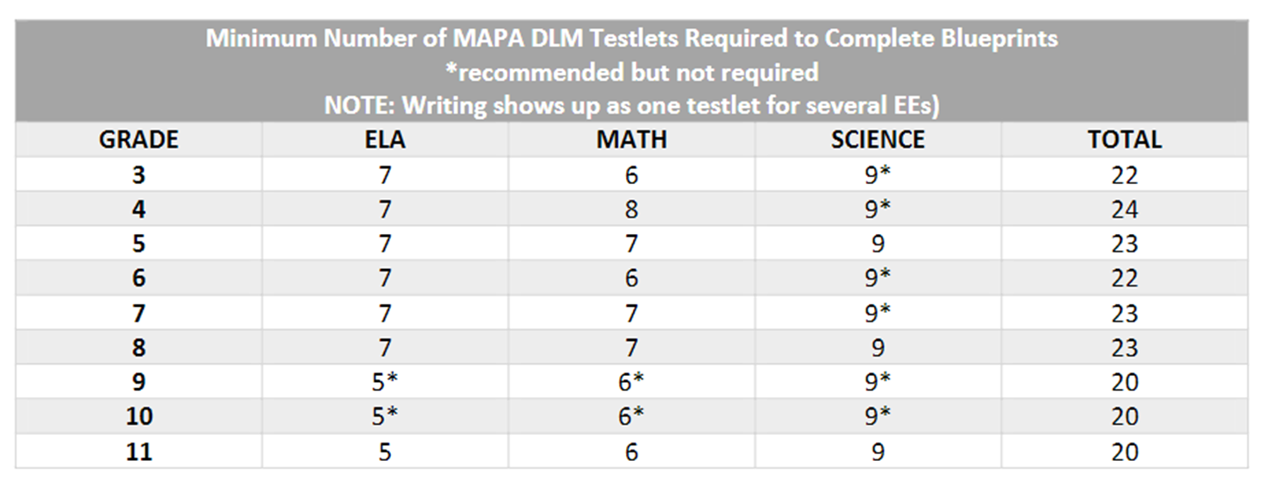
Number of Testlets to Cover
https://dese.mo.gov/media/pdf/asmt-mapa-resources-testlets-required-chart
Notes:
This is in your packet and I showed you where to find it on the DESE webpage. It is the amount of testlets that need to be given. Keep in mind the total is skewed a little because it includes science at each grade level. It is your choice in grades 3, 4, 6, 7, 9, and 10 to give the science. Science is required in the spring, but is optional in the fall for grades 5, 8, and 11. So grade 3 has 13 testlets required in the fall and 13 testlests required in the spring, for a total of 26 testlets for the entire year.
Eleventh grade has 11 testlets required in the fall (just ELA and math are required) and 20 in the spring, because science is required, for a total of 31 for the entire year.
Asterisks mean they are not required; but can be done for local assessment.
Each testlet only tests one EE, except writing, but we will talk more about that later. Students must be tested individually, you can teach the EE in a group – but they must be tested individually.
Ideally other students would not be in the room when you test, but if they are in the room the computer monitor should only be visible to the one student being tested.
You will need to be organized and thoughtful about spacing your testing out during the testing window. Again, the goal is not to cram in all the testing in the last week that the window is open. As you think about the number of students you have to test and the number of testlets for each student, you may need to schedule two to three testlets per week per student.
As you think about your students that are MAP-A eligible, keep in mind that there are two testing windows. This means that ELA and math are tested both in the fall and spring window. So, when you look at the grade level of your student – double the number of testlets in ELA and math for the year.
Science only requires testing in the spring. You can do some practice testing in the fall, but it will not impact a student’s overall results. In ELA and math testlets, scores in both fall and spring impact their overall results.

Slide 57
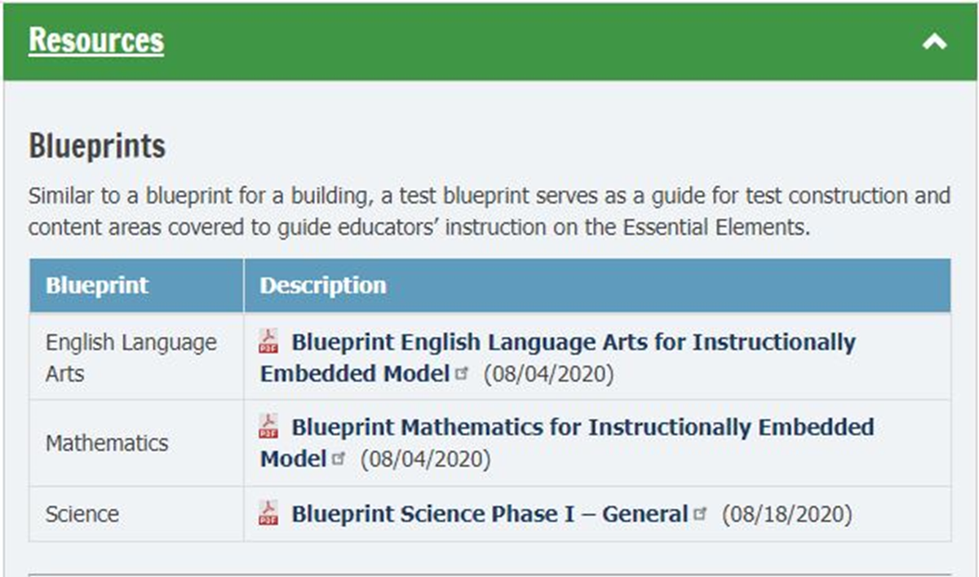
Use Blueprints to Plan Instruction
Notes:
The blueprints are the EE that has tests associated with them. This is where you go to develop your academic goals for your students. You have to test them on these concepts, so you need to be teaching on these concepts. I will say this over and over again. This is your go-to place for academic goals.
Remember MAP-A is designed to be instructionally embedded - we teach and then we test. Test Administrators need to embed the content of the testlets into their instruction. This way assessment informs teaching and benefits the student. It can also provide real-time data on IEP goal progress.
We encourage teachers to print off the blueprints from the resource tab as guides to integrate instruction and review and select the essential elements in the Instruction and Assessment Planner when it opens. We will talk more about the Instruction and Assessment Planner in later slides.

Slide 58

Determine Blueprints to Teach and Test
Review the IEP to determine which academic goals match the blueprints or look at blueprints to help create goals that match student needs.
Notes:
To Say: Your student’s IEP is based on their individual needs, but they are required to be assessed on their grade level standards. Remember these grade level standards are the essential elements. The essential elements with testlets are called the blueprints. So, whether you match your academic IEP goals to these blueprints to create appropriate academic goals, you will need to utilize the blueprints in creating your goals.
Do not think of it as teaching for the test. Instead, consider it testing what you teach. You are required to give the test so, it only makes sense to utilize the blueprints for the grade the student is in as you create academic goals. You may have academic goals that are not tested by the MAP-A, but you need to have goals that address the MAP-A standards.

Slide 59
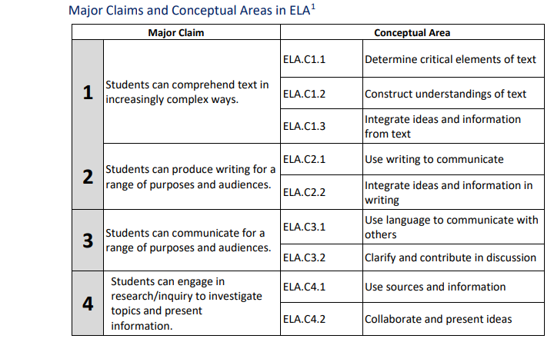
ELA Blueprint
https://dynamiclearningmaps.org/sites/default/files/documents/Manuals_Blueprints/DLM_IE_ELA_Blueprint.pdf
Page 1
Notes:
TO Do: Hand out ELA page
To Say: “Please take a few moments to look at this screen shot of the Major Claims and Conceptual Areas in ELA. Remember there are four claims and nine conceptual areas. You have a copy of the blueprints. Academic goals in ELA should be related to these blueprints. You will be directed on the second page to specific conceptual areas that need to be addressed. Before we turn to the next page, I want to remind you that there are Linkage Levels for ELA. We talked about Linkage Levels on the vocabulary slide. The EE is written at the target level, but their are three levels below what is written in the blueprints. I promise you will find a level that you can teach and assess with your students”.

Slide 60
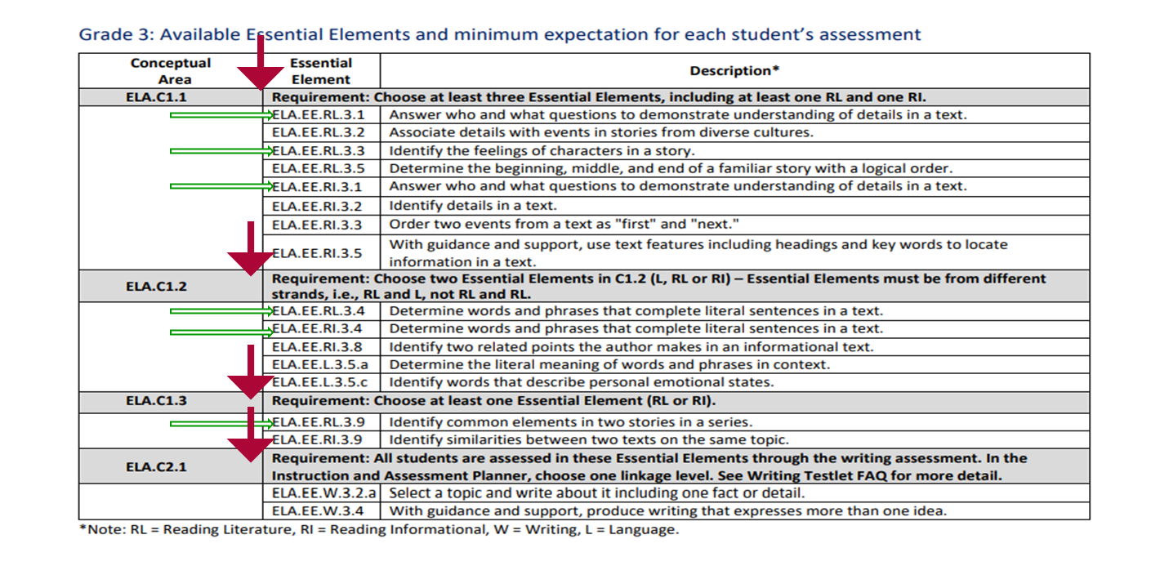
EEs for Each Conceptual Area - Blueprint
Notes:
To Say: “This is a screen shot of the EEs for Conceptual Areas 1 & 2 in ELA for grade 3. From the page associated with the grade of your student, you will chose the required number of EEs to teach and assess. Before you go to the page for your student, stay with me for a moment so we can talk through how to go about choosing the required EEs to teach and test. When you look at the dark areas in each section of the Blueprint, where the red arrow points, it will tell you the number of EEs that need to be selected to be administered in that section and what conceptual areas they need to come from. It is very important you follow those directions. Otherwise, you may end up giving testlets that do not meet the requirements and have to give more testlets that meet the requirements.
Let’s look closely at this student in third grade. In the first section it says to choose at least three EEs including at least one RL and one RI. At the bottom of the page it tells us RL is Reading Literature (Fiction) and RI is Reading Informational (Non-Fiction). For instance, in that box I could chose the first two (EE RL 3.1 and RL 3.2.), but then I need to choose an RI, so I may go to RI 3.1. It is the same skill with who and what questions, but in different types of books.
In the second section it tells me to choose two EEs and they must be from different strands. (RI, RL and L for language). In this case I have chosen an RI and RL; essentially the same skill, determining words and phrases that complete sentences, but in different types of books.
In the third section we need to chose one strand. I decided that my student does better with RL fiction books instead of informational texts, so I chose the RL EE; identifying common elements in a story.
The last section is writing. Your student will be evaluated on both of the EEs in the writing assessment that will be done each testing period. Writing is the only area that you will be testing more than one EE on a testlet. All of the other tests are over one EE. In writing, it can be from two to six EEs.
You should have goals on your IEP that relate to the ELA standards for the grade level the student is enrolled. In this case I would have goals related to who and what questions, determining how characters feel (which I could cover in who questions), what words complete a sentence (could be related to feelings) and what the two stories have in common It is not required to have the essential element listed with the goal, but it certainly comes in handy in many ways and informs parents that all academic instruction is tied to grade level standards.
Generally, when teachers see this for the first time, their stress level rises because they see skills that they know their students will not be able to master. Remember, each of these EE have levels called Linkage Levels. What you are seeing is the Target level. The Target level is most closely aligned to the skills and concepts of the EE. But there are 3 levels below this and 1 level above that a student can be taught and tested at. There are tests at all 5 of the Linkage Levels for the Blueprint EE. So if your student cannot do these things do not panic. I promise there is a level they can do for each EE.
I am going to give you a minute or two to find the page with your students grade level. Go in and get a sense of how many EE in each area need to be addressed. Do not pick them yet, lets look at the levels first.

Slide 61

Example of Linkage Levels
https://dynamiclearningmaps.org/essential-elements/ela
Notes:
To Do: Click the link. Pick an EE. Scroll down and show the Linkage Levels.
To Say: “Let’s look at the Linkage Levels for an EE in ELA. Remember, what you see on the Blueprint is always written at the target level. On the left, you can filter by grade. Under the grade levels are the “Keys to MAP Codes” and then the “Guides to the EE Codes”. When I click on one of the EEs, I am taken to a document that outlines all five of the Linkage Levels. There is a testlet at each Linkage Level that you can give the students. I am going to click on the ones I chose on the last slide (EE RL 3.1). Here are the levels – go over them. I can chose any of these to teach and test. (Go through the others as needed: EE RI 3.3; EE RI 3.1 EE; EE R.L 3.4: EE RI 3.4; EE RL 3.9).
(You can ask if they want to see other levels) You do not have to go to the mini-maps yet. We will cover them in subsequent slides – but you can if you chose).
We can teach and assess at whatever Linkage Level the student is capable of doing. We want to push them to the best of their ability, but also be realistic.
When we look at the Linkage Levels, the target level is what most closely aligns with the EE, but we can teach at any of those levels and then assess when they are ready.

Slide 62
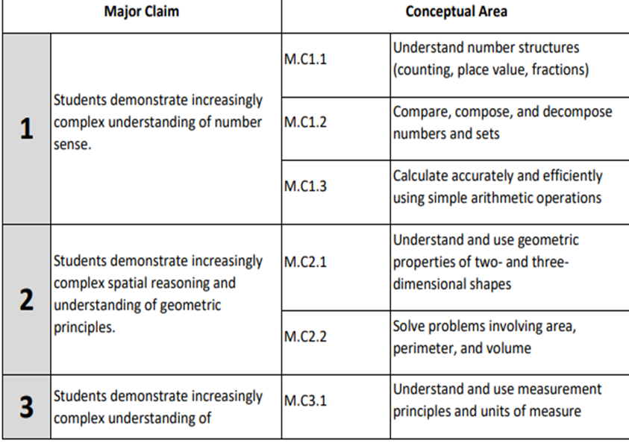
EEs for Each Conceptual Areas – Math Blueprint
https://dynamiclearningmaps.org/sites/default/files/documents/Manuals_Blueprints/DLM_IE_Math_Blueprint.pdf
There is another Major Claim.
Notes:
To: Do: Hand out math page.
To Say: This is the first page of the Math Blueprints. We do not have a full copy of it on the slide. You have a copy of it. Notice that it has four Claims and nine Conceptual Areas just like ELA. Again, your IEP goals in math need to be related to these standards. This time, as a group, lets turn to the sixth grade page and go through it. You will have time to look at the grade page for your student. But, there have been more issues in math of teachers not choosing the correct areas and having to do more tests than required because they did not chose the correct ones.

Slide 63
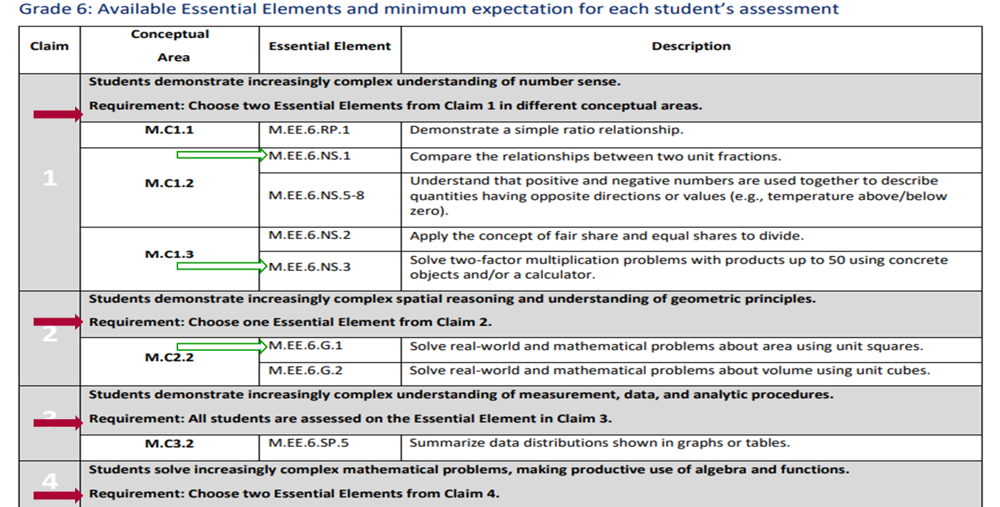
Claims, Concepts, and EEs in Math - Blueprint
Notes:
To Do: Allow participants to look at green handout packet, page 2.
To Say: This is the sixth grade page. Please find it in your packet. Again, we will look in the gray areas, where the red arrows are to determine how many EEs that we need to select to teach and assess. In the first claim area it says select two EEs from Claim I from different conceptual areas. There are three different conceptual areas. So, one conceptual area will not get assessed. So, let’s say that we want to focus on fractions and multiplication; we would chose Claim 2 M. EE 6 NS (Number Sense) 1 and in Claim 3, M EE. 6 NS. 3.
In the second claim area we chose one of the two provided. Lets pick the first one M. EE. 6 G (Geometry) 1. In the three conceptual areas all sixth graders are assessed on that one claim related to using graphs or tables and then, even though you can’t see the fourth claim, you are choosing two or three of the EEs given.
Think about your district and having conversations with the teachers that have your students in grade levels above and below you and begin to line out some articulation so when you make choices about what to teach and assess, there may be some foundational knowledge to build on.
Find the grade level for the children you work with (if its more than one grade level, just pick one for now). Again, this is what should make up your IEP goals and academic content.
Like ELA this is written at the Target Level, there are three Linkage Levels of skills below this and one Linkage Level above this.

Slide 64
Example of Linkage Levels
https://dynamiclearningmaps.org/essential-elements/math
Notes:
To Say: Let’s look at the Linkage Levels for an EE in Math. Remember, it is always written at the target level. Notice on the left is a filter – I will click on sixth grade. Also, notice below the MAP codes there are keys to the math codes. There are a lot of math codes. This will help you understand the areas of math you are teaching and assessing. When I click on one of the EEs, I go to a document that outlines all five of the Linkage Levels. There is a testlet at each linkage that you can give the students.
I am going to click on the ones I chose on the last slide (Click on M. EE 6 NS 1). Let’s go through the levels. I can chose any of these to teach and test. (At this point you can ask if they would like to go through other levels of EE that you chose; EE. 6 NS. 3. M. EE. 6 G 1.)
We can teach and assess at whatever Linkage Level the student is capable of doing. We want to push them to the best of their ability, but also be realistic.
When you look at the Linkage Levels, the Target level is what most closely aligns with the EE, but we can teach at any of those levels and then assess when they are ready.

Slide 65
Science is Different
Notes:
To Know: Science is organized differently than ELA and math
To Do: Show the slide
To Say: “The structure of science is different than that of ELA and math.” The Science MAP-A is only required in the spring and at specific grade levels. Do you remember what they are? (Grades 5, 8, and 11)

Slide 66
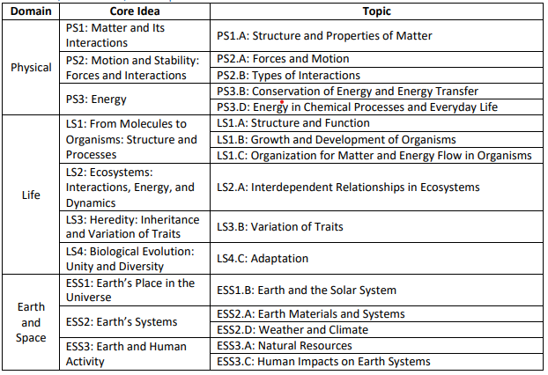
Science
https://dynamiclearningmaps.org/sites/default/files/documents/Manuals_Blueprints/DLM_Science_Phase_I_Blueprint.pdf
Notes:
To Know: The relationship among Domains, Core Ideas, and Topics for MAP-A science.
To Do: Have participants take a few moments to look at the Domains, Core Ideas, and Topics.
To Say: “Please locate your packet and refer to Page 1. What do you notice that is different from ELA or math? (Pause for answers). You should see that science has three Domains, ten Core Ideas, and sixteen Topics.

Slide 67
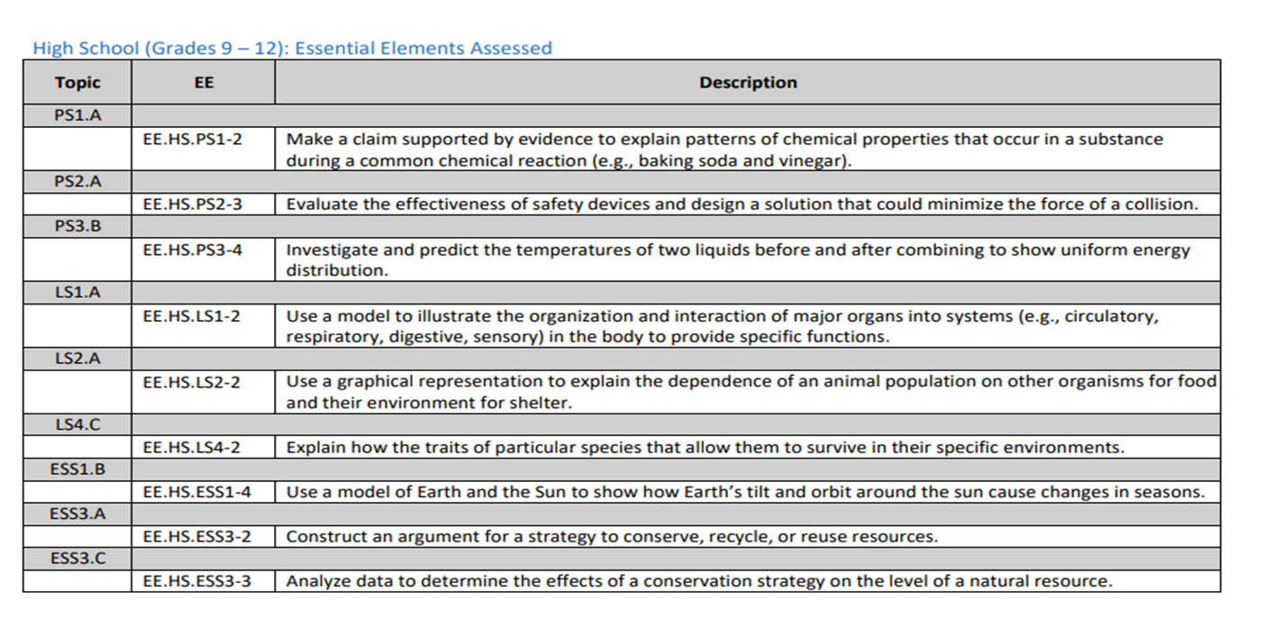
Science Blueprint for High School
Notes:
To Know: The relationship among Topics and EEs for MAP-A science.
To Do: Have participants take a few moments to look at the Topics and EEs.
To Say: “This screen shot is for High School 9-12 and shows the relationship between the Topics and EEs. Science uses grade spans and not specific grade levels. The idea being that for the 11th grade level where the test is given, the grades leading up to 11th grade, teachers are teaching, just not assessing these EE as a part of their instruction. There is no place to select specific EE because all nine EEs are taught and tested.
The MAP-A Science is designed to also be taught in grades 9 and 10 and then taught and assessed in grade 11. If you teach high school special education, work with your teachers and think about developing some articulation on how you intend to teach science at those three grade levels. You might introduce and teach a specific number of EEs each year, with a review of all of them and assess in the students 11th grade year. This way you are not trying to cram it all in during one year. In 11th grade you would review some of the EEs already taught and teach some new ones. Perhaps you might want to do nine EEs over a three-year span, or do three a year with some extra review in 11th grade. You would do the same thing in grades 3-5 and 6-8.
Or, you can teach the lower Linkage Levels of all nine in the years prior to the assessment year. Then during the assessment year you can build on that knowledge and teach/test at a higher Linkage Level.
Like ELA and math there are Linkage Levels in science, but science only has three Linkage Levels. The target - which is what this is written at and two levels below that.

Slide 68
Example of Linkage Levels
https://dynamiclearningmaps.org/essential-elements/science
Notes:
To Say: Let’s look at he Linkage Levels for an EE in science. Remember, it is always written at the target level. Notice that on the left is a filter. I will click on high school. Also, notice in the MAP codes that there are only three areas of science you are assessing. Science is a bit different as it is flipped between the Blueprints page and the screen. Also, there are more than nine EEs on the screen. That is because some states assess high school Biology. Make sure you match your areas that you’ve chosen to test to the Blueprints. Let’s pick the first one to look at. It is Sci EE PH (Physical Science 1-2). Click on that. We can teach and assess at whatever Linkage Level the student is capable of doing. We want to push them to the best of their ability, but also be realistic.
When we look at the Linkage Levels, the Target level is what most closely aligns with the EE, but we can teach at any of those levels and then assess when they are ready.

Slide 69
Calendar
Notes:
Schedule in possible dates for testing in the fall window. This is when you will compare your IEP goals against the Blueprints to see which ones you will be teaching and assessing. Use the required DLM testlets to help you plan how many testlets you will need to provide.

Slide 70
Quizlet IV
How is science different from ELA and math?
All other students must be out of the room when you give the MAP-A.
Target is the linkage level that is most closely aligned to the skill and concept of the EE.
How do you know which of the EE need to be tested?
Notes:
Science is different in it is not required in the fall. The EEs are grade bands instead of individual grades. Test scores from the spring test are only used in the end-of-year score report. Blueprint organization is different because they use domains, core ideas and you do not get to chose – you test all nine. There are only three Linkage Levels compared to the five in ELA and math.
Other children should not be able to see the screen.
Blueprints for that grade level and subject will tell you which EE you can chose from – except science. In science, you will test them all.

Slide 71
Section 6:
Instructionally Embedded Instruction
Using the Linkage Levels

Slide 72
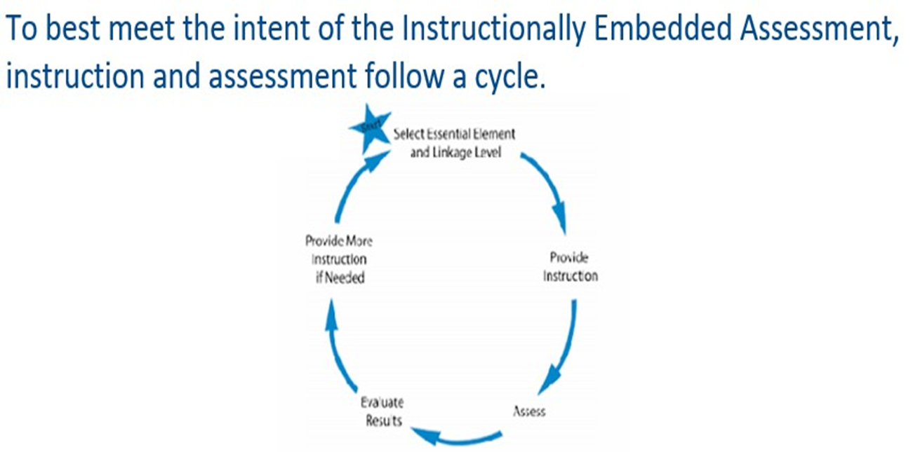
Instruction and Assessment Cycle
Instruct
Assess
Evaluate
Report
Notes:
To Know: Be familiar with the new assessment format for the 2022-23 school year.
To Do: Make sure you have watched the two educator resource videos prior to training and read the Test Administration Manual (TAM).
To Say: The instructionally embedded alternate assessment encourages this cyclical approach by giving teachers the opportunity to choose an EE or elements and Linkage Levels, develop and deliver instruction for the chosen EE, and then assess the student when the teacher determines the student is ready. This graph demonstrates the cycle: instruct, assess, evaluate, and report.
You instruct the material, assess with the MAP-A, and evaluate the results of the assessment. If they are ready, you move on to evaluate and use the report to determine whether or not the student demonstrated understanding of the concept. DLM characterizes it as instruct, assess, evaluate, and report.
DLM Instructionally Embedded Assessments
https://dynamiclearningmaps.org/educator-resource-videos-ie
Getting Started in Educator Portal
https://dynamiclearningmaps.org/educator-resource-videos-ie

Slide 73
How are Essential Elements (EEs) Tested?
Each EE found in the Blueprint can be selected for assessment in ELA, math and/or science. Each testlet is comprised of three to nine items and has an engagement activity.
The testlets for each EE in ELA or math come in five levels of complexity called Linkage Levels.
Linkage Levels are related to the EE and show a graduation of complexity and difficulty.
Notes:
To Know: How EEs are tested.
To Do: Discuss the information on the slide.
To Say: Each EE in the Blueprints can be selected for teaching and assessment. Just make sure you meet the requirements as spelled out on the grade level page. Remember, in science there is no selecting, you do them all. Each testlet will be comprised of three to nine items. They are designed to take between five to fifteen minutes to complete. There is an engagement activity designed to be done before the test to motivate the student, activate prior knowledge, and provide context for the items tested.
There are testlets at all the Linkage Levels. Remember in ELA and math there are three Linkage Levels below and one above. Linkage Levels are designed to help you address the EE at the student’s academic level. The target level is where the essential element is written. Linkage Levels are related to the EE and show a graduation of complexity/difficulty. The linkage levels become more difficult as you move up from the initial level. Each level gets a little more complex as you move through the levels from Initial to Target or even the Successor level.

Slide 74
How are Essential Elements (EEs) Tested?
The testlets for each EE in science only come in three levels of complexity called Linkage Levels.
A student new to the Kite System is placed into the assessment at a Linkage Level based on information the examiner places in the First Contact Survey (FCS).
Notes:
To Know: How EEs are tested.
To Do: Discuss the information on the slide.
To Say: Remember science only has three engagement levels, two below the target. They do not have a Proximal or Successor level like ELA and math.
When you are putting in information about the student in the First Contact Survey (FCS), the Kite system will use that information to determine a Linkage Level they deem appropriate for the student, but you can always override that. You can test at a higher or lower level if you do not think the level chosen by the system will work.
The First Contact survey will be mentioned later. But, it involves information about the students sensory and motor characteristics, ability to access computers, communication and academic skills.

Slide 75
Five Linkage Levels for ELA and Math
Initial Precursor
Distal Precursor
Proximal Precursor
Target (At the EE level)
Successor (Getting closer to Grade Level Standard)
Notes:
To say: There are five Linkage Levels for ELA and math:
Initial precursor
Distal precursor
Proximal precursor
Target
Successor
The target level aligns with the knowledge and skills described by the EE and indicate a student’s performance in relationship to the grade level target.
The least complex level is called the initial precursor, they reflect the foundational skills and understanding necessary for learning academic content (for example focus attention). They are generally for students who do not yet have symbolic communication. Testlets at this level are administered by the test examiner and not on the computer. In this case, the teacher would observe the student’s behavior and record responses.
The two Linkage Levels in between are the distal and proximal. Testlets at these two areas allow students to develop the knowledge, skills, and understanding necessary to reach target.
Testlets at the successor level give students the opportunity to take the next step beyond the expectations described by the EE. If you have students consistently scoring at the successor level, they are probably a candidate for the MAP, not MAP-A.
You will also sometimes find untested nodes between the Linkage Levels. They will help you understand the steps you have to go through to get to each Linkage Level. We will look at some of those untested nodes later today.

Slide 76
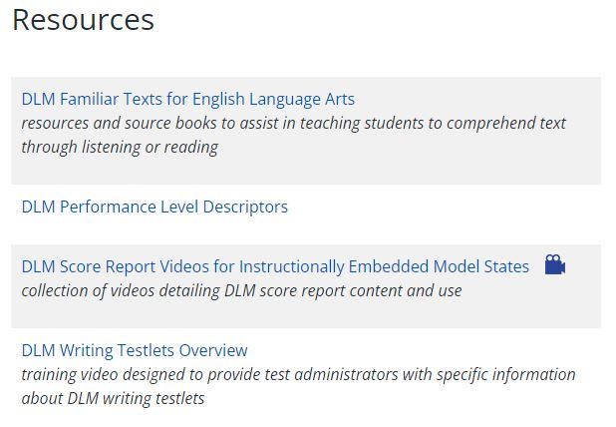
Writing Overview
Notes:
As a part of the ELA, students qualifying for the MAP-A will do a writing assessment each testing window. Because it is administered differently and scored by the teacher, there are helplets on the DLM website you can watch about administering the writing testlets. Writing testlets are required for every student in every MAP-A required grade.
The writing testlets are a little different than other testlets.
Writing testlets assess a combination of two to six writing EE, depending on the grade. All other testlets in ELA, math, and Science measure just one EE.
Even though the computer is the most common way to take a MAP-A testlet, students will always work outside of the DLM system to take the writing testlet.
They can be taken a variety of ways: pen, pencil, crayon, on a whiteboard, a traditional keyboard using word processing software, adapted keyboards, alternate keyboards (switch enabled) alphabet flip charts, eye gaze displays of letters, dictation, or using word-prediction software.
Only the score on the spring writing testlet is used in the end-of-the-year individual score report.
Writing testlets are at one of two levels: Emergent or Conventional

Slide 77
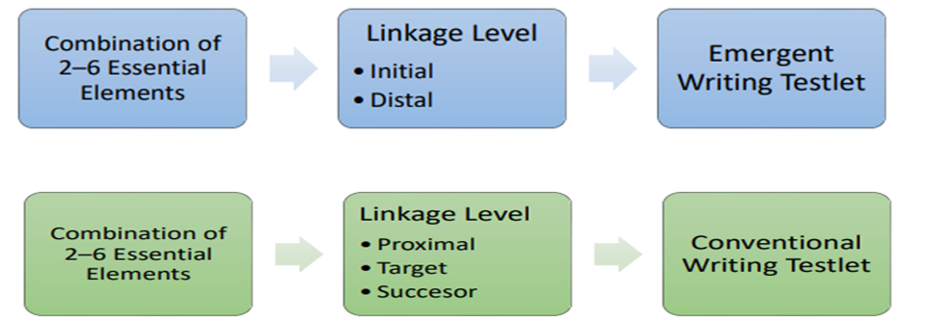
MAP-A Writing – DLM Writing Testlet Overview
https://dynamiclearningmaps.org/instructional-resources-ie/English_language_arts/writing
Notes:
To Know: This is a link to the writing helplet.
To Say: Because the writing testlet is taken outside of the DLM system, it is considered a teacher administered testlet. There will be specific directions called “Educator Directions” that tell you what to show and say to the student. You will score the writing assessment based on your observation. You will be given a range of statements that describe your observation of the student. You need to give students topics to write about, that they are familiar with, and have practiced and written about during instruction. The level of the writing testlet is determined by information in the student’s, we will cover that soon.
Emergent writing testlets are used for students who do not have or are working on early Symbolic Understanding. They would take the testlet at the Initial or Precursor level. Some of the students you’ll assess cannot spell or write words in a way that others can read. These are your Emergent Writers. They are assessed on skills that lead toward conventional writing. For example, if you have a nonverbal student or one who cannot hold the pencil and can only make a mark, he/she would be an Emergent Writer at the Initial Level. Students in grades 3-8 are assessed only on the writing process, they are not expected to produce a written product. Emergent writers in high school are scored on the process, but also expected to produce a product.
For students who cannot hold a pencil or need help accessing the alphabet there is a module on writing with alternate pencil. It is in the PD portion of the DLM page. There are PD Modules in all the content areas of the MAP-A on the DLM PD Website that we will visit later.
Students who have Symbolic Understanding (understanding that letters and words convey meaning) and can use more traditional writing tools to communicate would be at the conventional level. Students who are assessed at the conventional level are assessed on their writing process and are also expected to produce a written product.
The link noted on the slide is to a nine-minute video about giving the DLM writing assessment. On your Navigating DLM handout there are directions on how to get there. It is worth watching as the writing testlet is very different from any other MAP-A testlet you will give.
Students are permitted to use writing tools or letter-by-letter dictation to complete the writing testlets.

Slide 78
The Professional Development Package for Writing
The Professional Development (PD) packages are multi-hour presentations for in-depth training
https://www.dlmpd.com/all-modules-organized-by-claim/
ELA Claim 2 - Includes Working with Emergent Learners: Emergent Writing Module (Three videos and two Learning Activities)
https://www.dlmpd.com/emergent-writing/
Notes:
Because the writing is administered and scored by the teacher there is specific professional development for writing on the DLM site. They are organized by claim and we will spend more time there later today. But just know that in ELA Claim 2 there is PD on teaching writing to students with significant cognitive disabilities. (You can click on the link above)
Modules on Emergent Writing
Writing w/Alternative Pencils
Text Types and Purposes
Writing Information and Explanation Rexts
Writing: Production and Distribution
Writing: Getting Started with Narrative Writing
Writing: Getting Started in Witing Arguments
Predictable Chart Writing
There is also a video on what Emergent Writing is, review some ideas for Emergent Writing activities, and discuss strategies to support emergent writers.
You can also find helpful information regarding the writing test in the Test Administrator Manual (TAM) starting on page 85.

Slide 79

Three Linkage Levels for Science
Initial Precursor
Proximal Precursor
Target (at the EE level)
Notes:
To Know: To learn how students are provided access to an EE in science.
To Do: Read the slide.
To Say: Remember science only has three linkage levels. The top level is target which is how the EE is written on the blueprints and is most aligned to the content of grade level standards. The Initial and Precursor levels are less complex than Target and provide access to the target-level at a reduced depth, breadth, and level of complexity. Testlests at the Initial level are intended for students who do not yet have Symbolic Communication.

Slide 80
Science Assessment
Fall Window
Essential Elements for instruction and assessment are selected in the Instruction and Assessment Planner.
Testlets are optional, but strongly encouraged, during this window.
Testlets taken are NOT used for accountability purposes.
Spring Window
Essential Elements are NOT selected in the Instruction and Assessment Planner.
Testlets are required during this window & used for accountability.
You do not control the order of testlets or the Linkage Level
Found in Test Management tab.
Notes:
To Know: Be familiar with the new assessment format for the 2022-23 school year.
To Do: Make sure you have watched the two educator resource videos prior to training and read the TAM.
To Say: Remember - The DLM science assessment differs from the ELA and mathematics assessment.
During the fall window, science EEs are selected by the teacher in the Instruction and Assessment Planner and are optional. Any science testlets completed in the fall window are not used for accountability purposes. DESE strongly encourages teachers to instruct and assess on science EEs in the fall window, just as they would for ELA and mathematics. It is also set up in grade-level bands so that teachers of MAP-A Eligible students will teach science in grades that it is not tested to help students prepare for the nine required testlets in 5th, 8th, and 11th grades.
In the spring window, science EEs are not selected in the Instruction and Assessment Planner. Rather, the system assigns the science testlets one at a time to the student until the blueprint is covered. It also determines the order on which the EEs are assessed and the Linkage Level for each. As the Test Administrator, you can’t change the order or Linkage Levels. Science testlets taken in the spring window are used for accountability purposes.
Again, DESE encourages all teachers to instruct and assess on science EEs during both windows.

Slide 81
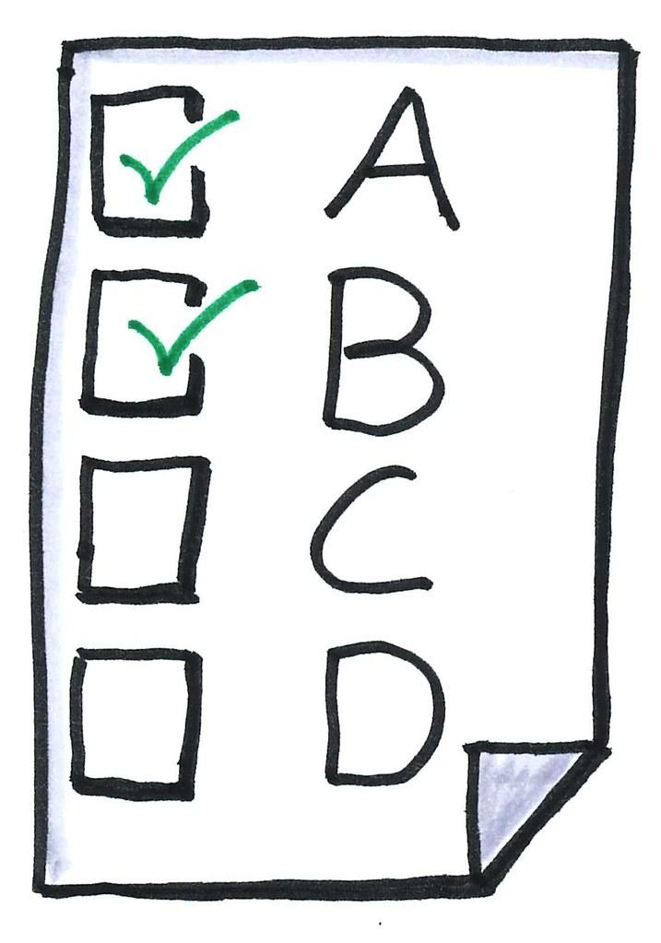
Administering the Instructionally Embedded Assessments
Individual assessment – not a group assessment where the class takes the same test at the same time
Not to be administered in a group at the end of a window, where all testlests are taken in a short time
Multiple choice is the most the common type of test questions
Each activity begins with an engagement activity
Most testlets are designed to be taken on a computer
Notes:
To Know: Be familiar with the new assessment format for the 2023-24 school year.
To Do: Make sure you have watched the two educator resource videos prior to training and read the TAM.
To Say: The assessment is delivered in testlets. Each testlet assesses one EE at one Linkage Level except for writing. In writing depending on the grade it may assess between 2-6 EE.
There is only one assessment at each Linkage Level, so if you assess an EE and the student does not do well, you can’t assess at that level again in the same testing window. DLM has been adding more tests at each level, but at this time we do not know which EE may have more than one test at the same level.
Instructionally Embedded Assessments are administered after the student has received instruction on an EE. Each student is assessed individually, even if several students received the same instruction and may have the same EE as a part of an IEP goal.
Instructionally Embedded Assessments should be administered throughout an assessment window. Students with the most significant cognitive disabilities are best able to demonstrate what they know and can do so when a cyclical approach to their instruction, assessment, and evaluation is used. As opposed to being assessed at the end of a semester or school year on a whole unit of instruction, they must remember from weeks and months ago.
There are various types of questions on the assessments but multiple choice is the most common type.
We mentioned this earlier but it bears repeating, there is an engagement activity designed to be done before the test to motivate the student, activate prior knowledge, and provide context for the items tested. If in ELA or science they are listening to a story being read it is a pre-read and a chance to talk about the story and make connections. In math it provides context to what they will be asked to do. Often times the engagement activity does not require a response. Science engagement may be a screen with pictures that introduced the topic, or it might describe a scenario that taps prior knowledge or possibly a short video where they will respond to some items on the video. Do not skip the engagement activity. It is designed to get students ready to be assessed.
The MAP-A is designed to be computer administered. Most of the testlets will be taken on the computer with a few exceptions. All the initial level testlets are teacher-administered because students do not have the symbolic representation skills for computerized assessments. All of the writing subtests are not on the computer and a few of the successor-level math items are not on the computer because they are too abstract.

Slide 82
Instructionally Embedded Assessments
Identify student’s knowledge, skills, and understanding relative to grade-level targets
Utilizes student progress reports to
  Evaluate if additional instruction is needed
  Determine if the student is ready to move on to another Linkage Level or EE
Notes:
To Know: Be familiar with the new assessment format for the 2022-23 school year.
To Do: Read the TAM. Possibly highlight where to find answers to common questions.
To Say: Instructionally embedded assessments can be used to identify a student’s knowledge, skills, and understanding relative to the EE and IEP goals after receiving instruction. A progress report is generated regarding whether students passed or failed the assessment on a particular EE.
The student’s progress report may be used at any time within the cycle to evaluate if additional instruction is needed or the student is ready to move on to another Linkage Level or EE. It is very helpful to look at the fall progress report to plan for the spring instruction and assessment cycle.

Slide 83
Instructionally Embedded Windows
One testlet per EE chosen in the Instruction and Assessment Planner in ELA, math and science
Each teslet is assigned separately
Test administrator schedules sessions within instructional testing window in BOTH fall and spring for ELA and math
Notes:
To Know: How to administer the MAP-A.
To Do: Show slide and share information.
To Say: “This slide summarizes some of the information mentioned earlier. It never hurts to hear complex information more than one time.”
One testlet per EE, except in Writing. We will talk more about the Instruction and Assessment Planner in the next section.
It is also important to understand that you can only assign one testlet at a time in a specific area. For instance, you can have one ELA and one math testlet assigned, but you can’t have two ELA testlests assigned. After the student takes the testlet, you can assign the next one right away. But, it can take anywhere from ten minutes to two hours for the testlet to show up in the student portal where the student can access it. You assign the testlets in the Educator Portal, but they will show up in the student portal for the student to take.
Then you need to access the TIP page to ensure you have all the materials necessary to give the test. People who are familiar with the MAP-A talk about assigning the test the day before they plan to give it so they can assure they have the items necessary to give the MAP-A. We will show you some of the types of materials needed in a later slide.

Slide 84
Important Dates for Testing Windows
Fall window: REQUIRED – ELA, math and science (optional in fall)
  September – December
Spring window: REQUIRED – ELA, math and science
  February – May
DLM will be closed from 5:00 P.M. on December 23 through February 4!
You will need to RE ENTER the EEs again on the IAP before you can begin testing in the spring. The first day the IAP will be open is February.
Notes:
To Know: The dates are important for participants to know.
To Do: Show slide
To Say: These are the two testing windows that all testing for that window needs to take place. We showed you where you can find these on the DESE webpage. They have been known to change at times by a day or two - so check occasionally. Because when that window closes, there is no opening it - period. When the window closes in December you will not be able to test, even if you did not finish.
When DLM is closed you will not be able to go into the system and select your EE for testing in the spring window. You might want to go ahead and print out the student progress report before you leave for Christmas break so you can begin the process of teaching EE - but you can’t start assessing until February 5. You can’t even select the new EE in the system until February 5. So use your blueprints and currently tested EE to pick the EE and Linkage Levels and go ahead and start teaching and then plug them in the system as soon as it reopens in February.

Slide 85
Quizlet V (Eight Questions)
Testlets include an engagement activity followed by test questions.
The Embedded Instruction cycle is evaluate, report, assess and instruct.
First Contact Survey (FCS) contains only questions about a student’s academic skills.
There are no professional development (PD) modules in ELA.
Notes:
TRUE - The engagement activity is designed to engage the student in the testing process.
FALSE - The cycle is instruct, assess, evaluate and report.
FALSE – The First Contact Survey (FCS) involves questions about sensory and motor characteristics, ability to access computers, communication, and academic skills.
FALSE - There are PD modules in ELA, math and science.

Slide 86
Quizlet V - Concluded
Testlets are always aligned to more than one Linkage Level.
Question and answer is the most common format found on the MAP-A testlets.
The most common way to give the MAP-A is a computer-delivered testlet.
Linkage Levels are related to the EE and show a gradation of complexity and difficulty.
Notes:
False - Items within a testlet are aligned to only one Linkage Level.
False - Multiple choice
True
True

Slide 87
Section 7:
Tasks & Tools for Teachers
Notes:
To Say: As you have probably figured out by now, there are lots of moving parts to the MAP-A. Let’s dive in and start looking at some of the tools. Again, we have a sheet of directions that will walk you through this section.

Slide 88

DLM Landing Page
Notes:
It is our goal that you have done this step already. It was in the e-mail you received from us. One of the first things a Test Administrator needs to do is make sure they can login to the DLM site. Getting you into the system needs to be done by the District Test Coordinator or the District Technology person. There are directions to do that in their manuals. Once they put you in the site, it may be up to a week before you are activated. You should get an e-mail from DLM. If you know you are in the system and after a week you did not get one, you may want to try to go ahead and login. We will talk about that process more at length a little later.
This page is known as the landing page. At the top middle of the landing page is “Educator Portal”. Remember, this is where you take the assessments. This training is designed to help you be ready for the tests. The brief quizzes provided throughout this presentation today were modeled on those questions. Read the questions carefully when you take the test, because sometimes the wording can be a little confusing.

Slide 89
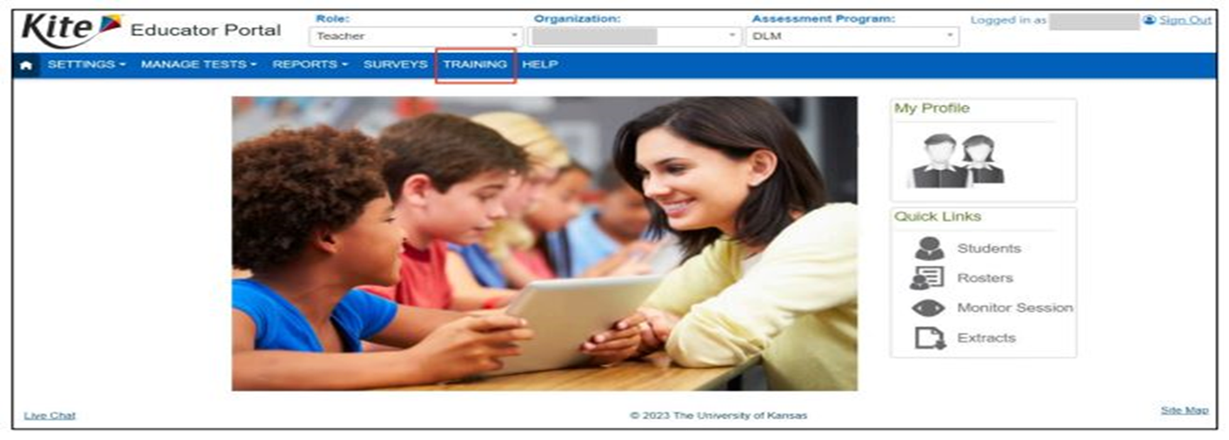
Access to Training
Training courses are now in the Educator Portal.
mbscherer@ucmo.edu Password: mbscherer
Notes:
To Know: Teachers will be expected to read “Guide to DLM Required Test Administrator Training Manual”.
To Do: Show the slide and the guide.
To Say: The Guide to DLM Required Test Administrator Test Manual helps ensure you have the information you need to administer the tests to your students with fidelity. Because it is a nationally normed test, the consistency in administering it is vitally important.
Once you are in the system you will be able to gain access to your required modules and tests. Since you have been through RPDC training, you can go straight to the tests. u can take them in the facilitated format, since you have been through RPDC training and go straight to the tests. List your district as where you received the facilitator training. If you take them in the self-directed you will have go through the modules to get to the tests.
On page 4 of the Required DLM Test administrator training manual you will find the steps to set up your account. You can access the required training log-in (click) through the Educator Portal
Your log-in is your e-mail address and your password is your name up to the ampersand Once you log in you will be prompted to change your password. Make sure you keep it in a safe place, you will need it everytime you log-in.

Slide 90
Required Test Administrator Training
READ the Guide to DLM Test Administrator Training Manual
    Module 1: Overview of the DLM Alternate Assessment
    Module 2: Testlets
    Module 3: The Instructionally Embedded Model
    Module 4: Becoming Familiar with the DLM website and its Resources
Any person administering a MAP-A for the first time, must complete the four modules in the order listed above and receive an 80 percent or higher on the post-tests in order to administer testlets.
Notes:
To Know: Modules needed to become qualified to administer MAP-A for the first time.
To Do: Be sure participants are aware that they must complete these four modules and pass with 80 percent accuracy BEFORE the teacher will receive information on the First Contact Survey and the Personal Needs and Preferences Profile (PNP).
To Say: Remember, you will need to be sure to complete each of the four required tests with 80 percent accuracy.
These modules may be done as self-directed or facilitated. However, you will need to take the tests individually. Please be sure that once you have completed all four tests successfully, you click “Get Certificate” and print for your files. But first, review the Guide to DLM Required Test Administrator Training Manual. It will make things much easier when you take the time to prepare.
Once all modules tests have been passed with at least 80 percent accuracy, DLM will give access to student information within the Educator Portal.
If you have not started in the system, you will need to receive access immediately. It will take time to get you into the system. Then you will need to take the tests and input data on the students you will oversee BEFORE you can begin selecting your EE that you will be teaching and assessing in the system. If it takes longer than one week for you to receive confirmation that you are in the system, please contact your assessment coordinator or data manager.

Slide 91
Calendar
Notes:
Be sure to schedule on the calendar when you will be taking the training courses.

Slide 92
Educator Portal-Kite
DLM Landing Page
Notes:
You see the two green arrows. The Educator Portal is the part of the system that you will use. It is where you will put in information on the student and where you will select the EE that you will teach and assess. The Kite Suite is where you will find the student portal. It is where they will take the tests if they are being done in the system on a computer or tablet. Take time to read the Educator Portal User Guide. This is a great resource that explains all the features that are provided. It takes you step-by-step through what is in the Educator Portal and has pictures of what the screens actually look like. There are also some short videos on navigating the Educator Portal.

Slide 93
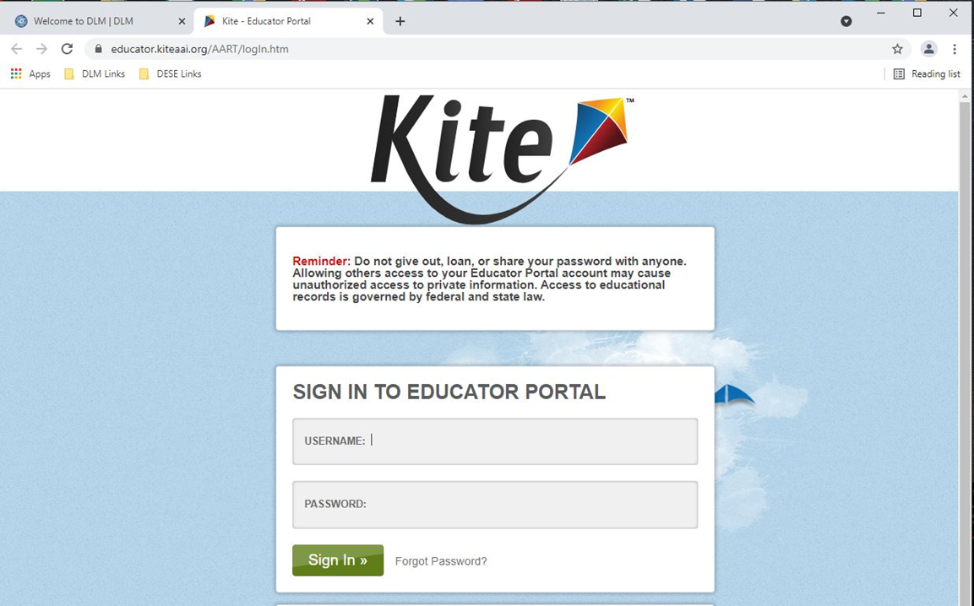
Login to Educator Portal
Notes:
To Do: If you have a sandbox ID, immediately after this slide, you will be taken to the Educator Portal. Log in and go into FCS and Personal Needs and Preferences (PNP) tabs. You should have 50 students in the sandbox. Sign in and use “Role of Teacher” and “Find Students” to do FCS. Once completed, you may then go to the IAP.

Slide 94
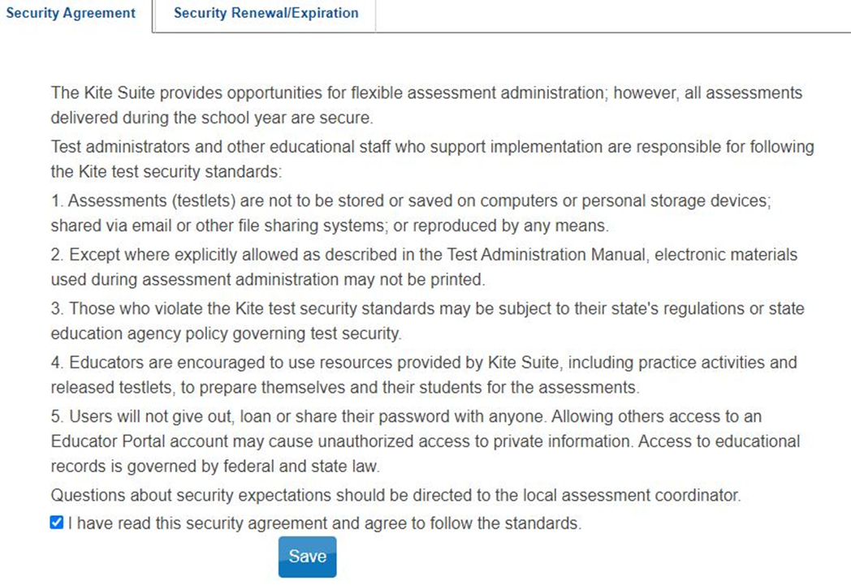
Sign the Security Agreement
Notes:
To Say: The first thing you will do after you pass your tests and login to the to Educator Portal is click on the Security Agreement tab. You will not be able to do anything in the Educator Portal until you do this. Test Administrators are required to do this step every year.

Slide 95
Test Security
Things you CAN’T do:
Share Educator Portal passwords
Save testlets on a personal storage device
Post items on social media
Test outside regular school hours
Notes:
To Say: Read the test security agreement before you sign off. This is a nationally normed test which means we need to use it in the same way and treat the test items as secure.
If you have a password, it is for you ONLY (not your para or another teacher)
You can’t save the testlets on a personal storage device for practice. You can use the released testlets to practice - but not a regular testlet
You can’t share questions on the test with others on social media or in person
You should only test students during regular school hours.
If the system detects testing at night or on weekends, your district will get a call and an explanation will be required. There may be instances where this might be justified (student is out sick and must complete process outside regular school hours), but that is very rare and it will generate a phone call. There have been instances where districts have been notified of “outside of regular hours testing” and there was no justification for it. The consequences for the Test Administrator were not positive.

Slide 96
The First Contact Survey (FCS)
Go to Landing Page and then Educator Portal
Login using email address as your Username and Password
Click on “Settings” and then select “Students”
Click “Search”
Find student’s name
Find “First Contact” column
Click on “Hotlink” in First Contact column
See TAM, Appendix A for First Contact
ALL previous First Contact Surveys are gone and MUST be REDONE!
Notes:
You need to check the students that are assigned or what DLM calls “rostered” to you. These are the students that you will be assessing. If you see a student’s name that is not familiar to you, let your Test Coordinator know right away.
You are required to do a FCS for every student. (Click) All previous FCSs that were in the system have been deleted. You will need to redo FCSs for all students! You will need to have the student’s evaluation report and IEP to help you fill out this section. The FCS must be completed before testing.
We talked about the First Contact Survey (FCS) earlier while discussing Linkage Levels. The FCS helps the system determine at what level you will need to teach and assess the student. It will recommend a level; you can always override it if you do not agree. In the FCS you are providing information about the student’s disability, their sensory and motor characteristics, their computer skills, communication, and academic skills.
In the Test Administrator Manual under Appendix A on page 120 you will find the questions you will be asked to address on your students in the FCS.

Slide 97
Personal Needs and Preferences (PNP)
The teacher uses Education Portal to complete Personal Needs and Preferences (PNP)
One PNP is completed by the Test Administrator for each MAP-A student.
The PNP lists accessibility options that will be used by the student as he or she takes tests administered in Kite Student Portal
Completing a PNP for each MAP-A student ensures the testlets are personalized and accessible for each student
It ensures that the student’s academic skills are what is being assessed and NOT their use of technology
Notes:
To Know: The purpose of a Personal Needs and Preferences (PNP)
To Do: Show the slide and share information.
To Say: One “Personal Needs and Preferences” (PNP) is completed by the Test Administrator/teacher for each MAP-A student. The PNP lists accessibility options that will be used by the student as he/she takes tests administered in Kite Student Portal. Completing a PNP for each MAP-A student ensures the testlets are personalized and accessible for each student.
Some students may not need any accessibility options. There will be a place you can check “No Accessibility Options” and be done. Others may need enlarged printing or light printing on dark screens to better access and respond to the test questions. There is an Accessibility Manual should your students need accessibility options. Keep in mind if you do not need to teach using the accessibility features, do not test with them. Be consistent in how you teach and how you assess.
The MAP-A is not a test on a student’s computer skills. Their use of technology is not being assessed. This is why there are so many built-in accessibility features. The MAP-A is a test of academic ability!
Changes to the PNP take 24 hours to refresh. So, if you have to change something, remember that you will not get the accommodations you need on the student testlets for at least 24 hours.

Slide 98

The Two Main Parts of the Kite System
Kite Student Portal is an application students will use to take tests. Students will need a Kite username and password.
  Student Portal Version 9 is still current
Kite Student Portal is an application that allows educators to enter and manage student data, enroll students in instructionally-embedded assessments, retrieve test tickets, and access professional development and training modules.
  Limited login attempts (5) and automatic time out after 40 minutes
Notes:
To Know: Where and how to access Kite Student Portal and Educator Portal and the purpose for each.
To Do: Show the slide and share information.
To Say: Five systems operate under the Kite umbrellas, but there are two parts that you will mainly use:
Kite Student Portal (for students) is an application students use to take tests. Each student will have a Kite username and password. They will need those to access the testlets. You will need to make sure they are kept in a secure place. If they are 4th grade or older, they should already have a username and password. You will need to find out from the Test Coordinator what that is. If they are new to the system, you will create one for them. The Kite Student Portal needs to be loaded on all student devices on which the MAP-A will be taken.
(Click for 23-24 Update). Generally, every year your tech folks have to update the Student Portal to get the most current version. But, this year we are still using Version 9.
Educator Portal (for educators) is an application that allows educators to enter and manage student data, enroll students in instructionally-embedded assessments, retrieve test tickets, and access professional development and training modules. Educators have an Educator Portal username and password. Keep it in a safe, secure place.
(Click for 23-24 Update) One of the changes this year is limited log in attempts - you only have 5 attempts and you will be timed out after 40 minutes if it has been opened and not in use.
You can find information about logging in in the Educator Portal in the Educator Portal User Guide. The Educator Portal User Guide is the place to go to learn about what happens in the Educator Portal or the other really helpful manual is the Test Administration Manual.

Slide 99
The Teacher Duty Checklist
Complete First Contact Survey (FCS)
Update Personal Needs Profile (PNP)
Create instructional plans in the Instruction and Assessment Planner
Instruct students
Test students in Student Portal
Check the DESE MAP-A Update to keep up with current guidance and deadlines
Caryn.Giarratano@dese.mo.gov
Notes:
Once you are in the system and have taken the required modules, this list shows you the things that will need to be done. The first three bullets are completed in the Educator Portal. We will talk about the Instruction and Assessment Planner next. You prepare for the testing in Educator Portal, but the student takes the test in the Student Portal. Also, keep reviewing the MAP guidance from DESE or your district. You can email Caryn Giarratano and asked to be put on the MAP-A mailing list.

Slide 100

Parental Notification of Test Results
By July 1, notify parents to let them know how and when they will receive their child’s test scores.
Notes:
To Say: This tends to be a little known federal requirement. We are required to notify parents by July 1 of each year to let them know how and when they will receive their child’s test results. Develop a notification method that goes home with the student to the parents prior to the end of the school year. It should outline your procedure for providing the parents with test results. You can send test results home the first week of school or at a parent-teacher conference. Just let the parents know how they will receive notification prior to July 1.

Slide 101
Calendar
Notes:
Be sure to schedule on the calendar when you will be checking your roster, putting in or reviewing the FCS and PNP profiles.

Slide 102

Quizlet VI (Nine Questions)
Why do I need to read or review the DLM Required Test Administrator Manual?
Where do I ensure that the student received the accessibility supports they need?
I will complete the Test Security Agreement in the Student Portal?.
Which manual would I reference on how to use the Educator Portal?
It is not a violation of the test security policy to use released testlets as practice pieces.
Notes:
Ensures teachers administer the assessment with fidelity – remember, this is a tests used across many states. It needs to be administered the same way for the scores to mean something.
The Personal Needs Profile section in the Educator Portal
False – The Educator Portal
Educator Portal User Guide
True – It is a violation to share or keep test questions or share passwords.

Slide 103
Quizlet VI
The list of students that I am responsible to test is called the Test Administrator’s __________________________.
Because the test is administered on the computer, it is also used to assess the student’s technology skills.
The Kite System will suggest a level for the student to test at and that is the level you will have to go with.
What is the name of the application where students take the test?
Notes:
Roster
False - Although it is a computer-based assessment, it is not intended to assess their technology skills because of all the built-in accessibility features.
False - The Kite System will recommend a level based on the First Contact Survey, but the Test Administrator can override the system and chose the level they think is best.
Student Portal

Slide 104
Instruction and Assessment Planner (IAP)
Notes:
To Say: You will no doubt spend a lot of time in the Instruction and Assessment Planner, better known as the IAP. It is in the Educator Portal. Let’s check it out.

Slide 105
Making a Plan for Assessing Students
Access the Instruction and Assessment Planner
This planner is a section in the Educator Portal where Test Administrators create plans for their students and assign testlets.
  Select Essential Elements
  Assign testlets
  Access the Test Implementation Sheet (TIP)
  Review test results
  Print the Essential Element Status Report
All Test Administrators should read the Educator Portal User Guide.
Notes:
To Say: The Instructional and Assessment Planner is a section in Educator Portal where Test Administrators create plans of what EE will be tested for their students and assign testlets. In the Instruction and Assessment Planner, the Test Administrator can complete a variety of tasks.
Because the Instruction and Assessment Planner (IAP) does not open until the testing window opens, I would suggest completing the FCS and PNP as soon as you can. This way, when the testing window opens on September 11th, as the Test Administrator, you can log in and choose the EE you intend to teach. You will also assign the tests in the IAP when the student is ready to be assessed.
We tell the Test Administrators that they should have already selected, at least on paper, some or all of the EEs they plan to teach and assess and start teaching the EEs before the window opens in September. Just because you can’t get into the IAP does not mean you do not start the teaching.
Also in the IAP, you will review the Test Implementation Sheets (TIPs). We will go more into the TIP sheets a little later. Once a testlet is taken in the Student Portal, you are able to review how the student did and periodically print out an EE status report to check the progress on your students completing the required testlets. The IAP is part of the Educator Portal that you will interact with often throughout the MAP-A process.
There is a good helplet on Using the Instruction and Assessment Planner. It’s only about five minutes long. It can be accessed on the DLM page under the Educator Resource videos.
To Do: If time allows, show the video called, “Using the Instruction and Assessment Planner” (4:49). https://dynamiclearningmaps.org/erp/videos#EPUsingPlanner

Slide 106
Testing Pattern
Instruct Essential Elements (EEs)
Assign the test in the Instruction and Assessment Planner (IAP)
Test immediately in the Student Portal
Evaluate results
Check report
Repeat
Instruct
Assess
Evaluate
Report
Notes:
Remember, this is the cycle that you will go through during each testing window. You instruct the material; assess with the MAP-A; and evaluate the results of the assessment. You will then move on to evaluate and use the report to determine whether or not the student demonstrated understanding of the concept. DLM references the cycle as Instruct, Assess, Evaluate, and Report.

Slide 107
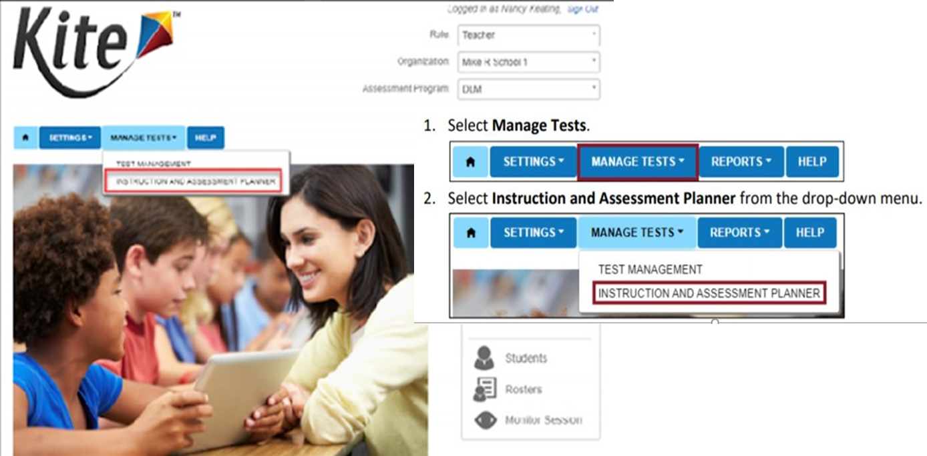
Instruction and Assessment Planner
Notes:
To Do: Make sure you have watched the two educator resource videos prior to training and read the TAM.
To Say: The Instruction and Assessment Planner (IAP) is located in Kite Educator Portal under the “Manage Tests” tab. The IAP is where you chose the EE you are teaching and assessing at the correct Linkage Level for your student(s). Also, when the student is ready, this is where you will launch the testlet into the Student Portal. Your work is in the Educator Portal, primarily in the IAP and the student will take the testlets in the Student Portal.

Slide 108
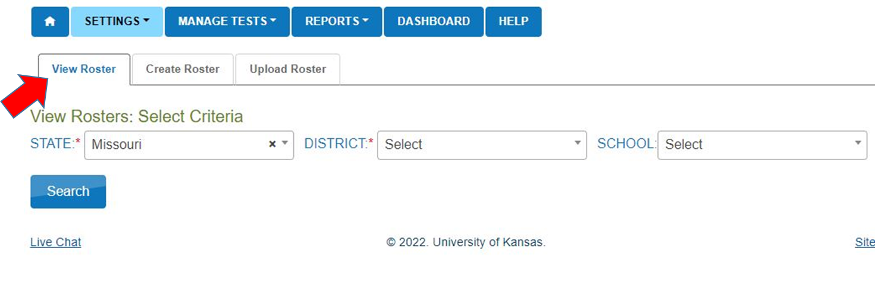
View Roster
Notes:
To Say: Remember, we discussed when the testing window is open you will want to view the roster. This is where you will see the students that are rostered to you – or assigned to you by your district for MAP-A completion. If you see students you do not recognize, talk to your District Test Coordinator or your data manager.

Slide 109
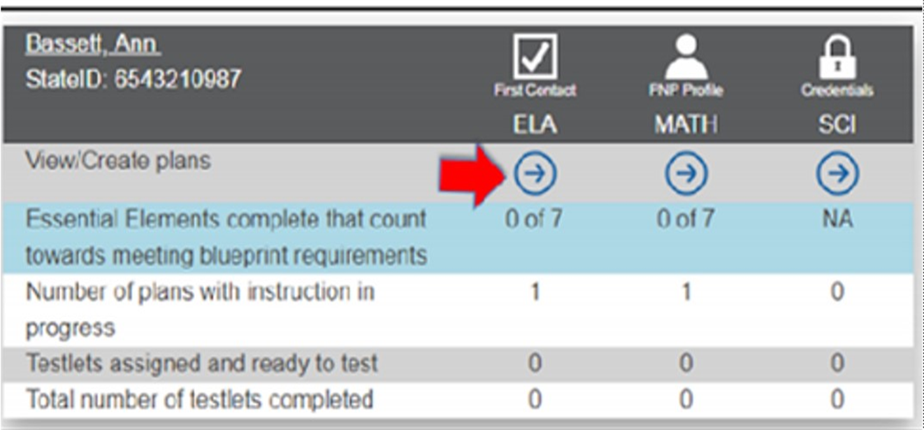
Instruction and Assessment Planner
Notes:
To Do: Make sure you have watched the two educator resource videos prior to training and read the TAM.
To Say: When opening the IAP, the first screen is the Student Activity Table. This table is where all students rostered to a teacher will appear. The Student Activity Planner provides a quick overview for all rostered students on where they are in meeting blueprint requirements, plans for instruction, and testlets assigned during an assessment window. If you look at this student, you can see that she has completed 0 of the 7 required testlets in ELA and math, but the instructor has one ELA and one Math EE where instruction is in progress. Notice the “N/A” in science which tells us that, for this student, science is not required.
Please note at the top of this slide in the gray area on the IAP that you can also access the First Contact Survey, the PNP Profile and the Credentials, where the student login information is kept. You are able to access these important locations from the IAP.

Slide 110
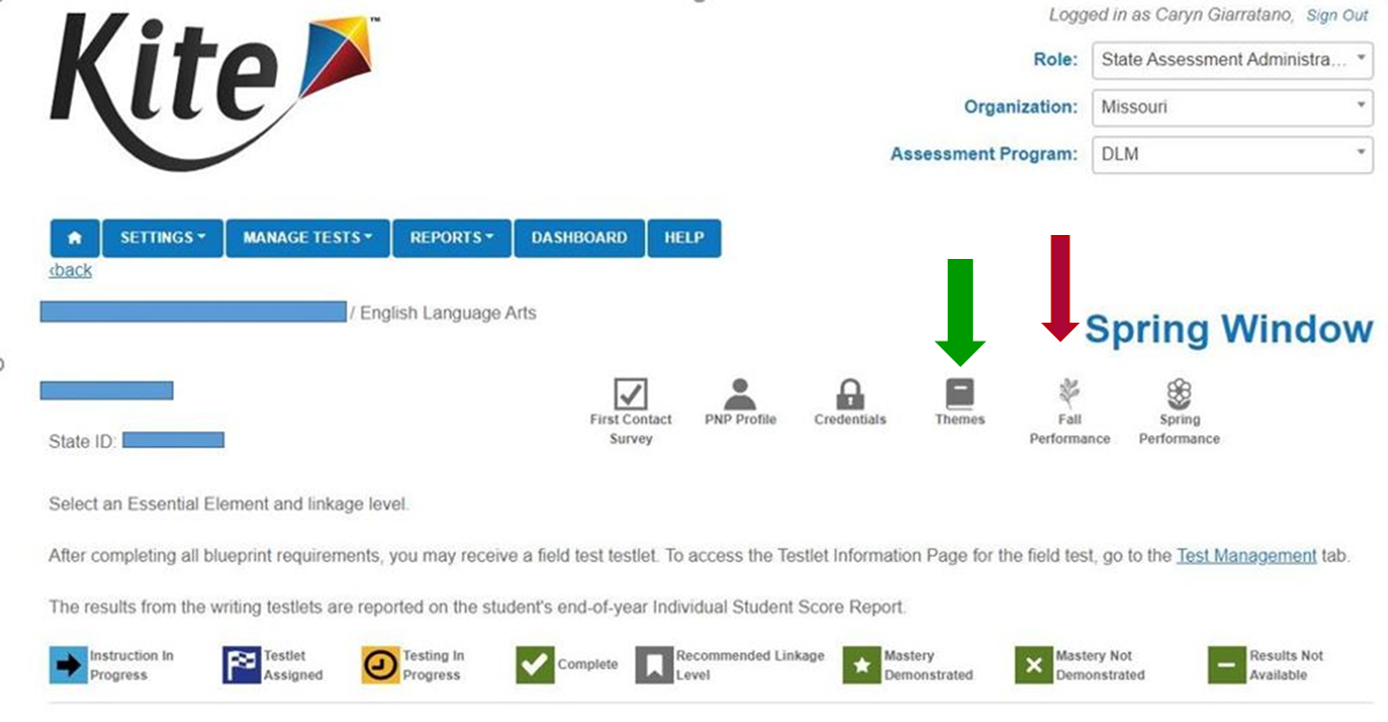
Student View Page
Notes:
To Say: This is the individual page for a student for the spring window. On this page, you can access the Essential Elements Status Report for fall, which tells you what EEs have been tested and how the student did. This report can be printed for reference and determining what EE to select for the spring window. On the right side of this slide under the red arrow is where you will find the Fall Performance tab. It shows information including the blueprint coverage and mastery. The other icons across the top have been covered on previous slides, except for “Themes” which is marked with a green arrow.
The “Themes” icon brings up choices for the teacher. The teacher selects the themes that a student should NOT receive. These themes need only be selected one time for the entire year and will impact the EE during both windows. It will also carry over to the next year. A teacher can change the selections at any time during the year when the window is open. An example of when you might use it would be if a student has a fear of dogs and you do not want them to have a story on dogs because they might become upset and make testing difficult. You can click on “Dogs” and no stories about dogs will appear. It is quite possible that you may not have to select themes.
At the bottom of this slide are icons that will appear on the section where you chose the EE to teach and assess. Let’s take a moment to go through them. The first one (arrow) denotes that you have picked that EE and instruction is in process. Many experienced teachers pick all their EEs at the beginning of the window and this icon will appear because the EE was chosen. Even though you may not be instructing on all of them, you have designated the ones you will be addressing specifically in this testing window. It may help with your planning instruction.
The next icon, the flag indicates the testlet has been assigned and will be available for the student to take in the Student Portal shortly. Once the testlet is assigned, it is difficult to unassign it, it can’t be done by the Test Administrator. Do not assign it unless you are ready to test. After teaching you may decide you need to test at a higher or lower level.
Once the student starts testing, the icon will be orange which means the student is taking the test.
When it turns green and has a checkmark, it means that testlet is complete.
When you put in the first Contact Survey information and chose your EE you will see one of the Linkage Levels (ribbon). That is the level the Educator Portal suggests. But, as the Test Administrator, you have the final say and can chose another level if you believe it is more appropriate.
The last three green icons tell you how a student did on the testlet. Though not detailed the star represents that mastery was demonstrated. An X indicates that mastery was not demonstrated and a minus sign will indicate that results are not available which could mean that they started the testlet, but didn’t finish it.

Slide 111
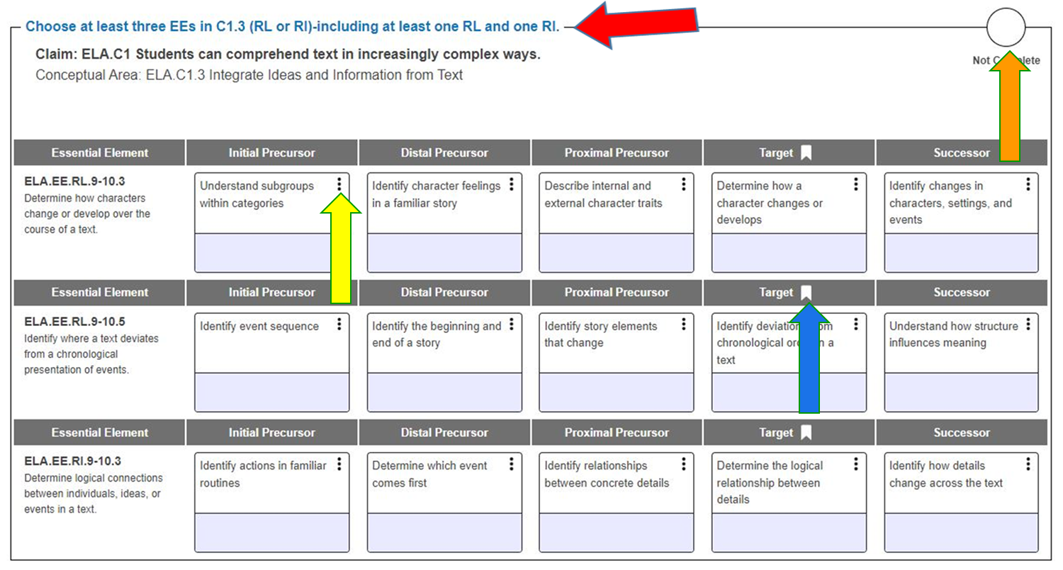
ELA Student View Page Example
Notes:
This gives you an idea of what an IAP will look like. This is a portion of the ELA Student View page for a grade 4 student. Notice the similarities to the grade 4 ELA Blueprint covered earlier in the presentation.
Red Arrow: Is similar to the shaded area on the blueprints page, it includes the blueprint requirements. This one says chose three EEs in Claim 1 EE must be from two different strands (RL & RI).
Blue Arrow: The ribbon/flag indicates where the First Contact Survey placed the student. The recommended Linkage Level for the selected EE was Initial Precursor, as indicated by the ribbon/flag. Again, the Test Administrator has the final decision of the Linkage Level.
Yellow Arrow: The three dots are called a kebab and when clicked on it gives you the Linkage Levels and Mini-Map. Remember, we also can find this in the Currently Tested EE on the MAP-A and DLM websites. We will review Mini-Maps on an upcoming slide. Also, in the kebab you will find the complete EE, because they could not put the entire verbage for the EE in the little boxes.
Orange arrow: In the circle, when you have all the testlets completed in this area, there will be a check and the circle will be green. It helps you to quickly see what you have completed.
The light blue at the bottom of the EE are will change color as you progress through the instruction and assessment cycle. When it is a teal blue, it means you have instruction in process. It will turn dark blue when a testlet is assigned; orange when testing is in progress; and finally green when testing is complete. If you recall the codes on the previous slide on the left side of the box there will either be a star for Mastery, an X for Not Mastered or a minus sign for “Not Available” and the date the test was completed will be on the right side
To Do: Make sure you have watched the two educator resource videos prior to training and read the TAM.

Slide 112
Instruction and Assessment Planner as a Tool
Combine several EEs into an instructional unit and select them at one time.
When the assessment window opens, select all EEs planned for instruction so a student meets blueprint requirements.
Print the Student View page after making selections and create a timeline for instruction and assessment throughout the window in order to meet requirements.
Notes:
To Say: When you select all the EEs you intend to teach and assess in each of the testing windows in your IAP, as soon as the IAP opens, it serves as a road map for instruction for that time period. Print out the Student View Page and refer to it as you plan instruction. It helps to print them out for all your MAP-A students. You can compare the various Student View Pages to find the common EEs and plan to teach them together if possible.
It makes sense to combine more than one EE item in lessons and activities. It is not designed that you teach each EE as a completely separate skill. You do not need to teach each one discretely. Combine them into units. We will talk a little more about that as we move forward. Testlets include one EE at a time, except in writing. Writing testlets will include between two to six EEs. You can only assign one testlet at a time in the same area. When the testlet is taken you can move on to the next testlet in that specific area.
So, do not assign the testlet until you are ready to test and keep in mind that it can take anywhere from ten minutes to two hours for that test to be loaded by the Kite System into the Student Portal, where the student will take the testlet. Experienced testers recommend assigning the testlet 24 hours before you plan to give it in order to give yourself time to prepare for the process. That is another reason why you do not want to wait until the end of the testing window to do all your testing. Also, do not assign the testlets until you are ready to have the student assessed. Once they are assigned it is very difficult to unassign them. It could be that after you teach, you realize that the Linkage Level is too difficult and you may need to assess at a lower level. If you assess at one level and they do not demonstrate mastery, you most likely cannot test at that Linkage Level again during that testing window. DLM is adding more tests to the Linkage Levels, hoping that one day there will be multiple tests at each Linkage Level. Right now we do not know which EE have more than one test at a Linkage Level.
You will have to do this process twice, both in the fall window and then again in the spring window. You cannot do it in the spring until the window reopens on February 6th. We encourage teachers to already have your spring window EEs chosen using your fall report. You want to be able to start teaching the chosen EEs in January, prior to the window reopening.
You can teach and assess the same EE in both testing windows. You might teach and assess that EE at a higher level, or if they did not do well at the Linkage Level, you can chose in the fall, to teach and assess at the same Linkage Level or a lower Linkage Level.

Slide 113
Calendar
Notes:
On the calendar, note when you will be choosing the blueprint EE in the IAP.

Slide 114

Quizlet VII
Where do Test Administrators chose the EE they intend to assess?
What are the two places that Mini-maps can be found?
The FCI, PNP, and Student Login information can all be found in the IAP.
Notes:
The Instruction and Assessment Planner (IAP)
The IAP and Currently Tested EE on DESE and the MAP-A webpage
True

Slide 115
Section 8:
Resources for Success
Notes:
To Say: We are going to review some of the PD resources that are available to help you understand and navigate the DLM system as well as understand the MAP-A and the Instructionally Embedded Cycle.

Slide 116
Resources for Success
View the Professional Development (PD) site to better understand how to teach the EEs.
Use the Practice and Released Items for the teacher and the student.
Use the information from the Linkage Levels and Mini-Maps for ELA and math to plan instruction and create IEP goals.
Gain a clear understanding of the EEs by deconstructing or unwrapping them.
Use Familiar Text for Teaching.
Use the fall testing report to plan for spring.
Notes:
To Say: We have a few suggestions that will help you be successful. Let’s look at these suggestions and we will go over them individually on the next few slides. Read slide.

Slide 117

Suggestion 1
View the Professional Development Modules, Instructional Resources, and District Training Resources provided by DLM to better understand how to teach the EEs.
https://www.dlmpd.com/all-modules-organized-by-claim/
Notes:
To Say: One of the nice things about the MAP-A and DLM is the number of resources that are available to you. Not only by giving you MAP-A, but understanding how to teach the EEs in your day-to-day practice. They have their own PD site. You can access it from the DLM page. At the top there is a link to this page or you can use the link listed on the slide or on your DLM handout. You can use the PD Modules online for support in either instruction or assessment. They have modules for ELA, math, and science. They help you better understand how to teach EEs and use EEs to write IEP goals. (Click on the link)
The modules are setup so they can be done individually or in a group. They give you ideas on how to better teach the EEs. If you are struggling in an area or see a pattern of low scores in a specific area in your building or grade, these are designed to help you do a better job of teaching the subject areas. It is not necessary to watch these training modules before administering the assessment. All of the modules contain excellent information (you can click on one of them to show the participants). Watch the ones that you feel will best meet your needs and help you better serve your students.
Other links on this page include instructional resources (click on it). We will talk in a minute on DLE Essential Elements Unpacking. But some of the other resources in this section include Text resources - this section includes examples of what shared reading would look like at different grade levels (you can decide what you want to click on here) and using the anchor-read-apply strategy for teaching reading comprehension. The communication supports have some training activities. It also DLM Core vocabulary which are words that students will need to understand to take the test. They are words you may want to teacher. It also includes some communication boards and cards that can be printed and used in teaching.
The writing resources has files that can be pringed and used as alternatives to pencils in writing activity, various eye gaze frames and letter flip charts. (You can decide if you want to click on any). The Lesson supports are observation and reflection forms that can be used, to ensure you are doing it correctly.
Exemplar text support include a library of texts that can be used for reading. We will cover this more in another slide.
Even the blog section has helpful links - there is a video series put out by PBS with 33 short videos on teaching ELA for students with significant cognitive disabilities. They cover reading, writing, speaking, listening and language. There are videos for K-12th grade. (click on this) Also in the blog section are small Pinterest boards with some DLM type activities (click on this)

Slide 118

Suggestion 2
Use the Practice and Released items with students prior to administration of the actual testlets.
https://dynamiclearningmaps.org/sites/default/files/documents/Manuals_Blueprints/Guide_to_Practice_Activities_and_Released_Testlets.pdf
The Kite Student Portal must be installed BEFORE you can access practice activities or released testlets or administer testlets. Kite Portal automatically updates when logging in.
Notes:
To Say: You can use the Practice and Released items with your students prior to administration of the actual testlets. This may be helpful for students who are new to MAP-A or have not taken the MAP-A in a couple of years. The manual is called, “The Guide to Practice Activities and Released Testlets”. These released testlets can be accessed in the student portal using the demo student login credentials found in the guide on page two. (Click on the link on the screen and go to page two and show the released items). They will also show what some of the supports will look like on a test, everything from magnification to a colored overlay to computerized reading of the test with spoken audio.
If you are new to MAP-A and would like to see what MAP-A looks like there are released items that you can access as pdfs. The is also a link in the Guide to Practice Activities Handbook. (Click on the link on page one - released testlets in the middle and go to page two and show one of the released testlets link - scroll down and click on link in sample released testlets - make sure you click on “Instructionally Embedded”). There are released testlets in ELA, math and science. You do not need access to the system to look at these pdf files.
Released testlets are similar to the real DLM testlets in content and format. A released testlet is a publicly available sample DLM assessment. Students and educators can use released testlets as examples or opportunities for practice. Released testlets are developed using the same standards and methods used to develop testlets for the DLM operational assessments. New released testlets are added periodically.
You will need to make sure all the computers or tablets that the students take the MAP-A on have Kite Student Portal installed on it. That is generally a job for your technology person. If you remember, they have a manual too. Occasional updates are required to the Student Portal. The update must be downloaded to the computer. Usually the Kite Educator Portal will automatically update if it is already on the device. If it does not, check with your technology manager. There will be information on the DLM website if you need to update and we will share that with you during training. Just a reminder that we have told you that you will need to update the Student Portal.

Slide 119



Parent Information Page
Parents have access to the Released Items.
https://dese.mo.gov/quality-schools/assessment/map-a
Notes:
To Say: If their child is new to MAP-A, parents may have questions about the MAP-A. A link can be found under the Parent Information section on the DESE MAP-A website. (You can click on the link and go the MAP-A page. Scroll down and click on Parent Information). During the IEP meeting, if the parent wants to see what the testlets will look like, they can access the same released items that you have access to. This may alleviate concerns regarding their child with a severe cognitive deficit taking a state achievement test.

Slide 120
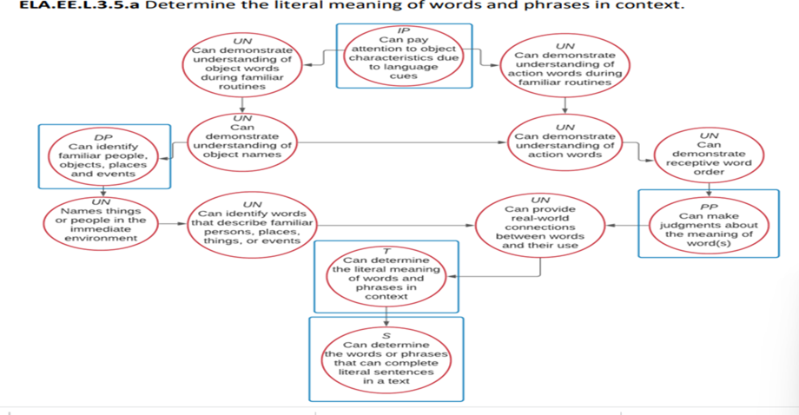
Suggestion 3
Use the information from Linkage Levels and Mini-Maps for ELA and math to plan instruction and create IEP goals.
Notes:
To Say: We have looked at the Linkage Levels already on the DLM page under currently tested EE for ELA, math and science and on the IAP where you select the blueprint item(s) to teach and test. The Mini-maps are a part of the Linkage Levels. They are a part of the same document. It can be very helpful in both planning instruction and creating IEP goals.
When we plan instruction, we have an idea of where we want the child to be - the Mini-Maps can provide the instructional steps that the child needs to master the EE. Let’s look at this slide as an example.
Let’s say that my goal is based on the Distal Precursor of: When presented with familiar and unfamiliar representations of people, objects, places, and events, the student can correctly identify the familiar representations. You don’t see the entire goal in the circle because it is too small. I want them to recognize their occupational therapist, speech therapist, para professional and school secretary.
And let’s say their baseline is at the Initial level. When provided with language cues, the student can pay attention to the entire object, a characteristic of the object, or an action the object can perform. If I call attention to the paraprofessional, they will look at him/her.
I can use the two untested nodes between the skills to help get me to the Distal level. We will continue to reinforce looking at the people I want them to recognize. But, I want them to be able to recognize the OT when he/she is coming in to work with them by a mutually recognizable word or action. That would be the first untested node. The second untested node I would have them point to would be either the paraprofessional or speech therapist when I say, “Where is…?”. Working on these two skills will help the student recognize the people who work with them when I show pictures of them or they see them in the hall. Mini-Maps are very useful in organizing instruction and developing a lesson.

Slide 121
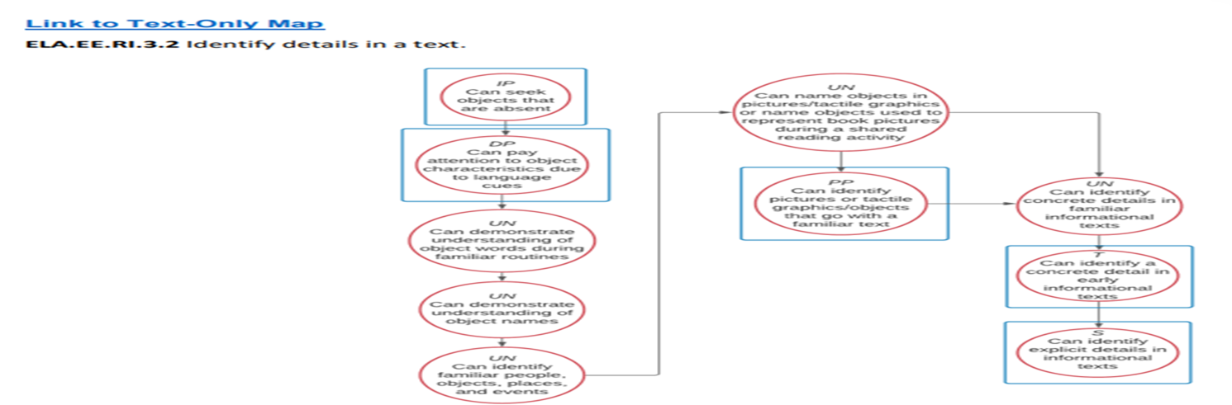
Benchmarks
Students taking or eligible for the MAP-A are required to have Benchmarks with the IEP goals.
Notes:
Missouri requires benchmarks on IEPS for students who take the MAP-A. Benchmarks are the interim steps a student will need to take to reach an annual goal. They also serve as a measurement gauge to monitor a child’s progress and determine if they are moving toward meeting the goal. The Mini-Maps and Linkage Levels provide good information regarding the steps it will take for a student to achieve a specific level.
Let’s look at this 3rd grade ELA blueprint EE as an example. The target is to identify detail in a text. I want my student to achieve this goal on the Proximal precursor level. They can identify pictures of tactile graphics or objects with a familiar text. Any of the circles that come before it can be used for benchmarks. They are the steps it will take to achieve that goal. (You can talk through the process again if you think you need to).

Slide 122
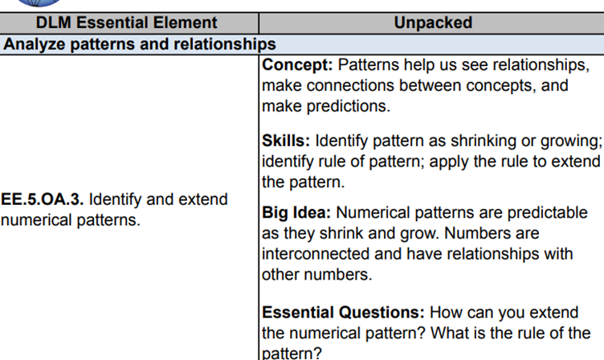
Suggestion 4
Gain a clear understanding of the Essential Elements by deconstructing or unwrapping them.
https://www.dlmpd.com/dlm-essential-elements-unpacking
Notes:
To Say: Suggestion 4 is used to gain a clear understanding of what the EE wants the child to be able to do. Sometimes, it can be a little confusing. The unpacking document gives you more information, and in some cases, examples of what that skills is. There is an unpacking document on the EE page on the DLMPD.com website. It is under the “Instructional Resources” section. It gives more details and the essential questions that the EE wants the students to be able to answer or do to demonstrate they have learned that particular EE. It can help you understand what you need to teach specifically.
(Click on the link - this example is 5th grade)
The information on the slide is from the DLM deconstruction on 5th grade math. I chose math because I don’t speak math well and it does not take much for me to become confused. This is EE 5 for 5th grade, Analyze Patterns and Relationships. Already I am confused. This Essential Element relates to identifying and extending numerical patterns.
But, when I go to the unpacked section and look at the concept: “Patterns help us see relationships, make connections between concepts and make predictions”, it is beginning to make sense. If I understand the patterns, I can predict what comes next 2, 4, 6, etc.
The skill is to identify patterns as shrinking or growing; identify rules of a pattern; and then apply the rule to extend the pattern. So, 10, 8, 6, 4 is shrinking by two and “2” would come next.
The idea is that numerical patterns are predictable as they shrink or grow. Numbers are interconnected and they have relationships with other numbers because they are larger or smaller than another number by a certain amount.
The essential question is, “How can you extend the pattern and what is the rule of this pattern?” Ask 3, 6, 9,12 - what would come next? The answer would be “15”. Now, what is the pattern? It is “adding by 3” and in this case, the pattern is growing.
Remember, these are written at the Target Level. So, you will have to break it down to a lower level for many of our students. But, you may have a better understanding of what you are attempting to teach.

Slide 123
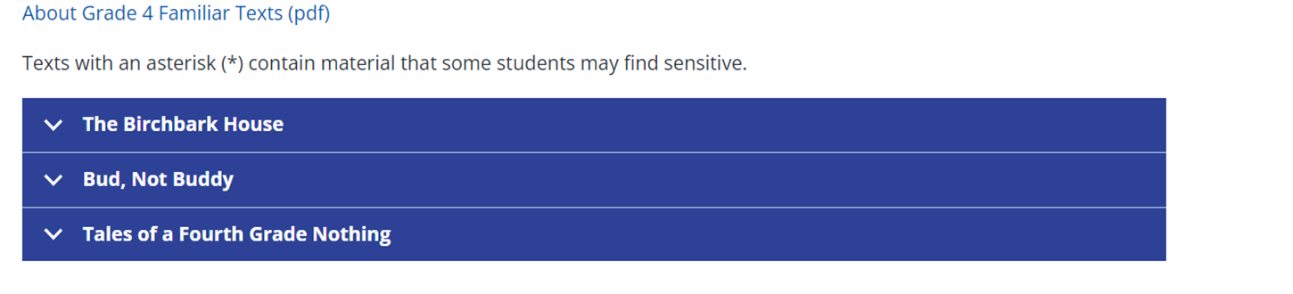
Suggestion 5
Use Familiar Texts
https://dynamiclearningmaps.org/instructional-resources-ie/English_language_arts/familiar-texts
Notes:
The DLM Alternate Assessment supports students with the most complex disabilities by providing them with the texts they will encounter in the English Language Arts assessment before they are assessed. Students are expected to interact with and learn about the texts during ongoing instruction before they encounter them in the assessment. The topics of many DLM Familiar Texts are drawn from texts that are often used in general education. These familiar texts are used in all Initial Precursor testlets and in some other Linkage Levels for some Essential Element testlets. They are intended to also be used in classroom instruction. They can be downloaded and printed.
Unfamiliar texts are used in some Linkage Levels where access to the text prior to administration is not necessary for the student to demonstrate their understanding. The familiar texts are available through the Educator Resource Page for our state. (Click on link; scroll down and click on link in “Using DLM Familiar Text” and chose a specific grade level). When you click on the text, underneath you will find a series of short stories that can be printed and used in class. They have both Reading Literacy (RL-fiction) and Reading Information (RI-non-fiction) stories related to the original story.
Reviewers do their best to make sure these books are marked with “CAUTION”. As a result, students should NOT be sent independently to the Tar Heel Reader site. Teachers can avoid books that they might find offensive by limiting their search to books that are “Reviewed Only” and “Rated E/Everybody.”

Slide 124
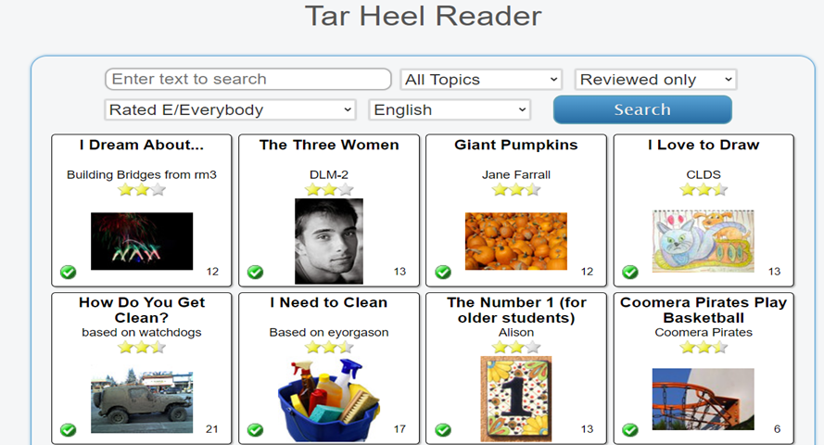
Tar Heel Reader
https://tarheelreader.org
Notes:
To Say: You can find other appropriate books in the Tar Heel Reader, but they are not the familiar texts that are used in the assessment. (Click on link) Tar Heel Reader is a large, open-source library of books. Books are contributed to the site by teachers, students, parents, and others from all over the world. There are books on the site that are inappropriate for some audiences. We encourage teachers to use the “Reviewed Only” and “Rate E/Everybody” in your search to ensure they are materials that are suitable for your students. You can search by topics. There are books on a variety of topics. This is useful if you want to combine EE into various units such as a science unit on Earth (type “Earth” into the search bar and “math and science” in the topics area and hit “Search”). This is how you can combine science and ELA.
There are also books related to stories that are a part of the general education curriculum for students of various ages, such as, “Because of Winn-Dixie” (type “Because of Winn-Dixie” into the search bar).
Tar Heel Reader can be found in the Home Learning Resources for Teachers.

Slide 125

Suggestion 6
Use the Fall Performance Report to Plan for Spring teaching and testing.
Notes:
To Say: Report - The Fall Performance Report looks exactly like the Individual Student Report, but includes just fall testing results. Test Administrators may use this report to evaluate instructional progress, and improve instruction and student learning.
Instructions
Logon to Educator Portal
Choose “Reports”
Choose “Alternate Assessment”
Choose “Instructionally Embedded”
Choose “Performance Report”, or
View this report in the Instruction and Assessment Planner in the top right corner
Viewing the results of this report allows teachers to adjust instruction and choose the EEs for the spring to encourage student growth.

Slide 126
Quizlet VIII
Familiar texts can only be used for testing.
Where can students access the practice activities and released items?
What academic areas have professional development modules?
Notes:
False - Familiar texts are intended to be used in classroom instruction so that if a student receives a testlet that uses a familiar text it will be familiar to the student.
The Student Portal, using the demo student log-in credentials found in the guide to practice activities and released items.
ELA, math and science all have PD modules.

Slide 127
Develop a Process
Do we need or want this?
Make a folder on your desktop for Map-A
Within this folder, create a subfolder for each of your students taking MAP-A
Within this subfolder, create a subfolder for each student ELA, math, and if needed, science. Mini-Maps, and any additional materials for each student will be placed in this folder.
Keep these folders up-to-date and share them with the parent(s) and include notes monitoring the student’s progress
Notes:
These steps will help you to outline an organizational process to keep the EE and Mini-Maps for each student in one place so you can access them easily and quickly for lesson planning.

Slide 128
Section 9:
A Deeper Look at Giving the MAP-A

Slide 129

Testing Times
Testing is only to be conducted during the regular school day.
Looking at the testlet prior to giving the testlet is considered a violation of test security.
Notes:
As mentioned before, testing is only to be conducted during the regular school day. If the system indicates that testing is done before of after regular school hours or over the weekend, it is flagged and your district will get contacted by the state MAP-A Coordinator, Caryn Giarratano. Contact your district testing coordinator immediately and make them aware of the situation.
A Test Administrator looking at the testlet prior to giving the testlet is considered a violation of test security. The Test Information Page (TIP) Sheet is sufficient to answer questions about what is needed for the test.

Slide 130
Students are Tested Two Ways
Direct student interaction with the device is MOST COMMON
Teacher administered testlets
  Testlets in the lowest Linkage Levels
  Some math testlets at high Linkage Levels
  All writing assessments
  Scripts are provided for educator-administered testlets.
Notes:
To Know: Know the two ways students may be tested.
To Do: Show slide and go over information. Emphasize: On educator-administered testlets, teachers can substitute items with content that the student is more familiar with such as balls instead of paper clips.
To Say: “Students may be tested two ways
Direct student interaction with the device is the most common way that testlets are administered
There are three kinds of educator-administered testlets
Testlets in the Linkage Levels for students who may or may not have symbolic understanding
Some math testlets at higher Linkage Levels representing the content making the tasks too abstratct
All writing assessments
For the educator-administered testlets there are scripts provided for the Test Administrator to use while assessing the student. You will use the “Show and Say Instructions” to administer the testlet and you will administer the response option that best matches the observed student behaviors.

Slide 131

Testlet Information Page (TIP)
Prior to administering a testlet, the Test Administrator should obtain the Testlet Information Page (TIP) which gives test administration guidelines and the materials that will be needed.
How to obtain the TIP is described fully in the Test Administration Manual on page 42 for math and ELA and page 111 for science.
  TIPs are SECURED TESTING MATERIALS and need
  to be destroyed after the testlet is given.
Notes:
To Say: “The Test Administrator will be provided with a Testlet Information Page (TIP) for each testlet a student takes. The TIP is described fully in the Test Administration Manual starting on page 42. The TIP is acquired in the Instructional Assessment Planner during the fall window when you click on “Ready to Test”. Select the Test Information pdf. Double click to download and print.
During the Spring Summative Testing Window, select “Summative for Testing Program” and click “Search”. Select the Test Information pdf. Download or print each TIP sheet. Please be aware that in the Spring Summative testing window, TIP pages are in pdf format, but will not be accessible after the first viewing. It is vital for educators to download or print the TIP page.
The TIP has the information regarding what materials will be needed for the testlet. That is one of the reasons it is vital to have prior to administering the testlet. It tells you how the test will be administered either on the computer or by the teacher. Remember, if it is teacher-administered, there will be a script to follow to administer the test on the TIP sheet. There is a lot of important information on the TIP sheet. However, the answers to the questions on the testlet are not provided on the TIP sheet.
The TIP is considered part of the secure testing materials and needs to be destroyed after the testlet is given.

Slide 132
Materials Collections
https://dynamiclearningmaps.org/ela-materials-collections-ie
https://dynamiclearningmaps.org/mathematics-materials-collections-ie
https://dynamiclearningmaps.org/science-materials-collections
Notes:
Let’s look at the supplies that may be necessary for the administration of the test. This is another reason we advise teachers to allow 24 hours after assigning the test to administer it. Sometimes different items will be needed to give the test. These can be found on the DLM website under “Resources”. There are materials collections for each area (click on one of the links above).
You will not know what is needed until the test is assigned and you receive the TIP sheet. If you have students who are also blind or have visual impairments, they will need a different list.
Here are some hints for using the collections materials lists:
Look at the whole list for each grade and find materials that can meet multiple purposes. Note the types of materials that are mentioned more than once.
Find materials that already exist in the classroom or are easily found somewhere in the school building.
Pick materials that are familiar to the student.
Remember that in most cases, materials can be substituted if they have the same attributes as those on the list. Examples of possible substitutions are found in the table below.
Materials substitutions are listed for individual testlets on the corresponding TIP.
The student’s safety should be the primary concern when choosing materials or substitutions.
With some of the tip sheets there will be pictures to use that will need to be copied (often in color) so be aware of that - it will say “Picture Response Cards Included in the TIP.”
Some schools have put together testing kits so they are not scrambling to try to find one shoe, or two familiar identical objects.

Slide 133
Test Administration Practices
Test Administrators may need to use their best judgment and be flexible while administering the assessment
Test Administrators may provide additional supports beyond the Personal Needs and Preferences (PNP) profile options
Most supports are allowed for testlets unless exceptions are noted in the Testlet Information Page (TIP)
Students take the test individually, even though the instruction may be provided in small groups
Notes:
To Know: Appropriate test administration practices.
To Do: Show slide and go over information.
To Say: “Test Administrators may need to use their best judgment and be flexible while administering the assessment. Again, the goal is to find out what the student knows. They may provide additional supports beyond PNP options. These are described in the “Practices Allowed” section of the Test Administration Manual on page 97.
“Learn about the Accessibility Supports” section of the Accessibility Manual is on page 20. These supports are allowed for testlets unless exceptions are specifically noted in the Testlet Information Page (TIP).
You can pause a test if a student is melting down or you run into recess time. You can pause up to 90 minutes until the student is logged out. If they do not finish the testlet, the information is not saved and the student must go in and retake the test.
Remember even if you teach the EE in small groups you must test each student on an individual basis.

Slide 134
Testlet Results
Final screen of the testlet only shows whether each item was answered or left blank
In the ELA and math testlet, results from both windows impact student’s year-end report
Only the required spring science testlet results will impact student year-end results
Notes:
Here are some important things to keep in mind. You will not be able to determine how your student performed on the testlet during the testing situation. The final screen will show which items were answered and which were left blank. Because most often times you are sitting with the child to help with the testing process, you will have a pretty good idea of whether or not they demonstrated mastery of the EE. The IAP will show whether or not they mastered the EE, but not how they did on each question.
For ELA and math there are no practice items, other than the released items. All testlet results in ELA and math from both windows will inform the year-end report. You do have the opportunity to practice in science because testing is not required and the fall window will not impact the year-end report.

Slide 135
Troubleshooting
Your first step is to read The Test Administrator's Manual and all other manuals.If you are still having difficulty, call your RPDC consultant for further assistance.
If unable to log into the training site, check to make sure you have an Educator Portal account or use the option for “Forgotten your username or password?”
If those steps do not resolve the issue, please contact Missouri’s DLM Help Desk at 1-844-675-4479 or DLM-support@ku.edu
  It is recommended that ONE person be appointed to contact the DLM Help Desk and not individual teachers. Individual teachers should NOT contact DLM.
Notes:
To Know: How to troubleshoot problems.
To Do: Show the slide and go over information.
To Say: Read the slide to the participants and ask for questions. Emphasize that “buildings should appoint ONE person to be the primary contact between the building and the DLM Help Desk. The district should only have one person designated to contact DLM by phone/email. Individual teachers should NOT contact DLM.”

Slide 136
Clarifications
A common pitfall is that a user does not complete the Security Agreement and, as a result, does not have access to some critical features in Educator Portal.
Who enters the users and students in Educator Portal?
  The Data Manager is responsible for uploading all users (both educators and students) into Educator Portal. See information in Data Management Manual.
  The Assessment Coordinator (DTC) is to “monitor the creation of Educator Portal” user accounts.” The Assessment Coordinator Manual will contain this information.
Notes:
To Know: A common pitfall when trying to log into Moodle.
To Do: Show the slide and go over information.
To Say: “You will need to find out the following: Data Manager, Assessment Coordinator and the Technology Representative. These positions have their own roles, webinars, and manuals to ensure success of the MAP-A assessment process.”

Slide 137
Transfer Student Information
There is not a cut off date for transfer students
If a student moves into your district from in-state or out of a DLM state, you will obtain the information from the previous district. Your Assessment Coordinator will contact the Assessment office at DESE, and they will assist you in this process so information will not be lost.
DESE Assistant Director of Assessment, Caryn Giarratano, 573-751-6731 or caryn.Giarratano@dese.mo.gov
Notes:
To Know: There is not a cutoff date for transfer students
To Say: If the student transfers from a district in Missouri, best practice is to contact Caryn Giarratano for help in getting the information transferred about the student so all the information can slide into your data. If they come from out-of-state, check on the DLM website to see if they use the DLM process. Again, there is a process that Caryn can facilitate to get you all the information you will need about the student.

Slide 138
Transfer Student Information (Concluded)
If a student moves to another building in your district, the assessment coordinator will transfer that student and information.
If a student moves into your district from out-of-state that does not use DLM, you must first determine eligibility and then enroll the student as a MAP-A student. Now you will begin the same process as any other student taking the MAP-A in your district.
Accountability is the same as any other student.
Notes:
To Know: There is not a cutoff date for transfer students
To Say: Read slide. “If you have questions about this, please contact your assessment coordinator and they will contact DESE.” One thing we ask districts to remember about MAP-A is that the process for getting into the system is the same whether you start in September or in March.
We encourage districts to have teachers in all buildings trained in the MAP-A even if you do not currently have a MAP-A student. A student can transfer in at any time and you have to begin the process of preparing to administer the MAP-A.

Slide 139
Quizlet IX (Six Questions)
Feel free to share TIP sheets with others as a resource.
The TIP sheet provides the answers to the testlet.
When a teacher administers a MAP-A test, they can pretty much do it however they want.
Notes:
False - TIP Sheets are considered secure testing information and should be destroyed after testing.
False - The TIP Sheet contains: How the testlet will be administered; materials needed; and parameters for testing.
False - Items in the teacher-administered testlet have a script provided to follow as they are assessing the student.

Slide 140
Quizlet IX (Concluded)
The last screen on the testlet will provide you with the students overall score including which questions that were answered correctly.
Which of the subjects have testlets whose results are used in both windows for the end-of-year report?
If you teach more than one student the same EE, you can just test them together.
Notes:
False - Only those questions which were answered and which questions were left blank.
ELA & math only; not science - science results window is only in the spring when the test is required
False - You can only test one student at a time.

Slide 141

We’re Back!
After a three-year hiatus, MAP-A Quality Assurance visits are back!
Notes:
To Say: The plan is that improvement consultants will be doing quality assurance visits in both the fall and spring testing windows. The schools receiving quality assurance visits will be chosen by Caryn Giarratano based on the last time they received a visit. The process is to verify and encourage districts to follow procedures, not to punish a district. During a district visit the IC will observe a teacher giving the MAP-A to a student; interview the MAP-A District Test Coordinator and teacher about procedures; and review the IEP to ensure the eligibility for MAP-A process was followed.
It is possible that the visits could be virtual or in-person. That has not been decided at this point. Districts selected for a visit will be contacted and will receive all the necessary documentation to prepare for the visit. At this time, we are being told that each IC will visit six districts in the fall window and six in the spring. But, a final decision has not been made of the number of districts and whether or not fall visits will occur.

Slide 142

Thank you for your hard
work today!
Have a safe trip home!!!
Notes:
CONSULTANTS may want to change this slide to fit needs.
To Know: The need to complete an evaluation and how much they are appreciated.
To Do: Show the slide and have participants complete an evaluation form.
To Say: “Thank you for your hard work today. Have a safe trip home. Please take a moment to complete an evaluation form. Your input is valued and used.”

Slide 143
Special Education Improvement Consultants
https://dese.mo.gov/media/pdf/regional-professional-development-center-rpdc-consultant-list-0823
1.Southeast
Berkley Rosenquist
brosenquist@semo.edu
2.Heart of Missouri
Jennifer Statler
jhstatler@missouri.edu
3.Kansas City
Carrie Turner
cturner@umkc.edu
4. Northeast
Tonya Grant
tgrant@truman.edu
5. Northwest
Pam Madison
pmadison@nwmissouri.edu
6. South Central
Connie Cromwell
cromwellco@mst.edu
7. Southwest
Melynda VanNote
MelyndaVanNote@Missouri
state.edu
8. St.Louis
Patti Stenger
pstenger@eduplus.org
Michilene Carbol
mcarbol@edplus.org
9. Central
Mary Beth Scherer
mbscherer@ucmo.edu
Notes:
Last update 8/2023

