Slide 1
Co-Teaching
Mary Beth Scherer mbscherer@ucmo.edu
Pam Madison pmadison@nwmissouri.edu
Notes:
Body of the slide 32 point;
Title should be at least 36 point but 40 if preferred
Title on each slide should go within the white or blue bar on the top of the slide
Font is Calibri
The Slide Deck is in the Modules - be sure to make your own copy
MB 1-10
Pam: 11-21
MB 22-30
Pam 31-36

Slide 2
Co-Teaching is NOT
Teaching with a paraprofessional, volunteer, or other non certified assistant
Implementing the same lessons in the same way as classes not co-taught
Having two certified teachers provide instruction to a homogeneous class (class composition)
Grouping students with disabilities or language differences to work with the special education teacher or the English as a second language teacher at the back table or removing them to receive instruction in their special or separate classroom (Class-within-a class)
Murawski (2016)
Notes:
To Know: Familiarize yourself with what Co-Teaching is not. Be prepared to give examples. This is a good time to discuss the differences between Class-Within-a-Class (CWC) and Co-Teaching models.
Dos and Don’ts of Co-Teaching
To Do: Explain each bullet in further detail.
To Say: While looking at the Co-Teaching characteristics handout, let’s discuss why the items listed on this slide are not reflective of Co-Teaching.
Certified staff members have been specifically educated regarding instructional practices for content delivery and pedagogy. Why would we ask non-certified to fulfill the role of a teacher?
Lessons should look different in a Co-Teaching classroom where both teachers bring specialized tools to intensify instruction.
A Co-Teaching classroom is always heterogeneous and differentiation within lessons is required.
Both teachers work with all students in the classroom. Emphasize “all”.
During this training, we will take time to look at actual classrooms where effective Co-Teaching exists. The plan is for you to walk away today with that picture in mind and also have a few lessons sketched out for implementation.

Slide 3
What is Co-Teaching?
Service delivery system in which:
Two or more professionals with equivalent certification and employment status share instructional responsibility for a group of students
They primarily teach in a single classroom or workspace where they teach required curriculum
They share mutual ownership, pooled resources, and joint accountability
Each individual’s level of participation may vary while joint planning occurs with both educators delivering
Notes:
To Say: Twenty-first century classrooms are filled with many diverse students who were not a part of most 20th century classrooms. In the past, school systems created segregated classrooms to teach and support various populations of learners. This is no longer the case.
With the provision of least restrictive environment the regular education classroom is often the best placement for students with disabilities. Real co-teaching can not take place unless both the classroom professionals are teachers. It is not within the general role of a paraprofessional to share instructional responsibility. The word para-professional means alongside the professional; in place of the professional.
Public Law 94-142 from the beginning required all special education students be provided access to the regular education curriculum. Often the best place for that is in the regular classroom being taught by the content expert.
The Missouri Learning Standards (MLS) identify advances in instruction to ensure all students are college and career ready by the end of 12th grade. The major shift in classroom practice tied to the MLS is that teaching is a shared responsibility. Teachers across all grades and disciplines are expected to foster the learning of diverse students through collaboration.
According to researcher, Marilyn Friend (2016), Co-teaching allows 2 teachers to work together planning and delivering instruction in multiple ways to best meet the needs of all students.

Slide 4
Purpose of Co-Teaching
To provide greater opportunities for students to receive differentiated instruction from qualified professionals.
To ensure students with disabilities (identified or not) have access to the general education curriculum and specially designed instruction in the general education classroom.
Notes:
To Say: Co-Teaching opportunities can reach the unique needs of all students not just those who have a disability. Qualified professionals work collaboratively to address the unique needs of the learners. Even though we are here today as a special education instructional improvement consultant, it is important to understand that co-teaching done well will not just benefit special education students it will benefit all students.
There is a growing population of students that do not qualify for special education, but struggle in school. They are the students that may score to high to meet the criteria of ID but do not have the necessary discrepancy to meet the criteria for SLD.
These students may be missing important skills or content area because of absences, mobility or the need for more intensive instruction. A Co-teaching classroom with 2 educational professionals can help provide the educational intensity to meet the needs of these students.

Slide 5
Co-Teaching Provides
Increased
Instructional
Intensity
Notes:
To Say: Co-Teaching promotes inclusive practices. We cannot expect students to master curriculum in which they have not been instructed. The importance of having two teachers in the classroom is to use the expertise of both teachers at the same time everyday. Without both teachers in the classroom the instruction is less effective and cannot occur as planned. When two educators are using their expertise the instructional intensity is increased!
The instructional intensity is increased because co-teachers are able to work with students in small groups, they are able to differentiate and provide instruction to students that need additional review, they are able to utilize highly effective instructional strategies they are better able to implement with two teachers. The magic is not just having two teachers in the classroom; there is nothing special about that, but the magic occurs when they are designing lessons and activities designed to meet individual students wherever they are in their learning and provide the needed instructional intensity.
.

Slide 6
Why Co-Teach?
Reduced behavior problems (Chalfant & Pysh, 1989)
Significant gains in reading & math for students with learning disabilities (Murawski & Swanson, 2001)
Students with disabilities interact more with the general education teacher & receive more individual instruction (Magiera, & Zigmond, 2005)
Teachers in interdisciplinary & multidisciplinary teams feel less isolated and more supported (Spraker, 2003)
Increased time in Least Restrictive Environment for students with disabilities (IDEA, 2004)
Notes:
To Say: What does research say about the benefits of co-teaching? Take a moment to review some the qualitative and quantitative research cited with benefits of Co-Teaching on this slide. There is limited research available in published form but many unpublished documents have proven Co-Teaching as an effective practice.
As well as helping Reduce the stigma of being in special education (Keefe, Moore, & Duff 2004)
Increased individualized help and modifications for students without disabilities (Keefe, Moore & Duff, 2004)
There are Successful case studies at all educational levels and in all content areas (Mastropieri, Scruggs, Graetz, Norland, Gardizi, & McDuffie, 2005)
Meta-analysis research of articles from 1990-2010, which support this Collaborative models of instruction. (Solis, Vaughn, Swanson, & McCulley, 2012)

Slide 7
Every Student Succeeds Act
Passed December 2015
Replaced No Child Left Behind
Requires ALL students in America be taught to high academic standards that will prepare them to succeed in college and careers
Only 1% of students in special education will not take regular state exam, take another exam.
Notes:
Just a little history lesson, many of us may remember the No Child Left Behind days. It was passed in 2001 & was the main law for K–12 general education in the United States from 2002–2015. The law held schools accountable for how kids learned and achieved. It said that by 2014 all students would be performing at grade level. The law was controversial in part because it penalized schools that didn't show improvement.
ESSA replaced NCLB and although it was not as punitive for schools; but it was still challenging. The provisions included (read 3rd bullet). This was really the intent of IDEA from the beginning; that special education students have access the general education curriculum. ESSA also made it impossible for us to exempt students from testing. So we needed to ensure our students to access the curriculum they were going to be tested. Students with disabilities will be taking the general assessments; in our case the MAP and EOC tests, we needed to make sure they had access to that curriculum content.
The bill also placed a 1 percent cap of the percentage of all students who can take alternate assessments. These alternate assessments are intended for students with severe cognitive disabilities. So special education students unless they were in the lowest 1% generally students with an IQ of 55 or lower had to take the MAP or EOC at their grade placement. If they are being tested at the grade level standards, then it only makes sense that they are learning grade level standard material.

Slide 8
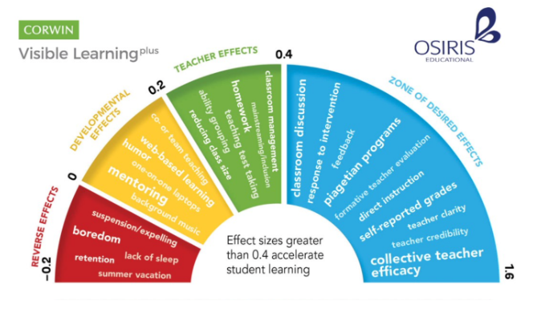
Hattie’s Research
Notes:
We always want to make sure that everything we teach is research based and right now Dr. John Hattie is the gold standard in educational research.
Dr. Hattie is a researcher who researches educational research. His research is now based on analysis of over 1,200 research studies from all over the world. Throughout his research he has identified over 250 things that influence student achievement. He measures the effect size. The effect size is how much they improve student learning. For instance a Hattie effect size of .7 means that the score of the average student who received the intervention is .7 standard deviations higher than the student that did not receive the intervention. In other words it exceeds the score of 69% of the similar group of students who did not receive the intervention. The bigger the effect size, the more impact on student achievement.
So with that information where do you think Co-Teaching rates in terms of effect size? You can put it in the chat box.
The effect size is .19. it is just higher than things like school choice/tracking .12 Home Schooling .16 web-based learning .16
So what are you thinking now….
Simply putting 2 teachers in one classroom does not do a lot – but it is what those 2 teachers do that makes a difference. Two teachers each working with a group of students allows for more instructional intensity. But if you are not doing anything any different in your classroom with a second teacher, then do really expect any differences. It is how you use that other person that makes the difference.

Slide 9
Co-Teaching Effectiveness
It’s NOT having 2 people in the classroom it is what you can do with those 2 people.
Increase Instructional Intensity occurs when both teachers are fully involved in the educational process.
Notes:
Remember, Simply putting 2 teachers in one classroom does not do a lot – but it is what those 2 teachers do that makes a difference.. But if your teachers are not doing anything any different in their co-teaching classrooms, then do really expect any differences. If they are presenting lessons that can be taught by one teacher; when two teachers are in the room, you wont’s see much of a difference. It is how both teachers spend their time that makes the difference.
Two teachers each fully engaged in working with a group of students provides for more instructional intensity.

Slide 10
Co-Teaching Expertise
Special education and general education content teachers are trained differently and practice their professions from very different points of view.
Subject (Content) vs Learning Strategies
Notes:
To Say: Special education and general education content teachers are trained differently and practice their profession from very different points of view. Content area teachers are experts in their content area. They generally bring a strong background and expertise to the subject. Special Education teachers have studied strategy, the best ways to ensure students are comprehending what they read, how to break down instruction into discrete steps. The different expertise that they bring to the classroom is where the magic occurs. It is where they are able to deliver instructional strategies with a high effect size.

Slide 11
Co-Teaching Approaches
One Teach, One Observe
Station Teaching
Parallel Teaching
Alternative Teaching
Teaming
One Teach, One Assist
Notes:
To Say: The different approaches listed here are the foundation for providing specially designed instruction in the most effective ways. Teachers over the course of implementation have found multiple ways to use these approaches to differentiate lessons. The approaches are not stand alone practices. More than one approach may be used during an instructional period. Some are more powerful than others in changing student learning.
There are benefits of each approach and drawbacks or cautions that must be considered when selecting which approach would best fit the needs of the student, the content to be learned and the ways the student must show application of the learning for assessment.
They are not equal in the amount of instructional intensity that they can deliver. The one teach, one observe does not really gain the Co-teaching classroom much instructional intensity at all. Essentially it relegates one of the teachers to the passive role of just watching. It should only be used to gather data for short periods of time. It is not a good ongoing use of a professional's time. It may be a place to start co-teaching, but it is not place to stay very long.

Slide 12
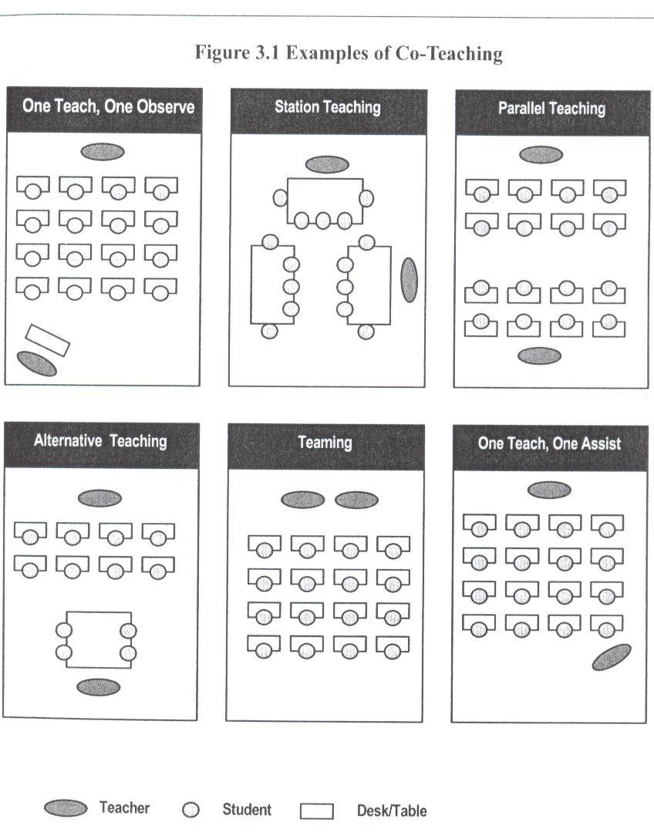
Classroom Configurations
Notes:
To Say: This visual represents how the different approaches might look in practice. It does not mean that this is the way the room must look or where the teachers might be placed. It is much more than teacher placement or student placement. It is about how you divide instruction and differentiate for students. It is also about how we can increase the instructional intensity of our lessons while also increasing the opportunities of engagement for the students.
Each example proves to be more effective than having just one teacher in the room, but some are more powerful than others for increasing instructional intensity. Data on student needs will drive the selection of the approach for instruction as well as, the placement of students in different groups. Planning for instruction takes intentional collection and sensitivity to what the ‘end’ goal for learning will be for success.

Slide 13
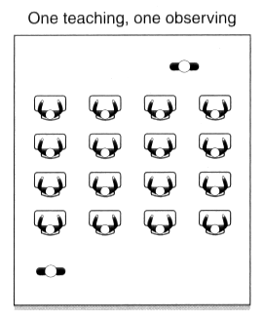
One Teach, One Observe
One teacher manages the instruction of entire group
Other teacher gathers data.
Teachers analyze the data together.
Notes:
To Say: In one teach, one observe, there are two teachers in the room, but one is not teaching. They are observing for the documentation of data which will be analyzed after the lesson. This allows time for data collection on IEP goals, observation of student growth and development against a rubric, or collecting formative data to determine if all students can complete specific steps during instruction or students’ responsiveness to teacher direction. Therefore, this approach entails one teacher instructing while the other quietly moves or stands gathering data for academic, social or behavioral decisions.
If are deciding which students are struggling, gathering data for a special education student IEP goal or monitoring a class discussion to make sure students are participating.

Slide 14
Benefits
Allows for data collection on students
and teachers
Can be used as formative assessment multiple times during any lesson so immediate instructional adjustments can be made
Notes:
To Say: The goal of using One Teach, One Observe is to gather data. The data can be used to ‘group’ students immediately following the collection. Teachers may use the information as formative data to determine grouping or students that need additional help. This allows for the use of more than one approach during a classroom period according to students’ skill level.

Slide 15
Drawbacks
Can result in one teacher, most often the general education teacher, taking the
lead role the majority of the time
Can also be distracting to students if the observer drifts through the room as one teaches
*Caution: Should be used sparingly!
Notes:
To Say: If used too often this approach can relegate one teacher to appear more like an assistant or classroom aid. The general education teacher usually takes the lead which leaves the special education teacher appearing to have less knowledge or authority.
Another drawback can be caused by the movement of the teacher who is not instructing. As one teacher drifts and takes notes this can be distracting for some students.
This approach should be used sparingly for a few minutes of a class period for data.

Slide 16
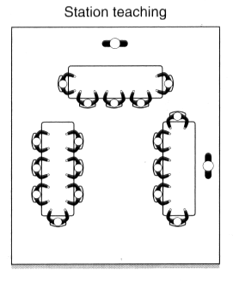
Station Teaching
Teachers divide the responsibility of planning and instruction.
Students/teachers rotate on a predetermined schedule through three or more stations.
Teachers repeat instruction to each group that comes through
Delivery may vary according to student needs.
Notes:
To Say: Station Teaching values the instructional abilities of each teacher in the room. Teachers collaborate on what will be covered in each station but can divide the responsibility of planning for their own groups.
Teacher or students may rotate on a predetermined schedule. The skill or strategy is repeated for each group but delivery may vary according to student needs.
Most teachers use 3 stations with one being an independent group or a group facilitated by peer tutors. However there can be less or more than 3 stations.
There are many different ways to set up stations at any grade level and as they become more comfortable with grouping there are many ways to rotate, flip or manage differentiation in station teaching

Slide 17
Benefits
Involves both educators in instruction
Enables a clear division of labor for planning and teaching
Allows for different teaching styles
Students benefit from a lower teacher-pupil ratio
Students with disabilities are integrated into groups, rather than singled out
Notes:
To Say: Station Teaching provides Increased Instructional Intensity; both teachers are teaching! There is greater opportunity for students to respond in smaller groups. Therefore students are provided more immediate feedback. This approach also allows for integration of the specially designed instruction in a very efficient way.
Many students with disabilities require closer teacher proximity, more hands-on practice or multi-sensory learning which can be done more easily in small groups than whole group settings. Some students need explicit instruction when others are ready for steps that lead to gradual release to independence.
Station teaching allows for more variation of student groupings and can also help to overcome the matter of special educator content expertise inside of some high school settings. General Educator content specialist can provide instruction while the learning strategist works in a station on guided practice or application.

Slide 18
Drawbacks
Noise and movement within the classroom
Teachers or students may be distracted by two teachers talking in the classroom at the same time.
Teachers need to think about how to divide instruction. Hierarchical material cannot be presented using this approach.
Lessons must be timed so groups can move as scheduled.
Notes:
To Say: The greatest obstacle teachers learn to overcome when using Station Teaching is to practice the movement and noise level that can become distracting when two teachers are teaching at the same time.
The material, concept activities or process being instructed or practiced in each station cannot be hierarchical.
Lessons must also be explicitly timed so groups can move at the same time.
We encourage teachers to
Not let groupings become static so that students never change
Do not always group based on ability level

Slide 19
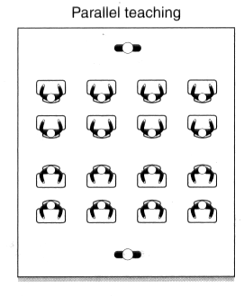
Parallel Teaching
Teachers share responsibility for planning and instruction
Class is split into heterogeneous groups and each teacher instructs half on the same material
Content covered is the same, but methods of delivery may differ
Both teachers need to be proficient in the content being taught
Notes:
To Say: Please take a moment to read through the Parallel Teaching Approach. Parallel has great potential to increase the instructional intensity of instruction by increasing the students opportunities to respond. They have more of a chance to ask and answer questions and participate in group discussions. .
Teachers can strategically place students in the groups to maximize the style of instruction needed for their groups. This approach can also allow for teachers with different instructional styles to vary the method of practice and application more easily.

Slide 20
Benefits
Lowers the teacher-student ratio, while inspiring diversity in each group
Is good for review, introduction of vocabulary, drill-and-practice activities, topics needing student discussion, or projects needing close teacher supervision
Notes:
To Say: Many teachers find this approach to be one they use frequently. There are 3 categories of instruction commonly used.
Identical material covered, but how it is covered might reflect the needs of the learner for SDI, learning styles, level of engagement needed or use of manipulatives
This approach works great to teach perspective by having two groups discuss different viewpoints in relation to a topic.
The instruction could be teaching the same standard or learning goal but at a different readability of text or type of product completed.
**Some teachers find that there is a rhythm or pattern in their curriculum that happens over and over which can be instructed each time by using Parallel Teaching. Little planning is needed as the teachers become efficient with this approach other than to understand which teacher will take which group of students.

Slide 21
Drawbacks
Cannot be used for initial instruction unless both educators are qualified to teach the material (primarily at the high school level)
Noise and activity levels need to be monitored;
Teachers need to pace instruction similarly
Requires that both teachers are familiar with content and how to teach it
Notes:
To Say: This approach means both teachers must be comfortable and have the knowledge to teach the material. Teachers will need to be aware of their location in the room so the instructional voices do not compete and distract the students.
Teachers must also take care in rotating the students’ location and ensuring the groups are diverse.
Noise and activity levels need to practiced and monitored for efficiency. Teachers also must be alert to ‘time’ so one group is not waiting on another group to move.

Slide 22
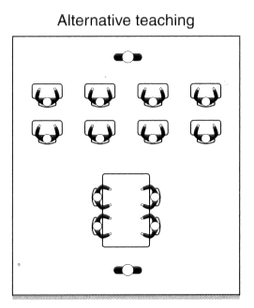
Alternative Teaching
Teachers divide responsibilities for planning and instruction.
The majority of students remain in a large group setting, but some students work in a small group for pre-teaching, enrichment, re-teaching, or other individualized
Notes:
To Say: Teachers can divide the responsibilities for planning and instruction based on student data and needs. This approach is used in short bursts of time. The majority of students remain in the large group setting. A small group is pulled aside for a short period of time for pre-teaching, for enrichment, re-teaching or other small group individualized tasks. This small group might be pre-selected or a group that appears to need more guided practice as the lesson continues. The small group is soon moved back within the larger group.

Slide 23
Benefits
Provides highly intensive instruction
Ensures that all students get to interact with a teacher in a small group
May assist with reducing behavior problems with some students
Notes:
To Say: Alternative Teaching proves highly effective when the classroom has a great diversity in learning levels. It also allows for the instructional intensity that might be needed by a very small group. This group might be the students who need prep in vocabulary or procedures.
It proves to be an asset for behavioral management, if a student who has difficulty handling change is prepared ahead of time in alternative teaching before joining the group of ‘change’. This approach also allows for enrichment, if there is a group of students who already have mastered material the other students are practicing and could possibly be taken deeper in a discussion or alternative lesson.

Slide 24
Drawbacks
Students with disabilities may be stigmatized by being grouped repeatedly for preteaching or re-teaching
Each teacher must take turns working with the small group or may be viewed as an assistant
The same students must not repeatedly selected for the small group. Documentation must be kept so all students may participate
Notes:
To Say: This approach is often misused, as many teachers resort to using the small group as a de facto “pull-out.” If students with special needs are continually being chosen for the small group and are then taught by the special education teacher, the results is a “Class Within a Class” approach. This brings back the old special education technique of “pull-out.”
Too often the same students are asked to go to the small group merely because they are students with special needs or have an IEP. If the special education teacher always works with the group that needs review or re-teaching, this further stigmatizes these students because student differences are made even more apparent to both students with and without disabilities.
** This approach cannot keep students from accessing instruction. The greatest caution here is to ensure there is no new instruction going on while the small group is separated from the larger group. It is suggested to pull the group prior to the new instruction or at the end of the instructional time as students are practicing or reviewing.

Slide 25
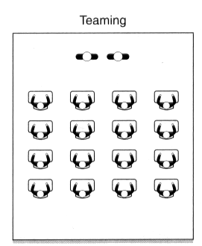
Teaming
Teachers share responsibilities for planning and instruction
Both teachers are delivering the same instruction at the same time. Playing off of each teacher’s style and ability
Notes:
To Say: Teaming is sometimes referred to as Duet Teaching by some authors in the Co-Teaching world. Teachers work as a team to introduce new content, work on developing skills, clarify information, and facilitate learning and classroom management.
This requires mutual trust and respect between the two teachers and requires that they be able to mesh their teaching styles. Teachers will share responsibilities for planning and instruction. This approach becomes more natural for teachers who have spent more time together in a Co-Teaching setting. As teachers begin to know each other as colleagues, this approach becomes more of a conversation.
This approach requires trust and respect between teachers because it is the only approach in which Co-teachers are teaching the same content at the same time.

Slide 26
Benefits
Shared planning and instruction by both teachers for the large group
Allows teachers to play off one another
Can be energizing and entertaining
Notes:
To Say: Here are some benefits of Teaming when the educators are comfortable with each other’s teaching style. Teaming has lots of synergy!
Teaming is good to teach two different ways to problem solve or how to think from one viewpoint to another.
During Teaming one teacher may always be interjecting a question or special strategy to help SDI or memory retention as the other one instructs.
Teaming can teach students how to discuss a topic and respectfully disagree or argue a point well. Often times are students do not have good role models of what respectful communication looks like and sounds like.

Slide 27
Drawbacks
Loss of the valuable instructional technique of grouping
May not be comfortable for new partnerships of teachers
Notes:
To Say: Teaming can have high levels of ‘teacher talk’ instead of student engagement in learning. Young children can be confused easily by being shown two different ways to solve a problem, at the same time, so caution must be used when teachers area using this Co-Teaching approach.
This approach can limit the ability to give SDI for specific students. Teaming should only be used by teachers who are sure they will not offend one another when providing different viewpoints. Teachers who have taught together for a long time find this comfortable while new co-teachers can feel threatened by someone bantering back and forth with them.

Slide 28
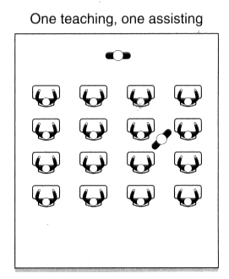
One Teach, One Assist
One teaches while the other supports the instructional process by assisting students who need redirection or who have questions.
Notes:
To Say: One Teach, One Assist may be used for student assistance or teacher assistance. One teacher might be charting as another teacher instructs or talks through a process. They may be passing out papers, writing on the board or helping students stay on task. This is not a model that provides strong instructional intensity. But is one that can often be seen in Co-teaching classrooms.

Slide 29
Benefits
Allows for individual and classroom support during a lesson
Allows for more effective and efficient instruction while one can check student responses and carry out management tasks such as distributing materials or behavior reinforcers
Notes:
To Say: This approach is helpful as a new Co-teacher becomes acquainted with the other teacher’s teaching style or in hearing new content. It can help provide feedback to students who have difficulty with multi-step directions during classroom experiments or labs. It cah help redirect problem student behavior.

Slide 30
Drawbacks
Has the greatest potential to be over-used and abused, with little benefit to the students over a traditional, one-teacher classroom
May distract students from attending to the teacher during instruction
Notes:
To Say: One Teach, One Assist is the least effective Co-Teaching approach. Many students do not want to be singled out by another teacher during instruction. Students will not look to the teacher who assists as the real teacher. This approach also does not allow for the Increased Instructional Intensity nor does it provide greater opportunities for the student to respond during critical instruction.
Using this approach one teacher is usually seen as the teacher and the other teacher is seen as a para-professional. It is not a good use of an instructional professional’s time.

Slide 31
Different Expertise
Effective interpersonal skills
Patience, flexibility, and positive attitude
Content Area
Scope and sequence of curriculum
Management strategies for large groups
Pacing of curriculum
Knowledge of content standards
Knowledge of state testing
Knowledge of additional resources for content areas
High student expectations
Effective interpersonal skills
Patience, flexibility and positive attitude
Learning Styles
Behavior management techniques
Learning Strategies
Educational accommodations/modifications
Knowledge of IEPs
Monitoring and documenting student progress
Diagnostic/prescriptive teaching
High student expectations
Notes:
To Say: It is understood that each teacher in a co-teaching classroom has an area of expertise. This is not an all inclusive list of the skills or knowledge the teachers who are involved in Co-Teaching utilize. When teachers who were co-teaching were queried, this is how they saw the differences between a content area teacher and a special education teacher. On the left area the expertise of content level teachers, on the right special education teachers. If you notice they start with many of the same areas of expertise and then branch out in different areas of expertise based on thier education and training.
Think of this list as a guide to help your understanding that the two teachers will think differently about classroom planning and implementation. Yet, over time, both teachers will gain personally and professionally from the knowledge or experience the other brings to the classroom. Both will and must learn the content to be instructed and both will also learn different ways to ‘make learning stick’.
When reading the role of the general educator (left side) their skills and knowledge lie in the understanding the curriculum, pacing and what the student learning needs to look like for state assessment and content mastery.
The special educator (right side) will bring to the classroom different learning strategies and specially designed instruction needed for access to the learning and content.
Together Co-Teaching professionals ensure a creative, high-energy classroom where the needs of all students can be met. Students benefit from the expertise of two teachers. Co-Teaching improves skills in students and teachers.

Slide 32
Components for Co-Teaching
Shared Philosophy
Prerequisite Skills
Collaborative Relationship
Clear Plans and Procedures
Administrative Support
Professional Development
Notes:
To Say: Successful Co-Teaching teams share several common beliefs that administration needs to foster that will constitute a philosophy or a system of principles that guide their practice. We plan to give you the foundation you need to create the successful Co-Teaching classroom.
When entering into Co-Teaching, encourage teachers to think of it as a Business Partnership. Some books refer to it as a marriage. You will want your teachers to collaborate together to develop the best instruction they can for the students they teach. Each member of the Co-Teaching team is a professional whose role is outlined and overseen by supportive administrators.
Administrators are there to help evaluate the effectiveness of the situation according to student and teacher needs. They need to provide to their teams allocated time to be spent on content, process or implementation development. Administrators are a defining piece that can enhance or inhibit the development of successful Co-Teaching.
Training is a necessary component to utlize both team members well and gain that increased educational intensity.

Slide 33
Effective Co-teaching
Two Certified Teachers
Common Plan Time
Training and/or Coaching for Teachers
Classroom Composition
Building Administrator Support
Notes:
Effective co-teaching does just not happen. There are some important things that administrators need to consider before moving their district or building into co-teaching.
Co-teaching is designed to be done by two certified teachers, not a teacher and a paraprofessional. Consideration of both teachers in the model ensures an equal partnership in the classroom. Both participants share the collective responsibility for instruction, planning, and assessment and are the concern of both teachers. Both teachers will share in everyday grading and data collection. The Co-Teaching relationship hinges on the concept of parity. It is hard to have that parity if one is a teacher and one is a paraprofessional
Common planning time is often one of the more difficult concepts to work around. However it will difficult for both teachers be involved in the planning and instruction if they never have joint planning time. It is hard to get to the strategies that provide the instructional intensity without common planning time.
Training and/or coaching is essential to ensure teachers know how to use their time well and to keep the special education teacher from being used as a classroom aide instead of a trained professional educator.
Having two teachers in the same classroom is not an excuse to dump all the special education students into the same classroom or add additional students to the class. While for many students with disabilities, a Co-Teaching classroom helps students access the general education curriculum, this placement is not appropriate for ALL students with disabilities.
Some administrators believe that you can put twice the number of students in a co-taught classroom because there are two teachers in the classroom. The co-taught classroom needs to have the same or lower number of students in it as the other general education classrooms or sections.
Marilyn Friend recommends that the percentage of students placed in a co-taught classroom is optimal when there are no more that 20-25% of elementary special education students or no more than 25-33% of secondary special education students in the general education classroom. If the percentages become higher, the likelihood of successful Co-Teaching diminishes.
Support from the building administration is important. They need to understand the class will look different and sound different than classes with just one teacher. They need an idea of what to expect to see and how both teachers are being utilized. They must be willing to protect the planning and instructional time for the teachers and give consideration to strong teacher teams when planning the building schedule each year.

Slide 34
Look fors
Mutual Respect
Enhanced Partnership
Collaborative Teaming
Same Outcomes
Organizational Structures
Quick Quiet Transitions
Teach Simultaneously
Both Teach Content
Shared Planning
Researched-Based Teaching Practices
Flexible Grouping
Varied Co-Teaching Models
Student Centered Tasks
Real World Tasks
Differentiated Instruction
Student Participation
Informal Daily Assessment
Use of Data for Planning & Grouping Students
Student and Teacher Feedback
Notes:
To Say: This slide is a great quick reference for administrators to use when observing Co-Teaching. If your district opts to implement co-taught classrooms, when you observe in the classrooms these are things that you should be seeing. These are the strategies that will help provide increased educational intensity. Remember for many of your teachers these will be new ways of doing things. It takes time to develop a well structured co-taught classrooms. Your teachers may need training and on-going coaching to continue to grow into the practices that provide the most instrcutional intensity for your students.,
Co-Teaching can change many facets of a classroom. This is just a short list of places where you will find evidence of what a difference Co-Teaching can make. If you are not seeing any of these in the co-taught classrooms then you will want to strongly consider Professional Development for your teacher teams.

Slide 35
Improvement Consultants
1.Southeast
Berkley Rosenquist
brosenquist@semo.edu
2.Heart of Missouri
Jennifer Statler
jhstatler@missouri.edu
3.Kansas City
Carrie Turner
cturner@umkc.edu
4. Northeast
Tonya Grant
tgrant@truman.edu
5. Northwest
Pam Madison
pmadison@nwmissouri.edu
6. South Central
Connie Cromwell
cromwellco@mst.edu
7. Southwest
Melynda VanNote
MelyndaVanNote@missouristate.edu
8. St.Louis
Patti Stenger
pstenger@eduplus.org
Michilene Carbol
mcarbol@edplus.org
9. Central
Mary Beth Scherer
mbscherer@ucmo.edu
Notes:
Your improvement consultants located at the Regional Professional Development Centers across the state, can provide Co-teaching training and coaching to your teachers. Please reach out to them to ensure your teachers have what they need to make the most the most of their co-teaching classrooms and provide the increased instructional intensity that makes co-teaching successful.

