Slide 1
SPECIAL EDUCATION COMPLIANCE TIERED FEDERAL MONITORING SELF-ASSESSMENT TRAINING COHORT 1
2023
Missouri Department of Elementary and Secondary Education
Notes:
Welcome to the Self-Assessment Training for Cohort 1 public agencies.

Slide 2
Learning Objectives
Participants will learn
1. the steps in the special education monitoring process for local agency self-assessment,
2. the required activities for the self-assessment and their due dates, and
3. how to find resources for assistance with questions.
Notes:
I am going to talk about
1. the steps in the special education monitoring process for local agency self-assessment,
2. the required activities for the self-assessment and their due dates, and
3. how to find resources for assistance with questions.

Slide 3
Program Monitoring of Districts
Missouri utilized a 3-year cyclical monitoring process. Cohort 1 is beginning their self-assessment year.
The cyclical monitoring process includes:
Self-Assessment (Year 1)
Corrective Action (Year 2)
Maintain & Retrain (Year 3)
Notes:
Missouri utilized a 3-year cyclical monitoring process. Cohort 1 is beginning their self-assessment year. The cyclical monitoring process includes Self-Assessment (Year 1), Corrective Action (Year 2), and Maintain & Retrain (Year 3). Today we will explain processes for monitoring in Year 1, the Self-Assessment year with file reviews.

Slide 4
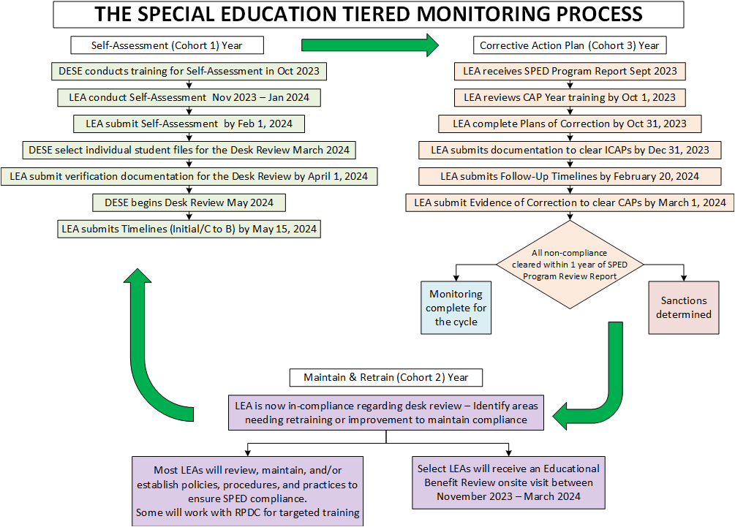
Notes:
Here you can see a flow chart of the Tiered Monitoring Process. Cohort 1 is beginning Year 1. You can fine this chart on our website. It is easiest to find if you Google “DESE Tiered Monitoring Flowchart.”

Slide 5
Self-Assessment Year 1
Training for Self-Assessment - October 2023
Conduct Self-Assessment - November 2023 - January 2024
Submit Self-Assessment in IMACS 2.0 - February 1, 2024
Submit Verification Documentation for the Desk Review - April 1, 2024
Submit Timelines (Initial/C to B) - May 15, 2024
Notes:
Here you can see the steps in the Self-Assessment process and the due dates. Today we are conducting the training for self-assessment and will cover each of the others steps in detail. From November to January, you will conduct self-assessments. In February, you will use IMACS 2.0 to submit files. In April compliance supervisors will start conducting desk reviews using the documentation districts have uploaded into IMACS 2.0 to determine whether each indicator being reviewed is in or out of compliance. On May 15, you will submit initial and C to B timelines to DESE.
.

Slide 6
Five Components of the Self-Assessment
File Review
Initial Evaluation Timelines
C to B Transition Timelines
Upload requested documents in IMACS 2.0
Parent Surveys
Notes:
There are five components in the Self-Assessment process.
Completing the Self-Assessment File Review
Collecting and submitting initial evaluation timelines
Collecting and submitting C to B transition timelines
Uploading documents for the desk review verification
Facilitating Parent Surveys (typically second semester)
The self-assessment and desk review are tailored to the district based on data collection by DESE on several factors.

Slide 7
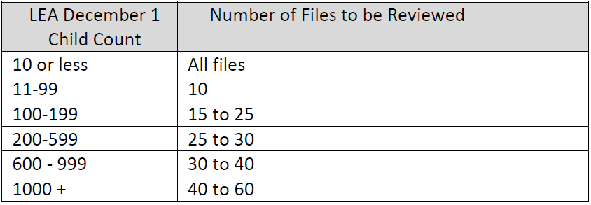
File Review: Number of Student Files Included
Based on the December 1, 2022 child count for the agency, the following number of files should be used as a guideline for determining the total number of files included in file review:
Notes:
This slide describes the number of files you will review based on the number of students with IEPs reported in your most recent December 1 child count. Files are then selected by your DESE compliance supervisor for the desk review verification. Compliance supervisors will generally select files which serve multiple purposes for review. For example, files for a high-school student would be used to review reevaluation indicators, IEP indicators, and postsecondary transition indicators. This chart is posted on our website.

Slide 8
File Review: Selecting Student Files
Student files selected by the district for self-assessment should represent:
A cross section of ages, grade levels, and buildings within the district, including ECSE students and students with postsecondary transition plans, that have had an initial evaluation, a reevaluation, or have post-secondary transition IEP completed since January 2023
Provide a variety of disabilities and placements. Select districts will be asked for specific conditional areas such as: Intellectual Disabilities (ID), Other Health Impaired (OHI), and Specific Learning Disability (SLD)
Students from your districts who are enrolled in an Approved Private Agency or virtual learning. (See next slide for more information.)
Select files for students who were evaluated or reevaluated in the current (23/24) and prior school year (22/23).
DO NOT submit files that used triennial waivers.
Avoid using transfer student’s files, if possible.
Notes:
Student selection for self-assessment file review should include
A cross section of ages, grade levels, and buildings within the district, including ECSE students and students with postsecondary transition plans, that have had an initial evaluation, a reevaluation, or have post-secondary transition IEP completed since August 2022
Select districts will be asked for specific conditional areas such as: Intellectual Disabilities (ID), Other Health Impaired (OHI), and Specific Learning Disability (SLD)
Students from your districts who are enrolled in an Approved Private Agency or virtual learning. If you are a MOCAP Host districts you will be required to submit a few student files of those with IEPs attending their district’s virtual school.
Select files for students who were evaluated or reevaluated in the current (23/24) and prior school year (22/23).
DO NOT use files that used triennial waivers Triennial waivers are not reevaluations.
Avoid using transfer students, if possible.

Slide 9
Students Attending Approved Private Agencies or Enrolled in Virtual Learning
Districts who have full-time students placed in a DESE Approved Private Agency (APA) must include one or more of those students in their self-assessment file review.
Resident districts who have full time students enrolled in virtual learning through an Memorandum of Understand (MOU) or enrolled with a non-hosted MOCAP provider must include one or more of those students in their self-assessment file review.
Host districts who have full time students enrolled with their hosted MOCAP provider must include one or more of those students in their self-assessment file review.
Notes:
Districts who have full-time students placed in a DESE Approved Private Agency (APA) must include one or more of those students in their self-assessment file review.
Resident districts who have full time students enrolled in virtual learning through an Memorandum of Understand (MOU) or enrolled with a non-hosted MOCAP provider must include one or more of those students in their self-assessment file review. A Resident District is the public school district or charter school the student would attend if receiving classes in-person that would receive state aid for the student.
Host districts who have full time students enrolled with their hosted MOCAP provider must include one or more of those students in their self-assessment file review. A Host District is the public school district, charter school, or higher education institution that enrolls the student in the online provider’s program.

Slide 10
Students Attending Approved Private Agencies or Enrolled in Virtual Learning
Number of students placed in an APA, enrolled in virtual learning through their resident district, or enrolled in virtual learning with a host district | Number of files to include in their self-assessment selection
Up to 5 students | 1 or 2 student files
6 to 10 students | 3 or 4 student files
11 to 19 students | 5 or 6 student files
20 or more students | 7 student files
APA or virtual learning files selected must be an initial evaluation, a reevaluation, or have post-secondary transition IEP completed since January 2023 as described in the selection criteria on slide 8.
Notes:
The chart shows you the number of files you should include for your review.
APA or virtual learning files selected must meet selection criteria outlined on the previous slide such as be an initial evaluation, a reevaluation, or have post-secondary transition IEP completed since August 2022. **Be aware that there will be an expectation In the documentation for Year 2 that CAP statements will include how virtual providers will be trained and how needed corrections for them would be monitored.

Slide 11
Required/Conditional Indicators
Required Indicators
Referral (initial only)
Evaluation
Reevaluation
IEP
Present Level of Academic and Functional Performance
Annual Goals and Goal Progress Reports
Postsecondary Transition
Conditional Indicators
MAP-A
Eligibility (SLD, OHI, ID)
Long Term Suspensions
Notes:
Required indicators are those every public agency must address through student file reviews.
For the required indicators, the referral (initial evaluations only), the evaluation, and the Individualized Education Program (IEP) including the postsecondary transition planning and goal progress reports will be reviewed by the you and by compliance supervisors.
Conditional Indicators are those included in the file review only when district special education performance data reflects the need. Conditional indicators are included when districts do not meet performance targets for MAP-Alternate (MAP-A) participation, identification of students in the eligibility areas of Specific Learning Disability, Other Health Impairment and Intellectual Disability, and long-term suspensions of students with disabilities. For review of students who have been long-term suspended, include records for three students meeting the description in the Special Education Program Review Indicators 300.30 through 300.80 in the self-assessment file review.
In the next part of this training that covers how to use IMACS 2.0, we will show you where to look to find out if conditional indicators apply for your district.

Slide 12
File Review: Selecting a Variety of Files
Initial Evaluations
When conditional indicators are triggered, include students eligible using criteria for SLD, ID and/or OHI. Conditional indicators need initial evaluation for review.
Reevaluations (with and without assessment)
NO triennial waivers, these are NOT reevaluations
IEPs
A variety of grade levels and placements including one or two ECSE students as well as students enrolled in APAs and virtual learning
A minimum of five IEPs with postsecondary transition plans
IEPs for students enrolled in MAP-A when conditional indicators are included
Notes:
When selecting files for a file review select from a variety of files.
Include a variety Initial Evaluations so your practices for determining eligibility in several area can be reviewed. If you are required to review conditional indicators, initial evaluation must be used. IMACS 2.0 will not count reevaluations for the required conditional areas when you are submitting files. Initial evaluations must be used for conditional SLD, ID, and OHI files.
Include Reevaluations (with and without assessment). NO triennial waivers, these are NOT reevaluations
Include IEPs from a variety of grade levels and placements including one or two ECSE students as well as students enrolled in APAs and virtual learning.
If conditional indicators are required for students enrolled in MAP-A, include student files for students who are MAP-A eligible.
Please make every effort to include at least five IEPs with postsecondary transition plans in the self-assessment. The self-assessment and desk review verification results for the indicators applied to postsecondary transition planning will be used to calculate your district’s Special Education Profile Indicator 13 performance data until the next monitoring cycle. Don’t put all your eggs in one basket. For example, if you only include two students with transition plans in your self-assessment and one of those students has one transition indicator that is out of compliance, the district’s score for Indicator 13 transition planning will be 50% because the score is based on the number of students who meet all of the postsecondary transition planning requirements included for indicator 13 reporting.
A handout titled SELF‐ASSESSMENT PROCEDURES FOR MONITORING is posted on the DESE Special Education Compliance IMACS Tiered Monitoring webpage.

Slide 13
Enter Student Demographic Data In IMACS 2.0
There are now two ways to add data:
Type individual student demographic data in IMACS 2.0.
Upload bulk student demographic data to IMACS 2.0 via a CSV file.
Notes:
You can enter student demographic data in IMACS 2.0 in two different ways. You can enter data for each student individually by clicking on Add New Student File Review , or you can enter student data in a spreadsheet and import the spreadsheet by clicking on Import Student File Review Data from CSV file .

Slide 14
File Review: Assemble Documents
Initial Evaluations
Referral, review of existing data, evaluation report, and IEP
Prior Written Notices and Meeting Notifications
IEP Goal Progress Reports (copies of what was sent to the parent)
Meeting Notes or Contact Logs, if applicable
Discipline documentation (if discipline is a conditional indicator)
Documents with a Parent Signature (when required)
Notes:
The following documents should be reviewed and provided to DESE for all the student files with initial evaluations. Please review and upload the
· Referral, review of existing data, evaluation report, and IEP
· Prior Written Notices and Meeting Notifications
· IEP Goal Progress Reports that were provided to the parent
· Meeting Notes or Contact Logs, if applicable
· Discipline documentation (if discipline is a conditional indicator)
· Documents with a Parent Signature (when required)
Except for the referral, the same information is needed for reevaluations.
In preparing files for scanning and then uploading, be aware of double-sided pages which only scan one side which causes missing documentation. The order in which the documentation is scanned into the pdf file needs to be according to the special education process with the referral, review of existing data, evaluation report and IEP with meeting notifications and Prior Written Notice in the correct order. If pages slip in the scanning process information can be missing. Double-check uploaded documents to make sure they are complete and readable.
It is helpful to create a file folder on your desktop with the files you are going to upload so that files are easily accessible and all in one place.

Slide 15
File Review: Conducting Self-Assessment
Read the entire indicator.
Refer often to the Special Education Compliance Program Standards and Indicators manual for guidance and clarification. Do not rely only on the IMACS 2.0 checklist language.
Determinations are
Yes = documentation is present/correct
No = documentation does not meet compliance
N/A = indicator doesn’t apply
Notes:
When Conducting self-assessment for the file review. Read the entire indicator.
Use the Special Education Program Review Standards and Indicators manual as you review files and are entering responses into IMACS. Do not rely only on the IMACS 2.0 checklist language.
As you review, you will select
Yes = YES means the documentation is present and meets the compliance requirement.
No = NO means the documentation does not meet compliance requirements.
N/A = NA means the indicator doesn’t apply to the special education process for this student.

Slide 16
Documentation for the Desk Review Verification
Upon request by the DESE compliance supervisor, upload documentation from the files of specific students chosen for the desk review.
Upload to IMACS 2.0 no later than April 1, 2024.
DESE supervisors will review and verify each district’s self-assessment in IMACS 2.0 during desk monitoring conducted from April through August 2024.
Provide your supervisor with summer contact info (cell phone #, email address) in case they have questions or need additional documentation to complete the verification.
Keep an electronic copy of the documents, including those that have
signatures, in an easy-to-access, central location.
Notes:
Your DESE compliance supervisor will request documents used to verify the self-assessment results through the IMACS 2.0 system. Upload documents described in the request for selected students. Make sure all documentation is included which determined the decision for a particular indicator. For example, be sure to include all the supporting documents for each part of the process being reviewed. For an initial evaluation you will need the referral form, any other documents such as a contact log that includes the date Procedural Safeguards were provided to the parent, Prior Written Notice for consent to evaluate, Notification of Meeting for the eligibility determination, and the evaluation report.
Upon request by the compliance supervisor, upload documentation into IMACS 2.0 by April 1, from the files of students chosen for the desk review.
Compliance supervisors will review and verify each district’s self-assessment in IMACS 2.0 during desk monitoring conducted from April through August 2024.
It is important to provide your compliance supervisor with summer contact info such as your cell phone number or an email address you used in the summer, in case additional documentation is needed to complete the verification or questions arise.
Keep an electronic copy of the documents, including those that have signatures, in an easy-to-access, central location preferably one that can be accessed remotely.

Slide 17
Timelines: Submission
Timeline submission due May 15, 2024.
Initial Evaluations
Include all students with initial evaluations (ineligible and eligible).
Include initial evaluations that began after July 1, 2023 and are finished before April 30, 2024
Part C to Part B Transition
Include children who were referred from First Steps between July 1, 2023 and April 30, 2024 and whose third birthday occurs before April 30, 2024.
Notes:
Timeline Submission are due May 15 . Since the timeline collection period ends April 30, do not submit timelines prior to April 30.
Initial evaluations include all students (ineligible and eligible). Include initial evaluation that began after July 1 and are finished before April 30.
Part C to Part B timelines include any children whose 3rd birthday falls within the data July 1 - April 30 data collection period.

Slide 18
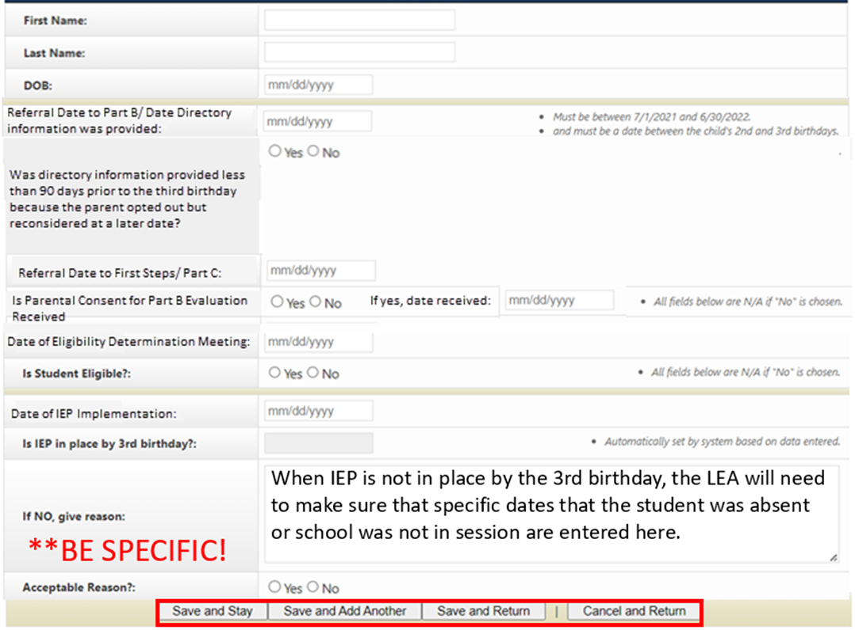
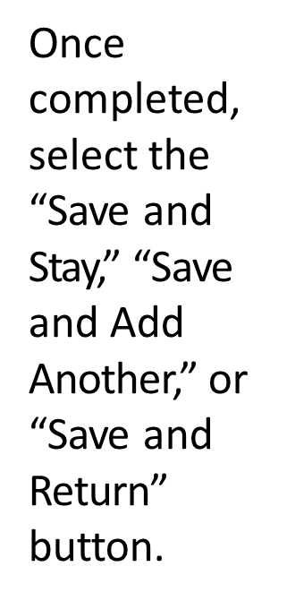
Timelines: C to B Submission
Notes:
The template for entering the C to B information has been updated to help ensure that the correct information is submitted.
· The referral date to Part B is not the same as the date as the referral to Part C. Providing the referral date to Part C helps DESE compliance supervisors know when referrals to part C are made less than 90 days from the child’s third birthday, so LEAS are not counted out of compliance if an IEP is not implemented by the third birthday.
· “Date of IEP” was changed to “Date of IEP Implementation”. The date the IEP is implemented should be provided not the date of the IEP meeting. For this reason, the IEP must be implemented by the third birthday. The child is no longer eligible for Part C services at age three (unless using the summer birthday extension) so implementing the IEP later would result in a gap in FAPE.

Slide 19
Parent Surveys
Purpose is to increase parent engagement and provide data for State Performance Plan (SPP) Indicator 8 which states:
Percent of parents with a child receiving special education services, who report school facilitated parent involvement as a means of improving services and results for children with disabilities.
All parents of students with disabilities served by the LEA should participate in the Parent Survey.
During first semester of the 2023-24 school year,
University of Missouri Institute of Public Policy (IPP) will send out the survey,
LEAs provide parent with the survey or a survey link, and
parents complete the survey and mail it back to the IPP or submit it electronically.
LEA will receive results of surveys to use in planning for increasing parent involvement.
Notes:
The purpose of the Parent Surveys is to improve parent engagement in the special education process and to provide data for SPP Indicator 8 which addresses parent involvement and is included district’s special education profile.
During second semester, the Office of Social and Economic Data Analysis (OSEDA) at the University of Missouri will send an email containing the survey information to each director. This email copied to the superintendent as well. It will contain instructions, timelines, and district specific surveys. Parent Surveys are anonymous. The surveys are available online, but since some parents do not have access to the internet, paper copies are also distributed. The paper copies should be mailed by the parent, no the district, to IPP. Some LEAs provide parents the paper surveys after the annual IEP meeting in the spring. Another option to get parent’s input is for the district to provide a computer set-up with the survey for parents to use at an open house, parent-teacher conference, or after the IEP meeting. It is important to note the each LEA will receive a copy of their Parent Survey results to assist the LEA to increase parent engagement and involvement. The results are not parent specific.

Slide 20
Resources for Tiered Monitoring and IMACS
DESE’s Self-Assessment (Year 1) Guidance and Resources
Copies of both PowerPoints presented today
List of Things to Remember for Self-Assessment
Self-Assessment Procedures for Monitoring
LEA Special Education Compliance Monitoring Checklist
Tiered Monitoring Flowchart
Notes:
DESE has the following resources posted on their website. The easiest way to locate them is to Google “DESE Self-Assessment (Year 1) Guidance and Resources”. Also remember to reference the Missouri Special Education Standards and Indicators and the Missouri State Plan for Special Education.

Slide 21
Compliance Consultants
Region | Compliance Consultant | Phone Number | Email
Southeast | Tiffiney Smith | 573-651-2621 | tdsmith@semo.edu
2. Heart of Missouri | Lynn Lynch | 573-424-7847 | lynchly@missouri.edu
3. Kansas City | Bailey Tennesen | 816-235-5957 | tennesenb@umkc.edu
4. Northeast | Dawn Lichtenberg | 660-785-6080 | dlichtenberg@truman.edu
5. Northwest | Julia Schmitz | 660-562-1995 | julia@nwmissouri.edu
6. South Central | Leasa Day | 573-341-6821 | ldnd3@mst.edu
7. Southwest | Amy Phipps | 417-836-4082 | amyphipps@missouristate.edu
8. St. Louis | Jeanne Rothermel | 314-724-6736 | jrothermel@edplus.org
9. Central | Julie Harris | 660-232-0387 | jlharris@ucmo.edu
Notes:
Your Regional Professional Development Compliance Consultant is also a helpful resource.

Slide 22
Questions? Please contact:
Office of Special Education
Special Education Compliance (Part B)
P.O. Box 480, Jefferson City, MO 65102-0480
Phone: 573-751-0699
Email: secompliance@dese.mo.gov
Notes:
If you have any questions at any time during this process, you may contact us by either phone or email. Thank you for attending our presentation on Cohort 1 Self-Assessment. If you have any questions, please contact the compliance supervisor identified on the IMACS 2.0 Tiered Monitoring: Monitoring Module page under Assignment Information by calling this number on the slide. Questions will also be answered via the email address. This powerpoint and handouts associated with training will be posted on the Office of Special Education, Compliance webpage.

Slide 23
The Department of Elementary and Secondary Education does not discriminate on the basis of race, color, religion, gender, national origin, age, or disability in its programs and activities. Inquiries related to Department programs and to the location of services, activities, and facilities that are accessible by persons with disabilities may be directed to the Jefferson State Office Building, Office of the General Counsel, Coordinator – Civil Rights Compliance (Title VI/Title IX/504/ADA/Age Act), 6th Floor, 205 Jefferson Street, P.O. Box 480, Jefferson City, MO 65102-0480; telephone number 573-526-4757 or TTY 800-735-2966; fax number 573-522-4883; email civilrights@dese.mo.gov

