Slide 1
SPECIAL EDUCATION COMPLIANCE TIERED MONITORING
CORRECTIVE ACTION PLAN YEAR TRAINING & GUIDANCE
Missouri Department
of Elementary and Secondary Education
Fall 2023

Slide 2
Learning Objectives
Participants will know
the corrective action steps in the special education monitoring process cycle for federal tiered monitoring;
how to read and understand the Special Education Program Review Report for the self-assessment and desk review;
the required activities for clearing any identified non compliance;
the timelines for showing evidence of correction of non compliance;
how to enter information into IMACS; and
resources for questions and assistance.

Slide 3
Corrective Action Plan (CAP) Year
Read CAP Year Guidance/Receive Special Education Performance Report - Sept
Create Plan for Correction in IMACS using Rubric – Oct 31 or sooner
Submit Documentation to Clear I-CAPs - Dec 31 or sooner
Submit sample of correction documents in IMACS to clear CAPs - March 1 or sooner
Submit Follow-up Timelines – Feb 20
Yes
ALL non compliance cleared within one year
of Special Education Program Review Report
No
Monitoring Complete for the Cycle
Sanctions Determined
Notes:
The “Corrective Action Plan Year” is when LEAs who have indicators that were found to be “OUT” of compliance develop corrective action plans to address the root cause of the non compliance.
Note that any LEA with 100% compliance as a result of the self-assessment, desk review, and timeline review will NOT have corrective action plans and will NOT participate in the tiered monitoring activities during the corrective action plan year!
Those LEAs with less than 100% compliance will first submit their plans for correction. Then they will submit documentation as evidence that shows individual non compliance has been corrected. Finally, the LEA must upload five samples of documentation for each indicator that was out of compliance. Note: While ALL non compliance must be cleared NO LATER THAN one calendar year from the Special Education Program Review Report, there are intermediate deadlines to ensure the correction is being implemented.
Onsite monitoring occurs the following year between November-March. Approximately 5-10% of the districts in the cohort are chosen for an onsite visit. They will be notified by mid- November in IMACS.

Slide 4
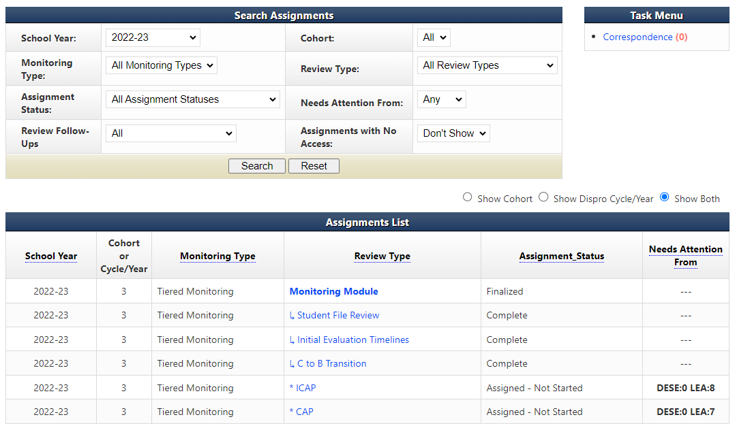
Digging into the information
Make sure that the school year is set to the school year in- which the self- assessment was completed. Then select Monitoring Module.
Notes:
When IMACS 2.0 opens to the districts after the Self-Assessments have been finalized, one of the first things to do is review the reports to see the results.
First make sure that the school year is set to 2022-23 (the school year in-which the self-assessment was completed) on the district’s home page, and then click on search. When the Assignment List populates, click on Monitoring Module.

Slide 5
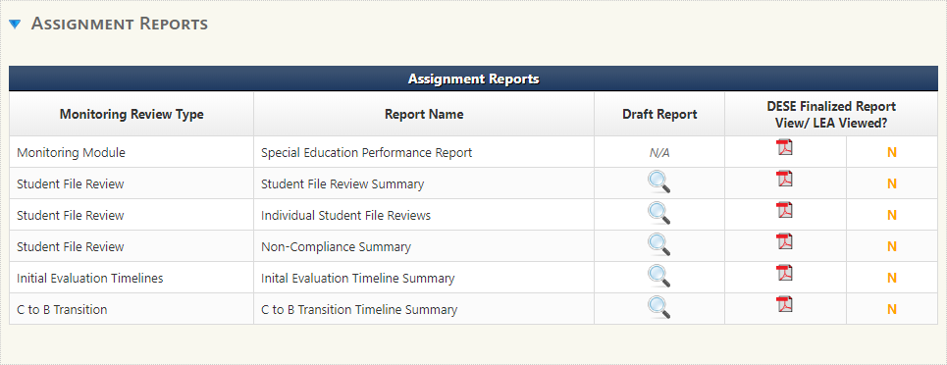
IMACS 2.0 Reports
Select the blue arrow next to Assignment Reports.
Notes:
Once you reach the Monitoring Module page, scroll down until you see Assignment Reports. Click on the blue triangle (circled in red) to the left of Assignment Reports to open the reports list. The Special Education Performance Report contains many parts including the letter to the district Superintendent explaining the outcome of the Self Assessment, Corrective Action Plan information, and the Special Education Monitoring Report which lists whether an indicator reviewed was found to be in or out of compliance. The Student File Review Summary breaks down all the answers – yes, no, and NA – and gives the LEA the compliance percentage for each indicator included in the review.
The Individual Student File Reviews report gives the Yes, No, and NA for the indicators reviewed for each student. Remember that the Supervisors just check for compliance with the Standards and Indicators, but something that meets minimal compliance requirements may not be an effective practice. The Non-Compliance Summary report gives you the No’s and the reason behind that answer. The Initial Evaluation Timeline Summary and C to B Transition Timeline Summary reports display the results of the timeline reviews and notes that the Supervisors wrote in regards to any timeline that was determined to be out of compliance.

Slide 6
Next Steps
If all indicators are “IN” compliance then you are finished with the desk review process!
If any indicator is “OUT” of compliance then you must:
complete the Plan for Correction
correct individual non compliance (I-CAP)
document systemic compliance for each indicator (CAP)
If selected for an onsite review then you will need to:
watch for correspondence with specific details
speak with your Compliance Supervisor
Notes:
After reviewing the Special Education Performance Report, each LEA will need to analyze the information and determine the next steps in the process.
Some districts will have a Special Education Performance Report which shows 100% compliance. These districts have NO Corrective Action Plan activities that need to be completed.
If any non-compliance was identified, the LEA will be required to participate in the Corrective Action Plan year steps. The first step, Plan for Correction, is due no later than October 31.

Slide 7
The Two Prongs of Correction
Type of Correction | Why | How
INDIVIDUAL (ICAP) | Correct the identified individual student non-compliance Use the special education process to address noncompliance in the individual student’s paperwork. | Follow directions given in the Non-Compliance Summary Report or in the ICAP portion of IMACS 2.0 and provide copies of the correction(s) to DESE.
SYSTEMIC (CAP) | For each indicator in the CAP, write a plan to address the underlying issues that resulted in non-compliance. Provide evidence that the systemic issues found during the file review are no longer occurring. | Follow directions given in the CAP portion of the Special Education Performance Report or in the CAP portion of IMACS 2.0 and provide five copies of compliant documentation.
Notes:
Clearing non compliance for each “NO” call involves two types of correction and evidence. The first is individual correction or ICAP. During this step all identified individual student non-compliance must be corrected. The second is systemic correction or CAP. During this portion the LEA must show systemic correction of all identified non compliance.
This method allows each LEA to correct the non compliance for the student when a “No” call is made and also further demonstrates that correction of the non-compliance issue has been done district wide.

Slide 8
Corrective Action Plan (CAP) Steps
Three steps to completing a CAP:
Write and submit activities of correction. This step is completed BEFORE ICAPS are done.
Implement activities of correction once approved. This step is completed BEFORE ICAPS are done.
Provide sample of documentation that demonstrates compliance requirements are being met. This step is completed AFTER ICAPS are done.
Notes:
The Corrective Action Plan is usually the first activity started and the last one completed in the year following the self-assessment so we are circling back to the third step for completing the CAP – providing evidence of correction.

Slide 9
Plan of Correction
The written Plan of Correction is due October 31, or sooner:
Districts must develop an action plan for correcting any non compliance identified through the self- assessment and desk review verification.
Corrective action plan MUST include strategies and timelines for achieving compliance.
The Corrective Action Plan rubric can be found on the Tiered Monitoring web page of the DESE Special Education Compliance website.
Notes:
The first step is to develop the Plan for Correction. For every indicator shown as “OUT” of compliance, the LEA must first develop a corrective action plan that describes the steps that are needed for the district to be in compliance with specific indicators. The Plan for Correction should also identify school district personnel responsible for implementing the plan as well as personnel who have a role in reaching and maintaining compliance. Each Plan for Correction should be compared to the rubric provided. The plan must give clear statements of strategies to be taken and implemented.

Slide 10
Beginning to work on your Plan of Correction
Notes:
Go to your LEA’s home page in IMACS 2.0. Make sure the School Year drop box (found near the top left of the page) is set to the 2022-23 school year. Proceed to the correct area to begin this process by clicking on the blue CAP found in the Review Type column.
Note: You will be able to quickly see how many CAPs or ICAPs your LEA has as well as which side of the process they are on by noting the number found under the Needs Attention From column. The example on the screen shows DESE 0 LEA 8 and DESE 0 LEA 7. This means the LEA has eight ICAPs, and seven CAPS that should be completed and submitted to DESE.

Slide 11
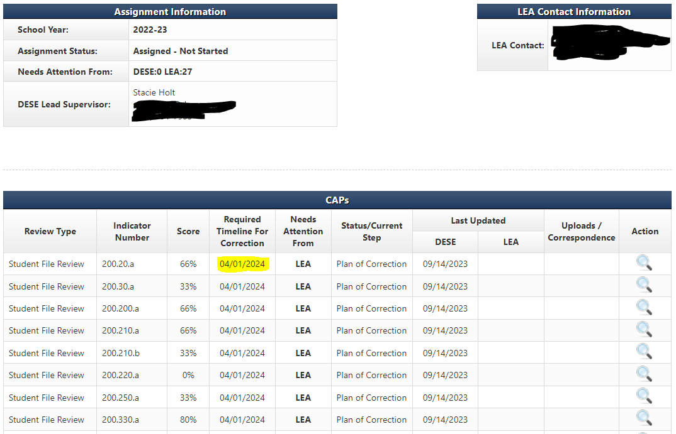
Beginning to work on your Plan of Correction
The required timeline for correction is actually 3/1/24!
Notes:
After you have clicked the blue CAP under the Review Type column on the LEA’s Monitoring Module page you will see this Cap Summary screen which will display the indicators that were found out of compliance during the desk review verification.
The Indicator Number column will tell you which indicators were found out of compliance. The Required Timeline For Correction is NOT April 1, 2024, it is March 1, 2024. The Last Updated column will show who last worked on each indicator and when. Action is the final column. It will either have a magnifying glass (view only), or a pencil (able to take action). Click on the pencil at the end of the row for the indicator on which you wish to work.

Slide 12
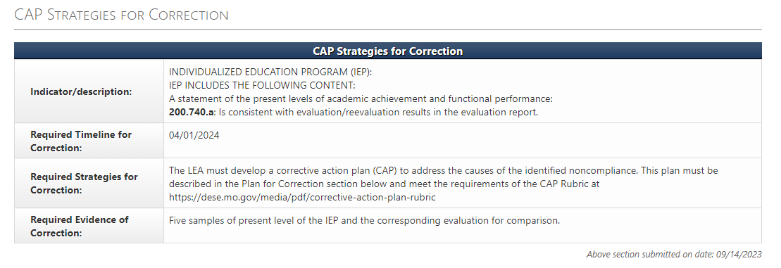
Plan of Correction Rubric and Required Evidence
The Required Timeline for Correction box is the date the evidence of correction is due to the Supervisor. The Plan for Correction is due no later than October 31, 2022.
The Required Strategies for Correction box contains the web address for the Corrective Action Plan Rubric.
The Required Evidence of Correction box details the type of information the Supervisor will need from the LEA as evidence of systemic correction.
Notes:
When you navigate to the CAP page for each indicator that requires correction, the first box is the CAP Strategies for Correction. This box describes what is out, when the evidence is due, how to write the district plan of correction, and what paperwork to submit to your Supervisor. NOTE: Keep in mind that the deadline shown on this page is the deadline for the Evidence of Correction, the LEA’s 5 samples that show they are doing things correctly, and the deadline for the Plans of Correction is October 31.

Slide 13
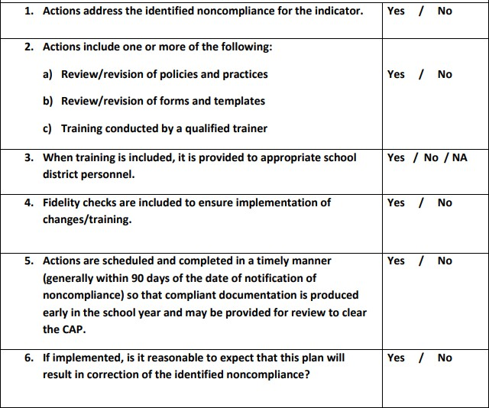
Corrective Action Plan Rubric
Answer this question if you pick C above
Notes:
An approvable corrective action plan describes the steps needed to result in compliance with specific indicators. It also identifies school district personnel responsible for implementing the plan as well as personnel who have a role in reaching and maintaining compliance. Each Plan for Correction should be compared to the rubric that has been created by DESE to assist LEAs to develop an approvable Plan for Correction. This rubric is posted with the other CAP Year Tiered Monitoring Guidance.

Slide 14
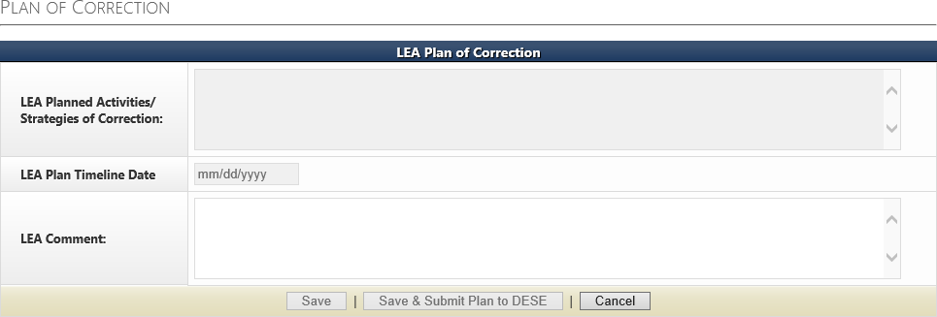
Writing the Plan of Correction
Write the Plan of Correction in this box.
STOP
Do not proceed to the next box on this page until told to do so by your DESE Supervisor.
Notes:
The second section on this page is where you will write your Agency’s Plan for Correction. Type your plan to correct the non compliance in the text box. Each indicator found “OUT” of compliance has its own box. Once each indicator has been addressed, the district will save and submit the Plan for Correction for approval. Do NOT go any further in the process until you have checked with your compliance supervisor. Your special education compliance supervisor will approve and/or discuss revisions to your Plan for Correction in the next section.

Slide 15
Writing the Plan of Correction
This section will be filled out when a DESE Supervisor has approved the plan. Once a DESE Supervisor approves all the LEA’s Plans of Correction you can begin the ICAP Process.
Notes:
This is where your special education compliance supervisor will approve and/or discuss revisions to your Plan for Correction.

Slide 16
Individual Corrective Action Plan (ICAP)
During the ICAP phase of the Corrective Action Plan Year -
Districts correct all individual student non compliance and submit documentation of correction no later than December 31 .
Documentation showing correction for each individual student must be uploaded in IMACS under the ICAP.
DESE Compliance Supervisors will review the documentation in order to clear the I-CAP.
Notes:
The next activity is to correct individual non compliance.
The I-CAP satisfies the Individual Prong for correction of non compliance. The Student Non Compliance Report in IMACS will provide a list of all individual student non compliance identified.
Please note that there are some circumstances which prevent correction of noncompliance for individual students. Call your compliance supervisor when a student with an ICAP no longer lives in your district or has exited special education. Your supervisor will also discuss with you the documentation they would expect you to upload in each case as evidence of correction. Correction of all individual non compliance is expected no later than December 31.

Slide 17
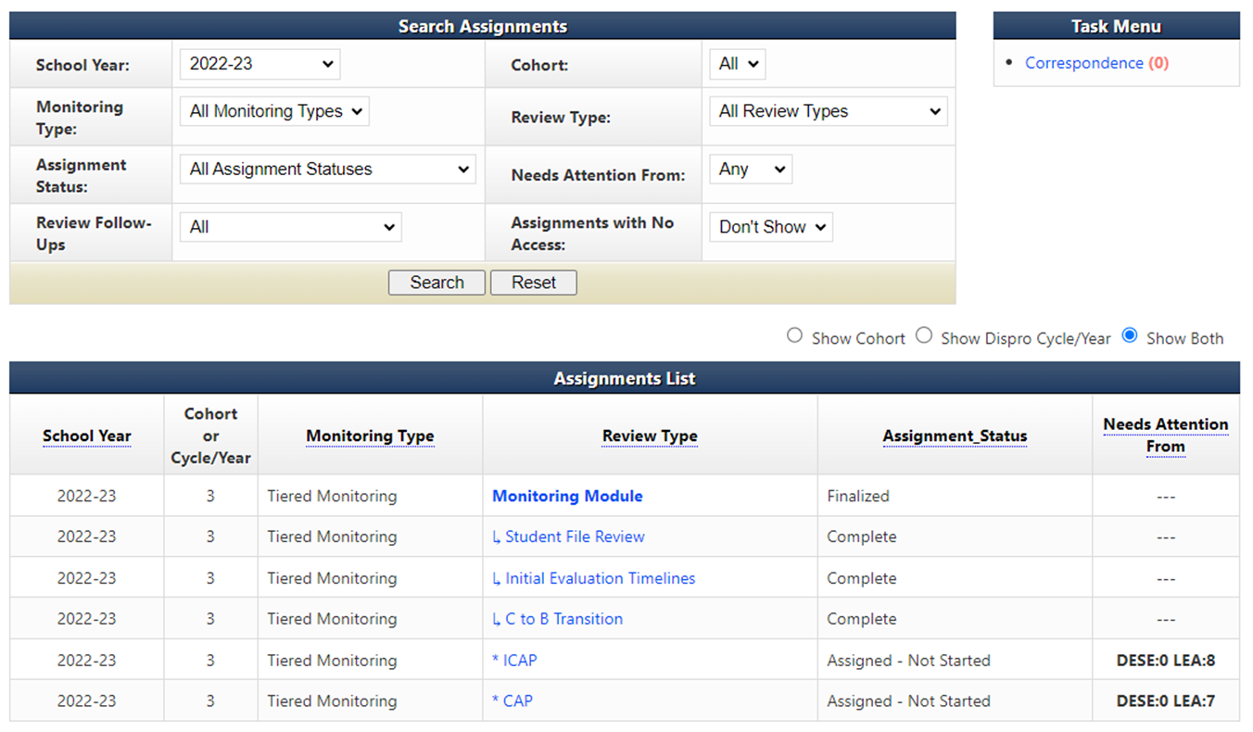
Beginning to work on the Individual Plan of Correction
Notes:
Go to your LEA’s home page in IMACS 2.0. Make sure the School Year drop box (found near the top left of the page) is set to the 2022-23 school year. Proceed to the correct area to begin this process by clicking on the blue ICAP found in the Review Type column. Note: You will be able to quickly see how many CAPs or ICAPs your LEA might have as well as which side of the process they are on by noting the number found under the Needs Attention From column.
These students’ files are to be reviewed and corrective action taken. All this documentation must be submitted no later than December 31.

Slide 18
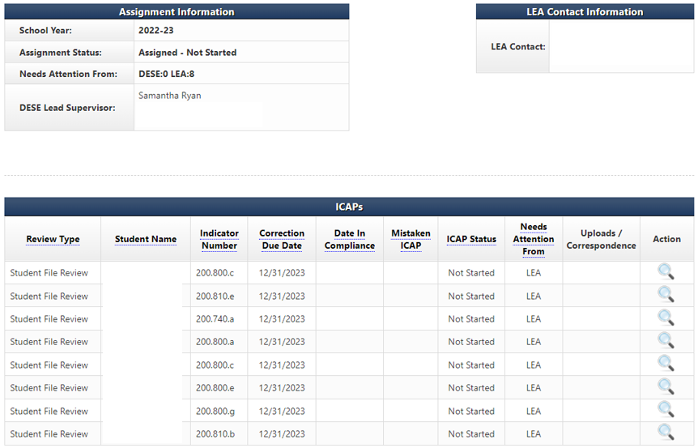
Working on the Individual Plan of Correction
Notes:
After you have clicked the blue ICAP under the Review Type column on the LEA’s Monitoring Module page you will see the ICAP Summary screen which displays the names of individual students and the indicators that were found out of compliance during the review process.
The Student Name column will tell you which student you are working with. The Indicator Number column will tell you which indicators were found out of compliance. The Required Timeline For Correction column will have the final date that all the evidence is due. The Last Updated column will show who last worked on each indicator. Action is the final column. It will either have a magnifying glass (view only), or a pencil (able to take action). Click on the pencil at the end of the row for the indicator you wish to work on.

Slide 19
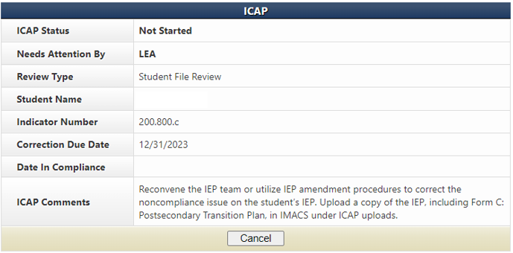
Working on the Individual Plan of Correction
If the student left the district or graduated, the I-CAP can be cleared by uploading documentation from the student information system showing the withdrawal date.
If there were any missing documents that demonstrate compliance that did not get uploaded for file review verification they can still be uploaded to clear the I-CAP.
If there has already been a new IEP or reevaluation done since the self-assessment, that documentation might be used to clear an I-CAP, if it meets compliance requirements.
If the I-CAP cannot be cleared with one of these three ways then proceed with the corrections found in the ICAP Comments row.
Notes:
The top half of the ICAPs page is a dash board that displays the name of the student, the indicator that was found out, and 2 important dates – the date it is due and the date it is found in compliance. The evidence needed to correct the individual mistake is located in the ICAPs Comments row.

Slide 20
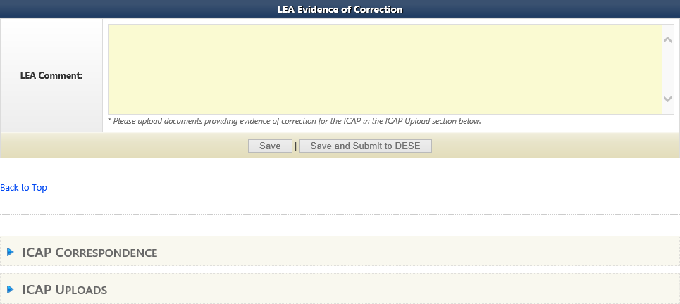
Submitting Evidence for the Individual Plan of Correction
Do not click save and submit until you have uploaded your evidence.
Upload evidence of INDIVIDUAL correction under the student’s name and correct indicator number (see slide 17 if unsure about getting to the correct location).
Notes:
The bottom half of the ICAPs page has a space for the LEA to comment and a space to upload the evidence to clear that student’s individual indicator errors Click on the blue triangle (in the red circle) to the right of the ICAP Uploads. It will open up the uploads section.
Save, but do not click on the Save and Submit to DESE until after you have completed uploaded evidence of correction for each student with an ICAP.

Slide 21
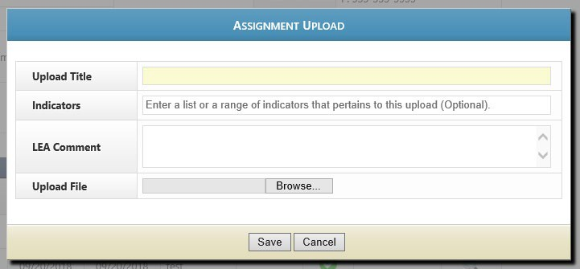
Uploading ICAP Evidence
Click on New Upload to open the Assignment Upload box.
Fill in the name of the document here
This section is optional but always welcome.
Browse for the file you wish to upload
Notes:
Under Assignment Uploads use the New Upload option to add evidence of correction.
Make sure to fill in the name of the document to make easily recognizable. Use a title such as the student's name and the name of the form (Welch RED). Click on browse and find the file on your computer to upload.

Slide 22
Initial Evaluation & C to B Transition Timeline I-CAPs
Individual student non-compliance as a result of exceeding a timeline MUST be corrected by showing:
The parent was informed that the evaluation exceeded the allowed timeline.
The IEP team convened to determine if the provision of FAPE was impacted due to the delay in providing special education and related services as a result of exceeding the timeline.
The IEP was amended to include compensatory services, if any are owed. Submit a copy of the prior written notice (PWN) describing the outcome of the IEP team meeting or meeting summary, if PWN not needed.
Timeline I-CAPs must be corrected by December 31.
Notes:
Note: IEP teams could address the need for compensatory services at the initial IEP team meeting. If they have documentation that they did these things before we identified noncompliance, we would accept that documentation to clear the I-CAP.
If an out-of-compliance timeline is concerning a student who DID NOT qualify for SPED services, the LEA does not need to contact the parent. The LEA will need to write up an assurance that they know this timeline was over and upload that under the student name.

Slide 23
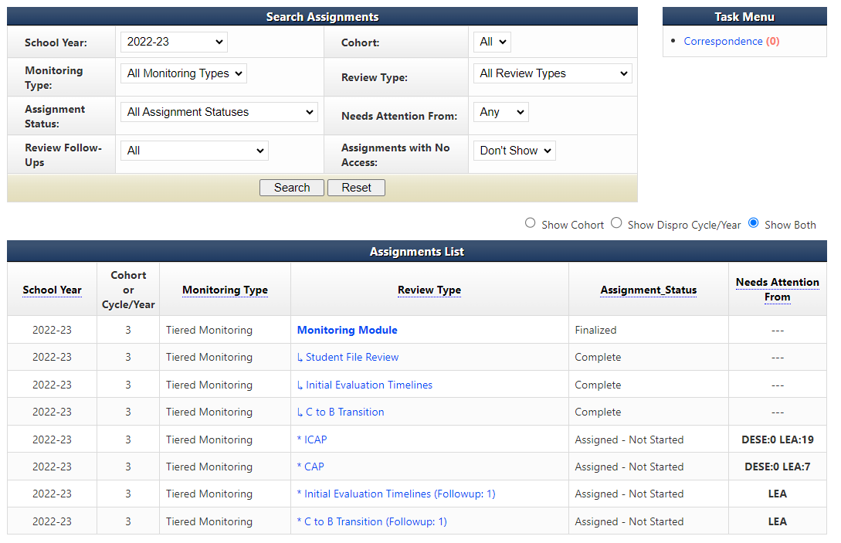
Follow-Up Timelines
If the Initial Evaluation or C to B Transition timelines were found out-of- compliance then click on the follow-up timeline link under Review Type on the LEA’s home page.
Notes:
If one or more of the timelines are found to be “OUT” of compliance, a link for a follow-up timeline collection will appear on the LEA home page of IMACS 2.0. The green arrow shows timeline follow-up for this LEA’s Initial Evaluation Timeline. If this LEA also had C to B Transition Timelines in follow-up then they would be in the same location. The next several slides will demonstrate the “Initial Evaluation Follow-up Timeline” submission.

Slide 24
Beginning Follow-Up Timelines
The data collection period for follow-up timeline is from the date you receive the final report (September 16, 2022) through February 1, 2023. They are due by February 20, 2023.
Include the following information dependent on non-compliance:
Initial Evaluations – include all students for whom consent for an initial evaluation was received and eligibility determined within the data collection period.
C to B Transition Evaluations – include all students referred from Part C whose referral date, 3rd birthday and IEP date fall within the data collection period.

Slide 25
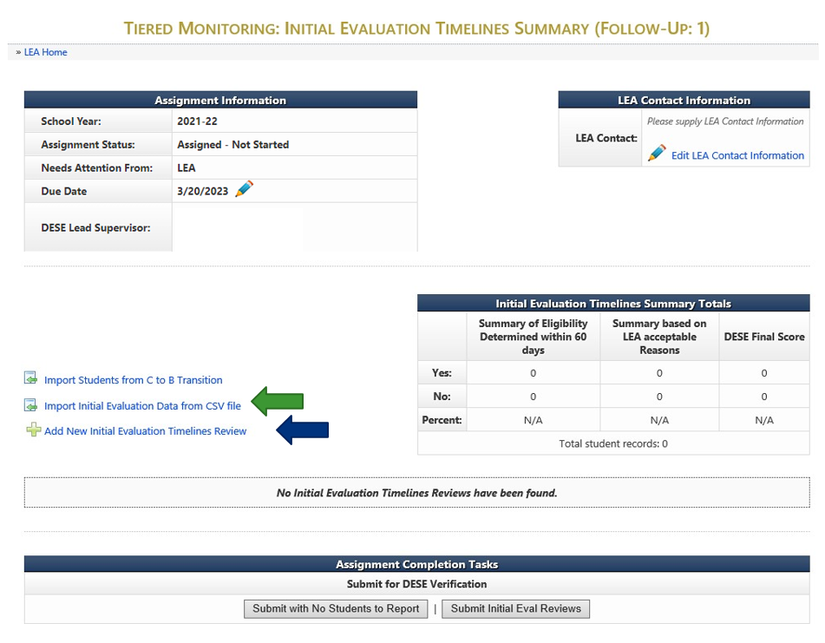
Follow-Up Timelines
Notes:
There are two options for entering the Follow-Up timeline information now in IMACS 2.0.
You can either compile you data collection on a spreadsheet and import that by clicking on Import Initial Evaluation Data from CSV file (green arrow) or you can enter each student individually by clicking on Add New Initial Evaluation Timelines Review (blue arrow).

Slide 26
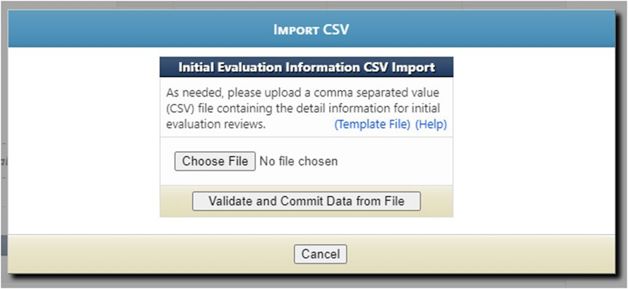
Importing Data from CSV file
Template File allows you to use the blank Excel template that DESE created.
Help gives directions for preparing the CSV/TXT upload.
Choose File locates the CSV/TXT document to upload from your computer.
Click on Validate and Commit Data from File once when the name of the selected
file is showing.

Slide 27
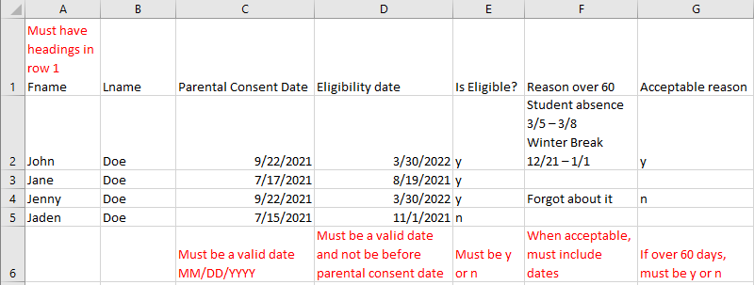
Importing Student Data for Initial Timeline Follow-Up
The file can have an extension of .csv or .txt.
Upon submitting a file, the website will first validate and, if valid, will then prompt the user to commit the data.
Data rows should contain only information intended for Initial Evaluation Reviews.
If 'Is Eligible' is 'N' the remaining fields are not required
'Reason 60 Days' column is only required if student eligibility was not determined within 60 days.
When you list an acceptable reason in the ‘Reason 60 Days’ column, you also need to list the applicable dates.
Notes:
As you enter students you do have the option to edit (pencil icon) or delete (red cross) your entry on the right hand side of the main Follow-Up timeline page. The system will allow as many CSV/TXT imports as needed. It will take the file and add the data to the existing with no overwriting of previous information.

Slide 28
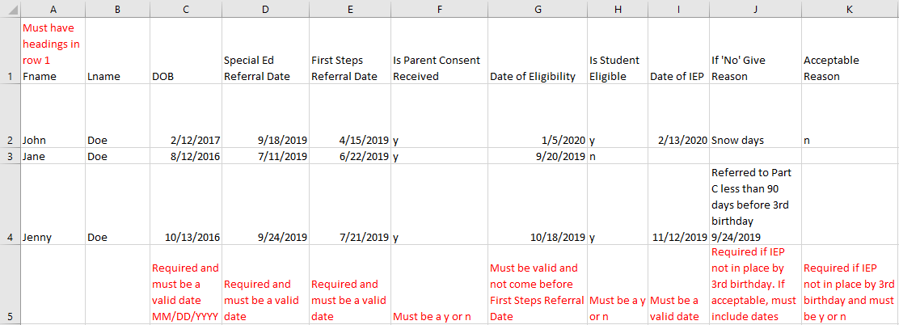
Importing Student Data for C to B Transition Follow-Up Timelines
The file can have an extension of .csv or .txt.
Upon submitting a file, website will first validate and if valid will then prompt the user to commit the data.
Data rows should contain only information intended for C to B Reviews.
If 'Is Parental Consent Received' is 'N' the remaining fields are not required.
If 'Is Student Eligible' is 'N' the remaining fields are not required.
Notes:
As you enter students you do have the option to edit (pencil icon) or delete (red cross) your entry on the right hand side of the main Follow-Up timeline page. The system will allow as many CSV/TXT imports as needed. It will take the file and add the data to the existing with no overwriting of previous information.

Slide 29
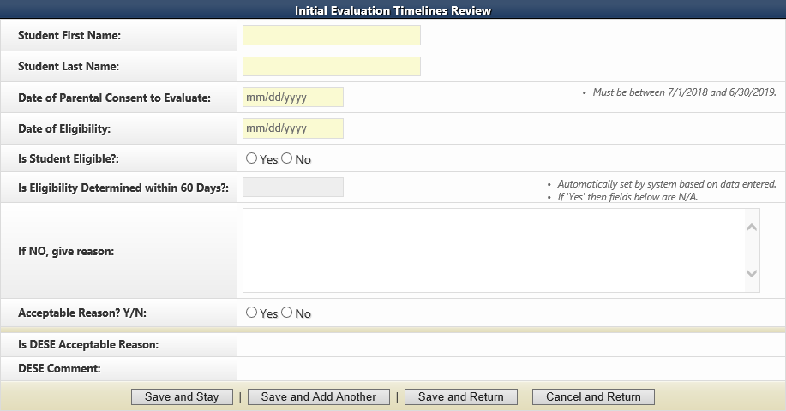
Adding New Student Timeline Data Individually
If you decide to enter your timeline data one student at a time in IMACS 2.0 by clicking on Add New Initial Evaluation Timelines Review then you will see the familiar student demographic screen below. When you list an acceptable reason you also need to list the applicable dates. For example: Student absence 3/5 – 3/8 or Winter Break 12/21 – 1/1.
Notes:
There are reminders on the student demographic screen reminding you of important dates.
At the bottom of the screen there are many save options. Save and Stay will keep you on the same page after saving the material. Save and Add Another will save the student you just finished working on and give you a new student demographic screen to begin the next student. Save and Return will save the student you just finished working on and then take you back out to the main timeline page. As you enter students you do have the option to edit (pencil icon) or delete (red cross) your entry on the right hand side of the main Follow-Up timeline page.

Slide 30
Submitting Follow-up Timeline Data
The data collection period for follow-up timelines is from the date you receive the final report (September 16, 2023) through February 1, 2024.
The Follow-Up timelines are due by February 20, 2024.
When you are done collecting the data you will need to submit the timelines to DESE for verification. You will either click to submit the timeline data or you will click on Submit with No Students to Report, if no initial evaluations were completed.
Notes:
If you have entered ANY students in the timeline data collection section then you will not have the option to select the Submit with No Students to Report button.

Slide 31
Corrective Action Plan (CAP) Steps
Three steps to completing a CAP:
Write and submit activities of correction. This step is completed BEFORE ICAPS are done.
Implement activities of correction once approved. This step is completed BEFORE ICAPS are done.
Provide sample of documentation that demonstrates compliance requirements are being met. This step is completed AFTER ICAPS are done.
Notes:
The Corrective Action Plan is usually the first activity started and the last one completed in the year following the self-assessment so we are circling back to the third step for completing the CAP – providing evidence of correction.

Slide 32
Evidence of Correction
After the Plan for Corrective action (training, change in policy or procedure, etc.) has been completed the District should begin compiling their evidence of correction.
LEA should collect samples demonstrating correction that were completed after the district implemented its approved corrective action plan
District must submit up to five samples of compliant documentation to demonstrate correction of non-compliance no later than March 1, 2024.
Documentation showing examples of compliance for each indicator identified must be uploaded into IMACS 2.0 on the CAP page under the correct indicator number for DESE to review the documentation.
Notes:
The one of the final activities of the Corrective Action Year process is clearing the systemic non-compliance by providing evidence of correction. This is accomplished by providing up to five new samples of documentation that address each indicator found “OUT” of compliance. This documentation should establish that the district followed their Plan of Correction and must demonstrate that the LEA is currently “IN” compliance with the targeted indicator. The evidence of correction should be uploaded into IMACS and submitted no later than March 1.

Slide 33
Submitting Evidence of Correction
CAP Summary page
CAP page
Notes:
To begin submitting the district’s evidence of correction you will need to click on the arrow (red circle) at the right side of the each row.
When the computer redirects you to the CAP page go to the CAP uploads below the CAP Status Information box. Click on the blue triangle (red circle) next to CAP UPLOADS to open up that section of the page and then click on New Upload (green arrow).

Slide 34
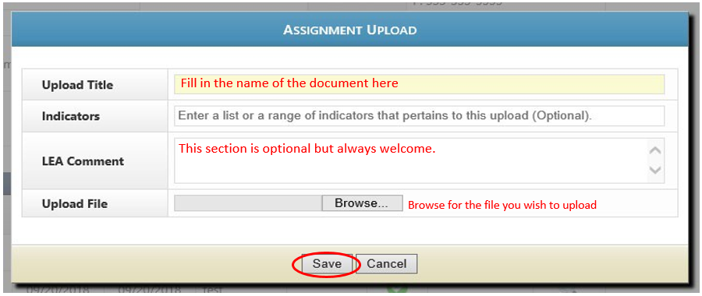
Submitting Evidence of Correction
Assignment Uploads page
Notes:
Fill in the name of the document on the Upload Title line and then use the browse feature to find the file on your computer. LEA Comment box is optional, but always welcome. Click on the Save button after you are done.
You can choose to upload your samples of correction for a particular indicator separately or you can combine your pdf documents into one file to upload.

Slide 35
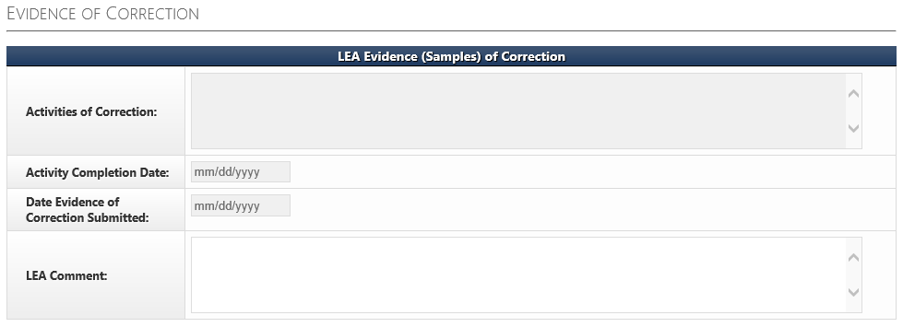
LEA Evidence (Samples) of Correction
The FINAL STEP of the CAP process for each indicator is completing the LEA Evidence (Samples) of Correction section on the CAP page. The Activities of Correction box should be completed using the Evidence of Correction rubric.
Notes:
Once the documentation showing evidence of correction has been uploaded into IMACS, the LEA must complete the FINAL STEPS in order to clear the identified non compliance. The final steps are completed in IMACS by the LEA in order to document the dates and outcome of the planned activities for correcting the non compliance.
Complete the Activities of Correction box using the Activities of Correction rubric at https://dese.mo.gov/sites/default/files/Evidence%20of%20Correction%20Rubric.pdf The Activity Completion Date is the date that the Corrective Action Plan written at the beginning of the process was completed.
The Date Evidence of Correction Submitted is the date you submit it to DESE. LEA Comment is optional.

Slide 36
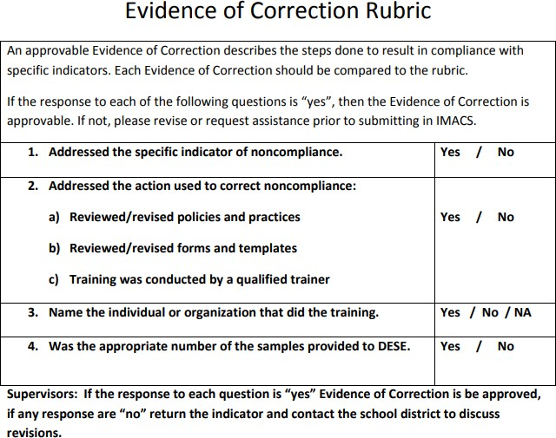
Evidence of Correction Rubric
Notes:
An approvable evidence of correction plan describes the steps that were followed to become in compliance with specific indicators. It is the conclusion of the Corrective Action Plan and should touch upon the training or changes that the district put in place to stop the non-compliance from occurring again. It identifies the personnel responsible for implementing the plan as well as personnel who have had a role in reaching and maintaining compliance. This rubric is posted with the other CAP Year Tiered Monitoring Guidance on the DESE SPED Compliance pages at https://dese.mo.gov/sites/default/files/Evidence%20of%20Correction%20Rubric.pdf .

Slide 37
Final Thoughts
Statewide, all LEA level non-compliance must be corrected within 12 months of the date of the final report so the SEA sets up intermediate deadlines.
Sanctions may be imposed for any non-compliance not corrected within 12 months of the date of the Program Review Report.
Deadline for clearing all identified non compliance for Cohort 3 LEAs is no later than September 13, 2024.
Notes:
Please note the compliance supervisors and compliance consultants are ready, willing, and able to assist LEAs in correcting identified non compliance. However, if an LEA is unwilling or unable to correct the identified non compliance, sanctions may be required.

Slide 38
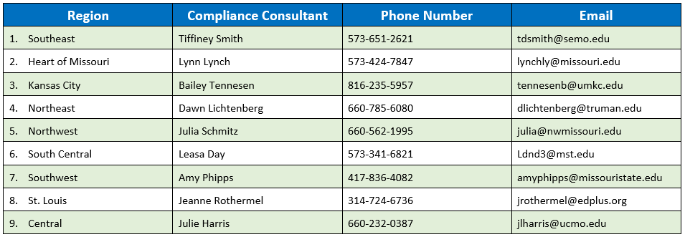
Compliance Consultants
Notes:
The RPDC is your first line of defense in regards to issues of compliance. You should have these numbers on speed dial. When you have a question or need an extra set of eyes to help you in this process call your RPDC Compliance Consultant.

Slide 39
Resources
Office of Special Education
Special Education Compliance (Part B)
P.O. Box 480, Jefferson City, MO 65102-0480 Phone: 573-751-0699
Email: secompliance@dese.mo.gov
Notes:
This slide shows one of your best resources – the Compliance staff at the Office of Special Education. We encourage you to call or email if you have questions or need assistance.

Slide 40
The Department of Elementary and Secondary Education does not discriminate on the basis of race, color, religion, gender, national origin, age, or disability in its programs and activities. Inquiries related to department programs and to the location of services, activities, and facilities that are accessible by persons with disabilities may be directed to the Jefferson State Office Building, Director of Civil Rights Compliance and MOA Coordinator (Title VI/Title IX/504/ADA/ADAAA/Age Act/GINA/USDA Title VI), 5th Floor, 205 Jefferson Street, P.O. Box 480, Jefferson City, MO 65102-0480; telephone number 573- 526-4757 or TTY 800-735-2966; email civilrights@dese.mo.gov.

