Slide 1
Beginning of the School Year Special Education Hot Topics
Bailey Tennesen KC-RPDC & Jeanne Rothermel STL-Ed Plus
September 2023
Notes:
Jeanne

Slide 2
Zoom Support Meeting Norms
Mute unless you are speaking to the group
Use the chat to ask questions
Be mindful when asking questions about specific situations. Do not give out personally identifiable information.
Remember all questions in the chat will be gathered and answered at a later date. A Q&A will be posted on our virtual special education resource page.
Notes:
Read Slide

Slide 3
Objectives for Today
State Plan Updates
Local Compliance Plan Reminder
Special Education Form Updates
Special Education Hot Topics
Reading Success Plans
Substitutes in Sped
Kindergarten Assessments
Physical Therapy
IEP Records
Virtual Schools
Non Public Consultation Meeting
Special Education Data
Resources

Slide 4
State Plan Updates
Effective July 30th, 2023
Notes:
Jeanne:
We are going to get things started with the Missouri State Plan Updates. These updates have been effective since July 30th 2023. One suggestion that I would have is that you print off a new/updated copy of both the Missouri State Plan and Standards and Indicator and place them in a binder and have them readily available. They will come in handy as the school year kicks off

Slide 5
Regulation I
General Provisions
Page 21
Services Plan: Services plan means a written statement that describes the special education and related services the LEA will provide to a parentally-placed child with a disability enrolled in a nonprofit private elementary or secondary school who has been designated to receive services, including the location of the services and any transportation necessary, consistent with 34 CFR 300.132 and is developed and implemented in accordance with 34 CFR 300.137 through 300.139.
Notes:
The first update that we will talk about today is in regards to service plans.
Reasoning for Change: Add wording to align with 20 U.S.C. § 1412(a)(10)(A) and 34 C.F.R. §§ 300.130 through 300.144 and federal Office of Special Education Programs (OSEP) guidance for providing proportionate share services to parentally placed private, parochial, and home schooled students described in a February 2022 OSEP Q&A document.

Slide 6
Regulation IV
FAPE IEP LRE
Page 45
AGENCY RESPONSIBLE FOR FAPE
The public agency or special school district in which a student with a disability resides is responsible for implementation of FAPE. Students with disabilities or severe disabilities who are admitted to programs and facilities of the Department of Mental Health or whose domicile is in one public agency, but actually reside in another public agency as a result of a placement arranged by or approved by the Department of Mental Health, the Department of Social Services, or a court of competent jurisdiction shall be provided special education and related services in the public agency where the student actually resides. Students enrolled in full-time MOCAP approved virtual education programs hosted by a Missouri school district are enrolled in the host school district. The host school district is responsible for implementation of FAPE.
Notes:
Our next change comes on page 45 and discusses the agency responsible for FAPE. We added the description of MOCAP hosted district enrollment because it is an exception to the residency rule and is a new addition to Section 161.670 RSMo.

Slide 7
Regulation IV
FAPE IEP LRE
Page 46
AGENCY RESPONSIBLE FOR FAPE
Listed below are the statutes of the state of Missouri which provide the legal basis and source Missouri’s policy relating to FAPE.
(1) Section 162.670, RSMo
(2) Section 162.675, RSMo
(3) Section 162.680, RSMo
(4) Section 217.355(4), RSMo
(5) Section 162.700(1), RSMo
(6) Section 219.021, RSMo
(7) Article IV, Section 37(a), Missouri Constitution
(8) Section 161.670 Subsection 3(4), RSMo
Notes:
Our next change comes on page 45 and discusses the agency responsible for FAPE. We added the Section 161.670 RSMo, implementing new requirements to the MOCAP statute, to the list of state statutes that provide the legal basis and source of Missouri’s policy relating to FAPE.

Slide 8
Regulation V
Procedural Safeguards/ Discipline
Page 65
A copy of the state approved procedural safeguards available to the parents of a student with a disability and a copy of the Parents’ Bill of Rights, per section 161.850 RSMo, shall be given to parents only one (1) time a school year, except that a copy also shall be given to the parents:
Notes:
When looking at page 66 which discusses parental consent for reevaluations.
Rationale: Add wording to describe when a copy of the Parents’ Bill of Rights is to be provided to parents per RSMo 161.850. There were several comments on how parents with disabilities may not understand the Parents Bill of Rights and requested that they be read aloud prior to the meeting. The Americans with Disabilities Act (ADA) provides protections for parents who need assistance accessing materials due to a disability. Publicly funded agencies must comply with ADA guidelines making the proposal to require the Parents’ Bill of Rights to be read aloud prior to any meeting required under IDEA unnecessary.
DESE does not need to change the State Plan to post a recording of the Parents’ Bill of Rights and will take steps to make a recording available.

Slide 9
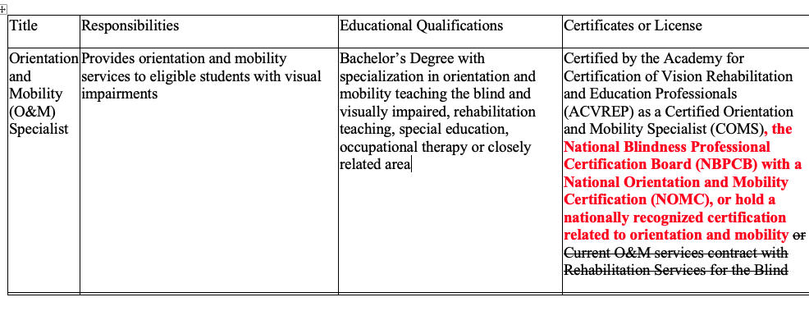
Regulation VIII: Personnel Standards- Orientation and Mobility Specialist
Page 103
Notes:
Add names of additional nationally recognized certification agencies to meet the requirements of the BRITE Act, 167.225 Sections 9(4) and 10(3) RSMo.
Remove wording that does not comply with BRITE Act requirements

Slide 10
Adopting/Adapting the Local Compliance Plan
http://dese.mo.gov/local-compliance-plan
Notes:
Jeanne:
Federal regulations implementing Part B of the Individuals with Disabilities Education Act (IDEA) require responsible public agencies providing for the education of children with disabilities within their jurisdiction to have in effect policies, procedures, and programs that are consistent with the state policies established under applicable federal regulations. At this time, the Office of Special Education has published an updated model Local Plan for Compliance which is consistent with the provisions in the Missouri State Plan for Special Education which became effective June 30, 2022. This document is available on our website at http://dese.mo.gov/local-compliance-plan.

Slide 11
Remember:
Public agencies must adopt or adapt a Local Compliance Plan by October 1, 2023
Please note: Even if your agency does not receive any IDEA Part B funds, your agency is still required to have a local compliance plan and submit annual assurances to DESE regarding the provision of services to students with disabilities under the IDEA.
Notes:
Remember that public agencies must adopt or adapt their local compliance plan by October 1st, 2023. This means that you will want to make sure that the local compliance plan is a part of the agenda for September school board meeting

Slide 12
Step 1: Local Compliance Plan Options
Option A.
Adopt the model plan provided by the Department of Elementary and Secondary Education (DESE). If the agency adopts the state’s model plan, it is automatically approved by DESE. You do not need to submit a copy of your plan to DESE, but a certification statement must be submitted.
Option B.
Adopt the model plan with local revisions. The agency must submit a copy of the pages on which revisions have been made with the revisions highlighted. These revisions must be approved by DESE before the agency’s compliance becomes final. (Note: Simply placing your agency’s name into the model plan does not constitute a revision. Revisions are substantive changes to the content of the plan.)
Option C.
Write your own compliance plan. The agency must submit a copy of the plan for approval by DESE. The agency’s plan will not become final until receipt of approval from DESE.
Notes:
Step 1. Your agency must choose one of the following options for their local compliance plan

Slide 13
Step 2:
Your agency’s governing board must approve the Local Compliance Plan and complete the enclosed certification statement. (see notes 1-4)
If your agency’s governing board chooses Option B or C please contact DESE for documents needed at Pam.Blagden@dese.mo.gov

Slide 14
Step 3:
For all options listed above, submit the certification statement to the address below. The certification can be found at: https://dese.mo.gov/media/pdf/certification-statement .
Also, submit the model compliance plan to DESE only if required in accordance with the instructions in Step 1, option B or C.
All required documentation is to be submitted to:
MO Department of Elementary and Secondary Education Office of Special Education-Compliance
Attn: Madison Bockover
P.O. Box 480
Jefferson City, MO 65102
Fax: 573-751-0699
Email: secompliance@dese.mo.gov

Slide 15
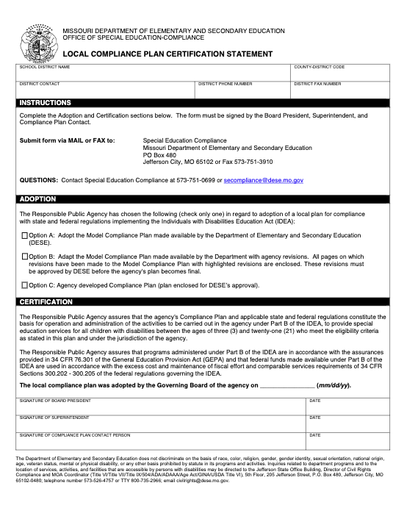
Certification Statement
https://dese.mo.gov/media/pdf/certification-statement
Notes:
PLease note that it should be signed by the board president, the superintendent and the compliance plan contact person (typically the sped director).

Slide 16
More information:
https://dese.mo.gov/local-compliance-plan
Notes:
On this webpage- you can access instructions on your local compliance options and also view the Model Missouri Local Compliance Plan

Slide 17
DESE Special Education Form Updates
https://dese.mo.gov/media/pdf/forms-change-chart
Notes:
Bailey:
The last big updates that I would like to speak with you all is on our updated Special Education Forms.

Slide 18
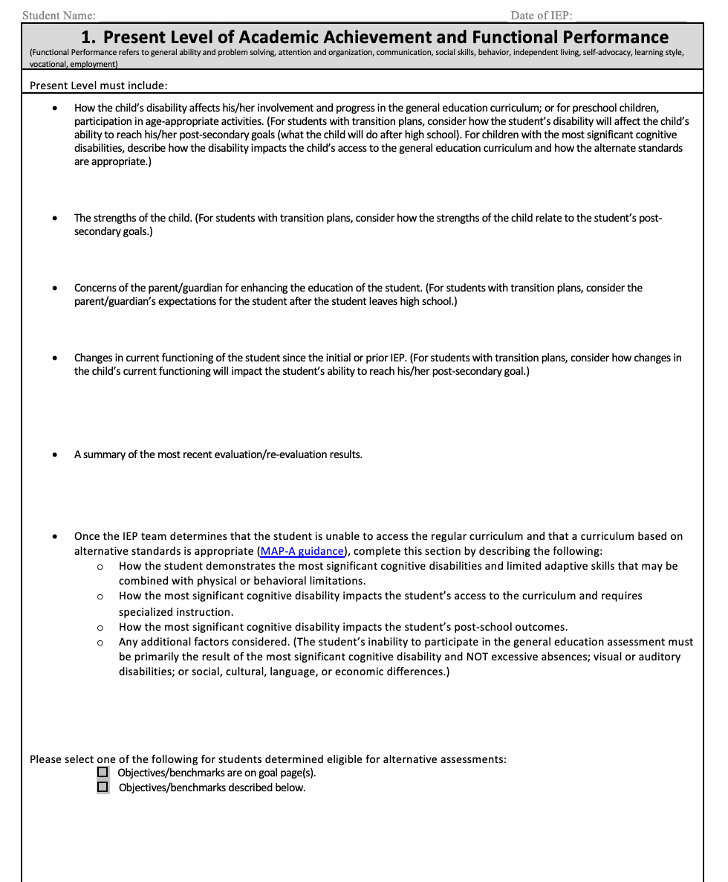
Present Level: Removal of Informal and Formal Transition Assessments
Notes:
The first thing I would like to address is that within the Present Level of Academic Achievement and Functional Performance, DESE compliance has removed the section on the summary of informal and formal transition assessments and has now placed that into the top portion Form C.

Slide 19
IEP Special Considerations Page
Notes:
The next area that I would like to address is the IEP Special Considerations Page. Adding wording to the End of Course Exam. This was intended to clarify that the IEP must address participation in End of Course (EOC) Exams when the student is enrolled in a course that both has an End of Course Exam and participation is required by the state or LEA or both. The other addition to this section was that we added the word “WIDA” for EL students in grades K-12.
This update kept us consistent with the assessment manual.

Slide 20
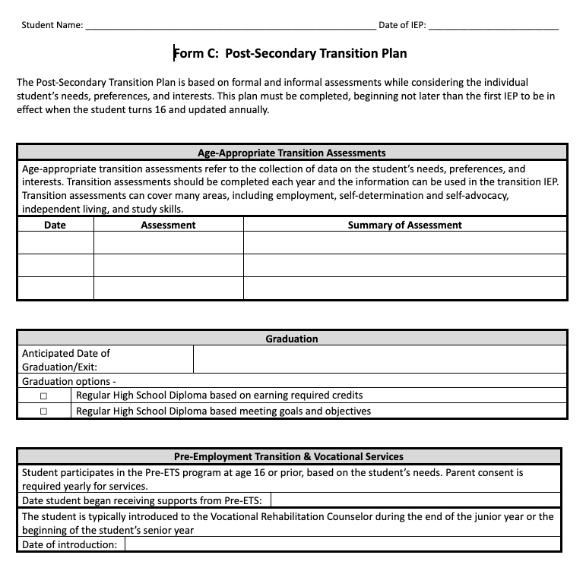
Form C:
Notes:
So now let's get to the biggest update :
Added the following section to the front page of Form C:
1) Age-Appropriate Transition Assessments has now been moved from the PLAAFP and placed on the top of Form C
2) In section 2, Graduation information determined by the team has now been rearranged to be at the top of Form C instead of the bottom. Our intention was to ensure that the graduation conversation happens during the IEP meeting.
3) Next is Pre-ETS & Vocational Services: Please note that the first date you will fill out is for Pre-ETS while the date of introduction is for Vocational Rehabilitation. It is also important to know that Pre-ETS is an IEP team decision and not required for every student. IF the student does not require Pre-ETS, then you do not need to put a date in this section and just document that Pre-ETS is not necessary at this time.

Slide 21
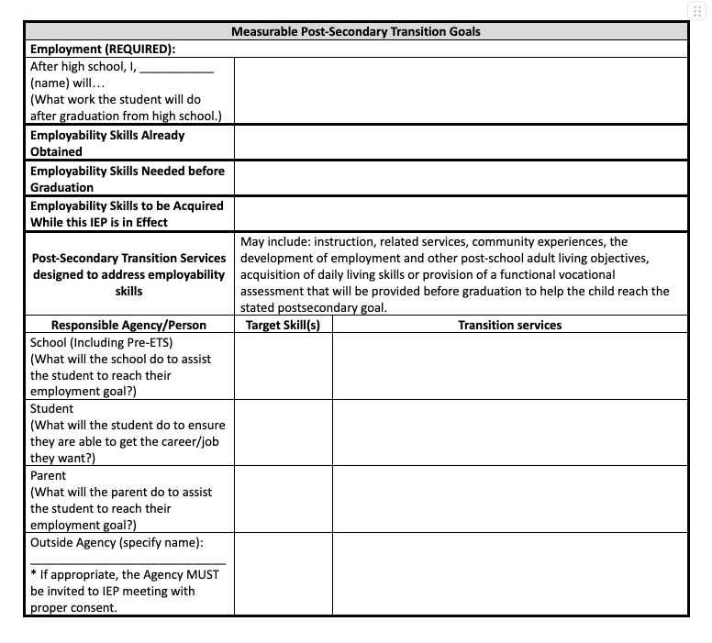
Form C: Post-Secondary Transition Goals
Notes:
On the second page, we still have the Measurable Post-Secondary Transition Goals.
However now we have added a section underneath each Measurable Post-Secondary Transition Goals to document-
1) Skills already obtained by the student
2) Skills needed before graduation (over the course of the student's secondary career)
3) Skills to be acquired while this annual IEP is in effect:
This section is designed to record decisions resulting from the rich post-secondary transition discussion within the IEP team by listing which skills related to postsecondary transition the student already has, which skills the student will need to obtain while still in high school, and which skills the IEP team must focus on through Form C activities during the course of this current IEP.
Postsecondary transition planning information may be recorded here to facilitate a rich discussion among IEP team members by having all the information in one location.

Slide 22
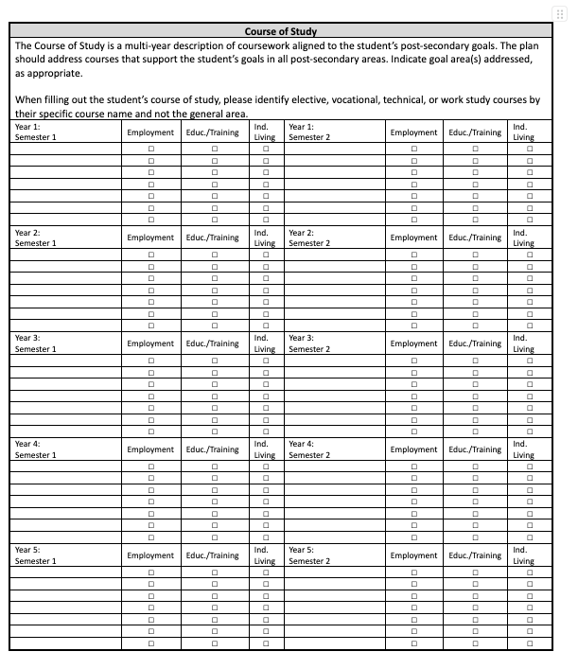
Form C: Course of Study
Notes:
Course of Study section now includes room for a fifth year of high school for students who don't complete high school in four years. This provides more room for students whose secondary career may take longer than the standard four years.

Slide 23
Need more resources on transition plans?
Contact your local RPDC Compliance and Improvement Consultants for transition training opportunities and resources!
Notes:
Commercial slide

Slide 24
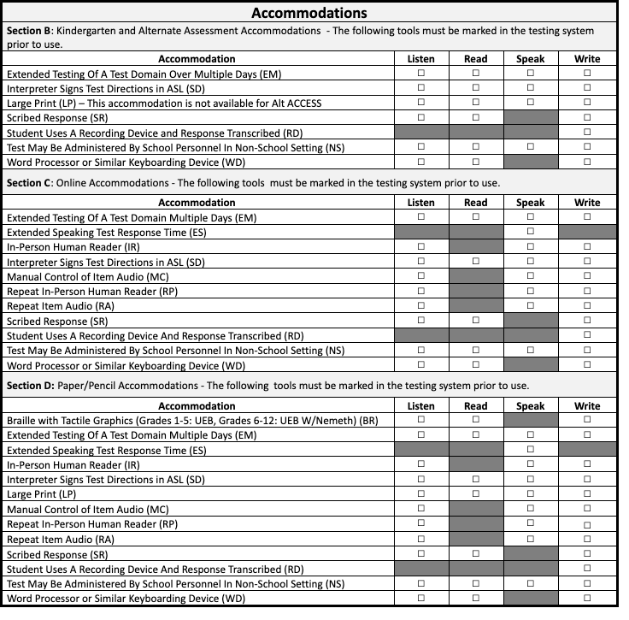
Form D: Accommodations
Notes:
WIDA ACCESS accommodations and modifications have been updated to reflect the test administration manual
ACCESS for ELLs name has been changed to WIDA ACCESS which keeps it consistent with the assessment manual.

Slide 25
Form D- DLM
Notes:
There has been some confusion in core data and MOSIS regarding EOC’s and whether or not kids who are MAP-A kids should have participated in those EOC’s that districts give as ‘local’ assessments. Because nothing on Form E gets transferred into Core Data, etc. this was DESE’s way of indicating that students in grade 12 (and those other grades) will take the DLM as their ‘local’ or ‘district-wide’ assessment. If the district has determined that’s what the local assessment will be. There is no requirement to use the DLM for that purpose but it is an option and somehow it has to be noted that they will NOT be using the typical ‘local’ assessment.
If the district IS not using the EOC’s for any form of ‘local’ assessment, the last box in the section would be checked. The top box is simply about the required participation on the state required EOC’s. It has no bearing on any use of other EOC’s for local assessment purposes. Hence the reason for the addition of grade 12 in the bottom part of that section.
The question will be if any of the SSD partner districts use the EOC’s as local assessments and if so, they will need to check the appropriate box in this part

Slide 26
Special Education Hot Topics
Notes:
Bailey

Slide 27
Reading Success Plan Guidance (RSP)
for Students with Disabilities
Notes:
Bailey:
An RSP is a well- developed and descriptive plan to support any student who exhibits a substantial reading deficiency (SRD).

Slide 28
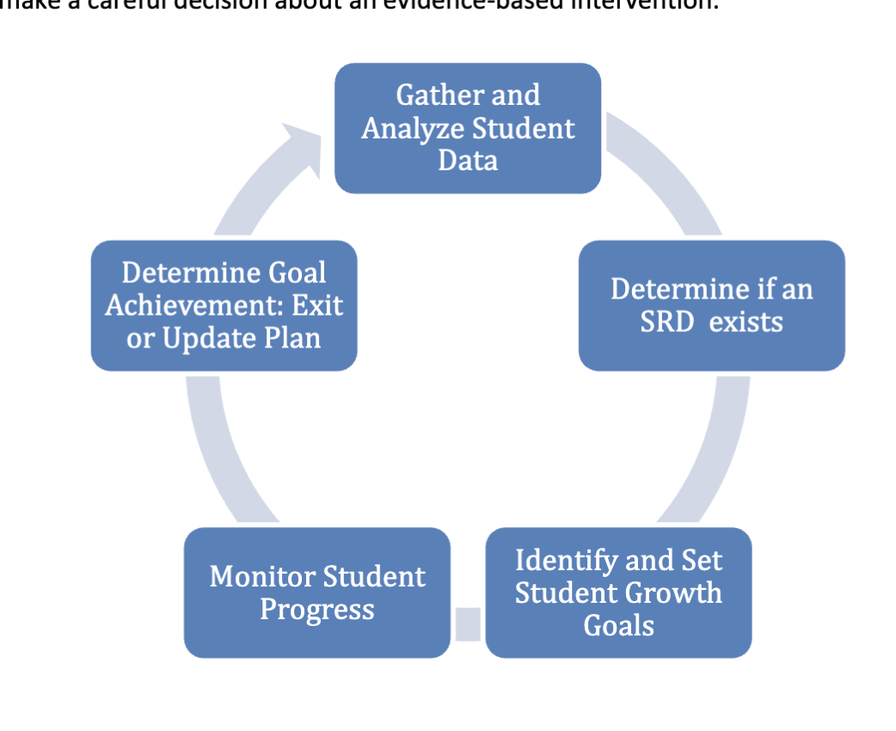
RSP Process for
ALL students in grades K-3
https://dese.mo.gov/media/pdf/reading-success-plan-guidance-missouri-school-districts
Notes:
First step is to gather and analyze student data. Data will be from state approved foundational reading assessments and dyslexia screening. Once collected, LEAs will review and determine if an RSP is required.
Any student that is identified as “at-risk” on the designated reading assessment or is one or more grade level behind on lexile score will be provided with an RSP.
By using the body of evidence of student reading data, teachers are able to pinpoint a student’s specific area of growth, which provides in-depth information about the instructional needs. Once student growth goals are set, the RSP should be updated and revised as new progress monitoring data is collected.
RSP is designed to monitor the specific skills needing improvement identified by teacher observation, reading assessments, dyslexia screener and any other relevant student reading data.

Slide 29
RSP Guidance
The Missouri reading initiatives address the instructional needs of all students who are found to have a substantial reading deficiency (SRD). Each IDEA eligible student comes with unique backgrounds and learning experiences. Some students will have RSP elements embedded within their IEPs and others will have a separate RSP document.

Slide 30
RSP Guidance
“Students who have an IEP that includes reading goals do not require an RSP. However, students who have an IEP that does not include reading goals and meet the requirements for an RSP must have an RSP. The individual needs of the student should dictate the goals and supports provided. All reading instruction must be evidence -based and grounded in the science of reading”
https://dese.mo.gov/media/pdf/reading-success-plan-guidance-missouri-school-districts
Notes:
It should be noted that the RSP guidance on special education is currently being revised. Just any reading goal will not meet the requirements for a goal under an RSP because the instruction is through the science of reading.

Slide 31
Remember:
Students with disabilities should always be considered general education students first and only removed from the instruction provided in the general education setting, including interventions for reading, when the specific needs of the child cannot be met in that setting.
Notes:
It is not SPED responsibility for RSP plans for all students with disabilities. In fact, in very few would we see RSP plans embedded.

Slide 32
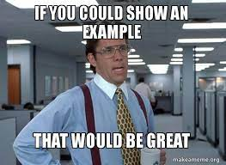
RSP Scenarios
Notes:
The intention of these scenarios is to highlight the variables that a team should review to determine the plan that will be used to meet the requirements of current reading mandates. The team in this document is defined to include parents and general education, and special education personnel working with the student.

Slide 33
RSP Scenario 1
Meet Jason
Other Health Impaired (medical diagnosis of ADHD)
Met criteria that qualified him for an RSP.
IEP Team agrees reading challenges are not a result of ADHD.
Does Jason need a separate RSP or have it embedded within his IEP?
Notes:
Jason is a third grade student eligible for special education by meeting the state criteria for Other Health Impairment based on being diagnosed with ADHD. Additionally, he recently met criteria that qualified him for an RSP. The third grade teacher has worked closely with special education staff, including serving on the IEP team, and agrees that identified reading challenges are not the result of Jason’s ADHD. Jason’s ADHD affects his ability to organize his work, pay attention to lessons, and transition from one activity to the next. Through specially designed instruction on organizational skills and accommodations (such as setting a timer for homework completion, limiting visual distractions in the classroom, providing guided notes, using technology, and giving prompts on how to prepare for the next transition, etc.) delivered through the IEP, Jason is generally able to participate in class discussions and complete assignments on time.

Slide 34
What did the team determine?
RSP will be developed separately from the IEP
RSP will be implemented by general education teachers
The reading teacher will reference the IEP for needed accommodations.
Notes:
As such, the team agrees that the RSP will be developed separately from the IEP, but the RSP will link to the IEP to detail the needed accommodations for Jason. The RSP outlines the reading interventions that will be implemented by the general education teacher to assure that Jason will receive the full benefit of the literacy expertise in the building.

Slide 35
Key Takeaway From Scenario 1
Jason requires an RSP. The team would collaborate to ensure that the student is receiving universal and targeted instruction designed to meet his reading needs and that his progress is documented in the RSP. The IEP will continue to address Jason’s educational needs related to ADHD.

Slide 36
RSP Scenario 2:
Meet Georgia
Specific Learning Disability in Basic Reading Skills and Reading Comprehension.
IEP has included reading proficiency information within the present levels and goals to address identified concerns
Does Georgia need a separate RSP or have it embedded within her IEP?
Notes:
Georgia is a 3rd grade student eligible for special education services as a student with a specific learning disability in basic reading skills and reading comprehension. Georgia also met the criteria for an RSP. At Georgia’s annual IEP meeting, the team developed an IEP that addressed all the components of an RSP. Reading proficiency information was included in the present level that indicated a need for specially designed instruction and goals to address those identified concerns.

Slide 37
What did the team determine?
A separate RSP is not necessary
Special education teacher will provide SDI for reading deficits. General education reading interventionist will collaborate with sped staff to ensure reading instruction is evidence based and grounded in the science of reading
Notes:
Due to the IEP including these components, the team agreed that the IEP would be used in place of a separate RSP. The special education teacher will provide specially designed instruction and implement the components of the RSP within the IEP. Special education reading teacher will collaborate with the general education reading intervention teacher to ensure that the reading instruction is evidence based and grounded on the science of reading.

Slide 38
Key Takeaway from Scenario 2
A separate RSP is not necessary. Due to the student having a reading disability in the same areas identified on the required reading assessment, the information has been embedded into the IEP. Collaboration between general education and special education is key. Reading instruction must be evidence-based and grounded in the science of reading.
Notes:
It should be noted that the individual needs of the student should dictate the goals and supports provided

Slide 39
Substitutes in Special Education
Notes:
Bailey:
Let’s talk about substitutes in special education for a quick second. One of the earliest challenges we are facing right now is finding fully certified staff in special education.

Slide 40
Can Substitutes Provide Special Education Services?
The IDEA requires special education teachers be properly certified according to their state requirements. IDEA does not address substitute teachers specifically.
The MO State Board of Education approved new changes in June 2022 that allow different paths to becoming a substitute teacher in Missouri. With continuing teacher shortages many districts are turning to the use of long-term substitutes.
Long-term substitutes may be used to fulfill shortages in the special education classroom, but special attention needs to be paid to the compliance requirements of IDEA regarding FAPE and IDEA required paperwork
Notes:
The biggest question is can substitutes provide special education services? Here is what IDEA as well as the MO State Board of Education have to say about this: READ SLIDE
*It is important to know “Case Law” – Parents have prevailed against LEAs in several cases that have been decided through the legal system when the LEA failed to prove a substitute special education teacher had provided FAPE.

Slide 41
Can a substitute teacher case-manage, write IEP’s to students with disabilities?
There is currently nothing in Federal Law or Missouri Law that prohibits a substitute for a special education teacher from doing any of these things.
Substitutes should be supervised and be provided with support from a certified special education teacher, process coordinator, or administrator. Positions filled by long-term substitutes will need to be monitored more closely to ensure compliance.
MAKE EVERY EFFORT to have a properly certified special education teacher perform as many of those duties as possible.

Slide 42
Helpful Tips When Using Long Term Subs:
Involve them in any Special Education Professional Development (SPED PD) training you conduct in the district or that are offered by the RPDC.
Show them all of DESE’s compliance resources (including recorded Zooms, Myths, forms etc).
Conduct a “boot camp” in which you give them an overview of the SPED process, IEP implementation, how to collect IEP goal data on their specific IEPs, and any specific instructional strategies they may need to fully implement their students’ IEPs.
Keep detailed records of all the training you have provided them.
Assign a mentor to each long term substitute teacher - someone who can check in with them on a frequent basis to provide support and answer questions.
Consider having a mentor to assist them with IEP development and have the mentor attend their IEP meetings.
Notes:
Positions filled by long-term substitutes will need to be monitored more closely to ensure compliance. Here are some helpful tips when using a long-term substitute in a special education classroom:
See the MOM for further information on substitutes and special education. This will be posted on the general education page under DESE SPED compliance.

Slide 43
Kindergarten Assessment
Notes:
Jeanne:

Slide 44
Are students who have already been identified as eligible for special education required to take the kindergarten assessment?
YES, all kindergarten students need to take the kindergarten assessment.
The Kindergarten Observation Form (KOF) option is mostly observational, which could be utilized for our students with disabilities.
There is also a “don’t know/not observed” option that can be chosen as well - use this option sparingly.

Slide 45
Physical Therapy
Notes:
Jeanne:

Slide 46
Senate Bill 51
This act repeals provisions limiting the ability of a physical therapist to examine and treat certain conditions or injuries without a prescription or referral.
PTs should consult with approved health care providers after 10 visits or 30 days (whichever occurs first) before continuing physical therapy.
Work with your PT and 3rd party billing administrator for more information.
Notes:
Keep in mind: if you want to use this provision to provide PT services to kids, keep in mind every 10 visits or 30 days you will have to get in touch with the medical provider if you don't have a prescription.
Certain conditions:
This act repeals provisions limiting the ability of a physical therapist to examine and treat certain conditions or injuries without a prescription or referral. Under this act, physical therapist shall refer to an approved health care provider patients with certain conditions, including those with conditions beyond the scope of practice of physical therapy as well as any patient who does not demonstrate measurable or functional improvement within ten visits or 30 days, whichever occurs first.
A physical therapist shall consult with an approved health care provider after ten visits or 30 days, whichever occurs first, before continuing physical therapy if a patient's condition has improved and the physical therapist believes that continued physical therapy is reasonable and necessary. The physical therapist shall provide the provider certain information specified in the act during such consultation and continued physical therapy shall proceed in accordance with input from the provider. The physical therapist shall notify the provider of continuing physical therapy every 10 visits or 30 days unless the provider directs otherwise.
This act allows the Board of Registration for the Healing Arts to file a complaint against a physical therapist for evaluating or treating a patient in a manner inconsistent with provisions of the act and existing law governing the scope of practice for physical therapists, rather than allowing the Board to file a complaint for practicing or offering to practice independent of a prescription and the direction of certain health care providers listed in current law.

Slide 47
Physical Therapy Information Cont.
The State of Missouri has passed new laws that allow Direct Access to Physical Therapy without a physician's script. These new laws will go into effect on August 28, 2023. These laws will repeal some old language and revise it with new language to reflect the changes in the Physical Therapist Practice Act. These are found in the RSMO 334.100, 334.506, and 334.613. These do come with visit limit restrictions. However, House Bill 115 was introduced by Representative Brenda Shields to remove those visit limit restrictions from students in a primary educational setting, under the age of 21, and under an annual IEP. This bill passed and also went into effect August 28, 2023.
This means that physical therapy does not need a script to see kids. HOWEVER, Medicaid as a payer still requires a script for billing and reimbursement of services for Medicaid eligible students. The Medicaid eligible kids will still need the script to bill Medicaid but not to be seen.

Slide 48
IEP Records
Notes:
Jeanne:

Slide 49
Senate Bill 106
For the 2023-2024 school year and all subsequent school years, a students special education record shall be deemed a permanent record and shall be maintained as part of the child’s cumulative scholastic record (75 years).
A special education record means an IEP, an IFSP, or a 504 Plan
Law says must maintain ‘the most recent’ special education record.
The most recent IEP (hard or electronic copy) should be stored- but keep in mind that if it is electronic, you need to ensure that it is securely maintained.
(Section 167.027)
Notes:
In the past, records had to be maintained for a period of 3 years from the time they were no longer educationally relevant. Legislation was passed this last term that indicated the most recent IEP should be maintained as a permanent record, but DESE and/or the Secretary of State’s Office have not issued any clear guidance yet, so pending clarification of the requirements, it would be prudent to maintain SPED documents as you have in the past until further guidance is released, or you can always consult your legal counsel if you need answers sooner than DESE guidance is released.
My personal opinion is that you will probably end up keeping both the most recent IEP and most recent evaluation report in the student’s permanent record, but again, nothing “official” has been sent out as guidance. Nothing in the law that specifically says this.

Slide 50
Virtual Schools
Notes:
Jeanne:

Slide 51
Are IEP teams still required to meet to determine FAPE provision with virtual education?
The State MOCAP statute does not require teams to meet before a parent enrolls a student in a full-time hosted program.
When children are enrolling in a hosted virtual program, the host district is responsible for providing FAPE. They should follow the IDEA transfer student process.
If the child is enrolling in a non-hosted program, the resident district still maintains the obligation for FAPE, IEP’s and special education services to the child

Slide 52
Non-Public Consultation Meeting

Slide 53
Consultation Meeting Details:
At least annually, the Individuals with Disabilities Education Act (IDEA) requires a timely and meaningful consultation among the public school district, officials of private schools, and representatives of parents of parentally-placed school children in private, parochial and home schools with disabilities within the jurisdiction of each public school district.
To ensure this consultation meets all of the requirements of the IDEA, districts should document decisions made during the consultation process and share the completed plan with the private school representatives involved in the consultation.

Slide 54
Where are the consultation resources?
Consultation process: DESE's Special Education Home Page for Parentally Placed Private School Children
September 23, 2021: Parentally Placed Private and Parochial School Students with Disabilities virtual training.
Finance Considerations: Special Education Finance's Part B Proportionate Share Guidance webpage.

Slide 55
Special Education Data
Notes:
Jeanne or Mary

Slide 56
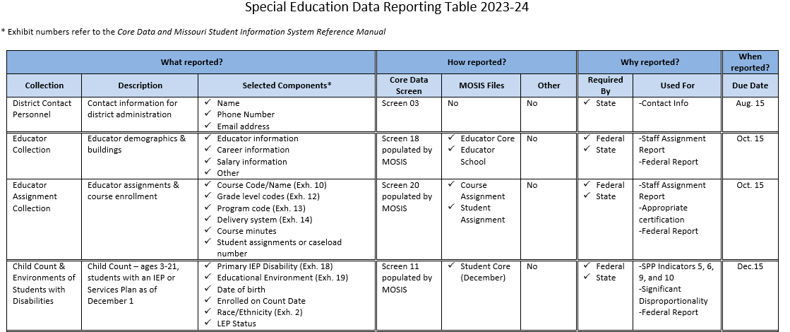
Special Education Reporting Table
https://dese.mo.gov/special-education/special-education-data
Notes:
The Special Education Data Reporting Table can help you stay on track with the data collections throughout the school year.
This slide just shows the first few rows of the table. The complete table is available at the link shown.
The table lists each data collection that includes special education data in order by due date. The table provides a brief description and selected data fields for each data collection. The middle section indicates the associated Core Data Screens, MOSIS files or other reporting mechanism. The next section gives information about the data requirements and use. And last is the due date for the collection.

Slide 57
Screen 3 Contact Info
Core Data Screen 3 collects contact information
Special Education contact
ECSE contact
Please check for accuracy!

Slide 58
Seclusion and Restraint
LEAs report through the Tiered Monitoring web application
Report within 30 days of the incident
A limited set of data fields describing the incident
Upload of the report sent to the parent
Sending district will be responsible for reporting incidents involving LEA students placed at private agencies. It is important that districts partner with private agencies and communicate on incidents involving seclusion and restraint.

Slide 59
Data Resources
2023-24 Special Education Reporting Table
https://dese.mo.gov/media/pdf/2023-24-data-reporting-table
Data Collection Resources
https://dese.mo.gov/special-education/special-education-data/data-collections
Seclusion/Restraint Model Policy, reporting instructions, and a template for reporting multiple incidents
https://dese.mo.gov/data-system-management/core-datamosis/documentation

Slide 60
Resources at Your Fingertips!
Notes:
Bailey: Last but not least, we want to direct you to resources on the DESE website.

Slide 61
Utilize the To-Do List
Office of Special Education shares a monthly To Do List to remind LEAs of deadlines and requirements throughout the school year.
https://dese.mo.gov/special-education/compliance/general-guidance

Slide 62
Highlights of August 2023 To Do List
Updates to State Plan, Standards & Indicators, sample forms, and other changes effective with the new school year
Important reminders about annual requirements such as FERPA training, public/private consultation, and tiered monitoring
Information about free online PD opportunities (monthly compliance ZOOMs)

Slide 63
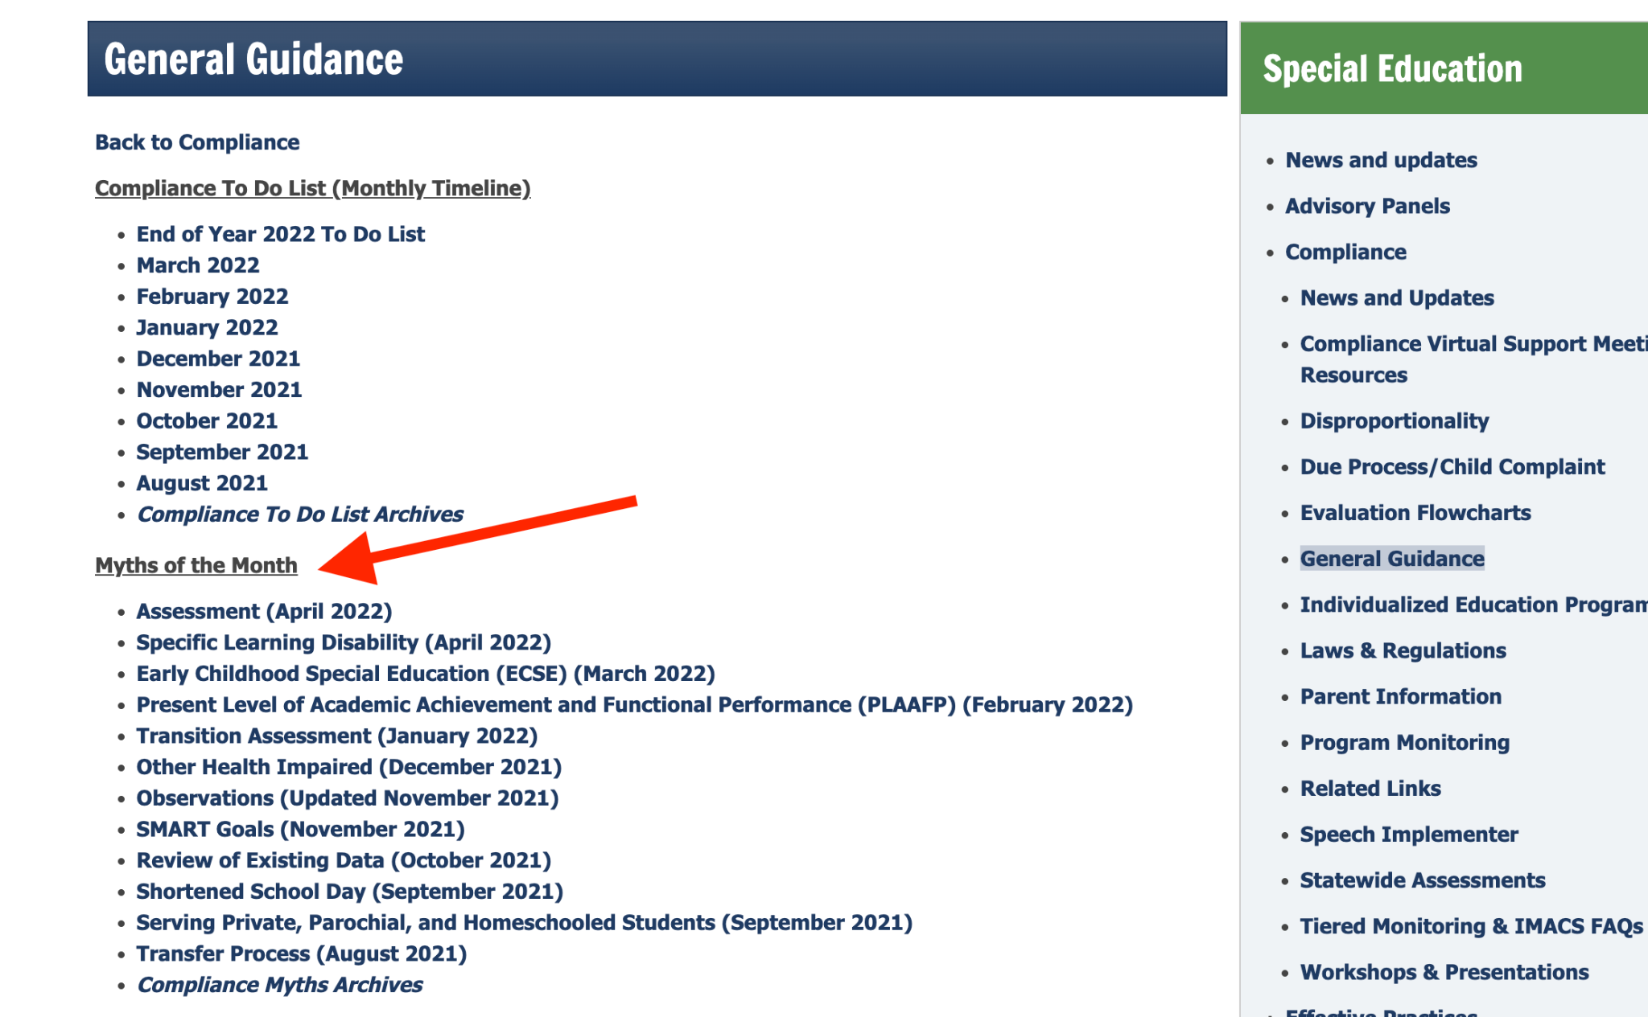
Myths of the Month
Each month DESE rolls out new information on a particular special education hot topic.
Myths of the Month provides guidance on misconceptions that surrounds topics
You can access all the myths of the month by visiting: https://dese.mo.gov/special-education/compliance/general-guidance
Notes:
The next MOM will be on substitutes and special education. This will be posted on the general education page under DESE SPED compliance which should be rolled out pretty quickly after this training.

Slide 64
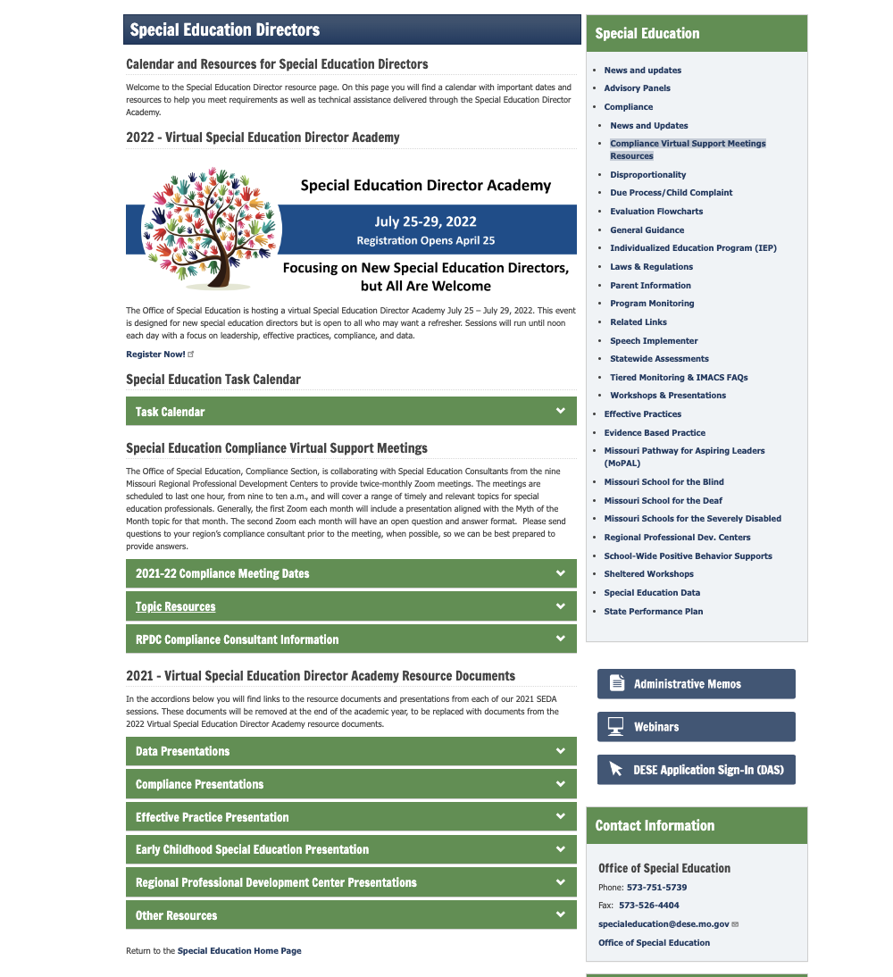
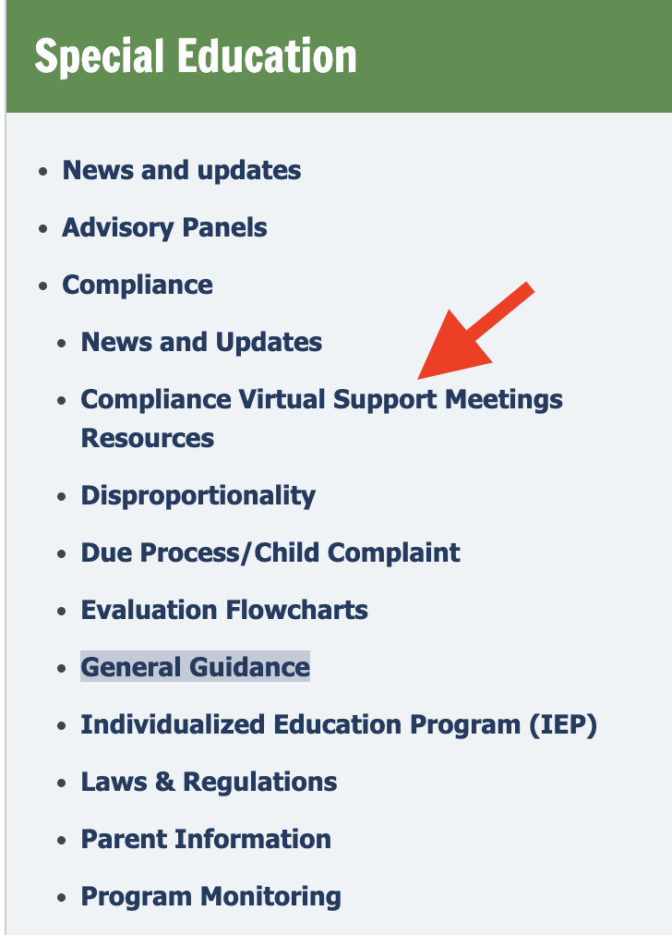
Compliance Virtual Support Resources
2.
https://dese.mo.gov/special-education/effective-practices/special-education-directors
Notes:
On this page you will find a calendar with important dates and resources to help you meet requirements as well as technical assistance delivered through the Special Education Director Academy.

Slide 65
Utilize Your Special Education Compliance Consultants

Slide 66
Notes:
Your compliance consultants are here ready to help you all make this year a success, please feel free to contact any of us when a question arises.

Slide 67
Thank you for your time!
Notes:
Thank you so much for spending this hour with us. We appreciate your time and look forward to having a great 23-24 school year!

