Slide 1
FAM AUGUST 2023
MONTHLY FINE ARTS MEETINGS with DR FRANKS
Kendra Franks, Ph.D.
Director of Fine Arts
Department of Elementary & Secondary Education
Kendra.franks@dese.mo.gov
573-751-9610

Slide 2
Dates of fam meetings
August 30^{th,} 2023
Sept. 27th
Oct. 25th
Nov. 29th
Jan.31st, 2024
Feb. 28th
Mar. 27th
Apr.24th

Slide 3
WORDS OF WISDOM OUTLINE
Preparedness is essential
Problem-solving is necessary
Purposeful relationship is key

Slide 4
Words of wisdom - PREPAREDNESS IS ESSENTIAL
Imagine Big Picture for next 3 years
Imagine Big Picture for this year
Explore dreams; imagine what could be
Place marker points or signposts on a timeline
Plan routes for the journey to the big picture
Each month, each week, and each day has goals
BIG PICTURE

Slide 5
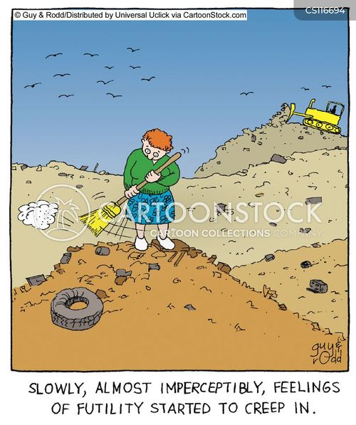
Words of wisdom - PREPAREDNESS IS ESSENTIAL
DAILY EFFORT
DAILY EFFORT

Slide 6
EXPRESS
DESIGN
TO TRY….AND FAIL
FEEL THE STRESS OF AMBIGUITY
COURAGE
I
N
N
O
V
A
T
E
SAFE SPACES
TO THINK
TO SKETCH
TO GENERATE IDEAS
INFLUENCE

Slide 7
Words of wisdom - PREPAREDNESS IS ESSENTIAL
When you plan even one lesson, you must consider the amount of time for everything, even getting and putting away supplies, music, etc. and taking attendance
Everything is a part of the lesson
Think of probable questions that will arise and prepare succinct answers for OR, more preferably, PLAN ways to guide them TO DISCOVER the answers
In our arts classes, we are always assessing, so figure out how to quantify what you are already doing – checklists, rubrics, and student self-evaluations
Projects and/or songs are for teaching concepts and increasing student literacy
Have GO-TO LESSONS you can always do no matter how you feel or what project or music you are working on

Slide 8
Words of wisdom - PREPAREDNESS IS ESSENTIAL
Over prepare and plan extra
Have a substitute folder
BACKPACK of IDEAS or CURIOSITIES
When you plan, you will endure less behavior issues from students.
When you plan, you show you care about them and what they learn.
When you plan, you can live your own life and experience less stress.
Yo-Yo Ma Cello Suite No. 1 in G major, BWV 1007: I. Prelude - Google Search

Slide 9
Culture
the way we express ourselves and understand each other
can bind us together as one world.
Yo-Yo MA

Slide 10
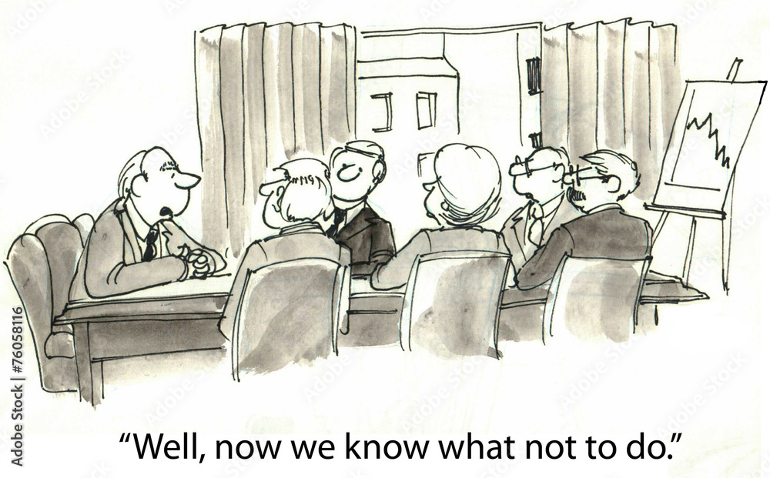
Words of wisdom - PREPAREDNESS IS ESSENTIAL
Discussion
Ideas
Questions

Slide 11
TIPS/TRICKS/TOOLS
Smithsonian Learning Lab: Discover, Create, Share (si.edu)

Slide 12
Next FAM sept. 27th, 2023
MONTHLY FINE ARTS MEETINGS with DR FRANKS
Kendra Franks, Ph.D.
Director of Fine Arts
Department of Elementary & Secondary Education
Kendra.franks@dese.mo.gov
573-751-9610

