Slide 1
End of The Year Wrap-Up: End of the Year To-Dos and Resources
Tiffiney Smith
Amy Phipps
May 11, 2023

Slide 3
Agenda
ESY and Summer School Reminders
Core Data Reporting
Progress Monitoring
Special Education Evaluations and Assessment
PD Opportunities and Resources

Slide 4
Extended School Year (ESY) vs Summer School
ESY
Should be considered for every IEP student
Purpose: Prevent regression of skills related to student’s IEP goals
Summer School
Open to all students
Purpose: enrichment, credit recovery or remediation
ESY can be provided over any break in school year
Held in summer
Individual determinations made by IEP team (goals, services, duration, etc)

Slide 5
Points To Remember
If summer school is offered to all students, special education students must be allowed to participate as well
SPED- Equal participation and accessibility is key
IEP accommodations, modifications, supplemental aids and services may be needed to be provided so student can have equal access and participation in district offered summer school
504 supports may need to be implemented for student to access summer school programming
Review summer school policies for potentially discriminatory practices
Field trips (students without a disability can attend without parent, but students with a disability must have parent attend with them)
Students who have a behavior intervention plan (BIP) or student’s who meet eligibility of ID are not allowed to attend summer school
Notes:
Many times the accommodations, modifications, and the supplemental aids and services will suffice for access to the summer programs.
504 Plan can be written to address jus the summer school session.
Accommodations: be sure to mention: If student requires a para during the school year, same applies to summer school; nursing services, If transportation and extra supervision are needed for field trips during school year, same applies to summer school.

Slide 6
Core Data – Specifically the June Cycle
Bookmark or save a shortcut of the DESE Core Data Manual to keep it easily accessible
The 2022-23 Manual can be found at: https://dese.mo.gov/media/pdf/core-data-and-mosis-manual
The June Cycle begins on page 211

Slide 7
The June Cycle – A Lot of Data which Impacts Special Education

Slide 8
The June Cycle – Discipline Data (Screen 9)
The discipline data for all students is reported in June – this is the data that determines if a district is disproportionate for discipline based on disability and/or race. Reference Core Data Manual pages 215-218

Slide 9
The June Cycle – Special Education Exit Data (Screen 12)
The June Core Data Cycle will include the Exit Data for Students with Disabilities so make sure before the data is submitted, that the exit codes are correct – Core Data Manual page 225-227
Make sure your Exit Code are correct – if you aren’t familiar with the exit codes, review pages 225-227

Slide 10
The June Cycle – Student Core cont.

Slide 11
The June Cycle: Student Core (pages 271-282)
End of Year ECSE Child Count – this is vital you submit the number of students you served during the entire year because you want all of those students to figure into the FTE allotments on the ECSE grant for the most reimbursement possible – you likely have added several to a lot of students since the Dec 1 count and you want credit for those
This is also the file set that will report your Early Childhood Outcomes data for make sure your EC/ECSE teachers are doing the exit ECO scores for students leaving ECSE for K

Slide 12
The June Cycle – High Need Fund
In the Student Core, you will need to identify any student(s) that you think will exceed three times the ADA who you will be applying for reimbursement through the High Need Fund
Anyone that you think might be eligible, say yes – you don’t have to turn them in if they don’t meet the 3X threshold but if they aren’t in this file set and you need to submit them, they will have to go back and edit the June Cycle and resubmit it – easier to do it now

Slide 13
Progress Monitoring
Do it, review it, act on it (make instructional decisions) , share it with parents
Remind teachers to collect and share data with parents in alignment with progress reporting schedule noted in the IEP
DESE Progress Monitoring resources
Progress Monitoring PowerPoint
Progress Monitoring Myth of Month

Slide 14
Special Education Evaluation and Assessment
Evaluation “60 day timeline” can be extended due to summer break but the “last 30 days” to create an IEP can not be extended
Conduct internal review of assessments used for evaluations
Assessments should be current edition to ensure tools are reliable and valid
Switch to revised editions of assessments within 2 years of publication**
If you allocated any ARP funds for supplies to buy assessments, those need to be ordered ASAP if you haven’t done so yet in order to pay the invoice by 6/30
Assessment specific training for staff
Are staff trained on assessment administration? Scoring? Interpretation?
Test publishers often offer free webinars and training resources
Riverside Insights
Pearson
Observations: DESE SLD Observation chart, train all staff who conduct observations as to which skills to note in the observations.

Slide 15
Professional Development:
Opportunities and Resources
Transition Training Institute: June 26-28, 2023
Special Education Director’s Academy: July 25-26,2023
New to Special Education Academy: Each RPDC has variety of supports for new special education teachers and Directors
DESE Resources
General Guidance : To Do Lists, Myth of Month, OSEP Guidance letters
Special Education Director Zoom Meetings and Resources: Zoom meeting links, recorded Zooms, resource PowerPoints, topic guidance
DESE Model Forms: Discipline documentation form, evaluation flowcharts, alternative assessment (MAP-A) eligibility guidance, transfer flowcharts
DESE Literacy Initiatives and Efforts: Links to state literacy regulations and guidance, LETRS, links to DESE Dyslexia and Science of Reading resources

Slide 16
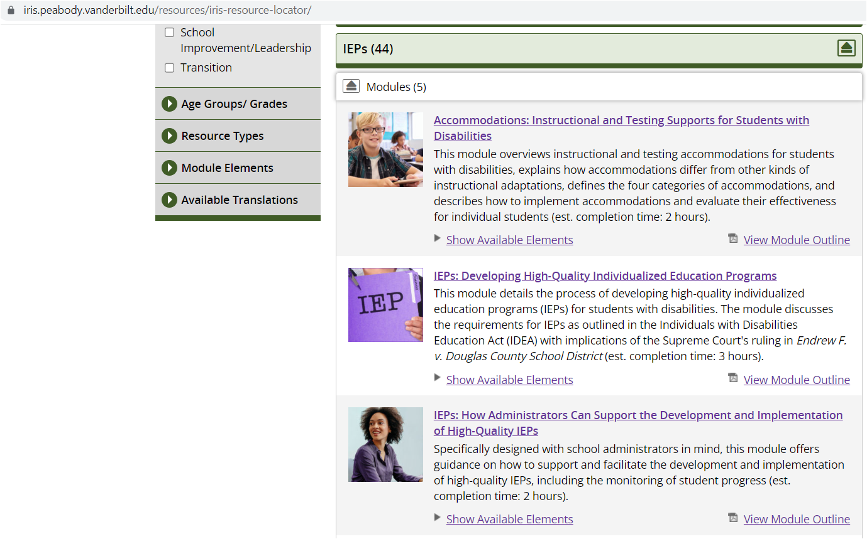
Professional Development:
Opportunities and Resources
OSEP Technical Assistance: IRIS Center

Slide 17
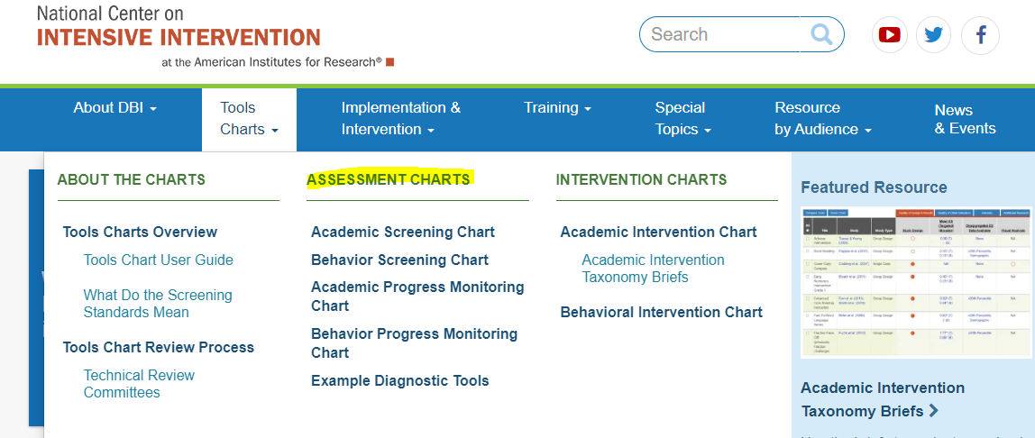
Professional Development:
Opportunities and Resources
OSEP Technical Center: National Center on Intensive Intervention

Slide 18
Professional Development:
Opportunities and Resources
OSEP Technical Assistance Center: Progress Center (resources and tools tab)

