Slide 1
Overview of Project ACCESS Services

Slide 2
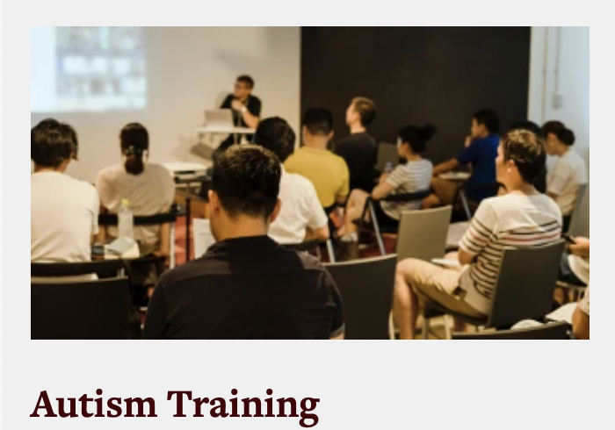

Slide 3
Training
Online autism educator academy
In-person trainings/professional development days
FBA consult training model
Para and Teacher bootcamps
Project ACCESS Autism Credential (PAAC)
Grad certificate in Autism (optional)
Autism Sped Eligibility Team training
Special Events and Guest speakers

Slide 4
Resources
Video library
Fact sheets
Resource library
Web resources

Slide 5
Services
Consultations
Autism program evaluation
Specific behavior consultations
Autism Classroom set-up
Autism helpline
Autism Educators network

Slide 6
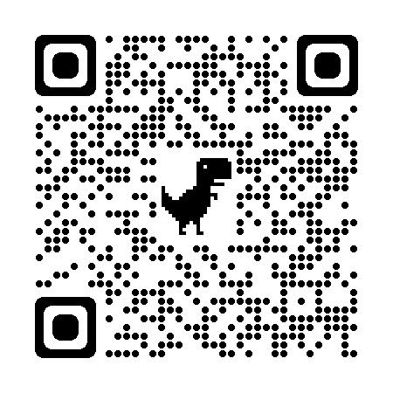
Contact Us:
Phone: 417-836-6657
E-mail: projectaccess@missouristate.edu

