Slide 1
ASCEND PROGRAM
Autism Support Can Empower New Directions

Slide 2

What is the ASCEND PROGRAM?
Our Mission
To encourage and foster self-confidence, self-advocacy, and growing independence in college students with autism; To understand students’ strengths and weaknesses and help them learn and apply skills and strategies to successfully navigate the communication, planning and problem-solving demands of college life.
Transition to college
The ASCEND Program at Missouri State University-West Plains seeks to provide additional support in comparison to the reasonable accommodation in the higher education setting.
Students in ASCEND receive service in four main areas: academic supports, executive functions development, social strategy supports, and daily living transitions. The program is mindful of skills needed as students transition to college life and general education coursework as well as later transitions.

Slide 3
Degrees & Certificates
Associate of Arts
Criminology
Child and Family Development
General Studies
Health Professions
Teaching
Associate of Science
Agriculture (Options: Agricultural Business, Agriculture Education, Natural Resources, Plant Science, Animal Science, General Agriculture, Wildlife Management)
Business
Nursing
Pre-Engineering
Technology
Associate of Applied Science
Agriculture
Business
Child and Family Development
Computer Graphics and Programming
Culinary and Hospitality Management
Enology
Entrepreneurship
General Agriculture
Health Information Technology
Law Enforcement
Technology
Viticulture
Wine Business and Entrepreneurship

Slide 4
PROGRAM STRUCTURE
Students in ASCEND receive service in the areas of: academic supports, social strategy supports, and daily living transitions. The program is mindful of skills needed as students transition to college life and general education coursework as well as later transitions for advanced coursework in their major and career planning.
To directly address executive function, academic, social, and daily living skills, ASEND will provide the following:
Early move-in for a calmer transition
Personalized campus tour
Meet university faculty
Weekly one-on-one meetings with Support Coordinator:
Customized for student’s needs
Create and achieve goals
Academic and Problem-solving guidance
Encourage self-advocacy
Foster positive self-esteem
Weekly ASCEND class:
Workforce Readiness
Executive Functions
Social perspective/Situational awareness skills
Weekly meeting/social event with ASCEND Allies
Internships starting their second year
Access to breakroom:
Sensory tools for calming and recentering.
Crash pad, massage chair, and swing.
Quiet study space with wi-fi and computers.
Alternative seating options

Slide 5
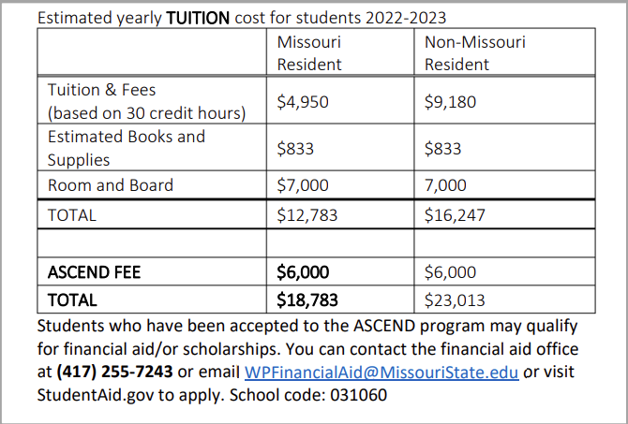
Tuition & Fees
A fee of $3,000 is required to participate in the ASCEND Program each semester in addition to regular tuition, fees, books, and room and board. This fee is put into place to ensure the needed materials and team members are available. When students have demonstrated success at MSU-WP and less support and skill building is needed, they can move from ASCEND to ASCEND-M (matintenance), which is $1,500 per semester. The fee will be assessed to your student account.
ASCEND follows MSU-WP policies in regard to tuition and fees.
Financial aid and scholarship information can be found at: https://wp.missouristate.edu/finaid/

Slide 6
First day of Class What to expect
Potential First Day Conversation Topics:
Where are you from?
What’s your major?
What dorm are you in?
Have you gotten books/supplies for whatever class you are in?
What other classes are you taking?
Have you heard anything about this class? Easy/hard/lots of work/professor?
Do’s and Don’ts
Do get your materials ready as soon as you sit down.
Do no interrupt the professor. Wait until he/she asks for questions to speak.
Do write down you questions as the professor will likely have time at the end for questions.
Do wait for the professor to officially end class before leaving
Do introduce yourself to your professor after class and disclose your diagnosis as you feel comfortable or ensure your professor received your letter of accommodations.
Don’t ask more than three questions – if you have more questions, email or wait to talk with the professor after class or during his /her office hours.
The people sitting around you will likely be engaging in small talk, you may choose to participate or not, but if addressed directly, it is best to respond. (May need to whisper if super quiet room.)
Class may not take the whole scheduled time. It is likely your professor will simply go over the syllabus, and outline course/classroom expectations. You may have to participate in an icebreaker activity, you may be assigned a partner or a group for that course. Classmates may ask for contact information on this day as well.

Slide 7
Differences Between High School and College
For Students with Disabilities
High School
College
Schools must guarantee the academic success of the student with disabilities. In high school, students have little or no responsibility for identifying their needs and seeking help
Schools provide testing for disabilities
Students are responsible for all aspects of identifying their needs, seeking help and monitoring the effectiveness of their accommodations. School must guarantee equal access, but academic success is up to the student.
Students are responsible for obtaining and providing the results of testing that documents their disabilities (documentation)
Who is responsible
Academic services determined yearly by IEP (a plan made by parents, professionals, and teachers)
Parent, professionals and teachers determine when services aren’t effective, and make adjustments
Teachers and other professionals typically provide services in the classroom setting
School specialist and parents inform teachers of specific services or adjustments
Academic services determined each semester by a meeting between student and a ODS representative
Student must decide if their accommodations are effective and if not, must contact the Office of Disability Services to discuss concerns
Services may be provided at various campus locations
After meeting with an ODS representative and agreeing upon accommodations, students must communicate and arrange their accommodations directly with their instructors
Services

Slide 8
Differences Between High School and College
For Students with Disabilities
High School
College
Teachers monitor and follow up on classroom absences
School schedules student classes back-to-back during regular school hours
Class size usually is under 35
Extracurricular participation dependent upon academic performance
Students must know and follow each instructor’s absence policy or pay the consequences
Students may choose to schedule classes at a variety of times throughout the day and evening
A variety of class sizes, some much larger than 35
Extracurricular participation not contingent upon grades
Classes
Students are responsible for their own academic success
Instructors rarely monitor homework (rarely counts in grading)
Students must recognize when they need additional help and find the resources that provide that assistance
Students must read and follow the deadlines established by the syllabus (extensions on deadlines are rare)
Students must self identify their disabilities directly with their instructors, provide the instructors disability verification information from an ODS representative, and work with each instructor to make accommodations arrangements
Teacher are responsible for students’ academic success
Teachers monitor homework (a big part of grades)
Teachers are responsible for identifying and working with students in academic difficulty
Teachers give assignments daily, offer frequent reminders, and often permit students extra time to complete their work
School personnel and parents alert teachers to students with disabilities in their classrooms and how to work with them
Role of Instructors
Grades may be based on many homework, tests, quizzes, papers and extra credit projects
Teachers may use any class work or effort to determine final grade and may use different criteria for different students
Grades generally based upon a few exams or papers with little to no extra credit
Instructors’ syllabi establish how grades will be assigned, including how each test, paper, etc. will count toward the final grade (in most cases, students with disabilities are graded on the same pre-determined scale)
Grading
Used with permission from Marquette University Office of Disability Services

Slide 9
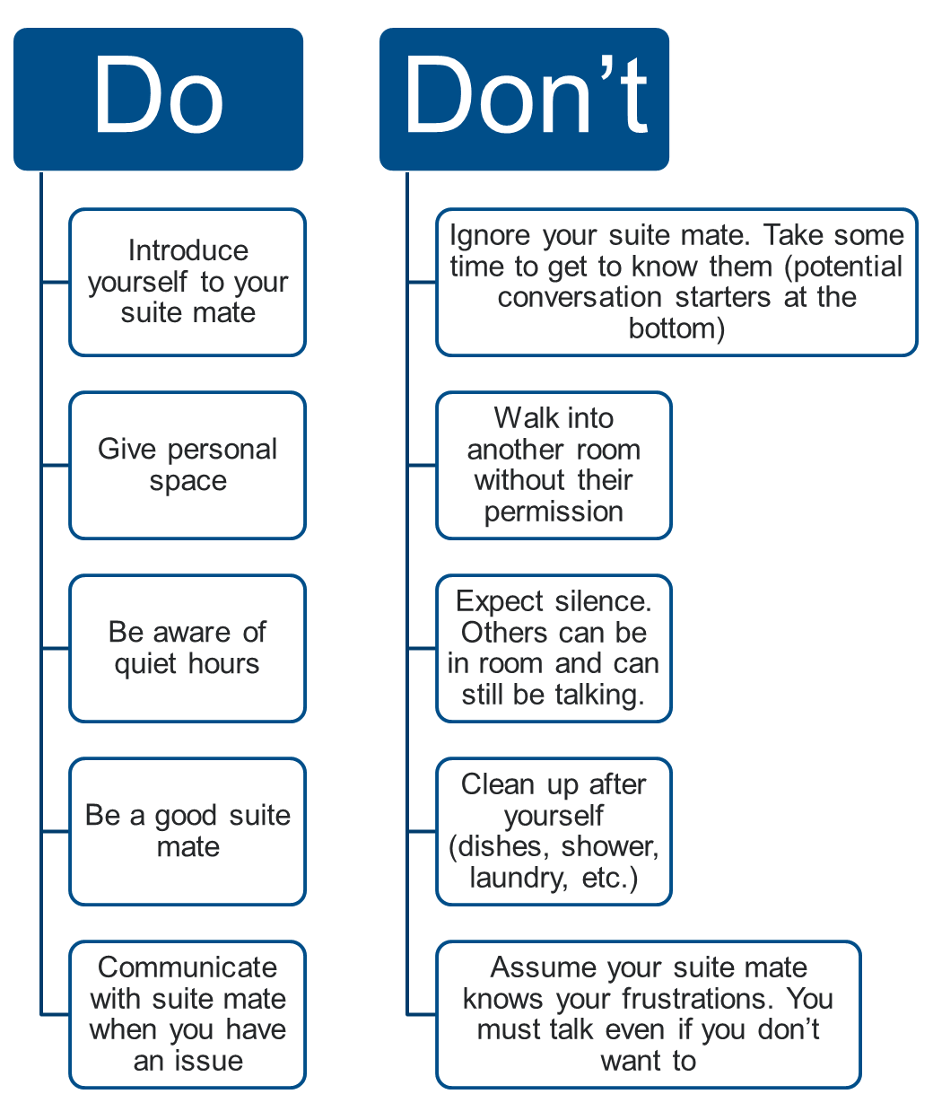
Things to work on For HOUSING
Conversation Starters:
My name is … Where are you from?
What do you like to do in your free time?
What your favorite movie?
What’s your major?
Follow up statements:
How long have you lived there?
That’s awesome! I like to …
My favorite movie is…
My major is…

Slide 10
Things to Process and practice
Self Advocate
  Know what your accommodations are prior to class starting.
  Ask for a meeting with your professor. Explain what accommodations you have.
  Know your strengths and weaknesses. See what needs you have and ask for help.
  Don’t assume things will be changed on their own. Be proactive!
Conflict Resolution
  Compromise – A compromise is a way for both people to get a little bit of what they want. Sometimes we have to give a little as well.
  Listen to what the other person is saying. Do not demand that only your voice be heard.
  Wait to talk until your emotions have calmed down. Do not avoid the conversation.
  Take responsibility for your actions.

Slide 11
Things to Process and practice
Student Etiquette
  Do not barge in yelling, “I’m here.” or abruptly leave class before dismissed
  Wait your turn to talk. Do not interrupt the professor.
  Reciprocate questions: “I’m well. How are you?”
  Arrive to class on time.
Problem Solving
  Identify the problem.
  What do you think happened & what does the other person think happened?
  What could I do to fix the problem? (Think of 3 solutions)
  What might happen if I try the solutions?
  What solution is best?
  Try it! IF it fails try another solution that you thought of.
  What did you learn from it?

Slide 12
Thank you
Website: https://wp.missouristate.edu/ASCEND/
Facebook: https://www.facebook.com/WP.ASCEND

