Slide 1
Addressing the Assistive Technology Needs of Students
David D. Baker
Missouri Assistive Technology

Slide 2
Today’s Game Plan
Brief overview of AT and AEM in the context of IDEA
Run through of devices
Overview of device loan and assistive technology reimbursement programs
Questions

Slide 3
Myths About Assistive Technology
All AT is complicated and high-tech
AT is expensive
There are prerequisites to using AT
AT is only for those with more severe disabilities
What worked great for one individual will work great for another individual

Slide 4
How to Know When to Explore?
Can’t read
Can’t write
Can’t complete math
Can’t get around
Can’t participate
Traditional intervention and modified instruction is not working
Goal of independence

Slide 5
Outcomes of AT
Support goal achievement
Expand educational / vocational options
Increase participation, productivity and independence
Improve quality of life

Slide 6
AT is an Umbrella Term

Slide 7
What is Assistive Technology?
“any item, piece of equipment or product system, whether acquired commercially off the shelf, modified or customized, that is used to increase, maintain, or improve the functional capabilities of children with disabilities.”

Slide 8
AT Services
Activities that directly assist a student in the selection, acquisition, and use of AT
Evaluation
Purchase & Leasing
Selecting, Designing, Fitting, Customizing, etc.
Coordination with other therapies
Training or Technical assistance
.

Slide 9
Who Must be Considered for AT?
IDEA requires assistive technology be considered for ALL students with an IEP.
Is it expected that the student will not be able to make reasonable progress toward educational goals without assistive technology devices and services?

Slide 10
AT Consideration
Consideration is defined at “to think about, to form an opinion about or to look at thoughtfully.”
Consideration uses key questions to begin the AT conversation.
There are only 4 potential outcomes for consideration:
AT is not needed
AT is in use and is working well
AT is in use but not working well
The team does not have enough information to make a decision and will investigate further.

Slide 11
What AT Comes Down To Is…
Implementation!

Slide 12
Assistive Technology Implementation
“Begin With The End In Mind”
- Stephen Covey

Slide 13
What Implementation Should Look Like
1. Involves the use of AT devices and services to promote student achievement.
2. Focuses on functional areas of concern when and where they occur
3. Is an ongoing process that involves all those who work with the student.
4. Requires a plan that is collaboratively developed by all who will be involved.

Slide 14
AEM Defined
Print and technology based educational materials (i.e. print textbooks, electronic textbooks and related core materials) that are designed or converted in a way that makes them useable across the widest range of learner variability regardless of format (e.g. print, digital, audio, video)
Individuals with Disabilities Education Act, as reauthorized in 2004 (Sec. 300.172)

Slide 15
LEA Requirements
Textbooks and related core instructional materials are provided
To students with documented print disabilities
In specialized formats
In a timely manner

Slide 16
Print Disability
Is not a new disability category
Functional ability of student’s with visual, learning and/or physical disabilities
To interact with and gain information from printed materials at an anticipated grade level.

Slide 17
Possible Clues
Can the student:
Decode letters/words and read with fluency at or near grade level?
See the materials
Physically manage the material
Maintain alertness and sufficient stamina
If the answer to any of these questions is “no” then the student may need AEM

Slide 18
Specialized Formats
Braille, large print, audio or digital text
Exactly the same information as the printed materials
Only the presentation of the materials is different

Slide 19
How to make decisions about AEM
Establish the need for instructional materials in accessible formats
Select format(s) and features needed by a student for educational participation and achievement
Commence steps to acquire needed format(s) in a timely manner
Determine supports needed for effective use for educational participation and achievement

Slide 20
Built-in Accessibility Features

Slide 21
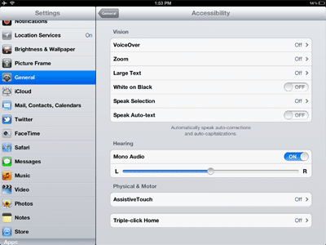
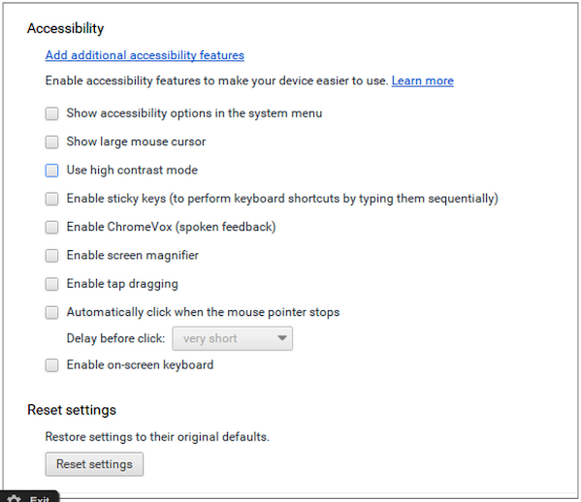
As Example
Windows
Apple
Google

Slide 22
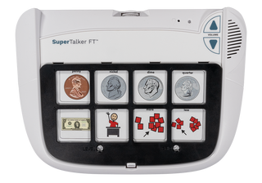
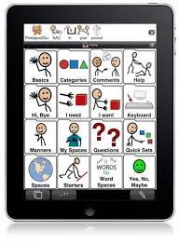
AAC
Digitized Devices
iPad + App Devices
Dynamic Display Devices

Slide 23
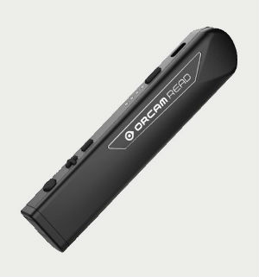
Reading
Mercury Reader
BeeLine Reader
Snap & Read
Orcam Read
Read Aloud: A Text to Speech Voice Reader
C-Pen
OpenDyslexic for Chrome

Slide 24
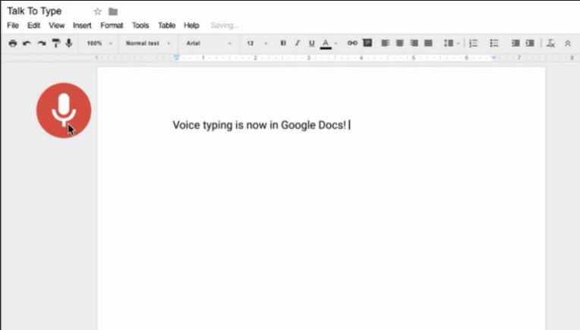
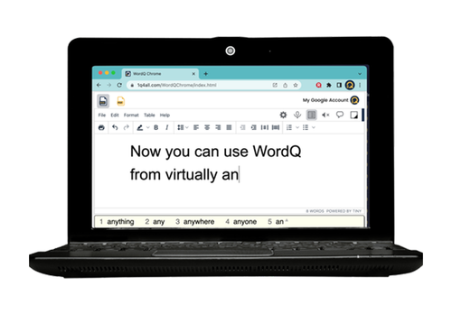
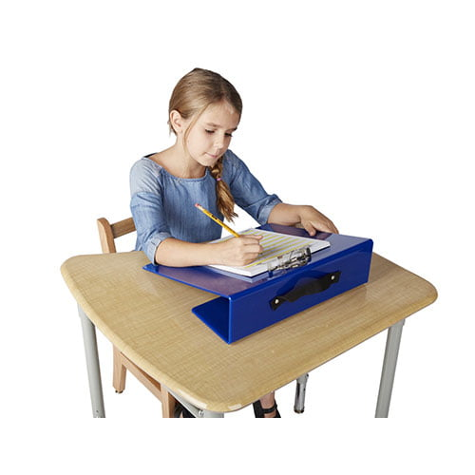
Writing
Co-Writer
Google Voice Typing
WordQ

Slide 25
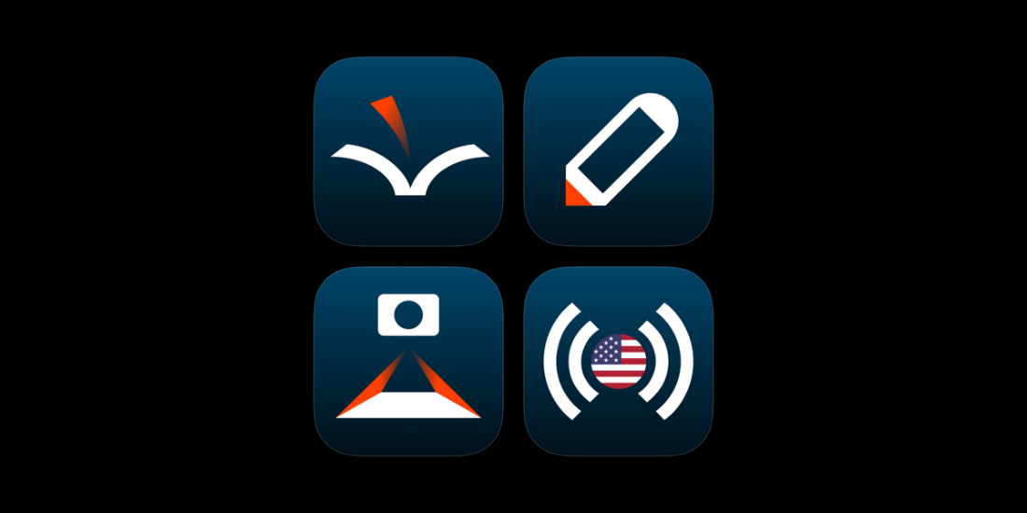
Reading & Writing
Voice Dream Suite
Helperbird
Read & Write

Slide 26
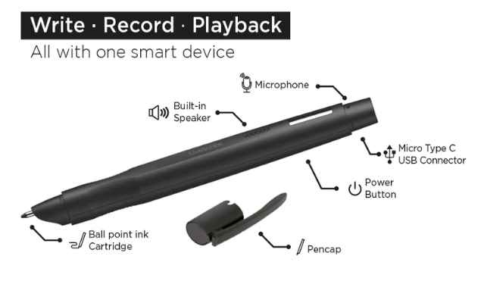
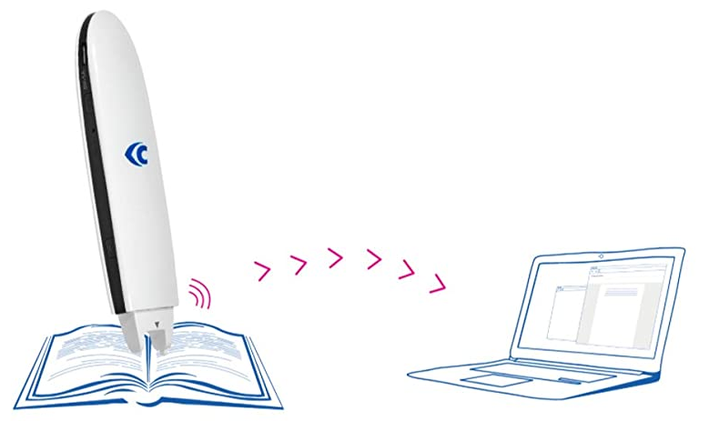
Executive Function: Notetaking
Echo 2
ROCKETBOOK Fusion
Noteability
Boogie Board
C-Pen Connect

Slide 27
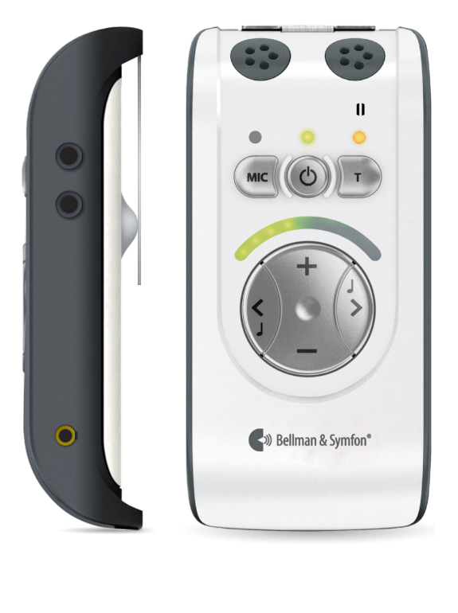
Hearing
Redcat
Bellman Audio Mino

Slide 28
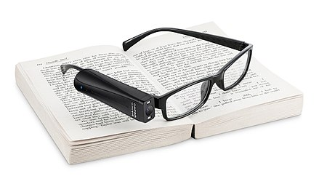
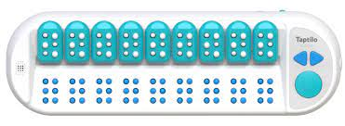
Vision
Lego Braille Bricks
OrCam Glasses
CloverBook Pro
Taptilo

Slide 29
Cause and Effect
My Way AT Kit

Slide 30
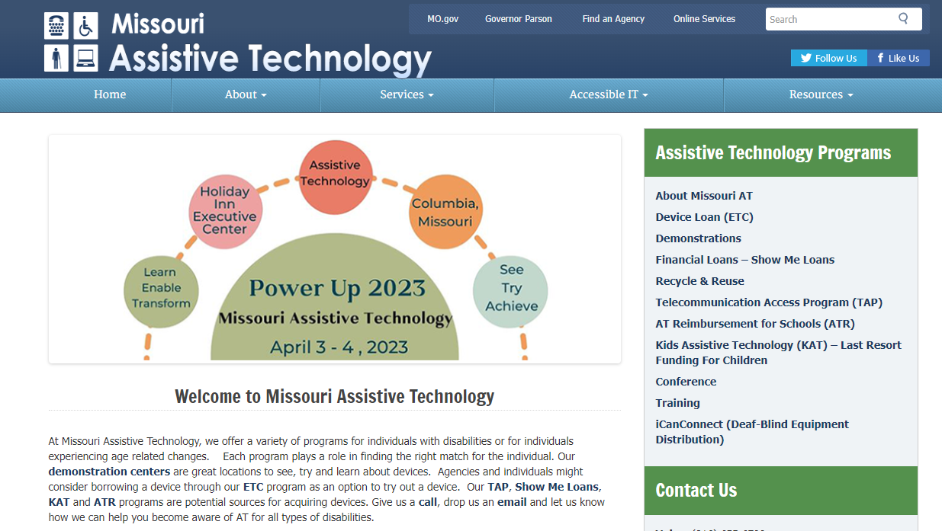
MoAT Programs and Services

Slide 31
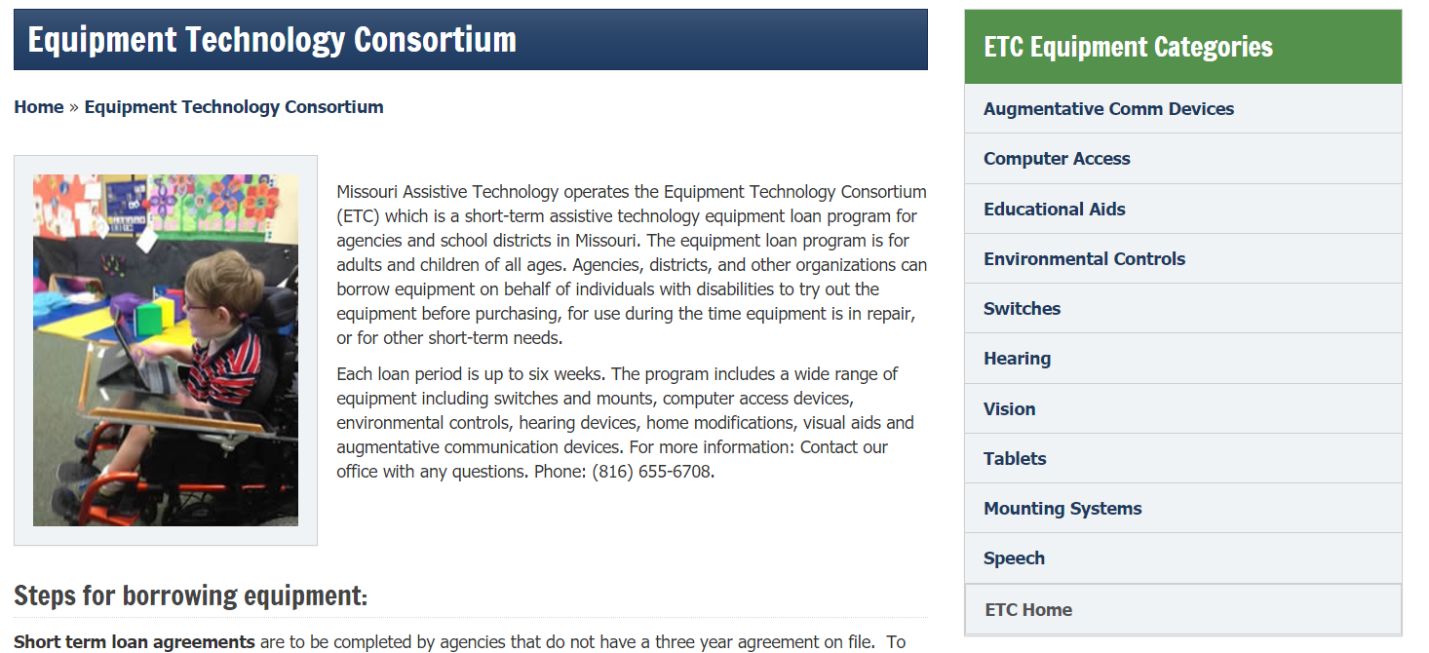
ETC – Device Loan

Slide 32
AT Reimbursement Program
Purpose: To help school districts offset the cost of purchasing AT
- Students that have it identified in the IEP
- Have done a device trial or had an evaluation
- Devices should cost between $350 and $5,000
Option B: MoAT will purchase the device on behalf of the approved student and long-term loan it to the student for the length of the student’s attendance at the school.
ATR Program Application

Slide 33
Contact Information
www.at.mo.gov
816-655-6700 info@mo-at.org
Facebook: @MOAssistiveTechnology
Twitter: @MissouriAT
David D. Baker
Missouri Assistive Technology
(816) 655-6707
Dbaker@mo-at.org

Slide 34
And Finally….

