Slide 1
Least Restrictive Environment
Tiffiney Smith, Southeast RPDC
Amy Phipps, Agency for Teaching and Learning
January 19, 2023
Notes:
A

Slide 2
Vocabulary
LRE: Least Restrictive Environment
FAPE: Free Appropriate Public Education
IEP: Individualized Education Program
IDEA: Individuals with Disabilities Education Act, 2004

Slide 3
Topics
Current reality
What is LRE?
What is Placement ?
Who determines LRE and Placement?
How are LRE and Placement determined?
Case studies
Resources

Slide 4
State Trend Data

Slide 5
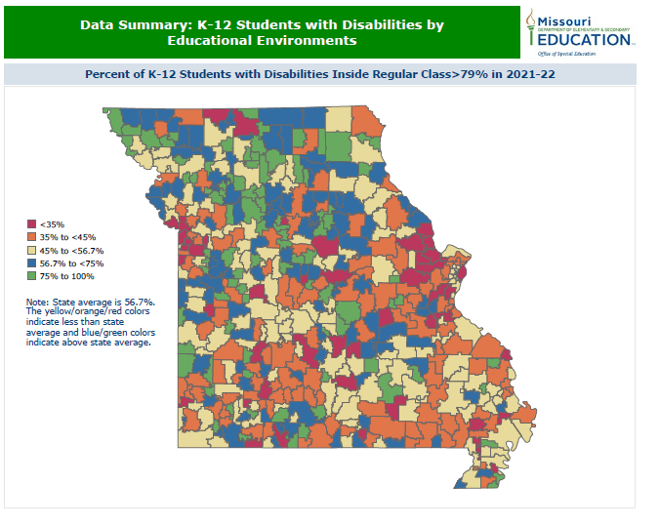

Slide 6
Educational Environment Data
Discussion starter data
Multiple root causes
Careful analysis is required to determine strengths, barriers, and resources needed for change
Individualized district data can be found in Special Education Profile
Reach out to you Special Education Compliance Consultant for assistance and guidance

Slide 7
What is LRE?

Slide 8
Six Guiding Principles of IDEA
Appropriate Evaluations
FAPE
IEP
LRE
Parent Participation
Procedural Safeguards

Slide 9
What is LRE?
LRE is a guiding principle of IDEA that ensures that students with disabilities are educated with their nondisabled peers to the maximum extent appropriate.

Slide 10
Key Concepts of LRE
LRE is a concept that guides a student’s educational programming, it’s not a place
Purpose of LRE is to guarantee students with disabilities are educated with their nondisabled peers to the maximum extent appropriate
Covers all aspects of a student’s education, including extracurricular and nonacademic settings
Required provision for ALL students with disabilities, PK-21

Slide 11
What Does IDEA Say?
300.114: LRE Requirements
300.115: Continuum of Alternative Placements
300.116: Placements
300.117: Nonacademic Settings
300.118 Children in Public or Private Institutions

Slide 12
What Does IDEA Say?
300.114 Each public agency must ensure that—
(i) To the maximum extent appropriate, children with disabilities, including children in public or private institutions or other care facilities, are educated with children who are nondisabled; and
(ii) Special classes, separate schooling, or other removal of children with disabilities from the regular educational environment occurs only if the nature or severity of the disability is such that education in regular classes with the use of supplementary aids and services cannot be achieved satisfactorily.
34 CFR 300.114 (a)(2), emphasis added

Slide 13
Breaking Down IDEA LRE Requirements
“maximum extent appropriate”
Will look different for EVERY student
Based on unique needs, abilities and circumstances of student
Individualized inquiry by IEP team driven by data

Slide 14
Breaking Down IDEA LRE Requirements
Removal from regular education environment
Occurs only after analysis of nature and severity of unique disability related needs
Should not happen if supplementary aids and services would allow the student to gain educational benefit from being educated in regular education classrooms

Slide 15
What is the Regular Education Environment?
The use of the term “regular educational environment” is longstanding in IDEA’s regulations. In response to a public comment on the scope of the LRE provision, the Department explained that the term “encompasses regular classrooms and other settings in schools such as lunchrooms and playgrounds in which children without disabilities participate” (71 Fed. Reg. 46585).

Slide 16
What Are Supplementary Aids and Services?
“Supplementary aids and services means aids, services, and other supports that are provided in regular education classes, other education-related settings, and in extracurricular and nonacademic settings, to enable children with disabilities to be educated with nondisabled children to the maximum extent appropriate in accordance with Sec. 300.114 through 300.116.” 34 C.F.R. 300.42
Examples
Support from a paraprofessional
Accommodations/modifications to educational environments and instruction
Specialized equipment and assistive technology (wheelchair, communication device, medical device, accessible materials, etc.)
Supports for school personnel (specialized training, consultative services from specialists, etc.)
Promoting Progress IDEA Center Tip Sheet
Parent Center Supplementary Aids Services Examples

Slide 17
How Can Using Supplementary Aids and Services Impact LRE?
By analyzing student’s unique needs and the barriers that are restricting the student’s access to an education alongside their nondisabled peers, teams can determine what supplementary aids and services may be warranted to allow the student more access to their nondisabled peers across all educational environments (instructional, extra curricular, and nonacademic)
Supplementary Aids and Services Parent Center

Slide 18
How Are LRE and Placement Connected?
LRE is a guiding principle used by teams to make individualized determinations about where the student will receive their education.
LRE shapes placement decisions
Placement refers to the environment or setting(s) in which the student will receive their educational programming

Slide 19
Who Can Make LRE and Placement Determinations?

Slide 20
Who Determines LRE For a Student?
A student’s LRE is determined through a data driven analysis conducted by the IEP team, which includes the student’s parent

Slide 21
Who Determines Placement For A Student?
Placement is determined after a careful analysis of the student’s LRE by the IEP team, which includes the student’s parent
Placement determinations are not made unilaterally

Slide 22
How are LRE and Placement Determinations Made?

Slide 23
Making the Determination
LRE and Placement determinations should be:
Made at least annually at the IEP team meeting
Driven by unique needs of student
Defined and supported by disability related needs, abilities and data noted in the evaluation and IEP (PLAAFP, IEP goals, Special Considerations, Post Secondary Transition, etc)

Slide 24
Making the Determination
LRE and Placement Determinations should NOT be:
Considered “fixed” or “static” over the student’s educational career
Driven by scheduling convenience or logistics of staff
Determined by disability label or category
Made prior to the IEP team meeting

Slide 25
Golden Thread Graphic

Slide 26
Remember This???
300.114 Each public agency must ensure that—
(i) To the maximum extent appropriate, children with disabilities, including children in public or private institutions or other care facilities, are educated with children who are nondisabled; and
(ii) Special classes, separate schooling, or other removal of children with disabilities from the regular educational environment occurs only if the nature or severity of the disability is such that education in regular classes with the use of supplementary aids and services cannot be achieved satisfactorily.
34 CFR 300.114 (a)(2), emphasis added
Notes:
Hit on the word ‘maximum’!

Slide 27
But Wait There’s More….
34 CFR 300.116
A child with a disability is not removed from education in age-appropriate regular classrooms solely because of needed modifications in the general education curriculum.

Slide 28
So…When Do We Discuss Accommodations and Modifications???
Many teams address accommodation and modification selection at the end of the IEP meeting because it’s the last page printed.
Accommodation and modification selection should be discussed at the same time as services and prior to any determinations regarding LRE and placement

Slide 29
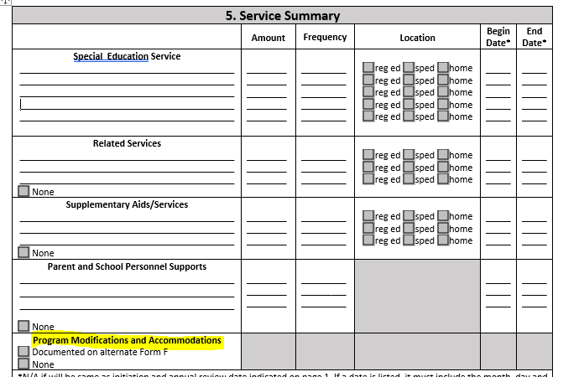

Slide 30
Placement Determinations : Two-Part Inquiry
The public agency must reach the placement decision from the assumption that a student with a disability should be educated with peers who do not have a disability unless the needs of the student with a disability require other arrangements.
The public agency must be able to justify the placement decision in accordance with a two-part inquiry:
(1) Whether education in the regular classroom, with the use of supplementary aids and services, can be achieved satisfactorily; if not, then,
(2) Whether the student has been integrated to the maximum extent appropriate.
Missouri State Plan Regulation IV

Slide 31
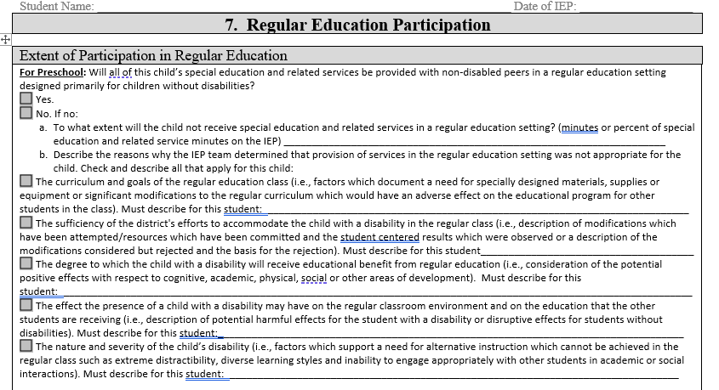
Factors to Consider When Determining LRE
Notes:
The factors listed on the IEP form are the same factors outlined in the State Plan to support the second part of the placement inquiry listed on previous slide.

Slide 32
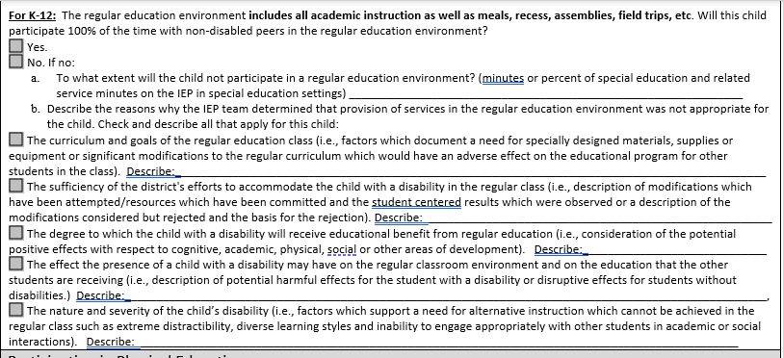

Slide 34
Take Aways
Consider if any supplementary aids and services could be provided in the regular education environment/regular education classroom
Small group instruction, reading materials aloud, etc. can be provided in the regular education classroom
What data do you have to prove accommodations, modifications or other supports can not provide a satisfactory education in the regular education classroom?

Slide 35
LRE Factor Analysis Leads to Appropriate Placement Determinations
LRE analysis must support placement determinations
Evaluation and IEP data must be congruent and support the placement determination
There must be evidence showing a continuum of placement options were considered and must be documented in IEP
While for many students, the regular education classroom is the LRE, for some students, the regular education classroom is not necessarily the least restrictive setting.

Slide 36
Continuum of Placement Options
300.115 Continuum of alternative placements.
(a) Each public agency must ensure that a continuum of alternative placements is available to meet the needs of children with disabilities for special education and related services.
(b) The continuum required in paragraph (a) of this section must—
(1) Include the alternative placements listed in the definition of special education under §300.39 (instruction in regular classes, special classes, special schools, home instruction, and instruction in hospitals and institutions); and
(2) Make provision for supplementary services (such as resource room or itinerant instruction) to be provided in conjunction with regular class placement.

Slide 37
Continuum of Placement Options
IRIS Center LRE Brief

Slide 38
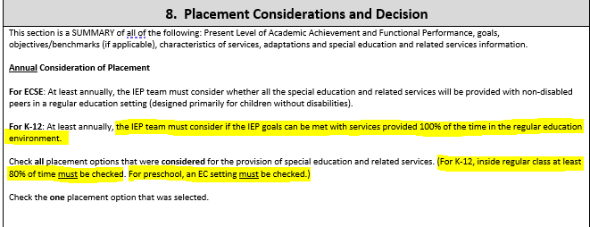

Slide 39
Missouri IEP Form Placement Continuum

Slide 40
Placement Takeaways
Placements are fluid, meaning they can and should change to meet needs of the student
Services follow the student, the student should not have to follow the services
Teams should look for solutions to barriers that may be keeping the student in an unnecessarily restrictive placement (ie modifications, accommodations, teacher supports, assistive technology, teacher training, supplementary aids and services, etc.)

Slide 41
Case Study Time
Charley: Kindergarten student, met eligibility under AU, mostly nonverbal, uses approximately five, one- word phrases to express wants and needs. Is currently in the general education classroom 75% of his day. Has recently started biting and hitting students and staff during transitions, small group center work and large group calendar time. No FBA has been conducted nor is a BIP in place. Mrs. Smith, the teacher, has been bit 3 times in the last month. The principal now wants you as the Special Education Director, to change Charley’s placement to “home”.
What would you do? What are your next steps as Sped Director or Charley’s case manager? What are some things the IEP team should consider?

Slide 42
Case Study
Lynn: 4th grade, SLD Reading Comprehension. Her weaknesses are in the area of vocabulary comprehension, making inferences and identifying the main idea from a selection she has read independently. These weaknesses impact her ability to gain meaning from grade level text passages that she is asked to read independently. Lynn does have a strength in the area of listening comprehension and has shown a great deal of success with comprehension of text if she is allowed to work in a small group, in which the students can discuss the text they are reading. When information is presented in an auditory fashion Lynn is able to answer comprehension questions with 95-100% accuracy however, if she is asked to read the text on her own, her comprehension drops to about 75% accuracy.
The team is trying to determine placement for Lynn. What types of supplementary aids should they consider providing Lynn? What other questions might the team want to answer prior to determining her placement?

Slide 43
LRE and Placement Resources
IRIS LRE Brief
MSSD Eligibility Resources
Parent Center LRE In the IEP
Pacer Center LRE Guide
Parent Center LRE Resource Kit

