Slide 1
Termination and Graduation of Special Education and Related Services
Bailey Tennesen KC-RPDC & Leasa Day South Central RPDC
December 2022
Notes:
Bailey -
Good Morning, my name is Bailey Tennesen and I am the Kansas City RPDC- Special Education Compliance Consultant. With me today is my dear friend and colleague Leasa Day who is a SPED Compliance Consultant from the South Central RPDC

Slide 2
Social Emotional Check In
1 | 2
3 | 4
5 | 6
7 | 8
Let us know your number in the chat!
Notes:
Right off the bat, I would love to hear how you are feeling today... put a number in the chat that describes which movie best relates to you this morning.

Slide 3
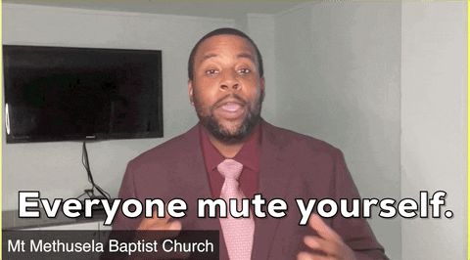
Zoom Norms
Mute unless you are speaking to the group
Use the chat to ask questions
Be mindful when asking questions about specific situations. Do not give out personally identifiable information.
Remember all questions in the chat will be gathered and answered later date. A Q&A will be posted at a later date on our virtual special education resource page.

Slide 4
Objectives for Today
Today we will discuss the following:
When an evaluation is necessary for dismissal of related services
Graduating on goals vs. credits

Slide 5
FAPE Standard
The provision of FAPE standard is whether the district, by virtue of a reasonably calculated IEP, made educational benefit available to the student in light of the student’s circumstances.

Slide 6
Critical Definitions
Special Education: specially designed instruction to meet the unique needs of the child with a disability, including instruction in the classroom, home, hospital or physical education settings. Special education includes:
Speech-language pathology services or any other related service if the service is considered special education rather than a related service under state standards
Related Services: transportation and such developmental, corrective, and other supportive services as are required to assist a child with a disability to benefit from special education.
(See the Missouri State Plan for Special Education, Regulation I - General Provisions, for the full definitions of special education and related services.)
Notes:
Let’s take a look at the definitions of Special Education and Related Services.
Read slide: Related services includes speech pathology , audiology services, interpreting services, psychological services, physical and occupational therapy, recreation, including therapeutic recreation, early identification and assessment of disabilities in children, counseling services, including rehabilitation counseling, orientation and mobility services, and medical services for diagnostic or evaluation purposes. Related services may also include school health services, school nurse services, social work services in schools, and parent counseling and training.

Slide 7
More Critical Terms
Change in eligibility: the process of using an initial evaluation or reevaluation to make an eligibility determination, including
making a change from no educational disability to eligibility under one or more of IDEA’s disability categories,
making a change from one of IDEA’s disability categories to another, and
making a change from eligible using one or more of IDEAs disability categories to ineligible under IDEA
Change in services: Using the IEP team meeting process to add or remove special education services for an IDEA eligible child or ending services following a determination the child is no longer eligible under IDEA for any special education or related services
Notes:
It is also important to know the difference between a change in eligibility and a change in service.
Read Slide:

Slide 8
Guiding Questions when Dismissing a Service
Consider the relationship between the service and the child’s eligibility for an IEP under IDEA
What data about the child’s educational performance forms the basis for the decision to dismiss the service?
Does the IEP describe how the child’s disability results in the need for other special education services besides the service being dismissed?
Is the service being dismissed a related service?
Notes:
When a team is looking at dismissing a service, these questions will help teams determine when a reevaluation is warranted. We will explain in more detail as we work through the next slides and engage in some scenarios.

Slide 9
Dismissing a Related Service

Slide 10
Do we need an evaluation report to dismiss a related service?
The question to ask is: Does the student continue to require special education services?
If the answer is YES:
Removing the related service is an IEP team decision that should be based on data. When the student continues to need services, the child’s eligibility for an IEP is not in question.
When there is no need for a reevaluation then there is no requirement to provide an evaluation report.
Myth of the Month: Evaluations March 2015
Notes:
This is a change in service, not a change in eligibility. As special education administrators, we need to remember that every situation is unique to the student. This is a generalized statement.
If the IEP team has sufficient evidence/data to support the dismissal of a related service, then the team can make the decision to remove the related service w/out needing to open up a reevaluation.
HOWEVER the team does not have sufficient evidence/data to dismiss a related service, then the team may decide to open a reevaluation to gather more data to support their decision.

Slide 11
Do we need an evaluation report to dismiss a special education service?
The question to ask is: Does the student no longer require ANY special education services?
If the answer is YES:
A reevaluation is required.
*If the team determines the student is no longer eligible under IDEA, write an evaluation report to document the basis for that decision and provide a copy to the parent.

Slide 12
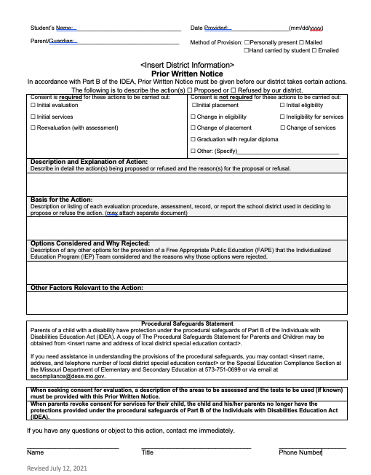
Would we need a PWN to dismiss related services?
The deletion or addition of a special education and/or related service would require a PWN.
Notice on the PWN that parental consent would not be required for ineligibility for services and/or change of services
https://dese.mo.gov/media/file/checklist-when-provide-prior-written-notice
Notes:
Read Slide
If we have a student with an eligibility of Sound System Disorder and speech was the only service, it would be a change in eligibility and a change in services. If the student was SLD and had speech as a related service, it would just be a change in services.
If the student is SLD and also meets the requirements of Sound System Disorder, this would trigger a reevaluation and then we would change eligibility and services. This would be different from where we have a SLD and the IEP adds speech as a related service.

Slide 13
To Evaluate or Not to Evaluate?
The team will need to make a data driven decision as to whether or not dismissing the related service would be warranted.
Related services should not be dismissed based on a ”feeling or hunch”.
Teams should look at progress reports, teacher anecdotal notes, performance on curriculum based assessments, along with gathering any additional information from IEP team to determine whether or not a related service should be continued/discontinued.
If teams feel that they do not have enough information to make a data driven decision, the IEP team can open a reevaluation and conduct additional assessments.
Notes:
When we a team is trying to decide whether or not to evaluate remember: related services are there to help the student benefit from special education services.
**If your data indicates that your goal is met for the related service, and the students skills are comparable to their peers, then the team can go forward with determining that a related service is no longer necessary.

Slide 14
Would we need a Prior Written Notice (PWN), if the team determines the child is no longer a child with a disability under IDEA?
The determination of eligibility upon completion of initial evaluation or reevaluation (with or without assessment) requires a PWN.
While prior written notice is required, parental consent would not be required to remove a special education or related service from the IEP.
Fact: There are multiple actions that can trigger the need for PWN to be provided to parents. Written notice must be given to the parents of a child with a disability a reasonable time before the public agency:
Proposes to initiate or change the identification, evaluation, or educational placement of the child or the provision of FAPE to the child; or
Refuses to initiate or change the identification, evaluation, or educational placement of the child or the provision of FAPE to the child. 34 CFR §300.503
Take note that a PWN is required not only when a LEA proposes to initiate or change the identification, evaluation or educational placement of the child or the provision of FAPE to the child but also when an LEA refuses to initiate or change the identification, evaluation or educational placement of the child or the provision of FAPE to the child
October 2022 Myth of the Month: Prior Written Notice & https://dese.mo.gov/media/file/checklist-when-provide-prior-written-notice
Notes:
Keep in mind that the provision of FAPE is a broad and overarching concept that is woven into every aspect of the special education process. IDEA defines FAPE as special education and related services that are provided free of charge to the parent, meets state standards and are provided in conformity with an individualized education program (IEP) that meets the requirements outlined in IDEA. When debating if an action could trigger a PWN under provision of FAPE, teams will need to consider if the proposed or refused action will impact the special education or related services provided to the student. If the answer is “yes”, then the need for a PWN is most likely triggered.
“When in doubt, give it out” might be a mantra LEAs might want to follow when determining if a PWN needs to be provided.

Slide 15
Scenario Time

Slide 16
Scenario #1
David has been identified as having a Specific Learning Disability in Basic Reading Skills and Reading Fluency and has a related service of Occupational Therapy for his fine motor deficits with handwriting. At the IEP meeting, Mrs. Tennesen, the Occupational Therapist, suggests dismissing David due to him meeting his annual OT goal and getting “caught back up to his typical peers.” She shares with the rest of the IEP team the progress monitoring data along with the Missouri Learning Standards for what students David’s age should be doing with writing and where he is currently functioning.
Is this enough to dismiss OT services?
Would we need to have an evaluation, or could the team dismiss OT from the IEP?
Where would you document this change?
Notes:
It is an IEP team decision on whether or not there is enough data to dismiss a related service. If the team determines there is sufficient data, they can go forward with dismissing OT as a related service at the IEP team meeting. You would document this change under - current changes of functioning as well as in your meeting notes and in the PWN.
If the team determines we need more data to make an informed decision on whether or not to dismiss services, we would need to open up an reevaluation w/or w/out assessment. Once the data is there, the team could go forward with dismissing services and writing a PWN to document the change.
We cannot stress enough about making data driven decisions. When we make data driven decisions it can save meetings and guarantee better outcomes for the students. Remember it is the case of facts over feelings.

Slide 17
Scenario #2
Dana is a student who is identified under Sound System Disorder. The description of adverse educational impact does not extend beyond speech concerns. Dana’s only special education service is speech-language therapy. During her annual IEP, the team discusses Dana’s progress and her current levels of functioning compared to her typical peers. The team determines that Dana no longer needs her speech-language therapy services.
What is the next step?
Is this an IEP team decision or do they need to reevaluate the student?
Notes:
The team would need to open a reevaluation w/or w/out assessment. Once the data is collected and shows that there is no longer a need for speech language therapy services, the team make an eligibility determination, write an evaluation report, and move forward with dismissing services. The team would also create a PWN that describes the child is no longer eligible under IDEA.

Slide 18
Scenario #3
Georgia is identified with Orthopedic Impairment and Language Impairment. During the IEP, the team discusses changes in orthopedic functioning as a result of Georgia having a surgery. Although the impairment still requires accommodations, it no longer requires specially designed instruction. The team concludes that Georgia no longer meets the requirements under IDEA for an Orthopedic Impairment. Georgia’s Language Impairment still requires specialized instruction because there still is adverse educational impact.
What are the next steps?
Notes:
This situation would trigger a re-evaluation- because the child was dual eligible under both categories under IDEA.
Remember, if the team during the eligibility staffing determines that the student is found eligible in two categories of special education and later they decide the student no longer meets the criteria under one category, but still meets criteria under any category under IDEA, then you would need to conduct a reevaluation and provide a PWN on change of eligibility ****Not ineligible of services.

Slide 19
Graduating on Goals vs. Credits
When is it appropriate?

Slide 20
Graduating on Goals vs. Credits
Two Ways to Meet Graduation Requirements
Earn a high school diploma (a diploma fully aligned with state academic standards) [34 CFR 300.102 (a)(3)(i)].
Earn a high school diploma by meeting IEP goals, or some similar mechanism [34 CFR 300.102 (a)(3)(ii)].
If a student cannot meet requirements of #1 or #2 above, the student exits the educational system at the maximum age for receipt of special education services (age 21) [34 CFR 300.102 (a)(2)(i)].
Students with disabilities that withdraw from school without completing the education program (drop out), still have an entitlement to FAPE until they reach the age at which eligibility ceases under the age requirements within the state [34 CFR 300.102 (a)].
Notes:
Up to this point, we’ve talked about ways a student can be dismissed from services by the IEP team and exit special education, but now we turn our attention to the ways a student’s entitlement to FAPE under IDEA is terminated .
First, earn a regular diploma. This would include students who graduate earning credits with regular courses and content OR students who earn credits with modified courses OR students who graduate with a combination of regular and modified courses
Second, in Missouri, all students who graduate get the same diploma, whether they have modified or regular courses. However, this is where the student who graduates on goals fits in. If a student is graduating on goals, that student receives the same diploma as a student who graduates on credits, but there is a distinction made when the student is reported in the MOSIS file, and we will discuss that in a few minutes.
Students who can’t earn the credits or master goals by the age of 21 “age out” and in Missouri, these students typically receive a certificate of attendance if they have stayed until age 21. Students that receive a certificate of attendance are not reported as graduates.
Finally, if a student drops out before earning a diploma, the student continues to be entitled to FAPE until age 21. For example, say you have a student who drops out at age 18 before earning credits or graduating with goals, and then the next year when the student is 19, she returns to enroll again. That student still has an entitlement to FAPE until the age of 21.

Slide 21
Graduating on Goals vs. Credits
IEP Team Role in Graduation Decisions
Notes:
The point of the information on this slide is that it’s an IEP team decision as to whether a student graduates with a diploma or graduates on goals. And the team needs to be having these conversations well before the 12th grade year. The discussion about whether a student will graduate on credits or goals really needs to take place in the 9th grade year, when the student enters high school and has the opportunity to earn credits. Teams need to keep good meeting notes about these discussions and document decisions in the student’s IEP.

Slide 22
Graduating on Goals vs. Credits
FACTS about Students Who Graduate with a Diploma
The IDEA does not require school districts to provide FAPE beyond the level of secondary education. 34 CFR 300.17 (c). As a result, the right to receive special education and related services ceases when a student with a disability has earned a regular high school diploma. 34 CFR 300.102 (a); See, e.g., Yankton Sch. Dist. v. Schramm, 24 IDELR 704 (8th Cir. 1996); Daughtery v. Hamilton County Schos. , 29 IDELR 699 (E.D. Tenn. 1998)
The IDEA does not make achievement of the IEP goals of a student with a disability a prerequisite for award of a regular high school diploma. In fact, the statute does not establish standards for graduation as a general matter. See, e.g., Letter to Richards, 17 IDELR 288 (OSERS 1990).
Districts may deny a student FAPE by graduating the student if the student has not actually satisfied the state and local requirements for graduating with a regular diploma. See, e.g., Tacoma Sch. Dist., 64 IDELR 28 (SEA WA 2014).
IMPORTANT: Districts must be able to establish that the IEP has provided an appropriate program.
Notes:
Here are some reminders about students with disabilities and exiting services.
First, the provision of FAPE ends the day the student earns the diploma. Students do not take IEPs with them to college or technical school.
Second, students are not required to master their IEP goals as a condition of graduating on credits.
Finally, it may be found that a district has denied FAPE to a student if the district graduates the student and the student has not completed the requirements for earning the diploma.

Slide 23
“Regular High School Diploma”
34 CFR 300.102 (a)(3)(iv) defines “regular high school diploma” as
“the standard high school diploma awarded to the preponderance
of students in the State that is fully aligned with State standards, or
a higher diploma, except that a regular high school diploma shall
not be aligned to the alternate academic achievement standards
described in section 1111(b)(1)(E) of the ESEA.
A regular high school diploma does not include a recognized
equivalent of a diploma, such as a general equivalency diploma,
certificate of completion, certificate of attendance, or similar
lesser credential.”
LRP Conference: Graduation and Termination of Special Education Services: When Does the Duty of FAPE End? David B. Hodgins April 25, 2022
Notes:
So when thinking about the information on the previous slide and the fact that a district might be denying FAPE if a student doesn’t graduate with a regular diploma, it’s important to note that a GED or certificate of attendance is not recognized as a regular diploma.

Slide 24
Graduating on Goals vs. Credits
And Another FACT about Transition Services and Graduation
Students who graduate without transition services may be entitled to post-graduation relief. See, J.B. v. Killingly Bd. Of Educ., 27 IDELR 324 (D. Conn. 1997) (ordering compensatory relief when a school district failed to provide appropriate transition services prior to awarding a regular high school diploma); and Black River Falls Sch. Dist. 40 IDELR 163 (SEA WI 2004).
Notes:
IEP teams also need to note that whether a student is graduating on goals or earning credits towards graduating, transition services must be present and appropriate to allow the student to reasonably be able to achieve postsecondary goals, and students who have not had appropriate transition services prior to graduation may be entitled to compensatory services.

Slide 25
Graduating on Goals vs. Credits
Each State Determines Graduation Requirements for Its Students
In Missouri, these requirements are set forth in Graduation Requirements for Students in Missouri Public Schools.
https://dese.mo.gov/media/pdf/graduation-requirements
Local school districts may establish additional graduation requirements.
https://dese.mo.gov/media/pdf/graduation-requirements
Notes:
Missouri graduation requirements can be found in the Graduation Requirements for Students in Missouri Public Schools handbook.
As noted, local districts may establish graduation requirements that are above and beyond MO requirements, but they must make sure the requirements are not discriminatory in nature.

Slide 26
Graduating on Goals vs. Credits
MO Minimum Graduation Requirements by Units of Credit
Source: Graduation Requirements for Students in MO Public Schools
The Coordinating Board for Higher Education has additional recommendations for coursework, and colleges have specific admission requirements.
Subject | Units of Credit | Additional Requirements
English Language Arts | 4
Mathematics | 3
Social Studies | 3 | Passing of U.S. & MO Constitution and American Civics exam
Science | 3
Fine Arts | 1
Physical Education | 1 | 30 minutes of CPR instruction and training in first aid for choking
Practical Arts | 1
Health | ½ credit
Personal Finance | ½ credit
Electives | 7
Total | 24
https://dese.mo.gov/media/pdf/graduation-requirements
Notes:
Here are the minimum requirements for students to graduate on credits. The next slide provides some clarification for IEP teams about how students with disabilities can meet these requirements.

Slide 27
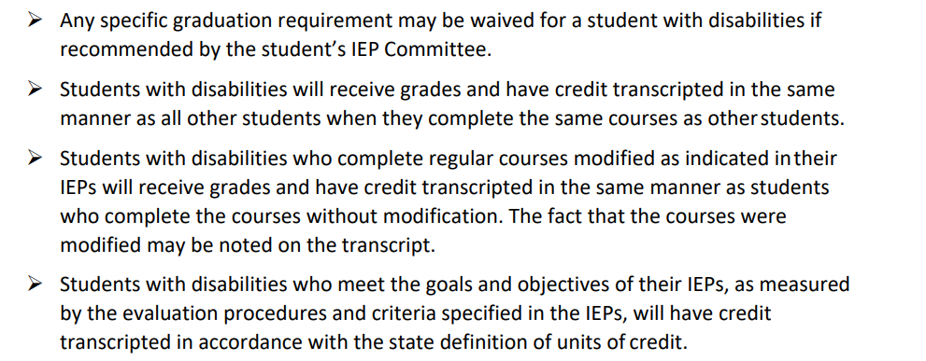
Graduating on Goals vs. Credits
Policy Considerations for Students with Disabilities under IDEA
Source: Graduation Requirements for Students in MO Public Schools
https://dese.mo.gov/media/pdf/graduation-requirements
Notes:
Two big takeaways from this slide:
First, the IEP team can waive any specific graduation requirement - it just needs to be documented in the IEP.
Next, if a student’s course is modified, the fact that it is modified can be noted on the student’s transcript. For example, many districts use course titles such as “Special ELA” or “Life Skills Math” to indicate the course is modified.
Another important thing to note is that if IEP teams determine appropriate, students with disabilities can have modified versions of constitution tests and CPR/choking instruction or the team might choose to waive these requirements altogether. Again, document these decisions in the IEP.

Slide 28
Graduating on Goals vs. Credits
Policy Considerations for Students with Disabilities under IDEA
Source: Graduation Requirements for Students in MO Public Schools
https://dese.mo.gov/media/pdf/graduation-requirements
Notes:
We also often get the question about whether a student’s entitlement to FAPE ends the day he turns 21 or does it continue until the end of the school year in which the student turns 21. As of this time, the answer is that in Missouri, it ends the day the student turns 21. However, some districts permit students to stay through the end of the school year in which they turn 21. For example, I turn 21 in January of the 22-23 school year, but the school district might have a policy that I can remain until school ends in May of 2023. On the other hand, some districts have a strict policy that a student cannot attend past the day of the 21st birthday. These decisions are at the discretion of the district - a district is not required to allow the student to stay past the 21st birthday. This age varies on a state-by-state basis.

Slide 29
Graduating on Goals vs. Credits
Don’t Forget the Prior Written Notice – Change of Placement, Change of Services and Graduation
For a student meeting regular graduation requirements or graduating on goals, the IEP team must provide a PWN at least 10 days prior to the last day of attendance.
For a student who “ages out” of special education, the IEP team must provide a PWN at least 10 days prior to the student’s 21st birthday.
Notes:
This is just a reminder that whether a student graduates with credits or on goals, a PWN must be provided 10 days prior to the last day of attendance to inform that provision of FAPE ends at graduation. This holds true for students graduating early in December, in May, or July/August after they complete credit requirements in summer school.
If the student ages out at 21, then a PWN must be provided 10 days prior to the student’s birthday to inform that provision of FAPE ends on the 21st birthday.

Slide 30
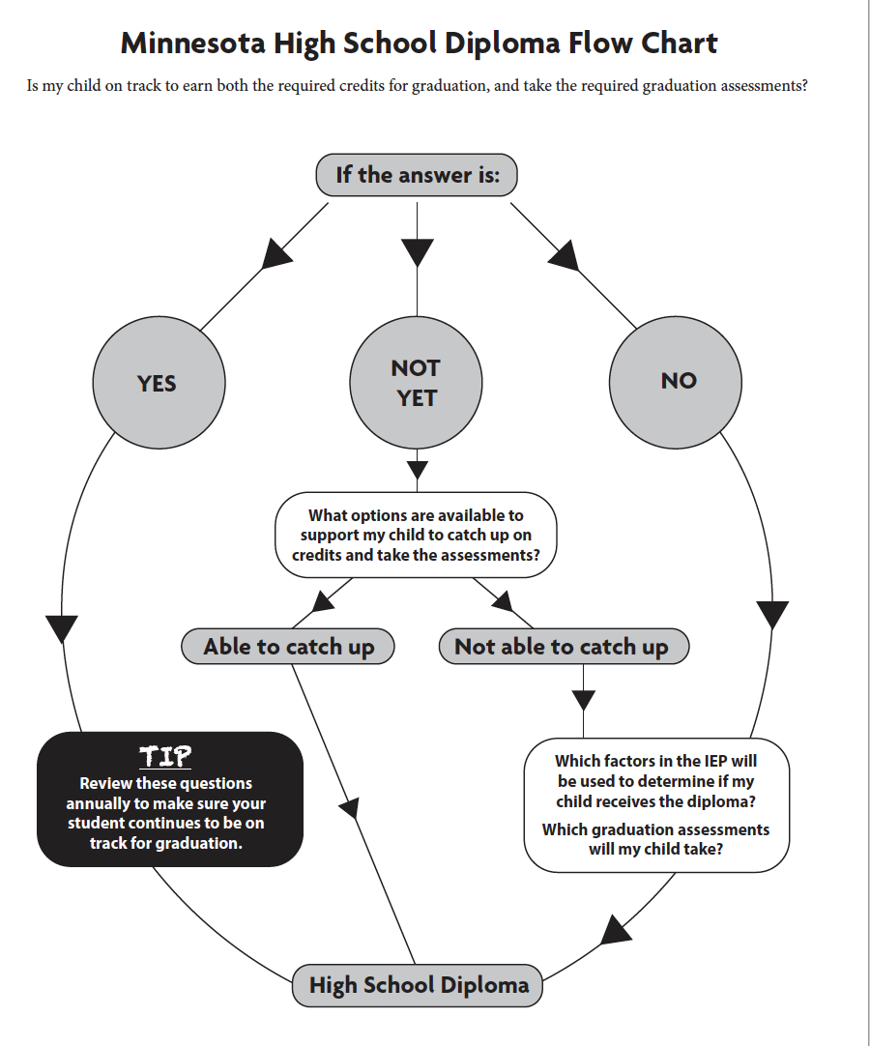
Awesome Flow Chart!
Is my child on track to earn both the required credits for graduation and take the required graduation assessments (basic standards tests at the State or Individual Level)?
Minnesota- Pacer Center Action Information Sheet Pacer.org
Notes:
Here’s an awesome flow chart that can be found in the source noted on this slide. For students earning credits for graduation, it can serve as a springboard for annual IEP team discussions surrounding the student’s progress toward earning those credits. The following slide includes some questions that IEP teams might address if the answer is “not yet.”

Slide 31
If the Answer is “Not Yet”
Ask your team what options are available to support your teen in catching up. For example:
• What additional accommodations, modifications, or specialized instruction might my teen need to earn credits or take assessments?
• What assistive technology is needed to support my teen’s learning?
• What alternative or online learning programs are offered in this district?
• What challenges (such as attendance or behavior) is my teen facing that may impact earning credits or taking required assessments? How will we address those challenges?
Pacer Center Champions for Children with Disabilities: Minnesota High School Diploma for Students Receiving Special Education Services
Notes:
If the answer to the “Is the student on track to graduate with credits” question is not yet, then here are some discussion points for the team. Things to consider include:
what adjustments might be appropriate to the IEP such as a change in accommodations or services?
does this student need support through assistive technology?
what is available to the student as far as credit recovery opportunities?
are there concerns in attendance or behavior that need addressing?
These are all questions for discussion annually as the team continues to monitor whether or not the student is on track to graduate with credits.

Slide 32
If the Answer is “No”
Consider these questions:
Is this a student that will likely require significant support as an adult?
Is this a student with significant cognitive delays such that MAP-A is appropriate?
Is this a student who will likely need to attend high school past the end of the 12th grade year to develop functional skills?
Is this student’s special education needs so significant that their participation in high school coursework requires drastic modifications and pull out services?
Does this student’s curriculum focus mainly on increasing independence and functional skills?
What are the possible consequences of earning a diploma based on meeting IEP goals?
How might graduating on goals impact the student’s plans for post-secondary education, employment, and independent living?
What goals will be used to determine if the student receives a diploma?
Pacer Center Champions for Children with Disabilities: Minnesota High School Diploma for Students Receiving Special Education Services
Notes:
On the other hand, these are some of the kinds of questions that can guide the team in determining whether or not this student is a candidate for graduating on goals.
REVIEW THE QUESTIONS
Typically, the team would be able to answer “yes” to most or all of these questions if the student is graduating on goals.

Slide 33
Graduating on Goals vs. Credits
Reminders
IEP team has the authority to set graduation standards for students with disabilities.
IEP teams must evaluate several factors before making decisions.
If the team makes the decision to graduate the student on goals, that decision is typically made at the beginning of high school and then is reported annually on Form C of the IEP. (This option is most commonly used for students who are attending high school past the end of their 12th grade year.)
Decisions should be data based and documented in PLAAFP and/or IEP team meeting notes.
Notes:
Once again, we want to emphasize the importance of IEP conversations concerning graduation on goals vs credits starting in the 9th grade year.
If the team determines that graduation on goals is appropriate, that should be documented on Form C and the decision also discussed in the PLAAFP.

Slide 34
Graduating on Goals vs. Credits
Districts Have an Obligation to Ensure Educational Benefit
In analyzing a district’s decision to graduate a student with a disability, the correct standard is whether the district, by virtue of a reasonably calculated IEP, made educational benefit available to the student. See, e.g., Doe v. Marlborough Pub. Schs., 54 IDELR 283 (D. Mass. 2010) (holding that because the 12th-grade IEP contained transition services, provided services to address the student’s identified areas of difficulty, and was based on the student’s 11th-grade IEP, it was reasonable to conclude that the IEP was reasonably calculated to provide the student with educational benefit).
Minnesota- Pacer Center Action Information Sheet Pacer.org
Notes:
Remember, no matter what method a student uses to graduate, goals or credits, the district must be able to demonstrate that they made educational benefit available to the student.

Slide 35
Scenario Time

Slide 36
Scenario #1
The IEP team met for an 18 year old student with an eligibility category of Emotional Disturbance. The student was on track to graduate with credits by completing regular education courses until the most recent semester when the behaviors really starting interfering with academic performance and the result is that the student will earn no credits this semester, putting him a semester behind in graduating. During this quick IEP meeting, the team determined that they were going to change the student from graduating with credits to graduating by meeting goals due to the significant behavior concerns.
Is this a good decision?
If we make this decision, has this student received FAPE?
Notes:
No, the IEP team should have been having conversations and creating intervention plans to deal with student behaviors. The IEP team should have looked at how we could develop a new IEP with behavior supports, not whether we should graduate the student on goals just so he could leave “on time.” There is definitely a potential for a denial of FAPE complaint in this situation.
Generally when teams make decisions on graduation on goals, this is reserved for students who are utilizing curriculum based on the alternate standards. The student in this scenario, is on track to graduate by completing regular course work.

Slide 37
Scenario #2
IEP team comes together to discuss a 17 year old student that has been identified as having a Specific Learning Disability. The team determines that the student will graduate based on goals due to the fact that the student is rarely present for class (63% attendance rate).
Can the team graduate on goals even though they are behind in credits?
If we make this decision, has this student received FAPE?
Notes:
As always, it is an IEP team decision. However, you must ask yourself, has the student received FAPE or is this an easy way to get a student out?
If the student is not coming to school, an intervention related to attendance should be implemented. In these situations, the student is lacking credits because they have missed school, causing them to get behind in content and assignments. For students who have been absent from school and consequently failed classes due to poor attendance, the student needs to attend school until they have passed enough classes and therefore earned enough credits to graduate. This could mean going to school through age 21 or participating in after-school and summer credit programs. It is important for the team to consider using a motivational intervention to help keep the student attending and earning their credits.
A special Education guideline for graduation requirements Number 9- St. Croix River Education District.

Slide 38
Scenario #3
The IEP team meets to discuss Georgia, a 16-year-old student who is Other Health Impaired due to having Attention Deficit Hyperactivity Disorder. During the meeting, information is brought up that Georgia is failing classes due to not completing work in her general education courses causing her to fall behind on receiving her high school credits.
How should the team proceed?
Should they determine they will graduate her on goals due to work completion?
Should they continue to graduate her on credits even though she is behind?
Notes:
If students are behind in credits, due to failing classes (either as the result of poor academic performance or truancy) schools need to encourage the student to continue to attend school in order to earn the credits (gain the education) needed for graduation. Classroom and instructional accommodations, modifications and interventions should be made to insure the student the greatest chance to succeed. Teams have an obligation to provide FAPE to their students.
A special Education guideline for graduation requirements Number 9- St. Croix River Education District.

Slide 39
Scenario #4
The IEP team was asked to convene due to the parents having concerns about their child graduating on time. Bentley is a 12th grade student who has been identified as having an Intellectual Disability. He receives all of his classes in a self-contained classroom but is working towards graduation on credits, although a little behind. Both parents would like to see Bentley graduate on time with his typical peers and are asking that the team change him to graduating based on goals so that he can graduate with his class in the spring rather than stay on additional semesters.
Does the parent make the final decision?
Notes:
Although the parent has input, the IEP team makes the final decision which should be based on data to determine whether or not changing his graduation plan provides FAPE for the child. Teams would need to consider whether or not the student needs continued specialized instruction in the area of transition where they focus on increasing independence and functional skills such as- employment skills or services provided by an agency outside the school (work based learning opportunities).
A special Education guideline for graduation requirements Number 9- St. Croix River Education District.

Slide 40
Let’s Talk about MOSIS Reporting

Slide 41
Guidance on Reporting Graduates
Two types of students:
G01: student is held accountable for regular curriculum/content and graduation requirements. (Modified classes may also be used to meet this requirement.)
G03: student is not held to the same curriculum/content and graduation requirements as all students (might have earned some credits through modified standards and typically, graduating on goals). Most commonly these students are MAP-A with significant cognitive delay, but not always as there could be other locally determined reasons for exiting a student as G03.
https://dese.mo.gov/media/pdf/sped-graduate-reporting
Notes:
Several slides ago, we indicated that whether a student graduates on credits or goals, that student earns the same diploma. However, the distinction between the two is made when doing the graduation coding.
So students who are coded G01 are those who are graduating with credits. And remember, modified classes are still okay under G01. Students who graduate on goals are coded in MOSIS as G03 which indicates this student graduated on IEP goals. .
This slide includes a link that provides guidance and explanation when making the decision about correct coding.

Slide 42
Guidance on Reporting Students Who Receive Certificate of Attendance
Two types of students:
D03: Dropped Out: Received Cert - student with disability who exited through receipt of certificate of attendance.
D04: Dropped Out: Reached Max Age - student with disability who exited because he/she reached maximum age for receipt of educational services and did not receive a diploma or certificate of attendance.
Notes:
Unfortunately, we occasionally have students who age out but haven’t met their IEP goals. Generally speaking, the student who continued to attend but didn’t earn required credits or achieve goal mastery would be coded D03. That student earned a certificate of attendance but that is not recognized as a graduate because no diploma was earned.
Students who are coded D04 are those who did not earn either a diploma or a certificate of attendance.

Slide 43
Will a student who graduates on goals and stays in the district until age 21 negatively affect the district’s graduation rate?
The answer to this is “yes” and “no.”
DESE calculates a 4-year, 5-year, 6-year, and 7-year graduation rate.
Students who stay past the “usual” 4 years won’t be in the 4-year grad rate.
Eventually, these students will be picked up in an extended year grad rate - if they leave with a diploma.
Students who are 12th graders for more than one year are reported as Remained:Retained (R002) in the June Cycle until they graduate or age out at which time they are then coded as G01, G03, D03, or D04, whichever applies .
Notes:
Finally, a little note about students who do not graduate with their four-year cohort - once these students do graduate, whether it be at the 5, 6, or 7 year mark, then DESE picks the student up in an extended year graduation rate.
And remember, if a student stays in 12th grade for more than one year, for MOSIS reporting purposes, that student is considered retained and must be reported in the June Cycle as Remained-Retained. Once that student achieves graduation status, then they are picked up in the district’s graduation rate.

Slide 44
Graduating on Goals vs. Credits
Helpful Resources
Myth of the Month- Evaluations March 2015
https://dese.mo.gov/media/pdf/evaluations-myth-month
Myth of the Month – Graduation April 2021 file:///C:/Users/ldnd3/Desktop/Graduating%20on%20Goals/se-compliance-2021-April-Myth-Graduation_2.pdf
Special Ed Connection – SmartStart: Decisions about Graduation file:///C:/Users/ldnd3/Desktop/Graduating%20on%20Goals/LRP%20Graduation%20Decisions.pdf
Special Ed Connection – SmartStart—Graduation and Termination of Special Education Services file:///C:/Users/ldnd3/Desktop/Graduating%20on%20Goals/Special%20Ed%20Connection.pdf
Grading, Awarding Credit and Graduation for Students with Disabilities file:///C:/Users/ldnd3/Desktop/Graduating%20on%20Goals/GradingAwardingCreditGraduation.pdf
Coming Soon: Myth of the Month- Graduating on Goals December 2022

