Slide 1
Missouri Department of Elementary and Secondary Education
Missouri Schools for the
Severely Disabled:
Eligibility Process
2022

Slide 2
Zoom Support Meeting Norms
Mute unless you are speaking to the group
Use the chat to ask questions
Be professional and helpful
Be mindful when asking questions about specific situations - don't give out any information that could reveal the identity of a person with a disability

Slide 3
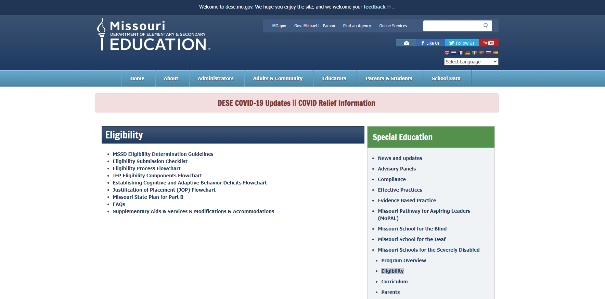
Link: https://dese.mo.gov/special-education/missouri-schools-severely-disabled/eligibility1

Slide 4
MSSD Eligibility Page Resources
MSSD Eligibility Determination Guidelines
Eligibility Submission Checklist
Eligibility Process Flowchart
IEP Eligibility Components Flowchart
Establishing Cognitive and Adaptive Behavior Deficits Flowchart
Justification of Placement (JOP) Flowchart
Missouri State Plan for Part B
FAQs
Supplementary Aids, Services, Modifications & Accommodations

Slide 5
Eligibility vs Referral
Eligibility – The process in which MSSD reviews LEA submitted documentation, then determines a student’s eligibility to receive our services.
Referral – A form and accompanying documentation submitted to MSSD by the LEA once a student is deemed eligible for services.

Slide 6
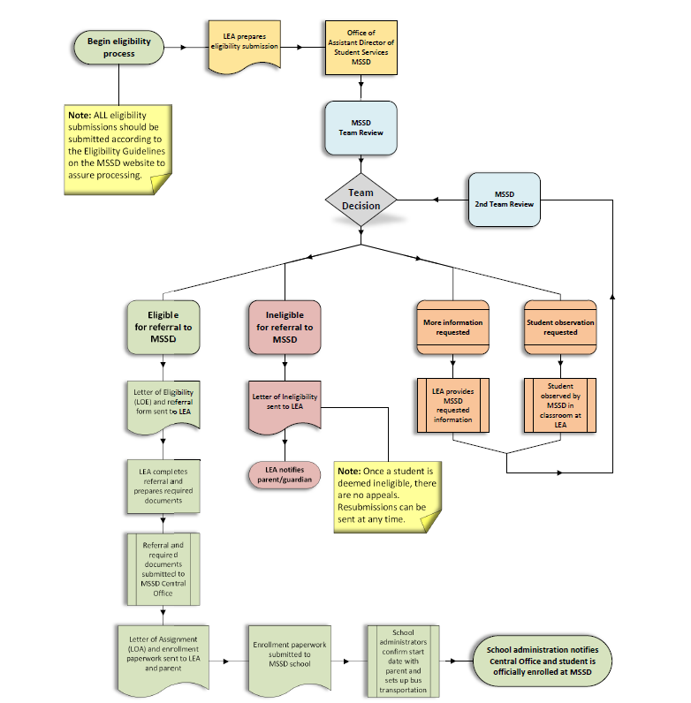
Eligibility Flowchart
A student must first be found eligible in accordance with the State Plan for Special Education, Part B before they can be referred to MSSD by the LEA.
Once a student is referred by the LEA, the parent can complete enrollment paperwork and the student can be enrolled.

Slide 7
Documents submitted by LEA
Cover letter stating request for eligibility determination (including LEA contact information)
A current Request of Information (ROI), signed by parent/guardian
Evaluation Report (including current cognitive and adaptive behavior assessment results)
Justification for Separate Placement Statements (JOP)
Current IEP
2 Previous IEPs
Progress Notes for each IEP

Slide 8
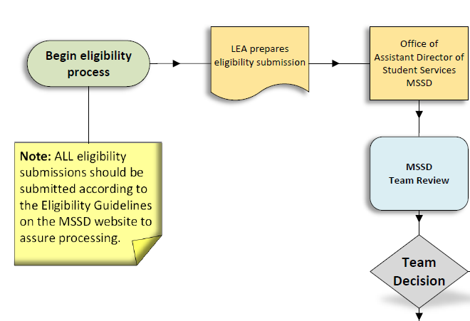
Eligibility Determinations
How is the team decision made?

Slide 9
Eligibility Determinations
Evaluation Report
Standard Cognitive Assessment
Adaptive Behavior Assessment

Slide 10
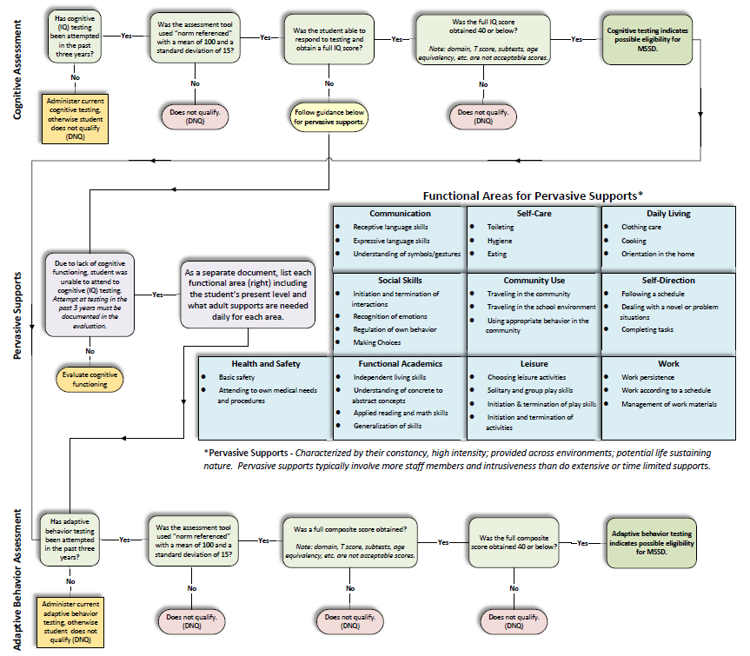
Establishing Cognitive and Adaptive Behavior Deficits

Slide 11
Assessment requirement
Both cognitive (IQ) and adaptive behavior assessments must be “norm referenced” (mean score of 100) and four standard deviations (SD) below the mean.

Slide 12
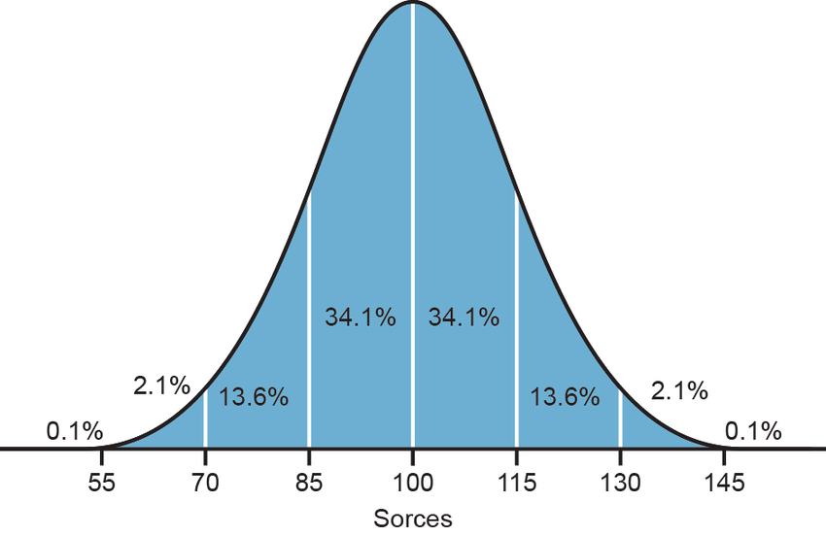
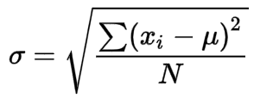
What does that “mean”?
mean score (100)
average performance of a group
standard deviation (15)
4 standard deviations below
40

Slide 13
Cognitive Assessment

Slide 14
Frequently Asked Question
What does it mean to need Pervasive Supports?

Slide 15
Pervasive Supports
Pervasive Supports – Supports characterized by their constancy, high intensity; provided across environments; potential life sustaining nature. Pervasive supports typically involve more staff members and intrusiveness than do extensive or time limited supports.

Slide 16
Pervasive Supports
Communication
Self-Care
Daily Living
Social Skills
Community Use
Self-Direction
Health and Safety
Functional Academics
Leisure
Work

Slide 17
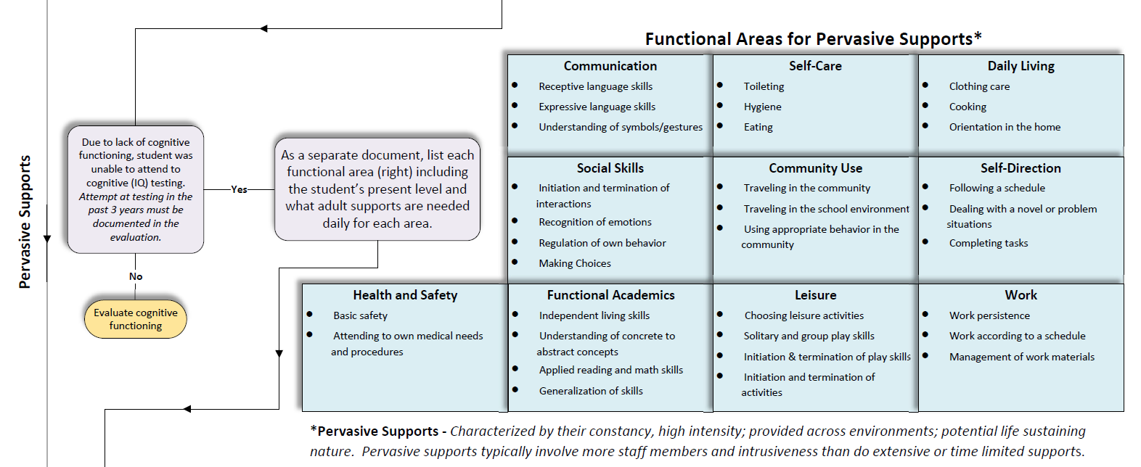
Cognitive Assessment/Pervasive Supports

Slide 18
Adaptive Behavior Assessment

Slide 19
Establishing Cognitive and Adaptive Behavior Deficits

Slide 20
IEP Components

Slide 21
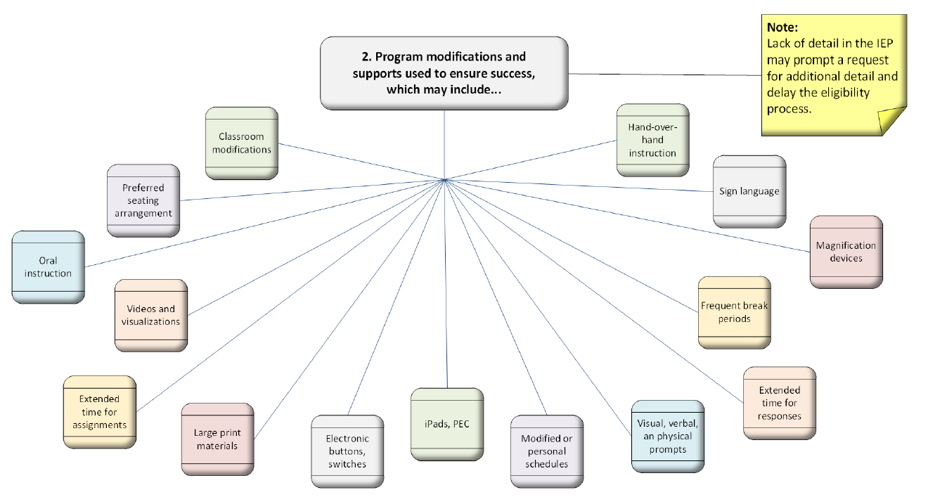
IEP Components

Slide 22
IEP Components

Slide 23
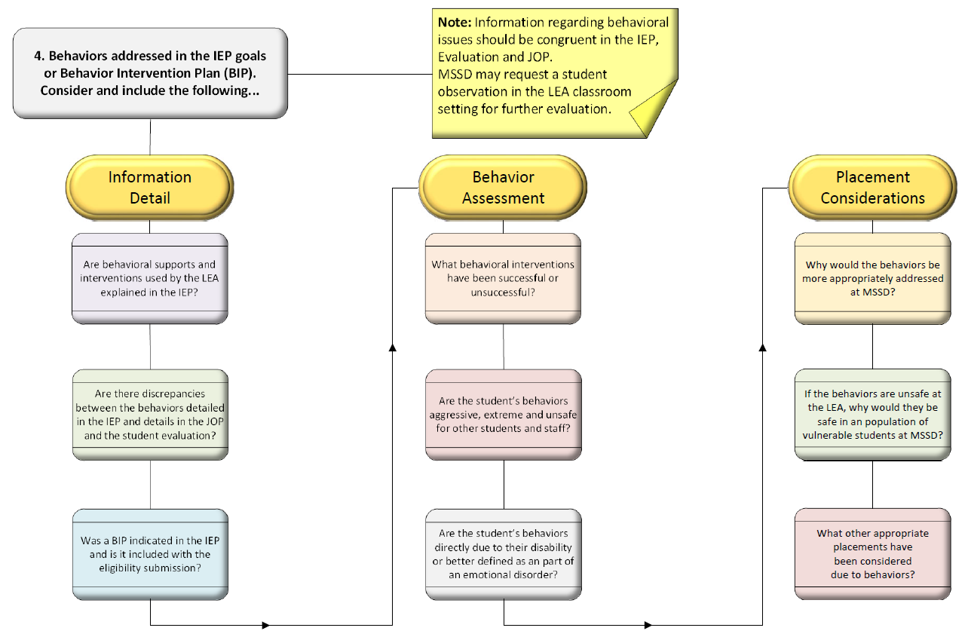
IEP Components

Slide 24
Justification for Separate Placement (JOP)
What does this mean?
The LEA’s “justification” for moving a student to an educational “placement” that is “separate” from the regular student population, such as MSSD.

Slide 25
Justification for Separate Placement (JOP)
This is essentially the LEA’s narrative about their efforts to educate the student in their district with their resources. It explains what worked, what failed, the student’s progress, resources used or considered, why the current placement is no longer appropriate, and more.

Slide 26
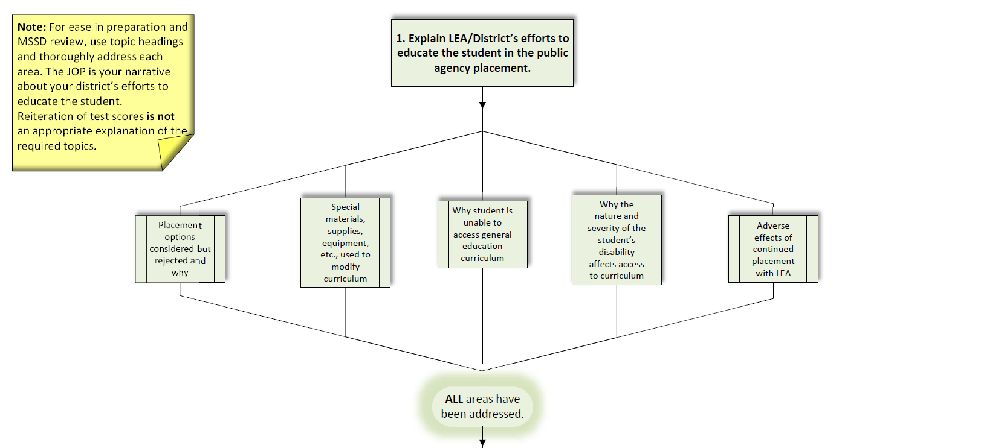
Justification for Separate Placement (JOP)

Slide 27
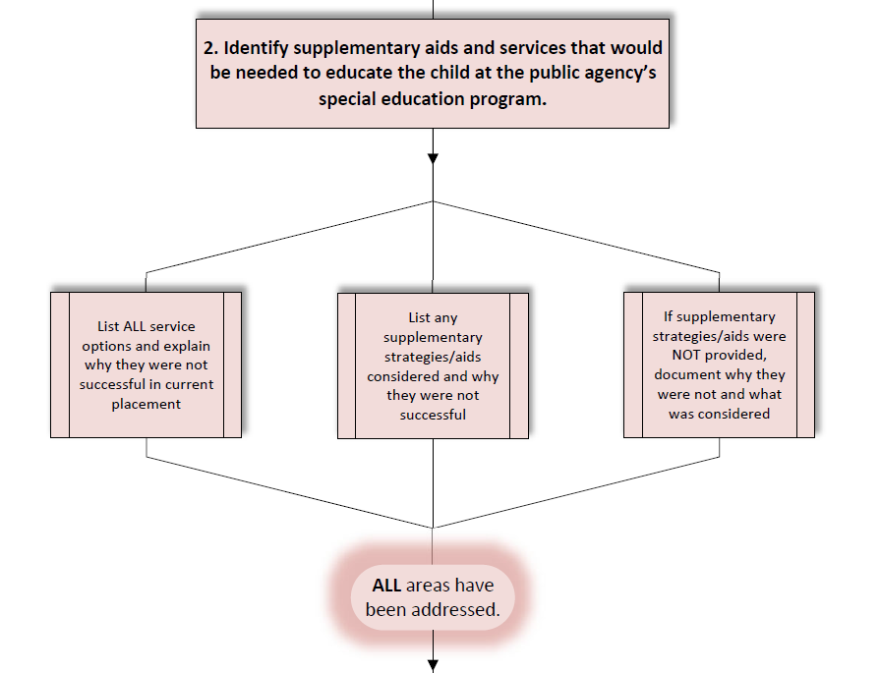
Justification for Separate Placement (JOP)

Slide 28
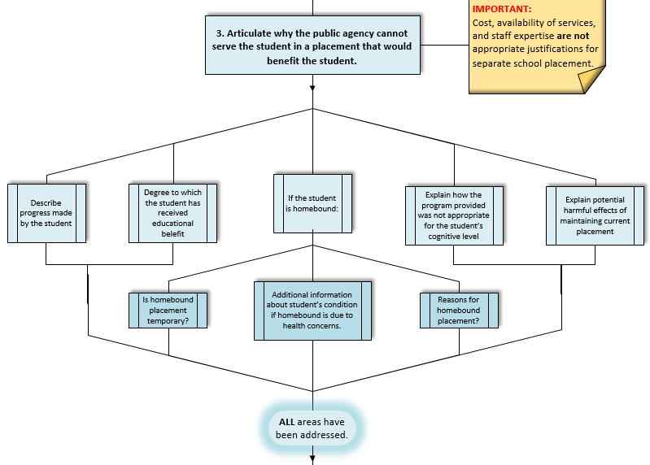
Justification for Separate Placement (JOP)

Slide 29
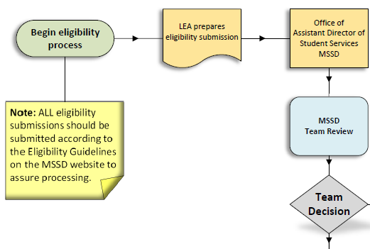
Eligibility Process
Decision made…
…now what?

Slide 30
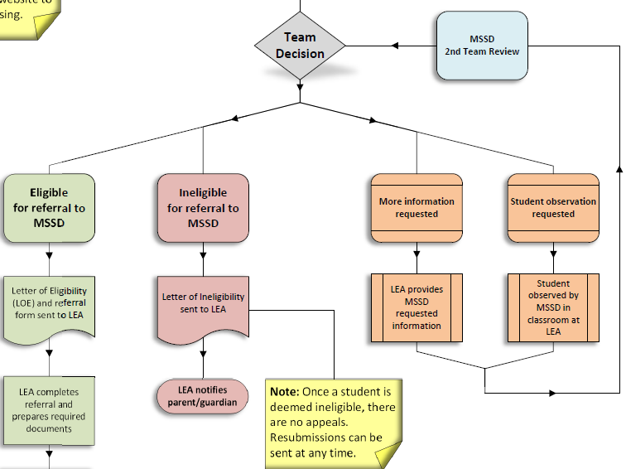
Eligibility Process

Slide 31
Now What?
Additional Info
An email is sent to the LEA requesting further clarification.
Most cases an email reply will provide enough information.
Observation
A request is sent to the LEA to observe the student in the classroom setting.
Usually the BA at the school where the student will attend is assigned to conduct the observation.

Slide 32
Common additional Information requested by MSSD
Why would separate school placement be more appropriate considering the student as made some progress in the local school district program?
Additional information about the student’s challenging behaviors in the school setting and why they would be more appropriately addressed in a public separate day placement.
Considering the low student/teacher ratio at MSSD, would the student need a 1:1 paraprofessional or nurse to meet their educational needs?
Would the student be able to attend a full 6 hour day at MSSD?

Slide 33
Common reasons for an observation requested by MSSD
Extreme (aggressive, overt, frequent) behaviors that may be considered unsafe at MSSD due to our student population
Suspected predominate health or mental health issues
Incongruence in cognitive or adaptive behavior scores
To get “eyes on” a student when certain aspects of the eligibility submission seem suspect or unclear

Slide 34
Now What?
Eligible
Letter of Eligibility (LOE) is sent to LEA.
Includes the Referral form and instructions to submit the referral to MSSD.
Ineligible
Letter stating the student is ineligible is sent to the LEA.
Includes the reason(s) for ineligibility.
LEA contacts parents
There are no appeals, however resubmission with new information allowed at any time.

Slide 35
Next?
If a student is found to be eligible for services at MSSD, the IEP team convenes to discuss the change in placement.
If the IEP team agrees, the referral to MSSD is made by the LEA.

Slide 36
Making a referral
Provide the following within one (1) year of the eligibility determination date:
Completed referral form
IEP stating placement in a Public Separate Day Facility
IEP includes 1800 minutes of instruction and related services combined, or less if shortened school day is appropriate
Notice of Action for change in placement

Slide 37
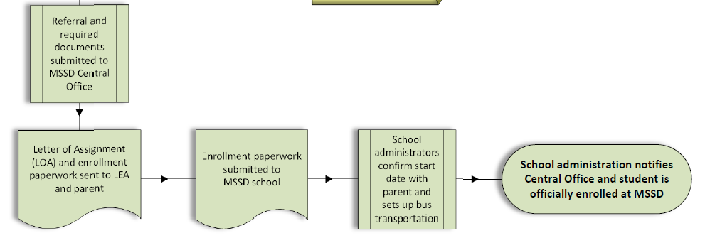
Enrollment
Letter of Assignment (LOA) sent to LEA and parent (also site BA and Area Director)
Includes Enrollment Packet
60 days to enroll (ESY not included)

Slide 38
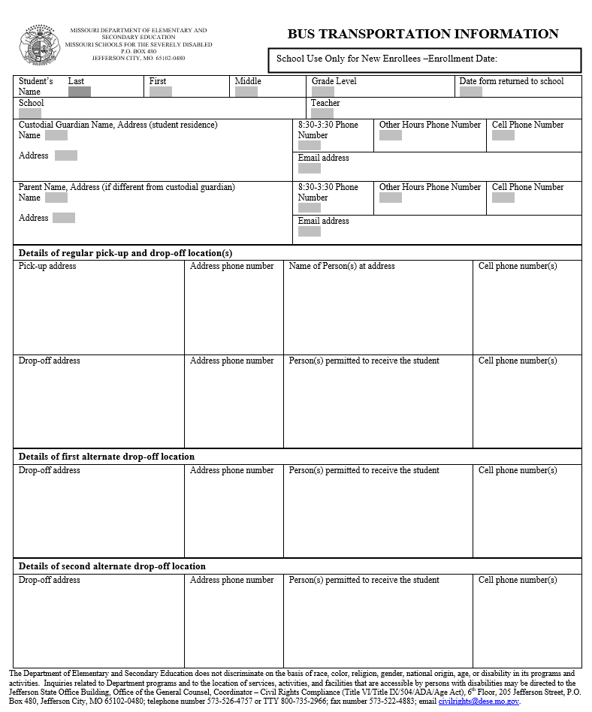
Must be completed!
Enrollment Date
Grade Level
Teacher
School
Demographic Information – Completed by parent
From the enrollment packet, send the Bus Transportation Information form ONLY to the Bus Transportation Information email group:
DESE.MSSD Bus Transportation Information desemssdbustransportationinformation@state.mo.us
Upload the rest of the enrollment forms to the student’s file in SISK12.
Send this form at least a few days BEFORE the enrollment date if possible.

Slide 39
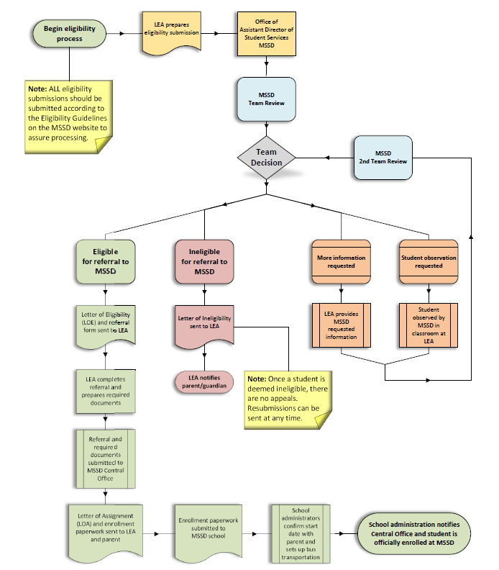
Eligibility Process
Eligibility decision usually within 2 weeks of receiving the submission paperwork
Additional information or observation delays eligibility
LEA must return the referral before enrollment paperwork can be sent
Student is enrolled according to the stated enrollment date once bus form is received at CO

Slide 40
Contact Information
Samantha Marsicovetere
MSSD Director of Program Services
Email: Samantha.Marsicovetere@dese.mo.gov
Telephone: (573)751-0407
Danny Rydman
MSSD Assistant Director of Program Services
Email: Danny.Rydman@dese.mo.gov
Telephone: (573)751-0992

Slide 41
Questions?

