Slide 1
What You Will Need
Handout #1 - Writing Glossary
Handout #2 - Application of Ehri’s Phases
Handout #3 - Sentence Frames
Handout #4 - Powerful Thinking Frames for Summarization
Handout #5 - Variated Venn
Handout #5a - Compare and Contrast Summary Frame
Handout #6 - Fabulously Funky Text Only
Resource #1 - Variated Venn with Example Ideas
Resource #1b - Summary Frame for Variated Venn
Resource #2 - Fabulously Funky Xplor article
Notes:
To Know and Do: Hide this slide when presenting.
There are two versions of the Fabulously Funky article that will be used for writing. One is a text only version. The other version is found inside the Missouri Department of Conservation magazine from January/February 2019. The full article from the magazine is a rich, visually appealing article that we have found teachers love to use with students. We would suggest you make one good color copy per table but provide the black and white as a handout for individual teachers. The text-only version has the website link on it for teachers to access the color version in their districts.
What you will need
Handout #1 - Writing Glossary - This is the same Glossary as Comprehension. There are no new terms for this module.
Handout #2 - Application of Ehri's Phases
Handout #3 - Sentence Frames
Handout #4 - Powerful Thinking Frames for Summarization
Handout #5 - Variated Venn
Handout #5a - Compare and Contrast Summary Frame
Handout #6 - Fabulously Funky-- Text Only
Resource #1 - Variated Venn with Example Ideas
Resource #1b - Summary Frame for Variated Venn
Resource #2 - Fabulously Funky Xplor article

Slide 2
Writing
Components of Effective Literacy
Module 7
Notes:
To Know and To Say: Welcome to the final module created for the Components of Effective Literacy (CEL). This module is number seven in the series. This series is not the most valuable contribution to instruction for literacy, but rather the opening window for each of us to always seek to look at what works in teaching literacy for all students. There are many resources that have been shared and will be shared as we learn forward. Our hope is that we have helped you begin on the journey to equip your instruction aligned with "what works" in the science of reading.

Slide 3
Learner Intentions
Participants will
Understand the difference between foundational and compositional skills
Recognize four phases of writing development
Understand the link between reading and writing
Identify writing instruction for student needs; from simplest to more complex
Recognize ways to examine student development of writing
Practice writing development from foundational skills and beyond
Notes:
To Know: This module is the seventh, and final, in a series of the research-based modules that address phonological and phonemic awareness, phonics/spelling connections, vocabulary, assessment, comprehension, and writing.
To Do and Say: Today, we will be looking at (state each of the learning intentions for the day).

Slide 4
Missouri Teacher Standards
The following Missouri Teacher Standards will be addressed
Standard #1: Content knowledge aligned with appropriate instruction
Standard #2: Student learning, growth, and development
Standard #3: Curriculum implementation
Standard #7: Student Assessment and Data Analysis
Notes:
To Know: These are the teacher standards we will address today.
To Do: Direct participants to the slide.
To Say: If you need to document for your professional development reference, here are the Missouri Teacher Standards that we will be addressing today. I will pause a moment while you note these if needed. We will address Standards #1, #2, #3, and #7.

Slide 5
Norms
Be Present
Turn cell phone off or silence
Minimize sidebar conversations
Take care of personal needs with minimal distractions
Ask questions
Have open heart and open minds
Be patient
Notes:
To Know: There are norms for virtual or face-to-face. Please place the norms that fit your group into the slides so that all attending are comfortable and ready to learn hitting the expectations needed for the building or district.
To Do: Use norms and expectation that fit the group and situation.
To Say: Today we are going to ask that you be present with us considering how this learning "fits into what you already do. It will either confirm some things you are already doing or it might push you to consider what might be different according to research on what works in the world of literacy development. We would ask that you have cell phones on silent, minimize outside conversations or distractions for us or others attending. We will take formal breaks but please, take care of your personal needs when needed without interfering with others learning.
Since our goal is to make this apply to you and your students we hope you will ask questions as we journey to clarify the content for you or how it relates to you and your students. As you open your mind up to confirm your practices or align your practices with research, we know it takes a stretch or patience and a heart for doing what is best for students. We deeply appreciate your professional passion and drive to share, learn and apply for student success.

Slide 6
Virtual Norms
Ask questions (chat box, raise hand, unmute)
Engage fully (clock icon when you step away)
Integrate new information
Open your mind to diverse views
Utilize what you learn
Adapted from: Mallia, G. (2013). The social classroom: Integrating social network use in education.
Notes:
To Say: Are there additional norms you would like to add for the sake of the group?

Slide 7
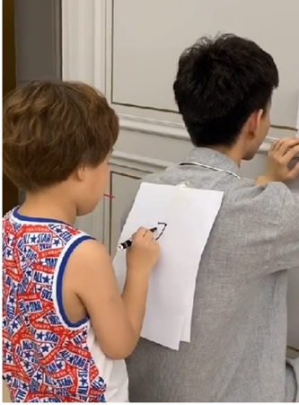
Backwards Greetings
Notes:
To Know: Icebreaker for face-to-face trainings
To Do: Trainers should model the process of Backward Greetings and how to select one letter to tell something personal or professional as an introduction.
To Say: Ask participants to get a sheet of paper and pencil or marker with cap on. In a few minutes, you will take your paper and writing tool and find a partner. Don't speak to your partner. Using your fingers, show how many letters are in your first name. The partner with the most letters in their first name will be the writer. The other partner will stand with their back to the writer. The writer places the sheet of paper on their partners back and using the eraser end or capped end of a marker writes their first name. You want to “print” slowly and with large lettering one letter at a time. Wait until your partner accurately prints that letter on a piece paper for you to check accuracy. Once the person accurately prints your name, you will switch rolls and repeat the process. Only after each person has deciphered their partners name can the partners greet each other verbally. Selecting one letter from your name which can represent something personal or professional about you.
Are there any directions that need clarifying?
You may begin.

Slide 8
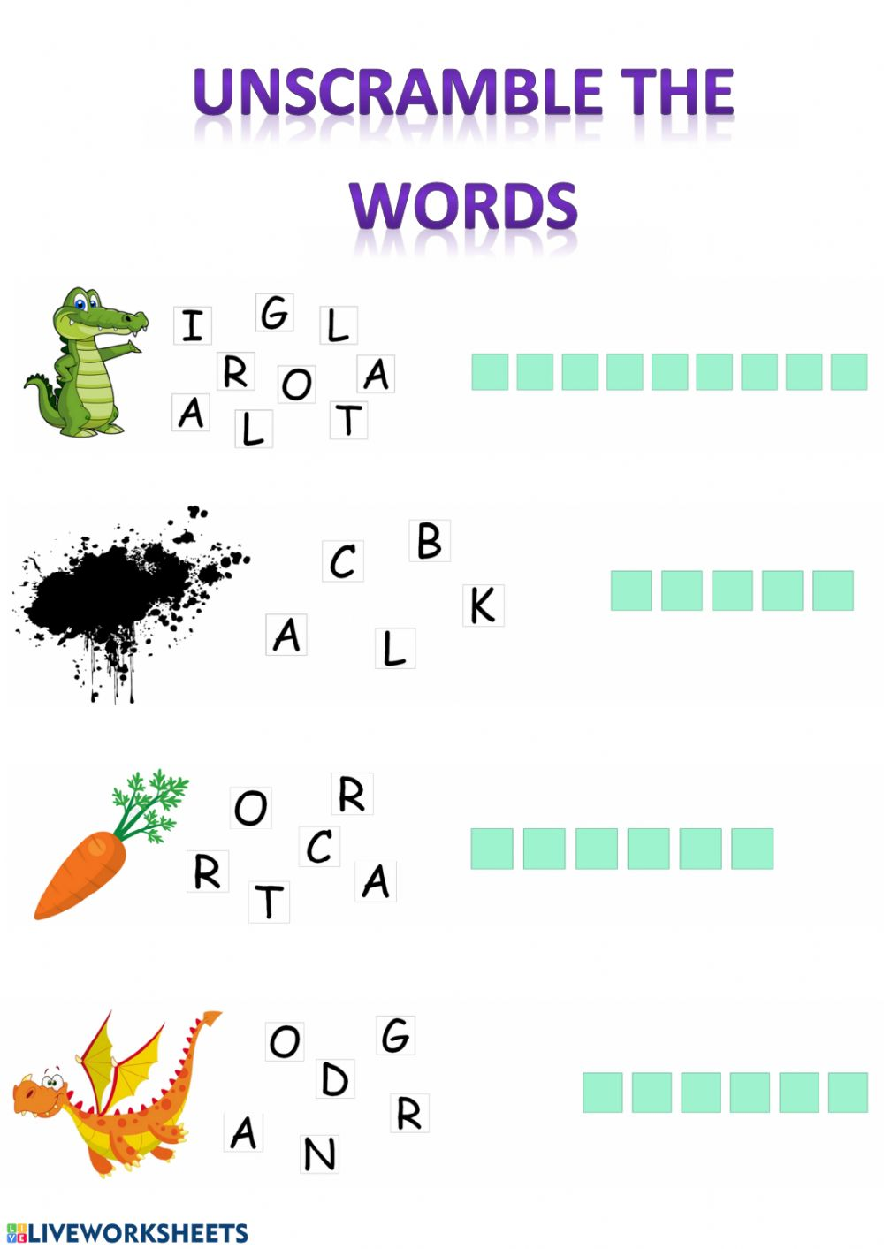
Notes:
To Know: Icebreaker for virtual training. A picture for each answer will appear on the forward click (four clicks to reveal all the answers).
The answers are
Alligator
Black
Carrot
Dragon
To Do and Say: Ask participants to see how many of these words they can decipher in two minutes. These words are not related to our literacy modules. They are kid-friendly words we might find in their elementary reading.
Write your answers on a piece of paper and then at the end of two minutes we will check your answers (participants may unmute to respond or put answer in chat).
Thank you for your participation.

Slide 9


How Do You Define Writing?
The activity or skill of making coherent words on paper
or
the activity of composing text for publication
Notes:
To Know: Smaller print and pictures will appear on click.
To Do: Ask the question and then allow time for participants to write a response.
To Say: How do you define writing? Take two minutes to write a response.
(After revealing “the activity” statements; clarify, for our purpose at this time, the term “publication” as referring to the multiple steps of the writing process: brainstorming, proofreading, revising, editing, final draft, and publishing that students go through when producing a written piece, usually for a grade.
Ask participants to show which definition aligns closest to what they wrote down:
Hold up one finger if their definition aligns closest with the first statement.
Hold up two fingers if their definition aligns closest with the second statement.
Hold up three fingers if their definition is a mix of the first and second statement.
Hold up four fingers if there is no comparison between your definition and the ones on the screen.
Thank you for sharing your definition of writing. Today we are going to look at writing from it's skill development in making letters and words on paper up to composing personal ideas which could lead to publishing or going through all the steps in the writing process to share in a revised form.

Slide 10
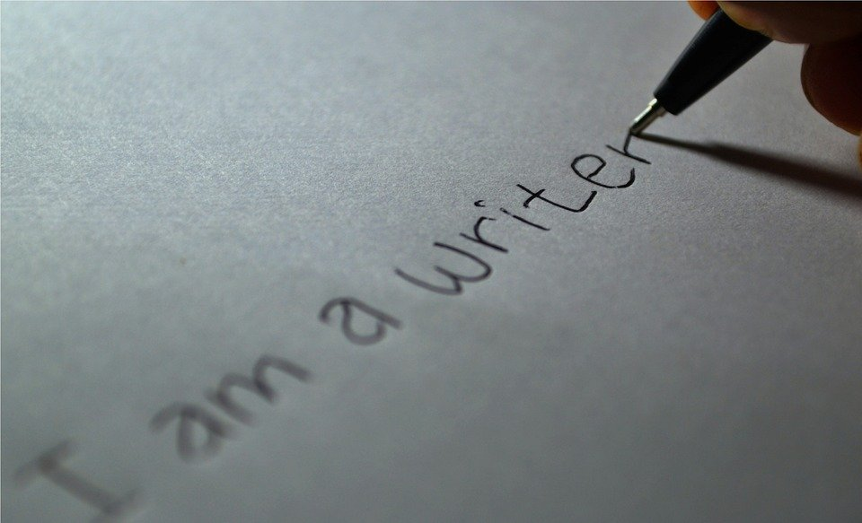
Foundational Skills Versus Compositional Skills
Notes:
To Know: This is a transition slide.

Slide 11
Children’s writing is reflective of the way they talk and speak. It is also a reflection of their confidence in putting words on paper which is motivated and inspired by other writers and readers.
Notes:
To Know: This statement is a compilation of research. (No single author)
To Do: Read the slide.
To Say: Read the slide with me.
Writing is a process which results in a product of varying abilities with language. The act of putting thoughts on paper in your own words is harder than reading the words written by others. Take a moment to consider this thought.
Children will start writing using the words they speak; yet it can become labored when they cannot spell what they want to write or have the perseverance/ability/skill level to write what they have to say. Children have many stories to tell and share.
One of the tasks we will not have time to indulge in today will be how you inspire and motivate writing. Our journey will move through the skills necessary to become a writer. However, there is so much more to learn for young authors; the way they persevere, express their thoughts, and how we show value to their voice.
The time you spend today will help you examine what skills might not have been addressed in the student learning and development.

Slide 12

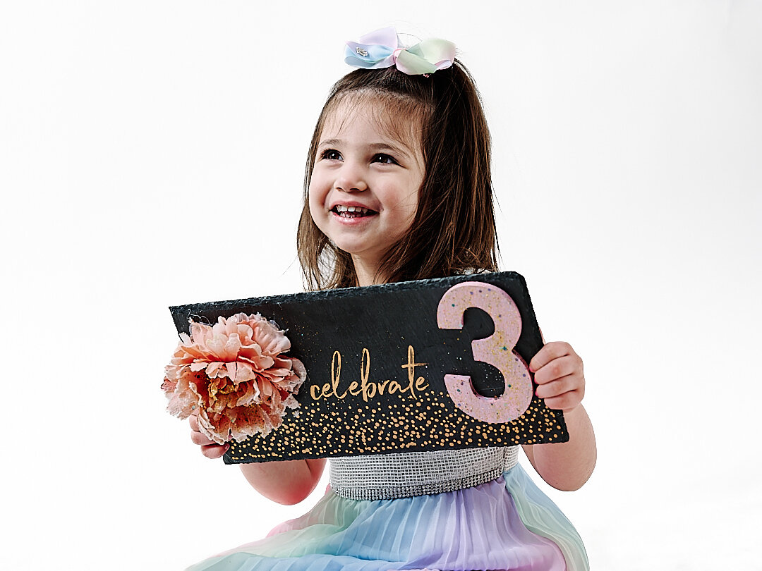
Developing Print Awareness
One-to-Three-Year-Olds
Learn how to handle books and turn pages
Attend to books for short periods of time
Begin to recognize some shapes, logos, and containers of favorite food familiar in their environment
Recognize and name a few letters
Notes:
To Know: Sourced from Reading Rockets website.
To Do: Allow time for participants to read the slide.
To Say: Let us start at the beginning with print awareness. Print awareness develops as adults modeling the various aspects of reading: read from the top to the bottom, moving left to right, touching the words as they are read, pointing to an object while naming it (example: ball, duck, truck), all of which deliver the message that print carries meaning.
You may be familiar with the quote by Emily Buchwald, “Children are made readers on the laps of their parents.” That statement encompasses both the modeling of reading as well as the positive emotions associated with being reading to by parents, grandparents, or loved ones.
This is also true with regards to writing. Understanding that print has meaning begins before children ever come to school. It begins with the skills listed on the slide. Pause for participants to read the slide.

Slide 13



Developing Print Awareness
Three-to-Four-Year-Olds
Recognize signs and logos
Understand that print is read
Begin to learn about the letters of the alphabet
Recognize beginning letters in familiar
words
Attempt to read and write
Notes:
To Know: Sourced from Reading Rockets website.
To Do: Allow time for participants to read the slide.
To Say: Take a moment to consider the growth of meaning through print.
As stories are read to children, they begin to see that print has meaning. They associate this print with places that are familiar to them such as the golden arches for McDonalds or logos for a specific candy. Gradually, children begin to find their own names or names of those in their family. They also begin to recognize colors or letters in print they can read or in books read to them.
What are some common things young children quickly begin to associate with print? (Pepsi, Skittles, M & M, Coke, Fruit Loops, Popsicles, etc.)

Slide 14

Developing Print Awareness
Four-to-Five-Year-Olds
Understand that writing is used to convey messages
Know that print has specific letter formation and symbol structure
Recognize and read some words
Recognize, name, and write many alphabet letters
Relate letters to specific sounds-especially letters
that relate to words that are important to that child
Attempt to write simple words
Notes:
To Know: Sourced from Reading Rockets website
To Do: Allow time for participants to read the slide and pause for some discussion or whole group sharing after posing the questions about development issues.
To Say: These are standards for students in kindergarten; and could be the first formal print awareness instruction for some students.
Writing is intertwined with sound, print formation, recognition and an understanding of what print conveys. Writing was created as a way to communicate without verbally. It is not natural. We were not wired to read or write. Rather we were wired to orally communicate.
Today, the hope is that this training will validate some things you are doing to support these students and provide ideas to consider for stronger development.
Take a moment to share with your partners your thoughts on the print awareness that develops during this age compared to this list.
What are ways these skills are developed or how do we expose these skills to young children?
What is common from your experience?

Slide 15

Foundational Skills
Letter formation
Handwriting
Spelling
Punctuation
Word/sentence spatial organization
Keyboarding fluency
Notes:
To Know and To Say: Writing is based on the foundational skills needed to produce symbols that represent sounds through letters in words. It requires a process and ability tied to handwriting then gradually transfer to putting letters in print with keyboarding. There have been many conversations about how the "act" of writing imprints words within the brain.
It was evident there was a difference in programs which built words with letter tiles only versus the programs that practice making and building words through writing. Writing the letters to make and build words imprinted the spelling side of phonics application. Building with letter tiles and writing are needed to connect this relationship.
The inter-relationship of writing with reading and spelling connects our language from oral to written.
Stanislas brain research even revealed that no matter the language, brain activation patterns and locations were all wired the same as literary developed.
As teachers, these foundational skills are the anchor that must be developed prior to deepening the compositional skills.
Letter formation, space between words and spelling of the student's vocabulary must become automatic so the generation of ideas on paper can be free flowing in order to develop compositions.

Slide 16
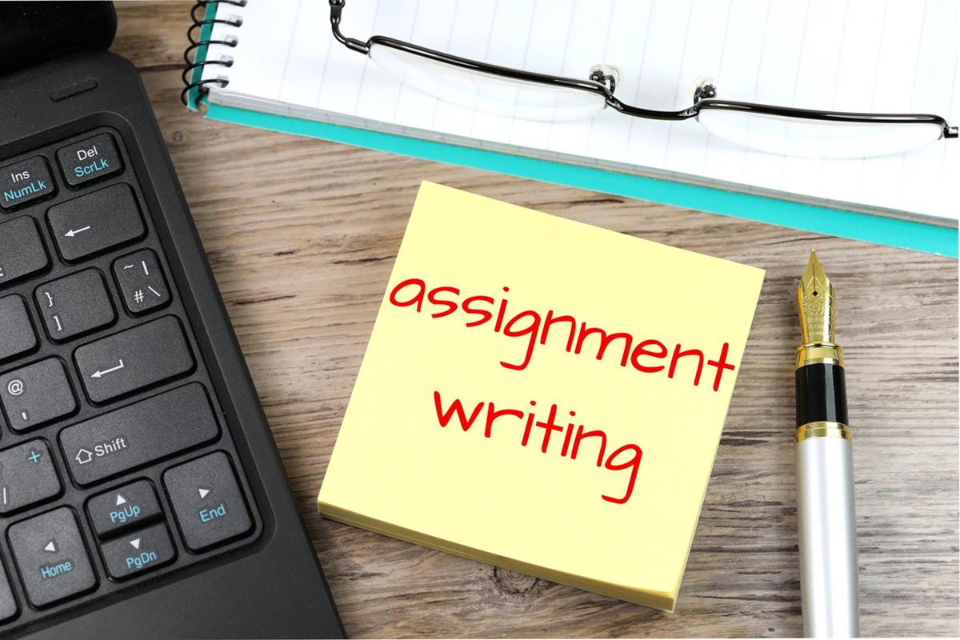
Handwriting and Letter Formation
Explicitly teach students how to form letters
Be consistent with the type of writing paper until the student is proficient with letter formation
Practice for fluency
Reinforce your expectations for their handwriting all day long
Notes:
To Know: Expectations and explicit instruction are the anchors to quality handwriting at each grade level.
To Say: Explicitly teach - Handwriting is important. Teachers in a building/same grade should use the same handwriting terms with students. Additionally, using the same types of handwriting paper helps promote fluency.
Be consistent - Using various types of paper distracts from fluency because the student's attention is divided adjusting to lines, size, and positioning shifting the focus to paper rather than the letters. Be aware of when students are ready to use the "cute" paper without the guiding lines for proper formation and spacing.
Practice Fluency - Fluency is important so students can clear their cognitive desk space when it's time to write and think about what they are going to be writing. To practice fluency, give students a set amount of time to write the alphabet, and slowly decrease the amount of time students have to complete the task.
Reinforce your expectations all day - Student may write beautifully during the designated handwriting time and then their writing might be unreadable during math or when writing their name on a paper. Students should be expected to perform quality handwriting throughout the day across all content areas. This must be reinforced from day one. Students must practice their very best handwriting and letter formation at all times.
If our goal is to help students become proficient writers, we cannot neglect handwriting instruction.

Slide 17
In Reference to Handwriting
What you accept is acceptable in the eyes of the child.
Notes:
To Know: What you expect becomes the standard.
To Say: What does this mean to you? Pause for participants to respond to each other.

Slide 18

Ehri's Phases
HO. # 2
Pre-Alphabetic
Early Alphabetic
Later Alphabetic
Consolidated Alphabetic
Notes:
To Know: Phases of Reading and Writing Development published by Paulson and Moats 2018 linked Ehri's Phases of Reading Development with writing.
To Do and To Say: Linnea Ehri (1996 and 2014) conceptualized reading into four phases: pre-alphabetic, early alphabetic, later alphabetic, and consolidated alphabetic. Each stage illustrates how word-reading develops for typical children between the ages of four and six. In 2018, Paulson and Moats linked Ehri's phases to the writing skill development (Sturm, Cali, Nelson, & Staskowski, 2012) which allows us to consider what we need to address for instruction as we examine student writing.
Let's use Handout #2, Application to Ehri's Phases, as our Note Catcher for Writing Development. Jot notes regarding each phase below the title of that phase.
More to Know:
https://www.voyagersopris.com/blog/edview360/2020/01/09/the-write-stuff-for-young-writers-the-picture-story-word-story-strategy

Slide 19
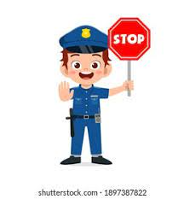

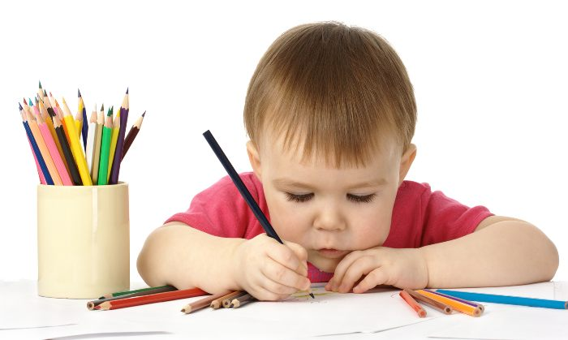
Ehri's Pre-Alphabetic Phase
The writer
Knows that print carries meaning and wants to communicate a thought/idea.
Forms visual attributes of letters and words.
Has little or no letter to sound relationship when a recognizable letter is formed.
Notes:
To Know: This is the first phase of writing development.
To Do: Ensure you provide time for participants to take notes on Handout #2 as you discuss.
To Say: In the Pre-Alphabetic stage, the writer knows that print carries meaning and wants to communicate by putting thoughts and ideas on paper. Those thoughts might be represented by marks filling up space on a page, some shapes and drawings represent letters they have seen frequently, or are part of their first name.
The alphabetic principle - predictable relationships between written letters and spoken sounds - may not be understood, but they are trying to tell you something on paper. At this stage, letters are not clearly formed and it can be hard to see the difference between letters, shapes or scribbles. Children will tell you the message/idea their scribbles represent; but that message/idea can sometimes change over a period of a few minutes or days.
Regardless of what the child “reads” from the page, it is clear that there is an idea on the page. Those ideas are formed from the read-alouds and the expressive language of the child. This normally develops between the ages of two-and-five-years-old.

Slide 20
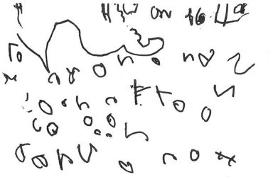
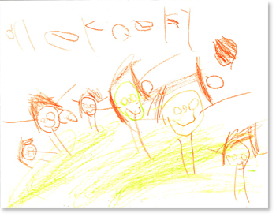
Pre-Alphabetic Phase
Notes:
To Know: These are actual examples of the Pre-Alphabetic phase. The green outlined box is an example found on the Reading Rockets website.
To Do: Allow participants 20-30 seconds to make a few comments to the group or teams about what they notice.
To Say: These are examples of what Pre-Alphabetic writing can look like.
What are some features you notice? Pause to allow time for participants to briefly comment
This is the stage where children continue to develop fine motor skills for strength and stamina. Children in this stage love to mark on paper trying to mimic adults. They like to show and tell others about their “writing”. You will notice that writing is random. Some scribbles resemble shapes and some letters.
There will be some variance within the same phase with some left-to-right features or just mixed random placement, with the student even rotating the paper as they mark on it. Pictures and shapes are mixed together.
During this stage, focus instruction on conversations with the child to develop vocabulary and language through stories. In these conversations children start to make connections between letters and sounds. Children will begin to identify the first letter of their names and match upper with lowercase letters for naming and ordering letters.
Many researchers felt it was important for children at this stage to use lowercase letters for writing. (Paulson, Moats and Tolman)

Slide 21

Engaging Activities
ABC
Hang your tails on down, down
Hang your tails on down
Some letters are short,
Some letters are tall
and some hang their tails on down, down!
Coloring
Tracing
Rainbow Letters
Notes:
To Know: The experience with writing at this level is to maintain the joy and fun of using symbols to represent our thoughts. There is a video inserted within the folder to learn the tune for, “Hang Your Tails on Down”. Please DO NOT show the video. Use the video to LEARN the tune.
To Do and Say: On the Steps of Handout #2, list these three ideas. Some fun activities for this phase include:
Coloring increases finger strength with guidance in using finger motion with the crayon instead of whole arm movement.
Notice the difference in the finger strength needed for finger motion instead of arm motion.
Trace Race: Students "drive" their crayon or colored pencils to trace along lines to practice writing letters and numbers. By following the arrows to help them form letters or numbers, students are trying to drive on a race track without going off.
Rainbow Letters: Students need five different crayons or colored pencils. With teacher support, students write a letter then use the other four colors, one at a time, tracing over the top of the previous color on the letter they made.
ABC: Hang Your Tails: As you point to each letter of the alphabet, say the letter names. Use your body and hand position to represent the letter placement within the writing lines.
Stand up. Place both hands in front of you with your palms facing away from you. Hold the hands straight in front of you to represent letters that fall between the baseline and midline.
Hold above head for tall letters.
Place your hands on your knees and squat down for letters that have tails that hang DOWN below the baseline,
Singing Hang Your Tails on Down. (Watch the video to get the tune)
Hang your tails on down, down.
Hang your tails on down.
Some letters are short,
Some letters are tall,
And some hang their tails on down, down.
______________________________________________________
Background: Lined paper for handwriting has three lines. For our purposes today: the bottom line is called the baseline. The midline is the dotted line of the three lines and the upper line is called the topline.
___________________________________
__ __ __
___________________________________
To begin, place your hands in front of you facing outward to represent where the letters are located in relation to the baseline. Letters that fall between the baseline and midline are shown by holding hands in front of you at hip level. Tall letters are represented by your hands reaching above your head. You will place your hands on your knees and squat a little to hang your "tail" below the line for letters that fall below the baseline.
a, b, c, d, e, f, g? (Sing the song) then continue letters and hold hands to represent the space in which the letters are made, such as baseline to midline or baseline to topline.
h, i, j? (Sing: Hang your tails on down, down, etc.)
k, l, m, n, o, p? (Hang your tails on down, down, etc.)
q? (sing again)
r, s, t, u, v, w, x, y? (sing again)
z

Slide 22


Early Alphabetic Phase
The writer
Shows partial connections between some letters to sounds.
Uses first, and sometimes last, sound to represent the whole word.
Might use the letter’s name to represent the word. C=see
Notes:
To Know: Early Alphabetic characteristics also link reading and writing.
To Do and To Say: (Pause for participants to make notes about this phase)
In Early Alphabetic phase the writers
Show partial connections between some letters and sounds particularly initial and final sounds in words.
Uses first and sometimes last sounds to represent the whole word: such as deleting or omitting vowels when writing a word.
They may just use one letter to represent a word: C = see or Y for why.
As these writers develop more fully in this phase, you will see them begin to distinguish the difference between drawing and writing. They also begin to write from left-to- right and top-to-bottom.
Our instructional time is still devoted to developing the language of these writers with modeling retells and summarizing read-alouds.
Student practice during this time is also spent on strengthening the muscles for control in printing quality letter formation, as well as, blending phoneme-grapheme correspondence for spelling words.
This phase is normally developed in children ages four-to-six-years-old. Students may still be in this phase in first grade or later for any student who has a delayed or lower cognitive ability.

Slide 23
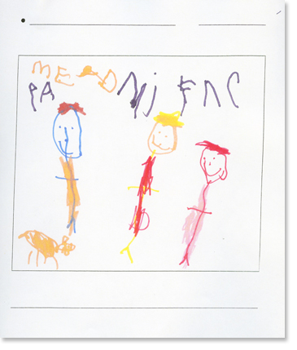
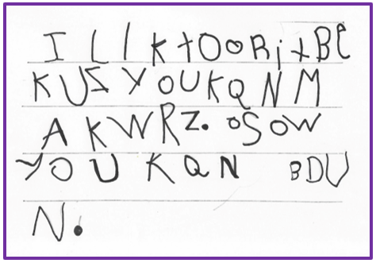
Early Alphabetic Phase
Notes:
To Know: These are actual examples of the Early Alphabetic phase. Green outlined box is an example found on the Reading Rockets website. (Kindergarten: Sample 2 on Reading Rockets site)
** Picture on the second sample was removed so that the print could be seen well.
To Do and To Say: The writing on the left says: “Me and my friends are playing.”
What do you notice here? What do you see as characteristics of the Early Alphabetic Phase?
Answers may include
Some letters are just random, but you do see a difference in whether the student was drawing a picture or writing.
Letters are below or above the picture so the writer knows the difference between writing and drawing for communication.
Some letters are just copied showing the student can make them.
The writing on the right says: “I like to write because you can make words. Also, you can be done.”
What do you notice about this writing in relationship to Early Alphabetic?
Answers might include
Student writes more consistently from left to right.
Showing connections between letters and sounds.
The words have first and last sounds represented in several words.
The letter "b" represents the word "be".
Words" does not have a vowel.

Slide 24
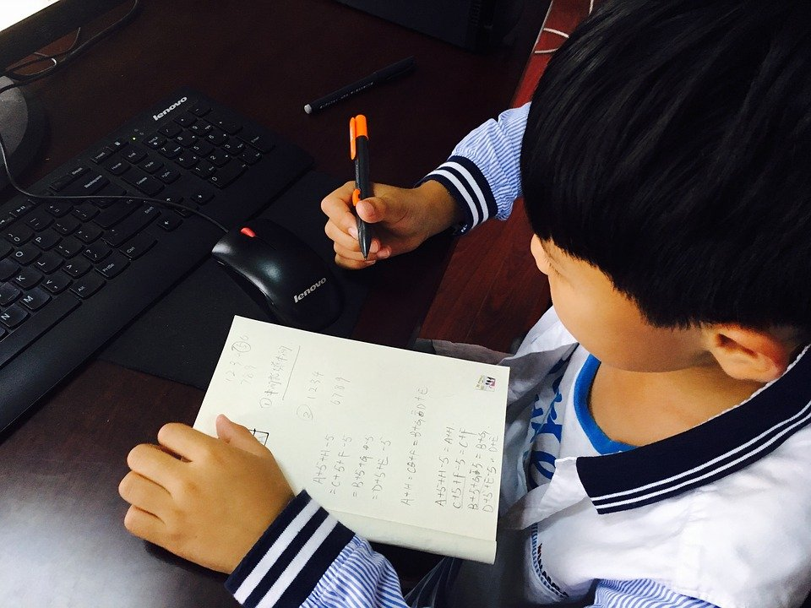
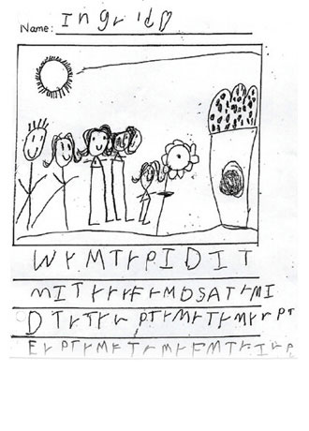
Intentional Practice
Back Art. What Am I?
Picture-N-Story
Notes:
To Know: These are ways to increase skill development to move students out of the Early Alphabetic Phase.
To Do and To Say: Here are a few ideas to list on the stair steps of our Handout #2 which can help move a student's skill development out of Early Alphabetic Phase.
Back Art or Back Writing: This is much like the icebreaker you did this morning. Have partners practice writing a vocabulary word on each others back.
Students are in pairs writing one letter at a time on a partners back.
Partner can state or write on paper what they think was “written on their back”.
Picture-N-Story:
This is a powerful way to develop writers as they begin to tell their stories of life yet have limited ability to “write or spell” what they have or want to say. Students are given paper which allows for a picture in the top and lines below for students to write their thoughts and ideas.

Slide 25

Later Alphabetic Phase
The writer’s
Compositions uses fairly complete and reasonable phonetic spelling of simple words.
Work reflects the way they talk.
/s/ s | /t/ t | /o/ o | /p/ p
Notes:
To Know: This is the next to the last phase.
To Do: Direct attention to their Handout #2 for the next phase.
To Say: Students in Later Alphabetic Phase apply what they have learned about phonic and letter sequences in common words therefore phonetic spelling is evident in everything they write. Sentences they write will sound just like their speech.
This is the phase where a student's reading level and writing or spelling ability begin to differ. When reading a word, ability progresses from grapheme to phoneme to morpheme. In other words, students look at a letter, or letter patterns, blending those sounds to form a morpheme.
However, when we spell a word, we progress from phoneme- morpheme- grapheme; making writing more complex than reading.
Consider a beginning first-grader whose writing is very difficult to understand because the words they print are run together and are incorrectly spelled. This student might benefit from an initial focus on putting spaces between words, learning to spell a small set of common irregular words, and improving phonetic spelling.
When those skills have been learned, instruction would move on to the next set of skills that would benefit the student's writing the most. Those would include skills such as more descriptive words, ending punctuation and increasing writing fluency in number of words easily written by a student.
Later Alphabetic Phase normally develops in grades K-1. But for some students, this is the phase they are still functioning in later grades due to the need for more explicit instruction in phonics patterns and/or morphological instruction.

Slide 26
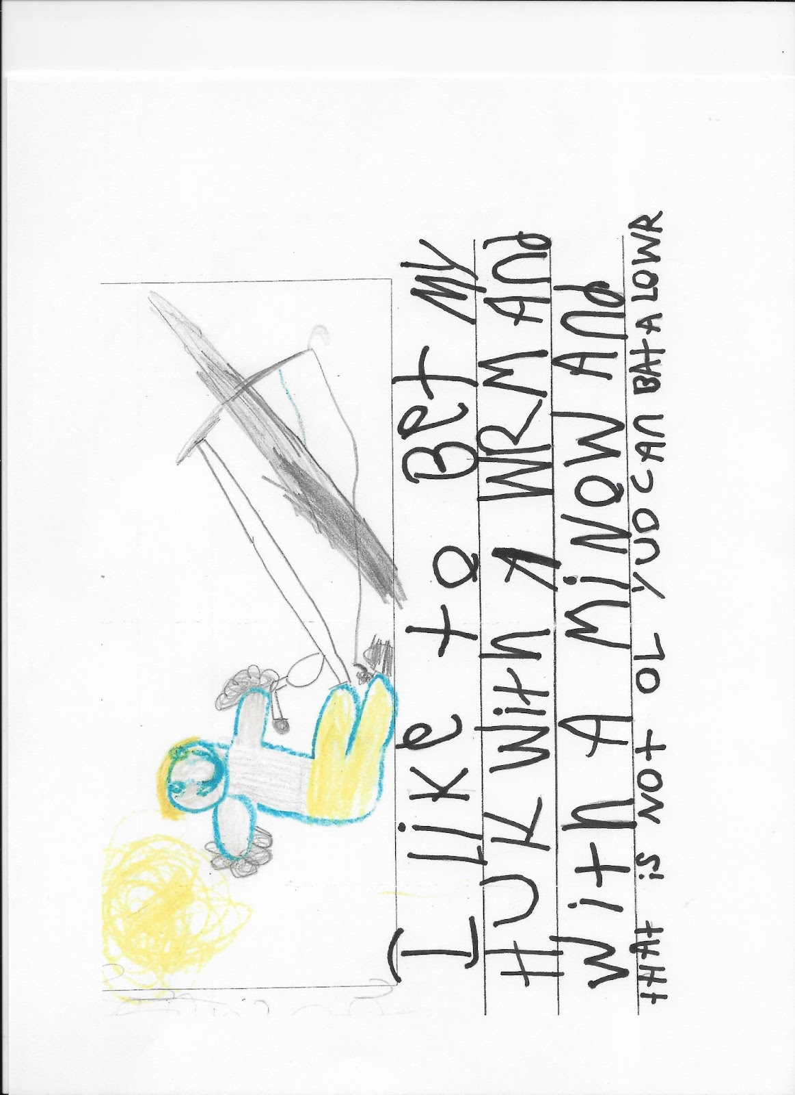
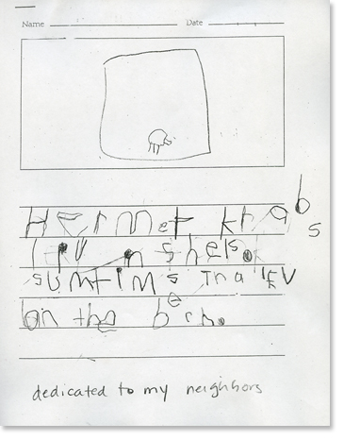
Later Alphabetic Phase
Notes:
To Know: These are actual examples of the Later Alphabetic Phase. Green outlined box is an example found on the Reading Rockets website, “Kindergarten, Sample 4”, on Reading Rockets site.
To Do and To Say: Writing on the left says: “Hermit crabs live in shells. Sometimes they live on the beach.”
Writing #2 on the right says: ”I like to bait my hook with a worm and with a minnow and that is not all you can bait a lure!”
What do you notice here? Pause for participants to respond.
What do you see as characteristics of the Later Alphabetic Phase? Pause for participants to respond. Example answers include
Reasonable, fairly complete phonetic spelling/writing
Spacing between words
They have not mastered all long vowel patterns or all irregular patterns
There are more expanded thoughts
Left to right directionality, top to bottom

Slide 27
Intentional Practice
Expanding Sentences - Sentence Frames
Who? | Did what?
Who? | Did what? | Where? When? How?
Notes:
To Know: This activity will take about four minutes; including the next slide.
To Say: On the "steps" of Handout #2, write the words, “Sentence Frames”.
Intentional instruction for students at this phase will include the connection of expanding and using Sentence Frames, which were first introduced in the comprehension section of these modules. Effective communication involves the ability to use language in complete sentences including all the different roles words play.
As students progress with knowledge, the vocabulary within sentences becomes more complex. The language used in every sentence answers specific questions concerning what is happening or is intended. When students begin to write more complex sentences, they need to be able to identify the "role" words play in sentences. (For example: "who becomes the subject", "did what indicates the verb", etc.)
Always remember the importance that this type of work has for increasing student writing and comprehension. The comprehension module introduced the use of Sentence Frames.
Sentence frames help students to understand the role words play in answering the who, what, where, when, and how.
The following slide will guide us to see what this looks like in practice for writing.

Slide 28
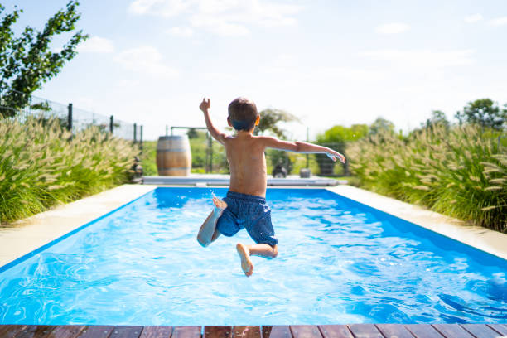
HO. # 3
I Do: Sentence Builders
Who? | Did what?
The boy
jumps
Where?
in the pool.
Notes:
To Know: Click forward to reveal the generated sentence under the appropriate portion of the sentence builder. This slide is to model the growth of sentence building.
To Do: Participants will also need Handout #3 to follow along as you model this activity.
To Say: Let's grow the development of sentences from intentional practice with pictures. As we look at this picture, we begin the development of simple sentences in the most basic form of the English Language using subject/verb.
Who? (click forward) The boy
Did what? (click forward) jumps
We could also go one more step as students are ready by adding more description of where, when or how.
Where? (Click forward) in the pool or in the water.

Slide 29
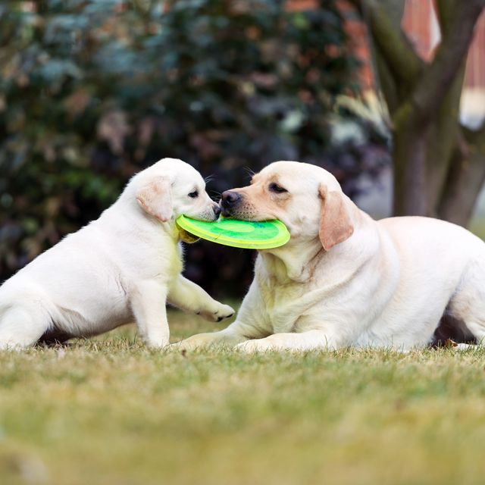
We Do
Who? | Doing/Did what? | Where?
The dogs
play
Notes:
To Know and To Do: Click forward to complete the chart with words to build the sentence from the picture as a group.
To Say: Let's do this one together on Handout #3.
As you look at the picture, who is doing something? (click forward) The dogs
What are they doing? (click forward) play
Where? (click forward) in the grass, in the yard, on the lawn

Slide 30
You Do
Who? Subject | Doing /Did what? Verb Predicate | Where? Adverb
Subject | Verb | Adverb | Adjective | Prepositional phrase
Notes:
To Know: Photo options to complete this writing are on next slide.
To Do: Continue using Handout #3 Sentence Frames.
To Say: Now for the “You Do” application. According to your grade/or content level, consider the terminology your students are able to manipulate. Use Handout #3 and select which labels or section of the handout is appropriate for your students.
We are going to show you two photo options on the next slide.
How might you build intentional sentence frames for your students? Pause to allow participants to respond.

Slide 31
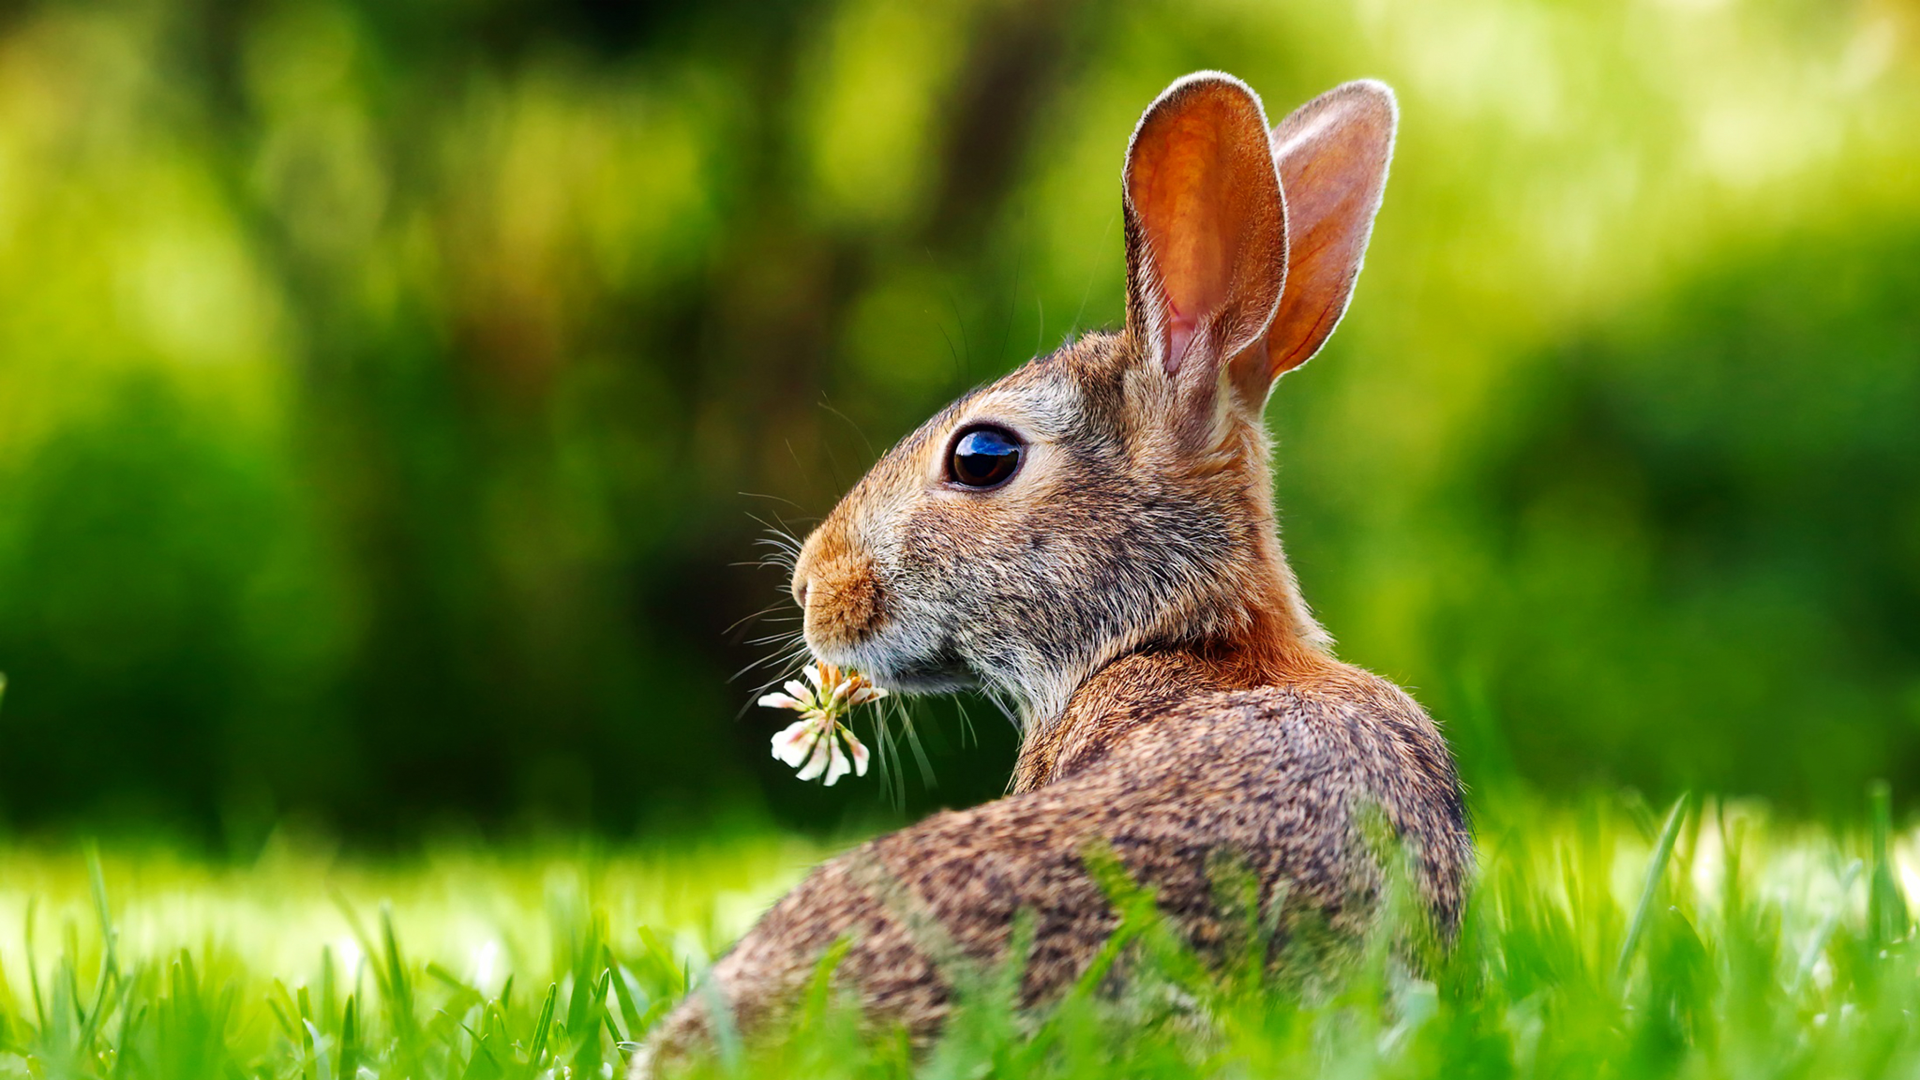
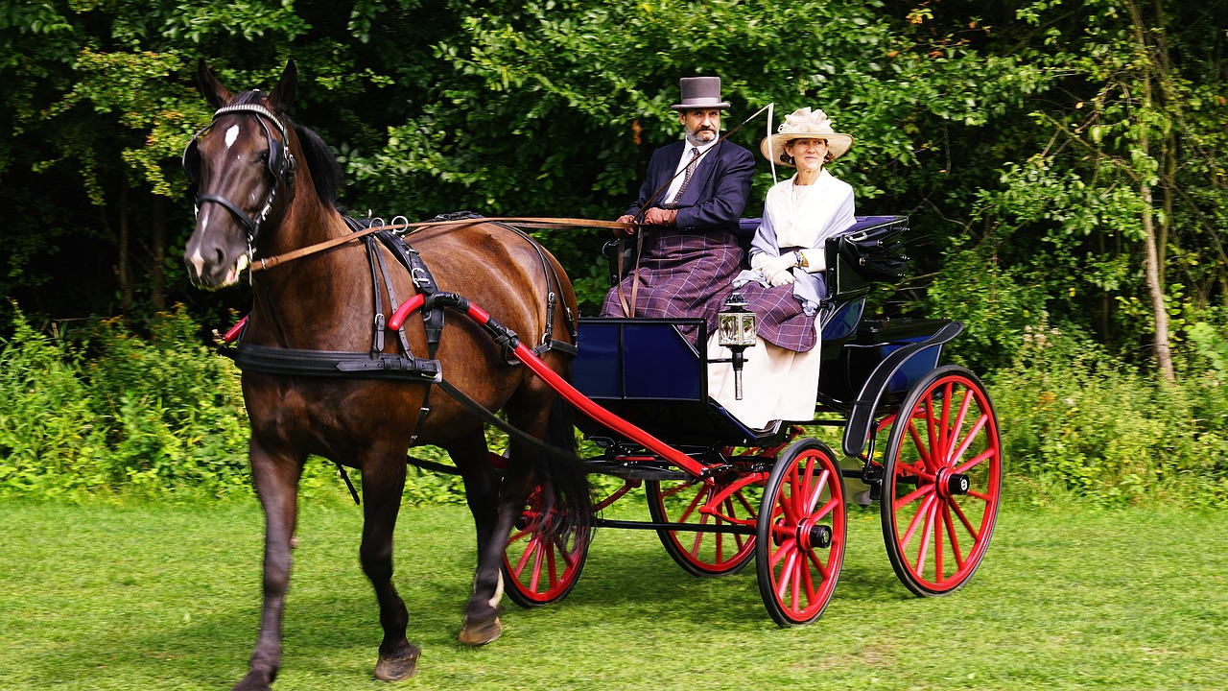
You Do
Notes:
To Know: Stress the underlined words to ensure participants understand the power is in the creation of sentences versus the ability to label and know grammar terms.
To Do: Pause for participants to develop their sentence on Handout #3 and then request they share with tables, teams, or the group.
To Say: Select one of the pictures above, using the terminology your students have mastered to complete the Sentence Builder.
Please share with your partners when everyone has completed the task.

Slide 32

Consolidated Alphabetic Phase
The writer
Composes readable compositions with capitals, end punctuation, and most words spelled correctly or phonetically.
Stop! I can feel the sled slowing and then stopping as I entered the ditch.
Needs continued word work with multisyllabic words and words with unusual spellings
Notes:
To Know: This is the fourth, and final phase. Participants will need Handout #2 to continue note taking.
To Do and To Say: The Consolidated Phase is the one on which foundational skills are well developed and students have more brain space to devote to the compositional skills of writing.
"Readable compositions” are found in this phase with students using complete sentences, capitalization, punctuation, and more correct spelling on a variety of words and forms of words.
These students are now reading and writing more complex sentences and multisyllabic words. Their ability to write multisyllabic words and unusual syllable patterns will need strengthening through direct and explicit instruction for reading and writing even beyond third grade.
Keep in mind that most students do not complete the transition into this stage with accurate and fluent writing until second or beyond. This phase is dependent on the growth and development of phonics skills.

Slide 33
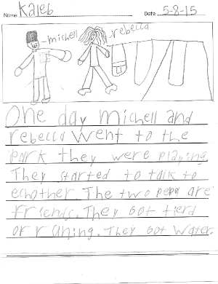
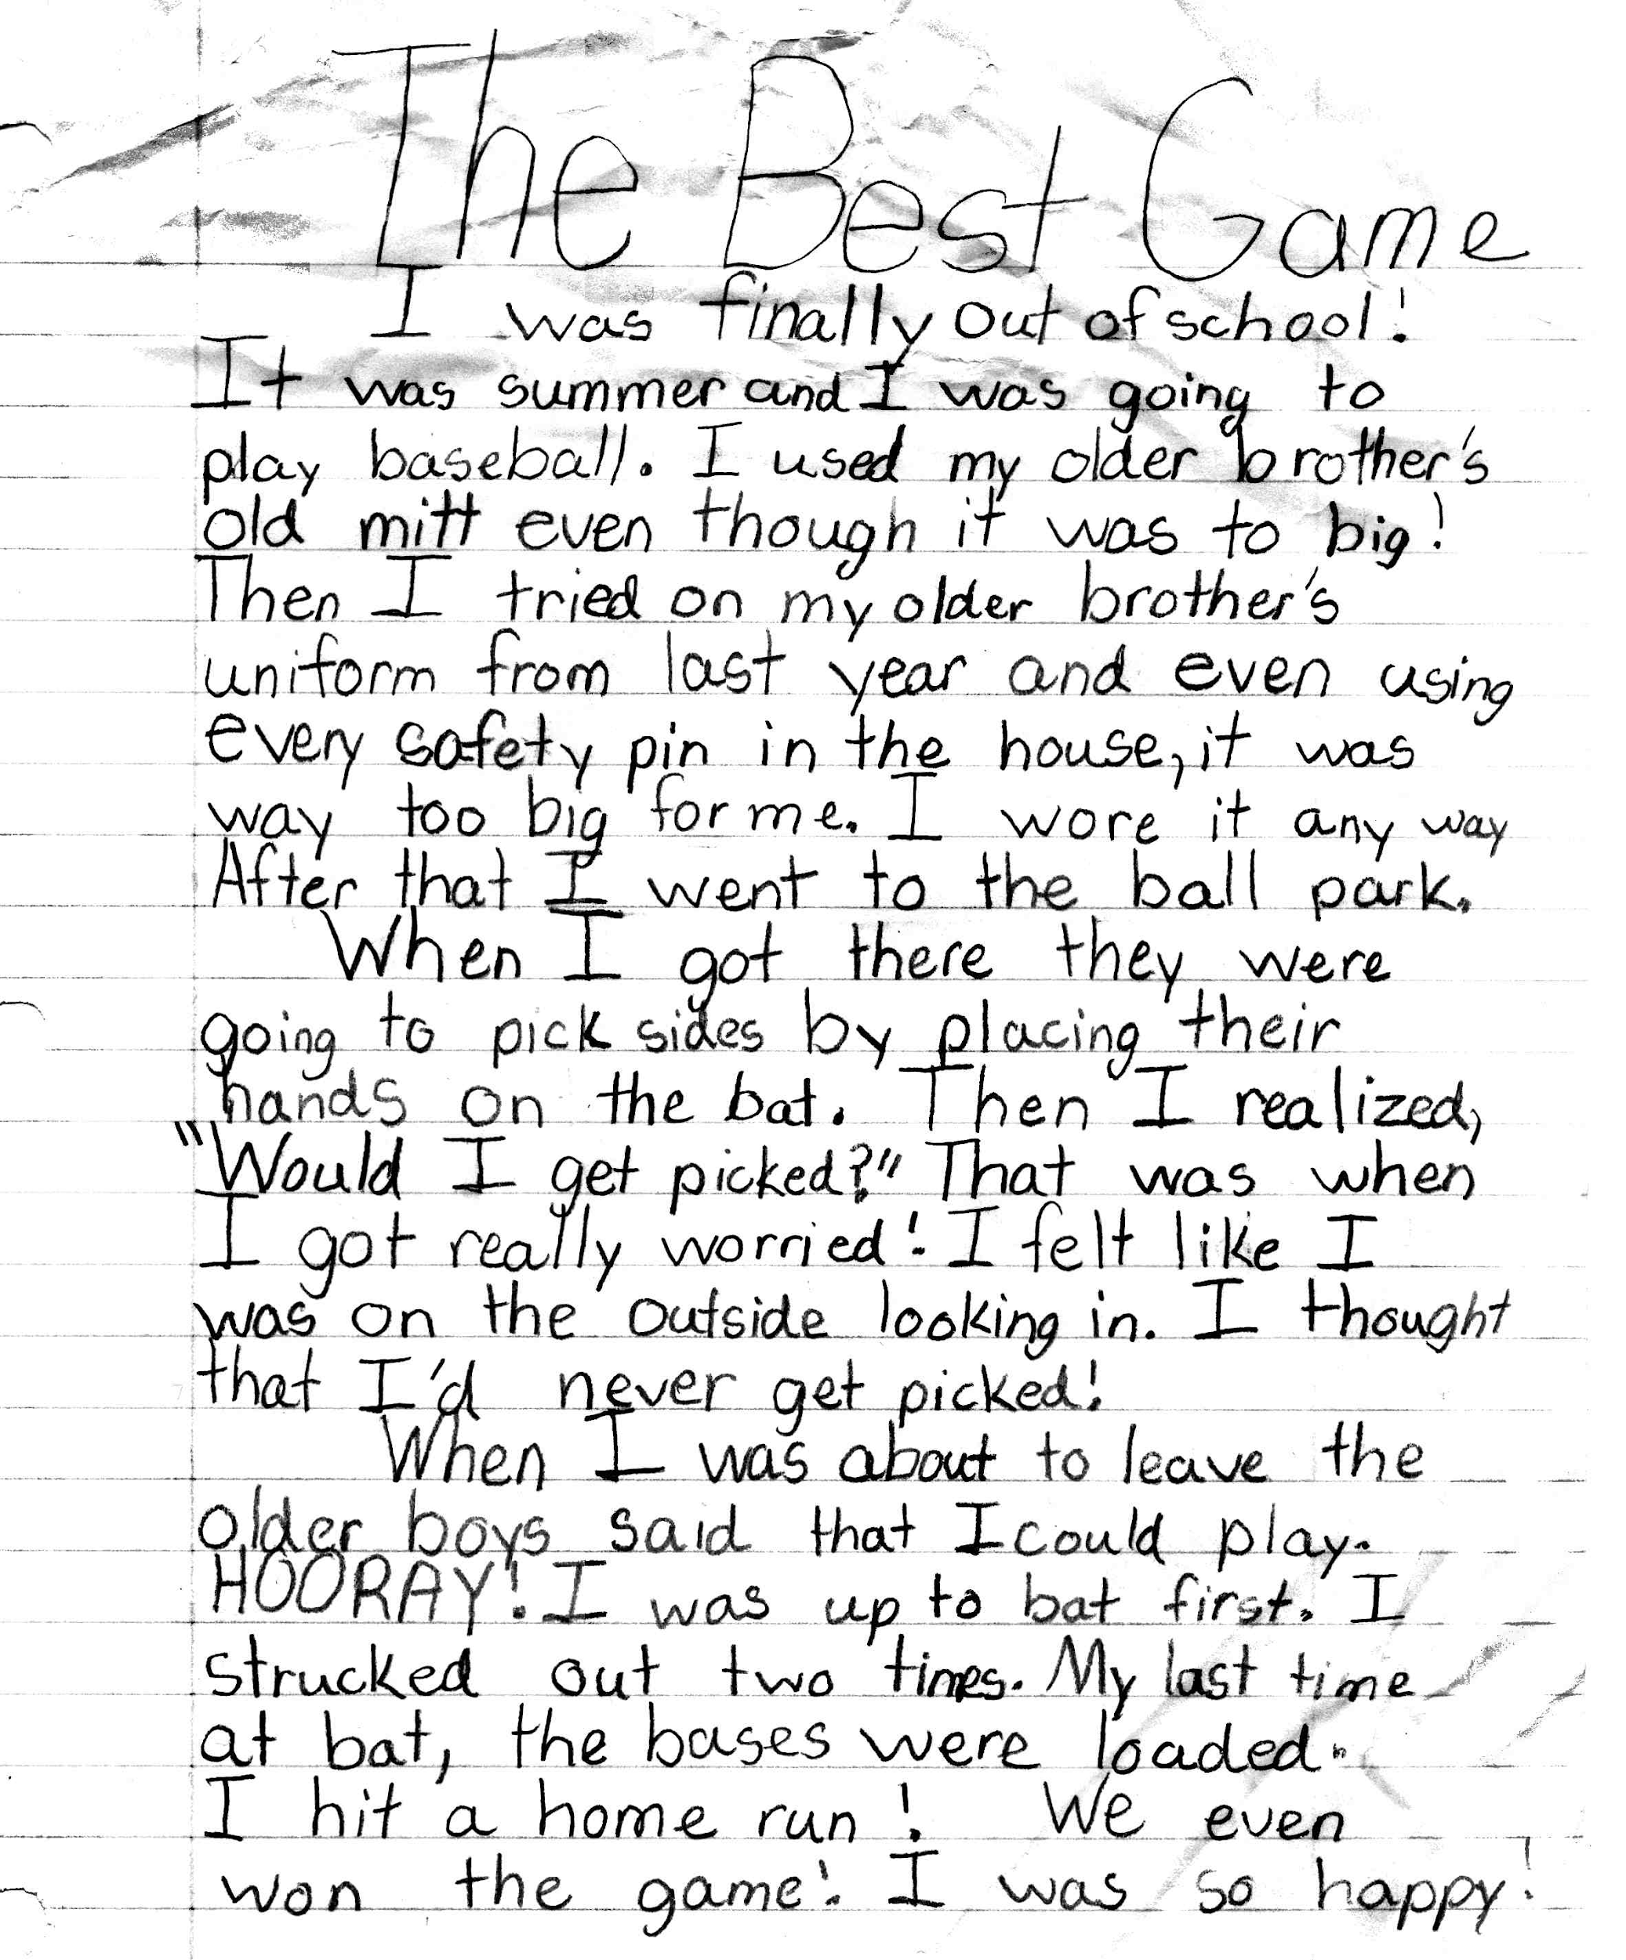
Consolidated Alphabetic Phase
Notes:
To Know: Children need exposure to a variety of well written genres for modeling, expanding vocabulary.
To Do and To Say: Here are examples of the consolidated alphabetic phase.
Writing #1: “One day Mitchell and Rebecca went to the park, they were playing. They started to talk to each other. The two people are friends. They both got tired of running. They got water.
Writing #2 - No transcription needed.
(Click forward)
What do you notice here? Pause for participants to respond.
What do you see as characteristics of the Consolidated Alphabetic Phase? Pause for participants to respond.
Example answers include
Complete sentences and more complex thoughts
Capitalization
Punctuation
More correct spelling on a variety of words and forms of words
Very few words are written phonetically
(Writing #2) You also begin to see the student use compositional skills including transition words, variety of sentence length, and types of sentences, as well as, paragraph variety

Slide 34
Summary Paragraph Frames
HO. #4
Chronological Summary Frame
____________has a specific order. At the beginning _______________.After that, _____________________. Then, ____________________. Next, _____________________. The, ____________ ended when ____________________.
Problem-Solution Summary Frame
The problem began when __________. The ___________ tried to __________. After that, ________________. Then, __________________ The problem was finally resolved when _____________.
Notes:
To Know: Participants will need Handout #4, “Powerful Thinking Frames for Summarization”.
To Say: Take a moment to read through the two different Summary Paragraph Frames. Pause for participants to read.
Intentional additions to increase a student's writing ability in this stage, begin with the use of “Summary/Paragraph Frames”. These frames provide the structure for beginning writers to focus on the important thoughts and ideas that need to be included in their writing. For these writers, the most common frames to begin with are ones that are strongly linked to the comprehension “process thinking” organizers that have been used in their reading.
Research has proven a strong correlation to comprehension and writing when students write in response to text they have read. The process starts with students taking notes on a graphic organizer as they read. Then, students are asked to use the information from their graphic organizer to complete a paragraph frame.
Teachers model this and scaffold the progression from the organizer to the written paragraph.
How many of you have used these types of Powerful Thinking Frames to support students thinking as they retell or summarize a story? Pause for participants to think and respond.

Slide 35
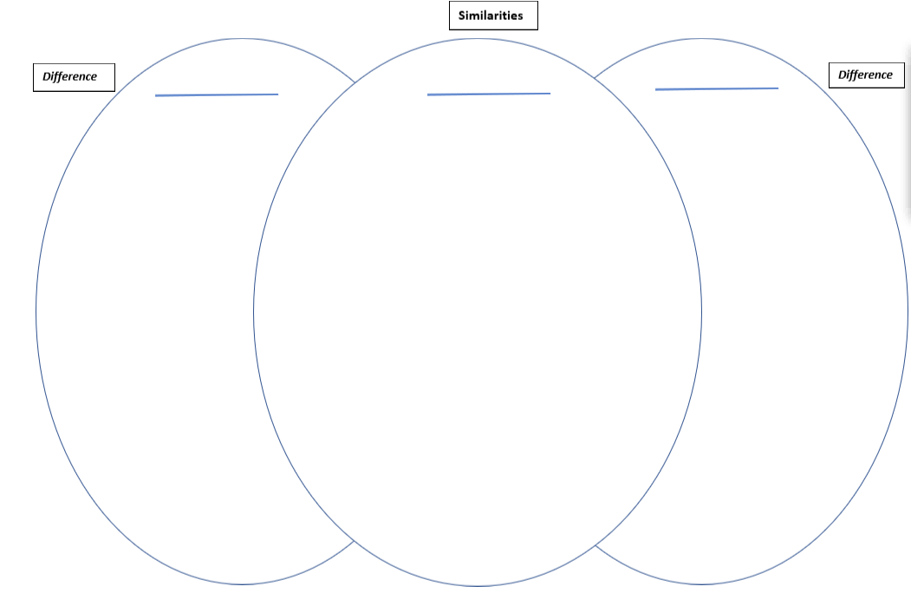
Compare and Contrast Development
HO #5
Compare-Contrast Summary Frame
______________ and _____________ are alike and are different in several ways. First, they are alike because __________ but they are different _________. Secondly, ______ is ________ while ________ is __________. Finally, both _____are alike because _______________. But, they are different because ___________.
Notes:
To Know: Participant will work in teams to develop a paragraph.
Resource #1 Variated Venn shows you, the facilitator, possible answers for filling in the Venn.
Once the Venn is completed, participants will select words from the Venn (Handout #5) to fill in the blanks on the Compare-Contrast Summary Frame (Handout #5a).
To Do: Provide Handout #5 Variated Venn and Handout #5a Compare-Contrast Summary Frame for participant to use with this slide. Once participants are finished, ask a few to share out. Remind participants to add Instructional Practices for this phase on steps of Handout #2.
To Say: Let's use these two pictures to complete the “process thinking” moving from an organizer into a paragraph form. Notice the pictures on the screen. (Pause for participants to look at the pictures.)
I see they both have water.
(Click for the Venn to appear on the slide.)
I would write “water” in the center of the Venn. Yet, the amount of water is different in each picture. One has a stream and the other has a large body of water. Write “stream” on the Forest side of the Venn and “large body of water” on the Wetland side of the Venn.
(Click for the Summary Paragraph Frame)
If I were finished noting all similarities and differences, I might begin my Summary Frame by saying “The Forest and Wetland are alike and different in several ways. First, they are alike because they both have water, but they are different because the Wetland has a large body of water instead of a stream.
(Click for Venn and Frame to disappear.)
Using these two pictures, fill in the Venn noting the similarities and differences between the two pictures and plan steps to complete a Summary Frame. Work with your team to walk through this together. Pause for participants to complete this task.
Upon completion of the task, ask teams to share out their paragraphs and how they could use this for their classroom. Allow time for participants to think and respond.
As students become fluent with using a graphic organizer or paragraph frame and show proof they can "think" and organize ideas and sentences in the way you explicitly taught, they will no longer need these protocols.
More to Know:
The MO LEAP blocks have examples of assessments and practice combining pictures, text, videos, and multiple resources for students to respond to in writing.
MO LEAP Blocks are integrated for each grade level according to priority standards see:
https://sites.google.com/view/priority-standards-mo-dese/home/english-language-arts/k-12-ela-supporting-resources?authuser=0

Slide 36
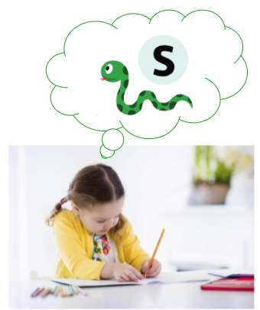
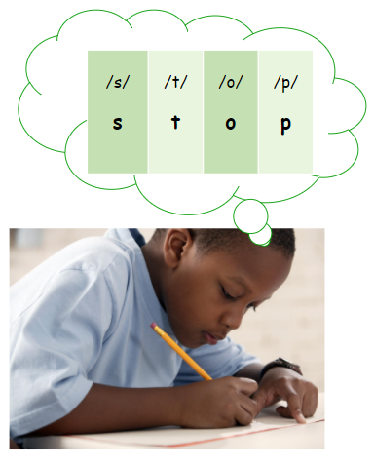
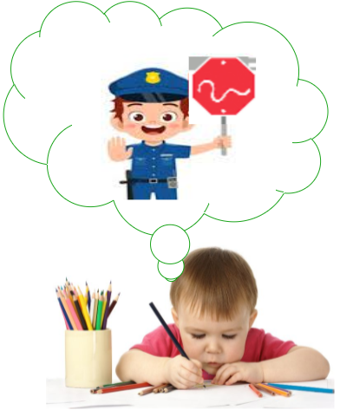
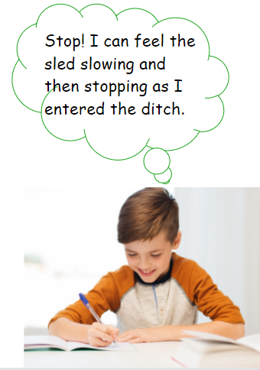
Review of Ehri's" Phases
Pre - Alphabetic
Early Alphabetic
Later Alphabetic
Consolidated Alphabetic
Notes:
To Know: Use this slide for a review of the learning.
To Do: Provide time for participants to discuss. (At least five to seven minutes), Do not rush good conversation.
To Say: Using Handout #2, Stand Up, Hand Up, and Pair Up with someone at least 10 steps away and review the learning.
What resonated with you about Ehri's four phases? Pause for participants to respond.
Which activities will you use to plan a lesson and develop more efficient writers? Pause for participants to respond.
Writing is developmental and there are students whose writing is not yet at Consolidated Alphabetic and that is the phase where students are fluent enough with foundational skills to work efficiently on compositional skills.

Slide 37

“Reading and writing cannot be separated.
Reading is breathing in; writing is breathing out.”
~ Pam Allyn
Notes:
To Know: This is the full quote. ”Reading is like breathing in and writing is like breathing out, and storytelling is what links both: it is the soul of literacy. The most powerful tool that we have to strengthen literacy is often the most underused and overlooked, and that is a child's own stories.” ~ Pam Allyn
To Do and To Say: Until a student has been repeatedly exposed to/heard and read a variety of well-written genres from which to model their written expression, they cannot be held accountable for composing and producing well written works. One cannot exhale if one has not first taken in a breath.
A student's writing allows insight into what is taking place in their head while they are reading. Reading and writing should not be viewed separately, but as a reflection of the other.

Slide 38
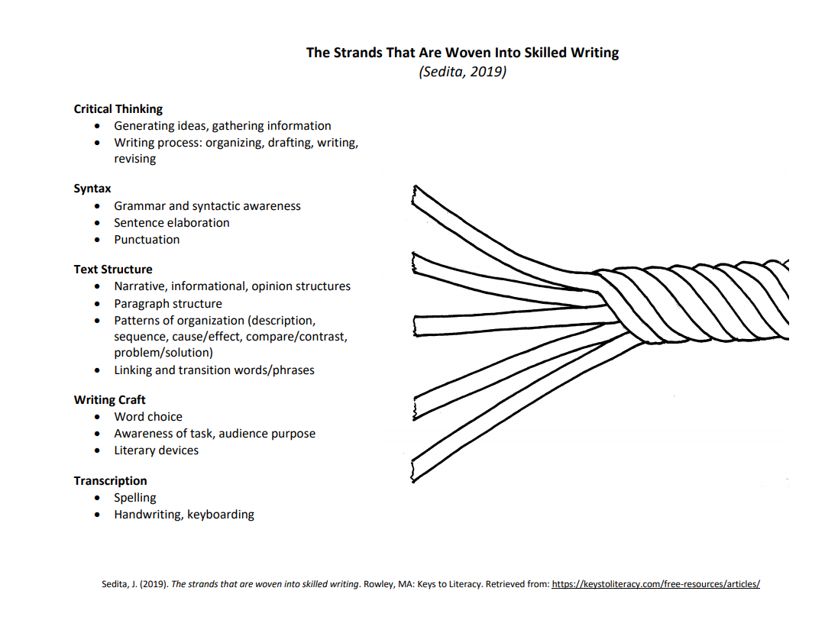
Notes:
To Know: Joan Sedita (2019) - keystoliteracy.com
To Say: This is the original work from Joan Sedita (2019) which outlines the strands woven into “Skilled Writing”.
Joan has multiple resources on keystoliteracy.com which you can reference upon completion of this training.
Let's take these skills and connect them to our learning today knowing what we have learned about Ehri's Phases.

Slide 39
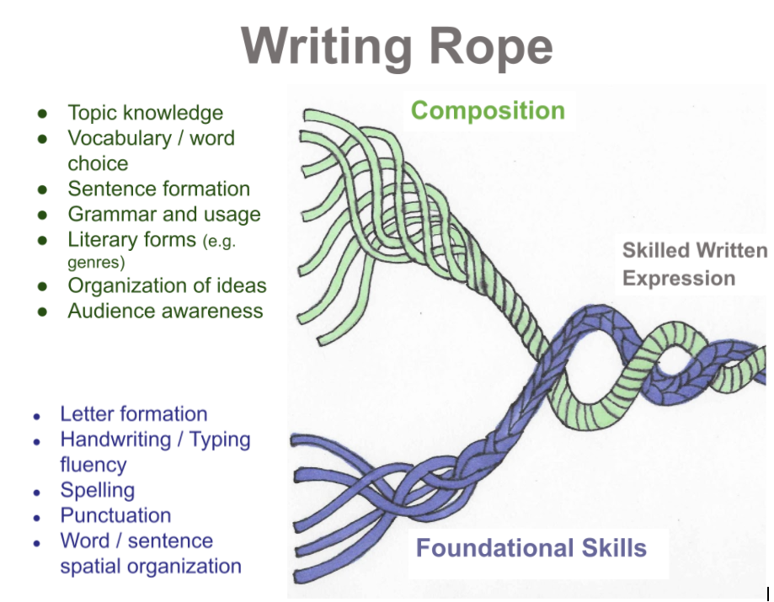
Notes:
To Know: The components of this are based off the work of Joan Sedita. However, she did not present it in this form. Click forward for a box to appear.
To Do: Allow time for participants to read through the slide.
To Say: This clearly demonstrates the various components needed to be a skilled writer.
(Click forward to show purple box) We have looked at the Foundational Skills.
(Click to show green box) Now let's take a closer look at the top part of this rope - composition. When students have moved into the Consolidated Alphabetic Phase they should have enough fluency to be able to focus on compositional skills. The key word is fluency. There is enough automaticity to be able to concentrate on the ideas the student wants to express without becoming labored in the foundational writing skills.

Slide 40

Effective Writers
Write daily
Fluent with handwriting, spelling, sentence construction, keyboarding and word processing
Use a writing routine
Express ideas with detail
Use feedback to edit writing for publication
Notes:
To Know and To Say: Compositional skill development produces effective writers. Teachers must provide time and explicit modeling, guided practice and feedback to support the growth in the areas listed here.
Turn and share at your tables how you support and develop effective writers everyday. Pause to give participants time.
Consider time, resources, and what works for you or what needs you have.

Slide 41
Writing Routine
State writing objective and outcome/project
Have clear goals: rubric, checklist
Provide scaffolding: model, examples, resources
Feedback and revision: peer collaboration, teacher
Notes:
To Know and To Say: Routines are what develops consistency and habits. Start with the “end” in mind.
Clear goals make targeted feedback and grading transparent. Therefore, select what the final outcome/project shall be considering what elements are needed for quality.
Design the rubric or checklist with clear, student-friendly statements.
In order to provide scaffolding towards the “end goal” teachers will move through the “I Do” for modeling or provide examples from student reading defining with clarity what elements are strong and weak.
Practice together (We Do) before asking students to work independently. When students have a clear example to view while writing, they know what the target looks like and it is not guesswork.
More to Know:
Other places to gather information on rubrics:
http://rubistar.4teachers.org/index.php
https://www.pbisrewards.com/blog/free-online-rubric-maker/

Slide 42
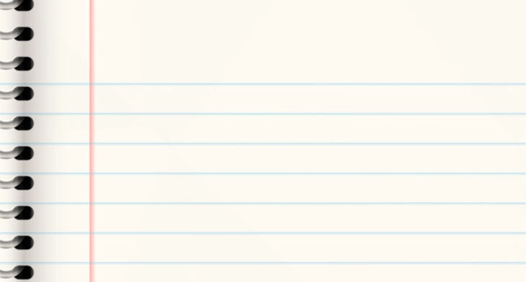
“If you have time to grade everything that students write, then they are not writing enough!”
Joan Sedita
Notes:
To Know and Do: Allow time for participants to think about this statement
To Say: Read this slide and think about what it means for our students. Writing is personal.
When we ask a student to place their ideas and thinking on paper, we are asking them to put into words their own story. There is a risk to putting words on paper. If we want them to view the feedback as a stepping stone of collaboration, we must treat it as that.
Once we put a grade on the student's paper, the writing is thought of as DONE. A closed book that is not to be given further thought.
The assignment served its purpose in the eyes of the student.
In order to generate deeper thoughts of expression, we must not make a "checklist" of qualities, but as a guide for continuing growth.

Slide 43
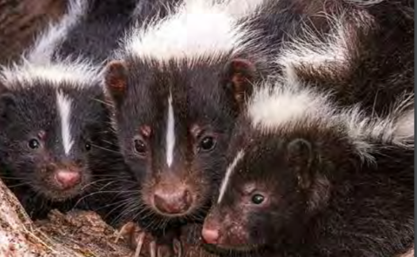
Let's Raise a STINK About Writing!
Fabulously Funky, M. Seek. eXplor
Notes:
To Know: Matt Seek wrote this article for Xplor magazine in January 2019. It is still available in the archives for Xplor.
To Say: There are many resources for developing writers. Let's Raise a Stink About Writing uses a model from a talented writer, Matt Seek, from Xplor magazine. This magazine is available free online and the specific article we will use today is found in the January/February 2019 archives.

Slide 44
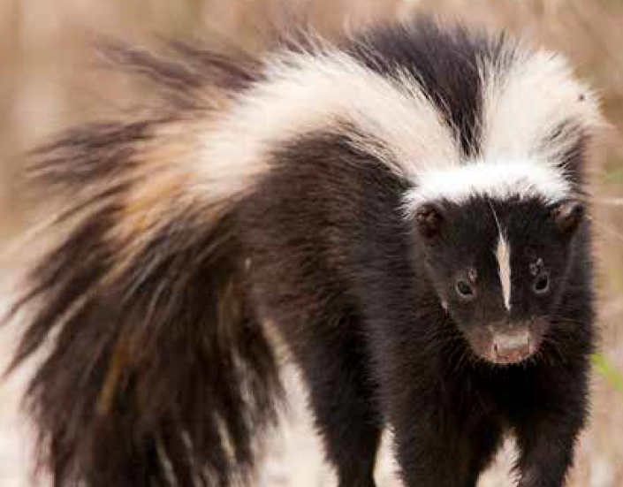
Quick Write Skunks
Do you have a skunk story because you have experienced an encounter with one?
What do you know or think about skunks?
Would a skunk make a good pet?
Notes:
To Know: This slide is to prepare participants to focus on “Skunks” and develop schema.
To Do and To Say: Take a moment to think about “Skunks”. Select one of the three different statements that might relate to you. Please pick up your pencil or pen and write in response to the statement that speaks to you. As you write, please skip every other line or leave space between the lines to write in case you want to add or change some ideas later.
I will give you about two minutes to write your thoughts and ideas. Pause for participants to write.

Slide 45
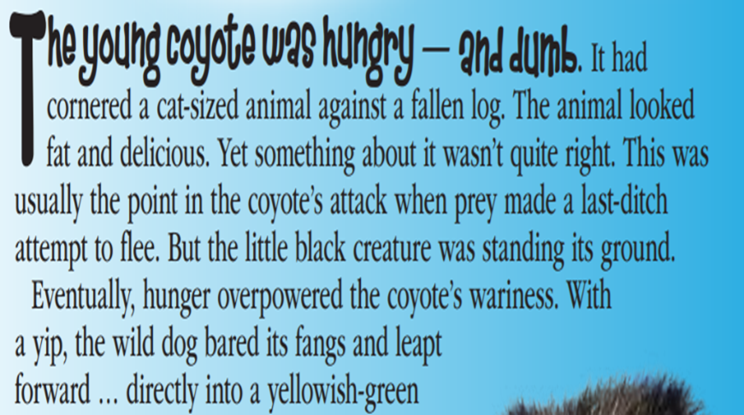
To Know:
To Do:
To Say:
Notes:
To Know: As a presenter, you will be reading the article for your participants as if you were the “teacher” in the classroom. Participants will have access to the article to develop further lessons upon completion. Words in parentheses are for you, the teacher, to share "your" thinking out loud.
To Do: Read as if you are the "teacher in the classroom".
To Say: I am going to read this selection to you and would like for you to read along in your head as a student in my classroom.
The young coyote was hungry — and dumb. It had cornered a cat-sized animal against a fallen log. (Think along with me: when I hear the words "cat-sized", I see an animal the same size as my cat at home standing in front of a fallen dead log in the forest)
The animal looked fat and delicious. (Oh! So the animal is one that might be dinner for the coyote! It might be the skunk)
Yet something about it wasn't quite right. This was usually the point in the coyote’s attack when prey made a last-ditch attempt to flee. (I see in my mind an animal who might be trying to move back and forth to get away. Can you show me what it might look like if you were cornered and what a "last ditch" effort might look like?)
But the little black creature was standing its ground. (Show me "standing its ground")
Eventually, hunger overpowered the coyote’s wariness. With a yip, the wild dog bared its fangs and leapt forward … directly into a yellowish-green cloud of stink. (Not only do I see the coyote jump here, I can hear the yip and if the coyote bared its fangs - I think I hear a growl. Do you see and hear what the author is telling you here? Show me thumbs up or down. I also see a color of STINK. Is that from the skunk?)

Slide 46
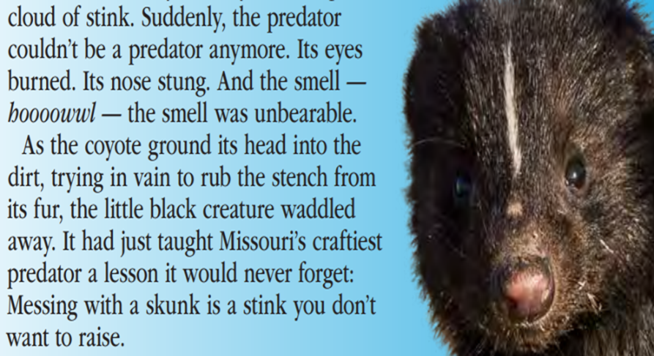
Notes:
To Say: Suddenly, the predator couldn’t be a predator anymore. Its eyes burned. Its nose stung. And the smell — hoooowwl — the smell was unbearable. (Turn and tell your shoulder partner what you see, hear and smell.)
As the coyote ground its head into the dirt, trying in vain to rub the stench from its fur, the little black creature waddled away. (Now I see a poor coyote who was once brave pushing his head in the dirt in circles trying to rub out whatever is burning his eyes while the skunk seems to happily waddle away. What does waddle look like? Can you show me?)
It had just taught Missouri’s craftiest predator a lesson it would never forget: Messing with a skunk is a stink you don't want to raise. (This makes me laugh. Messing with a skunk is a stink you don't want to raise! What does that mean? I have heard my grandmother tell me not to "raise a stink" about something so I guess that means my actions might not end well for both of us.)

Slide 47

Teaching Writing from Reading
What decisions did the author make as he wrote?
Organization
Style - visualization
Word choice
Layout
Craft moves
Narrative versus facts
Notes:
To Know and To Say: This author used some words which created a strong, visual picture in my head. The words that created a color, a size of an animal, the actions I could "act out" or the sounds I heard were placed right in his writing.
This author made some definite decisions in word choice with how he organized and took the craft of visualization and made me see what the coyote was doing which also made me feel a few emotions. Did he do that for you? Pause for participants to respond.
I am going to ask you to return to what you wrote and try to add words like the author did to help someone "see, hear, feel, or smell" clearly. If you feel you did that, underline the words you wrote that created visualization for you. In a few minutes, you will be asked to share your writing or part of your writing with a partner.

Slide 48

Share Your Writing
This STINKS!
Notes:
To Do and To Say: Take a few moments to share your writing with a partner. As you each share, tell which words helped you visualize what the author (your partner) was telling you.
Then take another moment to discuss how the model/example we shared guided you in your writing.

Slide 49
What skills might you address?
Figurative language
Alliteration
Descriptive and novel word choice
Metaphors
Similes
Personification
Humor
Commas in a series
Third person point of view
Vocabulary defined within a sentence - set off by commas
Use of dashes or
Nouns -- adjectives -- adverbs
Pronouns -- verbs
Subject verb agreements
Inference -- Predictions
Drawing conclusion
Many phonics patterns -- Latin/Greek roots
Plurals and words with suffixes needing a spelling change
Mixture of genre characteristics in SKUNKS
Notes:
To Know and To Do:
Do NOT click to show the lower portion of the slide until you have presented the task information and allowed time for participants to discuss their ideas.
Provide the “SKUNKS “ article from Matt Seek. It is more impactful to distribute one per table of the color example from Xplor but less expensive to provide the text only version. Point out the Missouri Department of Conservation Magazine for Xplor https://mdc.mo.gov/magazines/xplor?page=1 on the text only version so they can access it on their own. Allow at least five minutes to discuss and explore.
To Say: Using your reading as a way to deepen writing empowers your time. Instruction which allows use of the same text for reading and writing provides more efficient use of instructional time.
Writing in response to reading is how we see all assessment grades 3-up and MO-LEAP Blocks connect integrated learning.
Take a few moments to examine the full article. Think about the standards you are addressing with your students and share which skills you could pull from this article to deepen writers in your classroom.
(Pause for participants to list standards or skills on optional chart paper or in their teams. Click forward upon completion of the task to see some lists that have been generated by different grade levels.
What might you use?
More to Know:
If time permits, as teachers chart out ideas for instruction, have teachers find examples within the document to support the instruction. This will provide a strong variety of lessons across grade levels for classroom use.

Slide 50
The Writing Process
The steps include
Brainstorming/planning
Rough draft
Proofreading
Revising/editing
Final draft
Publishing
Not ALL writing needs to go through the complete process.
Notes:
To Know and To Say:
The writing process was actually published to provide a framework for college students to use in developing quality writing. The intent of the process has been taken and placed within many instructional resources.
Show of hands. How many of you teach this process? Pause for participants to respond.
Are these the same steps you teach? Pause for participants to answer.
How many pieces do you take to this depth each year?
Before a student can work on a compositional level, they must have the foundational skills. We should ask ourselves, do we model and scaffold the writing process with collaborative feedback; so a student has the skills to produce efficient writing?
Do we allow students to share their voice with others and prove they have stories worth sharing?
What are ways you or your district share writing across grade levels or with the public?
(Click for the box to appear on the right side of the screen.)
This might be the process we teach when we publish something two-to-four times a year. But, every piece of writing is not for publishing or should go through the complete writing process.

Slide 51
“The most powerful tool that we have to strengthen literacy is often the most underused and overlooked, and that is a child's own stories.”
Pam Allyn
Notes:
To Know and To Say: Read with me by finishing what I read from this slide. When I stop reading please finish the quote:
"The most powerful tool that we have to strengthen literacy is often the most underused and overlooked, and that is ___________________________________”. (a child's own stories).
We will not take time today to dive into how to use journals with students responding in writing to what they read or even allow students to go back and share things they wrote. But, students responding to text through a journal is a powerful way to grow confidence in writing and the value of their personal voice.
Other impactful growth ideas have students count how many words they could write earlier in a quarter, or month, and compare the number to what they are able to write now.
Students can also compare the difference in their writing when writing about something they know or have a passion for compared to a required topic. Bottom line is to value their voice -- let them tell their stories and thoughts.

Slide 52
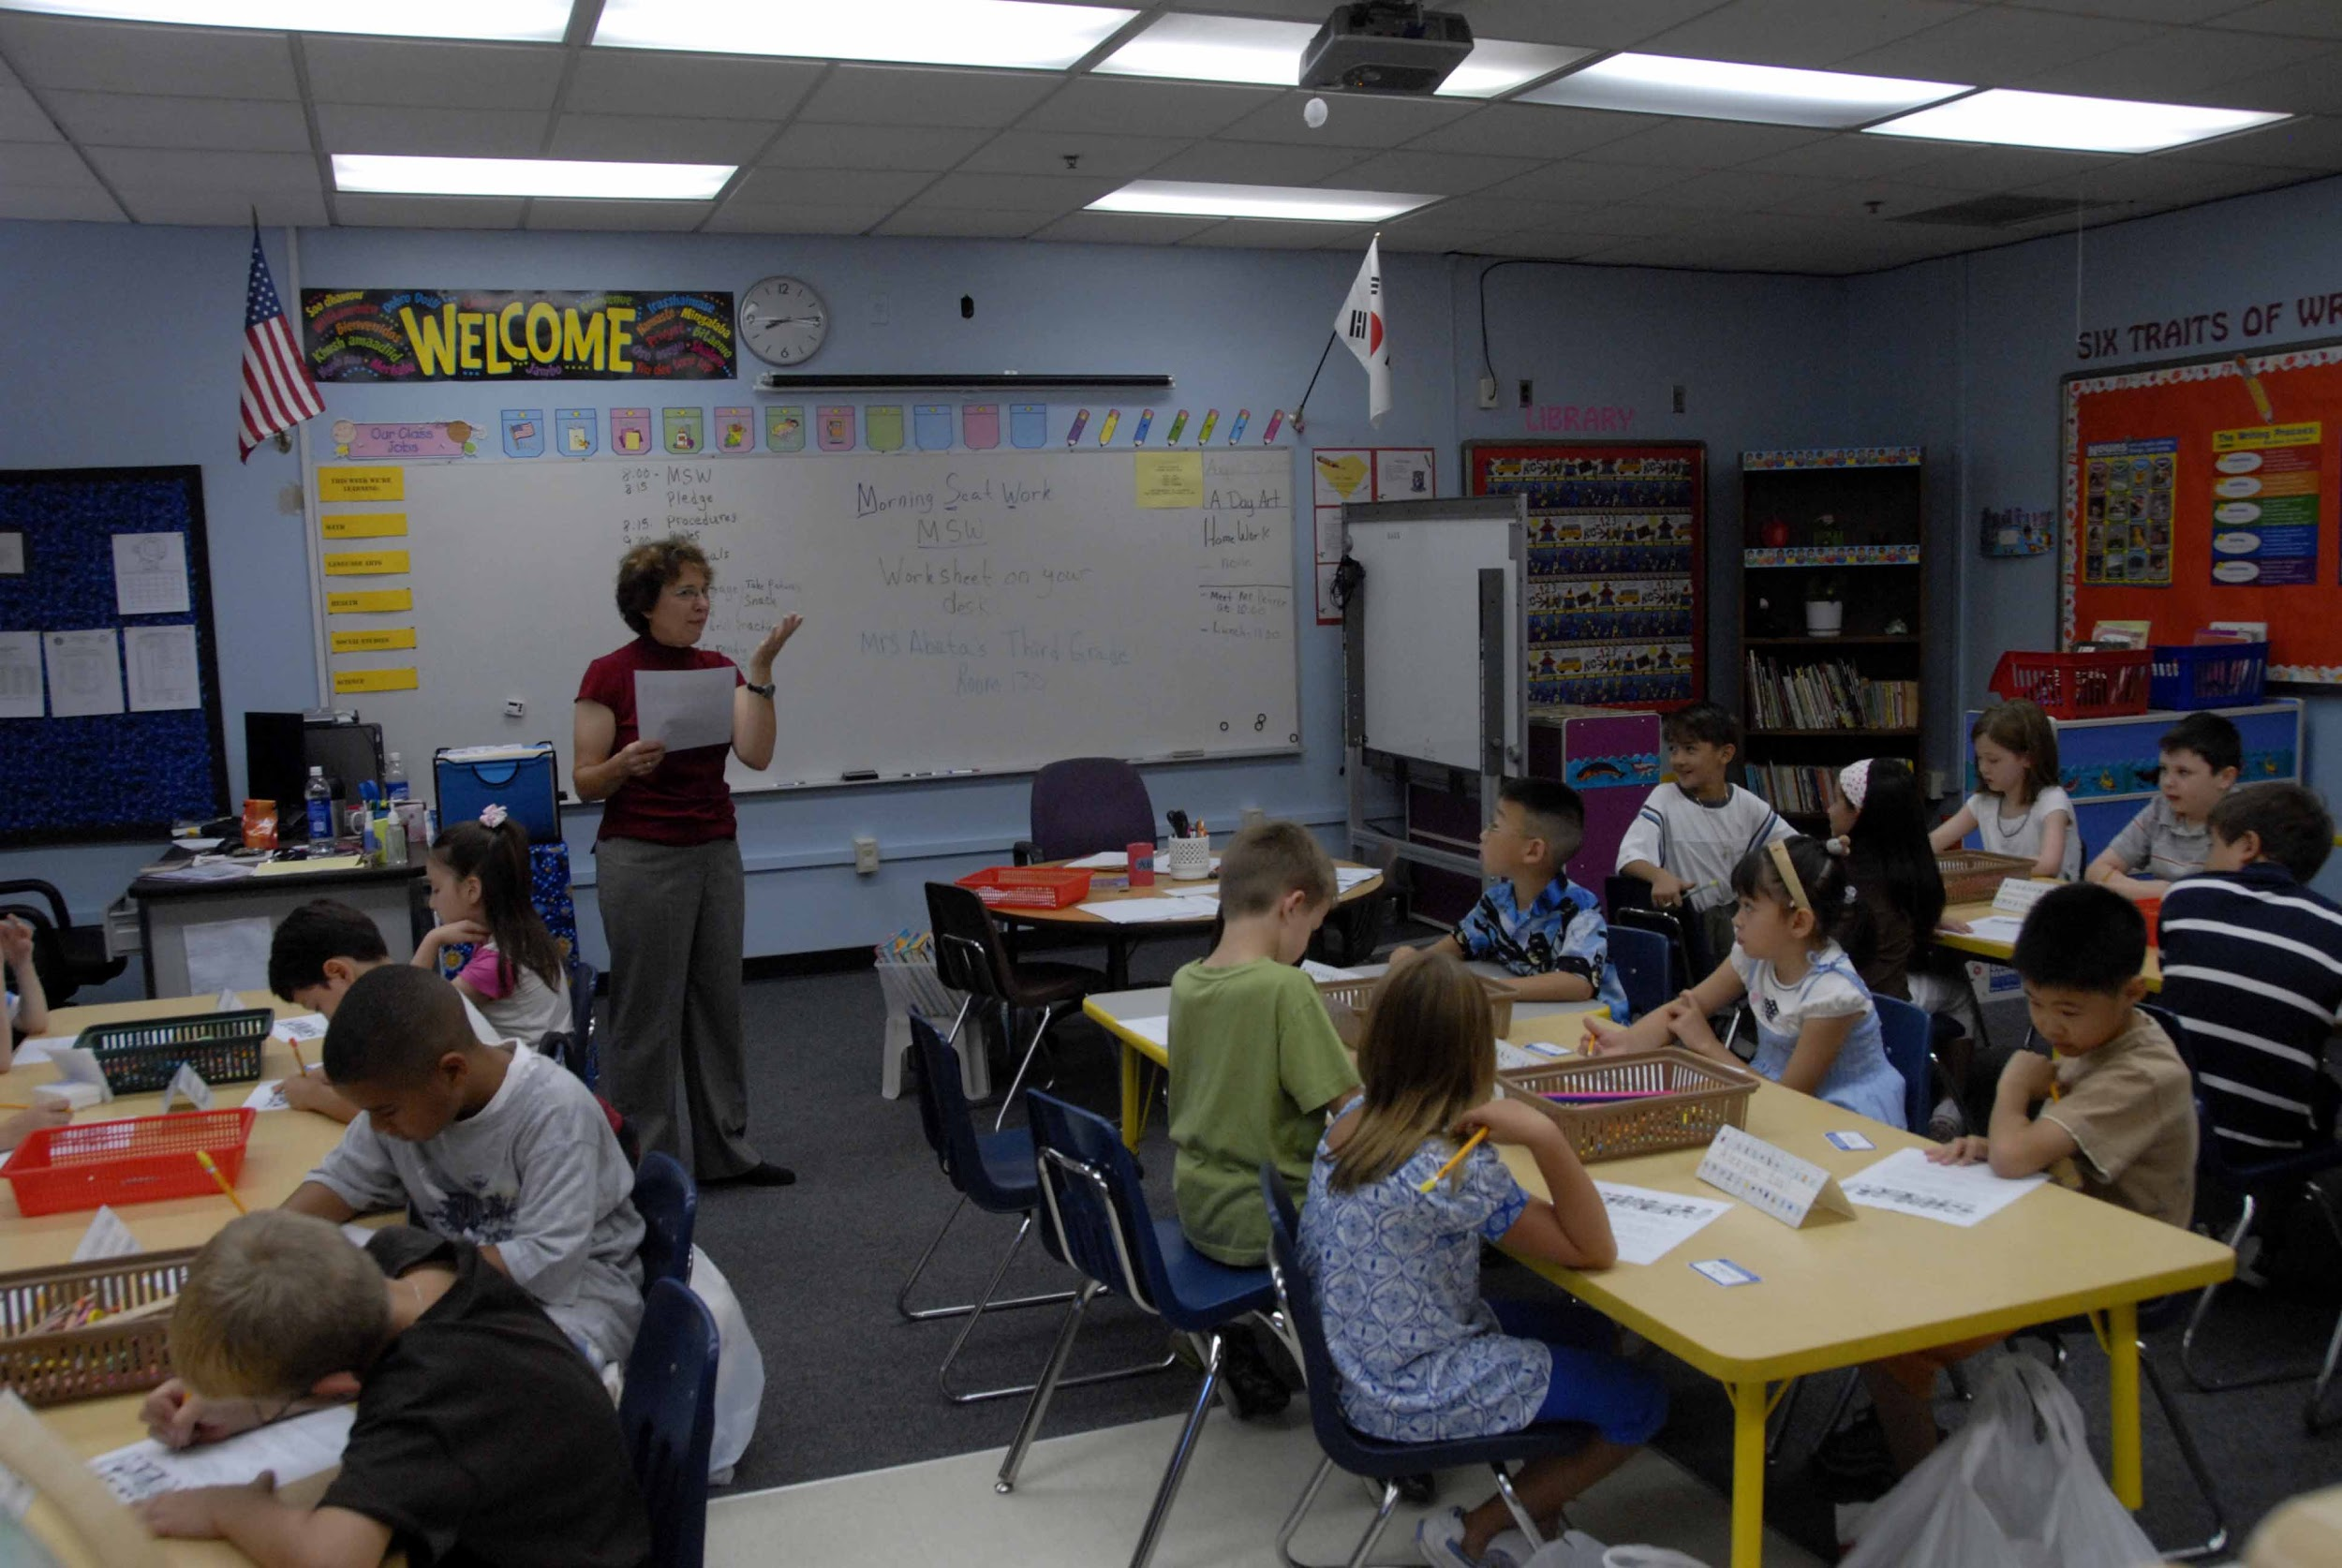
Six Traits Writing
Ideas/content
Word choice
Sentence Fluency
Conventions
Organization
Voice
Notes:
To Know and To Say: Many schools use instructional resources that value the Six Traits of Writing or Six Plus One Traits of Writing. We are not pushing a product but asking you to value the intention of these skills as processes to more efficient writing.
Missouri uses a scoring rubric for grades 3 and up which places the importance of the ideas/content, word choice for clarity of voice, and sentence fluency through an organization of ideas expressed in different genres. The point values assigned to those specific skills outweighs the points given to conventions (punctuation, capitalization, etc.) The largest value of writing is to convey the message.
As a presenter, make the following decision: Do you want to allow time to discuss these questions or use the following slide to break groups into grade level alike teams to discuss and then share out ideas?
You may place these on cards or charts to address or use the next slide.
How do we allot our time to writing instruction?
If we were to share our writing rubrics, which sections are given the largest number of points?
Do you use common rubrics across or within grade levels?
Do all teachers of different subject levels which require students responding in writing use the same rubric to score writing?

Slide 53

Discussion Questions
How do we allot our time to writing instruction?
If we were to share our writing rubrics, which sections are given the largest number of points?
Do you use common rubrics across or within grade levels?
Do all teachers of different subject levels which require students responding in writing use the same rubric to score writing?
Notes:
To Know and to Do: You may hide this slide if you placed the questions on charts around the room or on cards at tables for teams to discuss.
You can break groups into grade-alike teams to provide time for discussion within the grade levels and share out what they learned across grade levels.
*You decisions here are based on how much time you have to complete this task. Will you desire teams at tables to discuss or do you need district grade level teams to discuss and share?
To Say: I would like to give you about five to eight minutes to discuss the questions on the slide with your teams.

Slide 54

Struggling Writers
Explicitly teach to specific weak skill(s)
Thoughts before mechanics (. ? ! ,...)
Use technology: keyboarding and speech to print
Allow choice writing
Written response: to read aloud, summarize, new vocabulary
May need to draw first or talk about it with someone before writing
Provide time to talk about their writing
Celebrate writing
Notes:
To Know, Do and Say: Every writer trying or needing to express ideas clearly has moments of time he/she struggles to put the words on paper.
There are many ideas here which could be the motivating factor to impact student writing or the reason a student is unmotivated to write.
Putting words on paper takes stamina, persistence to task and being confident to say what I think. Those are executive functioning skills that impact emotion. We will need to explicitly teach those skills that are weak providing examples to a clear target.
Finding student voice places the focus on student thoughts and their ability to communicate those thoughts and less about the mechanics.
We all have classes in which keyboarding is taught. Do we also commit the same time and instruction with using speech to print?
Choice is a strong motivator. Make it acceptable for students to write in response to a text with their own ideas or thoughts. The choice in what they feel, think or believe opens the door for them to write with passion instead of a requiring a "canned response".
There is text in front of a student every day. When students respond in writing to what was presented to them, vocabulary and comprehension are deepened.
There are students who need to draw their thoughts or discuss their ideas before they can write. Many students write clearer when they have had time to develop ideas in their mind prior to committing it to paper. How many of you have to talk things out or mull things over before you can find clarity?
Offer the choice to share or talk about their writing. Sometimes when students share with peers, they "tell" more than they wrote which leads to deeper writing. Placing notes on the wall that says “What more do you want to know from the author you heard?” or “Tell your author friend thank you for sharing after they share.”
Celebrate! Celebrate any words on paper and the attempt to communicate.

Slide 55

How Do You Plan to Develop Writers?
Begin at instructional level and ability for confidence and enthusiasm
Multisensory approach - graphic organizers, pictures, verbal brainstorming, discussions, drawing
Small steps, clear guidelines, checklist of steps
Model with concrete examples at each step
Procedures same each time - memorize and automatic
Safe environment, respect
Notes:
To Do and To Say: How do you plan to develop writers? Take a moment to examine what is on the slide. Pause for participant to read the slide.
Some learning was a confirmation of what you do. But, some pushes you to determine what is needed to move your students to grade-level or a higher level.
Pause for participants to reflect on their learning to address the following
Which processes addressed today stand out as needing to be addressed by you in your classroom or district?
What do you plan to do?

Slide 56
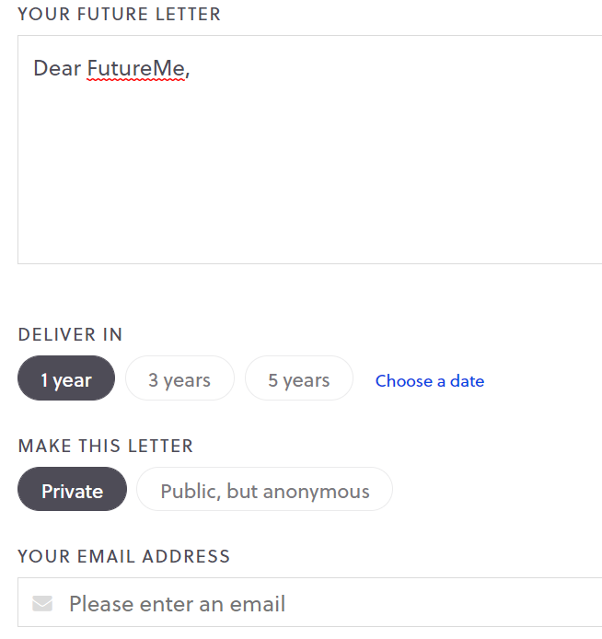
futureme.org.
Notes:
To Know: This is free! Futureme.org allows you to write a letter to yourself and determine the timeframe you wish it to be delivered to you.
To Do: Give participants time to share with their group before they go online to write the letter to themselves.
To Say: Think about what you are going to put into practice from this time of learning. When your partners are ready with their thoughts, share what you are going to put into action. Then, go to Futureme.org and write a letter to yourself. In that letter, outline your ideas or your plan to move your students to a higher level. Once your letter is finished, place your email in the frame and select a date in which you desire this letter to come back to you for you to reflect on what you have done.

Slide 57
Thank you for your professional attention.

