Slide 1

SPECIAL EDUCATION COMPLIANCE
TIERED MONITORING
SELF-ASSESSMENT YEAR
IMACS TRAINING & GUIDANCE
Cohort 3
Fall 2022
Missouri Department
of Elementary and Secondary Education

Slide 2
Features in IMACS 2.0
2
All communication between DESE and LEAs regarding compliance monitoring or containing student Personally Identifiable Information (PII) will be housed in IMACS 2.0.
Districts will receive email notifications from IMACS 2.0 when information from DESE is available in IMACS 2.0 (and vice versa).
Districts will have the ability in IMACS 2.0 to upload requested documentation to the individual student record at any time in the process.
DESE has the ability to tailor file reviews according to each LEA’s Special Education Performance Data. Districts meeting performance targets have fewer indicators in their self assessment file review.
IMACS 2.0 automatically saves each answer in the file review as it is entered.
Notes:
Please use IMACS 2.0 for all correspondence regarding any file review or timeline issue in so that we have a collection of all communications in one safe, secure place.
You will receive notifications via the email address entered by the LEA in IMACS 2.0. Pay attention to the notification messages so that you are looking in the right place when you open IMACS 2.0. You will get notifications when uploads are requested as well as when there is a communication from DESE to read. If multiple people work within IMACS 2.0 at the district level the first person who opens new communication needs to make sure the intended receiver knows about it because it will be marked as Read after it has been opened on the district side.
In previous versions of IMACS, LEAs could only upload information during certain timeframes when the IMACS system was on their side. That feature has been expanded so if a Supervisor is missing something they can request a document upload at anytime.
In previous file reviews LEAS had to answer up to 180 indicators and now the average is closer to 20 depending on the targeted areas for district.
In prior years you have to click the save button frequently during the review process or you risked losing the answers if the system timed out. Now IMACS 2.0 automatically saves the information.

Slide 3
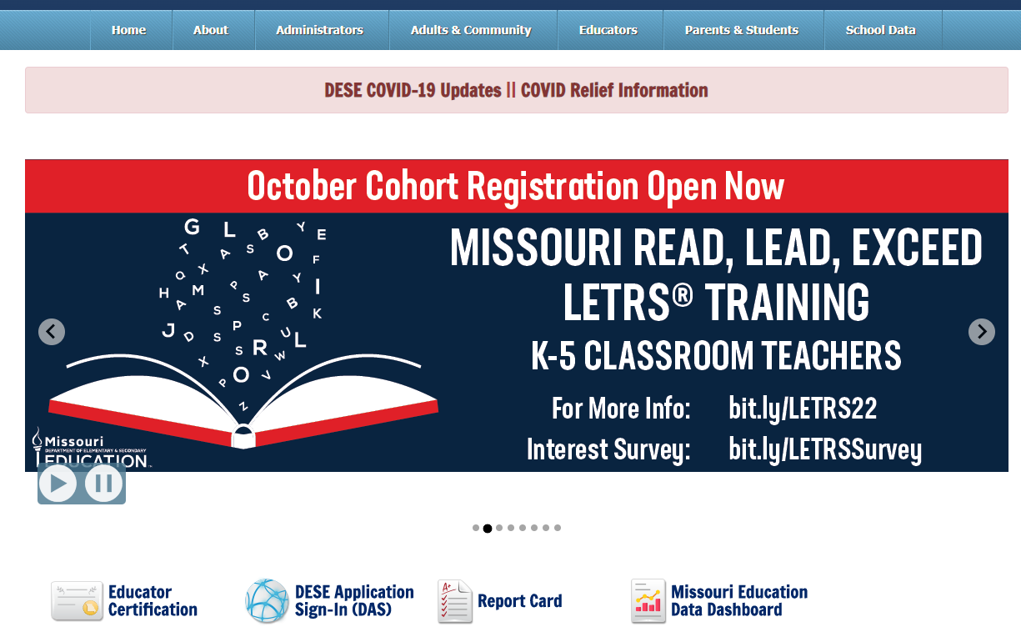
How to Find IMACS 2.0
3
From DESE homepage:
Notes:
On the DESE homepage (dese.mo.gov) click on the DESE Applications link underneath the scrolling banner to go to the Log In page.

Slide 4
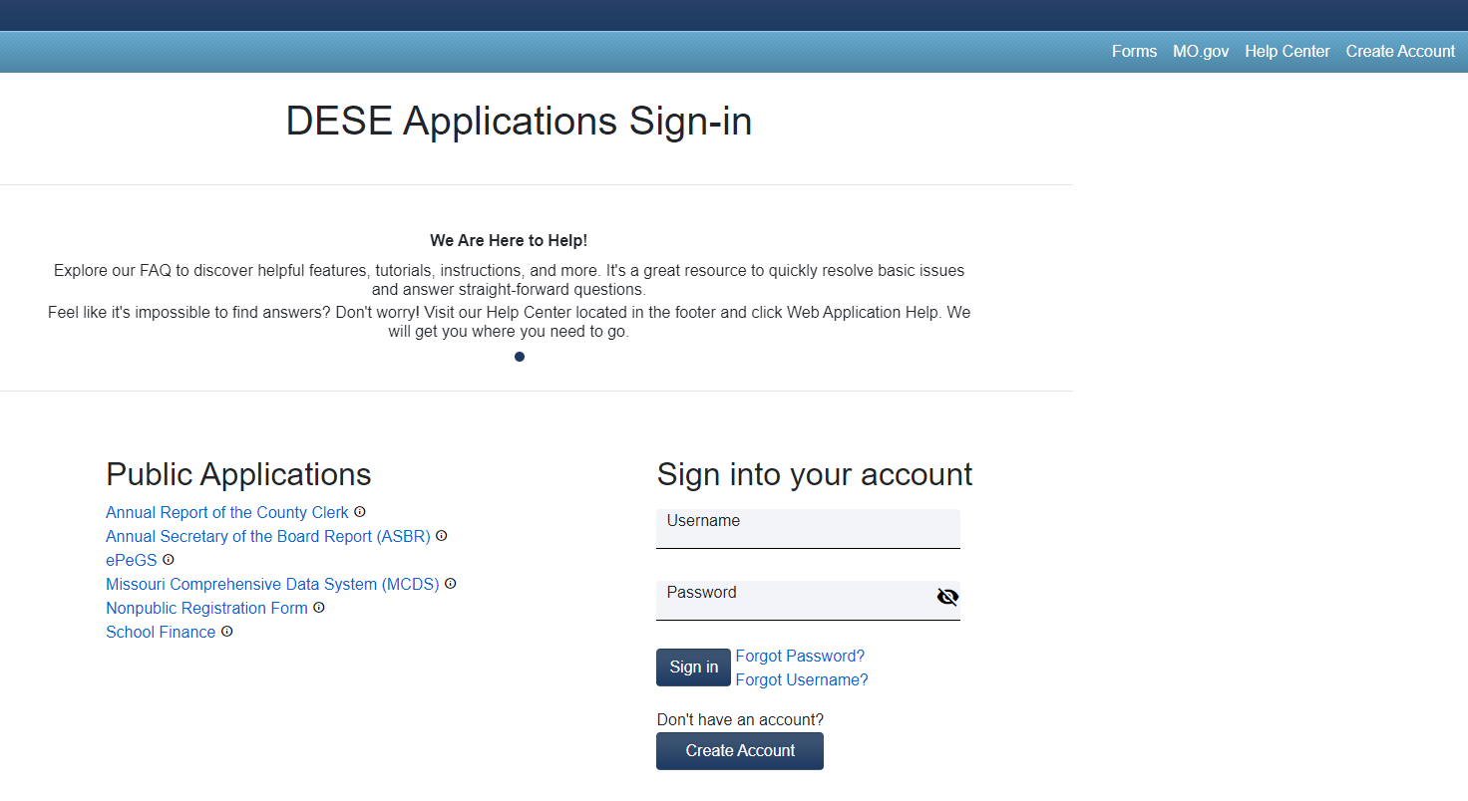
Gaining Web Applications Access
4
If you have not had previous access to DESE Applications you will need to request it before you can use IMACS 2.0.
Notes:
If you have not had previous access to DESE Applications you will need to request it before you can use IMACS 2.0 by clicking on the Login .

Slide 5
Access to IMACS 2.0
5
There are two access levels for IMACS 2.0:
  User Manager and
  User
User Manager access includes permissions to all functionality in IMACS 2.0, including the ability to grant access to Users
User access includes permission to view only or update specific modules in IMACS 2.0
Notes:
When you have access to DESE Applications, ask your agency’s DESE Web Apps User Manager to assign permissions so you can use IMACS 2.0.
The handout named SELF‐ASSESSMENT PROCEDURES FOR MONITORING includes a step by step description of the process for getting access to IMACS 2.0 and permissions to use it.

Slide 6
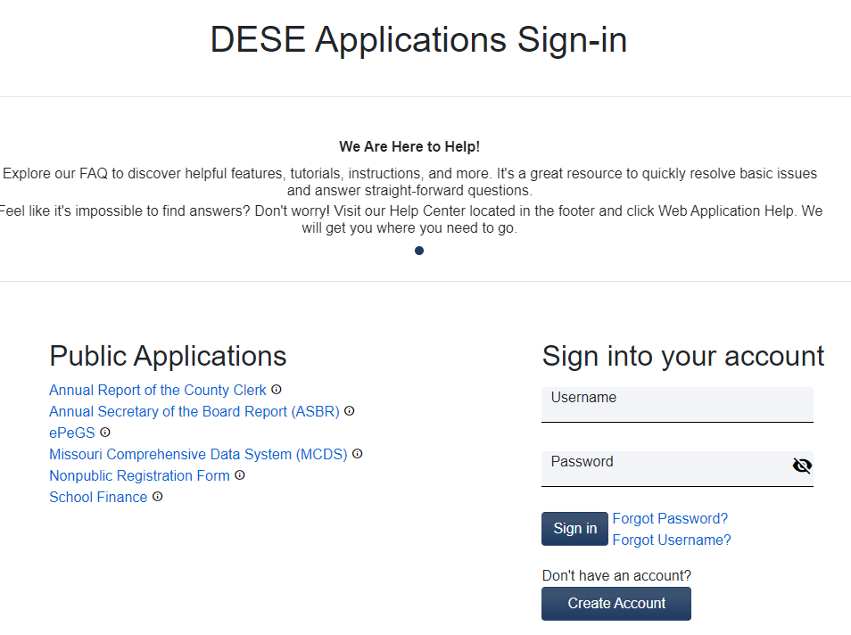
Logging into IMACS 2.0
Once you have been granted user access then you can log into IMACS 2.0.

Slide 7
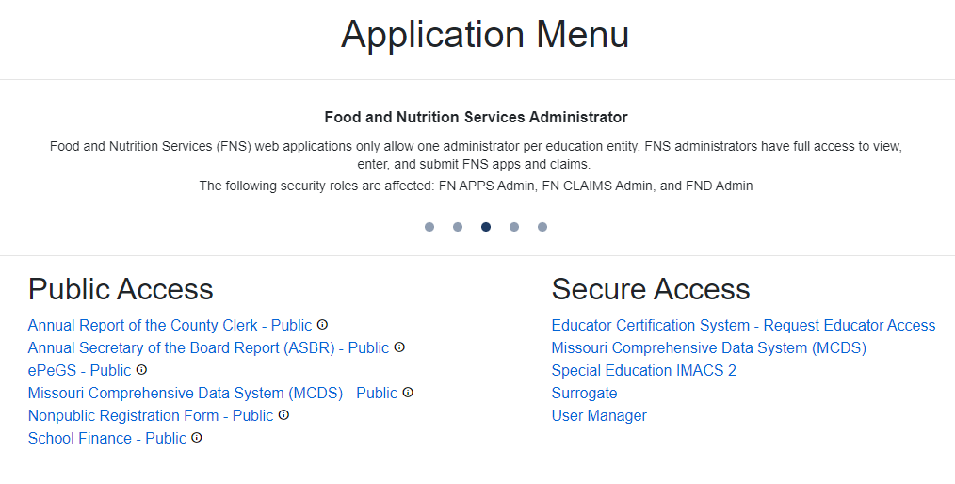
After Logging In: Menu
7
LEA will be taken to the DESE Web Applications menu page. Click on Special Education IMACS 2.0.
Notes:
The list of applications is dependent upon what User Access level you have been granted. If you are not the User Manager for your district you will need to contact that person if you do not see Special Education IMACS 2.0

Slide 8
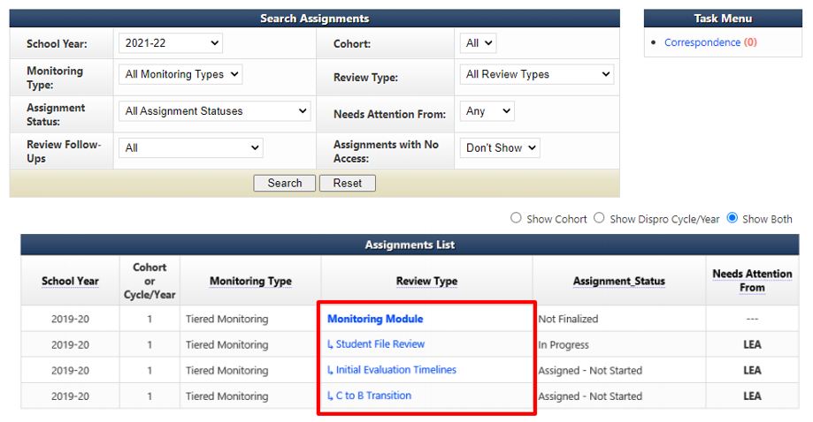
LEA Home Page in IMACS 2.0
8
Make sure that the year is set correctly 2022/2023
2022-23
Notes:
On the home page, under Assignment List, you will find the links to the over-arching Monitoring Module as well as the Student File Review, Initial Evaluation Timelines, and C to B Transition Timelines.

Slide 9


Monitoring Process
9
Monitoring Module
Student File Review
Initial Evaluation Timelines
C to B Transition Timelines

Slide 10
Assignments List
9
The Part B monitoring process is broken down into different categories by review type.
Review Type | What is it?
Monitoring Module | The over-arching layer of the tiered monitoring process that encompasses the Student File review, Initial Evaluation timelines, and the C to B Transition Timelines. All communication and uploads can be viewed here. Nothing should be uploaded here.
Student File Review | Contains student files selected for monitoring by the LEA and the student file documentation uploaded by the district. Any communication and uploads regarding student files can be viewed here. Upload documentation related to student files here.
Initial Evaluation Timelines | Contains student demographics & important dates for all initial evaluations done between July 1, 2022 and April 30, 2023. Any communication and uploads regarding initial evaluation timelines files can be viewed here.
C to B Transition Timelines | Contains student demographics & important dates for all C to B Transitions done between July 1, 2022 and April 30, 2023. Any communication and uploads regarding C to B transitions timelines files can be viewed here.

Slide 11
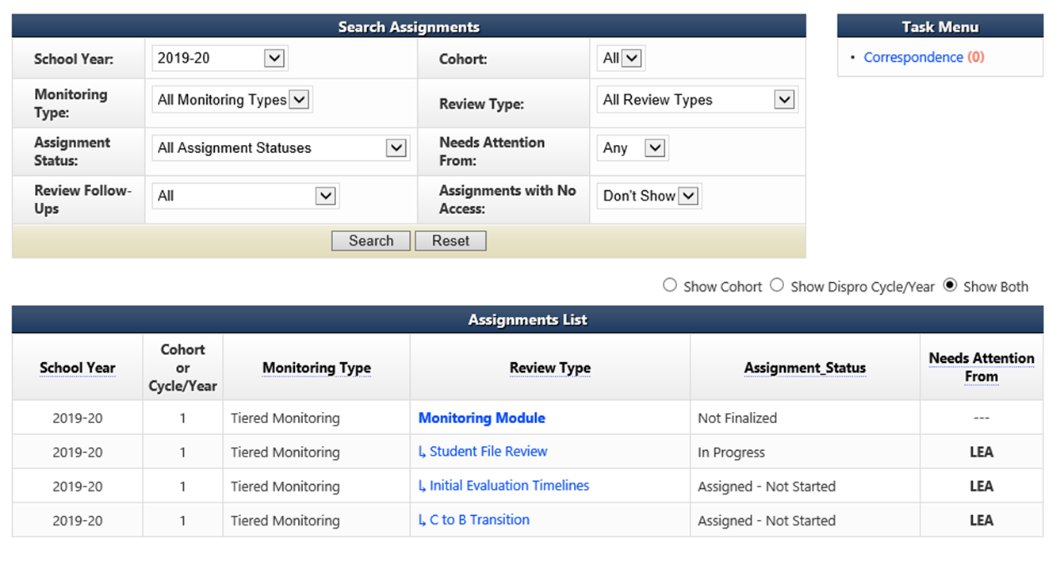
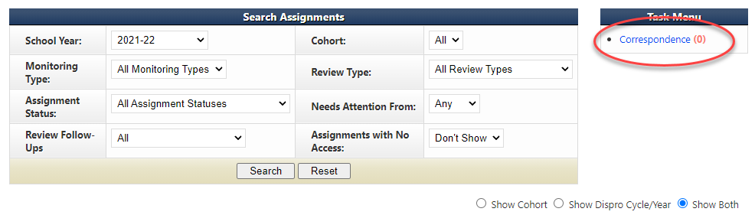
Locating Correspondence
10
To locate letters, from the LEA home page click on Correspondence under Task Menu.
2022-23
Notes:
On the home page, under Task Menu, you will find the number of unread correspondence (red number) at the LEA level. Remember if multiple people in the district are working in IMACS 2.0 you need to understand that once a correspondence is opened it will no longer be represented as unread in this field and it is the responsibility of the person who opened the correspondence to make sure the intended recipient also reads it.

Slide 12
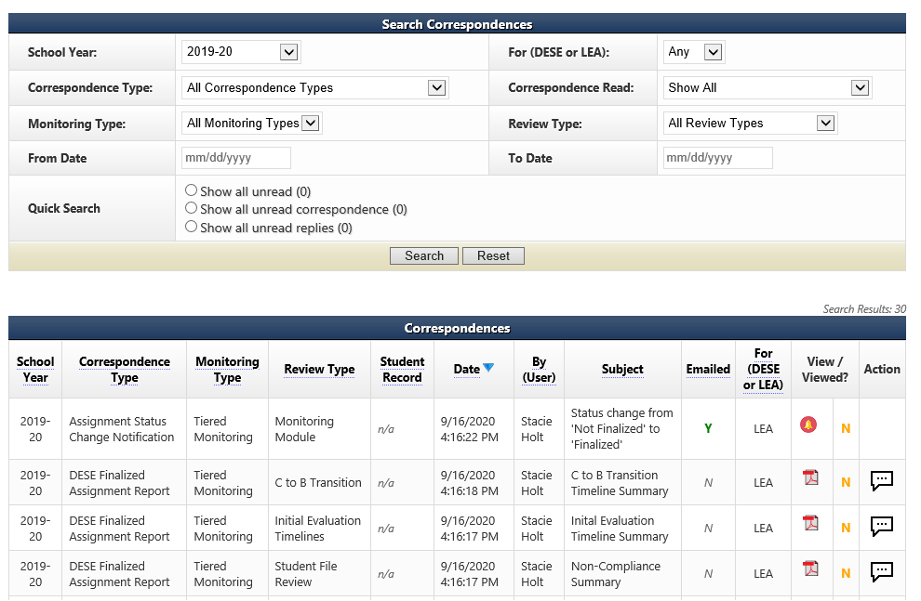
Locating Individual Correspondence
11
2022-23
Notes:
Under Correspondence Type you will be able to tell if it is a message, a notification about a change in status, a document request, or a report.
Review Type will let you know if the original communication was sent from main Monitoring module or one of the sub-reviews such as Student File Review, Initial Evaluation, or C to B Transition.
The Date and By (User) columns will list time, date, and from whom the correspondence originated.
For (DESE or LEA) column will let you know at a glance whether a compliance supervisor at DESE or an agency representative needs to pay attention to the message.
The View / Viewed? column displays icons that distinguish what kind of message it was and the Y/N help to determine if the message has been viewed.
The last column, Action, allows you to respond to that message if the conservation balloon icon is available.

Slide 13
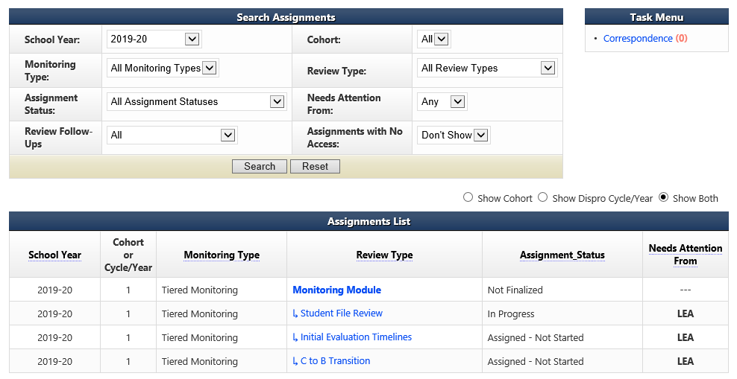
Student File Review Summary Page
12
Add the names of students whose files are being selected by the LEA for review by going to the LEA home page and clicking on Student File Review.
2022-23

Slide 14
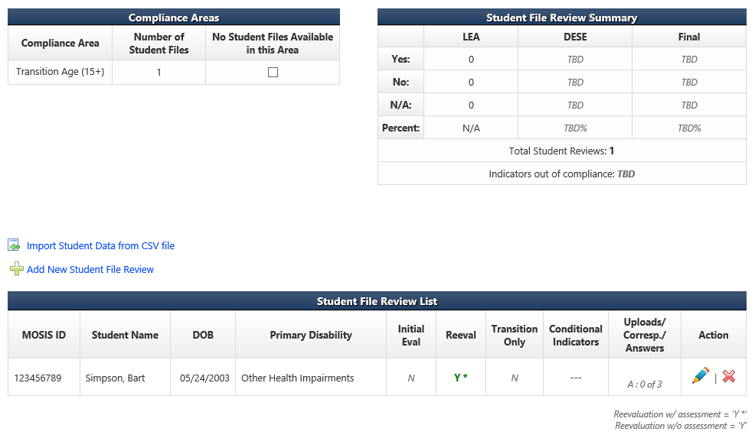
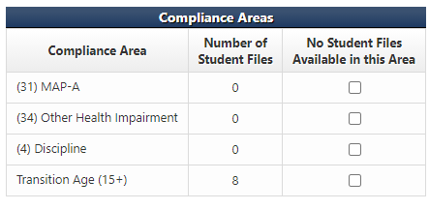


Student File Review Summary Page
13
The Student File Review Summary page is where LEAs add student names and demographic information.
Notes:
There are two ways to enter students on the Student File Review Summary page. You can either import student demographic data using a CSV file or you can enter student demographic data one by one. If you want to import a CVS file you will need to click on Import Student Data from CSV file and if you want to go one by one then click Add New Student File Review for each student record.
The LEA can also see their Compliance Areas dashboard on this page. The dashboard has a lot of important information such as how many of the students they are entering are included in compliance areas such as Postsecondary Transition, MAP-A, Discipline, or various areas of eligibility. If the LEAs is required to include students to meet certain conditional areas it will show up on this dashboard.

Slide 15
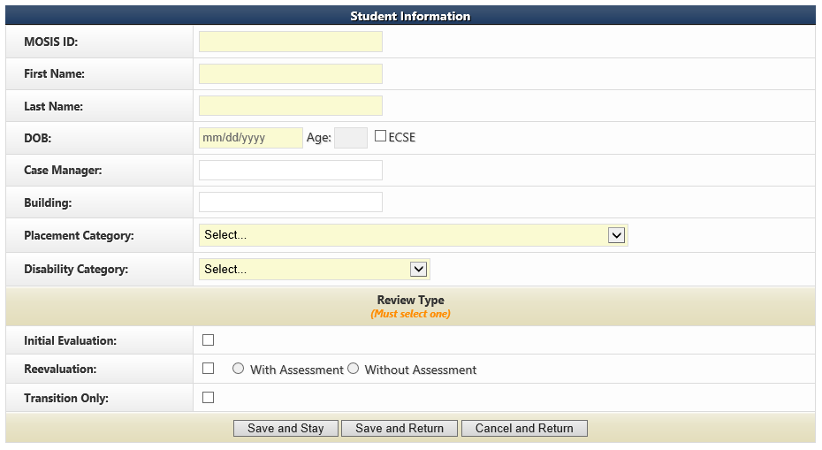
Adding New Student Reviews Individually
14
If you decide to enter your student demographics for the reviews one student at a time in IMACS 2.0 then you will do so by clicking on Add New Student File Review. It will bring up the familiar student demographic screen below.
After the LEA has completed filling in the boxes, they need to select either the Save and Stay or Save and Return button. The Cancel and Return button does not save.
Notes:
Save and Stay will keep one this page, Save and Return will send you back to the Student File Review Summary, and Cancel and Return will wipe off what you have typed and send you back to the Student File Summary.

Slide 16
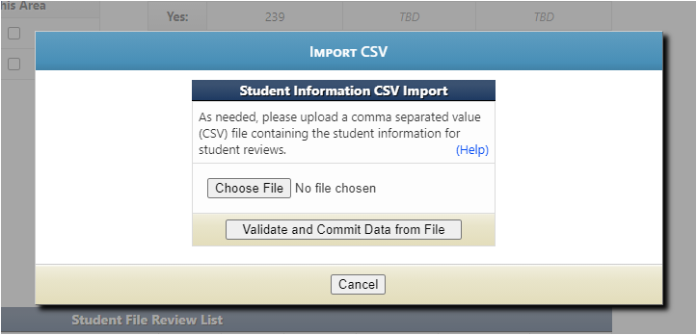
Importing Data from CSV file
Click on the Help to read the directions for preparing the CSV/TXT upload.
Click on Choose File to locate the CSV/TXT document and to upload from your computer.
Click on Validate and Commit Data from File once you are done with everything.

Slide 17
Importing Student Data for Student File Review
IMACS 2.0 Student Information Upload for Student File Review
The file can have an extension of .csv or .txt.
Upon submitting a file, the website will first validate the file, and if valid will then prompt the user to commit the data.
The file must contain column headings at row 1.
Data rows should contain only information intended for Student File Reviews:
'DOB' must be a Valid Date: 'mm/dd/yyyy'.
'Placement Category' must be a Valid Value: 1100= Inside regular class at least 80% of time,1201= Inside regular class 40% to 79% of time,1301= Inside regular class less than 40% of time,1403= Public separate school (day) facility,1402= Private separate school (day) facility,1401= Public residential facility,1701= Private residential facility,1601= Homebound/hospital,5100= Early childhood setting,5200= Early childhood special education,5300= Home,5400= Part-time early childhood/Part-time early childhood special education,5500= Residential facility,5600= Separate school,5700= Itinerant service outside the home
Continued on next slide.

Slide 18
Importing Student Data for Student File Review
IMACS 2.0 Student Information Upload for Student File Review
* 'Disability Category' must be a Valid Value: 13= Autism,11= Deaf/Blind,02= Emotional Disturbance,08= Hearing Impairment/Deafness,01= Intellectual Disability,12= Multiple Disabilities,04= Orthopedic Impairment,10= Other Health Impairments,09= Learning Disability,17= Language Impairment,20= Sound System Disorder,21= Speech/Fluency,22= Speech/Voice,14= Traumatic Brain Injury,06= Vision Impairment,16= Young Child with Developmental Delay
* 'is_initial_eval_review' must be a 'Y' or 'N' value.
* 'is_reeval_review' must be a 'Y' or 'N' value.
* 'is_reeval_with_assessment' must be a 'Y' or 'N' value.
* 'is_reeval_without_assessment' must be a 'Y' or 'N' value.
* 'is_transition_only' must be a 'Y' or 'N' value.
Format the disability column as text in order to keep the leading 0s.

Slide 19
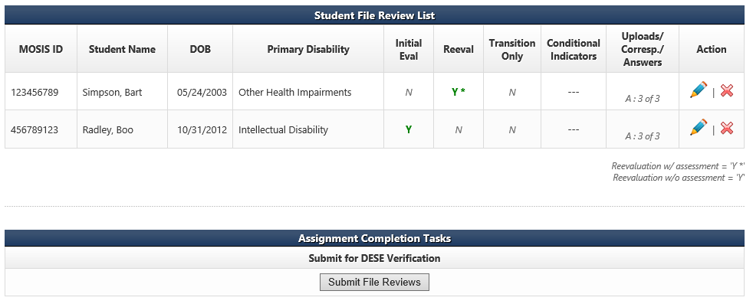
Student File Review Screen, cont.
15
After the district has answered the individual indicators under each individual student on the Student File Review List, the district will need to submit the file reviews. Complete the review and submit no later than February 1, 2023.
Notes:
The Uploads/Corresp/Answers column shows if all the indicator questions have been answered. (yellow circle)
Once the LEA is sure that they have entered all the students required and answered all the indicator questions then they need to click on the Submit File Reviews (red circle) button.
It is important to remember that you only need to submit file reviews with the indicator questions answered by February 1, 2023. You do not upload any files by that deadline. DESE compliance supervisors will request student files after March 1, 2023.

Slide 20
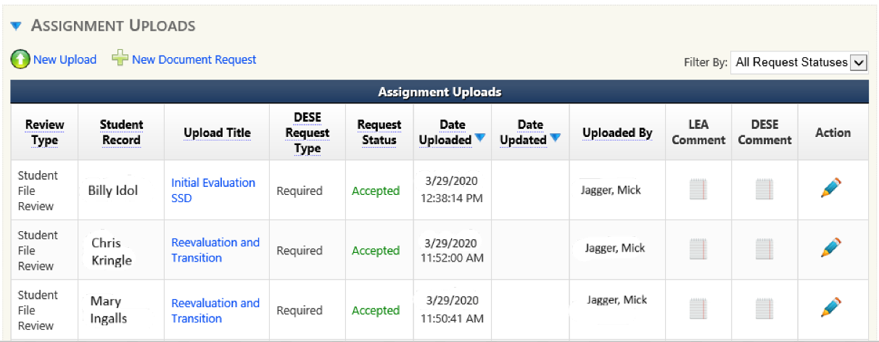
Uploading Documentation for the Desk Review
16
During late February/early March 2023 time period, districts will be notified via IMACs 2.0 correspondence of the student files chosen for desk review verification and what documents must be uploaded.
The LEA will upload the documentation requested in IMACS 2.0 for each student record requested.
Student documents should only be uploaded under the individual student file review page.
This documentation is due in IMACS 2.0 no later than April 1, 2023.
Notes:
At the bottom of the Student File Review Summary page is the Assignment Uploads area. When you click on the blue arrow next to the words Assignment Uploads the document requests from DESE will be listed.
To open each individual request click on the pencil at the end of the row (green arrow). This will open the Assignment Upload window for that student.
DO NOT UPLOAD WHEN IN THE MONITORING MODULE. ONLY UPLOAD IN THE STUDENT REVIEW, INITIAL EVALUATION TIMELINES, AND C TO B TRANSITION TIMELINES

Slide 21
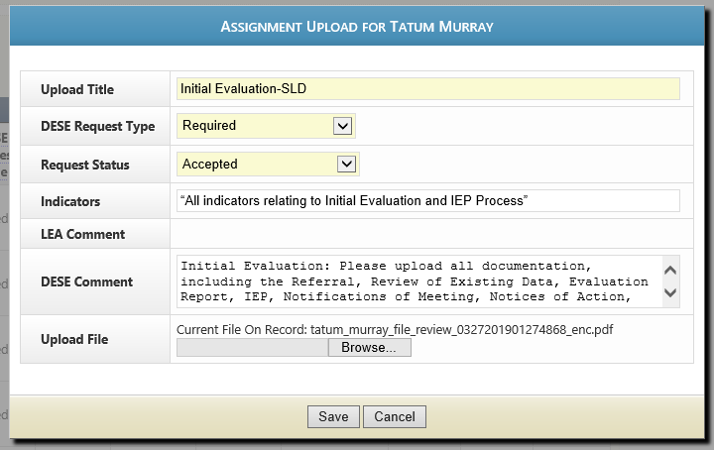
Uploading Documentation
17
Once the Assignment Uploads window has opened, the LEA may upload the requested student documents. You will receive one document request per student. It is preferred that all documents needed for verification are merged and uploaded as one file, in the order of the SPED process, for each requested student. An automated email will be generated to the Supervisor overseeing your district to let them know it is uploaded.
Billy Idol

Slide 22
Helpful Hints for Uploading of Documents
Merge all documents for a specific student into one file for that student’s Document Request. You might need to speak to your district’s IT manager or administrative staff to find out which program with merge capability is available. Documents may be uploaded as WORD, PDF, or zip files.
Before merging all of one student’s files together, place them in the order of the special education process.
Check to make sure each student’s file is 20 MB or less in size. Merging options impact file size. Again, work with your district’s IT manager or administrative staff, or use an internet search to learn about how to reduce the file size using the program you have available.
Make sure each file’s path name is less than fifty characters. Be aware that the location for saving your file prior to upload can lengthen the path name. The easiest way to limit size is to create a folder on your desk top for upload files.
Only upload files under the individual student and NOT the monitoring module or student file review summary page.
Notes:
DO NOT UPLOAD WHEN IN THE MONITORING MODULE. ONLY UPLOAD IN THE STUDENT REVIEW, INITIAL EVALUATION TIMELINES, AND C TO B TRANSITION TIMELINES

Slide 23
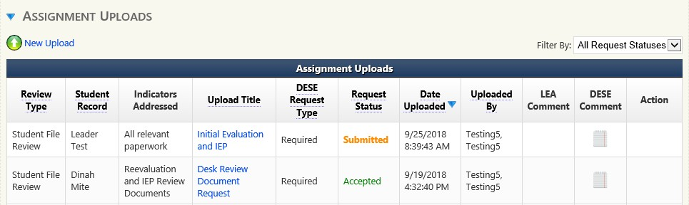
Documentation Request Status
18
The document status can be found in the Request Status box.
Submitted - Uploaded, but not yet looked at by DESE
Accepted – DESE has looked over the file and it seems like everything needed is there.
Rejected – DESE has looked over the file and something is not right.
If your file is rejected and you need to upload new information be aware that you will need to either:
1) merge new information into your file and re-upload the entire thing, or
2) upload the missing information under the student’s record using “New Upload” link.
Notes:
If your file is rejected you will probably get a phone call or email from your assigned DESE Supervisor. If you do not hear from them, please reach out to her or him.

Slide 24
Timelines Submission
19
Timeline submissions due May 15, 2023.
  Initial Evaluations
    Include all students (ineligible and eligible).
  Part C to Part B Transition
    Include all students referred from Part C whose referral date falls within the data collection period and whose 3rd birthday is prior to April 30, 2022.
Data collection for timelines will cover the period beginning July 1, 2022 and ending April 30, 2023.

Slide 25
Timeline Exceptions
Patterns of instruction do not extend a timeline. For example:
Virtual Schooling - Students attending school virtually are counted as in attendance for reporting and funding purposes. So it is a paradox to say a child is attending school but is unavailable for testing.
4-day School Week – weekends are longer, but still count in the 60 day timeline.
Timelines may be extended for just cause (school breaks for summer or holidays, student illness, and repeated failure by the parent to make the child available for testing) and not due to a pattern of instruction. Districts have to document good faith efforts to work with parents to complete assessments. Consider alternative settings or virtual assessments if necessary to access the student.

Slide 26
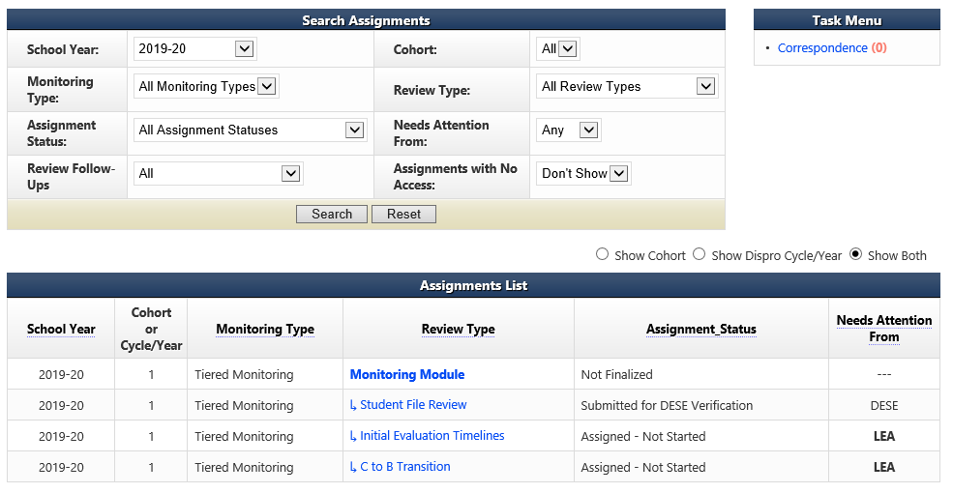
Initial Evaluation Timelines Summary Page
Add the Initial Evaluation Timelines information by going to the LEA home page and clicking on the Initial Evaluation Timelines review type.

Slide 27
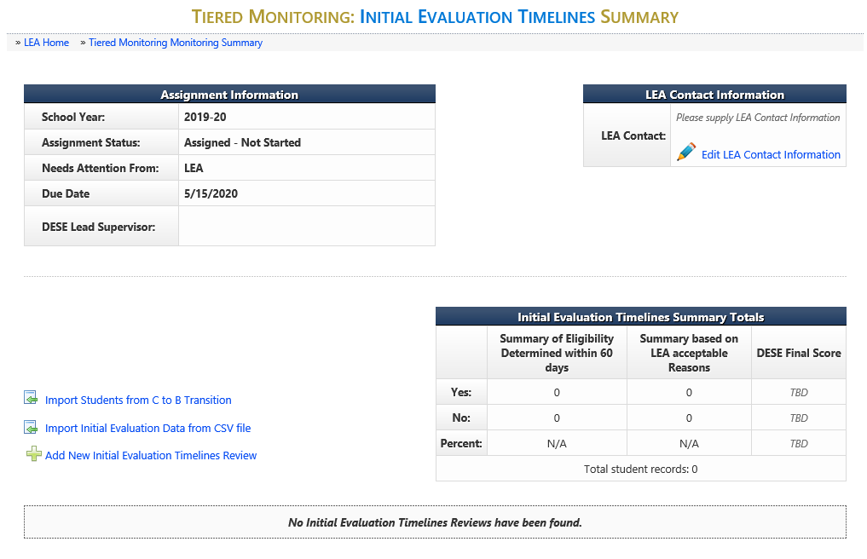
Initial Evaluation Timelines Summary
21
Notes:
There are two options for entering the Initial Evaluation Timeline information now in IMACS 2.0.
You can either compile the data collection on a spreadsheet and import that by clicking on Import Initial Evaluation Data from CSV file (green arrow) or you can enter each student individually by clicking on Add New Initial Evaluation Timelines Review (blue arrow).

Slide 28
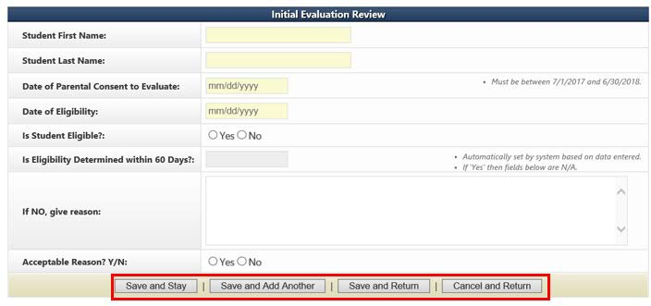
Adding New Student Timeline Data Individually
22
If you decide to enter your timeline data one student at a time in IMACS 2.0 by clicking on Add New Initial Evaluation Timelines Review then you will see the familiar student demographic screen below.
Notes:
There are reminders on the student demographic screen reminding you of important dates.
When the timeline is not met (exceeded 60 days) the LEA will need to make sure that specific dates that the student was absent or school was not in session are put into the “If NO, give reasons:” box.
At the bottom of the screen there are many save options. Save and Stay will keep you on the same page after saving the material. Save and Add Another will save the student you just finished working on and give you a new student demographic screen to begin the next student. Save and Return will save the student you just finished working on and then take you back out to the main timeline page.
As you enter students you do have the option to edit (pencil icon) or delete (red cross) your entry on the right hand side of the main Initial Evaluation Timeline Summary page.

Slide 29
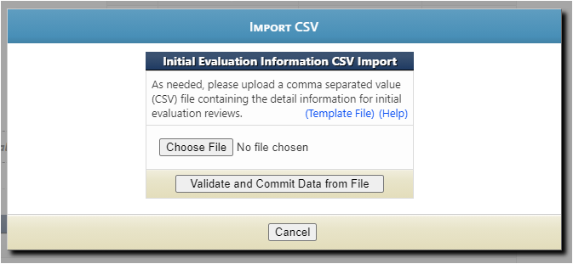
Importing Data from CSV file
23
Click on the blue Template File to use the blank Excel template that DESE created.
Click on the blue Help to read the directions for preparing the CSV/TXT upload.
Click on Choose File to locate the CSV/TXT document and to upload from your computer.
Click on Validate and Commit Data from File once you are done with everything.

Slide 30
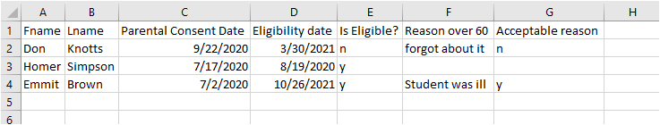
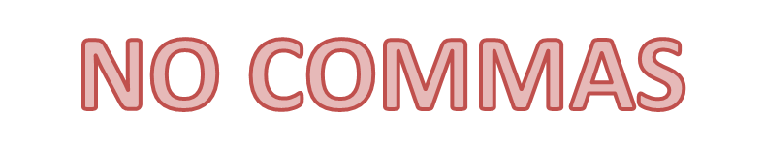
Importing Student Data for Initial Evaluation Timelines
24
IMACS 2.0 Student Information Upload for Initial Evaluation Timeline
The file can have an extension of .csv or .txt.
Upon submitting a file, the website will first validate and if valid will then prompt the user to commit the data.
The file must contain column headings at row 1.
Data rows should contain only information intended for Initial Eval Reviews.
'Parental Consent Date' column must be a Valid Date: MM/DD/YYYY.
'Date of Eligibility‘ column must be a Valid Date: MM/DD/YYYY and must not come before 'Parental Consent Date'.
'Is Student Eligible' column must be a 'Y' or 'N' value.
'Reason 60 Days' column is only required if student eligibility was not determined within 60 days.
If required, 'Is Acceptable Reason' column must be a 'Y' or 'N' value.
'Is Acceptable Reason' is only required if eligibility not determined within 60 days and must be a 'Y' or 'N' value.
Notes:
When the timeline is not met (exceeded 60 days) the LEA will need to make sure that specific dates that the student was absent or dates school was not in session are put into the “If NO, give reasons:” field. Do NOT use any commas within dates. Do not use any commas or hard returns within the description of the reason why the evaluation exceeded 60 days. Using commas and hard returns will result in data corruption in your upload because the system uses commas to separate the data being reported.
The system will allow as many CSV/TXT imports as needed. It will take the file and add the data to the existing records with no overwriting of previous information. Please review records in IMACS to make sure that there are no duplicates before submitting the Timelines for review.
After student timelines have been uploaded, you do have the option to edit (pencil icon) or delete (red cross) your entry on the right hand side of the main Initial Evaluation Timeline page.

Slide 31
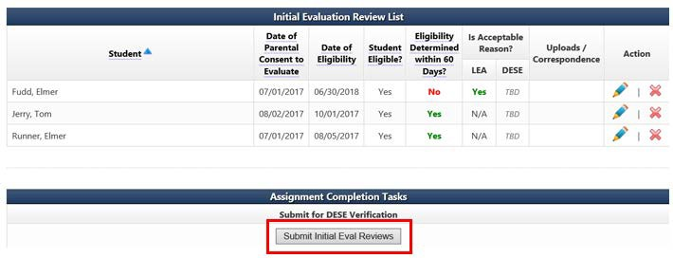
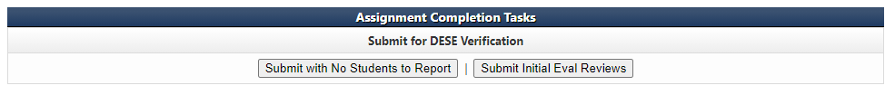
Submitting Initial Evaluation Reviews
25
After the district has entered the individual student information, the district will submit the initial evaluation review.

Slide 32
C to B Transition Summary Page
Add the C to B Transition Timelines information by going to the LEA home page and clicking on the C to B Transition review type.

Slide 33
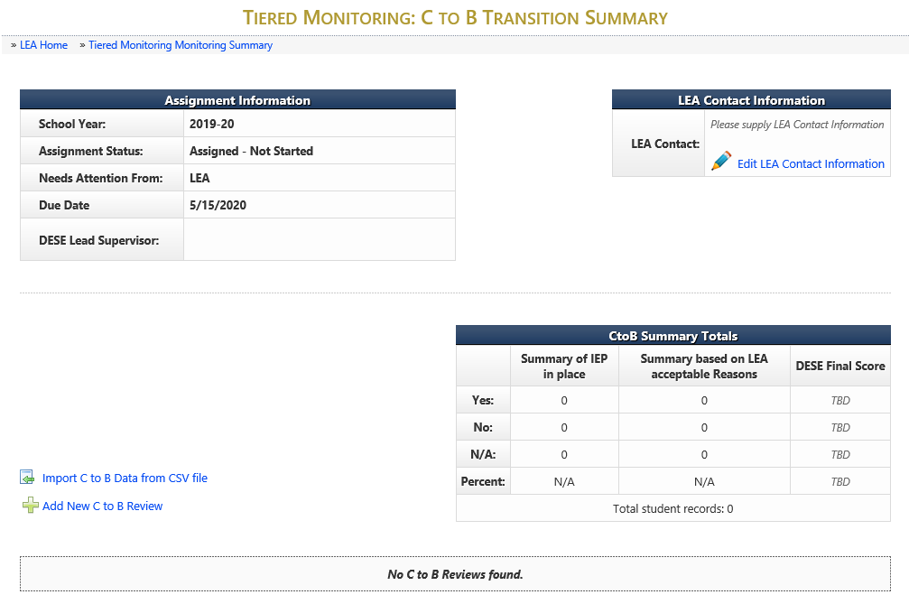
C to B Transition Summary
28
Notes:
There are two options for entering the C to B Transition information now in IMACS 2.0.
You can either compile the data collection on a spreadsheet and import that by clicking on Import C to B Data from CSV file (green arrow) or you can enter each student individually by clicking on Add New C to B Review (blue arrow).

Slide 34
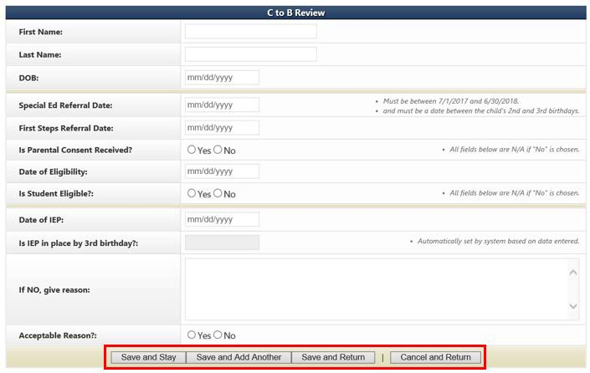
C to B Transition Review
28
Once completed, select the “Save and Stay,” “Save and Add Another,” or “Save and Return” button.
Notes:
Special Ed Referral Date and First Steps Referral Date are two different dates!
Special Ed Referral Date is the date the LEA received the directory information from First Step.
First Steps Referral Date is the date that the child was first referred for First Steps services.
When IEP is not in place by the 3rd birthday, the LEA will need to make sure that specific dates that the student was absent or school was not in session are put into the “If NO, give reasons:” box.

Slide 35
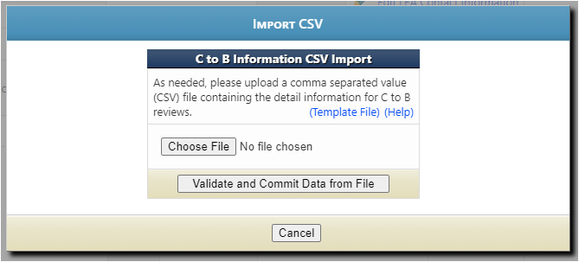
Importing Data from CSV file
Click on the blue Template File to use the blank Excel template that DESE created.
Click on the blue Help to read the directions for preparing the CSV/TXT upload.
Click on Choose File to locate the CSV/TXT document and to upload from your computer.
Click on Validate and Commit Data from File once you are done with everything.

Slide 36
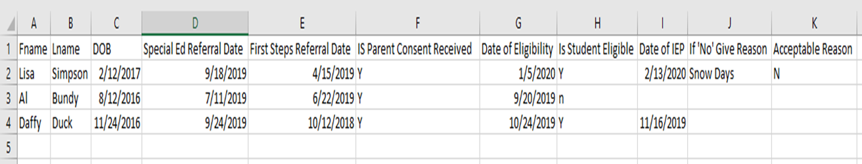
Importing Student Data for C to B Transition Timelines
IMACS 2.0 Student Information Upload for C to B Transition Timeline Follow-Up
The file can have an extension of .csv or .txt.
Upon submitting a file, website will first validate and if valid will then prompt the user to commit the data.
The file must contain column headings at row 1.
Data rows should contain only information intended for C to B Reviews.
'DOB' column is required and must be a Valid Date: MM/DD/YYYY.
'Special Ed Referral Date' column is required and must be a Valid Date: MM/DD/YYYY.
‘First Steps Referral Date’ column is required and must be a Valid Date: MM/DD/YYYY.
'Is Parental Consent Received' column must be a 'Y' or 'N' value.
If 'Is Parental Consent Received' is 'N' the following fields are not required.
'Date of Eligibility' column must be a Valid Date: MM/DD/YYYY and must not come before 'First Steps Referral Date'.
'Is Student Eligible' column must be a 'Y' or 'N' value.
If 'Is Student Eligible' is 'N' the following fields are not required:
‘Date of IEP’ column must be a Valid Date: MM/DD/YYYY.
'If 'No' Give Reason' column is required if IEP was not in place by 3rd birthday.
'Is Acceptable Reason' column required if IEP was not in place by 3rd birthday and must be a 'Y' or 'N' value.
Notes:
The system will allow as many CSV/TXT imports as needed. It will take the file and add the data to records already uploaded with no overwriting of previous information.
When IEP is not in place by the 3rd birthday, the LEA will need to make sure that specific dates that the student was absent or school was not in session are put into the “If NO, give reasons:” box. Do NOT use any commas within dates or when describing reasons. Do not use hard returns. Using commas and hard returns will result in data corruption in your upload because the system uses commas to separate the data being reported.
Please review records in IMACS to make sure that there are no duplicate records before submitting the Timelines for review.
After student C to B transition timelines have been uploaded, you do have the option to edit (pencil icon) or delete (red cross) your entry on the right hand side of the main C to B Transition Timeline page.

Slide 37
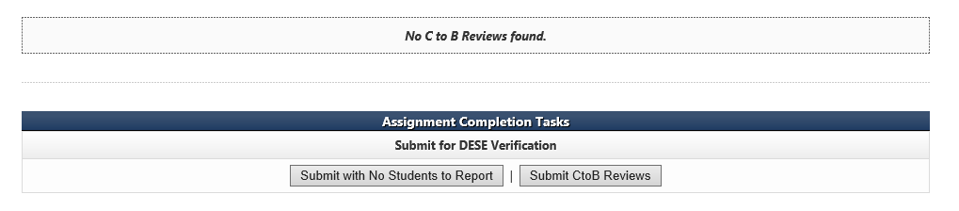
Submitting the C to B Transition Review
31
After the district has entered the individual student information, the district will need to submit the C to B Transition reviews.
If there are no C to B students then the LEA with select the Submit with No Students to Report button.

Slide 38
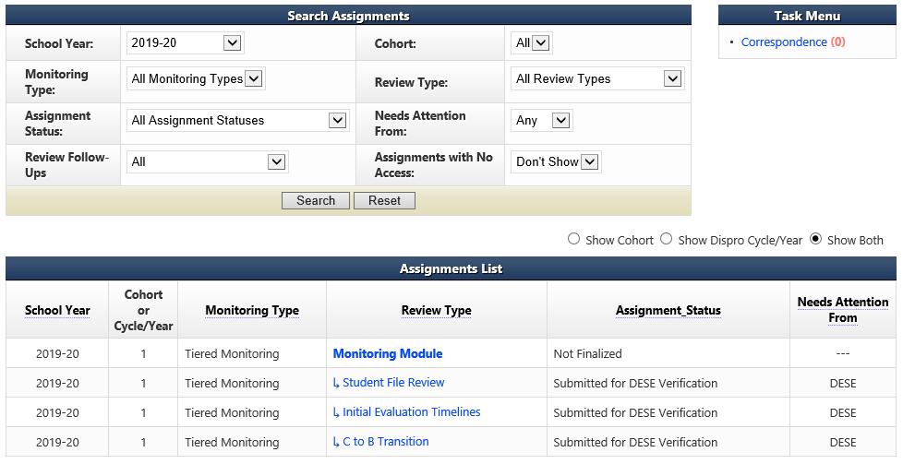
Self Assessment Completed
32
Once all the portions of the Self-Assessment are submitted to DESE the LEA’s home page will look like the screen shot below. When DESE has completed their portion of the review it will read Finalized next to Monitoring Module.
Notes:
The CAP Year Training & Guidance can be found at https://dese.mo.gov/sites/default/files/se-compliance-CAP-Training.pdf if you would like a preview of what it to come.

Slide 39
Reminders
33
All communication between DESE and LEAs regarding compliance monitoring or containing Personally Identifiable Information (PII) will be housed in IMACS 2.0.
The system will send an email notification to the Special Education contact and DESE each time information has been submitted or returned.
Districts will have the ability in IMACS 2.0 to upload requested documentation to the individual student record at any time in the process.
Districts will answer significantly fewer indicators than in previous years. DESE tailors file reviews according to each LEA’s Special Education Performance Data.

Slide 40
Compliance Consultants
Region | Compliance Consultant | Phone Number | Email
Southeast | Tiffiney Smith | 573-651-2621 | tdsmith@semo.edu
2. Heart of Missouri | Lynn Lynch | 573-882-7553 | lynchly@missouri.edu
3. Kansas City | Bailey Tennesen | 816-235-5957 | tennesenb@umkc.edu
4. Northeast | Dawn Lichtenberg | 660-785-4310 | dlichtenberg@truman.edu
5. Northwest | Julia Schmitz | 660-562-1995 | julia@nwmissouri.edu
6. South Central | Leasa Day | 800-667-0665 | ldnd3@mst.edu
7. Southwest | Amy Phipps | 417-836-4082 | amyphipps@missouristate.edu
8. St. Louis | Jeanne Rothermel | 314-724-6736 | jrothermel@edplus.org
9. Central | Julie Harris | 660-543-4274 | jlharris@ucmo.edu

Slide 41
Helpful links for Tiered Monitoring and IMACS
Self Assessment Google Folder:
  Copies of both PowerPoints present today
  Top Ten Non-Compliance Calls
  List of indicators used in the file review
DESE’s Self-Assessment (Year 1) Guidance and Resources
  Copies of both PowerPoints present today
  List of Things to Remember for Self-Assessment
  Self-Assessment Procedures for Monitoring
  LEA Special Education Compliance Monitoring Checklist
  Tiered Monitoring Flowchart

Slide 42

Resources
Office of Special Education
Special Education Compliance (Part B)
P.O. Box 480, Jefferson City, MO 65102-0480
Phone: 573-751-0699
Email: secompliance@dese.mo.gov
Notes:
This slide shows one of your best resources – the Compliance staff at the Office of Special Education. We encourage you to call or email if you have questions or need assistance.

Slide 43

The Department of Elementary and Secondary Education does not discriminate on the basis of race, color, religion, gender, national origin, age, or disability in its programs and activities. Inquiries related to department programs and to the location of services, activities, and facilities that are accessible by persons with disabilities may be directed to the Jefferson State Office Building, Director of Civil Rights Compliance and MOA Coordinator (Title VI/Title IX/504/ADA/ADAAA/Age Act/GINA/USDA Title VI), 5th Floor, 205 Jefferson Street, P.O. Box 480, Jefferson City, MO 65102-0480; telephone number 573-526-4757 or TTY 800-735-2966; email civilrights@dese.mo.gov.

