Slide 1
Beginning of the School Year Special Education Hot Topics
Bailey Tennesen KC-RPDC & Leasa Day South Central RPDC
August 2022
Notes:
Bailey -
Good Morning, my name is Bailey Tennesen and I am the Kansas City RPDC- Special Education Compliance Consultant. With me today is my dear friend and colleague Leasa Day who is a SPED Compliance Consultant from the South Central RPDC

Slide 2
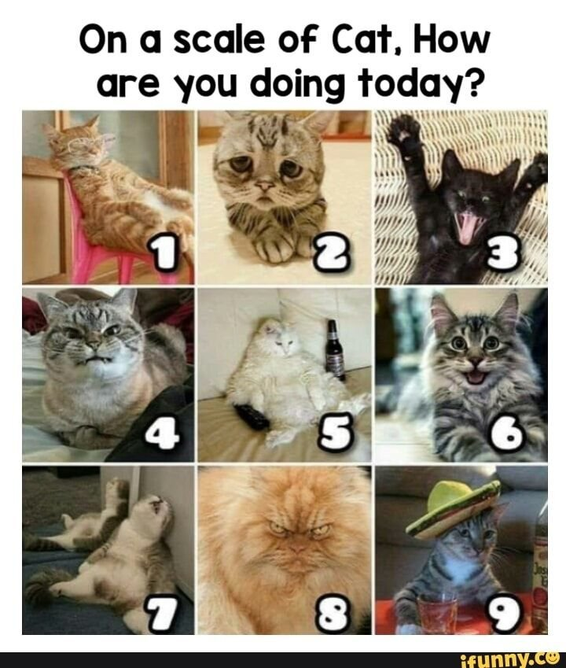
Tell Us in the Chat
Notes:
In the chat, please type a number of how you are feeling today... if you also want to add an explanation feel free to!

Slide 3
Zoom Support Meeting Norms
Mute unless you are speaking to the group
Use the chat to ask questions
Be mindful when asking questions about specific situations. Do not give out personally identifiable information.
Remember all questions in the chat will be gathered and answered later date. A Q&A will be posted at a later date on our virtual special education resource page.
Notes:
Read Slide

Slide 4
Objectives for Today
State Plan Updates
Local Compliance Plan Reminder
Special Education Form Updates
Special Education Hot Topics
Transfers
Seclusion and Restraint
IEP Implementation
Resources
To- Do List
Myths of the Month
Virtual Special Education Resources
Notes:
Read Slide

Slide 5
State Plan Updates
Effective June 30th, 2022
Notes:
We are going to get things started with the Missouri State Plan Updates. These updates have been effective since June 30th 2022. One suggestion that I would have is that you print off a new/updated copy of both the Missouri State Plan and Standards and Indicator and place them in a binder and have them readily available. They will come in handy as the school year kicks off

Slide 6
Regulation III
Identification and Evaluation
Page 27
Add two additional titles to the list of qualified personnel who can evaluate and identify a health impairment. It would read:
A student displays a Health Impairment when: (1) A health impairment has been diagnosed by a licensed physician, licensed assistant physician, Missouri State Board of Nursing recognized advanced practice registered nurse, licensed psychologist, licensed professional counselor, licensed clinical social worker, or school psychologist
Notes:
The first update that we will talk about today is in regards to Other Health Impairment qualifications:
Reasoning for Change: Physician assistants and advanced practice registered nurses are authorized to evaluate and treat patients, including prescribing medications, under the direct supervision of a licensed medical doctor. Accepting diagnostic reports from physician assistants and nurse practitioners will make it easier for parents and school staff to get access to medical personnel qualified to evaluate children.

Slide 7
Regulation IV
Other Measures to Ensure Parent Participation
Page 52
If neither parent can attend, the public agency shall use other methods to ensure parent participation, including individual or conference telephone calls, or video conferences, consistent with 34 CFR 300.328
Notes:
Our next change comes on page 52 and this change deals with ensuring parent participation at IEP meetings. DESE has now included video conferences as an alternative mean of parents participating in meetings. This change is consistent with IDEA 34 CFR 300.328

Slide 8
Regulation IV
In-State Transfers
Page 54
If the public agency does not agree with the current evaluation report, it must initiate a reevaluation as described in this State Plan. During the time that the reevaluation is being conducted, the agency shall implement the IEP, as written, from the sending agency or develop an IEP provide comparable services until the reevaluation is complete. Changes made to be consistent with 34 CFR §300.323Transfer within the same state. There is no requirement to develop an interim IEP.
Notes:
Our next change is on page 54 of the state plan which deals with In -State Transfers. During the time a reevaluation is being conducted, the agency should implement the IEP as written from the sending agency and provide comparable services until the reevaluation is complete. We took out that school districts need to develop an interim IEP which is consistent with 330.323.

Slide 9
Regulation V
Procedural Safeguards/ Discipline
Page 66
Add the following sentence to the section describing parental consent for reevaluations:
Informed parental consent need not be obtained if the public agency can demonstrate it made reasonable efforts to obtain such consent and the child’s parent failed to respond.
Notes:
When looking at page 66 which discusses parental consent for reevaluations.
In this section it discusses how the LEA must obtain informed parental consent, prior to conducting any reevaluation of a student with a disability. If the parent refuses to consent to the reevaluation, the public agency may but not required to purse the re evaluation by using the consent override procedures (mediation/ due process). The public agency does not violate its obligation under child find or evaluation if it declines to purse the evaluation or reevaluation. After this portion, DESE compliance added a sentence describing an exception to the consent requirement included in 34 CFR § 300.300(c) to make this section consistent with IDEA regulations. Please note that it states FAILED TO RESPOND this is different than a parent refusing to sign.

Slide 10
Regulation VIII
Speech Implementer
Page 105
Removed the title, responsibilities, educational qualifications and certificates or license requirements for Speech
Implementer. LEAs will no longer be allowed to use the speech implementer model beginning with the 2022 - 23 school year.
Notes:
The entire section of Speech Implementer has been removed due to LEAs will no longer being allowed to use the speech implementer model. This went into effect at the beginning with the 2022 -23 school year.

Slide 11
Regulation XVI
MSSD
Page 152
(9) (3)
At any time the IEP Team may determine, based on general functioning level and IEP goal progress shown, that the student is no longer eligible for MSSD, either because MSSD can no longer provide FAPE in the least restrictive environment.
Notes:
The last portion of the state plan to be updated was the MSSD section. In the MSSD referral section in the state plan we revised this section to make it clear that local public agencies are responsible for determining placement in the least restrictive environment. This alsoincludes when MSSD is no longer the appropriate placement.

Slide 12
Regulation XVI
MSSD
a.
The student’s cognitive and adaptive levels of functioning and performance at school no longer demonstrate a need for pervasive levels of supports across all life areas and a separate school placement no longer appears to be the student’s least restrictive environment,
or
b.
A separate school placement is no longer the student’s least restrictive environment because he or she demonstrates a need for homebound instruction that exceeds the scope of what would reasonably be considered intermittent in nature.
Notes:
We then decided to Remove the reasons why MSSD would no longer be able to provide FAPE in the LRE because IEP teams should apply the process for determining least restrictive environment. These two examples are not the only two possible reasons for changing least restrictive environment.

Slide 13
Regulation XVI
MSSD
In such instances, the public agency representative convenes the IEP Team, including a representative of MSSD, convenes to review/revise the IEP to consider determine placement in the least restrictive environment. The Team should consider IEP goal progress data, other existing data in the education record, information in from the most recent reevaluation, and any relevant medical information. MSSD will develop an IEP based on the IEP Team’s decisions, including services and IEP goals to be implemented by the public agency in accordance with the IDEA transfer processes, when the student re-enrolls at the public agency. The public agency will provide the parent with prior written notice of the change in placement and change in services
Notes:
Last but not least , when MSSD is no longer the appropriate placement, the public agency convenes the IEP team to change the placement in the least restrictive environment.
We also removed the reference to the transfer student process because the local public agency is responsible for determining placement when the student attends MSSD and continues to be responsible when placement in the LRE changes.

Slide 14
Adopting/Adapting the Local Compliance Plan
http://dese.mo.gov/local-compliance-plan
Notes:
Federal regulations implementing Part B of the Individuals with Disabilities Education Act (IDEA) require responsible public agencies providing for the education of children with disabilities within their jurisdiction to have in effect policies, procedures, and programs that are consistent with the state policies established under applicable federal regulations. At this time, the Office of Special Education has published an updated model Local Plan for Compliance which is consistent with the provisions in the Missouri State Plan for Special Education which became effective June 30, 2022. This document is available on our website at http://dese.mo.gov/local-compliance-plan.

Slide 15
Remember:
Public agencies must adopt or adapt a Local Compliance Plan and, by October 1, 2022
Please note: Even if your agency does not receive any IDEA Part B funds, your agency is still required to have a local compliance plan and submit annual assurances to DESE regarding the provision of services to students with disabilities under the IDEA.
Notes:
Remember that public agencies must adopt or adapt their local compliance plan by October 1st, 2022. This means that you will want to make sure that the local compliance plan is apart of the agenda for September school board meeting

Slide 16
Step 1: Local Compliance Plan Options
Option A.
Adopt the model plan provided by the Department of Elementary and Secondary Education (DESE). If the agency adopts the state’s model plan, it is automatically approved by DESE. You do not need to submit a copy of your plan to DESE, but a certification statement must be submitted.
Option B.
Adopt the model plan with local revisions. The agency must submit a copy of the pages on which revisions have been made with the revisions highlighted. These revisions must be approved by DESE before the agency’s compliance becomes final. (Note: Simply placing your agency’s name into the model plan does not constitute a revision. Revisions are substantive changes to the content of the plan.)
Option C.
Write your own compliance plan. The agency must submit a copy of the plan for approval by DESE. The agency’s plan will not become final until receipt of approval from DESE.
Notes:
Step 1. Your agency must choose one of the following options for their local compliance plan

Slide 17
Step 2:
Your agency’s governing board must approve the Local Compliance Plan and complete the enclosed certification statement. (see notes 1-4)
If your agency’s governing board chooses Option B or C please contact DESE for documents needed at Ashley.Buchmiller@dese.mo.gov.

Slide 18
More information:
https://dese.mo.gov/local-compliance-plan
Notes:
On this webpage- you can access instructions on your local compliance options and also view the Model Missouri Local Compliance Plan

Slide 19
Step 3:
For all options listed above, submit the certification statement to the address below. The certification can be found at: https://dese.mo.gov/media/pdf/certification-statement .
Also, submit the model compliance plan to DESE only if required in accordance with the instructions in Step 1, option B or C.
All required documentation is to be submitted to:
MO Department of Elementary and Secondary Education Office of Special Education-Compliance
Attn: Ashley Buchmiller
P.O. Box 480
Jefferson City, MO 65102
Fax: 573-751-3910

Slide 20
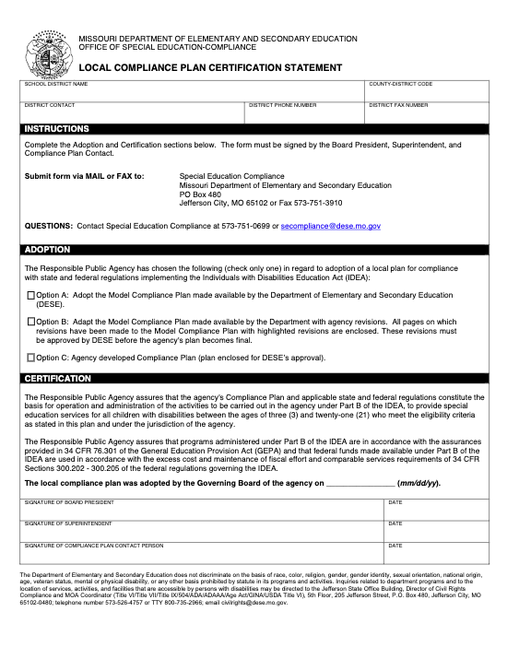
Certification Statement
https://dese.mo.gov/media/pdf/certification-statement
Notes:
PLease note that it should be signed by the board president, the superintendent and the compliance plan contact person (typically the sped director).

Slide 21
DESE Special Education Form Updates
Notes:
The last big updates that I would like to speak with you all is on our new and improved Special Education Forms.

Slide 22
Review of Existing Data
Health/ Motor Section is now split into two separate sections
Removed the term “Central Auditory Processing (CAP)” from the Hearing Section to the Language Section of the RED
Format changes:
Page 6 changed from vertical to horizontal
Reevaluation without additional assessment section asked for the team to provide data to support the decision (since it replaces the evaluation report).
https://dese.mo.gov/media/file/secompliancereviewofexistingdata20220docx
Notes:
The first form that we will discuss is the RED. We have now split up the health and motor sections into two. The reasoning behind this is that we wanted to accurately gather data and get more information regarding students health and motor issues.
The next change we made is to remove the term Central Auditory Processing from the Hearing section and move it to the Language Section. The reasoning behind this is that CAP is the neurobiological activity that underlies processing and consists of mechanisms that preserve, refine, analyze, modify, organize, and interpret information from the auditory periphery. It is not just hearing something.
In the event that the team determines they have sufficient evidence to continue eligibility without assessment, DESE has included a section asking for the team to provide data to support this decision since this form replaces the evaluation report.
The last change was just a formatting change which was that we changed page 5 from vertical to horizontal for the team conclusions and decisions.

Slide 23
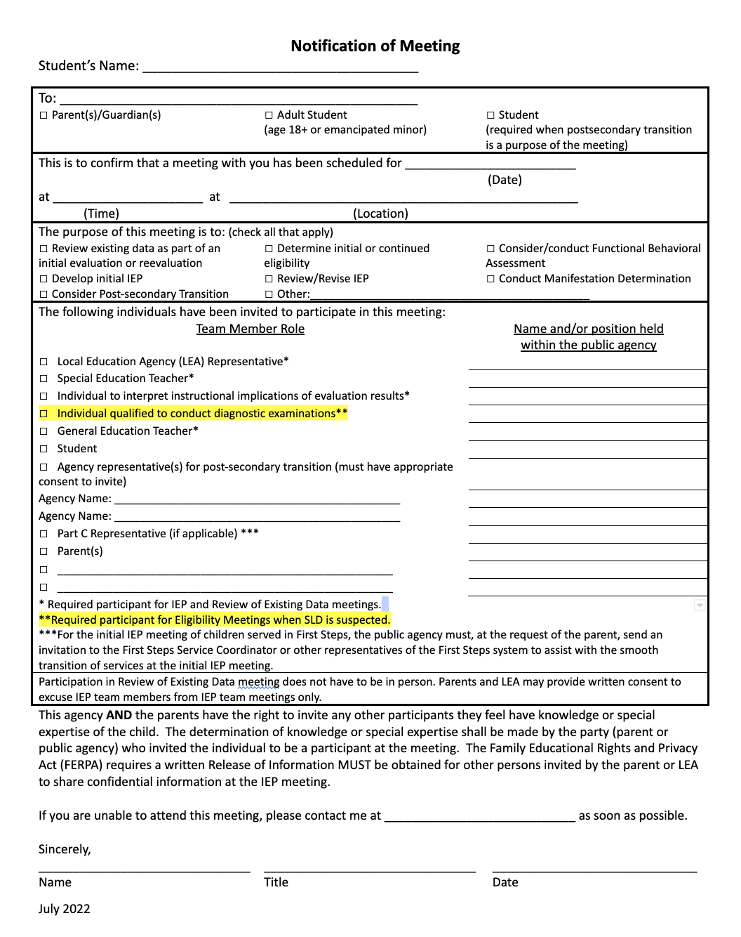
Notification of Meeting
Added "Individual qualified to conduct diagnostic examinations" and an explanation of when you would need them
https://dese.mo.gov/media/file/secompliancenotificationofmeeting20221docx
Notes:
In the NOM we added “individual qualified to conduct diagnostic examinations as a required team member at the eligibility meeting when SLD is suspected ”. We also added an explanation in the notes on when you need them.
At the state level it was determined that there is a HUGE issue with under qualified personnel making SLD eligibility determination. When we do our desk reviews every summer we see many children identified as SLD that should not be due the teams misunderstanding of the assessment results. In order to reverse this trend we are really pushing for the people who actually understand the nuance behind the numbers to attend the meeting , in person or virtually. We are trying to stress to LEAs that there is a difference between an individual who can interpret assessment results and an individual who is qualified to conduct assessments.
Notice the asterisks and when particular team members are required. This was to provide further clarification.

Slide 24
Evaluation Report
Changed title from Case History to Background Information
Changed the Hearing, Health, Motor and Language sections to align with changes on the Review of Existing Data form
Under Team Conclusions and Decisions-added the individual sections that a report should cover
Clarified Basis for Determination
https://docs.google.com/document/d/1y_RKgZy0GOmv8Mv-9tUADvBlc57ybs3yjBQhLcVUsRg/edit?usp=sharing

Slide 25
Discipline Documentation Form for Students with an IEP
Correction: Removed the word alcohol and replaced it with weapons
https://dese.mo.gov/media/file/secompliancereviewofexistingdata20220docx
Notes:
TYPO issue- we had the word alcohol instead of weapons :(

Slide 26
Section 4b of Out of State Transfer Form
Error Corrected- Deleted the word re-evaluation and added initial evaluation. This was not a change in requirements.
https://dese.mo.gov/media/file/secomplianceoutofstatetransfer20221docx
Notes:
No change in requirements. Error was corrected on page 4 was corrected.

Slide 27
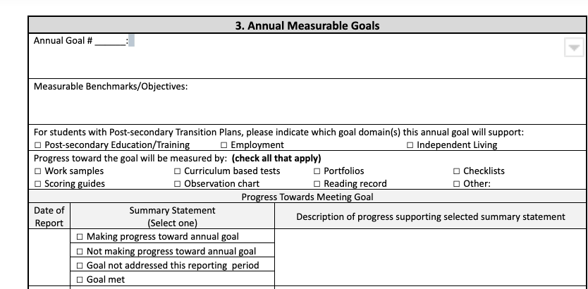
IEP
Reformatted the Progress Towards Meeting Goal
Added Description of progress supporting selected summary statement
https://dese.mo.gov/media/file/individualized-education-program-iep-form-august-2022
Notes:
The last changes that we made to the forms are on the annual IEP goal page

Slide 28
Special Education Hot Topics
Notes:
Leasa

Slide 29
Transfer Process

Slide 30
To ensure a smooth transition you need to train front office staff to LOOK, LISTEN and ASK….and then NOTIFY special education staff.
Train staff who process new enrollees to the district to listen for “trigger” words.
Check enrollment forms for common SPED language.
Have the office staff ask clarifying questions.
Notes:
Because this is one of the first activities that will occur at the start of the new school year, we will go through the transfer process compliance requirements a little bit more in depth to ensure a timely and seamless transfer from one school district to another for students with disabilities.
When receiving a new student in your district, school staff will need to look and listen for any indications the enrolling student may have been identified as a student with a disability.
The first place to begin determining if a new student is a student with a disability is with the initial contact with the school district and through the enrollment paperwork. It is important to know who in your district is responsible for this initial contact. In some districts, this can be the school building secretary or the school counselor. In other districts, it could be the principal or the registrar. No matter who it is, these staff should be trained to “look” and “listen” for indications that the new enrollee is a student with a disability since not all new students arrive at their new school with their IEP and Evaluation in hand. It is very important that these staff ensure that enrollment forms are thoroughly completed. Don’t be afraid to ask questions to clarify information the parent provides on the enrollment form!

Slide 31
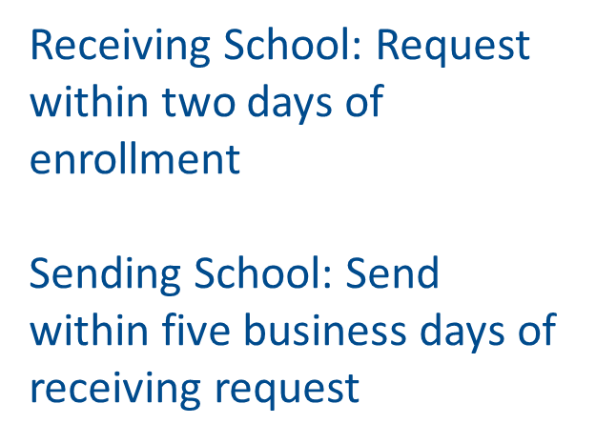
Notes:
In Missouri, the Safe Schools Act requires that receiving school districts request student records within two (2) days of enrollment. Sending Missouri school districts are required to send records within five (5) business days of receiving a request for records. Remember that FERPA allows for student records to be exchanged between LEAs when students transfer.
*Very important ---the receiving school cannot keep a student out of school pending the receipt of school records. In other words, districts cannot refuse to allow a student to begin attending school on the basis of waiting for the receipt of the special education records for a student.
Another way to gain information is the interview process. Interviews will provide valuable information. Interviews can be in person or over the phone. Interviews can be conducted with the student’s parents, with previous school staff such as the special education teacher, the school counselor, the building principal, the special education process coordinator, etc. Interviewing will provide a better picture of the types and amounts of services that a student received at their previous school than enrollment documents alone.

Slide 32
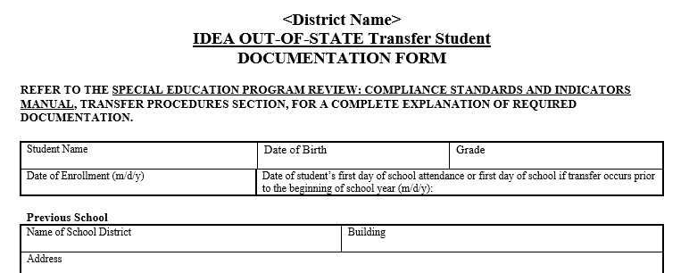
The 500s cover the In-State Transfer Process
The 550s cover the Out-of-State Transfer Process.
A LEA can accept a transfer evaluation report if they believe it is compliant and includes all information necessary to determine eligibility in the State of Missouri. If a LEA does NOT accept a transfer evaluation report because it is not compliant then:
An in-state transfer goes through the reevaluation process.
An out-of state transfer goes through the initial evaluation process.
Other key elements about transfer students with IEPs are:
IDEA requires that their Free Appropriate Public Education (FAPE) be provided during the transfer process. If paperwork is delayed from the sending school or the receiving school rejects the IEP, the public agency in consultation with the parent must provide FAPE to the child including services comparable to those in the previous IEP.
A transfer IEP can not be amended. Either it is accepted as written or a new one is written.
Notes:
In-state transfer requirements are found in the 500’s while compliance requirements for out of state transfers is found in the 550’s. There are model Transfer Documentation forms to assist LEA staff in documenting and following all of the steps in the process. These can be found in the Form section of Compliance’s website.
In some cases, students arrive at their new school with complete copies of evaluation reports and IEPs; in other instances, students enroll with little or no paperwork and incorrect information from parents regarding past special education services. The model forms are designed specifically to address the required considerations for various transfer scenarios. In addition, the Standards and Indicators Manual describes the steps in the process clearly for both options.
Key elements during the transfer process are:
Incoming Evaluation Report - One of the biggest differences between an in-state transfer and an out-of state transfer is how the evaluation report is handled. A LEA can accept a transfer evaluation report if they believe it is compliant and includes all information necessary to determine eligibility in the State of Missouri. If a LEA does NOT accept a transfer evaluation report because it is not compliant then:
An in-state transfer goes through the reevaluation process.
An out-of state transfer goes through the initial evaluation process.
IEP – If there is an IEP, the IDEA makes it clear that FAPE must be provided. There should be NO DELAY in providing special education and related services to students with disabilities that transfer between schools. Those services can be guided by accepting the previous school’s IEP, the receiving school developing a new annual IEP, OR the receiving school providing comparable services to the previous IEP until a new annual IEP can be developed.
Another point is that if your district decides to ACCEPT the IEP from the previous school, that means that the IEP from the previous school has to be implemented EXACTLY as written. That means you cannot make an amendment to a transfer IEP since it has to be implemented as written. If (or when) the team determines that the previous IEP is no longer appropriate, the previous IEP is REJECTED and a new annual IEP must be developed. Remember that there is no longer the need to develop an Interim IEP – the IEP Team will be developing the annual IEP at this point and the annual IEP can be amended or re-written as the IEP Team determines is necessary for the individual student.

Slide 33
Tips for Transfer Success
The person reviewing transfer evaluations must be familiar with MO Standards and Indicators and MO eligibility criteria.
DESE Model Transfer Forms guide the transfer process, step-by-step.
Conduct thorough interviews with parent, sending school, and student (if 18+).
Keep good documentation of consultation regarding comparable services provided until a new IEP is developed.

Slide 34
The Model Transfer Forms and Flow Charts are Found Here:
In State Transfer Model Form: https://dese.mo.gov/media/file/transfer-state-documentation-form-0
In State Transfer Flow Chart: https://dese.mo.gov/media/pdf/state-transfer-flowchart
Out of State Transfer Model Form: https://dese.mo.gov/media/file/transfer-out-state-documentation
Out of State Transfer Flow Chart: https://dese.mo.gov/media/pdf/out-state-transfer-flowchart

Slide 35
COMMON TRANSFER FACTS AND MYTHS
MYTH: Students transferring from out of state do not need to meet Missouri eligibility requirements.
FACT: The transfer report must comply with Missouri’s Standards and Indicators and meet ALL the compliance requirements for evaluation and eligibility.
MYTH: All evaluation reports and IEPs from Missouri LEAs should be accepted and implemented.
FACT: The receiving LEA must ensure the report and IEP are compliant with Missouri Standards and Indicators prior to accepting the documents.

Slide 36
COMMON TRANSFER FACTS AND MYTHS
MYTH: Transfer IEPs can be amended.
FACT: IDEA does not provide a process to allow for transfer IEPs to be amended.
MYTH: If a transfer student requires an evaluation, an interim IEP is written.
FACT: There is no such thing as an interim IEP. Comparable services should be provided while the evaluation is conducted.

Slide 37
COMMON TRANSFER FACTS AND MYTHS
MYTH: Once the LEA receives the evaluation report and IEP, there is no need to write a new IEP until the student’s annual review.
FACT: If the LEA cannot implement the IEP as written, a new IEP must be developed (usually within 30 days of enrollment). If the IEP can be implemented EXACTLY as written, there is no need to develop a new IEP until the annual review.
MYTH: Comparable services are decided solely by the LEA.
FACT: The LEA, in consultation with the parents, must determine what services are comparable to those described in the transfer IEP.

Slide 38
August 2021 Myth of the Month
Includes a comprehensive discussion of Transfer Process facts and myths:
https://dese.mo.gov/media/pdf/transfer-process-2021

Slide 39
Seclusion and Restraint

Slide 40
Disclaimer
The following slides on Seclusion and Restraint are for information purposes only.
They are not an indication that reporting and training are the duties of the LEA’s Special Education Department or the DESE Office of Special Education.
The decisions about who maintains records, files reports, and trains district personnel should be determined at the district level.
NOTE: Section 160.263, RSMo applies to all students in the district, not just special education students.

Slide 41
District Must Have Policy in Place by July 1, 2022
DESE Model Policy: https://dese.mo.gov/media/pdf/model-policy-seclusion-and-restraint-0
Notes:
MAKE SURE TO CHECK YOUR DISTRICT POLICY ON SECLUSION AND RESTRAINT-

Slide 42
Broad Overview
Districts Must:
Annually review policy and train all staff
Debrief ASAP (no later than 2 school days) after an event
Contact families the day of the event and issue a written report within 5 school days of the event – IEP or 504 Plans may include additional specifications for notification
Document the event AND report to DESE within 30 days of the event (this becomes an educational record)
You should familiarize yourself with your district policy

Slide 43
DESE Model Policy: Personnel Training
Personnel training:
LEAs shall ensure that all school personnel receive annual training and know the policy and procedures involving the use of seclusion and restraint. The training shall include
a continuum of prevention techniques;
environmental management techniques
a continuum of de-escalation techniques; and
information about the policy.
https://dese.mo.gov/media/pdf/model-policy-seclusion-and-restraint-0

Slide 44
DESE Model Policy: Personnel Who Utilizes Seclusion/Restraint
Personnel who utilize seclusion and/or restraint shall receive annual training in
de-escalation practices;
appropriate use of seclusion, inclusion, physical restraint, and mechanical restraint;
professionally-accepted practices in physical management and use of restraints;
methods to explain the use of restraint to the student who is to be restrained and to the individual’s family; and
information on the policy and appropriate documentation and notification procedures.
https://dese.mo.gov/media/pdf/model-policy-seclusion-and-restraint-0

Slide 45
Who Is Required to Follow Policy?
School personnel (includes employees of public/charter schools and/or any person, paid or unpaid, working on school grounds in an official capacity)
Publicly contracted private providers (any person working at a school function under a contract or written agreement with the school system to provide educational, behavioral, or related services)
School personnel assigned to programs not located on LEA premises (e.g., hospitals, detention centers, juvenile facilities, and mental health facilities) shall follow the policy and procedure of the facility/program where they work.
NOTE: Districts may adopt a policy prohibiting the use of seclusion and restraint.

Slide 46
Reporting the Data
Districts will determine who collects, maintains, and reports the data for the LEA.
Districts will report through the Tiered Monitoring System for all required components and will also be uploading a copy of the full incident report.
Sending district will be responsible for reporting incidents involving LEA students placed at Private Agencies. It is important that districts partner with private agencies and communicate on incidents involving S&R

Slide 47
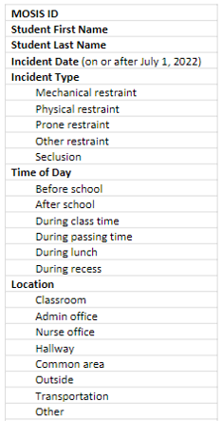
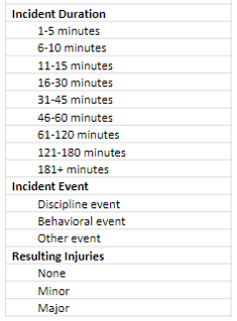
Seclusion and Restraint
Data collection fields required for each incident
Copy of the report given to parent/guardian required to be uploaded in addition the data fields shown here

Slide 48
Reporting the Data
A DESE Administrative Memo QS-22-008 was provided 7/8/22 and includes links to information about reporting incidents of seclusion and restraint.
https://dese.mo.gov/seclusion-and-restraint-policy-requirements
DESE Administrative Memo QS-22-008 includes a link to the DESE web page where you can find the reporting instructions and a template that can be used to report multiple incidents:
https://dese.mo.gov/data-system-management/core-datamosis/documentation

Slide 49
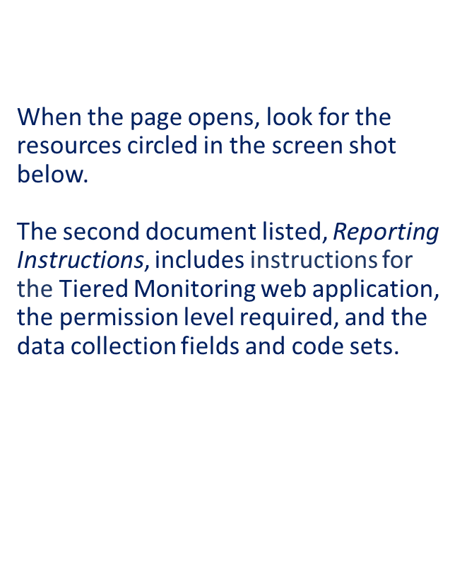
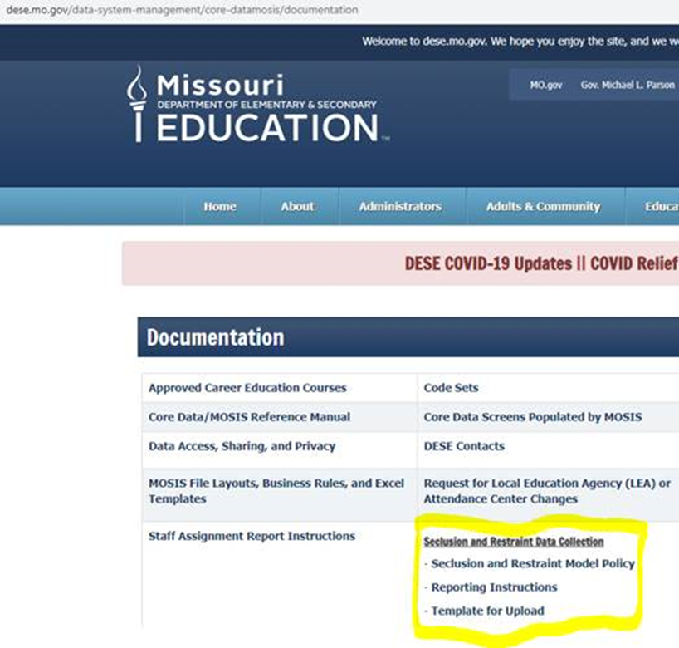
https://dese.mo.gov/data-system-management/core-datamosis/documentation
Notes:
add website

Slide 50
Reporting the Data
•Incidents will be reported through the Tiered Monitoring app in DESE’s Web Applications. This means that local education agency personnel who need access to the reporting tool in Tiered Monitoring will have to work through their agency’s User Manager for DESE Web Applications.
•The seclusion and restraint incident reporting tool in Tiered Monitoring is set up so that single incidents can be reported or a template can be used to upload multiple incidents.

Slide 51
Who can see the data?
District data will become part of a state-wide report
Report will be on the DESE portal and open to the public
The Department of Elementary and Secondary Education anticipates that there will be a lot of interest in this data. The expectation is that seclusion and restraint data be reported within the 30 day timeframe.

Slide 52
IEP Implementation

Slide 53
IEP Implementation Reminders
IEPs are a legal binding document. REMEMBER- IEP’s must be implemented within the classroom as they are written!
General Education Teachers and staff that work with students with disabilities should be provided with an IEP at a glance/summary describing the students IEP goals and accommodations/modifications at the beginning of the year.
They should understand their roles and responsibilities with students within their classroom environment.
Make sure general and special education teachers understand that accommodations/modifications need to be provided if they are marked within the IEP until an IEP amendment or IEP meeting is held

Slide 54
Resources at Your Fingertips!

Slide 55
Utilize the To-Do List
Office of Special Education shares a monthly To Do List to remind LEAs of deadlines and requirements throughout the school year.
https://dese.mo.gov/special-education/compliance/general-guidance

Slide 56
Highlights of August 2022 To Do List
Updates to State Plan, Standards & Indicators, sample forms, and other changes effective with the new school year
Important reminders about annual requirements such as FERPA training, public/private consultation, and tiered monitoring
Information about free online PD opportunities (monthly compliance ZOOMs)
August 2022 To Do List is located at: https://dese.mo.gov/special-education/compliance/general-guidance

Slide 57
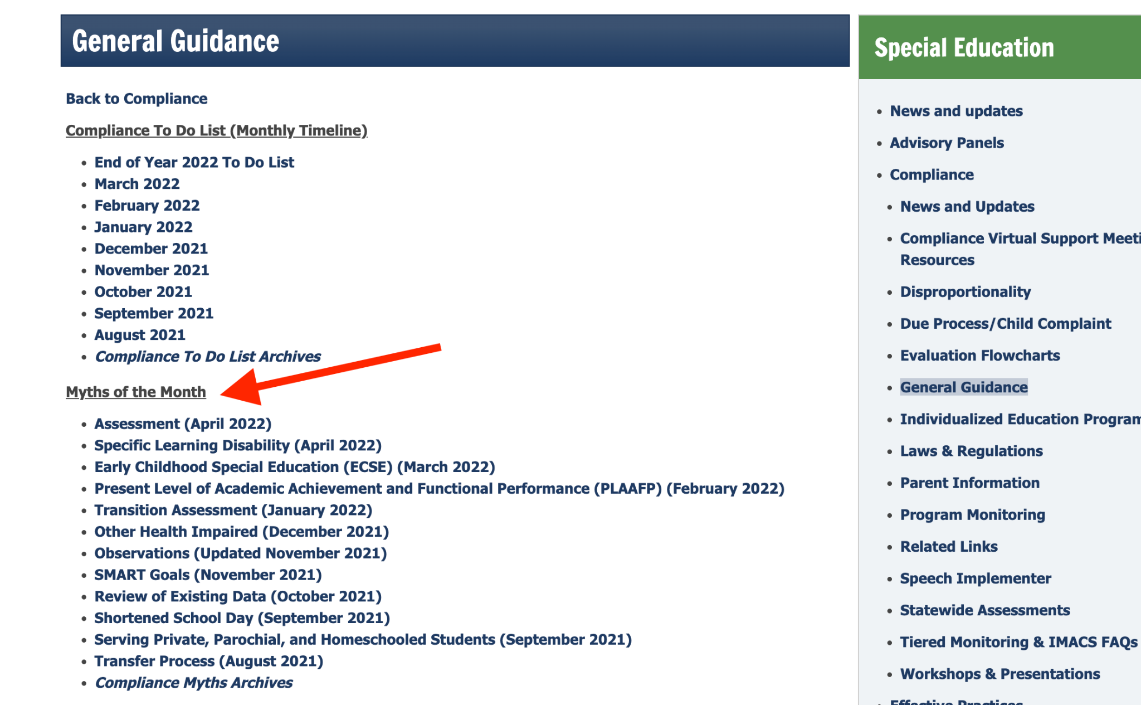
Myths of the Month
Each month DESE rolls out new information on a particular special education hot topic.
Myths of the Month provides guidance on misconceptions that surrounds topics
You can access all the myths of the month by visiting: https://dese.mo.gov/special-education/compliance/general-guidance

Slide 58
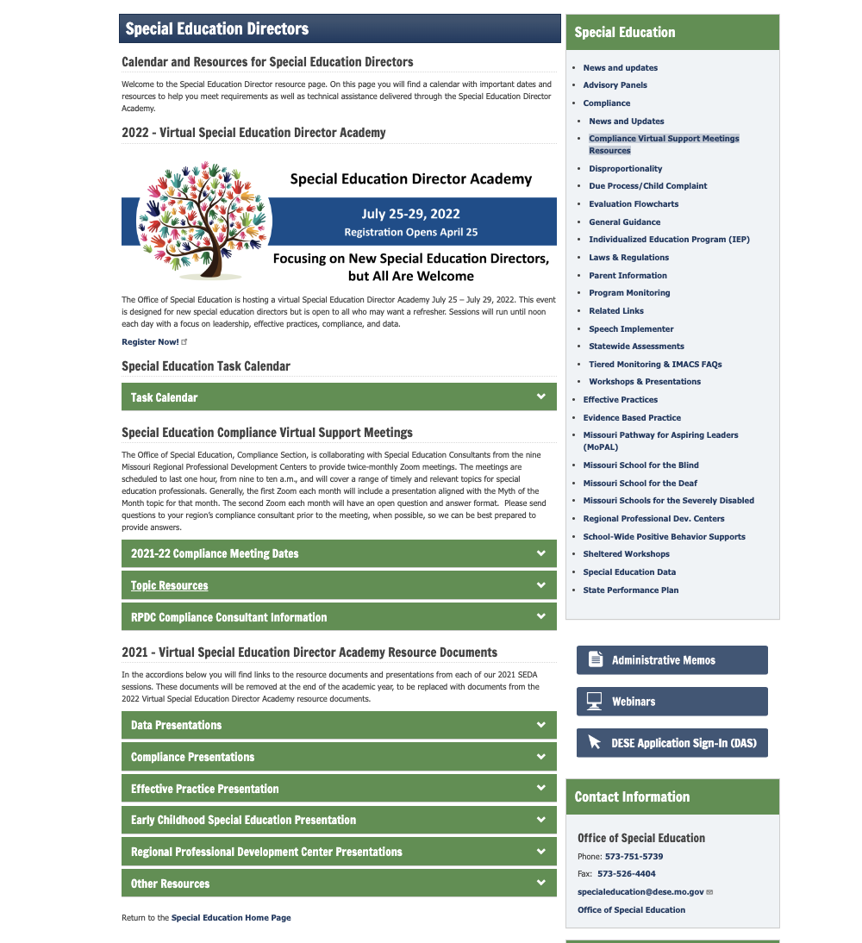
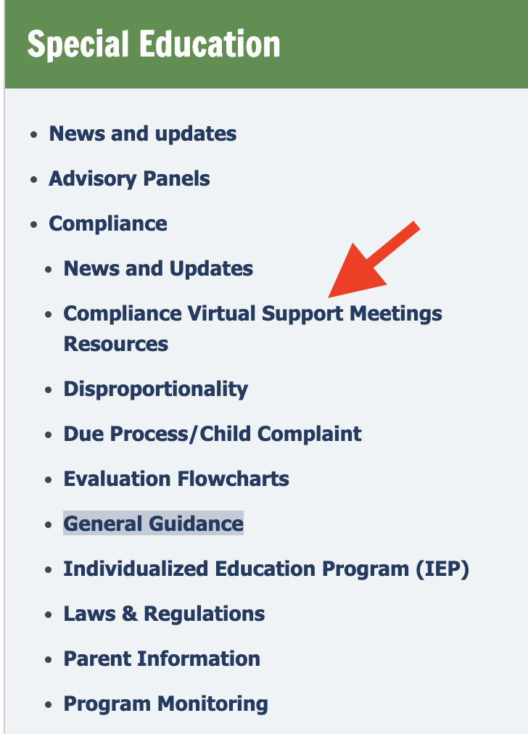
Compliance Virtual Support Resources
2.
https://dese.mo.gov/special-education/effective-practices/special-education-directors
Notes:
On this page you will find a calendar with important dates and resources to help you meet requirements as well as technical assistance delivered through the Special Education Director Academy.

Slide 59
Utilize Your Special Education Compliance Consultants

Slide 61
Thank you for your time!

