Slide 1
Alternate Assessment
August 8, 2022
MAP-A Teacher Training
Caryn Giarratano, Ph.D.
DESE Assistant Director of Assessment
Slide 1

Slide 2
Alternate Assessment
August 8, 2022
Part One: Overview
Caryn Giarratano, Ph.D.
DESE Assistant Director of Assessment
Slide 2

Slide 3
DLM Kite Programs
Educator Portal
Kite Suite
State Education Agency
Student Portal
Training Courses (Moodle)

Slide 4
Educator Portal
Enter information
Pull information
Perform tasks
STUDENT DATA
ROSTER STUDENTS
ESSENTIAL ELEMENTS
TESTLETS
REPORTS
USER NAMES
DATA EXTRACTS
TEST INFORMATION PAGE
ENROLL STUDENTS

Slide 5
Parameters of MAP-A
A student eligible for MAP-A does not participate in any other statewide standardized assessments
  EL in grades 1-12 may take the WIDA Alternate ACCESS English test
  MAP-A students are not included in national or international assessments

Slide 6
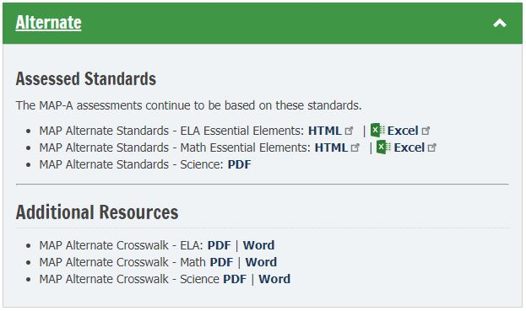
Standards and Crosswalks

Slide 7
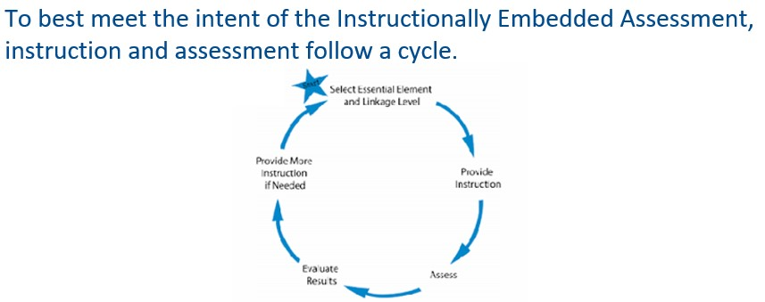
Instructionally Embedded

Slide 8
Missouri Uses Two Models
Instructionally Embedded is used for ELA and math with grades 3-8, and 11 required to test both windows
Year End is used for science with grades 5, 8, and 11 required test in the spring

Slide 9
Integrate Goals and EEs
Use the information from the Linkage Levels and Mini-Maps to plan instruction and create IEP goals.
Every goal must have a short-term objective or benchmark.

Slide 10
Alternate Assessment
August 8, 2022
Part Two: Eligibility Criteria
Caryn Giarratano, Ph.D.
DESE Assistant Director of Assessment
Slide 10

Slide 11
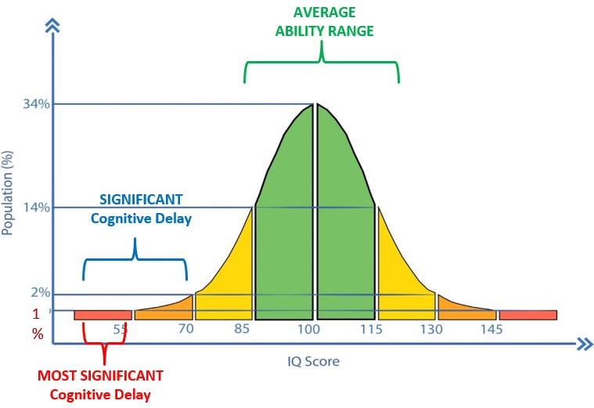
Student Eligibility

Slide 12
IDEA Guidance
Students must be assessed in the form most likely to yield accurate information on what the child knows and can do academically, developmentally, and functionally.
See Section 300.304(3)(c)(1) in the script for the full text of this section.

Slide 13
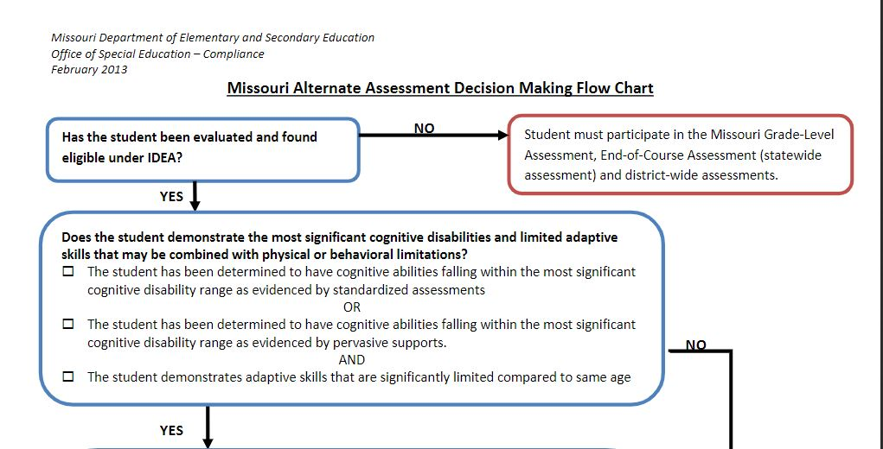
Decision Making Flow Chart

Slide 14
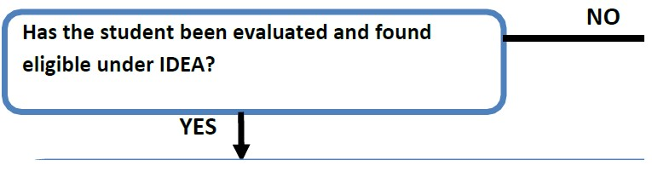
Flow Chart Step 1

Slide 15
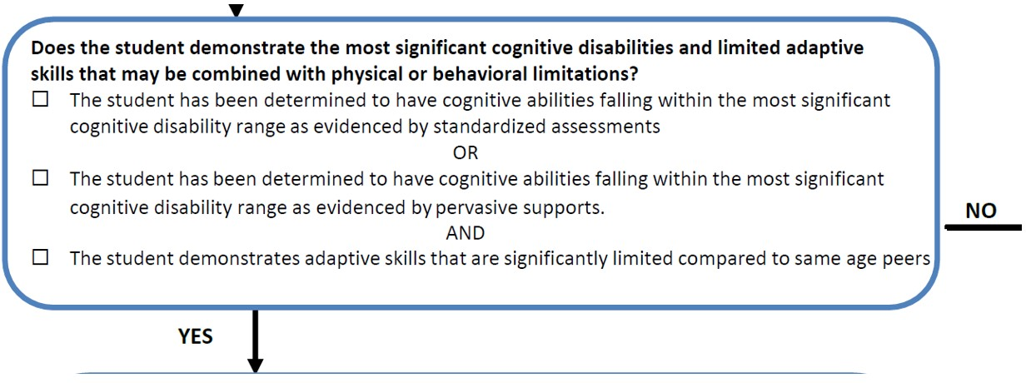
Flow Chart Step 2

Slide 16
IQ is Part of Decision-Making
IQ score not the sole criterion
Students are expected to score lower than peers
Valid score on general education tests is unachievable
Documentation shows level of support required
Skills can perform are identified
Skills have not mastered are identified

Slide 17
Student Review Areas
communication
self-care
daily living
social skills
access to community
self-direction
health and safety
functional academics
Leisure
work

Slide 18
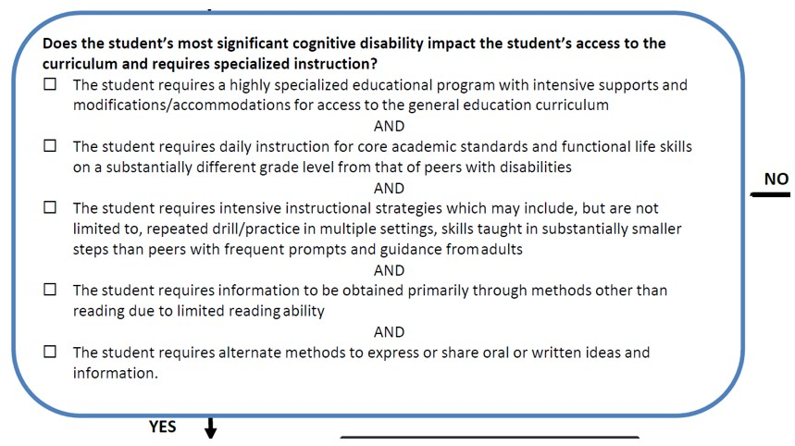
Flow Chart Step 3

Slide 19
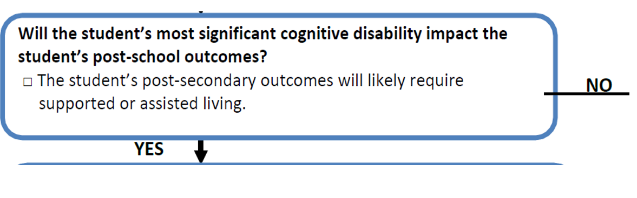
Flow Chart Step 4

Slide 20
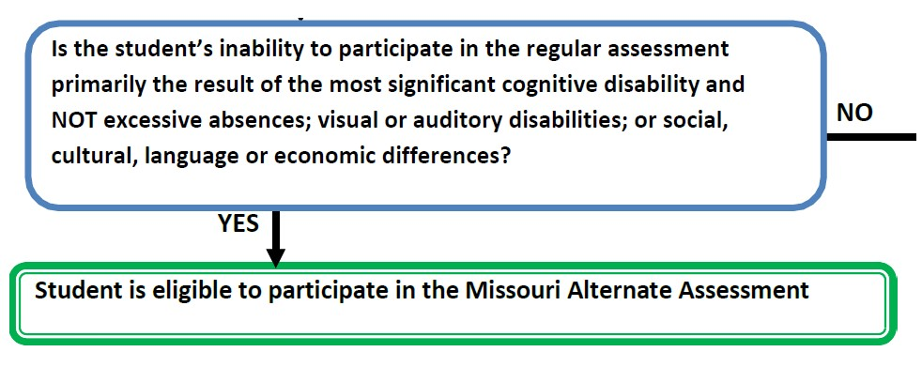
Flow Chart: Step 5

Slide 21
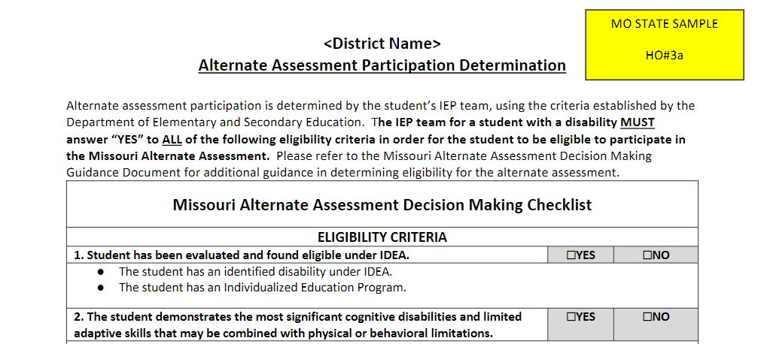
Eligibility Criteria Checklist

Slide 22
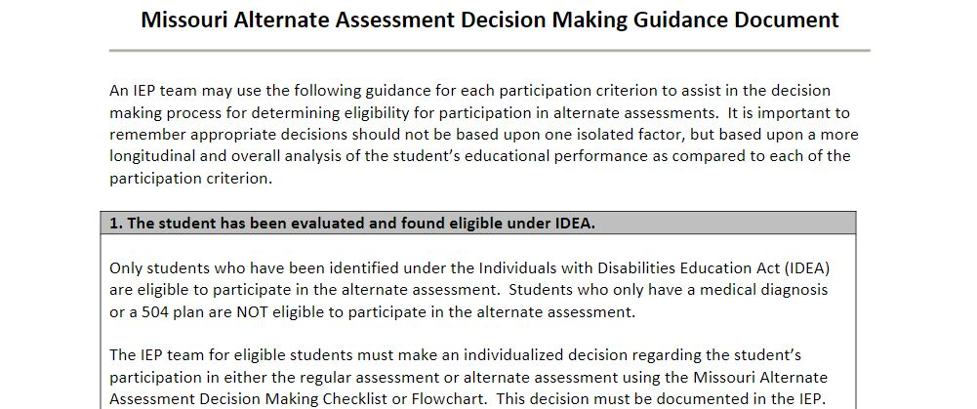
Guidance Document

Slide 23
Alternate Assessment
August 8, 2022
Part Three: Teacher Resources
Caryn Giarratano, Ph.D.
DESE Assistant Director of Assessment
Slide 23

Slide 24
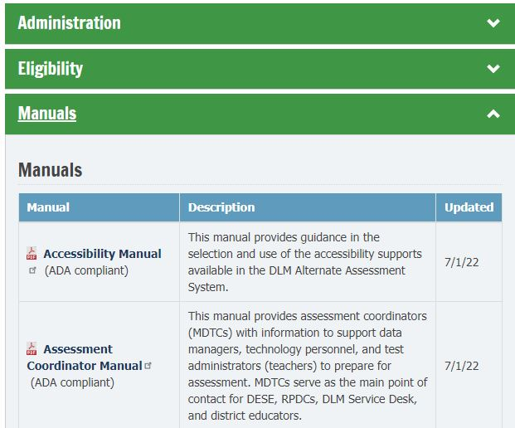
ReviewEducator Portal Manuals
Read five manuals:
Accessibility Manual
Educator Portal User Guide
Guide to Required Test Administrator Training
Guide to Practice Activities & Released Testlets IM
Test Administration Manual

Slide 25
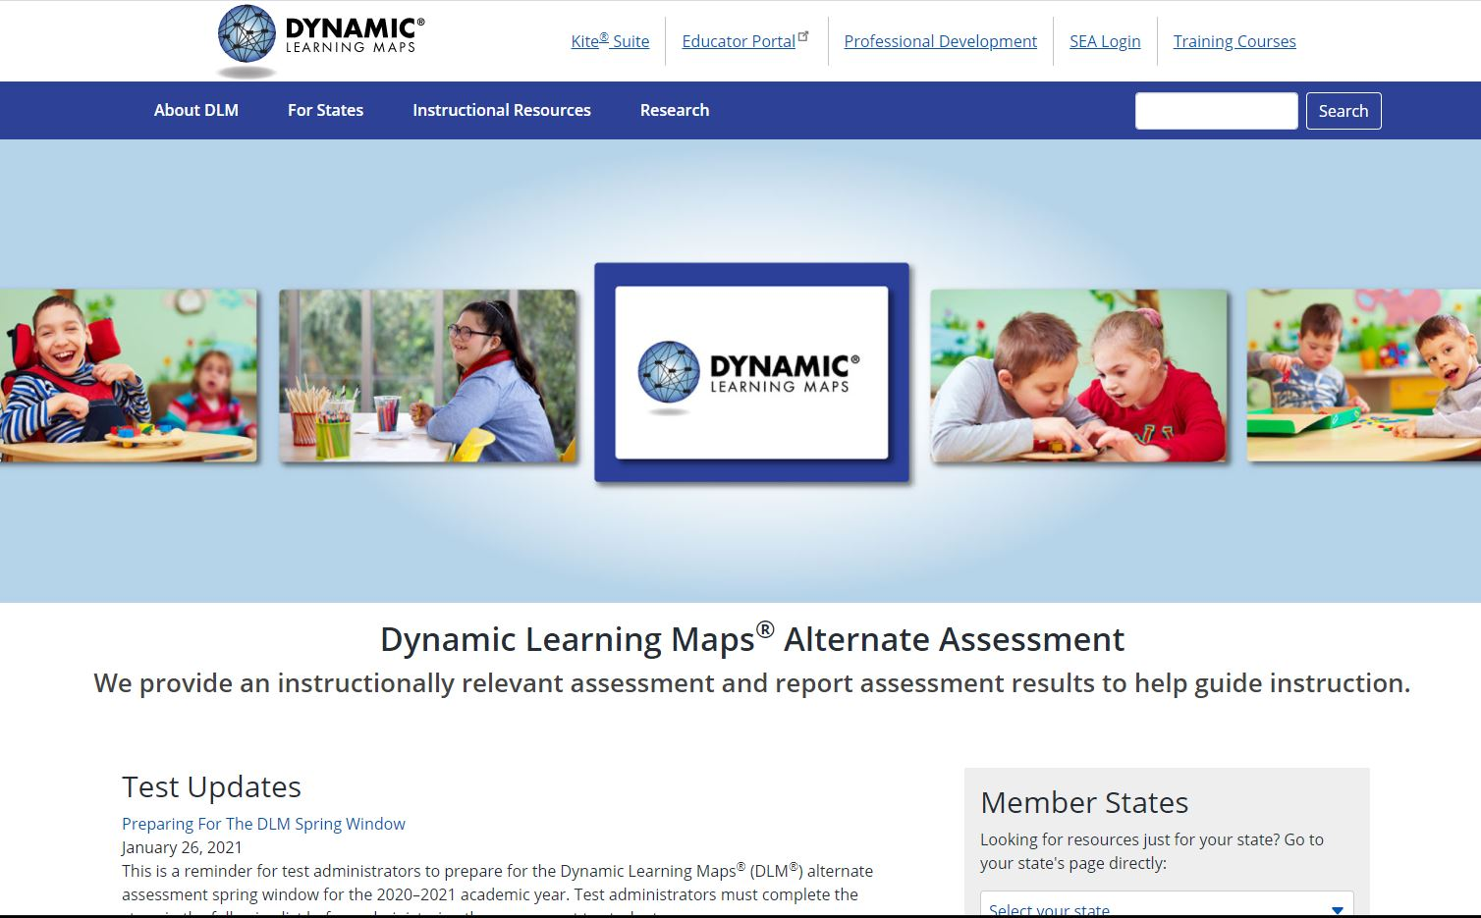

Slide 28
Find Help Learning MAP-A
An experienced coworker
MAP-A district test coordinator (MDTC)
RPDC consultant (see link in script)
DLM Service Desk (1-844-675-4479, DLM-support@ku.edu)
DESE Assistant Director of Assessment, Caryn Giarratano (573-751-6731, caryn.giarratano@dese.mo.gov)

Slide 29
Alternate Assessment
August 8, 2022
Part Four: DESE MAP-A Page
Caryn Giarratano, Ph.D.
DESE Assistant Director of Assessment
Slide 29

Slide 30
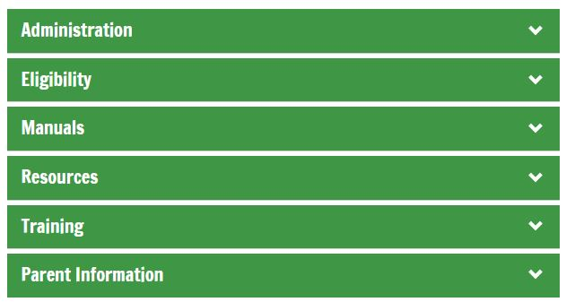
DESE MAP-A Page Tabs
  There are six tabs on the DESE MAP-A webpage to organize alternate assessment guidance documents.

Slide 31
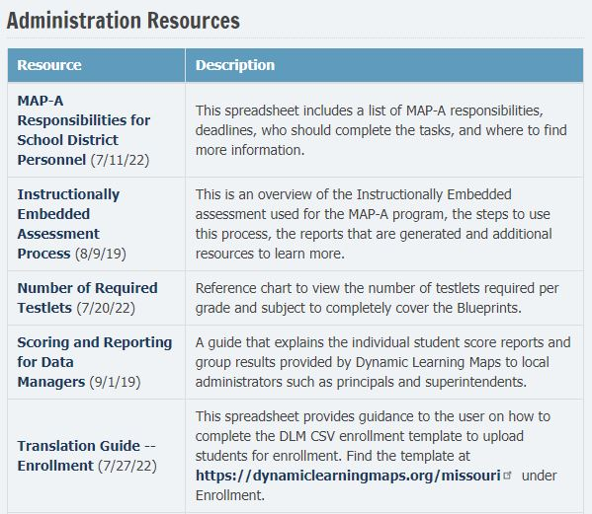
Administration Tab
Please view this guidance document for DTCs, MDTCs, data managers, and teachers, to learn MAP-A responsibilities for each.

Slide 32
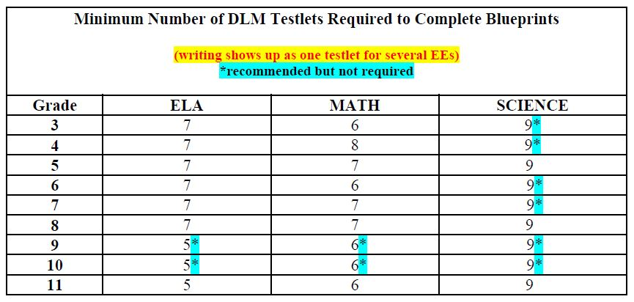
Testlets to Cover Blueprint

Slide 33
Eligibility Tab
The Eligibility tab links to the Compliance page for eligibility guidance for MAP-A students, with links to Form D, Form E, the IEP Form, Assessment Checklist, Decision-Making Flow Chart, and Decision-Making Guidance Document.

Slide 34
Manuals Tab
Links to the 11 Dynamic Learning Maps manuals are kept here for school district personnel’s convenience. Please note that there are guidance manuals for teachers, MDTCs, technology people, and data managers.

Slide 35
Resources Tab
Blueprints
Performance Level Descriptors
Kite Collector information
Student Portal closure procedure on a Mac How to submit student writing samples

Slide 36
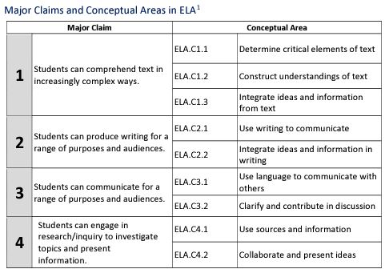
Blueprint Claims and EEs

Slide 37
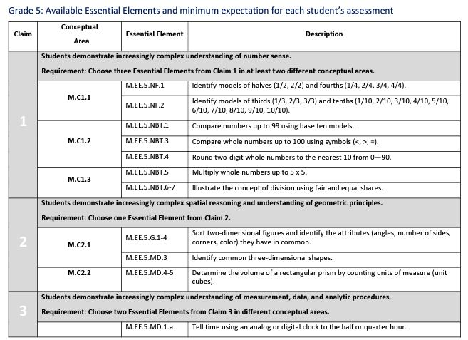
Math Blueprint Example
37
37

Slide 38
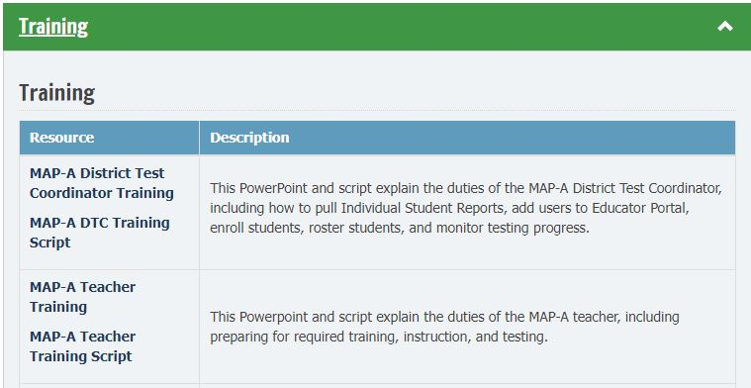
Training Tab
38

Slide 39
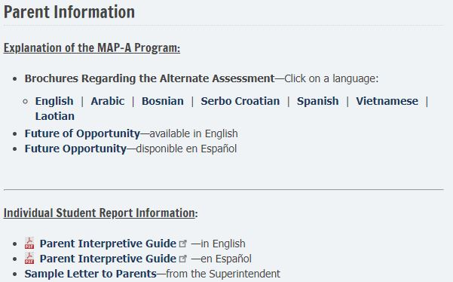
Parent Information Tab
39

Slide 40
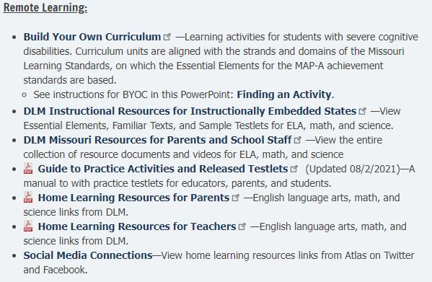
Parent Tab: Finding an Activity
40

Slide 41
Alternate Assessment
August 8, 2022
Part Five: DLM Missouri Page
Caryn Giarratano, Ph.D.
DESE Assistant Director of Assessment
Slide 41

Slide 42

Five Linkage Levels for ELA & Math
Initial precursor
Distal precursor
Proximal precursor
Target (at the Essential Element level)
Successor (Getting closer to Grade Level Standard)

Slide 43

Three Linkage Levels for Science
  Initial Precursor
  Proximal Precursor
  Target (mastery)

Slide 44
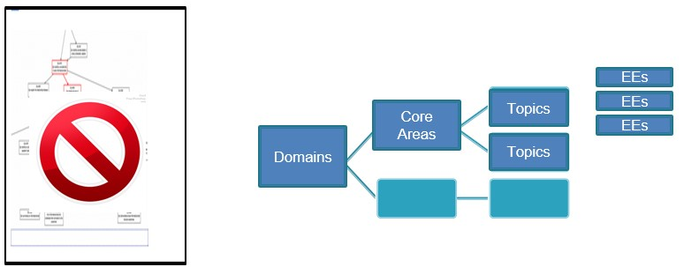
Science-Different from ELA & Math

Slide 45
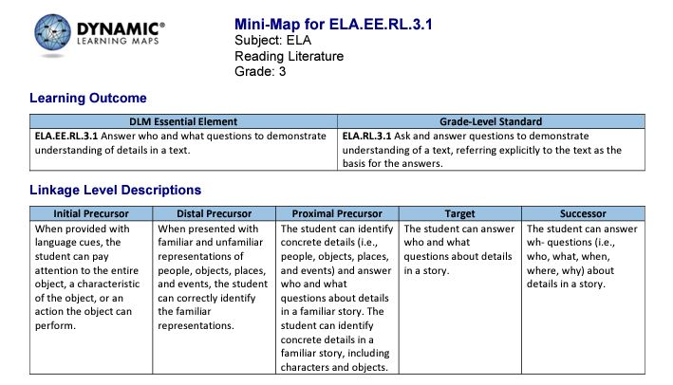
Mini-Map: EE, GLS, LL

Slide 46
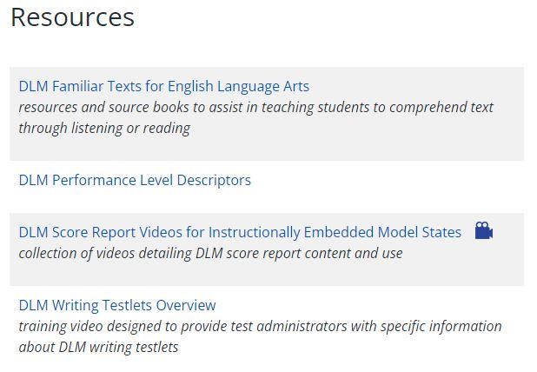
Writing Overview
46

Slide 47
Student Report Archive
47
To find a student’s past Individual Student Reports, click on the blue box called Reports and select Student Report Archive. A choice of two boxes are presented to allow the teacher to look up a student under the last name or under the MOSIS number/Student State ID.

Slide 48
Alternate Assessment
August 8, 2022
Part Six: Tasks for Teachers
Caryn Giarratano, Ph.D.
DESE Assistant Director of Assessment
Slide 48

Slide 49
Find EP Login on Landing Page
49

Slide 50
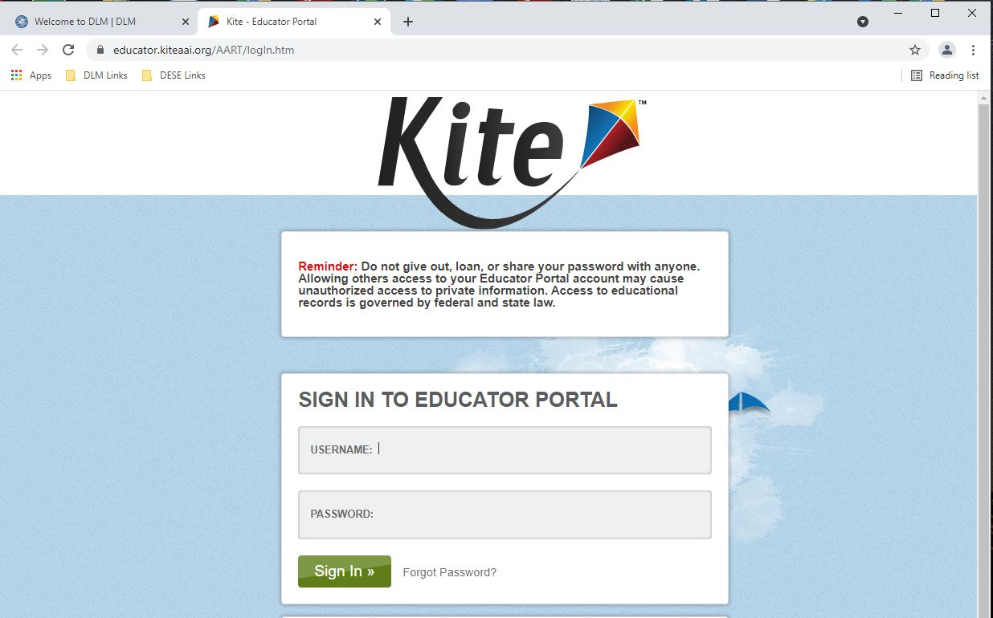
Login to Educator Portal
50

Slide 51
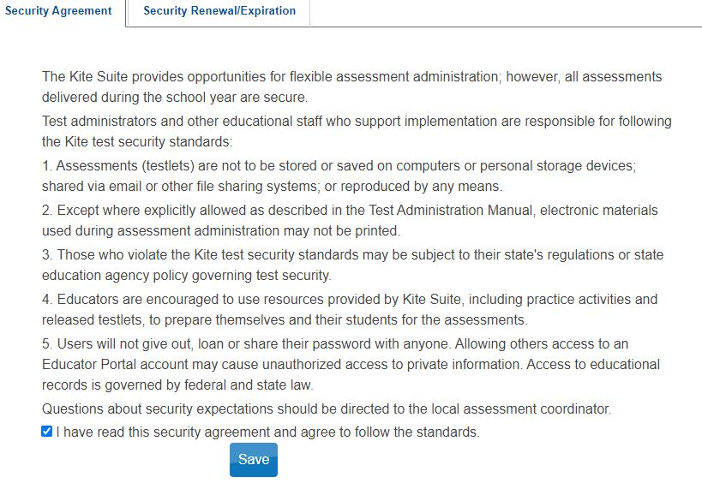
Sign Security Agreement
51

Slide 52
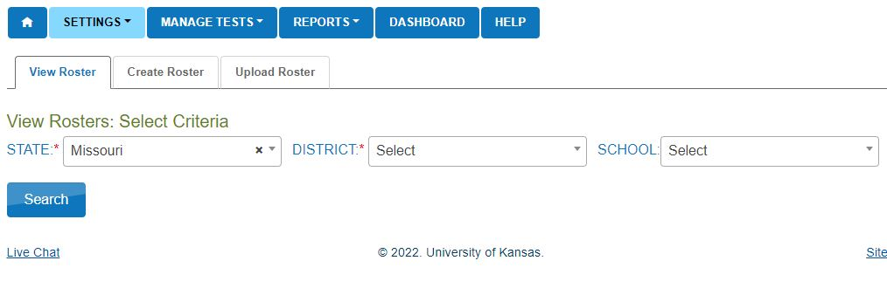
View Roster
52

Slide 53
Teacher Duty Highlights
53
Complete First Contact Survey
Update Personal Needs Profile
Creating instructional plans in the Instruction and Assessment Planner
Instructing students
Testing students in Student Portal
Reading each DESE MAP-A Update to keep up with guidance and deadlines

Slide 54
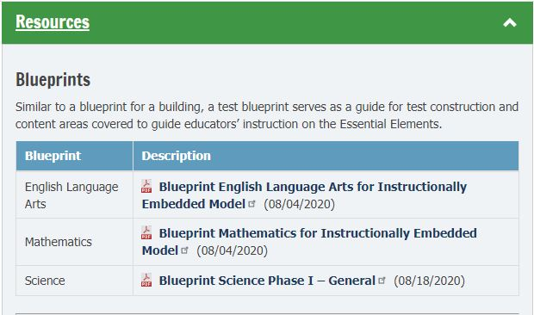
Use Blueprints to Plan Instruction
54

Slide 55
Clean Data in EP
55
Verify that email address and educator identifier match
Submit all First Contact Surveys, even if not planning to test
Complete Personal Needs Profiles, even if not planning to test
Check for accuracy in student profiles, especially MOSIS numbers
Keep MAP-A students enrolled in Educator Portal, even if not planning to test

Slide 56
Alternate Assessment
August 8, 2022
Part Seven: Student Testing
Caryn Giarratano, Ph.D.
DESE Assistant Director of Assessment
Slide 56

Slide 57
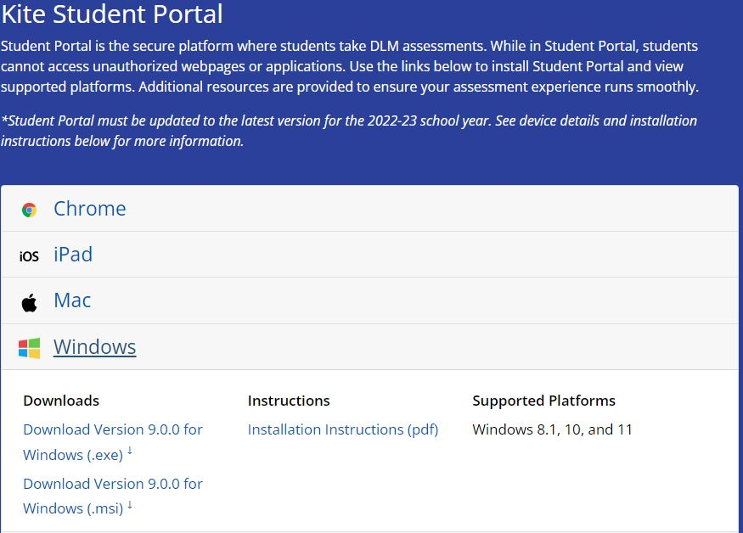
Update Student Portal
57

Slide 58
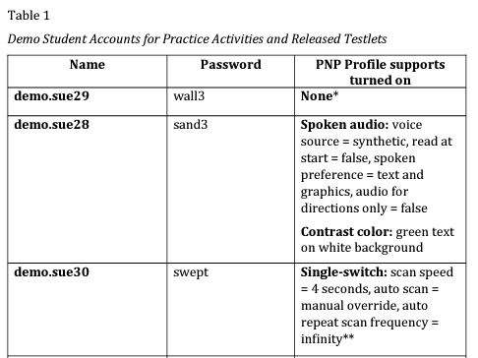
Take Practice Testlets First
58

Slide 59
Two Methods to Test
59
  1. Student interaction with the computer
  2. Teacher-administered testlets
      Lowest Linkage Level without symbolic understanding
    Highest Linkage Levels without ability to think abstractly
    All writing assessments during the spring window

Slide 60
Best Practice: Test Grades 3-11
60
Teach/test students all three subjects in grades 3-11:
Provide continuity of instruction
Remind students of test format
Non-required testing does not cost district, does not count against 1% cap, is not used for accountability

Slide 61
Testing Pattern
61
Instruct Essential Elements
Test immediately in Student Portal
Instruct Essential Elements
Test immediately in Student Portal
Repeat

Slide 62
First Contact Survey
62
Go to Landing Page, then Educator Portal
Logon using email address as user name and password you created
Click on Settings and select Students
Click Search
Find student’s name
Find First Contact column
Click on hotlink in First Contact column
Also complete Personal Needs Profile

Slide 63
Test Information Page
63
  Must view the TIP before giving each testlet
  See Test Administration Manual for more information
  Destroy TIP materials when finished
  Find TIP for ELA and math in same location
  Find TIP for science in a different location for fall than spring

Slide 64
TIP for ELA, Math and Fall Science
64
  Go to Instruction and Assessment Planner
  Complete boxes and click Search
  Find student’s table
  Click Blue Arrow
  Click stack of three dots (kebab)
  Click ready to test
  Click on TIP and download or print

Slide 65
TIP Location for Spring Science
65
  Go to Manage Tests
  Select Test Management
  Complete boxes and click Search
  Select Summative for Testing Program
  Click Search
  Select the Test Information PDF
  Download or print
  Destroy the TIP when finished.

Slide 66
Science Assessment Requirements
66
Fall Window
EEs are chosen by teachers
Testing is optional, but strongly encouraged
Testlets are NOT used for accountability purposes
Spring Window
EEs are NOT chosen by teachers
Testing is required
Testlets ARE used for accountability purposes

Slide 67
Test Administration Practices
67
Teachers use best judgment:
May provide additional supports
Read “Practices Allowed: section of the Test Administration Manual
Read Learn about the Accessibility Supports of the Accessibility Manual
Read instructions in TIP

Slide 68
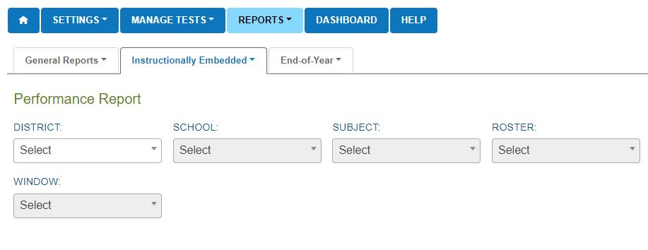
Performance Report

Slide 69
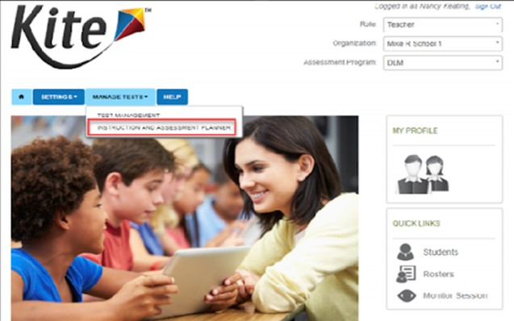
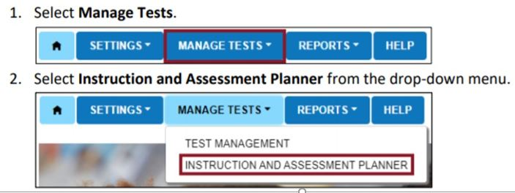
Instruction & Assessment Planner
69

Slide 70
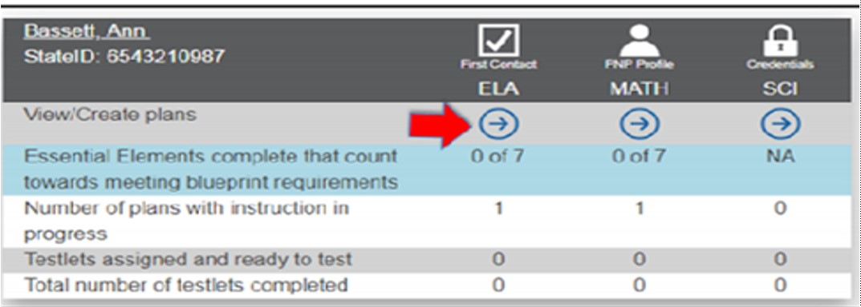
Instruction & Assessment Planner
70

Slide 71
Linkage Level Comparison
71
ELA & Math Linkage Levels | Science Linkage Levels
Initial Precursor | Initial
Distal Precursor
Proximal Precursor | Precursor
Target | Target
Successor

Slide 72
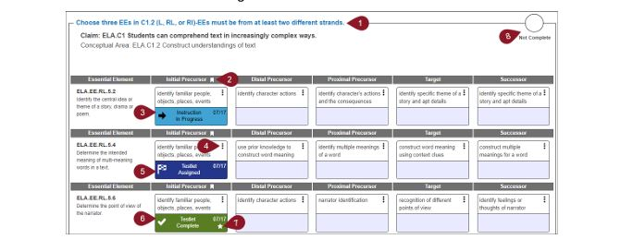
Planner and Linkage Levels
72

Slide 73
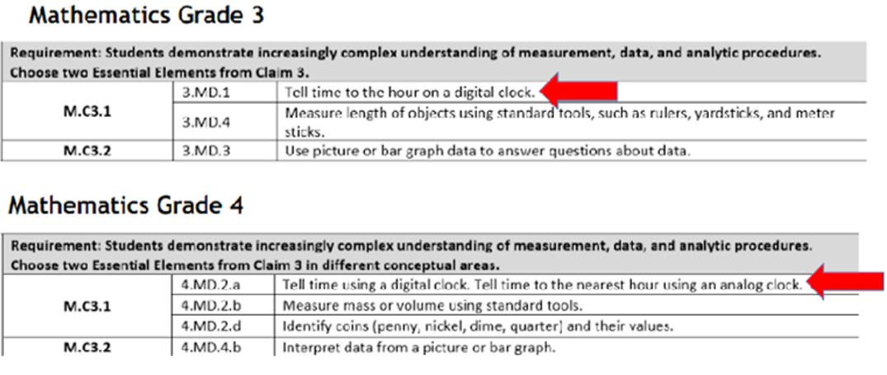
Teaching across Grade Levels
73

Slide 74
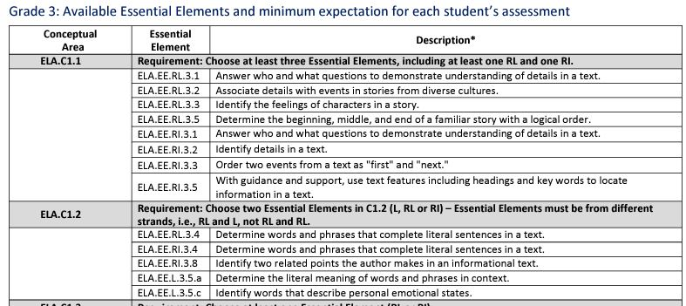
Teaching within Grade Level

Slide 75
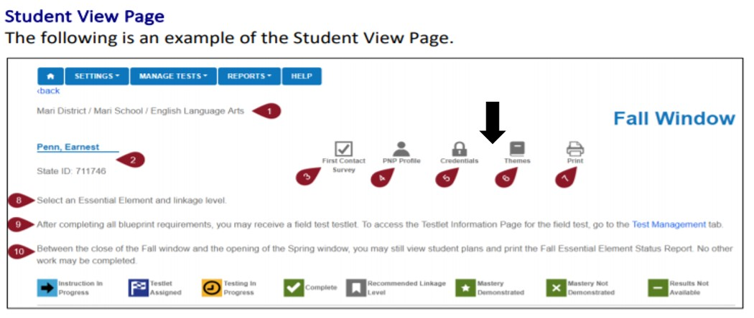
Top of Planner Page

Slide 76
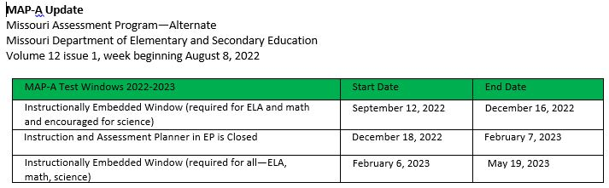
MAP-A Update

Slide 77

Who to Contact for Questions
Caryn Giarratano, Ph.D.
Assistant Director of Assessment
Alternate Assessment
573-751-6731
caryn.giarratano@dese.mo.gov

