Slide 1
Zoom Support Meeting Norms
Mute unless you are speaking to the group
Use the chat to ask questions
Be professional and helpful
Be mindful when asking questions about specific situations - don't give out any information that could reveal the identity of a person with a disability

Slide 2
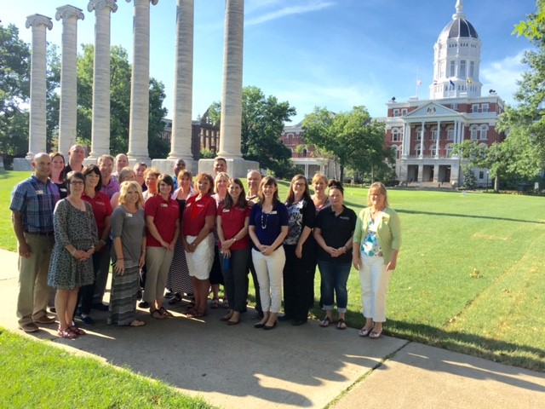
PRE-EMPLOYMENT TRANSITION SERVICES
UNIVERSITY OF MISSOURI--COLUMBIA

Slide 3
MU PreETS-Who are we? Where did we come from? What do we do?
Supported by the reauthorization of the Workforce Innovation & Opportunities Act (WIOA) signed into law July, 2014 –emphasizes transition services to students/youth with disabilities--focus on outcome to increase opportunities for competitive, integrated employment
A no cost outreach project of the University of Missouri-College of Education, funded via contract with Missouri Vocational Rehabilitation
Powered by certified educators-representing 44 regions with goal to serve every high school in the state as well as DYS, private and MSSD. As an example, in my region, I serve Cooper, Howard, Randolph and rural Boone counties. Our work force continues to grow to meet needs.
Work collaborativelywith teachers, counselors, transition coordinators, VR counselors, students, and parents with goal to help students reach successful and positive post-secondary outcomes

Slide 4
Who does MU PreETS serve?
Students ages 16-21 (ages 14-15 if specified in IEP) who are currently enrolled in school
Has a documented disability/medical condition (IEP, 504, medical records, etc)
Potentially eligible for Vocational Rehabilitation services

Slide 5
Current data as of 5/4/22 (2021-22 school year)
5,989 students have been served in
565 schools across the state of Missouri
22,839 contacts with
50,979 services provided

Slide 6
5 Core Areas of Transition Activities
Job Exploration
Missouri Connections and other web-based resources
Work-Based
Learning
Field trips and industry tours, informational interviews
Explore volunteer or part-time summer work opportunities
Post-Secondary
Counseling
Assist in post high school planning, decisions and goal setting
Discuss how to access accommodations in college under ADA
Workplace
Readiness
Training
Education and instruction in work readiness or ‘soft’ skills
Review and discuss transportation options for employment
Self-Advocacy
IDEAS/Pictorial Interest tools to meet diverse student needs
Self awareness surveys discussion for career planning
Job Shadowing
Promote school based work opportunities
Research degree/certification requirements for jobs within student interest area
Connect with adult based services including VR
Practice application and interview skills
Counsel students about empowerment, self-determination and self-advocacy
Increase self-awareness of disability and disclosure in education and work settings
Work with students to increase participation in their IEP, 504, and planning meetings
Explore jobs/careers in local labor market

Slide 7
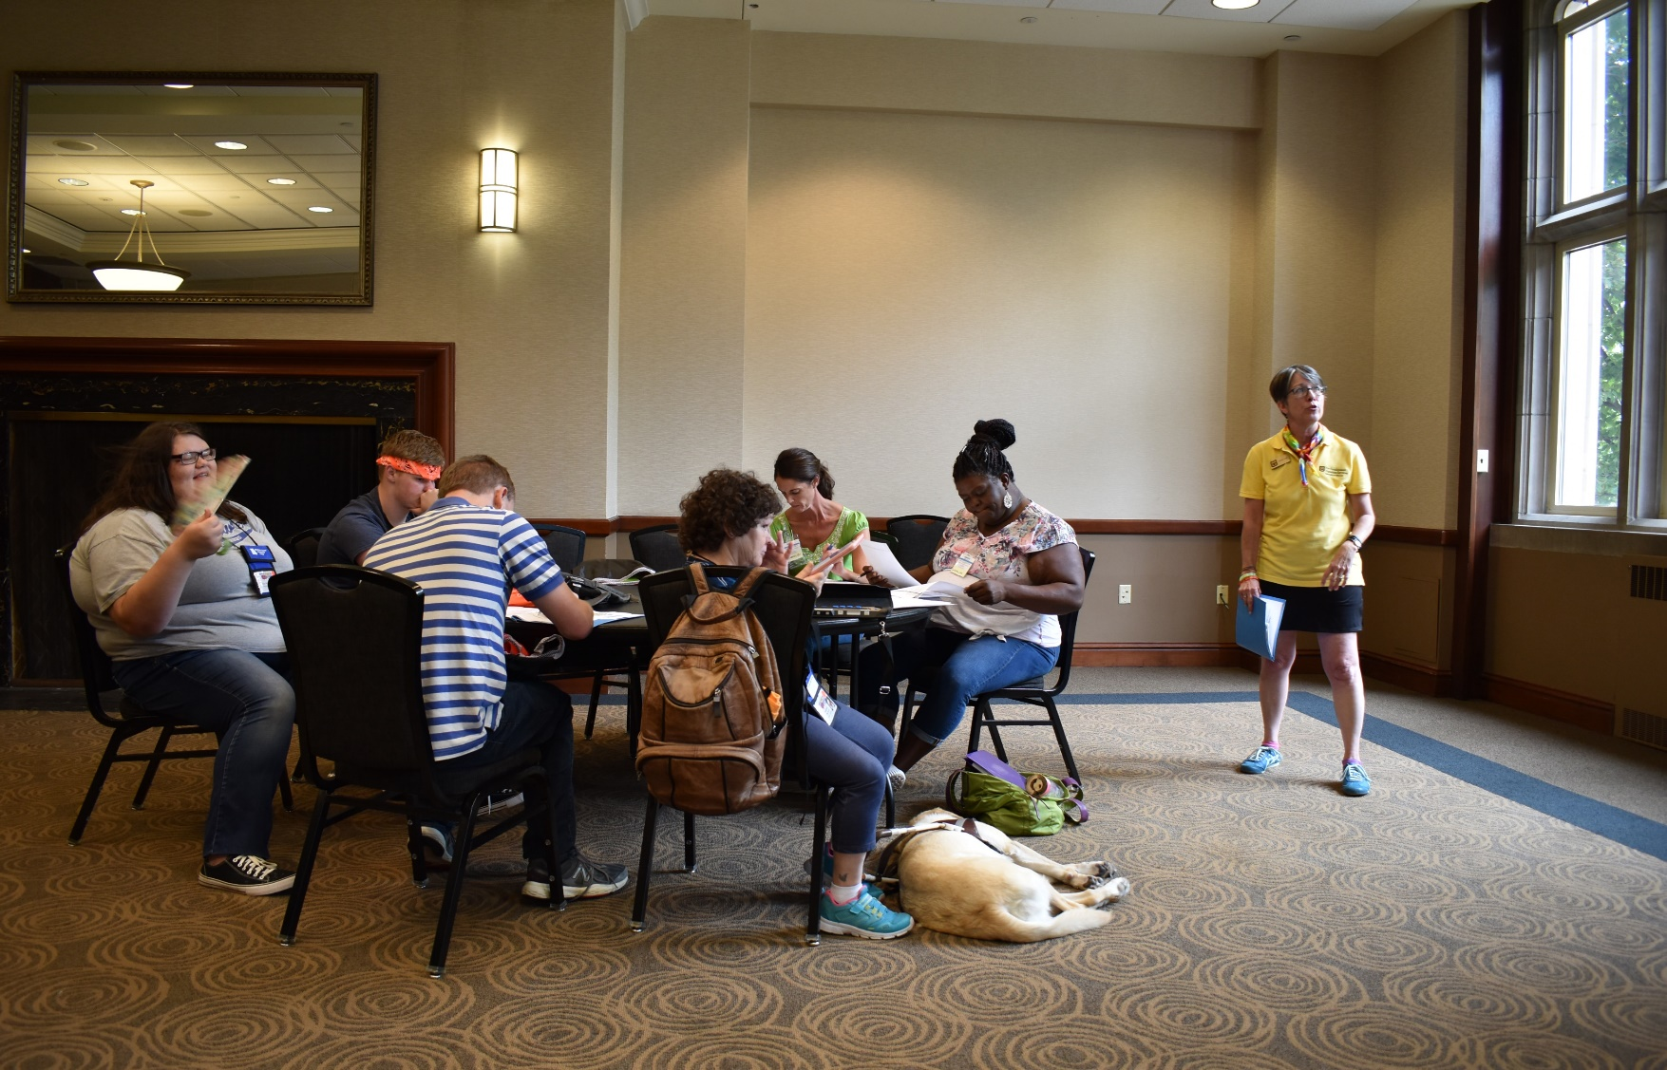
How does a PreETS Specialist provide services in your school?
Teachers/Guidance identify students; Parent/Guardian sign Pre-ETS release form
Meet with students individually/small groups on monthly schedule, may also conduct whole class lessons
PreETS activities are individualized for school/student needs; districts vary in size, transition resources and students have diverse needs
Assess student area of need (informal), develop plan for instruction in conjunction with teachers
Communicate with teachers on activities in order to collaborate and work cohesively, feedback for IEP
Facilitate visits to colleges and post high school training, job sites, job shadows (can not pay for/provide travel).
May attend IEP meetings as needed, refer to VR Senior year

Slide 8
Referral-Connection with VR Counselor
MU PreETS and school personnel work together to refer students to regionally based VR Counselor (VRC)- transition information is shared with VRC
Referral to VR typically occurs during student‘s Senior/exit year of high school
VR is an eligibility based agency-students/parents complete application and VRC obtains supporting documentation of the disability
With an open case, VRC can continue to collaborate with school personnel, provide transition services and help student move towards post secondary services
A VR referral is not mandatory for students to participate in PreETS!
Notes:
Paul lead but both Deb and Amy can jump in – cover the need to connect with VR before exit from school, “hand off”

Slide 9
VR Eligibility Criteria
Documentation of disability will be collected and the VRC must determine if the student meets eligibility criteria of:
A physical or mental impairment, [as determined by qualified personnel licensed or certified in accordance with state law or regulation]
that constitutes or results in a substantial impediment to employment
requires vocational rehabilitation services to obtain, maintain, or advance in employment [consistent with the applicant’s unique strengths, resources, priorities, concerns, abilities, capabilities, interests, and informed choice].
Notes:
Amy-basic VR eligibility

Slide 10
VR Services
The VRC and student/client cooperatively develops an individualized plan for employment and determines what services are most appropriate and necessary to achieve the vocational goal.
Examples of services include:
Vocational Guidance and Counseling
Supported Employment Services
Employment Services
College/Vocational Training
Rehabilitation /Assistive Technology
Notes:
Amy-basic VR services, not exhaustive list just examples, individualized, must have vocational goal via the IPE

Slide 11
What is the end result ?
A VR client’s case is considered successfully closed when they have completed a minimum of 90 days of competitive integrated employment and not in need of any further VR services.
In some programs the client will remain in services with the Community Rehabilitation Provider if client needs long-term follow along services.
VR is an adult agency and clients can reapply for services at any time in the future. VR is not a “one and done” service.
Notes:
Amy-basic VR case closure, emphasize it is not a “one and done” , adult clients can reapply, maybe give example of why they would reapply

Slide 12
Some recent successes…
Graduated 2 years ago, started at MACC, left school, reconnected with VR this year, currently enrolled in MACC LPN program with full VR funding–now doing well, one year training program in high demand labor market, has career pathway; example of the “not “one and done”
Student graduated last year, enrolled in college, receiving partial financial support from VR (at least $2000 year). PreETS provided career exploration, post secondary exploration, self-advocacy (accommodations in college), and support – saw significant growth over 3 years I served student, has made the transition to college, doing well!
Early graduate from this year, student had a 504 plan, engaged with PreETS , alternative education offered through school allowed student to successfully graduate, PreETS worked on work readiness, self-advocacy, realistic career exploration, vocational counseling/feedback; connected to VR , was worried about follow though BUT young adult continues to keep appointments and has started looking for job with support.
Current Senior is poised to receive 100% funding from VR for welding including housing and tools! This is a high demand, skilled trade career offering excellent income and growth opportunities. PreETS served student as Sophomore, Junior & Senior helping to navigate towards realistic career goals, non-college skilled training opportunities, job shadow, self awareness/advocacy.
Summer Work Experience program for rising Seniors. Have multiple worksites in 3 counties I serve, Juniors who will work for 6 weeks with on-the-job support, builds work skills, work readiness, work history and references

Slide 13
VERY IMPORTANT TO REMEMBER…
PreETS and VR work closely with the Special Services Teachers and Guidance Counselors at high schools throughout the state. This is a full TEAM effort! It requires communication, collaboration and feedback, everyone playing on their strengths and roles but most of all , everyone having a common goal of helping our students have a positive post-secondary experience where they receive supports to help them achieve at their highest level possible!

Slide 14
Contact Information
Website:
https://education.missouri.edu/outreach/pre-employment-transition-services/
Director of MU PreETS:
Kim Gee, MRC, CRC, LPC kimberly.gee@missouri.edu 636-697-5845
Pre-Employment Transition Specialist (presenter):
Debbie Reed, MEd reedde@missouri.edu 573-808-0614
Manager, Youth Services VR:
Amy Bowen, MRC, CRC amy.bowen@vr.dese.mo.gov 573-338-0931

