Slide 1
CTE Advisory Council
DESE / State Board of Education Update
January 24, 2022

Slide 2
Missouri CTE Advisory Council
DESE Updates
  Learning Services: Office Updates
  Legislative Updates
  DESE Strategic Plan Update
  Weekly Updates (Tuesday emails) and Admin. Memos
State Board of Education Updates
  Current State Board of Education Members
  December (2021) and January (2022) Updates

Slide 3
DESE Updates

Slide 4
DESE Update: Offices
Commissioner Margie Vandeven
Division of Learning Services: Tracy Hinds, Deputy Commissioner https://dese.mo.gov/learning-services
  Office of Childhood: Pam Thomas, Asst. Comm.
  Office of Special Education: Stephen Barr, AC
  Office of Quality Schools: Lisa Sireno, AC
  Office of Educator Quality: Paul Katnik, AC
  Office of Adult Learning & Rehabilitative Services: Tim Gaines, AC
  Office of College & Career Readiness, Bart Washer, AC

Slide 5
DESE Update: Offices
Office of Childhood
  PAT; Continues major reorganization: From three different state agencies to DESE; Rules Revisions.
Office of Special Education
  State Schools (Blind, Deaf, Severely Disabled); providing support for students/adults with disabilities)
Office of Quality Schools
  Assessment relocated to OQS, Competency-based Education, MSIP6

Slide 6
DESE Update: Offices
Office of Educator Quality
  Teacher Recruitment and Retention Grants (school districts, teacher preparation programs)
  TeachMo.org (teacher recruitment)
  Missouri Teacher of the Year Nominations
Office of Adult Learning & Rehabilitative Services
  Continues providing services with disability determination, independent living, veterans education, and vocational rehabilitation

Slide 7
DESE Update: Offices
Office of College and Career Readiness
  CTE: National CTE Month (February), Proclamation Signings, CTSO Events
  School Counselors: Student Wellness initiatives (SEL, Suicide Prevention, WSCC, FOBS)
  AEL: Continued support to LEAs & HSE (HiSET)
  Curriculum: Assessment to OQS, Curriculum remains with OCCR (Opportunity for CTE to Math, Science, English / Language Arts, English Learners)

Slide 8
DESE Update: Offices
Office of College and Career Readiness
  CTE: National CTE Month (February), Proclamation Signings, Spring CTSO Events, New Computer Science Rule
  School Counselors: Student Wellness initiatives (SEL, Suicide Prevention, Whole Child, FOBS)
  AEL: HSE Rule Revision December 2021 (public comment)
  Curriculum: Remains with OCCR, Assessment to OQS
    Continued opportunity for CTE to work closely with math, science, English/language arts, English learners

Slide 9
Legislative Updates

Slide 10
DESE Update: Legislative Updates
Pre-filing: December 1, 2021
Fiscal Note Analysis
Education-specific Updates
CTE-specific Updates
  Governor Parson’s State of the State Address

Slide 11
DESE Strategic Plan Update

Slide 12

DESE Strategic Plan

Slide 13
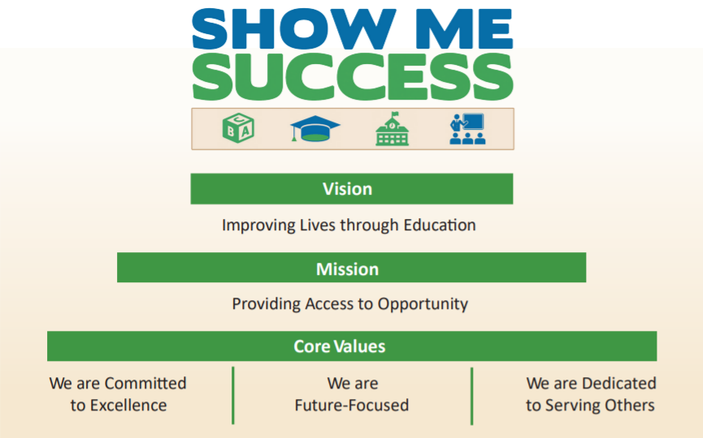
DESE Strategic Plan

Slide 14
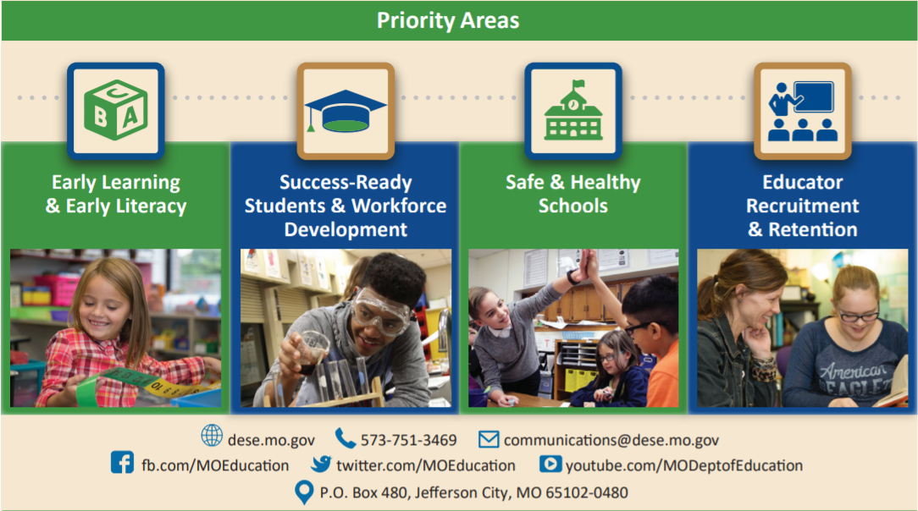
DESE Strategic Plan

Slide 15
DESE Strategic Plan Goals: Updates
Per October’s update, DESE did transition to Four (4) Strategic Plan Goals:
    Teacher Recruitment and Retention
    Early Learning / Literacy
    Success Ready Students / Workforce Development
    Safe and Healthy Schools
  Presented to State Board in December 2021
  Presently working on Action Plan with deliverable dates

Slide 16
DESE Updates / Administrative Memos

Slide 17
DESE Weekly Updates and Administrative Memos
DESE Updates:
  Emailed every Week
  https://dese.mo.gov/communications
  https://app.hatchbuck.com/OnlineForm/2790806811
Administrative Memos:
  Sent to all school administrators
  https://dese.mo.gov/administrative-memos

Slide 18
State Board of Education

Slide 19
State Board of Education Updates
Members:
Charles Shields, St. Joseph, President
Carol Hallquist, Kansas City, Vice President
Kim Bailey, Raymore, Member
Kerry Casey, Chesterfield, Member
(Replacing Victor Lenz, St. Louis)
Don Claycomb, Linn, Member
Peter Herschend, Branson, Member
Mary Schrag, West Plains, Member
Pamela Westbrooks-Hodge, St. Louis

Slide 20
State Board of Education Updates
November 2021: No meeting in November
December 2021:
Legislative Priorities
  Educator Recruitment & Retention
  Safe and Healthy Schools
  Success-ready Students & Workforce Development
  Early Learning & Early Literacy
  Providing Access to Opportunity
OCCR Proposed: HSE Rule Revision / CTE New Computer Science Rule (public comment period)
January 2022:
  Kansas City Public Schools: Reaccreditation
https://dese.mo.gov/state-board-education/news-and-updates

Slide 21
Questions?
OCCR Leadership Team:
Dr. Roger Barnes, Lori Brown, Steve Bryant,
Dr. Rene’ Yoesel
Bart Washer
Interim Assistant Commissioner, OCCR
Bart.Washer@dese.mo.gov

