Slide 1
What You Will Need
Handout #1 - Phonological Awareness Continuum
Handout #2 - How to Use Elkonin Boxes
Handout #3 - Affirmation and Action Planning
Glossary of Terms - Phonemic Awareness
*Make colored laminated copies of the Data Flowchart for Literacy Development from Session 1 to have on the tables
Notes:
To Know and Do: Hide this slide when presenting. The use of Handout #3 is optional.

Slide 2
Phonological and Phonemic Awareness
Components of Effective Literacy
Module 2
2021
Notes:
To Know: This module will be the second in a series of the research-based modules that will address phonological and phonemic awareness, phonics/spelling connections, vocabulary, comprehension, writing and assessment.
To Do: Ensure you read the background information needed and accessed the learning from Reading Rockets before beginning this training. Have ready the handouts for this training for attendees to download or have paper copies.
Handout #1 - Phonological Awareness Continuum
Handout #2 - How to Use Elkonin Boxes
Handout #3 - Affirmations and Action Planning
To Say: Welcome to Phonological and Phonemic Awareness. This module will be the first in a series of research-based modules that will address phonological and phonemic awareness, phonics/ spelling connections, vocabulary, comprehension, writing and assessment. We are pleased you can join us today. This training is meant to confirm some of your practices and understanding in literacy. Our focus will be anchored in the science of reading and information that research has proven to be most effective for successful reading instruction.

Slide 3
Welcome and Introductions
Notes:
To Know and To Do: Please add introductory information here to introduce yourself to the group.

Slide 4
Learner Intentions
Participants will
Understand the difference between phonics, phonological awareness and phonemic awareness
Identify phonological skills from simplest to more complex
Recognize the importance of phonological awareness in the process of learning to read
Practice phonological/phonemic awareness activities that can be used in the classroom
Notes:
To Know: This module will be the first in a series of research-based modules that will address phonological and phonemic awareness, phonics/spelling connections, vocabulary, comprehension, writing, and assessment.
To Do: Review the learning intentions for the day.
To Say: Today we will be looking at the difference between all the ‘ph’ words in literacy starting with the foundational skills of phonological awareness, phonemic awareness and their tie into phonics.
We will take a deep dive into the skills needed from simplest to more complex and how those skills can be the root cause of reading difficulties. As we recognize which skills might impact future reading success, we will also take time to look at how these are implemented in our own curriculum.
What might we need to do as a team working across teams of teachers within the system addressing the skills needed for the individual student? We will practice activities that address the different levels of phonological and phonemic awareness so that you walk away with a plan of how to ensure success for the foundation of literacy for every student.

Slide 5
Missouri Teacher Standards
The following Missouri Teacher Standards will be addressed today
Standard #1 - Content Knowledge Aligned with Appropriate Instruction
Standard #2 - Student Learning, Growth, and Development
Standard #3 - Curriculum Implementation
Standard #7 - Student Assessment and Data Analysis
Notes:
To Know: These are the teacher standards we will address today.
To Do: Direct participants to the slide.
To Say: If you need to document for your professional development reference, here are the Missouri Teacher Standards that we will be addressing today. I will pause a moment while you note these if needed. We will address Standards #1, #2, #3, and #7.

Slide 6
Norms
Be Present
Turn cell phone off or silence
Minimize sidebar conversations
Take care of personal needs with minimal distractions
Ask questions
Have open heart and open minds
Be patient
Notes:
To Know: There are norms for virtual or face-to-face. Please place the norms that fit your group into the slides so that all attending are comfortable and ready to learn the expectations needed for their building or district.
To Do: Use norms and expectations that fit the group and situation.
To Say: Today, we are going to ask that you be present with us by considering how this learning fits into what you already do. It will either confirm some things you are already doing or it might push you to consider what might be different, according to research, on what works in the world of literacy development. We would ask that you have cell phones on silent and minimize sidebar conversations or distractions. We will take formal breaks. So, please take care of personal needs with minimal distraction. Since our goal is to apply the content to you and your students, we hope you will ask questions to clarify the content and how it relates to you and your students. As you open your mind to confirm your practices or align your practices with research, we know it takes patience and a heart for doing what is best for students. We deeply appreciate your professional passion and drive to share, learn, and apply for student success.

Slide 7
Virtual Norms
Ask questions using chat box or unmute
Engage fully using the clock icon should you need to step away
Integrate new information
Open your mind to diverse views
Utilize what you learn
Adapted from: Mallia, G. (2013). The social classroom: Integrating social network use in education.
Notes:
To Say: Stay open to what you are hearing. Everything we are sharing with you is research-based on what good reading instruction looks like. Are there additional norms you would like to add for the sake of the group?

Slide 8

What Would Your Superpower Be?
Introduce yourself
Name
Grade(s) you teach
Your superpower
Tell us why you chose your superpower or what you will do with that power.
Notes:
To Know and To Do: Research has proven that high-quality professional development is anchored in the engagement and value we put into getting the personal voice and connections of the participants to each other and the content. Please provide opportunity for your participants to do this here.

Slide 9
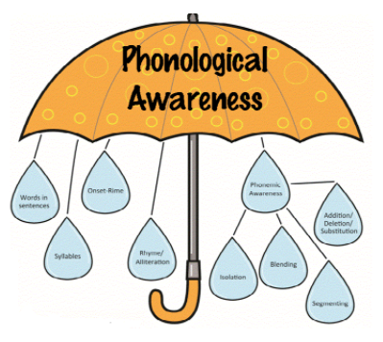
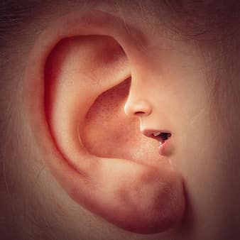
Phonological Awareness
The sound structures of speech and the ability to manipulate those sounds from whole words, syllables and into individual sounds.
Notes:
To Know: Here we will define a few necessary words.
To Do: Reference definitions document.
To Say: Phonological awareness is the sound structures of speech. It is the ability to manipulate sounds from whole words, to syllables, and then into individual sounds. We will call those individual sounds phonemes. For example, the word ‘cat’ has three phonemes or C/A/T. Sounds we hear and use in reading can be named by letters and letter patterns. Phonological awareness is the overarching word to represent all sound from the largest chunks of sound to the smallest individual sounds. As we progress in this training, we will find that phonological awareness does not just involve the ability to hear a sound but to articulate those sounds as well. Students who have difficulty in learning to read have difficulty processing sound whether they are students with a learning disability, dyslexia, or struggle with attaching letter patterns to sound. Phonological awareness is considered a foundational reading skill. Having good PA skills is a predictor of future reading success.

Slide 10
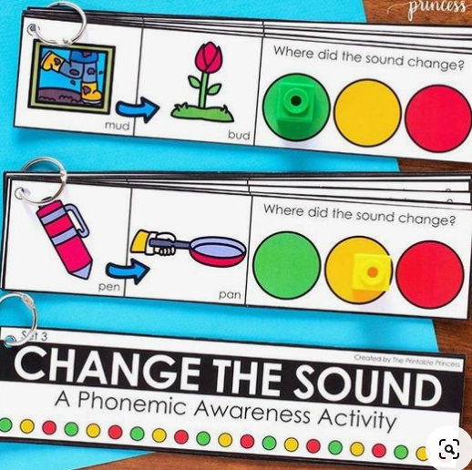
Phonemic Awareness
Refers to the awareness of the individual phonemes — the smallest units of sound — in spoken words, and the ability to manipulate those sounds.
Notes:
To Know: Phonemic awareness is the individual sounds/phonemes.
To Do: Read the slide or allow time for participants to read the slide.
To Say: Phonemic awareness is the ability to recognize the individual sounds/phonemes in words and be able to manipulate those sounds. From this point on, we will refer to phonemic awareness as PA. We find that many programs and curriculums include this in the early instruction for reading. We often do not have access or take the time to access this with older students who are not at the kindergarten or pre-kindergarten grade level. There are some people who use the word phonemics awareness and phonological awareness interchangeably. In the science of reading, they are not the same since phonological awareness is most commonly thought of as the manipulation of the words and syllable chunks of words.
Many people say we can do phonemic awareness in the dark since we do not need to see letters, we just need to understand the distinct sounds in a word. For example, the word ‘cat’ has three distinct sounds C/A/T. But we have found that some students need to see our mouths and even have a conversation about how to make the phonemes inside our mouths with tongue, teeth, lips and air or vocal cords. Not all students will need direct, explicit instruction in how the physical place, manner, and articulation work for good phonemic awareness, but it will be necessary for struggling readers. That type of training is for another day. Today we will need to understand the difference between phonemic awareness and, specifically, phonics.

Slide 11
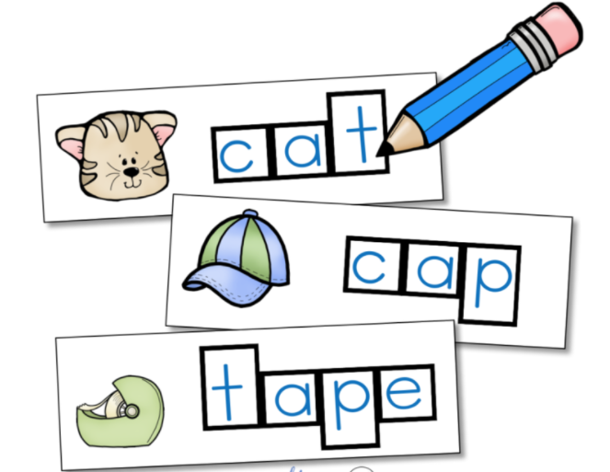
Phonics
Refers to knowledge of attaching letters to sounds and the ability to apply that knowledge in decoding unfamiliar printed words
Notes:
To Know: Phonics is usually our most common understanding of the ‘ph’ words. The two prior slides represent vocabulary that we normally do not include in upper elementary curriculum. As soon as we attach letters to sound it becomes phonics.
To Do: Note the difference of when phonemic awareness becomes phonics.
To Say: Phonics is the most common “ph” word we know. Phonics refers to letter knowledge. The ability to apply the letters and letter patterns in decoding unfamiliar printed words. As soon as we attach letters to sounds/phonemes in our lessons or curriculum we have moved into phonics.

Slide 12
Phoneme
The smallest unit (sound) of spoken language.
Phonemes are represented in writing with letters but sound is represented in writing as
/t/ /m/ /p/
Notes:
To Know: Phoneme is the smallest unit of spoken language. When you see a letter inside of virgules it means to say the sound not the letter. Example: on the slide, /t/ means to make the sound of the letter ‘t’.
To Do: Speak to the slide and allow participants to respond.
To Say: Phonemes are the smallest unit of spoken language. A phoneme is sound. Phonemes are represented in writing with letters. Sounds are represented by slashes before and after the letter. These slashes are called virgules ** .
There are over 40 phonemes in the English language. One important aspect about phonemes we need to remember is to ensure we are using clear and precise pronunciation. From these examples, you will notice three different kinds of sounds.
The first sound represented here reminds us that some sounds are a short burst of sound. We make those sounds with the tongue placed right behind our teeth on the roof of the mouth but pushed down to the bottom of the mouth laying right behind the lower teeth by forcing air from the throat. Keep the lips open to let the air out. Try making that sound without any voice from your throat, but only air pushing the tip of your tongue off the roof of your mouth. (Pause and have participants make the sound /t/).
Some sounds are sustaining sounds like those named by the letter ‘m’. You make that sustaining sound by pressing the lips together and making the vocal chords hum. Place your hands on your throat to feel it vibrate as you push air in your throat to hum with lips closed /m/. Notice what happens to that sound as you hold your nose. Can you still make that sound? This is fun with students and it helps them realize how the airflow through your mouth, nose and throat produce sound.
The final sound on the page is the one named by the letter ‘p’. You make that sound by pressing the lips together but pushing the air from the throat and forcing out of the mouth. Clip that sound like you did the /t/ sound. Be careful that you do not include the ‘schwa’ sound or the short ‘u’ sound as you attempt that sound. There are several other letters that we find ourselves adding the short ‘u’ sound to the letter sound. Can you name letters that we might do that besides the letter ‘p’? Answers: (b, d, g, v)
It is easy to add the ‘schwa’ or short ‘u’ sound when we are projecting our voice to a group of students. But, it is very confusing for some students as they learn these sounds and how to name and spell those sounds. There will be some students who will need explicit instruction in proper mouth formation and use of teeth, tongue, lips, and air from the throat using mirrors.
vir·gule
/ˈvərɡyo͞ol/
virgule - a punctuation mark (/) used to separate related items of information. Separatrix, solidus, slash, diagonal, stroke, punctuation mark, punctuation - the marks used to clarify meaning by indicating separation of words into sentences and clauses and phrases.

Slide 13
The Science of Phonological Awareness
Necessary for using the alphabetic code (sounds to symbols)
Can predict later outcomes in reading and spelling
Develops a phonological memory for sounds and vocabulary to stick
Notes:
To Know: These points are supported by volumes of research.
To Do: Take time to understand the research for participants who are not familiar with the science of reading.
To Say: The National Reading Panel in 2000 with 54 studies and Foorman et al, in 2016, plus research collected through Kilpatrick in (2016), and many more studies have proven that
Producing and manipulating sound is necessary to using the alphabetic code, the ability to understand that print represents meaning in sound and words.
Phonemic manipulation predicts outcomes in reading and spelling. We can predict who will struggle to learn how to read and spell efficiently by measuring and screening phonemic awareness. This indicator has been successful to predict in children as early as age five.
For a letter, symbol, or word to become known by sight, there has to be a phonological memory of that sound or word. You know that is true when someone tells you about a new word and you say, “I think I have heard that before.” When we sound out a word, if we do not have a phonological memory of that word, we are not certain that we just sounded out a real word.

Slide 14
Why Start With Phonemic Awareness
Phonemic Awareness is the CORE and CAUSAL factor that separates normal readers from disabled readers.
G. Reid Lyon
Notes:
To Know: Studies repeatedly over the last 30 years have confirmed that all language and learning in literacy is linked to understanding and manipulating sounds. The ability to match sound to letters and words and meaning to symbols has been proven to be an underlying factor of development in every language studied across the world. Reid Lyon is the former Chief of the Child Development and Behavior Branch within the National Institute of Child Health and Human Development (NICHD) at the National Institute of Health.
To Do: Direct attention to the slide.
To Say: Reid Lyon, formerly with the National Institute of Child Health and Human Development (NICHD), said it best while reviewing multiple studies of the factors found to predict and underlie reading development. He stated that phonemic awareness is the CORE and CAUSAL factor that separates normal readers from disabled readers.
The students given explicit phonemic awareness instruction developed phonic decoding skills more fluently in memory and connected patterns of sounds to letters more rapidly in short periods of time. Every disabled or struggling reader had a weakness or holes in their phonological development. But no matter the age or grade, students needed the phonological instructional gap to be addressed before other literacy skills would anchor in memory successfully.

Slide 15
What Does it Look and Sound Like?
Phonological Awareness Continuum Adapted from 95% Group
Skill | Explanation | Example | Clarification and Deeper Development
Words in a Sentence | Distinguish individual words in oral sentences | Teacher: Step for each word you hear in this sentence: The bird sings. Student: 1st step and say The, 2nd step and say bird, 3rd step and say sings
Syllables | Identify syllables in a word spoken orally | Teacher: Clap for each chunk/syllable of the word: elephant Student: el (clap) e (clap) phant (clap) -3 claps | Baseline: Begin with 2-3 syllable words.
Notes:
To Know: This continuum is adapted from the 95% Group. The original version can be downloaded for free: https://info.95percentgroup.com/literacy-component_pa_3
Participants will practice going down through the levels that are on the next slides using a handout. You will model the process they will be going through before you move to the next slide.
To Do: Direct participants attention to Handout #1, Phonological Awareness. Participants will be using this with partners to practice the different skill levels. If this training is virtual, make sure all participants have the handout to use in their breakout rooms.
To Say: We will be using Handout #1 as we look at phonological skill development. This is a research-based progression. Many students will normally pass through these skill levels without any formal instruction. However, this continuum will not be so easy for some students. When we screen students to identify students at risk of reading failure and address instruction for students struggling to read at grade level, we find there are holes in the development of these skills that need to be explicitly taught.
As we look at this document, we see it is divided into four columns. As each skill is identified, it is defined through the explanation and then there are examples of what this skill might look like in practice. The first skill, “Words in a Sentence”, is usually developed very early in the life of children. Children between the ages of two and four usually begin to understand that the words in a sentence are separate and can be changed for more specific meaning. “I want a drink”, can now become, “I want a soda”, “ I want a chocolate milk”, or “I want a shake." Of course, this later becomes the anchor for writing sentences and how many words will be in the sentence.
Now lets direct our attention to syllables. I would like to model how we are going to practice this with a partner. I will be the teacher first. This skill requires the ability to identify syllables in words spoken orally. As the teacher, I am going to direct you through a task. (Read the box for syllables) Clap for each chunk/syllable of the word ‘elephant’.
Ask a participant to be your student or request all to respond.
As the student you would respond: el (clap) - e (clap) - phant (clap) or three claps.
Now you will become the teacher.
Ask a participant to be the teacher and request you do the same task using a different word. Please begin with words that have only two or three syllables. Example: Clap for each syllable chunk you hear in the word ‘farmer’.
Move to the next slide.

Slide 16
Time for Practice
The person with the most buttons will be the teacher first explaining the skill and task.
After the student responds, they will become the teacher to provide another sample of the same task.
Then remain as the teacher to move onto the next skill level repeating the process.
Notes:
To Know: If you are doing this in a face-to-face training you may hide this slide or use it to clarify directions. Model sent to breakout room
To Do: Give them Handout #1, Phonological Awareness Continuum. Model what this practice will look like as they take turns with the role of student and teacher. Place teachers in groups of two to practice. Ensure they have the handout and understand the directions.
To Say: Before we begin this practice, we need to add a note to the top of this handout. This is a research-based developmental progression. Please add that statement to the top of your handout .
Repeat if needed – This is a research-based developmental progression. Pause to allow participants to write.
Every successful reader masters this progression. Struggling readers will have holes in their development of this progression. When we target those holes or lack of development, we will begin to see reading progress. I will pause a moment for you to make note of that thought because it is essential for you to understand.
Our instructional practice time will look like this
The person with the most buttons will play the role of teacher first explaining the skill and task.
After the student responds, they will become the teacher to provide another example by giving/using a different word for the same task.
Then stay as the teacher to move onto the next skill level repeating the same process down through the developmental sequence.
What may I clarify for you?

Slide 17
What Does it Look and Sound Like?
Phonological Awareness Continuum Adapted from 95% Group
Skill | Explanation | Example | Clarification and Deeper Development
Words in a Sentence | Distinguish individual words in oral sentences | Teacher: Step for each word you hear in this sentence: The bird sings. Student: 1st step and say The, 2nd step and say bird, 3rd step and say sings
Syllables | Identify syllables in a word spoken orally | Teacher: Clap for each chunk/syllable of the word: elephant Student: el (clap) e (clap) phant (clap) -3 claps | Baseline: Begin with 2-3 syllable words. Students in grade 1 and above will need to be able to identify 5+ syllables in words.
Notes:
To Know: This is the first slide that you will share as participants come back from practice. You will be having participants make notes in the Clarification and Deeper Development column on their handout. There is one text box on this screen which will disappear as you click ‘next’ to provide the key information that participants will add to their handout as you revisit the continuum. Participants will practice going down through the levels that are on the following slides using the handout.
To Do: Bring participants attention to Handout #1, Phonological Awareness Continuum, explaining that you are going to give them more information and to take notes on their handout.
Click to move forward and a text box will appear showing additional information.
To Say: Were you able to see how the skill began to get harder and more complex with smaller units of sound? Let’s go back and do some clarification of the different skills. We will add more information to the last column of the continuum to clarify and deepen the skill development.
(Make sure you click to advance so the text box disappears and the following information appears.)
Syllables - We will want to add that what you see in the example is the baseline for mastery. But, students in grade 1 and above will need to be able to identify five or more syllables in a word.
Some have students hold out one arm while tapping one finger at a time on their lower arm for each syllable for the word ‘misunderstanding’. Tap on the arm as if cutting the word in parts mis/un/der/stand/ing or five syllables.
The student can also place their elbow on the table and put their chin in the palm of their hand counting on the fingers as they feel each syllable push down on their wrist putting pressure on the table for the word ‘transcontinental’.
Or, the student may also place their elbow on the table and put their chin in the palm of their hand counting on the fingers as they feel each syllable push down on their wrist putting pressure on the table.
Trans/con/ti/nen/tal or five syllables.

Slide 18
Onset-Rime/ Rhyme | Separate sounds before the vowel sound from the rest of the word | Teacher: The first part / onset of take is /t/. What is the rest of the word /rime? Student: ake | Before a student can rhyme, they must be able to manipulate rimes. The next level of rhyming is to identify if the words they hear rhyme. Teacher: Do take and cake rhyme? Student: Yes, take and cake rhyme? Teacher: I am going to say three words and I want you to tell me which words rhyme: fit, big, hit. Student: Fit and hit rhyme. The hardest level of rhyming is to produce a word that rhymes given a word prompt. Teacher: Can you give me a word that rhymes with late? Student: rate
Adapted from 95% Group
Notes:
To Know: There are two text boxes covering information on this slide. It is important to know that rhyming grows from the ability to manipulate rimes.
To Do: Note the development of rhyming. You will need to click forward to uncover the white text boxes for information.
To Say: There are some students who never learn to rhyme. They can tell you some main words they have heard teachers say over and over that rhyme like ‘pig’ and ‘wig’ or ‘cat’ and ‘hat’, but when given a word, they are unable to come up with a word out of their head that rhymes.
(Click forward)
There are actually three levels in becoming proficient with producing rhymes. It starts with being able to separate the onset (which is the initial part of a word prior to the first vowel in a one syllable word) from the rime (which is the ending part of the word from the first vowel and the letters that follow it). Read down through the far right side of the screen noticing the different levels of difficulty. The next level of rhyming involves the ability to hear if the final part of the word sounds the same as the final part in another word.
This can be practiced by using word families. There are 37 most common word families according to researchers, Wylie and Durrel. These lists are easy to find and can make this level of phonology fun.
(Click forward to reveal the last note)
The last to develop will be the ability to produce a word that rhymes when given a word prompt. There may be students who will move farther in the different skill levels and later be able to produce a rhyme on their own. But, for others, it might be several months later or even after the ability to do the advanced phonological manipulation shown farther down on this chart.

Slide 19
Basic Phonemic Awareness
Identification | Recognize the same sound in different words | Teacher: What are the first sounds in fan, first and phone? Student: /f/ | Ability to identify the first sound in words develops before ability to identify the last sound. Teacher: What is the last sound in bed, had, and pad? Student: /d/
Categorization | Recognize the word in a set of 3 or 4 words that has the odd sound | Teacher: Which word doesn’t belong? top, see, tan, took Student: see because it starts with /s/, the others start with /t/ | Remember that a student’s ability to hear the first sound in words develops earlier than the ability to hear the final sound. Mastery of first sound manipulation for identification, categorization and isolation is key before final sound manipulation.
Adapted from 95%
Notes:
To Know: There are two text boxes on this screen. The text boxes will disappear as you click ‘next’ to provide the key information that participants will add to their handout as you revisit the continuum.
To Do: Ensure you provide time for participants to make the notes you reveal by clicking forward to reveal the information.
To Say: We are now moving into what many refer to as Basic Phonemic Awareness. This is the level which requires students to be aware of individual phonemes.
(Click forward)
Identification - Ability to identify the first sound in words develops before ability to identify the last sound. The ability to distinguish and manipulate the middle or medial sound will be the last to develop within this skill level.
(Click forward)
Mastery of FIRST sound manipulation for Identification, Categorization, and Isolation is key before FINAL sound manipulation. You will find many lessons and/or programs will provide tasks for students to ‘play‘ with sound in these different locations of the word.
Move to next slide to include isolation tasks in this thought.

Slide 20
Basic Phonemic Awareness
Isolation | Recognize individual sounds in words | Teacher: What is the first sound in hat? Student: /h/ | Teacher: What is the final/last sound in stop? Student: /p/
Blending | Combine phonemes to make a word | Teacher: What word is /ch/ /o/ /p/? Student: chop | For some students it is beneficial to start with words that begin with a sustaining sound (such as /s/, /m/, /f/)
Segmentation | Orally break a word into individual phonemes | Teacher: What are the sounds in stop? Student: /s/ /t/ /o/ /p/ | Begin with simple syllables which have 2-3 phonemes (no blends) then move to words with blends and 4+ phonemes in a word. Teacher: Say each sound in the word as you move a chip for each sound: /m/- /a/ - /t/.
Adapted from 95% Group
Notes:
To Know: There are two text boxes covering information on this slide. Segmentation is a strong predictor of reading success and will impact spelling.
To Do: Click forward as needed then provide time for participants to take notes.
To Say: Isolation tasks need to progress from isolating off the first sounds, last sounds, and before finally addressing the middle/medial sounds. This skill usually develops in tandem with the Identification and Categorization skills we just looked at on the top of your handout.
Blending requires students to hold phonemes in their short-term memory long enough to put them back together in sequence to form a word. Segmentation and blending tasks in kindergarten and first grade are a strong predictor of reading success (over 25 years of research, but confirmed by Moats and Tolman, 2019, Hogan,Catts & Little, 2005). Many curriculum-based assessments and screening tools choose this to focus on to ‘catch’ students early for intervention and remediation.
(Click forward)
For some students it is beneficial to start with words that begin with a sustaining sound (such as /s/, /m/, /f/). Struggling students have a tendency to hold the phoneme separate as they did with onset/rime and isolation and cannot blend it with the others. This will hold true as students use phonics skills to sound out words then blend the letter sounds into a word.
(Click forward)
For segmentation, begin with simple syllables which have two to three phonemes (no blends), then move to words with blends with four or more phonemes in a word.
We will take a few minutes to share a tool later in this training to help you choose appropriate screening tools which predict reading failure and help us screen and or progress monitor key skills.

Slide 21
Advanced Phonemic Awareness
Deletion | Recognize new words are created when phonemes are deleted from an existing word | Teacher: What is start without /s/? Student: tart | Baseline: begin with phoneme deletion in initial and final position Teacher: Say safe. Student: safe Teacher: Now say safe without /f/. Student: say Deletion using blends is usually not developed until age 8 or later. Teacher: Say slope Student: slope Teacher: Now say slope without /l/. Student: soap Deletion for medial and final positions is usually not developed until age 9 or later. Teacher: Say stroke without /r/.
Adapted from 95%
Notes:
To Know: Advanced phonemic awareness skills are often the ones that are never addressed in most curriculum and never mastered by struggling students. There are three text boxes on this page which will need the forward click to remove.
To Do: Click forward as you reveal information for notes.
To Say: Advanced phonemic awareness skills are often the ones that are never addressed in most curriculum and never mastered by struggling students.
(Click forward)
As a baseline, always begin with phoneme deletion in the initial position before deleting the final position and medial position.
(Click forward)
Deletion using blends is usually not developed until age eight or later.
(Click forward)
Deletion for medial or final positions is usually not developed until age nine or later.

Slide 22
Advanced Phonemic Awareness
Addition | Create a new word by adding a new phoneme to an existing word | Teacher: What word do you have if you add /s/ to the beginning of pace? Student: space | Teacher: What word do you have if you add /t/ to the end of the word temp? Student: tempt
Substitution | Create a new word by changing one of the phonemes to an existing word | Teacher: The word is pot -change /p/ to /h/. What’s the new word? Student: hot | Medial substitution is the last to develop. Teacher: The word is lane – change /a/ to /i/. What is the new word? Student: line Substitution skills can be enhanced by doing “phoneme chaining." Provide students with a series of words that change only one sound at a time, use colored blocks/chips to show addition deletion, and substitution. Teacher: Place chips to represent the sounds in line. Now change line to lune. Which chip did we move out and replace with another chip? Student: Now we have lune. Let’s move the chip to make moon. Now make moon – the word man.
Notes:
To Know: There are two text boxes to remove on this slide.
To Do: Click forward to reveal needed information.
To Say: Addition and Substitution are the final Advanced Phonemic Awareness tasks we will look at in the sequence of skills.
(Click forward)
Substitution of medial phonemes requires students to delete and then add or substitute different sounds. Medial or middle sound substitution develops later than initial and final.
(Click forward)
Substitution skills can be enhanced by doing “phoneme chaining." Provide students with a series of words that change only one sound at a time, use colored blocks/chips to show addition, deletion, and substitution.
Phonological Awareness develops before phonemic awareness. As you have seen in this progression, there is a difference in the levels of development and we will need to be able to identify student needs to address this development.
Remember, these skills may seem very simple and far below the grade our struggling student is currently enrolled in, but we will not be able to attach phonics letter patterns to sound until a student can discriminate and manipulate phonemes through these advanced levels.
The Science of Reading has proven to us that this is true. Phonological awareness interacts with and facilitates the development of vocabulary and word consciousness.
Phonological awareness and memory are involved in these activities of word learning. When we play with words in these ways, we develop the phonological memory that they have heard these words before and they are real words. These activities broaden the background knowledge of known or heard words. It provides students with
Attending to unfamiliar words and comparing them with known words
Repeating and pronouncing words correctly
Remembering (encoding) words accurately so that they can be retrieved and used
Differentiating words that sound similar so their meanings can be contrasted

Slide 23
Phonological: Simple to Complex
Words | Counting words in a sentence
Syllable | Counting syllables Segmenting syllables Identifying first, last, middle syllables Blending syllables Manipulating syllables (adding, deleting, substituting)
Onset - rime | Blending onset and rime Onset and rime completion Do words rhyme? Generating rhyming words
Phonemic Awareness | Saying sounds in isolation Identifying sounds in words (e.g., first, last) Blending sounds to form a syllable Segmenting sounds in a syllable Manipulating sounds (adding, deleting, substituting)
Simplest
to
Most
Complex
Notes:
To Know: The phonological awareness skills listed here are posted on Reading Rockets: https://www.readingrockets.org/teaching/reading101-course/modules/phonological-and-phonemic-awareness/in-depth
To Do: Provide Handout #4 Phonological: Simple to Complex. Take time to read and practice the activities on Reading Rockets understanding the progression of skills needed for phonemic and phonological development. During training, direct teachers attention to this slide providing time for them to read and connect what you are stating.
To Say: Here you see the development of phonological awareness from simple to more complex. The simplest represent the larger units of sound and then the more complex break larger units of sound into individual phonemes. What you see here is a representation of the developmental levels you just moved through with your teaching partners.
What types of skills do you see in syllables? What do you notice about those sound chunks?
Answer:
Syllable are larger units of sound. If you look at the progression of skills within the row describing manipulation of syllables you see those listed as a progression to more complex within the manipulation of syllables. This manipulation of sound is phonological awareness. Children begin to develop this level in preschool.
Do you notice more complex skills as you move down the section in each box?
Is blending sounds to form a syllable harder or easier than blending onset and rime?
Answer
Phoneme blending to make a syllable is harder.
The last section brings our attention to how we begin to move to the most complex level. It develops in students normally between the ages six to nine. However, for some students they never get to this level without direct instruction. This is phonemic awareness. The ability to manipulate individual phonemes. This level is what is needed for successful readers to decode and recode and spell words. The dark blue line is the division between what an efficient reader can do compared to what a struggling reader can do. When we teach students to be able to manipulate sounds to the most complex levels, we will find that no matter the age of the student, they will begin to make progress more efficiently and effectively in literacy.

Slide 24

How is This the Same or Different as Your Series or Practice?
Notes:
To Know: Networking is a benefit and much is to be gained from sharing what they have and noticing what is effective in their products or how to use their products with greater effectiveness.
To Do: Allow about five minutes to discuss their curriculum and instructional routines.
To Say: You have five minutes to discuss your curriculum and instructional routines. Did you find any practices in your program or curriculum that mirror some of these activities? Were you able to match examples in your program to specific levels? What is the same or different? Will you need to find someone teaching a lower grade level with materials to access this type of practice?

Slide 25
Time and Focus Reduces Reading Failure
Whole class instruction which includes phonemic awareness training for a few minutes per day several days a week is one of the best antidotes for future reading failure.
Reading Rockets, Moats 2018, Kilpatrick 2015 and others
Notes:
To Know: Teachers always want to know how much time to devote to instruction for phonemic awareness. There are students who develop as readers without specific instruction in phonemic awareness. However, research always digs at the diagnostic data which reveals that all students benefit from instruction in phonemic awareness. Students who struggle to learn to read always need direct, explicit instruction in phonemic awareness and it can be done in less than five minutes per day.
To Do: Pause for participants to read the slide.
To Say: Many researchers developed studies into the effectiveness of Tier I instruction of phonological awareness training including the Report by the National Reading Panel, Foorman et al., 2001; Hatcher et al., 2004, Shapiro & Solity, 2008, NELP, 2008, Australia 2005, United Kingdom 2006. All the research confirmed that that this should be a settled science. Meaning that there is enough evidence over time to say we should not be able to dispute the effectiveness of teaching phonemic awareness. There are some students who will only need one to three minutes per day to develop success, while struggling students may need five to ten minutes per day over 12-16 weeks or more. The older the student the more targeted and embedded this practice needs to become for success. Phonological awareness is not tied to intelligence. All students can learn to read.
* Add this comment if your audience works with students who exhibit characteristics of autism. The only students who cannot learn by developing phonological awareness are students with moderate to severe autism.
As we move forward, think about these questions.
Why are we not ensuring all students who struggle to read are getting time and focus on phonological and phonemic awareness?
Do we have time set aside to work as teams on shared students?

Slide 26
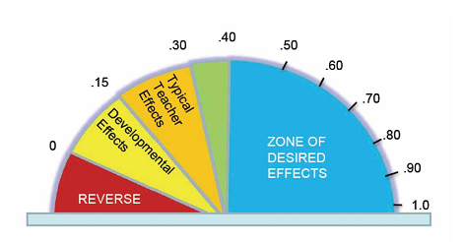
Segmentation 0.49
Vs.
Manipulation 0.87
“An overall effect size on phonological outcomes was 0.86”
Page 133, Visible Learning, John Hattie
Notes:
To Know: The greatest difference in phonological instruction came through the focus on the advanced levels of manipulation that, as reported by Kilpatrick and others, is often not mastered until grades 4 and above.
To Do: Explain the diagram if participants are not aware of how to read effect size.
To Say: John Hattie is an educational researcher who studies educational research. His research includes a meta-analysis of over 90,000 studies involving over 300 million students around the world. Hattie has determined the effect size of over 250 influences of student performance. Hattie has compiled numerous studies to determine that .4 effect size = one year growth; therefore .86 = two years growth.
We need to be diligent that our programs and our practices include assessment and practice in phonological outcomes. We also know that long term studies which follow students over time through elementary and up through grade 9 found students who received phonological awareness training early and to mastery had positive outcomes and fared better than their untrained counterparts in various aspects of reading. Snowling & Hulme, 2011, Keldsen et al., 2014 are among several who found at-risk students do not naturally develop phonological skills and need explicit training which positively impacts better word level reading, comprehension, and spelling. (Kilpatrick, 2016)

Slide 27
Examples for Practice
Take Time to Explore with a Partner
Go to Reading Rockets
https://www.readingrockets.org/teaching/reading101-course/modules/phonological-and-phonemic-awareness/phonological-and-phonemic-1
Practice with a partner some of the activities role playing as a student/teacher
Try to identify which level of skill development is being addressed.
Notes:
To Know: The link to Reading Rockets is meant to be a hot link for you to show participants how to look at the website. https://www.readingrockets.org/teaching/reading101-course/modules/phonological-and-phonemic-awareness/phonological-and-phonemic-1
To Do: Take time to go to Reading Rockets and show them all the different activities.
To Say: Let’s take some time to explore Reading Rockets and see the different types of activities provided to use as practice. Select a partner so you can role play as the teacher/student. As you explore, see if you can identify which level of development is being addressed. There are students who will need different levels but can still benefit from practice with peers.

Slide 28
Please Share Out
What did you learn?
How will this impact your instruction or your students?
Notes:
To Know: Sharing of knowledge broadens the view of all. Some will have gotten to parts of the website activities that others had not.
To Do: Allow time for participants to share. Summarize important facts before moving to the next slide.
To Say: Let us know what you learned. What did you find helpful? How will this impact your next steps with students?
Remember these important points from our instructional exploration:
Phonological development has a progression which is the basis for successful readers.
Phonological/phonemic awareness can be assessed, taught, and practiced through instruction and game-like activities.
Instruction for phonemic manipulation can and should involve multi-modal instruction for the most effective engagement in learning.
The skills of phonological awareness need to be taught to mastery. We do not stop practice in this area as we begin teaching letters. We need this skill development in all students no matter the age.

Slide 29
Developing Fluency in PA
Automaticity = Fluency
Practice using Elkonin boxes
Notes:
To Know: The most efficient and effective way to prepare a student to move phonemic awareness into the connection to phonics is to use Elkonin boxes. Many programs use these.
To Do: Talk about the slide.
To Say: You saw some practice on Reading Rockets using chips or manipulatives to represent sounds. The use of Elkonin boxes is a research-proven instructional strategy to practice the identification and manipulation of sound in a concrete way. It is a process for mapping sounds. It also leads us into the next step of attaching letters and letter patterns to sound.

Slide 30
Mapping – Phoneme / Grapheme
Say a word.
Tap out the sounds.
How many sounds?
Draw that many lines or pick up that many chips.
Move a chip into each box as you clip out the sounds.
Notes:
To Know: You may choose to hide this slide and show the video in the next slide to model what it looks like. Your audience might already be familiar with how to use Elkonin boxes. But, what will be most important is to ensure they understand the need to do this in a structured, explicit routine. That is what will develop the pathways in the brain to automaticity.
To Do: If your audience already uses and understand Elkonin boxes, you might need to alter what you say below to focus on the instructional routine.
To Say: The most important aspect of every instructional routine that is involved in making memory pathways is to do the same routine each day. Teachers will need to model this process first before doing it with students.
This is a replication of the most common routine used in research that involves multi-sensory engagement. First, you say the word and have the student repeat the word. Keep in mind that sometimes, in larger groups, struggling students do not repeat the words. Some students will listen and just process, or choose to stay quiet, especially if they process at a slower rate than many other students. If we want to change student progress, we need to ensure they do each step with us.
After the student says the word, have them tap out the sounds by touching each finger one at a time on their thumbs to see the number of sounds heard. Some research had the student draw a line for every sound or touch a box for every sound. Older students with strong finger dexterity are usually able to immediately touch a chip and move into a box as they say each sound individually. Will the color of the chips matter? At this point, no. The color will not matter. But, as we move into phonics, we will see that there is benefit in using different colors for vowels than consonants. When we work with phonemic awareness only, the focus is just sound.

Slide 31
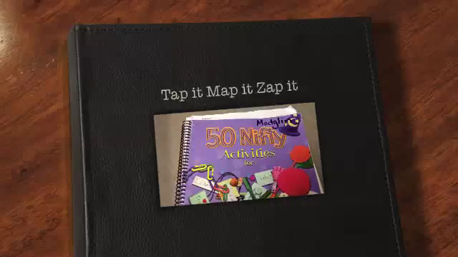
https://www.youtube.com/watch?v=FrGLGd2Rwdg
Notes:
To Know: This video provides a wonderful representation of good phonemic awareness instruction using Elkonin boxes. It is a over three minutes in length. Some people prefer to model it and have participants practice it. Tap It, Map It and Zap It. Taken from: https://www.youtube.com/watch?v=FrGLGd2Rwdg
To Do: View or model with your group.
To Say: This video will show you a proven strategy using multi-modal engagement to represent phonemes for preparation into phonics and spelling. Students are learning to map the sounds preparing them to attach sounds to letters and then being able to eventually spell words by sounding out. There are many, “Tap It, Map It, Graph It”, examples online. We are going to supply you with the directions from Reading Rockets in how to use Elkonin boxes using Handout #2.

Slide 32
Students do not learn to read by standards. They learn to read through developmental phases with exposure, direct teaching, and practice.
Notes:
To Know: We do have foundational reading standards for our curriculum base which include phonological and phonemic awareness.
To Do: Read the slide WITH participants then move right into the next slide.
To Say: Today you learned the developmental phases of phonological/phonemic awareness. Remember this quote from our last module? You have begun to take a deeper dive into the first steps of forming a phonological memory for sounds in the brain. When we notice a student is a poor reader or we are still working on instruction for phonics (which is the connections of sound to letters), the student will need us to take a look at the phonemic manipulation according to these developmental levels and use direct teaching and practice to remediate.

Slide 33
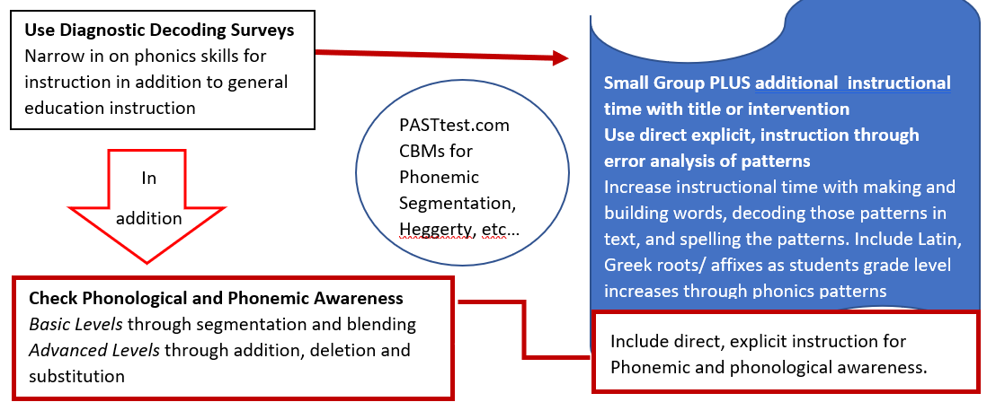
Data Flowchart for Literacy Development
Notes:
To Know: This is the Data Flowchart for Literacy Development which was given to participants in the Introduction to Reading Modules.
To Do: Ensure participants still have this handout to reference from Session #1.
To Say: If you take a moment to find the Data Flowchart for Literacy Development which was handed out in the first module, we will be moving from the bottom up in this chart. The very foundation of literacy is phonemic awareness or the manipulation of sounds.
(Click to point out the phonological/phonemic awareness section).
Students will need to be able to manipulate sound, attach letters to sounds for spelling, and decode words for reading.

Slide 34
What Works in Reading Instruction
Students were trained in phonological awareness to the advanced levels
Phonics decoding skills were taught in explicit, systematic ways and reinforced within text
Lots of opportunities to read connected text
Kilpatrick, 2016
Notes:
To Know: All the trainings presented in the literacy modules will anchor to the framework of the “Five Components of Literacy” which are - phonemic awareness, phonics, fluency, vocabulary and comprehension. These components are linked to the connections of research about effective reading instruction through programs. The programs found most effective in reading had all three of the components listed on this slide. Teachers need to know how to use the five components in an effective program to develop strong readers and reduce the number of at-risk readers.
To Do: Pause for participants to digest this slide
To Say: These are the components found in the programs which made the strongest gains in changing students’ reading ability.
Today, we defined and practiced the phonological awareness levels indicating which levels are the advanced levels which might never be addressed or mastered until upper elementary in some curriculums. You now have the tools to embed phonemic awareness to the levels which will impact progress. You also have the information you need to confirm what you are doing or help you to be intentional in addressing this skill with your students.
The second component found in the most effective reading instruction was phonics decoding skills explicitly taught in systematic ways and reinforced within text. This component of ‘What Works’ will be addressed in our next session.
The third component will be for the student to have lots of opportunities to independently read text, not just listen to the text.
Within our systems we must determine who and how we are making this reality happen for our students. Consider your focus and role.

Slide 35
More Resources
https://www.fcrr.org/student-center-activities/kindergarten-and-first-grade
https://www.readingresource.net/phonemicawarenessactivities.html
https://www.readingrockets.org/article/how-now-brown-cow-phoneme-awareness-activities
Notes:
To Know: There are many resources for phonemic awareness activities and some might have already shared their resources. These are or where hot linked for you to share.
To Do: Share the slide.
To Say: There are a few more places you can look for quality resources. Here are a couple more that are anchored in research. Let me show you that the Florida Center for Reading Research has activities that can be used in instruction and then placed in work stations or centers for students to practice. You will find resources for all five components of reading for elementary. You will also find that Reading Resource has activities that are very much like what we have explored, but were also patterned after what worked in research. What others do you have or use?

Slide 36
Our Intentions
Understand the difference between phonics, phonological awareness and phonemic awareness
Identify phonological skills from simplest to more complex
Recognize the importance of phonological awareness in the process of learning to read
Practice phonological / phonemic awareness activities that can be used in the classroom
Notes:
To Know: These were our learning intentions for the day. The Affirmation and Actions Handout may be used to guide or support action planning steps for further growth after the learning has been completed. This tool is to assist in development of a system of response to struggling students and develop a plan for instructional change.
To Do: Pass out the Affirmations and Actions Handout #2.
To Say: These were the learning intentions for our time. If possible, we believe you should be able to pass the Phonemic Awareness self-paced test on Reading Rockets found in Reading 101!
https://www.readingrockets.org/teaching/reading101-course/modules/phonological-and-phonemic-awareness/phonemic-awareness-post-test

Slide 37
Thank you for your professional attention.

Slide 38
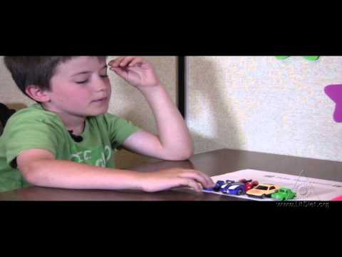
Park Those Sounds
Notes:
To Know: This is a fun way to map out sounds using the sound boxes. (Elkonin Boxes)
This is optional. But, if you would like more examples of using Elkonin Boxes, go to https://www.youtube.com/watch?app=desktop&v=bd7EQyRv3YA

Slide 39
A special thank you to Reading Rockets for sharing literacy information based on research and evidence-based practices.
Reading Rockets is committed to quality information accessible to all.

