Slide 1
Zoom Support Meeting Norms
Mute unless you are speaking to the group
Use the chat to ask questions
Be professional and helpful
Be mindful when asking questions about specific situations - don't give out any information that could reveal the identity of a person with a disability

Slide 2
Tidbits on Early Childhood Special Education
March 10, 2022
Compliance Team

Slide 3
Where do I find ECSE information on the DESE website?

Slide 4
Office of Special Education webpage
Compliance
General Guidance

Slide 5
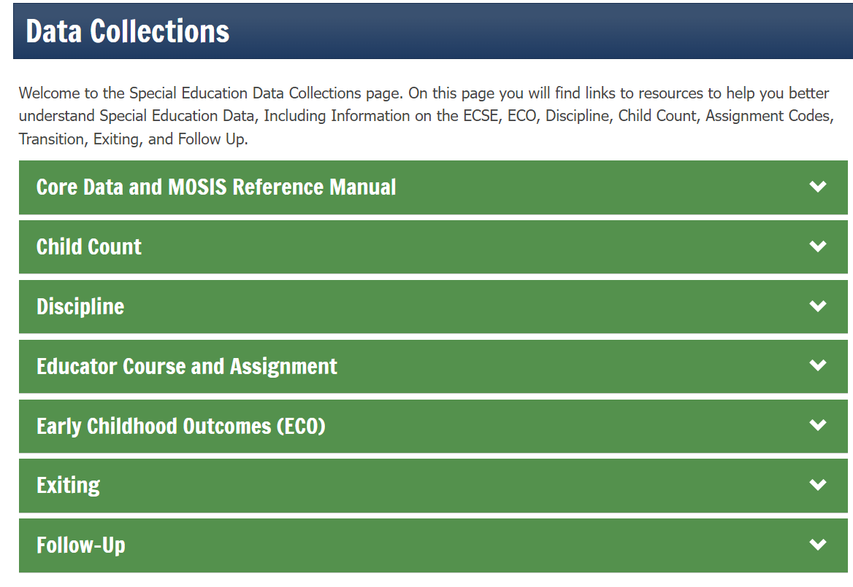
Child Count and
Educational Environments Information

Slide 6
Office of Childhood webpage

Slide 7
Who has to provide ECSE services?

Slide 8
What if we don’t have a typical early childhood program?

Slide 9
Getting To ECSE
There are numerous pathways to ECSE
Agency referral (to include PAT and typical school-based EC programs)
Parent referrals outside of First Steps (to include Head Start or other community day care or preschool settings)
For these referrals, typical 30-60-30 timelines apply and there is NO requirement to have an IEP in place by the 3rd birthday.

Slide 10
Getting to ECSE via First Steps (C to B transition)
First Steps referral, otherwise know as the C to B transition
ALL First Steps eligible children are potentially eligible for ECSE services. If qualify for ECSE, IEP must be in place by 3rd birthday
It is the First Steps provider’s job to explain to parents what happens when their child turns 3
First Steps is required to notify the ECSE provider in that area/district when a child is approaching age 3
Greater than 90 days prior to age 3 but not more than 9 months prior.

Slide 11
First Steps Referrals
https://dese.mo.gov/media/pdf/transition-first-steps-early-childhood-special-education-ecse

Slide 12
Directory Information Triggers Referral
First Steps must provide to ECSE:
Child’s name
Child’s birth date
Parent’s name
Parent’s address
Parent’s phone number
Best practice to do this in writing, but can be provided in any manner.
Unless all 5 pieces of information are provided, notification (and therefore ‘referral’) has not occurred.
There are various ways this happens

Slide 13
Why is the DATE Directory Information is provided important?
This date of notification is the Referral to ECSE date and the process begins
Requirement for IEP to be in place by 3rd birthday so no gap in services
If you aren’t made aware of the child, it makes it hard to do your part on time

Slide 14
Exceptions to IEP by 3rd birthday
Late referral to First Steps (less than 90 days from the 3rd birthday)
Parent ‘opts back in’ less than 90 days before the 3rd birthday (Documentation of reversal needs to be kept with ECSE referral)
Parent refuses to give consent for ECSE evaluation

Slide 15
Date of Referral to First Steps is KEY!
Date child was referred to First Steps is not part of Directory Information so:
ECSE should look for the date on page 1 of the First Steps Release of Info form; OR
ECSE can obtain the date of the referral to First Steps at the Transition Conference
ECSE is required to participate in the Transition Conference!

Slide 17
Eligibility

Slide 18
YCDD, Other Categorical or Both
Options for eligibility:
YCDD only
All other eligibility categories EXCEPT YCDD (or Language Impaired)
YCDD and other eligibility categories (except for Language Impaired)
Check with your district to see what your Local Compliance Plan allows
The YCDD diagnosis can be used until the child is first-grade eligible (age six by August 1) at which time a new diagnosis must be made. Child may carry YCDD through kindergarten if turns 6 during that year but must have a different categorical eligibility by day 1 of first grade.

Slide 19
YCDD
A comprehensive evaluation report is present which documents performance:
OR
At or below 2.0 Standard Deviations below the mean in one (1) of the following areas:
- Cognitive
- Adaptive
- Social/Emotional
Team agrees that child’s social/emotional/behavior significantly impacts educational development and explains the educational concerns
- Communication
Overall receptive and expressive communication must be at or below 2.0 SD
- Physical
Overall gross and fine motor scores are at or below 2.0 SD
At or below 1.5 Standard Deviations below the mean in a combination of any two (2) or more of the following areas:
Cognitive
Adaptive
Social/Emotional
Communication
Overall receptive and expressive communication must be at or below 1.5 SD
Physical
Overall gross and fine motor scores are at or below 1.5 SD

Slide 20
YCDD
A team may also use professional judgement when:
Team concludes that even though the standard scores or equivalent levels do not meet stated criterion levels, a significant discrepancy exists in one (1) or more of the developmental area(s). All other applicable steps in the eligibility criteria must be addressed with sufficient documentation(formal and informal assessment) which led the team to its decision. OR
Child is functioning above the stated criteria level but is eligible for services based on expected regression due to termination of previous intensive early intervention services.
Documentation includes a statement by team that child would regress without special education and related services
Data demonstrating functioning above criterion level.
Information regarding early intervention services such as type, frequency, intensity, duration of services, and where services were delivered
Child’s need for special education and related services as a result of the disability

Slide 21
YCDD
Cannot be used for initial eligibility for students who are kindergarten age-eligible (they are 5 and the current school year is over and they SHOULD go to kindergarten in August)
You cannot use Communication and Sound System Disorder as the two areas to qualify a student as YCDD
If the child is 2.0 SD below the mean in Communication alone, then qualifies as YCDD.
New language criteria can only be used for children who are 5 and can attend school that school year. For children ages 3-5, not kindergarten eligible, use YCDD criteria.
A child cannot be found ineligible for a categorical eligibility (if doing a re-evaluation prior to the end of ECSE) yet still go on to kindergarten with an IEP as YCDD.

Slide 22
Providing Services

Slide 23
Services
Services
SERVICES
FAPE

Slide 25
What happens if a parent doesn’t want services?
ECSE is not mandatory.
If parent declines to take advantage of services, it is NOT the same as revoking consent.
Child is still eligible and we still have a re-evaluation obligation, similar to our private/parochial/homeschooled population.
If parent declines services, we do not keep these students enrolled in our systems.

Slide 26
IEP’s for ECSE children have basically the same components as for K-12 students
Key words: Age-appropriate activities
Consider using the Missouri Early Learning
Standards (MELS) and a good developmental
milestones document to write IEP’s for ECSE
children

Slide 27
Data Reporting

Slide 28
Placement vs. Educational Environments
They are not the same thing and you need to capture both
Placement is found on the IEP but is not reported to DESE
Frequently Asked Questions dated May 2019 has a good explanation of each placement option. Found on ECSE page under Special Education Compliance

Slide 29
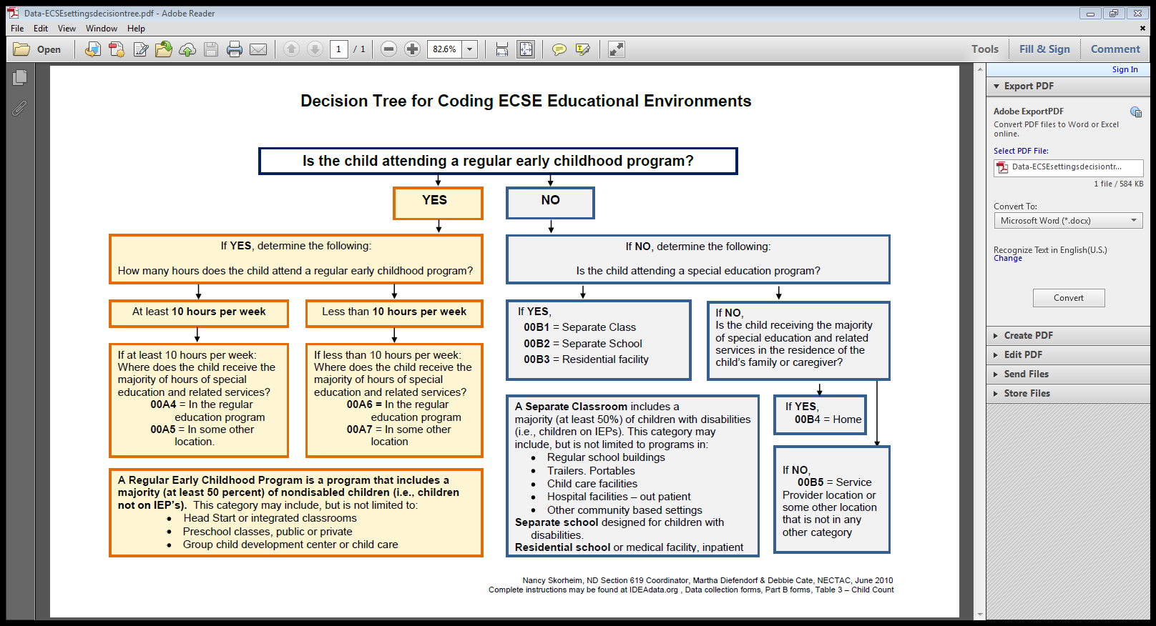
Placement vs. Educational Environments

Slide 30
Some notes on Educational Environments
Use the resources created!!
Some IEP programs do have this included but not all do. How are you reporting this information?
Remember, the first questions “Is the child attending a regular early childhood program?”
This is about where the child is during the day, NOT JUST ABOUT OUR SETTING!!
You will need to get this information from parents!!

Slide 31
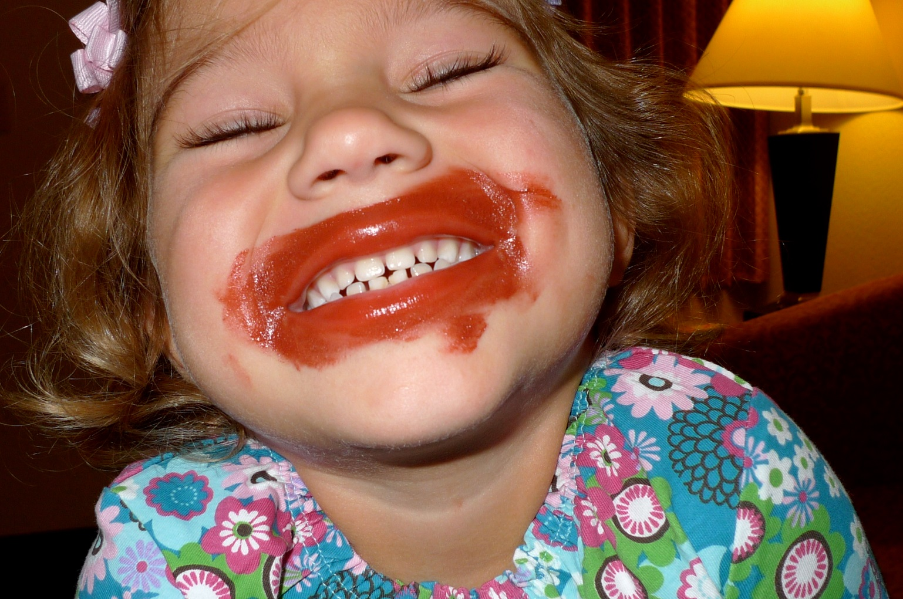
Early Childhood Outcomes (ECO)
Federal Reporting Requirement, just like Educational Environments for ALL children receiving ECSE services
Rating occurs two times: Entrance to ECSE and Exit from ECSE (a few exceptions)
Resources are being updated on the DESE website as we speak
7 module webinar series
Updated Family Flyer, Ratings Definition page, MOSS form
Additional resources to be developed
Staff needs training!!!

Slide 33
Office of Special Education - Compliance
Phone: 573-751-5739
Fax: 573-526-4404
specialeducation@dese.mo.gov

