Slide 1
Released Sample items Grade 8
Released Performance Event Item with Student work

Slide 2
Information about this PowerPoint
Performance Events in Mathematics will be either 3- or 4-point items. A student’s score for an item indicates the level of understanding they are demonstrating for the particular question. Each score point provides a range of possible papers, meaning there will be stronger or weaker papers within each point value.

Slide 3
Information about this PowerPoint
The sample in this presentation is an 8th Grade item that is worth 4-points. Students must determine whether a claim is correct, describe the context of the x-intercept and identify the better trend line. For each sample of student work there is an annotation indicating both the score as well as the scoring rationale.

Slide 4
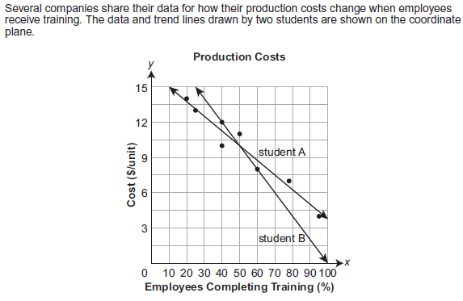

8th Grade Item

Slide 5
Scoring Guide
2 points:
The student explains that a production cost of $2 per unit is impossible for student A’s trend line and demonstrates this using a correct equation in slope‐intercept form.
1 point:
The student determines the x‐intercept of student B’s equation (100) and explains its meaning in the context of the data.
1 point:
The student describes why student A’s trend line is a better fit.

Slide 6

Score – 4 Points
Student correctly explains how $2 production cost is impossible using a correct equation in the correct form. Student determines the x-intercept and its meaning. Student correctly describes why student A’s trend line is best.

Slide 7
Score – 4 Points
Student correctly explains how $2 production cost is impossible using a correct equation in the correct form. Student determines the x-intercept and its meaning. Student correctly describes why student A’s trend line is best.

Slide 8


Score – 3 Points
Student has correct equation but lacks complete explanation how $2 production cost is impossible (use slope to show that over 100% of employees would have to complete training), so only 1 of 2 points in this section. Student determines the x-intercept and its meaning. Student correctly describes why student A’s trend line is best.

Slide 9
Score – 2 Points
Student has incorrect equation and lacks sufficient explanation how $2 production cost is impossible, so 0 of 2 points in this section. Student determines the x-intercept and its meaning. Student correctly describes why student A’s trend line is best.

Slide 10
Score – 1 Point
Student has incorrect equation and lacks sufficient explanation how $2 production cost is impossible, so 0 of 2 points in this section. Student determines the x-intercept and its meaning. Student incorrectly describes why student A’s trend line is best.

Slide 11



Score – 0 Points
Student has incorrect equation (missing) and lacks sufficient explanation how $2 production cost is impossible, so 0 of 2 points in this section. Student incorrectly determines the x-intercept and its meaning. Student selects student A’s, without support.

