Slide 1
Intellectual Disability: Overview of Eligibility
Jeanne Rothermel & Tiffiney Smith
09/09/21

Slide 2
A bit of Review
Evaluation process starts with Review of Existing Data
  Do not use this to decide whether or not you suspect a disability
  Results of RED: eligible, not eligible, or need more information
A variety of assessment tools and strategies are used.
No single tool is used as the sole criterion.
A group of qualified professionals, including the parent(s) of the child, make eligibility decisions.
Do not come to the meeting with the eligibility already included in the report!
Do not come to the eligibility meeting with recommendations for any specific type of services or related services included in the report.
Notes:
Some of you were here a couple of weeks ago when we went through all of these things, but for those who weren’t, here are some things to keep in mind. (Walk through each of the items. Add any info you want…here are some thoughts:
Variety of assessment tools and strategies….need to have multiple things in your toolbox, especially for the areas of reading, math and written expression in case you need them to back up decisions about SLD. If all kids are given the same battery, are we really individualizing the assessment.
No single tool is used as the sole criterion….we will talk much more about this later so I hope what you walk away with today is that NO eligibility is based on one assessment or one test score.
A group of qualified professionals….someone at the table MUST understand how to interpret all of this information and how it all works together toward eligibility. If you are currently contracting with outside school psychs or psych examiners who do not typically attent the meetings, some PD for those who do typically attend may be needed.
Do not come to the meeting with eligibility already in report….screams of predetermined!!

Slide 3
Review of Existing Data
Intellectual/Cognitive: Can the student solve problems, like get from one location to another after having been shown a couple of times? Figure out how to get something into their backpack by watching others or through trial and error? Recognize people after meeting them and interacting with them several times? Pick up on any skills within a reasonable amount of time after having been instructed and practiced? Reading, math, writing? What about outside of school, do parents see problems with understanding what to do when told?
Adaptive Behavior: Self-help skills like feeding self, dressing? Avoiding dangerous situations….age appropriate? Following school rules? Make friends? Interact with others at age appropriate level? Take responsibility for him/herself and his/her things?

Slide 4
It is NOT all about ONE number!

Slide 5
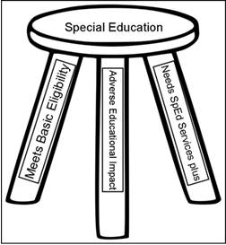
The 3 Prongs of Eligibility
Notes:
I think you can speak VERY personally about this graphic!

Slide 6
Cognitive Score
1000.10
Child performs 2.0 standard deviations (SD) below peers when measured by a standardized instrument of cognitive ability
Documentation regarding the child’s general intellectual functioning includes the following:
  1000.10.a. Name of individually administered, comprehensive cognitive measure used
  1000.10.b. Score obtained for child including any subtest or index scores in addition to the overall full-scale score
  1000.10.c. Evidence that score is equal to or below 2.0 SD from the mean for that measure and is a valid score of the child’s general intellectual functioning when considering age, ethnic and cultural background, mode of communication, and sensory and motor abilities.

Slide 7
Cognitive Score
NOTE (1): The score obtained will vary depending upon the assessment. It may be a full-scale IQ score, Z score, or developmental age. The score used by the team should be the score recommended by the assessment’s manual as being the most reliable and valid measure of the child’s general intellectual functioning.
NOTE (2): When using a score other than a full-scale IQ score due to variances in subtest or index scores that are statistically significant to the point that they impact the student’s full-scale IQ score, the team must explain what impact the variance in scores has on the student’s full-scale IQ score. The team must analyze the scores obtained to determine if communication, motor, or sensory weaknesses may have impacted the student’s obtained full-scale IQ score to such degree that the full-scale IQ score should not be viewed as the most representative score of overall intellectual ability.

Slide 8
Adaptive Behavior
Defined as: Adaptive behavior is defined as the degree with which the individual meets the standards of personal independence and social responsibility expected of the person’s age and social/cultural group. Adaptive behavior skills are the skills that people need to function independently at home, school, and in the community
Communicate with others
Take care of personal needs (dressing, bathing, toileting, etc)
Health and safety
Home living (laundry, cooking, cleaning, etc)
Social skills (manners, knowing rules of conversations, getting along in a group, making friends)
Reading, writing, and functional math
Skills that will facilitate holding a job
Practical, social and conceptual domains

Slide 9
Adaptive Behavior
1000.20
Adaptive behavior is consistent with cognitive abilities
Child performs 2.0 standard deviations or more below peers in the area of adaptive behavior skills as evidenced by overall composite scores from two or more adaptive behavior assessments.
Documentation of adaptive behavior, the effectiveness with which a child meets the standards of personal independence and social responsibility expected of a person in the child’s age and cultural group, includes the following:
  1000.20.a. Name of the adaptive behavior measure administered and name and title of each person who completed the adaptive behavior measure, including a parent or guardian when possible.

Slide 10
Adaptive Behavior
  1000.20.b. Results of the measures, including subtest and composite scores.
  1000.20.c. The overall composite scores on two or more adaptive behavior measures are 2.0 standard deviations or more below the mean for the measure being used.
  OR
  1000.20.d One composite score must be 2.0 standard deviations or more below the mean for the measure. Teams of qualified professionals may accept a second composite score allowing for the standard error of measurement when the criterion is met on the other composite score.
  NOTE (1): Adaptive behavior is defined as the degree with which the individual meets the standards of personal independence and social responsibility expected of the person’s age and social/cultural group. Adaptive behavior skills are the skills that people need to function independently at home, school, and in the community. The adaptive behavior measures used must provide a composite score that is based on the child’s performance in the areas of conceptual, practical, and social domains of adaptive behavior.
  NOTE (2): Teams should refer to the measure’s manual to determine the appropriate standard error of measurement to use for the second score.

Slide 11
Intellectual Disability
1000.30
Reduced cognitive ability and adaptive behavior adversely affects educational performance
The evaluation report includes a description of how the child’s reduced cognitive ability and adaptive behavior adversely affect educational performance through results from formal and/or informal assessments in academic achievement and other areas of functioning such as communication skills and social skill development including the following:
1000.30.a. Reduced cognitive abilities and adaptive behavior adversely affect educational performance
1000.30.b. Specific areas of impact are described in the evaluation report
1000.30.c. Information gained through observation of the child’s academic and functional performance completed in a variety of educational settings supports the description of adverse impact

Slide 12
Intellectual Disability
NOTE (1) Observation data should support the results obtained from adaptive behavior measures in order to support a valid eligibility determination of Intellectual Disability. The team should explain in the report any discrepancies between the scores from the standardized measures and the observational data and analyze how this impacts their eligibility determination.
NOTE (2): Data from all sources should be examined for consistency. Scores in the areas of adaptive behavior, general intellectual functioning, and academic achievement should all triangulate to form a learning profile that has a relatively low level of variance between the scores in all three of these areas.

Slide 13
ID Eligibility Determination Resources
ID Eligibility Checklist
ID Eligibility FAQ
Assessment Tips

Slide 14
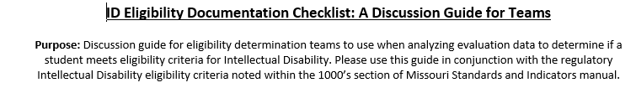

Slide 15
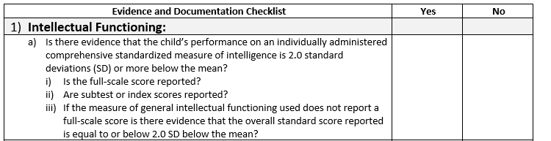

Slide 16
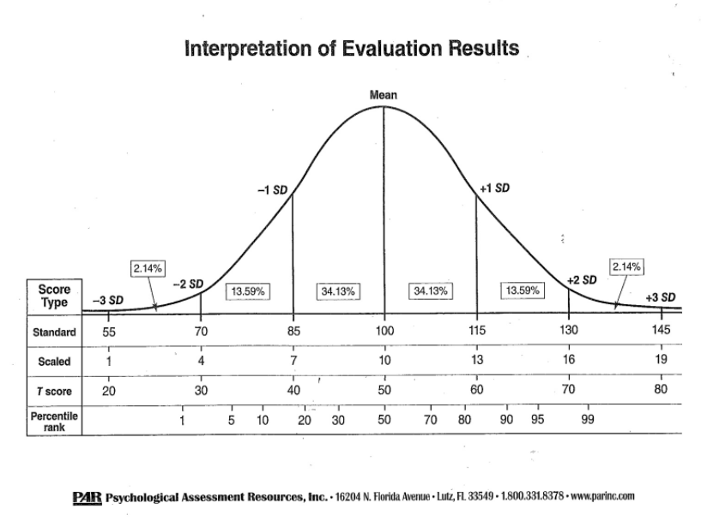

Slide 17
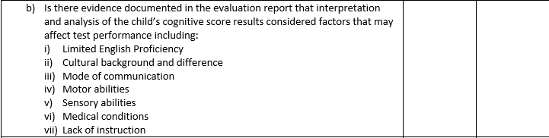

Slide 18
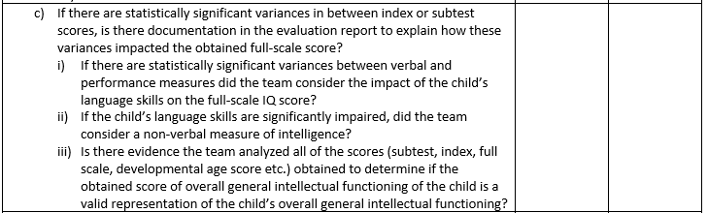

Slide 19
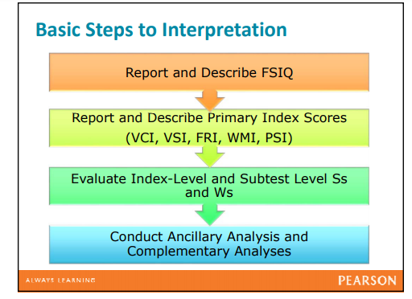

Slide 20
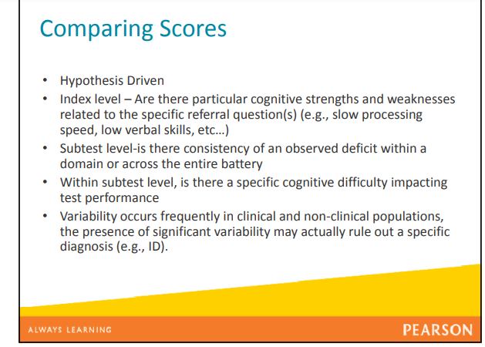
Interpreting Assessment Results

Slide 21
WISC V Score Interpretation
“With such variability within the index scores, statistically those index scores do not represent a unitary construct. When the full scale score is made up of such variable index and subtest scores, it is not a unitary construct, so it doesn’t tell us everything we need to know about the child’s ability to think and reason.”
Differentiating an Intellectual Disability from a Learning Difference – YouTube Dr. Gloria Maccow, Pearson(30:11)

Slide 22
Ruling Out ID
“Essentially what we are saying is, if you are working with an individual and that individual will meet eligibility for classification of intellectual disability you will not have that variability in terms of your scores (subtest, index, composite). Your scores will be relatively consistent and close to 2 standard deviations below the mean”
“Children with intellectual disabilities tend to have generally subaverage IQ closer to 70. “….That is what the Office of Civil Rights is looking for, is there a consistent pattern when you are looking at those scores (subtest scores, index scores). If you have a scaled score of 7 or two scaled scores of 7, they will probably ask you to justify your classification of intellectual disability.”
Differentiating an Intellectual Disability from a Learning Difference – YouTube,Dr.Gloria Maccow, Pearson, 56:24-59:16

Slide 23
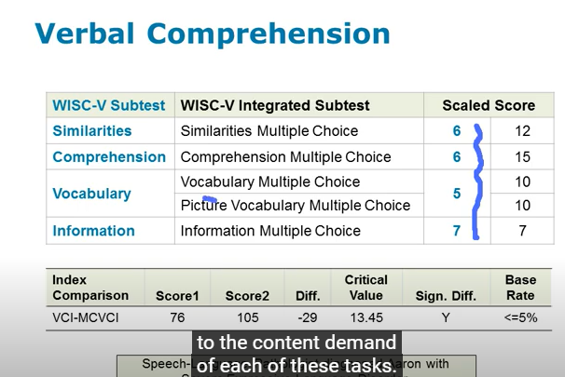
Impact of Language on Cognitive Ability Scores
If there’s a suspicion the child’s language skills may be impacting their cognitive ability scores, do further investigating to test this hypothesis
WISC V Integrated
  Pulls out expressive demands of subtests so you can measure content demands of subtests, so team can better understand cognitive abilities

Slide 24
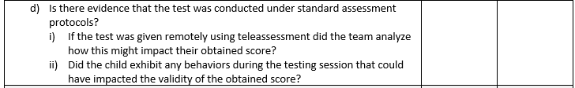

Slide 25
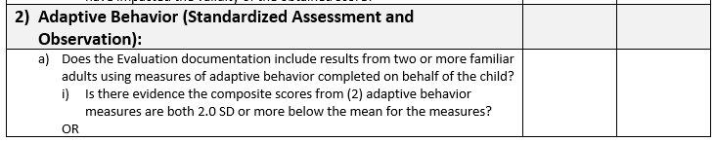

Slide 26
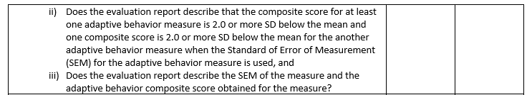

Slide 27
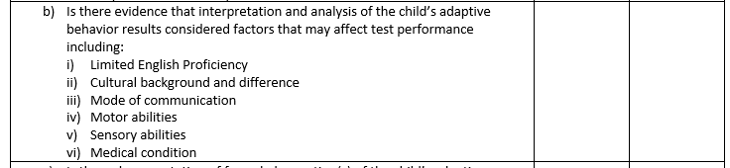

Slide 28
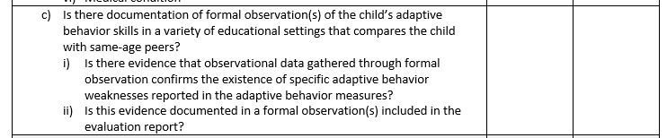

Slide 29
Adaptive Behavior
Defined as: Adaptive behavior is defined as the degree with which the individual meets the standards of personal independence and social responsibility expected of the person’s age and social/cultural group. Adaptive behavior skills are the skills that people need to function independently at home, school, and in the community. There are practical, social and conceptual domains of adaptive behavior.
Communicate with others
Take care of personal needs (dressing, bathing, toileting, etc)
Health and safety
Home living (laundry, cooking, cleaning, etc)
Social skills (manners, knowing rules of conversations, getting along in a group, making friends)
Reading, writing, and functional math (reading safety signs, writing personal information, telling time, counting money)
Skills that will facilitate holding a job

Slide 30
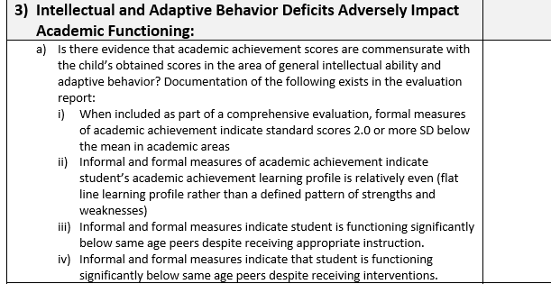

Slide 31
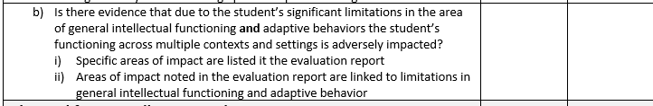

Slide 33
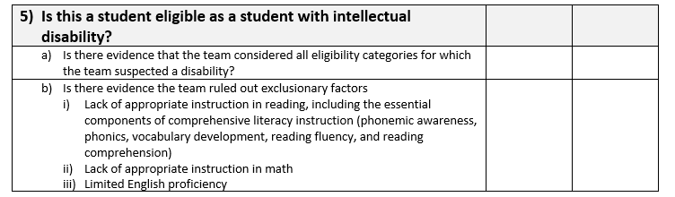

Slide 34
ID ELIGIBILITY FAQ

Slide 35
Can we list only the full scale score in the report?
No, all scores from the cognitive measure must be listed in the report. Without all scores available, teams cannot thoroughly examine, analyze and interpret the implications and impact of each one to the overall picture of the student. Unless there is clinically compelling evidence that the full scale score does NOT best represent the child’s overall cognitive ability, the full scale score or overall cognitive score should be the score the team uses to determine eligibility.

Slide 36
How many adaptive behavior measures are required? How many raters?
At least TWO different raters who are familiar with the child are needed on ONE adaptive behavior measure to obtain a comprehensive view of the child’s adaptive behavior skills functioning. If at all possible, one of those raters should be a parent or caregiver of the child.
It would not be compliant with the indicator for one teacher to fill out rating scales from two different adaptive behavior measures unless at least one additional person also filled out those measures.
Use the manual for the adaptive behavior measure to determine the best way to gather parent/caregiver information.

Slide 37
How many observations are required?
More than one observation may be required to document how the student’s disability impacts his or her academic and functional performance in a variety of educational settings.
If one observation contains documentation of academic and functional performance in variety of educational settings then it would meet the requirement, however, often times more than one observation will be necessary to collect data in a variety of settings.
Educational settings could include: classroom, lunchroom, transition times, bus, playground, special classes, before school/after school programs

Slide 38
What adaptive behavior scores can we use to determine eligibility?
The changes to the State Plan indicate that teams should use the overall adaptive behavior composite score to establish adaptive behavior functioning.
Using the overall adaptive behavior composite score gives the truest picture of the adaptive behavior functioning across multiple domains.
Teams should analyze and discuss all of the adaptive behavior scores to fully understand the student’s adaptive behavior strengths and weaknesses.

Slide 39
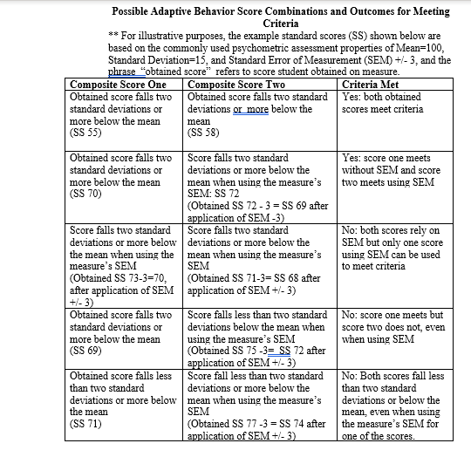

Slide 40
Case Study 1
IQ scores:
  Verbal Comprehension Index = 85
  Perceptual Reasoning Index = 72
  Working Memory Index = 50
  Processing Speed Index = 73
  Full Scale IQ = 63
Adaptive Behavior:
  School person 78
  Parent 86
Academics:
  No standard scores below a 77. Most in the low to mid 80’s
Core language = 83
Why should this student NOT be found eligible as ID?

Slide 41
Case Study 2
IQ scores:
  Verbal Comprehension Index = 63
  Perceptual Reasoning Index = 75
  Working Memory Index = 73
  Processing Speed Index = 80
  Full Scale IQ = 69
Adaptive Behavior:
  School person 79
Language Assessment:
  Core Language = 70 and 72
Academics:
  No standard scores below a 75.
Why should this student NOT be found eligible as ID?

Slide 42
Case Study 3
IQ scores:
  Verbal Comprehension Index = 63
  Perceptual Reasoning Index = 62
  Working Memory Index = 55
  Processing Speed Index = 56
  Full Scale IQ = 54
Adaptive Behavior:
  School person 1 = 56
  School person 2 = 65
  Parent = 73
Language Assessment:
  Core Language = 59
Academics:
  No standard scores above 58
Why should this student be found eligible as ID?

Slide 43
Assessment Tips

Slide 44
Qualifications of Assessment Users
Pearson: The "Qualified User" is the individual who assumes responsibility for all aspects of appropriate test use, including administration, scoring, interpretation, and application of results. To assist the qualified user, each test manual will provide additional detail on administration, scoring and/or interpretation requirements and options for the test.
Qualification “B”: Masters, formal training on assessment of children, Woodcock, WIAT, Vineland, ABAS
Qualification “C”: Doctorate, or Licensed Psy, Psy Examiner, WISC, SB, WJ Cog

Slide 45
Technical Knowledge
Users should be familiar and competent in aspects of assessment and receive training in the administration and interpretation on the specific assessments required for the evaluation
Continued professional development required each time test version updated

Slide 46
Assessment Scoring
Follow test manual for basal and ceiling rules
Give credit for all allowable responses, adhere to standardized scoring procedures
If hand scoring, use correct technical tables
If any outlier scores are obtained, recheck scoring or contact test publisher for explanation. You want an answer for this before other stakeholders ask

Slide 47
Assessment Scoring
Important considerations in scoring:
Score each item as it is administered
Do not to discontinue administering a subtest prematurely
This is particularly important when you are unsure how to score a response immediately
Better to administer more items in a subtest, even though some may not be counted in the final score
You do not want to short-change the child by discontinuing the subtest too soon

Slide 48
Telepractice: Remote Assessment Practices
Follow guidance of test publisher
Not every assessment can be completed remotely
If assessments are completed remotely, indicate in score report and discuss how this may impact test scores

Slide 49

Any Questions?

