Slide 1
New MAP-A Teacher Orientation
Dynamic Learning Maps Website
2021-22

Slide 2
DLM and MAP-A Relationship
Dynamic® Learning Maps (DLM) is a consortium that manages an alternate assessment
Missouri uses DLM as the alternate assessment and refers to it as Missouri Assessment Program–Alternate (MAP-A)
MAP-A measures content standards called Essential Elements (EEs)

Slide 3
DLM Kite Programs
Kite Educator Portal
Kite SEA
Kite Student Portal
Kite Training Courses

Slide 4
MAP-A is Year-Long
Instruction and assessment occurs throughout the year
There are two Instructionally Embedded test windows for ELA and math
Science is not instructionally-embedded, it is year-end

Slide 5
First Step to Using DLM
Ask your DTC to create your Educator Portal account.
If you already have an account, ask your DTC to contact DESE to have it transferred to your current district.

Slide 7
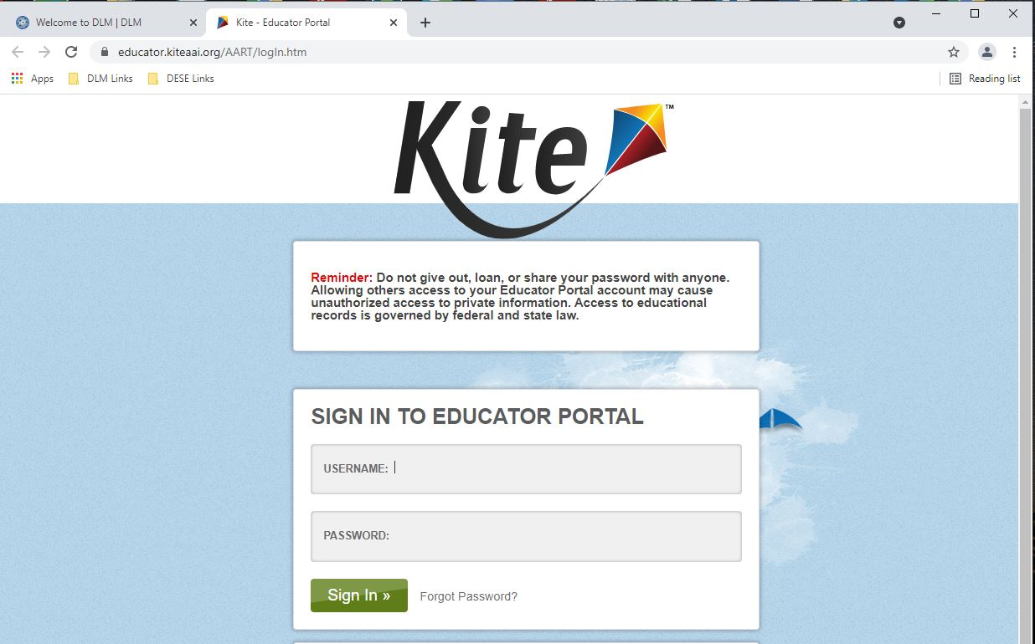

Slide 8
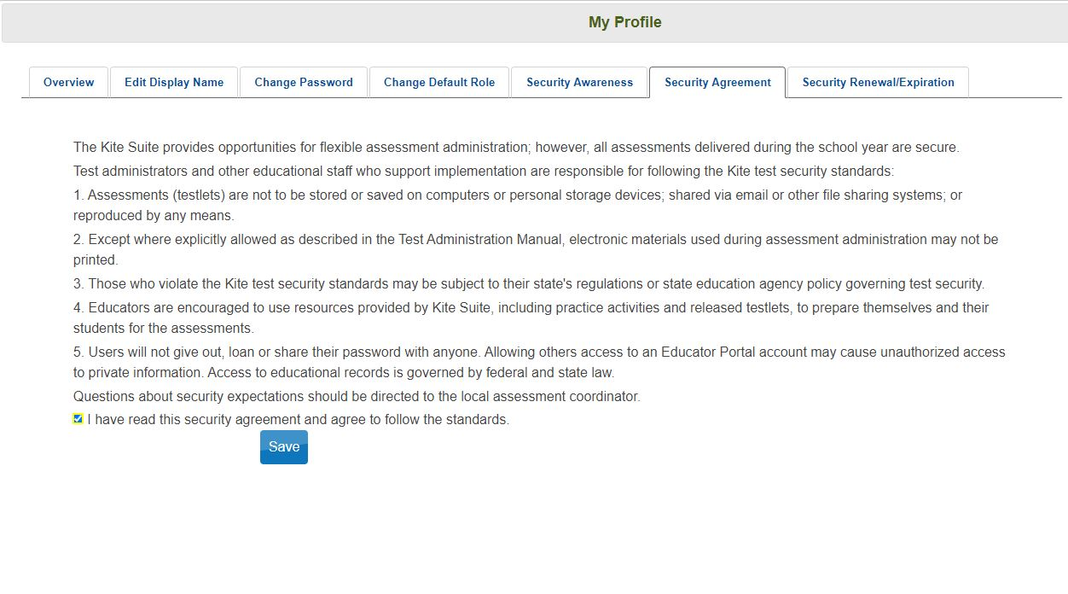

Slide 9
Claims, Conceptual Areas, and Essential Elements

Slide 10
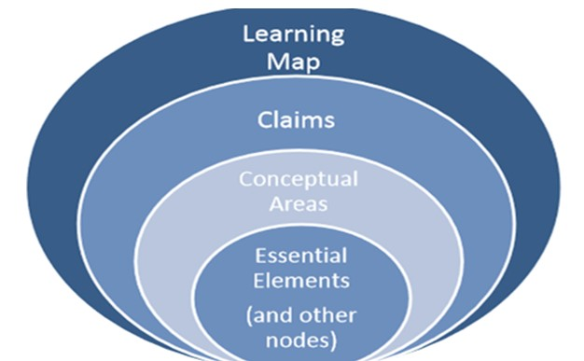
Relationship of Terms

Slide 11
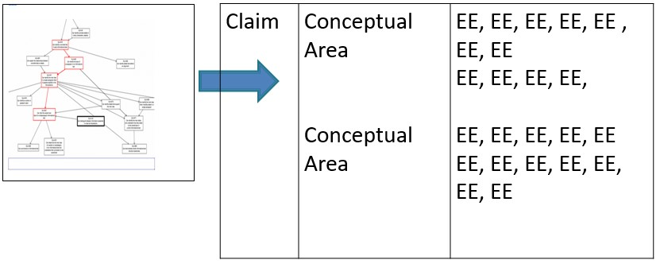
Organization of Learning Content

Slide 12
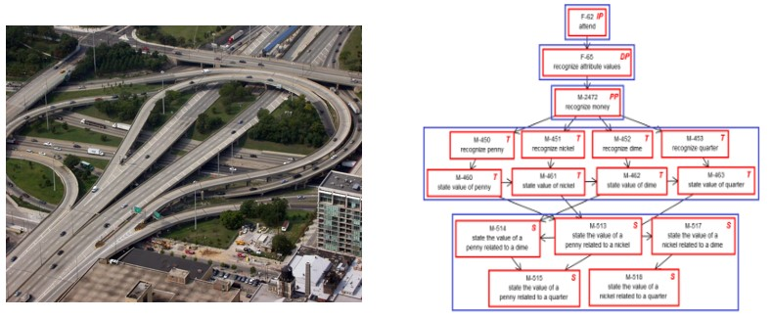
Exploring the Mini-Map

Slide 13
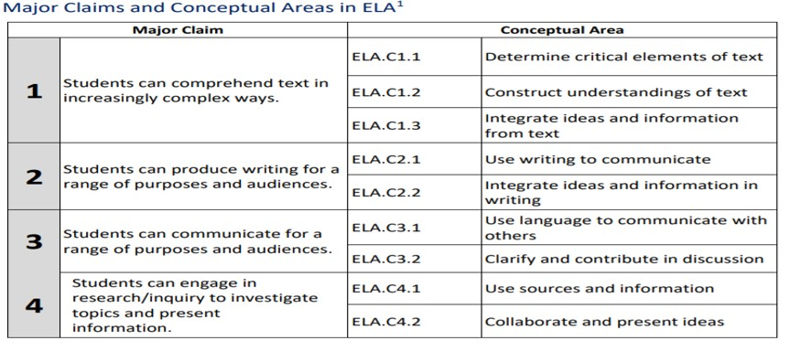

Slide 14
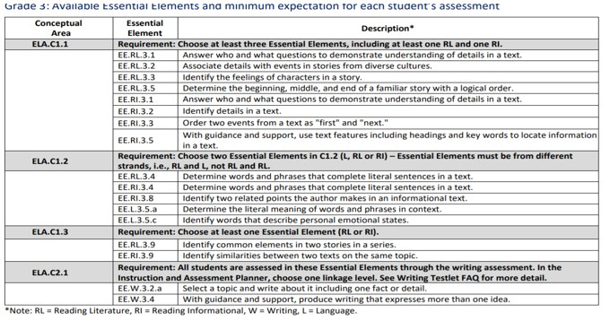
EEs for Each Conceptual Area Blueprint

Slide 15
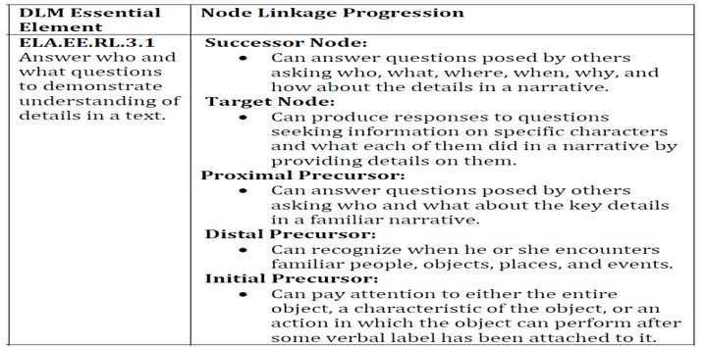
Linkage Levels for a Tested EE in ELA

Slide 16
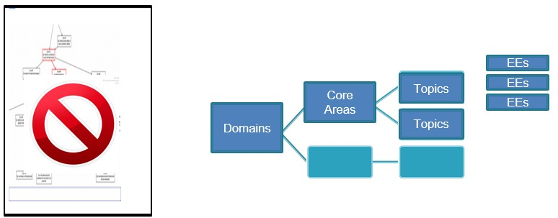
Science Uses a Year-End Model

Slide 17
Science Assessment Requirements
Fall Window
EEs are chosen by teachers
Testing is optional, but strongly encouraged
Testlets are NOT used for accountability purposes
Spring Window
EEs are NOT chosen by teachers
Testing is required
Testlets ARE used for accountability purposes

Slide 18
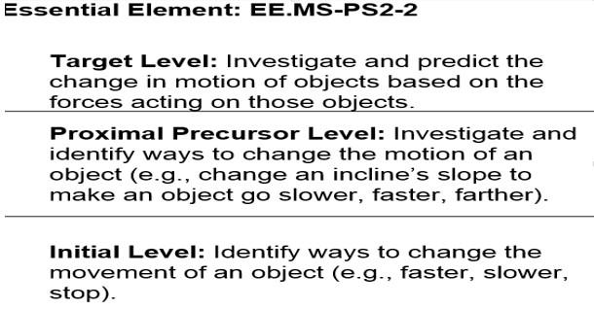
Linkage Levels for a Tested EE in Science

Slide 19
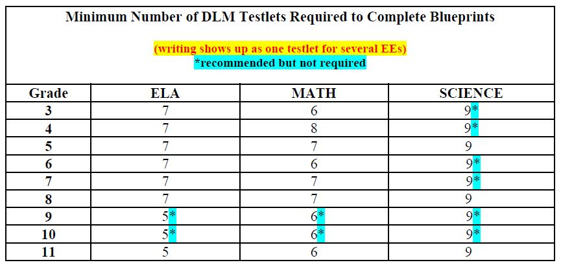
Testlets Required to Meet Blueprint

Slide 20
Instructionally Embedded Assessments

Slide 21
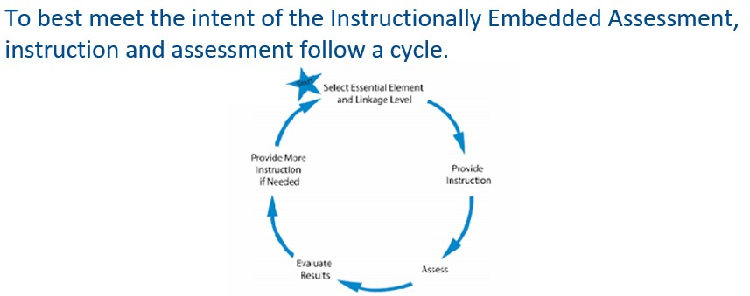
Instruction and Assessment Cycle

Slide 22
Instructionally Embedded Assessments
Seamless instruction integrated with assessment
Based on the student’s academic goals
Administered throughout the school year

Slide 23
Instructionally Embedded Assessments
Essential Elements for instruction are based on Blueprint guidelines
KiteⓇ Suite will suggest a Linkage Level, but the teacher may select a different level
Not a group assessment

Slide 24
Engagement Activity
Each testlet contains an engagement activity to activate prior knowledge
There is a testlet available for each Linkage Level

Slide 25
Five Linkage Levels for ELA and Math
Initial precursor
Distal precursor
Proximal precursor
Target (at the Essential Element level)
Successor (Getting closer to Grade Level Standard)

Slide 26
Three Linkage Levels for Science
Initial Precursor
Proximal Precursor
Target (mastery)

Slide 27
Linkage Level Comparison
ELA & Math Linkage Levels | Science Linkage Levels
Initial | Initial
Distal Precursor
Proximal Precursor | Proximal Precursor
Target | Target
Successor

Slide 28
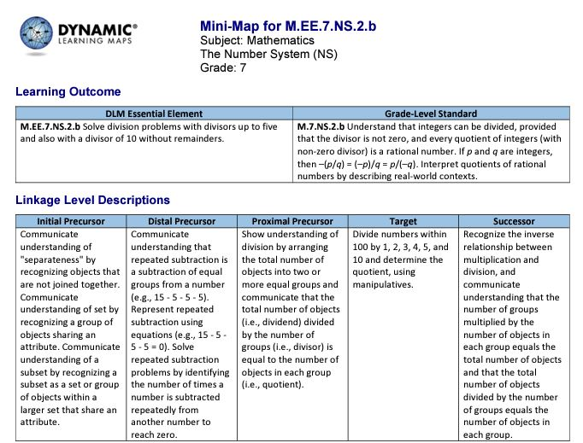
Example of Linkage Levels in a Mini-Map

Slide 29
Comparison: Grade Level, EE, Linkage Levels

Slide 30
Create IEP Goals
Use the information from the Linkage Levels and Mini-Maps to plan instruction and create IEP goals.
Every goal must have a short-term objective or benchmark.

Slide 31
Required Training for Teachers

Slide 32
Required Training for New Teachers
Module 1: Overview of the DLM Alternate Assessment (30 minutes)
Module 2: Testlets (25 minutes)
Module 3: The Instructionally Embedded Model (35 minutes)
Module 4: Becoming Familiar with the DLM website and its Resources (20 minutes)

Slide 33
Experienced Teacher Training
MAP-A teachers returning from last year must watch one required training video and pass with 80 percent or higher on the tests.
Best Practice is to review the manuals to learn the changes from last year.
Notes:
MAP-A teachers returning from last year must watch one required training video that has four parts and pass with 80 percent or higher on the tests. Best Practice is to review the manuals to learn the changes from last year. Recommended manuals are Accessibility Manual,

Slide 34
Access to Training Courses
New teachers may need to contact district test coordinators or data managers to request an account in Educator Portal
After your Educator Portal account is created, you will be able to access the training login

Slide 35
Steps for Help with Training
Read the Test Administrator's Manual
Ask staff in your district
Call your RPDC consultant
Contact Missouri’s DLM Help Desk

Slide 36
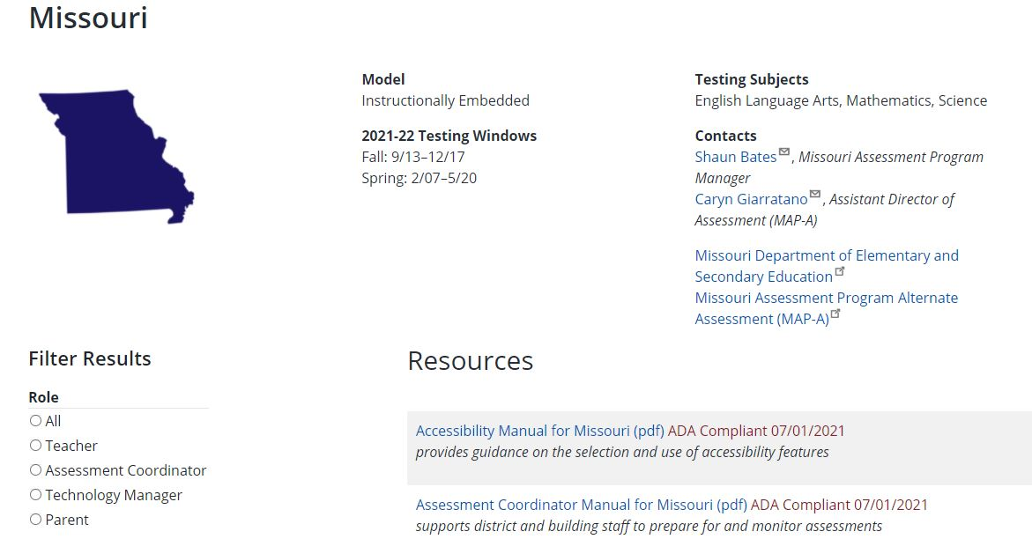
Training on Missouri Page

Slide 37
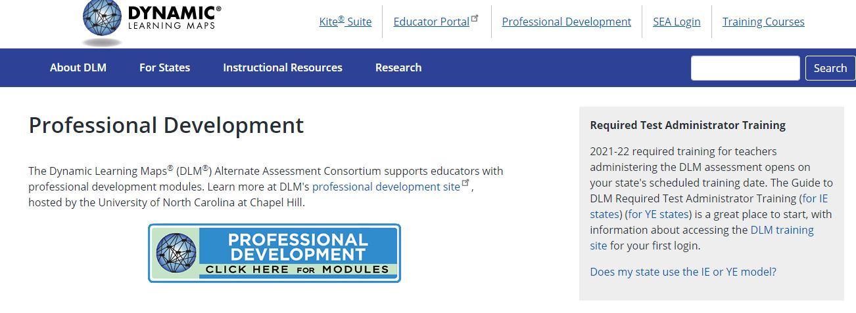
Professional Development Resources
Notes:
These resources and helplets can be a lifesaver for you. The videos and helplets (short videos on specific topics) shown here are a small sampling of what is provided.
https://dynamiclearningmaps.org/erp/videos

Slide 38
Using Kite® Suite

Slide 39
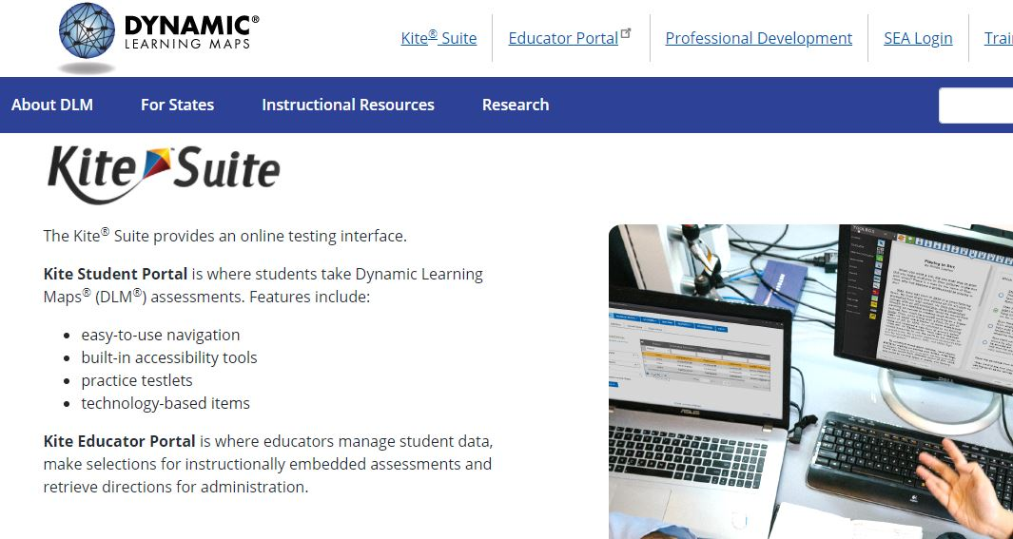
Student Portal

Slide 40
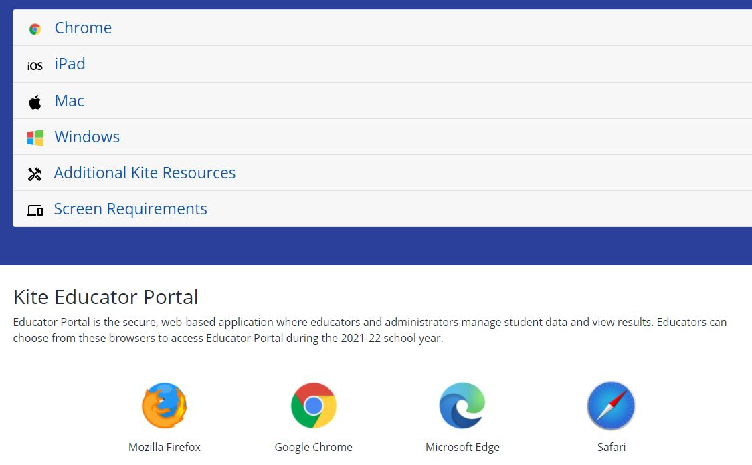
Educator Portal

Slide 41
Practice on Released Testlets
Sample Testlet Information Pages and Released Testlets in English Language Arts
Sample Testlet Information Pages and Released Testlets in Mathematics
Sample Testlet Information Pages and Released Testlets in Science

Slide 42
Using Educator Portal

Slide 43
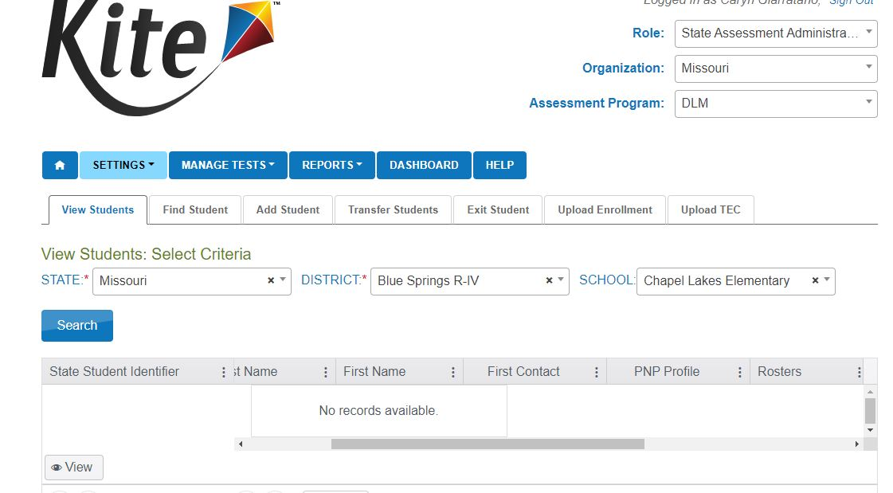
Access Educator Portal

Slide 44
Prepare for Student Testing
DTC must enroll and roster the student
Teacher must complete the First Contact Survey and Personal Needs Profile

Slide 45
Information Needed to Complete the FCS
Communication skills
Academic skills
Attention abilities
Services
Sensory capabilities
Motor capabilities
Computer skills

Slide 46
Instruction and Assessment Planner

Slide 47
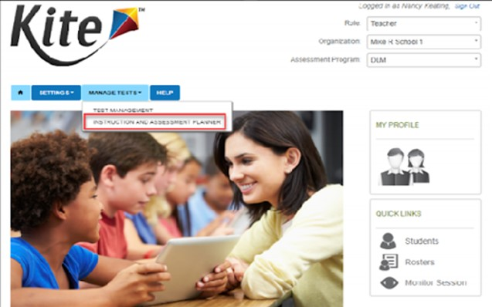
Instruction and Assessment Planner

Slide 48
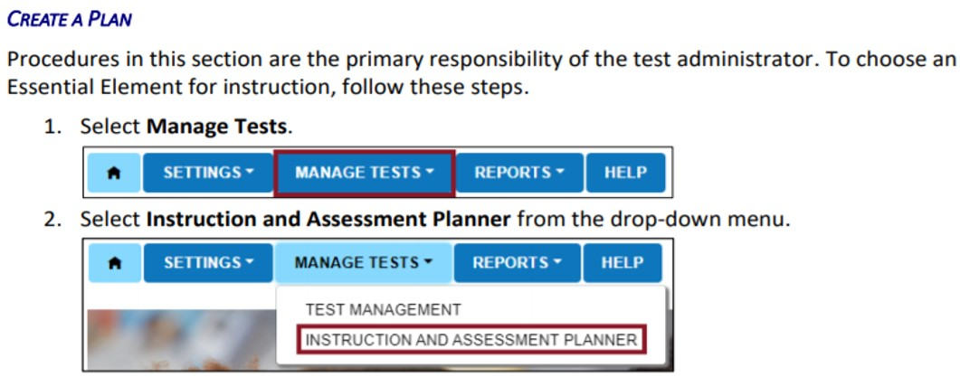
Closeup of the Filepath to the Planner

Slide 49
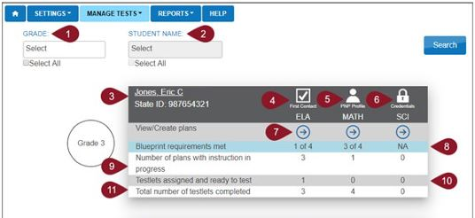
Student Activity Table
Notes:
This graphic is copied from Educator Portal, page 57.

Slide 50
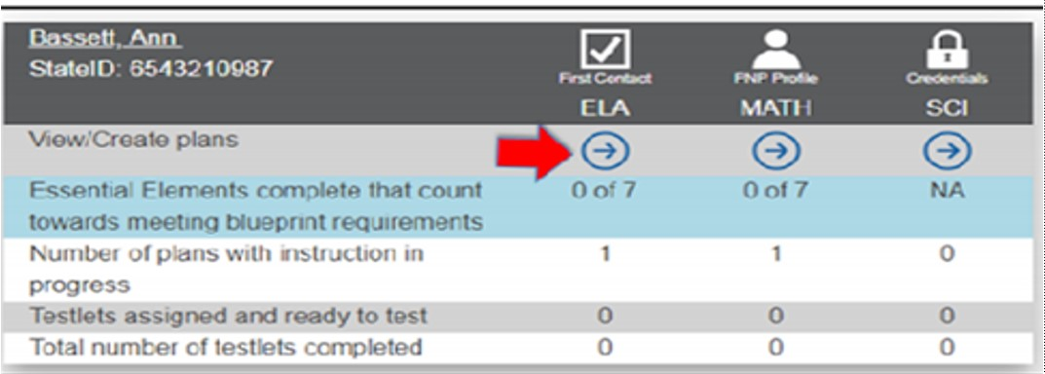
ELA Blueprint Filepath

Slide 51
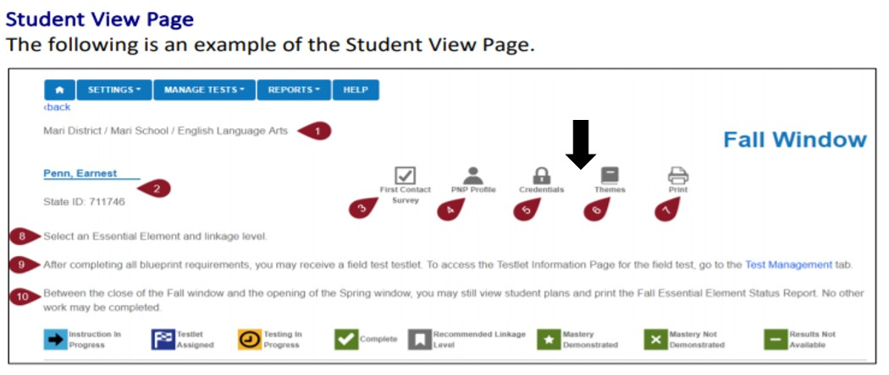
Top of Student View Page

Slide 52
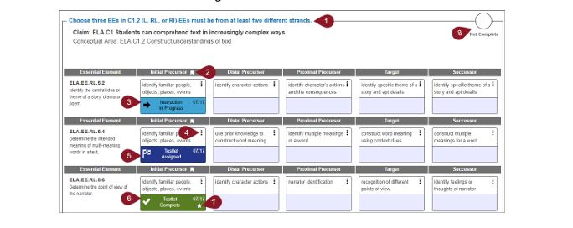
Blueprint on Student View Page

Slide 53
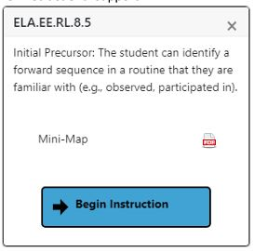
Blueprint Details in the Planner

Slide 54
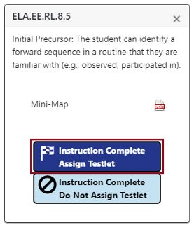
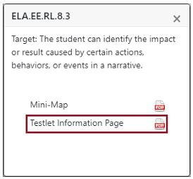
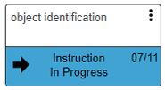
Blueprint Choices in Planner

Slide 55
Meeting Blueprint Requirements
Decide what Essential Elements are required for ALL grades
The same set of EEs may be chosen for both windows
Use professional judgment to create instructional units

Slide 56
Integrate Instruction and Assessment
Combine several EEs into instructional units
Select EEs to meet Blueprint requirements
Create a timeline for instruction and assessment

Slide 57
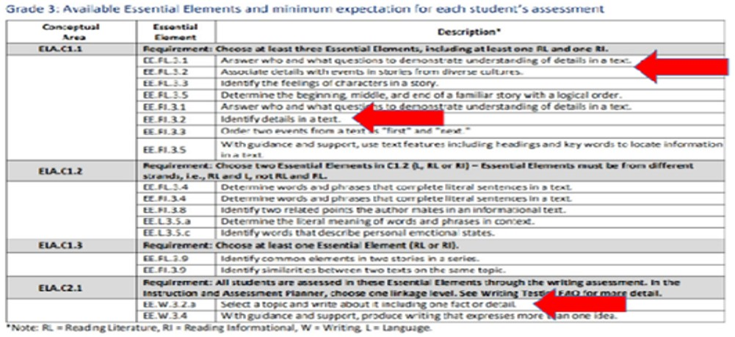
Creating an Instructional Unit with a Grade Level

Slide 58
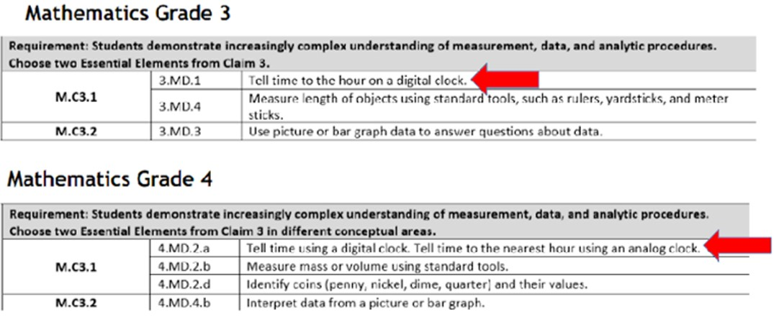
Creating an Instructional Unit across Grade Levels

Slide 59
Testing

Slide 60
Two Methods to Test
1. Student interaction with the computer
2. Teacher-administered testlets
Lowest Linkage Level without symbolic understanding
Highest Linkage Levels without ability to think abstractly
All writing assessments during the spring window

Slide 61
Testlet Information Page (TIP)
Test Administrators must view the TIP before giving each testlet
Details are in the Test Administration Manual, page 39

Slide 62
Test Administration Practices
Use best judgment and flexibility
Provide additional supports beyond PNP
See “Practices Allowed” in the TAM and “Learn about the Accessibility Supports” in the Accessibility Manual

Slide 63
Student Transfer Information for DTCs
No cutoff date to enroll transfer students
Request records from sending district
MAP-A eligibility is determined by the IEP team using DESE eligibility criteria
Transfer students may be expedited by DESE

Slide 64
Documents in Educator Portal
Blueprints for ELA, math and science
First Contact Surveys
Individual Student Reports
Instruction and Assessment Planner
Personal Needs and Preferences
Security Agreement
Test Information Page (TIPS)

Slide 65
DLM Resources for MAP-A Teachers
DLM Missouri Page
Instructional Resources
Professional Development
Training Course Login

