Slide 1
New MAP-A Teacher Orientation
Department of Elementary and Secondary Education 2021-22

Slide 2
Overview of the DESE MAP-A Program
Missouri Assessment Program-Alternate
Dynamic Learning Maps (DLM) serves as vendor
DESE Assessment and Compliance is a partner
* Tour the DESE MAP-A Page

Slide 3
First Step to Using MAP-A
Ask your DTC to create your Educator Portal account
If you have an account that was created in a former district, ask your DTC to contact DESE to have it transferred to your current district
DESE contact: Caryn Giarratano, Caryn.Giarratano@dese.mo.gov, 573-751-6731

Slide 4
Welcome!

Slide 5
Parameters of MAP-A
A student eligible for MAP-A does not participate in any other statewide standardized assessments
Students are required to be assessed in:
English Language Arts (ELA) in grades 3-8 and 11
Math in grades 3-8 and 11
Science in grades 5, 8, and 11

Slide 6
Best Practice Is to Test All Grades 3-11
Administering ELA and math assessments in grades 9, 10, and 12 and science assessments in grades 3, 4, 6, 7, 9, 10, and 12 requires use of compliance forms to indicate local assessment
Review compliance forms: D, E, IEP Form 2021, Checklist, and Decision-Making Guidance

Slide 7
Instructionally Embedded Assessments
Seamless instruction integrated with assessment
Based on the student’s academic goals
Administered throughout the school year

Slide 8
Instruction and Assessment is Year-Long
Instruction and assessment occurs all year
There are two Instructionally Embedded test windows for ELA and math
There is one Year End test window for science
Assessment items and tasks are embedded in day-to-day instruction

Slide 9
MAP-A/DLM Manuals
There are 11 manuals posted on the DESE and DLM websites
Teachers are encouraged to read 5 of them

Slide 10
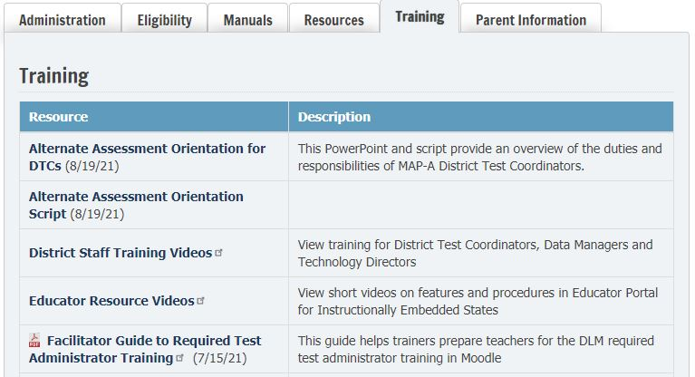
DESE MAP-A Training Tab

Slide 11
DESE MAP-A Parent Information Tab
This tab has been filled with new information, so it is recommended that teachers view all documents
However, of primary interest are: Brochure for Parents; Documents explaining ISRs; and Instructional Resources

Slide 12
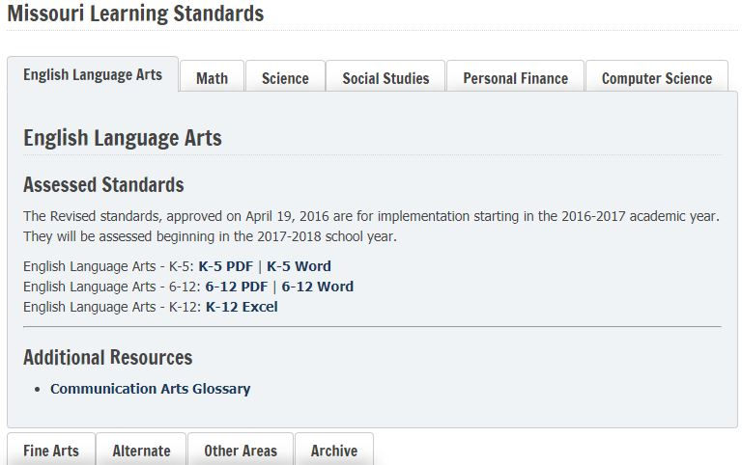
Missouri Learning Standards Web Page

Slide 13
Highlights of MAP-A Websites
DESE: dese.mo.gov
Best Practices for Teachers
MAP-A Compliance Resources
Chart of Required # Testlets
Build Your Own Curriculum Finding an Activity
DLM: dynamiclearningmaps.org
Missouri Resources
Materials Collections for ELA
Materials Collections for Math
Materials Collections for Science
Science Instructional Activities
ELA Familiar Texts
Math Glossary

Slide 14
Eligibility Criteria for MAP-A

Slide 15
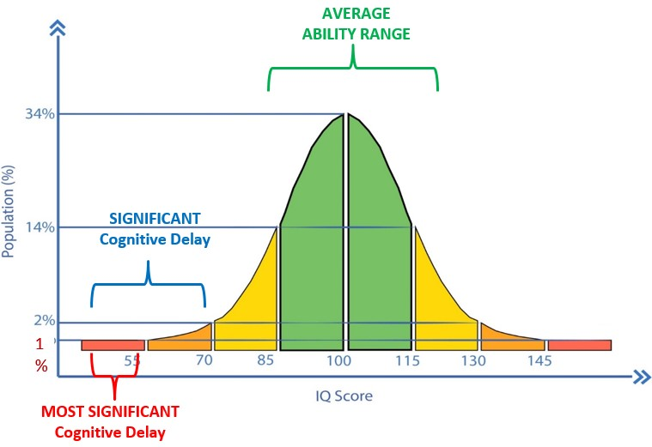

Slide 16
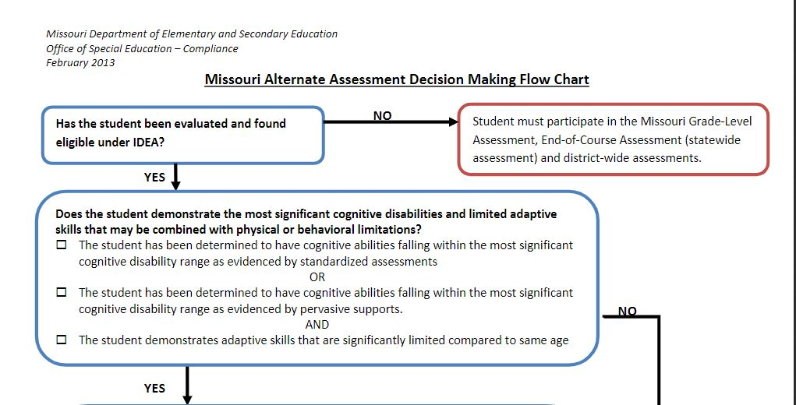
Decision Making Flow Chart

Slide 17
Flow Chart Step 1

Slide 18
Flow Chart Step 2

Slide 19
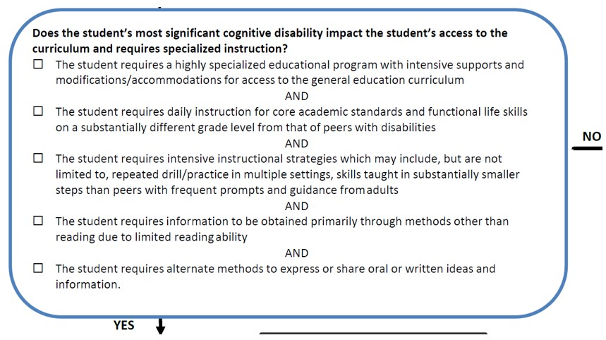
Flow Chart Step 3

Slide 20
Flow Chart Step 4

Slide 21
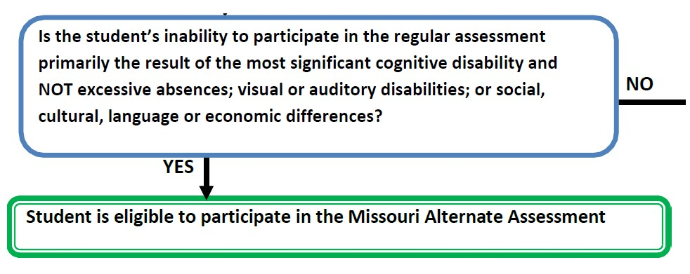
Flow Chart: Step 5

Slide 22
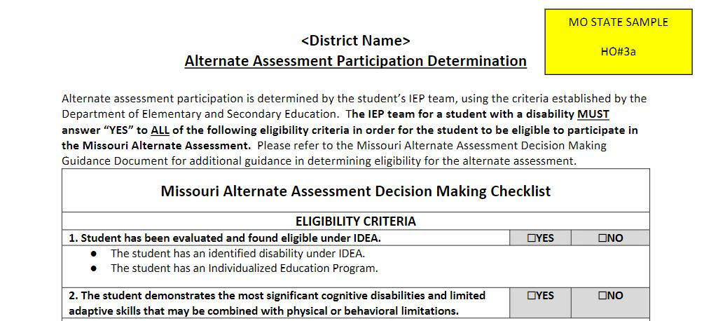
Eligibility Criteria Checklist

Slide 23
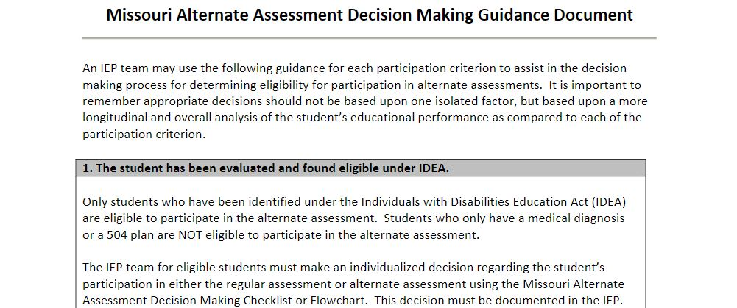
Guidance Document

Slide 24
Technical Assistance from RPDCs

Slide 25
