Slide 1
Resources for Test Administrators
IC Training MAP-A
Explore the Following Websites
DESE.MO.GOV
MAP-A
Missouri Learning Standards
Alternate Standards
Crosswalk
Notes:
To Know: THIS SLIDE SHOULD BE HIDDEN PRIOR TO PRESENTING
To Do: Send the following email to participants (consultants can adjust to include additional information and/or fit needs of RPDC) prior to training.
To Say: Thank you for registering for the New to MAP-A training. Before attending our training on (DATE), please complete the following prerequisites:
Review the attached glossary from the Test Administration Manual
Review the DESE MAP-A website at http://dese.mo.gov/college-career-readiness/assessment/map-a
Print or download the following manuals to use during training
Accessibility Manual
Test Administration
Educator Portal User Guide
Guide to DLM Test Administrator Training
All manuals can be found here: https://dese.mo.gov/college-career-readiness/assessment/map-a#mini-panel-map-a3
Bring a copy of your district calendar
We look forward to seeing you at (TIME) on (DATE) at (LOCATION)

Slide 2
Resources for Test Administrators
Access the Test Administration Manual
Print or download the following manuals
Educator Portal User Guide
Guide to DLM Required Test Administrator Training
Test Administration Manual
Guide to Practice Activities and Released Testlets
Notes:
THIS SLIDE SHOULD BE HIDDEN PRIOR TO PRESENTING

Slide 3
Consultants List of Materials Needed
HO #1 – Agenda
HO #2 – Form D
HO #3 – Form E
HO #4 – IEP Form
HO #5a – Eligibility Criteria
HO #5b – Flow Chart
HO #6 – Guidance Document
HO #7 – Tour of DESE MAP-A
Table Copies of Blueprints
ELA EE
Math EE
Science EE
Optional Handouts
Test Administrator Guide of Pages
MAP-A Resource Table
Notes:
To Do: Have copies for each participant.

Slide 4
Consultant Will Need to be Familiar With
Test Administrator Manual
Guide to Practice Activities and Released Testlets
Educator Portal Guide
Guide to Required Test Administrator Training
Educator Portal Sandbox
Notes:
To Say: If more Sandbox logins are needed, let Susan know.

Slide 5
Materials Needed
Accessibility Manual
Download the ELA, math, and science blueprints
Educator Portal Guide
Guide to Released Activities and Practice Testlets
Guide to Required Testing Manual
Guide to Test Administration Manual
Notes:
To Say: Please have these available on your computer or in print. You will need the following materials for today’s training:
Accessibility Manual
Download the ELA, math and science blueprints
Educator Portal User Guide
Guide Released Activities and Practice Testlets
Guide to Required Testing Manual
Guide to Test Administrators Manual

Slide 6
Overview
MAP-A 2021-22
Presenter’s Name
Notes:
To Say: Welcome to the in person/virtual training of MAP-A for 2021-22. There is quite a bit of information that might seem daunting; however, rest assured that there are many ways to receive help to your questions. This presentation is broken into six parts. So, let’s get started.

Slide 7
Agenda For the Day
Part 1: Getting Started: Welcome/Overview/Norms
Part 2: General Information About MAP-A, Dynamic Learning Maps (DLM), and Department of Elementary and Secondary Education (DESE)
Part 3: DLM Terminology and Organized Structure
Part 4: Instructionally Embedded Assessments
Part 5: Using Kite® Suite
Part 6: Instruction and Assessment Planner
# 1
Notes:
To Know: How the learning for the day will unfold.
To Say: For today’s training, when there is a handout associated with the slide, you will see a small yellow box with the number of the handout. Please take a look at handout #1, as indicated by the yellow box on this slide. This handout shows today’s agenda. This is how the training is lined out.

Slide 8
Part 1 Getting Started
Welcome, Introductions, and Norms
Notes:
Part I: Getting Started

Slide 9
Norms
Be present
Turn cell phone off or silence
Minimize sidebar conversations
Ask questions
Take care of personal needs with minimal distractions
Have open heart and open mind
Be patient
Notes:
To Say: Read the slide or add your own Norms.

Slide 10
Connections
Teacher Standards
Missouri Learning Standards
Standard #2 Student Learning, Growth and Development
Standard #3 Curriculum Implementation
Standard #7 Student Assessment and Data Analysis
The Essential Elements measured by the MAP-A in the content areas of ELA, math, and science are directly aligned to the Missouri Learning Standards
Notes:
To Say: Missouri Teaching Standards are noted here. The Essential Elements measured by the MAP-A in the content areas of ELA, math, and science are directly aligned to the Missouri Learning Standards.

Slide 11
MAP-A and DLM
Dynamic Learning Maps (DLM) is a multi-state consortium that has developed a computer delivered alternate assessment for students with most significant cognitive disabilities
Missouri uses DLM as the alternate assessment and refers to it as MAP-A
MAP-A measures content standards called Essential Elements which are aligned to Missouri Learning Standards, but at a reduced depth, breadth, and complexity
Notes:
To Know: The relationship between DLM and MAP-A.
To Do: Read slide
To Say: Dynamic Learning Maps (DLM) is a multi-state consortium that has developed a computer-delivered alternate assessment. Missouri uses this DLM alternate assessment and refers to it as MAP-A. The MAP-A (or DLM) measures Essential Elements which are aligned to Missouri’s Learning Standards but at a reduced depth, breadth, and complexity.

Slide 12
Essential Questions
Relationship between the MAP-A and DLM
Eligibility determination for MAP-A
Timelines for the MAP-A assessment
MAP-A resources
MAP-A terms and vocabulary
Resources on DESE or DLM website
Notes:
To Know: This is the intent of the training.
To Do: Briefly go over the questions with the participants.
What is the relationship between the MAP-A and DLM?
How is eligibility determined for MAP-A?
What are the timelines for the MAP-A Assessment?
Where are the MAP-A resources located?
What are MAP-A terms and vocabulary?
How can I locate resources on either the DESE website or DLM website?
To Say: This slide and the next are the essential questions that will be answered in today’s training.
What is the relationship between the MAP-A and DLM?
How is eligibility determined for MAP-A?
What are the timelines for the MAP-A assessment?
Where are the MAP-A Resources located?
What are MAP-A terms and vocabulary?
How can I locate resources on either the DESE website or DLM website?

Slide 13
Essential Questions
Similarities and differences for MAP-A ELA, math and science
Responsibilities of test administrators and other school district roles
Use of Instruction and Assessment Planner
Kite® Suite
Notes:
To Do: Read the questions on this slide.
To Say: What are the similarities and differences for MAP-A ELA, math and science? What are the responsibilities of test administrators and other school district roles? How do you use the Instruction and Assessment Planner? What is the Kite®Suite?

Slide 14
Part 2 General Information
MAP-A, DESE, DLM and Eligibility Criteria
Notes:
To Say: Part 2 is general information regarding MAP-A, what can be found on DESE and DLM webpages, and who have met the Eligibility Criteria.

Slide 15
Important Roles
Data Manager-Person who manages user, student, and roster data in Educator Portal
Test Coordinator-Person who prepares district and school staff for testing
Technical Manager-Technology personnel in preparing schools for DLM assessment
Test Administrator-Teachers who give the MAP-A testlets
Notes:
To Say: Do I know who is the data manager? Test coordinator? Technical manager? Test Administrator? You! You will need to know who has these roles. If you are unsure, check with your special education director.

Slide 16
Important Contact Information
Those of you NEW to the MAP-A/DLM and DO NOT have an Educator Portal account, contact your district’s Data Manager to be sure you are enrolled
If you are enrolled, but still cannot access Educator Portal, have your Data Manager contact Caryn Giarratano (Caryn.Giarratano@dese.mo.gov)
Notes:
To Do: Read the slide.
To Say: If you are new to MAP-A/DLM, and do NOT have an Educator Portal account, contact your district’s data manager to be sure you are enrolled.
If you are enrolled, but cannot access the Educator Portal, then you may want to have the data manager contact Caryn.Giarratano@dese.mo.gov.

Slide 17
What is MAP-A
Missouri Assessment Program-Alternate
MAP-A is designed to promote enhanced capacities and integrated learning opportunities via instruction
Is administered only to students with the most significant cognitive disabilities
Student eligibility is determined by the student’s Individualized Education Program (IEP) team using DESE-established eligibility criteria
Notes:
To Know: How to determine whether or not students qualify to participate in MAP-A.
To Do: NOTE: The level of discussion related to eligibility will depend on participants’ prior knowledge.
To Say: The questions on this slide and the next are there to help guide the training.
What is MAP-A?
Missouri Assessment Program-Alternate
MAP-A is designed to promote enhanced capacities and integrated learning opportunities via instruction
Is administered only to students with the most significant cognitive disabilities
Student eligibility is determined by the student’s Individualized Education Program (IEP) team using DESE-established eligibility criteria

Slide 18
MAP-Alternate
A student who is eligible for the MAP-A does not participate in any other statewide (i.e., End-of-Course exams (EOCs) or Grade-Level Assessments) standardized assessments
Required in these grades
English Language Arts (ELA) in grades 3-8 and 11
Math in grades 3-8 and 11
Science in grades 5, 8, and 11
Notes:
To Know: The purpose of MAP-A.
To Do: Share the information on the slide.
To Say: A student who is eligible for the MAP-A does not participate in any other statewide standardized assessments regardless of what classes they are attending! Therefore, the student will not take the EOCs or grade level assessments. It is important to note that any student who was a junior last year is considered to be a senior, and they will NOT need to take any testlets from last year. You may do the appropriate grade span as a check to see where they currently are. Remember that any child who qualifies on ALL criteria for MAP-A should take MAP-A. Only in rare instances will districts have more than one percent of their students who qualify on all criteria on the eligibility checklist. Districts having more than one percent will be asked to show justification. It is considered best practice to file the checklists and documentation with the IEP.

Slide 19
Important to Note
Districts may choose to administer the optional MAP-A ELA and math assessments to students in grades 9, 10, and 12 and the science assessments in grades 3, 4, 6, 7, 9, 10, and 12 for local assessment use. Please refer to forms D and E
Form D-State Assessments has been updated! It is now dated as July 30, 2021 https://dese.mo.gov/media/file/form-d-corrected
Form E has also been updated! It is now dated as July 30, 2021 https://dese.mo.gov/media/file/form-e-2021
#2 and #3
Notes:
To Know: The grades MAP-A are required and voluntary.
To Do: Show slide and go over information.
To Say: Form D - HO#2 has been updated so you will need to have a copy that is dated July 30, 2021. Form D-Part 3 pertains to MAP-A along with the MAP-A Justification which is now located on the present level of academic achievement and functional performance (PLAAFP). Form D needs to reflect the type of assessment given (i.e., local assessment). Form E-Part 3- If a district chooses to administer the optional assessments, then they are considered district-level as opposed to state-level. If you have questions about Form D or Form E, please contact your compliance consultant.

Slide 20
Updates to PLAAFP
Once the IEP team determines that the student is unable to access the regular curriculum and that a curriculum based on alternative standards is appropriate (MAP-guidance), complete this section by describing the following
How the student demonstrates the most significant cognitive disabilities and limited adaptive skills that may be combined with physical or behavioral limitations
How the most significant cognitive disability impacts the student’s access to the curriculum and requires specialized instruction
How the most significant cognitive disability impacts the student’s post-school outcomes
Any additional factors considered. (The student’s inability to participate in the general education assessment must be primarily the result of the most significant cognitive disability and NOT excessive absences; visual or auditory disabilities; or social, cultural, language, or economic differences.)
#4 IEP
Notes:
To Say: This is NEW to the IEP Page and is located at the bottom of page two. Be sure to answer all four of the questions

Slide 21
MAP-A is Unique
Instruction and assessment occurs throughout the year
There are two instructionally embedded test windows for ELA and math
The fall window opens September 13, 2021, and ends December 17, 2021
The spring window opens February 7, 2022, and ends May 20, 2022
Assessment items and tasks are embedded in day-to-day instruction and inform teaching
Notes:
To Know: How MAP-A testing is unique from other types of state assessments.
To Do: Read the slide pointing out the dates.
To Say: There are two instructionally embedded windows for ELA and math. The fall window opens on September 13, 2021, and ends on December 17, 2021. The spring window opens on February 7, 2022, and ends on May 20, 2022. Assessment items and tasks are embedded in day-to-day instruction and inform teaching. The Instruction and Assessment Planner is closed from December 17 through end of January to retrieve data. Once the window opens again on February 7, you are asked to enter the Essential Elements (EEs) in the Instruction and Assessment Planner.

Slide 22
DESE MAP-A Webpage
The place for resources
http://dese.mo.gov/college-career-readiness/assessment/map-a
How do I get to DESE’s MAP-A webpage?
Go to dese.mo.gov
Scroll to Topics
Choose MAP
On the right, choose MAP-A
NOTE: When you open the MAP-A page, be sure to scroll the length of the entire “MAP-A” webpage since it contains links to almost all needed information and/or materials
Notes:
To Know: How to get to DESE’s MAP-A website.
To Do: The consultant will model and guide participants through the use of the DESE MAP-A website. You may want to show the preceding slides or just model on the screen. It is the consultant’s choice.
To Say: DESE’s MAP-A webpage is the page to go for resources and current information. It can be cumbersome to navigate so the process is written. We are now going to look the next few slides which will show you each step on how to access the DESE webpage for MAP-A. The following slides are screen shots of the webpages.

Slide 23
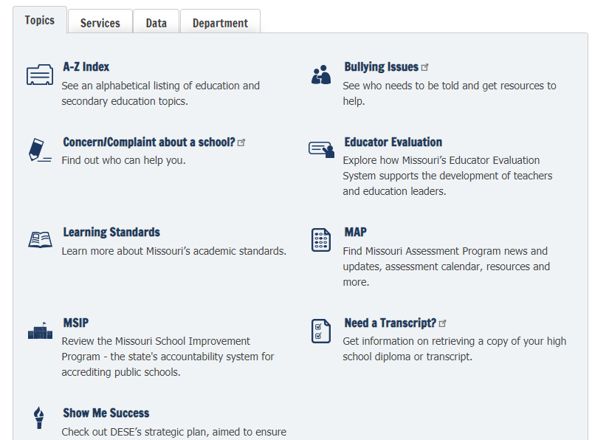
Notes:
To Say: You will go to the DESE Home Page and in the middle of the page where you see the blue arrow, you will see MAP. Click and it will take you to MAP-A.

Slide 24
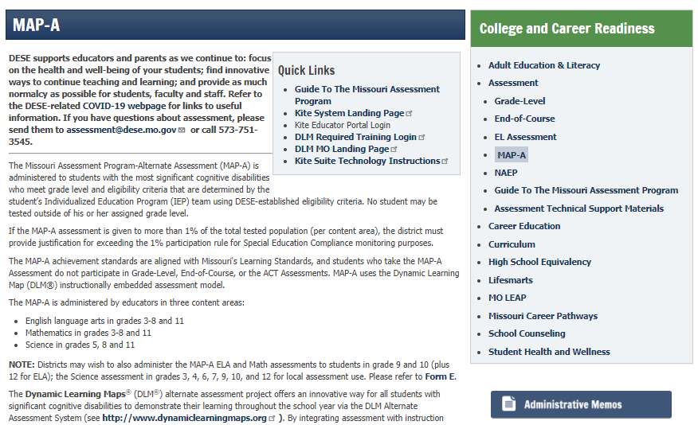
#7
Notes:
To Say: On the right hand side is MAP-A. Look for the Quick Links box in the middle and click on DLM Required Training Courses. You can get to DLM Training Courses from here or on the DLM Missouri page as well. Handout #4 is a step-by-step guide on how to navigate the DESE webpage.

Slide 25
Dynamic Learning Maps (DLM) Website
Notes:
To Say: In the middle of the DESE MAP-A page, there is a link to the Dynamic Learning Maps Website. There is a great deal of information that may be found on the DLM website to help you understand the MAP-A, instruction toward the MAP-A, and how to assess your students on the MAP-A.

Slide 26
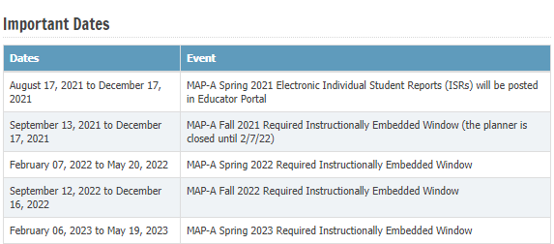
Important Dates
Notes:
To Say: Here is a list of the important dates for MAP-A 2021-22 and 2022-23.

Slide 27
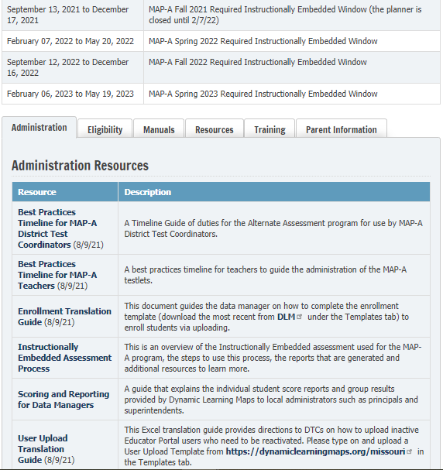
Six Tabs on the MAP-A Webpage
Six Tabs of Resources
Administration
Eligibility
Manuals
Resources
Training
Parent Information
https://dese.mo.gov/college-career-readiness/assessment/map-a
Notes:
To Do: Take participants to this page and navigate all six tabs. The consultant needs to be familiar with all information on the DESE MAP-A resources. Slides 31-38 can be used or hidden depending on your familiarity with the page. If you feel comfortable taking participants through the website, you may hide the next several slides. But, be sure and point out important information in each tab.
To Say: Once on the MAP-A page, you will then scroll down to the bottom. There are six tabs where you can obtain information needed for successful implementation of the MAP-A. The first arrows points to Best Practices Timeline for MAP-A District Test Coordinators and the second arrow is for the Best Practices Timeline for MAP-A Teachers. These are constantly updated and contain hotlinks to various information needed for successful implementation. This a monthly calendar that lists what needs to be completed within a fiscal school year.

Slide 28
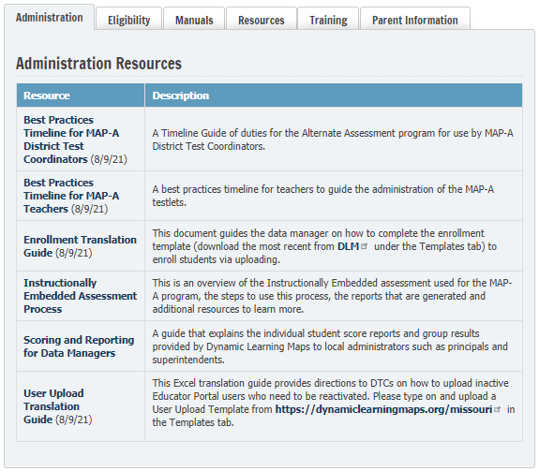
Administration Tab
Notes:
To Say: This tab is for the Administration to use. Best Practices for District Test Coordinators, Enrollment, Scoring, and User Upload.

Slide 29
Eligibility Criteria
https://dese.mo.gov/special-education/compliance/special-education-forms
Notes:
To Say: The Eligibility tab has a link to the guidance document, Flow Chart and the checklist. The link on the slide takes you to the Compliance link for the Alternate Assessment. The second tab takes you to MAP-A Eligibility. If you click on the MAP-A Compliance, you will find the Flow Chart, Eligibility Criteria and Guidance Document. We will discuss eligibility later in this section of the training. It is a good resource to go back to, if you have questions.

Slide 30
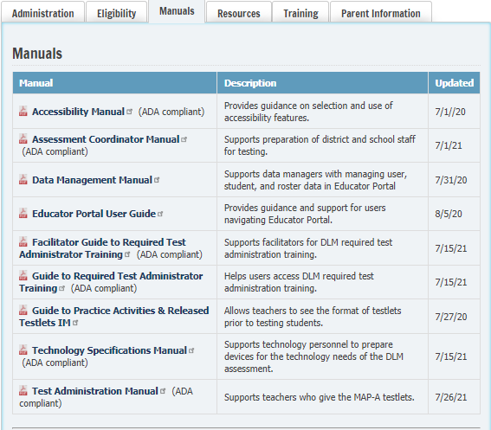
Manuals
Notes:
To Say: The third tab is marked Manuals. The six manuals we have marked with arrows are the Accessibility Manual, Educator Portal User Guide, Guide to Required Test Administration, Guide to Practice and Released Testlets, and Test Administration Manual. These manuals will answer many of your questions. The Guide to Required Test Administrator Training will help you navigate through the required testing to access the MAP-A assessment and the Test Administration Manual will help you through the process. Always check for the latest manuals. Most manuals were printed in July or August 2021.

Slide 31
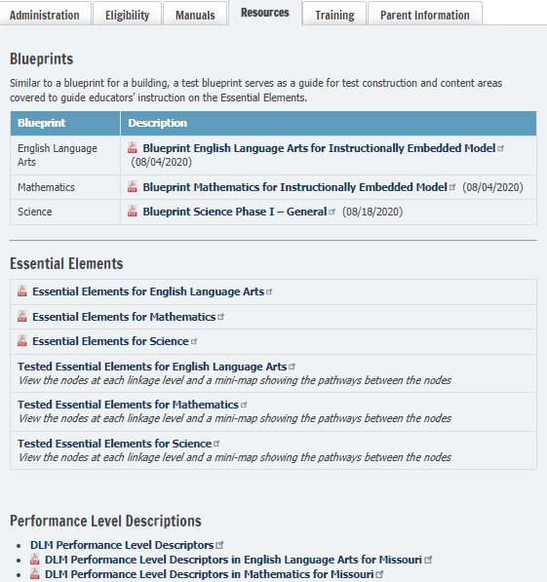
Resources for Blueprints and EEs
Notes:
To Say: The fourth tab is marked Resources. Resources are broken into three sections. The first will be the Blueprints for ELA, math and science. The second section is called Essential Elements to be assessed by MAP- A, beginning in grade 3 through high school or grade 11 resources. The third section contains the Performance Level Descriptors.

Slide 32
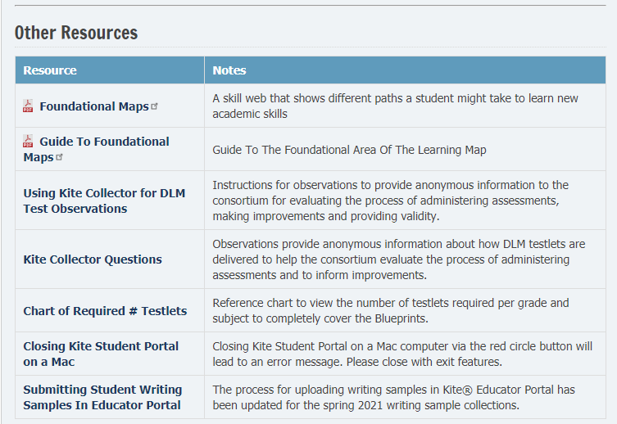
Additional Resources
Notes:
To Say: At the bottom of the Resources Tab is the Other Resources section. There is a chart of required testlets that will tell you the number of testlets that need to be given at each grade level. You can also find copies of the Foundational Maps. We will talk more about that in upcoming sections.

Slide 33
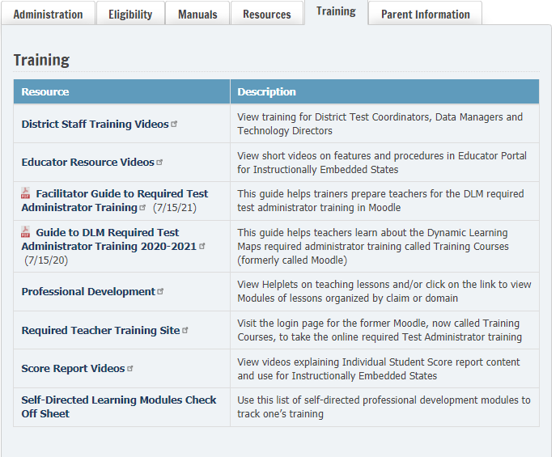
Training
Notes:
To Say: This is the tab marked Training. You will find links to training courses where you can watch the four required modules. Again, we will talk about that later. You will also find the Guide to Required Test Administrator Training. It will outline the process. There are short videos that will help you with both Instruction and Assessment using Essential Elements.

Slide 34
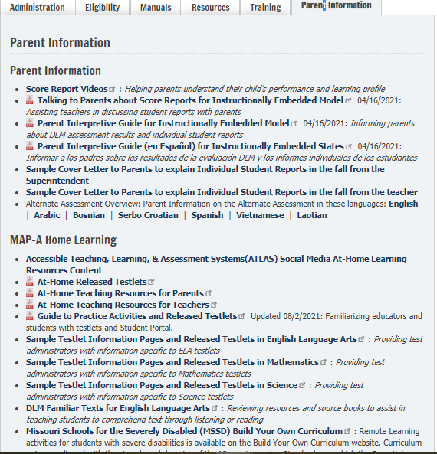
Parent Information
Notes:
To Say: The last tab is a section for parents. The arrows highlight information that can be useful for parents and supports Home Learning.

Slide 35
Missouri Learning Standards Webpage
https://dese.mo.gov/college-career-readiness/curriculum/missouri-learning-standards
How do I get to Missouri Learning Standards webpage?
Go to dese.mo.gov
Scroll to Topics
Choose: Learning Standards (bottom of TOPICS)
Scroll to the middle of the page
Alternate standards are in a tab
Item Specifications
https://dese.mo.gov/college-career-readiness/assessment
Notes:
To Know: How to get to DESE’s MAP-A website
To Do: The consultant will model and guide participants through the use of the DESE MAP-A website. You may want to show the preceding slides or just model on the screen. It is consultant’s choice.
To Say: Here are the steps to find the Missouri Learning Standards. The Missouri Learning Standards contain the standards for all content areas as well as the Alternate Standards or MAP-A. One of the documents developed is the item specification document, which includes all Missouri grade level/course expectations arranged by domains/strands. It defines what could be measured on a variety of assessments. The document serves as the foundation of the assessment development process.

Slide 36
DLM Webpage
The Place for Resources https://dynamiclearningmaps.org/
Go to dynamiclearningmaps.org
Scroll through the topics on the top banner
Test updates
Missouri’s page
Notes:
To Know: How to get to DESE’s MAP-A website using DLM.
To Do: The consultant will model and guide participants through the use of the DLM website. You may want to show the preceding slides or just model on the screen. It is the consultant’s choice.
To Say: DLM has refreshed their website and made it easier to navigate. DLM is another comprehensive site for resources. The Missouri Page on DLM contains much of the same basic information. However, DLM has many resources to guide you through your instruction and access to videos. There are helplets for instruction, Mini-Maps for ELA and math, education resources for science and released items, etc.

Slide 37
Notes:
To Know: Participants need to know where the updates are found on the DLM Website.
To Say: This is a screenshot of the landing page.

Slide 38
Notes:
To Know: Participants need to know this website.
To Say: Training courses MUST be completed by ALL new or experienced test administrators before being given access to change password or login to Educator Portal.

Slide 39
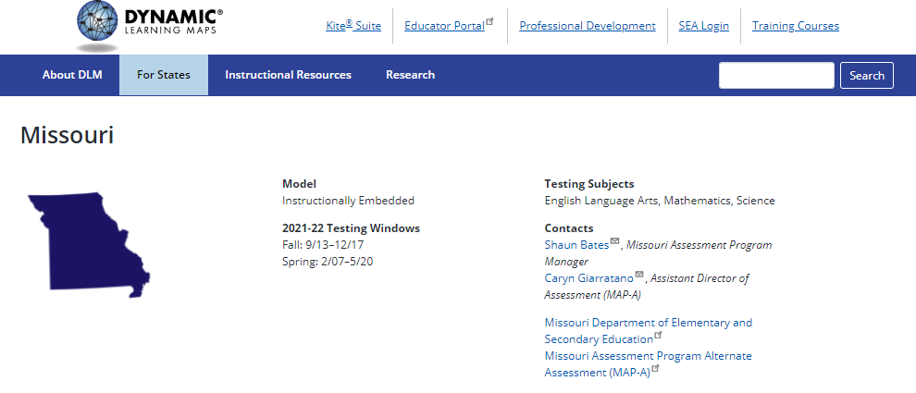
Missouri Page on DLM’s Website
Missouri
Notes:
To Know: Participants need to know where the updates are found on the DLM Website.
To Do: Show participants the location of the Missouri DLM website. Go to www.dynamiclearningmaps.org and click on the States tab (second from left) and then click on ‘Missouri’ under Integrated Model.
To Say: In addition to the Missouri specific page under the “For States” tab, you will click to find Missouri. Remember, we are an INSTRUCTIONALLY EMBEDDED ASSESSMENT (IE) state.

Slide 40
Summary of What is Found on Each Website
DESE-dese.mo.gov | DLM-dynamiclearningmaps.org
Quick Links to DLM Training Courses, Educator Portal, Kite© Suite and Test Update | Training Courses
Item Specifications/Missouri Learning Standards | Educator Videos, District Video and Helplets, PD, Resources for ELA, math and science
Manuals, Blueprints and Essential Elements | Manuals - Publication date will be listed on front page, Blueprints and Essential Elements
IEP Forms and Eligibility Criteria for MO | Educator Portal for Roster, Kite© Suite, Practice Testlets
Updated Information and Timelines | Instruction and Assessment Planner/Individual Score Reports (ISRs)
Notes:
To Say: Here is a summary of what is on DESE’s and DLM’s webpages. Please take time to explore each website.

Slide 41
Notes:
To Say: Let’s take 60 seconds to breathe, stretch, and get a cup of coffee. Break!

Slide 42
Eligibility Criteria for MAP-A
Notes:
To Say: Eligibility Criteria for MAP-A. Please refer to Handouts 5a-5b and 6.

Slide 43
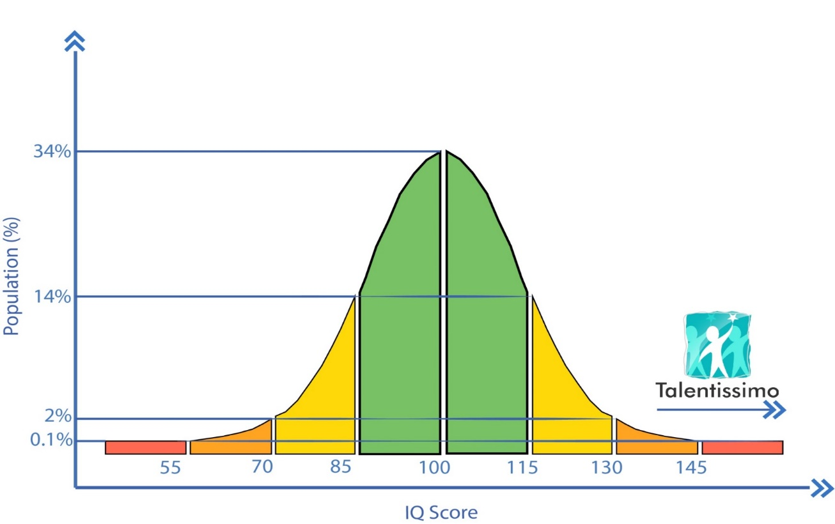
AVERAGE
ABILITY RANGE
SIGNIFICANT Cognitive Delay
1%
MOST SIGNIFICANT Cognitive Delay
Notes:
To Say: Using the Bell Curve as a graphic, average ability scores fall between IQ scores of 85 and 115 and approximately 68 percent of the population falls within this range of scores. A significant cognitive delay is found in approximately two percent of the population who have IQ scores that fall at 70 or below. The most significant cognitive delay is considered to be the one percent of the population who have IQ scores that fall at or below 55.
IQ is not the only determining factor. Students with the most significant cognitive delay require supervision and assistance at all times. These students need a significant level of support in all areas including communication, self-care, daily living, social skills, access to community, self-direction, health and safety, functional academics, leisure, and work.

Slide 44
Missouri Alternate Assessment Decision Making Flow Chart
https://dese.mo.gov/special-education/compliance/statewide-assessments
FLOW CHART CHECKLIST
# 5a-5b
Notes:
To Know: This link goes to the correct information. HO #5a is the Flow Chart and HO #5b is the Checklist. HO #6 is the Guidance Document for further clarification.
To Say: While an IQ score is not the sole criterion to determine if a student should participate in the Missouri Alternate Assessment, it is one of the factors. DESE has developed both a Flow Chart and a Checklist with the five criteria that must be met in order to determine a student’s eligibility to participate in the alternate assessment. IEP teams can use either resource to guide the process of considering each of the five criteria. These two resources are designed to be used in conjunction with a Guidance Document Handout #6 which provides more detailed information to assist IEP teams as they carefully consider each of the criteria. The Guidance Document lists each of the criterion and provides additional guidance and clarification as well as examples of students who would and would not be eligible for participation in the alternate assessment. MAP-A Eligibility is to be considered and determined at every annual IEP meeting. It is best practice to sign and date the checklist of all IEP team members and place it in the student's file. These resources can be found on the DESE website on the Special Education Compliance section. The web link is shown at the top of this slide.
We’re now going to take a few minutes to go over each of the criteria.

Slide 45
Flow Chart: Step 1
Use copy provided
# 5b
Notes:
To Say: Please refer to HO#5b - Guidance Document. The first criteria requires that only students who have been identified under the Individuals with Disabilities Education Act (IDEA) are eligible to participate in the alternate assessment. Students who only have a medical diagnosis or a 504 Plan are not eligible to participate in the alternate assessment.
The IEP team for eligible students must make an individualized decision regarding the student’s participation in either the regular assessment or alternate assessment using the Missouri Alternate Assessment Decision Making Checklist or Flow Chart. This decision must be documented in the IEP.

Slide 46
Flow Chart: Step 2
Notes:
To Say: The second criteria looks at cognitive abilities. While there is no one method of determining if a student demonstrates the most significant cognitive disability, it is clear this decision must be made by comparing the student to the entire population of other students of the same age—not just other students within the district or school building.
The most significant cognitive disability range can be evidenced by standardized assessments or pervasive supports. In addition to demonstrating the most significant cognitive disabilities, the student must also demonstrate adaptive skills that are significantly limited as compared to same age peers.
While IDEA does not provide any guidance on determining the most significant cognitive disabilities, it does state, under Section 300.304(3)(c)(1) “Assessments and other evaluation materials used to assess a child under this part—(i) are selected and administered so as not to be discriminatory on a racial or cultural basis; (ii) are provided and administered in the child’s native language or other mode of communication and in the form most likely to yield accurate information on what the child knows and can do academically, developmentally, and functionally, unless it is clearly not feasible to so provide or administer; (iii) are used for the purposes for which the assessments or measures are valid and reliable; (iv) are administered by trained and knowledgeable personnel; and, (v) are administered in accordance with any instructions provided by the producer of the assessments.”
Intelligence tests including, but not limited to, the Wechsler Scales, the Leiter International Performance Scale, and the Stanford-Binet Intelligence Scales all yield standard scores and provide a system of classification to assist trained personnel in determining a level of cognitive functioning.
The following ranges, based on standard scores of standardized intelligence tests, reflect the categories of the American Association on Intellectual and Developmental Disabilities, the Diagnostic and Statistical Manual of Mental Disorders, and the International Classification of Diseases.
These ranges include four levels of support:
People with an IQ of 55 to 70 require mild support
People with an IQ of 40-55 require moderate supervision and assistance
People with an IQ of 25-40 can be taught basic life skills and simple tasks with supervision
People with an IQ below 25 usually suffer from a neurological condition and require constant care
While an IQ score is not the sole criterion to determine if a student should participate in the Missouri Alternate Assessment, it would be expected that students taking the alternate assessment would score significantly lower than their peers with or without disabilities on standardized tests of knowledge and cognition, or that these students may not achieve a valid score on the standardized test.
If a standardized cognitive assessment instrument cannot be utilized with the student, information must be provided to show the pervasive level of support required by the student. This information must come from multiple sources of information (not just an adaptive behavior assessment) and include both skills the student is capable of performing as well as those areas in which he/she has difficulty. A comprehensive review would be expected to include each of the following areas of communication, self-care, daily living, social skills, access to community, self-direction, health and safety, functional academics, leisure, and work.
In addition to the above, adaptive skills as measured by tests of adaptive functioning MUST be commensurate with the scores from the cognitive evaluation and must also indicate that the student is functioning in the most significant classification ranges.

Slide 47
Flow Chart: Step 3
Notes:
To Say: The third criteria requires that the student’s daily instruction on the chronologically age appropriate academic content standards and the grade level benchmarks is substantively different from that of peers with or without disabilities. The student requires intensive instructional strategies which may include, but are not limited to, repeated drill/practice in multiple settings, and skills taught in substantially smaller steps than peers with frequent prompts and guidance from adults. The student also requires intensive supports in the school setting as evidenced by individualized instruction, adult supervision, and assistance throughout the school day. The student’s modified curriculum may consist of functional life skills such as: pre-academics, communication, self-care, daily-living and social skills.
The student requires information to be obtained primarily through methods other than reading due to limited reading ability and also utilizes alternate methods to express or share oral or written ideas and information with others.

Slide 48
Flow Chart: Step 4
Notes:
To Say: The fourth criteria is that the student’s postsecondary outcomes for independent living will likely require supported or assisted living. The student may have a guardian when he/she turns 18. The student would require moderate to significant supervision in order to access the community for recreation, employment, training, and daily living. The student’s postsecondary outcomes for education/training will likely include on-the-job training for sheltered or supported employment, as well as, skill acquisition for social, communication, and/or behavior. The student’s postsecondary outcomes for employment will likely result in sheltered or supported employment, part-time employment, participation in day activity centers, or home.

Slide 49
Flow Chart: Step 5
Notes:
To Say: The fifth criteria requires that the student’s difficulty in the general education curriculum is not primarily the result of excessive absences, visual or auditory disabilities, or social, cultural, language, or economic differences. The student’s difficulty in the general education curriculum is due primarily to the impact of the student’s most significant cognitive disability and limited adaptive skills.
If YES has been answered to all five of the criteria, then the student is eligible to participate in the alternate assessment.

Slide 50
Eligibility Activity
Three minutes to become familiar with eligibility documents
Eligibility Checklist Criteria
MAP-A Decision-Making Flow Chart
Guidance Document
Two minutes to discuss overlap and purpose between all three documents
Notes:
To Know: It is important for teachers to review the IEPS of their students to make sure there is documentation of eligibility.
To Do: Have participants think about the students they have. Presenter can use this or a similar activity.
To Say: Let’s take time to look at the three documents. For the next three minutes, familiarize yourself with the checklist, Flow Chart and guidance document. After three minutes, I will call time, then you will have two minutes to discuss the purpose and overlap of the documents. After the two minutes are up, we will discuss your questions, comments, and ‘a-ha’ moments.

Slide 51
Update of IEP Form
For children with the most significant cognitive disabilities, describe how the disability impacts the child’s access to the general education curriculum and how the alternate standards are appropriate will now be completed in the PLAAFP
Notes:
To Say: Last sentence was added to prompt LEAs to include a description of how the education is impacted for children with the most significant cognitive disabilities and how this relates to participation in the regular curriculum.

Slide 52
Part 3 Dynamic Learning Maps
Terminology and Organizational Structures
Notes:
To Say: The Dynamic Learning Maps (DLM) is the consortium and MAP-A is our name for the Missouri Assessment Program-Alternate.

Slide 53
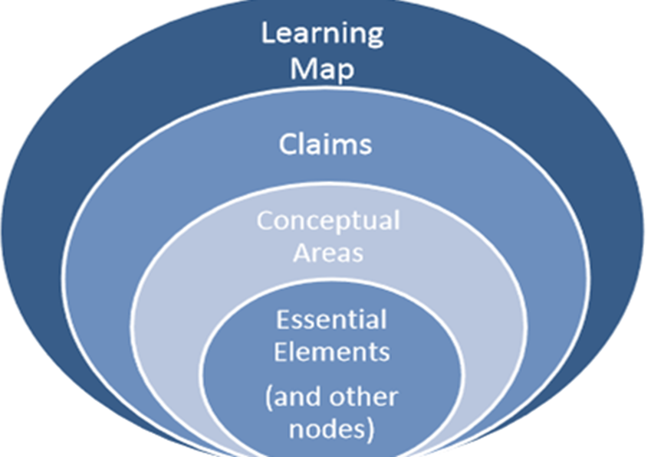
Important Vocabulary for ELA and Math
Notes:
To Know: How all the pieces fit together.
To Do: Show the slide and address the elements on the graphic. Handout ELA, math and science blueprints.
To Say: Please take a look at the graphic. Notice the terms on the graphic. In the next few slides, we will go through each term on this graphic. To understand MAP-A, you must understand how these terms fit together.
Learning map models were used to design the assessment for each subject. Learning map models are comprised of skills and concepts which build upon and connect to one another. However, since learning map models show all of the skills and concepts related to all Essential Elements, a full learning map model is not practical for classroom use. Therefore, Mini-Maps are used to focus on the linkage levels and skills for each individual Essential Element.

Slide 54
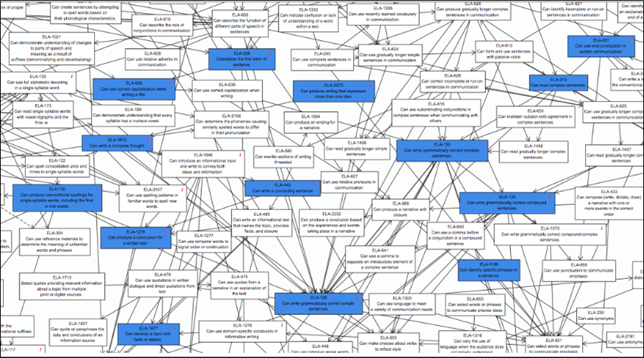
Portion of a Learning Map Model

Slide 55
What is a Learning Map
Think of a Learning Map as a road map that shows students going to the same destination but each one beginning his/her journey from a different starting point
The map also slows the shortest, most direct way for each student to reach his/her destination
However, a good road map shows several alternate routes in case the main route cannot be taken
These maps are large complex representations of how students develop academic knowledge and skills
Notes:
To Know: Learning Maps are large complex representations of how students develop academic knowledge and skills. Learning Maps show connections between and among pieces of discrete knowledge, skills and understandings (called nodes). These maps represent potential pathways that students may follow to learn ELA and mathematics.
To Do: Show the slide. Have Learning MAPs on table.
To Say: The Learning Maps are highly connected representation of how students acquire academic skills as reflected in research. The Learning Maps go beyond traditional learning progressions by including multiple or alternative pathways students may develop content knowledge. Think of a Learning Map as a road map that shows students going to the same destination but each one beginning his/her journeys from a different starting point. The map also shows the shortest, most direct way for each student to reach his/her destination. However, a good road map shows several alternate routes in case the main route cannot be taken.
Large complex representations of how students develop academic knowledge and skills. Each part of the learning map represents a different learning node – which is a discrete knowledge, skill or understanding that a student needs to be able to do in order to access the learning targets. Think of it as the backward design of higher- order thinking skills. We all studied Bloom’s Taxonomy – and the levels of critical thinking got deeper. Well, a Learning Map sort of does a task analysis of each skill and goes the opposite direction of how skills and understandings have foundational pieces underneath them and students must be able to acquire those before they are able to cognitively access the standards.
Shows connections between and among pieces of discrete knowledge, skills and understandings (called nodes).
Represents potential pathways that students may follow to learn ELA and mathematics.
To Do: Show the slide. Have Learning MAPs on table. Have teachers turn to page in the manual and assist in reading the Mini-map. Outlining the different levels for IP, DP, UN, PP, T and S. MARK on the page so teachers can remember and understand the linkage level and how each node represent a pathway of learning. Place a star beside the TARGET – that is the node that is closest to the grade level EE. Successor goes beyond the target, but not above grade level.

Slide 56
Learning Maps (LM)
Are large complex representations of how students develop academic knowledge and skills
The LMs show connections between and among pieces of discrete knowledge, skills and understandings (called nodes)
These maps represent potential pathways that students may follow to learn ELA and mathematics
Notes:
To Know: The overall meaning of Learning Maps.
To Do: Show the slide.
To Say: Learning Maps are large complex representations of how students develop academic knowledge and skills. Learning Maps show connections between and among pieces of discrete knowledge, skills and understandings (called nodes). These maps represent potential pathways that students may follow to learn ELA and mathematics.

Slide 57
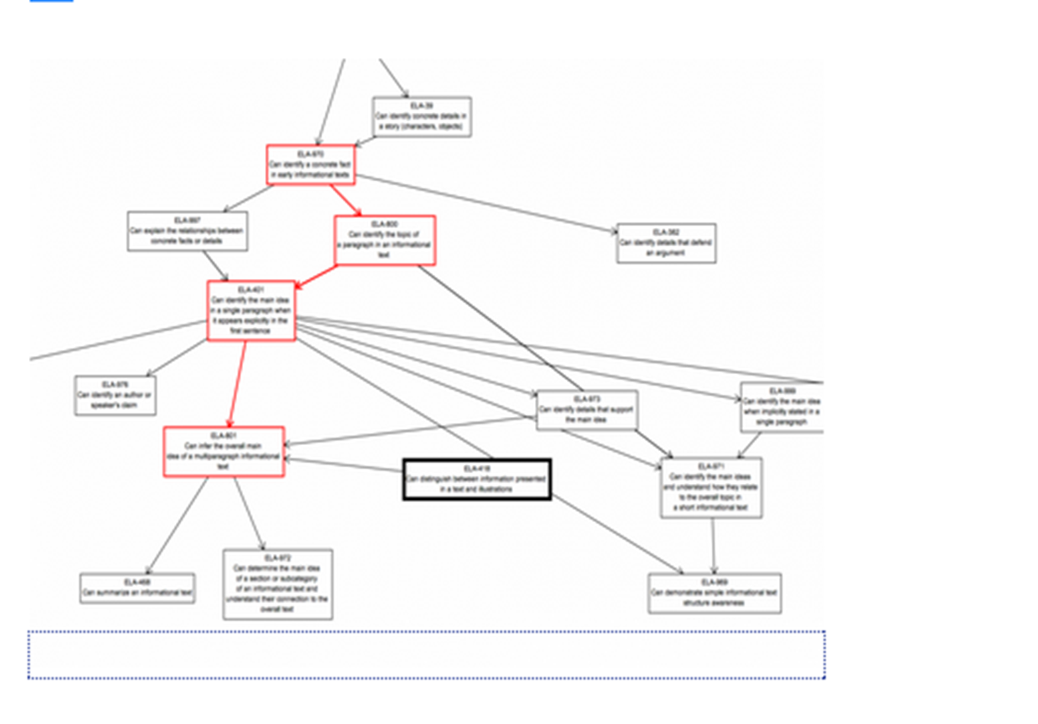
Claims, Conceptual Areas and EEs
Claim 1 | Conceptual Area Conceptual Area | EE, EE, EE, EE, EE , EE, EE EE, EE, EE, EE, EE, EE, EE, EE, EE EE, EE, EE, EE, EE, EE, EE,
Notes:
To Know: The relationship among the learning map, the claims, the conceptual areas and the Essential Elements.
To Do: Show the slide and point to the different areas.
To Say: The content within the Learning Maps is so vast that it needs to be broken down into manageable chunks.
Claims: Broad statements about what students are expected to learn and to do in relation to the content contained in the ELA and math.
Conceptual Areas: Broad statements that tell what students should know and do in relation to a claim.
Essential Elements EEs: Describe what students should know and do in relation to a conceptual area and are aligned to Missouri Learning Standards.

Slide 58
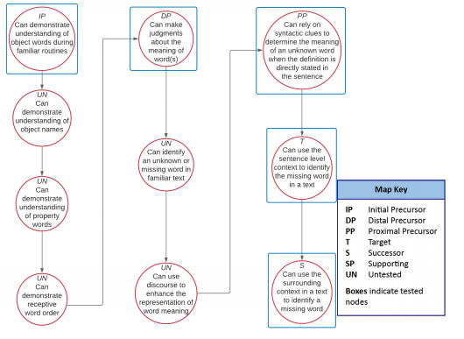
Learning Mini-Map
Notes:
To Know: Mini- Map
To Say: Essential Elements are embedded in the Learning Maps and are related to small clusters of nodes within the maps called Mini-Maps. The Mini-map outlines all the skills necessary for a student to master a specific node. The Mini-map has nodes at all the linkage levels, we will talk about linkage levels in a minute. Mini-Maps also contain untested nodes. Untested nodes are skills that area important for a student to gain the skill, but they are not tested for an essential element. Mini-Maps can be helpful as you plan instruction to help a student get to a specific skill. They allow you to see the skills the student must acquire to get to the skill you have identified the student needs in their IEP.

Slide 59
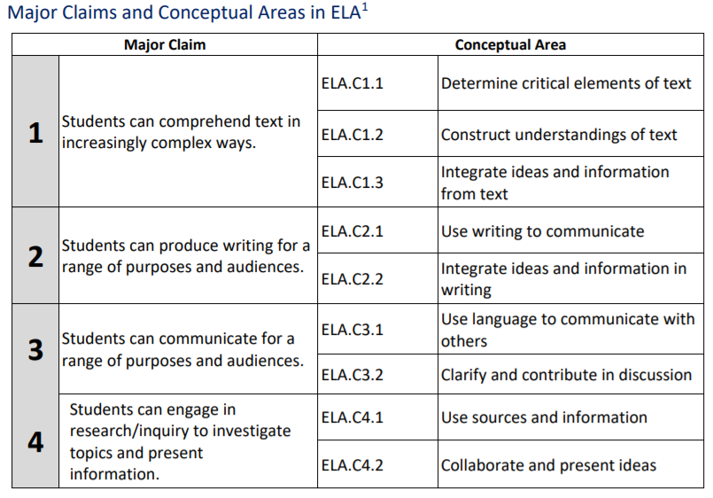
https://dynamiclearningmaps.org/sites/default/files/documents/Manuals_Blueprints/DLM_IE_ELA_Blueprint.pdf
See ELA Blueprint Page 1
Notes:
To Know: The relationship between claims and conceptual areas in English Language Arts (ELA)
To Do: Show the slide.
To Say: Please take a few moments to look at this. All blueprints for ELA, math and science are located on the DESE webpage under Resources (slide 32). This is a screenshot of blueprint on Claims and Conceptual Areas in ELA. Please look ONLY at the front page. Notice it has four Claims and nine Conceptual Areas. Remember Claims are broad statements about what students are expected to learn and to do in relation to the content contained in the ELA and mathematics. Conceptual Areas are broad statements that tell what students should know and do in relation to a Claim. We will talk about how to use the entire blueprint later in the training.

Slide 60
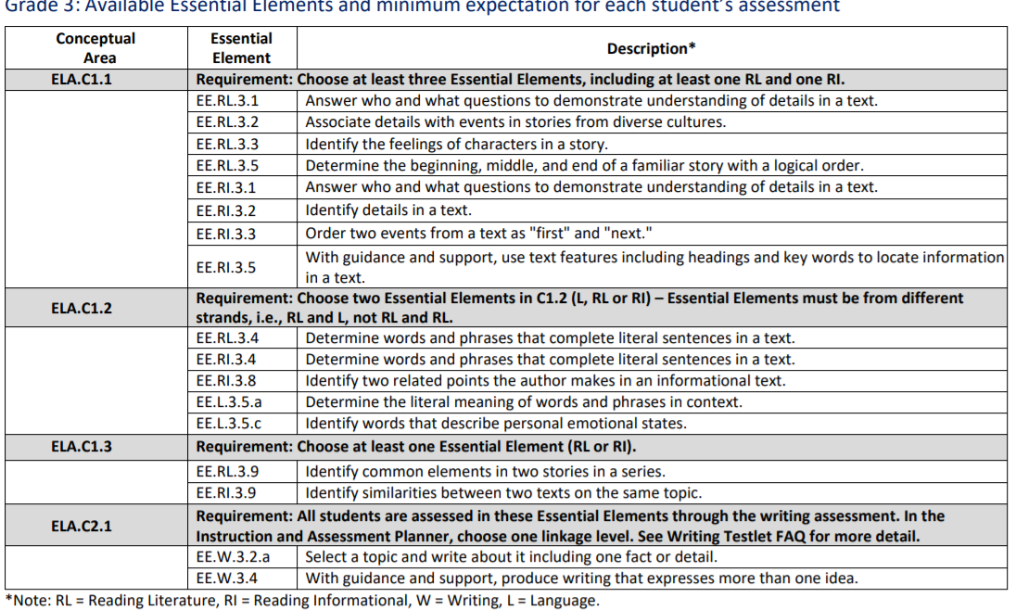
See ELA Blueprint Page 2
EEs for Each Conceptual Area -Blueprint
Notes:
To Know: To know the relationship between the Conceptual Area and the Essential Elements in ELA.
To Do: Show the slide and point to the various parts. Have participants look at the ELA blueprint.
To Say: This is a screenshot of the Essential Elements for each Conceptual Area. Remember, we will discuss more about the blueprints later. The blueprints are at the TARGET level. There will be a Mini-map for each of the Essential Elements that outline the academic steps to reach this skill.

Slide 61
Linkage Levels for a Tested EE in ELA
Notes:
To Say: Here is a screenshot of linkage levels for a grade 3 Essential Elements in ELA. The Target node is how you will find the skill written on the blueprint document we will look at on the next slide. We realize not all students with severe cognitive deficits will be able to work at that level. So students may be instructed and assessed at three levels below the Target level in ELA and math. As you look at the progression of the Initial, Distal and Proximal levels, you can see how they support the development of the Target node. These are some of the steps you will find in the Mini-Maps.

Slide 62
Claims and Conceptual Areas in Math
See Math Blueprint Page 1
Notes:
To Know: The relationship between the Conceptual Area and the EEs in math
To Do: Show the slide and point to the various parts. Have participants look at their math blueprint for a few minutes.
To Say: Notice that math, like ELA, has four Claims and nine Conceptual Areas. There are Mini-Maps to go with each of the Essential Elements.

Slide 63
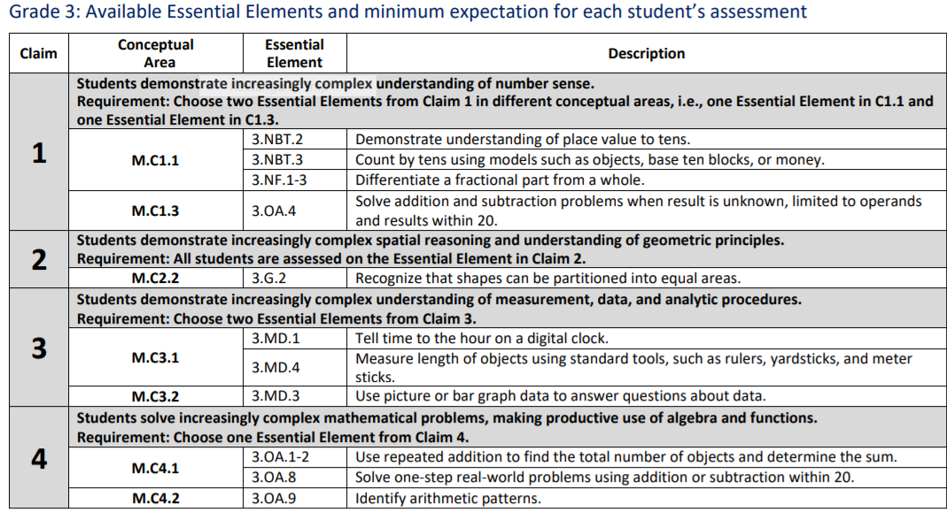
Claims, Conceptual Areas and EEs in Math
See Math Blueprint Page 2
https://dynamiclearningmaps.org/sites/default/files/documents/Manuals_Blueprints/DLM_IE_Math_Blueprint.pdf
Notes:
To Do: Allow participants to look at math blueprint
https://dynamiclearningmaps.org/sites/default/files/documents/Manuals_Blueprints/DLM_IE_Math_Blueprint.pdf
To Say: Here is a screenshot of the Claims, Concepts and Essential Elements in math. Again, like ELA, there are Mini-Maps that go along with each Essential Element in math.

Slide 64
Linkage Levels for a Tested EE in Math
Notes:
To Say: This is a screenshot that shows linkage levels for an Essential Element in math in grade 3. Math and ELA are the same as far as the number of linkage levels and the way they are set up. The Target is how the Essential Element will be written in the blueprints. However, you may teach and assess at whatever level provides an appropriate challenge for the student and represents a good instructional target.

Slide 65
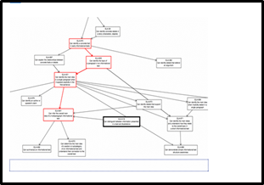
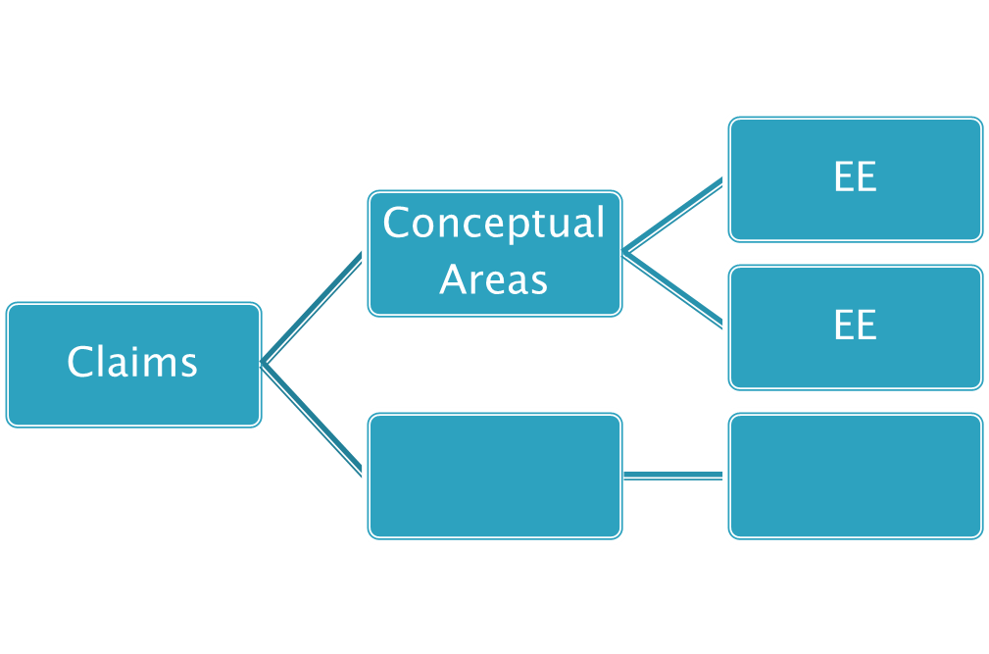
Science Structure - It is Different
EEs
Topics
EEs
Core Areas
EEs
Domains
Topics
Notes:
To Know: How science differs from ELA and math MAP-A.
To Do: Show the slide and point to the different areas.
To Say: Notice that science does not have a Learning Map and the structure for science is different than ELA and math. Science does not use Claims or Conceptual Areas. Instead it uses Domains, Core Areas and Topics. Science does have Essential Elements just like ELA and math that aligned to grade-level standards.

Slide 66
Science Assessment
Fall Window
Essential Elements for instruction and assessment are selected in the Instruction and Assessment Planner
Testlets are optional, but strongly encouraged, during this window
Testlets taken are NOT used for accountability purposes
Spring Window
Essential Elements are NOT selected in the Instruction and Assessment Planner, but under Test Management section of Educator Portal
Testlets are required during this window
Testlets taken are used for accountability purposes
Notes:
To Know: Be familiar with the new assessment format for the 2021-22 school year.
To Say: The DLM science assessment differs from the ELA and math assessment also in a very important way. During the fall window, science Essential Elements are selected by the teacher in the Instruction and Assessment Planner and are optional to test and meeting blueprint requirements is not required. Any science testlets completed in the fall window are not used for accountability purposes. DESE strongly encourages teachers to instruct and assess on science Essential Elements in the fall window, just as they would for ELA and mathematics. However, in the spring assessments are required. During the spring window, the DLM system assigns the Essential Elements and linkage levels. This cannot be changed by the test administrator. Linkage levels are assigned based on the information you have provided about the student to the system. The testlets are assigned one at a time to the student until the blueprint is covered. Science testlets taken in the spring window are used for accountability purposes. Again, DESE strongly encourages all teachers to instruct on science Essential Elements during both windows.

Slide 67
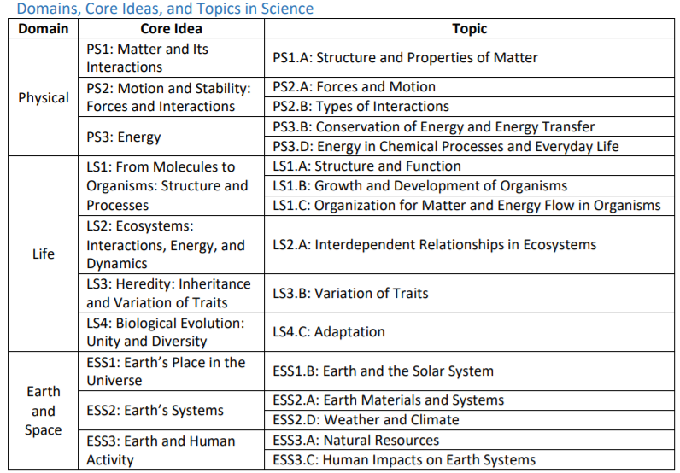
See Science Blueprint Page 1
https://dynamiclearningmaps.org/sites/default/files/documents/Manuals_Blueprints/DLM_YE_Sci_Blueprint.pdf
Notes:
To Know: The relationship among Domains, Core Ideas and Topics for MAP-A science. https://dynamiclearningmaps.org/sites/default/files/documents/Manuals_Blueprints/DLM_YE_Sci_Blueprint.pdf
To Do: Have participants take a few moments to look at the Domains, Core Ideas, and Topics.
To Say: Locate your science blueprint and refer to Page 1. What do you notice that is different from ELA or math? (Pause) You should see that science has three Domains, ten Core Ideas, and sixteen Topics. More science Core Ideas and Topics are continually being developed for future use.

Slide 68
Topic and EE-Blueprint
See Science Blueprint Page 2
Notes:
To Know: The relationship among Topics and EEs for MAP-A science.
To Do: Have participants take a few moments to look at the Topics and EEs.
To Say: Here is a screenshot is for Elementary Grades 3-5 and shows the relationship between the topics and Essential Elements. Science uses grade spans and not specific grade levels. Please turn to page 2 in the science blueprint. Science is a grade span testlet that assumes students were exposed to instruction in earlier grades (3 and 4). You should make friends with the science teacher and teachers who may serve students at lower grades to ensure your students are getting access to these blueprints to develop instruction.

Slide 69
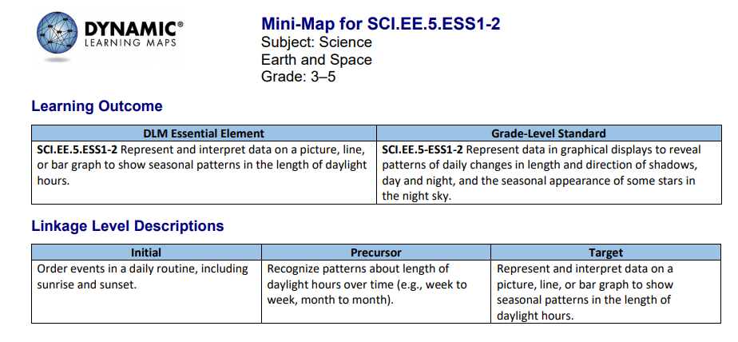
Linkage Levels for a Tested EE in Science
Notes:
To Say: Unlike ELA and math, science only has three linkage levels. The highest science linkage level is the Target linkage level and it is most aligned to the content of the grade-level standard. The Initial and Precursor linkage levels are less complex than the Target linkage level and provide access to the Target linkage level at a reduced depth, breadth and level of complexity. As you look at this specific Essential Element, you can see how the skill is more involved as you move up linkage levels. Testlets at the initial linkage levels are typically intended for students who do not yet have symbolic communication.

Slide 70
Verbal Paired Fluency Active Processing
Get into pairs
One person is A and the other is B
Person A uses 45 seconds to summarize to Person B what we just discussed when reviewing the content presented
Person B uses 30 seconds to add to the summary. Person A listens closely
Person A has 15 seconds to add anything that was left out of the summary
Notes:
TO DO: Presenter’s Choice for this. Process Time.

Slide 71
Part 4 Instructionally Embedded Assessments
Notes:
Part 4: Instructionally Embedded Assessments

Slide 72
Instruction and Assessment Cycle
To best meet the intent of the Instructionally Embedded assessment, instruction and assessment follow a cycle.
Notes:
To Know: Be familiar with the new assessment format for the 2021-22 school year. This infographic is found in the Test Administrator Manual.
To Say: The instructionally embedded alternate assessment encourages this cyclical approach by giving teachers the opportunity to choose an Essential Element or Elements and linkage levels, develop and deliver instruction for the chosen Essential Elements, and then assess the student when the teacher determines the student is ready. The Instruction and Assessment Cycle begins with the selection of the Essential Elements, Instruction, assess the student informally or via testlet, evaluate the results, and then provide more instruction if needed. Then, reassess and test.

Slide 73
Educator Resource Videos
https://dynamiclearningmaps.org/educator-resource-videos-ie
DLM Instructionally Embedded Model
Notes:
To Do: Take them to the link and scroll down.
To Say: Here is a link to the Educator Resource Videos. Copy the link to your browser so you can view some of these videos at a later time.

Slide 74
Instructionally Embedded Assessments
Instruction integrated with assessment seamlessly
Based on the student’s academic goals
Administered throughout the school year
Notes:
To Know: Be familiar with the new assessment format for the 2021-22 school year.
To Do: Be sure to take a few moment BEFORE training to look over these.
https://dynamiclearningmaps.org/educator-resource-videos-ie
To Say: Instructionally embedded assessments differ from the more traditional year-end testing where a student’s knowledge is assessed for all subjects during a few weeks in the spring, resulting in an individual student score report.
The primary intention of the instructionally embedded assessments is to connect instruction and assessment to a student’s individual goals. It may be tempting to think the instruction-assessment relationship encourages “teaching to the test,” but it is actually the other way around. They encourage assessing a student on what the student was taught, using a cycle of instruction and assessment that gives students with the most significant cognitive disabilities opportunities to show what they know and can do. The testlets are used as snapshots of what a student has learned through the teacher’s rich instruction in order to provide insight as to whether a student needs continued instruction for a particular skill or concept or is ready for instruction on a new skill or concept.
The instructionally embedded assessment is structured around the ELA and mathematics test blueprint requirements. Teachers make choices within the blueprint requirements based on each student’s academic goals for instruction and assessment.
Instructionally embedded assessments are administered in both a fall and spring window during the school year as the assessment is intended to be integrated within classroom instruction. Both fall and spring assessments are incorporated into the student’s overall performance toward their mastery of the alternate standard.

Slide 75
Instructionally Embedded Assessments
Instructionally embedded alternate assessment allows teachers to choose
Essential Elements for instruction based on blueprint guidelines
Linkage level for each testlet based on student needs
Kite® Suite will suggest a linkage level, but the teacher can select a different level, if desired
Notes:
To Know: Be familiar with the new assessment format for the 2021-22 school year.
To Say: The instructionally embedded alternate assessment allows teachers choice and flexibility for a student’s instruction and assessment. The Instruction and Assessment Planner in Educator Portal, which we will discuss in greater detail later, will provide for each student the blueprint requirements for the subject and grade, the Essential Elements and skills assessed at each linkage level, and a recommended linkage level for a specific Essential Element.
Within the options provided and the requirements for conceptual area coverage, educators should base Essential Elements instruction and assessment choices on a student’s learning targets, grade level and IEP goals. Teachers have the entire window to instruct and assess a student on the chosen Essential Elements to cover the blueprint.

Slide 76
Instructionally Embedded Assessments
Are taken any time during the window when a student is prepared, based on the teacher-provided instruction
Are an individual assessment-not a group assessment where the class takes the same test at the same time
Are not to be administered in a bunch at the end of a window, where all testlets are taken in a short time
Notes:
To Know: Be familiar with the assessment format for the 2021-22 school year.
To Say: The assessment is delivered in testlets. Each testlet assesses one Essential Element at one linkage level except for writing. Instructionally embedded assessments are administered after the student has received instruction on an Essential Element or Elements. Each student is assessed individually, even if in the same grade and classroom. Since not all students will have the same academic goals, have the same Essential Elements chosen, receive the same instruction, or progress at the same rate, the assessment is different for each student and delivered individually at the appropriate time.
Instructionally embedded assessments should be administered throughout an assessment window. Students with the most significant cognitive disabilities are best able to demonstrate what they know and can do when a cyclical approach to their instruction, assessment, and evaluation is used, as opposed to being assessed at the end of a semester or school year on a mass of instruction they must recall from prior weeks and months.

Slide 77
Instructionally Embedded Assessments
Utilize student progress reports to
Evaluate if additional instruction is needed
Determine if the student is ready to move on to another linkage level or Essential Element
Identify student’s knowledge, skills, and understanding relative to grade-level targets
Notes:
To Know: Be familiar with the new assessment format for the 2021-22 school year.
To Say: Instructionally embedded assessments can be used to identify a student’s knowledge, skills, and understanding relative to the Essential Elements after receiving instruction. The student’s progress report may be used at any time within the cycle to evaluate if additional instruction is needed or the student is ready to move on to another linkage level or Essential Element.

Slide 78
A Deeper Look at Assessment
Student learning is mapped throughout the year during two instructionally-embedded assessment windows
Each testlet contains an engagement activity to activate prior knowledge
There is a testlet available for each Linkage Level
Notes:
To Know: More about administering the MAP-A assessment.
To Do: Show slide.
To Say: Student learning is mapped throughout the year in Kite® Educator Portal for ELA and math:
The teacher may ask questions during the engagement activity. See Test Administrator Manual pgs. 70-74.
Research indicates that teachers who activate a student’s prior knowledge in a subject is more likely to re-engage and perform at a higher level. Engagement practices should be part of your instruction. For example, the story is about fishing. Ask “Have you ever been fishing? What did you like or dislike about it?” Then continue asking questions.
You might make a one hour Engagement Strategies as a separate office hour or TA.

Slide 79
Engagement Strategies
See Test Administrator Manual pages 60-63
Notes:
To Say: There are additional slides later which provide examples of how you might do an engagement activity for each of the content areas.

Slide 80
Testlet Design
One testlet per EE chosen in the Instruction and Assessment Planner in ELA, math, and science as an engagement activity
Teacher can choose Linkage Level (system will choose, but teachers can change, if necessary)
Each testlet is assigned separately
Test administrator schedules sessions within Instructional testing window
Notes:
To Know: How to administer the MAP-A
To Do: Show slide and share information
To Say: Remember
One testlet per EE chosen in the Instruction and Assessment Planner in ELA, math and science as an engagement activity
Teacher can choose Linkage Level (system will choose-- teachers can change if necessary)
Each testlet is assigned separately
Test administrator schedules sessions within instructional testing window

Slide 81
Five Linkage Levels for ELA and Math
Initial precursor
Distal precursor
Proximal precursor
Target (at the Essential Element level)
Successor (Getting closer to Grade Level Standard)
Notes:
To Say: There are five linkage levels for ELA and math. They are:
Initial precursor
Distal precursor
Proximal precursor
Target (at the Essential Element level)
Successor (Getting closer to Grade Level Standard)

Slide 82
Three Linkage Levels for Science
Initial precursor
Proximal precursor
Target (at the EE level)
Notes:
To Say: Science has only three Linkage Levels: Initial Precursor, Proximal Precursor and Target. Remember, Target level is mastery of a standard, however, it is at a reduced breadth, depth and complexity of the MLS.

Slide 83
Linkage Level Comparison
ELA & Math Linkage Levels | Science Linkage Levels
Initial | Initial
Distal Precursor
Proximal Precursor | Proximal Precursor
Target | Target
Successor
Notes:
To Know: The difference in Linkage Levels between ELA/math and science.
To Do: Show slide.
To Say: This chart shows the comparison in another way.

Slide 84
What is the Purpose of Having Linkage Levels
https://dynamiclearningmaps.org/essential-elements/ela
https://dynamiclearningmaps.org/essential-elements/math
https://dynamiclearningmaps.org/essential-elements/science
Linkage levels precede, correspond to, or go beyond the expectations expressed in the Essential Element. Linkage levels specify a student’s performance in relation to the grade-level target.
Once the student engages in testlets, Linkage Levels are adjusted by the DLM system
Notes:
To Know: The purpose in having Linkage Levels.
To Do: Read the slide and take the participants to this link and show examples of the linkage levels and the nodes. Trainer can choose what grade level and how many examples to show.
To Say: A student new to Kite® System is placed into the assessment at a linkage level based on information the examiner places in the First Contact Survey. Once the student engages in testlets, linkage levels are adjusted by the DLM system. The following slides will show examples of how the linkage levels look for the content levels. Remember: The test administrator can choose the linkage level as well.

Slide 85
Linkage Levels for a Tested EE in ELA
Notes:
To Know: How Linkage Levels are utilized to access the EEs in ELA.
To Do: Show slide
To Say: This is a screenshot of Node Linkage Progression for a grade 3 EE in ELA. Remember, in the Essential Element it is written at the Target node. But, you can choose at what level to teach and assess the Essential Element. Testlets at the Initial Precursor level are typically intended for students who do not yet have symbolic communication. Testlets at the Distal and Proximal Precursor linkage levels allow students to develop knowledge, skills and understanding to reach the target. Testlets at the successor linkage level give students the opportunity to take the next step beyond the expectations described by the Essential Element.

Slide 86
Linkage Levels for a Tested EE in Math
Notes:
To Know: How Linkage Levels are utilized to access the EEs in math.
To Do: Show slide.
To Say: This shows Node Linkage Progression for an Essential Element in math in grade 3. Remember, there is a Mini-Map that is associated with each Essential Element that shows how students gain the knowledge and skills that help them achieve the Target linkage level.

Slide 87
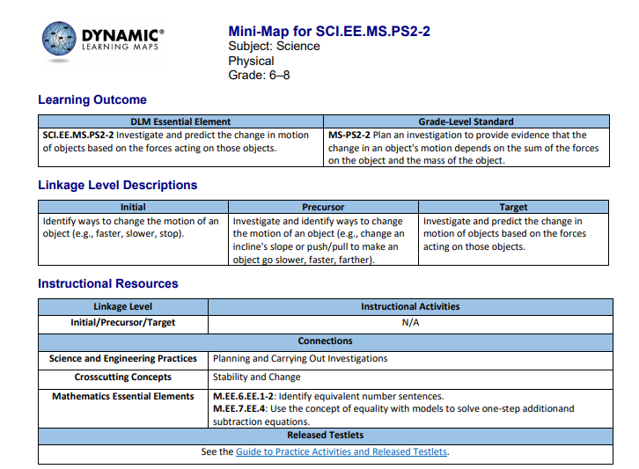
Linkage Levels for a Tested EE in Science
Notes:
To Know: How Linkage Levels are utilized to access the EEs in middle school science.
To Do: Show slide.
To Say: This is an example of an Essential Element in middle school science. Notice there are only three linkage levels. The Initial and Precursor levels are less complex than the Target linkage level and provide access to the Target linkage level at a reduced depth, breadth and level of complexity.

Slide 88
Mini-Map
Notes:
To Say: Mini-Maps for math and ELA have been refreshed with more in depth information between Initial Precursor and Distal Precursor. This is a screenshot of the NEW Mini-Maps.

Slide 89
To Be Noted: IEP, Mini-Maps, and Goals
Use the information from Linkage Levels and Mini-Maps to plan instruction and create IEP goals
Do Not Forget: Each and every goal MUST have a short-term objective or benchmark
Notes:
To Know: How to use information from Linkage Levels and Mini-Maps to plan instruction and create IEP goals.
To Do: Show slide.
To Say: Use the information from Linkage Levels and Mini-Maps for ELA and math to plan instruction and create IEP goals. Do NOT forget that each and every goal must have a short-term objective or benchmark. Check with your RPDC for training on Developing Standards-Based IEPS Using Essential Elements.

Slide 90
Check-In 3-2-1
3-Linkage Level Facts
2-Notes to self regarding Linkage Levels
1-Something to clarify
Notes:
TO DO: Processing activity (Presenter’s Choice). Can make this a handout if you wish.
THIS IS FOR IC LIVE OR VIRTUAL PRESENTATION ONLY!!!!!

Slide 91
Part 5 Requirements for Test Administration and Kite® Suite
Notes:
To Say: Part 5: Requirement for Test Administration and Kite® Suite.

Slide 92
New User Profile Information
You will need to have your Data Manager place you on the roster before you can complete your tests, manage students, or access testlets
Caryn Giarratano Caryn.Giarrantano@dese.mo.gov
Notes:
To Say: Again, if you are NEW to administering the MAP-A, you need to have your DATA MANAGER place you on the roster before you can take your tests, etc.

Slide 93
Notes:
To Say: You can access the Required Test Administrator Training two ways. One is through DLM and then chose Training Courses. The other way is through the DESE webpage under Quick Links. Scroll to DLM Required Training to login and access the information.

Slide 94
Training Courses for NEW Test Administrators
READ the Guide to DLM Test Administrator Training Manual
Module 1: Overview of the DLM Alternate Assessment (30 minutes)
Module 2: Testlets (25 minutes)
Module 3: The Instructionally Embedded Model (30 minutes)
Module 4: Becoming Familiar with the DLM website and its Resources (35 minutes)
Any person administering a MAP-A for the first time, must complete the four modules in the order listed and receive an 80 percent or higher on the post-tests in order to administer testlets
Notes:
To Know: Modules needed to become qualified to administer MAP-A for the first time.
To Do: Be sure participants are aware that they must complete these four modules and pass with 80% accuracy BEFORE the teacher will receive information on the First Contact Survey and the PNP( Personal Needs and Preferences Profile).
To Say: You will need to be sure to complete each of the 4 required modules in due time with 80% Accuracy. Feedback will be given on incorrect answers. These modules may be done as self-directed or facilitated. However, you will need to take the tests individually. Please be sure that once you have completed all four modules successfully, you click “Get Certificate” and print for your files. You MUST read the Guide to DLM Required Test Administrator Training Manual.
If you have experience, but did not take the modules last year, you are considered a NEW USER. Therefore, you must retake all four tests and pass with 80 percent rating.
Remember: If you do not take the required tests and a MAP-A student moves into your district, you will need to take the tests!

Slide 95
Access to Training Courses
READ the Guide to DLM Required Test Administrator Training Manual
Since you are new to administering MAP-A, you will need to contact your data manager or technology representative to be enrolled. This may take up to ONE full week before you are given access to Training Courses
Once you have an account, then you may begin taking the required modules for administering MAP-A
training.dynamiclearningmaps.org
Notes:
To Know: Teachers will be expected to read the “Guide to DLM Required Test Administrator Training Manual”.
To Do: Show the slide and the Guide.
To Say: To be able to gain access to your required modules, you must have an Educator Portal account. You must read the manuals for step-by-step instructions. Your data manager or technology representative will give you an account so you can log on. This may take up to ONE full week before you are given access to Training Courses.

Slide 96
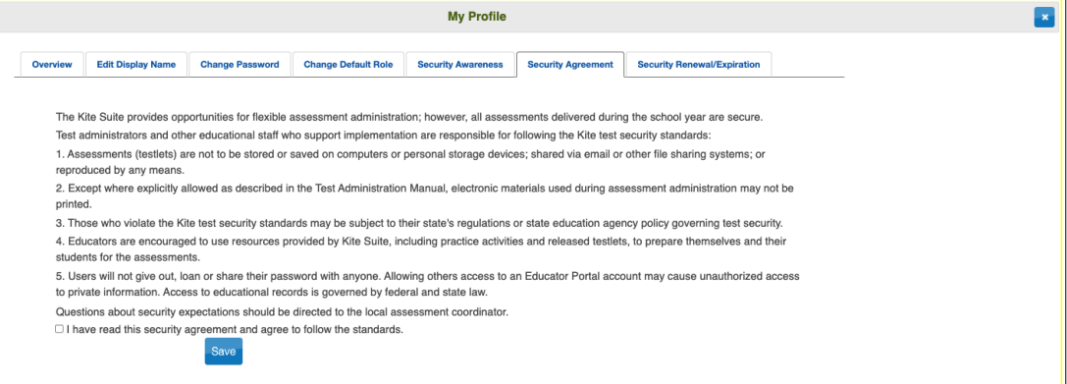
Security Agreement
Notes:
To Say: Security Agreement Radio Button
No selection will be made by default. Users must read the agreement and select the “agree” option and then click save. If you do not, you will not be able to go forward.

Slide 97
Resources to Help You
Your first step is to read The Test Administrator's Manual and all other manuals. If you are still having difficulty, call your RPDC consultant for further assistance
If those steps do not resolve the issue, please contact Missouri’s DLM Help Desk at 1-844-675-4479 or DLM-support@ku.edu
It is recommended that ONE person be appointed to contact the DLM Help Desk and not individual teachers. Individual teachers should NOT contact DLM
Notes:
To Know: How to troubleshoot problems.
To Do: Show the slide and go over information.
To Say: Buildings should appoint ONE person to be the primary contact between the building and the DLM Help desk. The district should only have one person designated to contact DLM by phone/email. Individual teachers should NOT contact DLM.

Slide 98
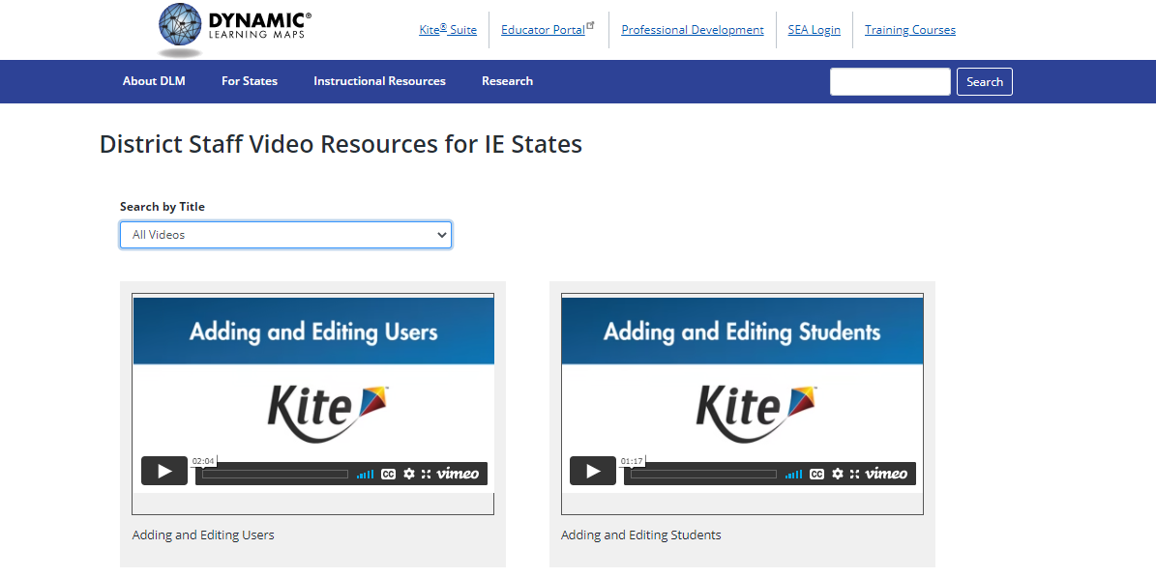
Educator Video Resources
https://dynamiclearningmaps.org/educator-resource-videos-ie
Notes:
To Know: Remember these videos again!
To Do: Make sure participant have these resources.
To Say: These resources can be a lifesaver for you. The videos shown are a small sampling of what is provided. There are Educator Resource Videos and the next slide has the link for District Resources Videos.

Slide 100
District Staff Video Resources
https://dynamiclearningmaps.org/district-staff-video-resources-ie
Notes:
To Say: This link will take you to helpful videos that are related to District Staff - adding or editing students, getting started in Educator Portal, Transferring of students, etc.

Slide 101
Using Kite® Suite
Notes:
To Say: Now we will move into Kite® Suite.

Slide 102
Kite® Suite - Two Main Parts
Kite Student Portal is an application students use to take tests. Students have a Kite username and password. Must be on all student computers
Kite Educator Portal is an application that allows educators to enter and manage student data, enroll students in instructionally embedded assessments, retrieve test tickets, and access professional development and training modules. Educators have an Educator Portal username and password. (web-based: see Quick Link)
Notes:
To Know: Where and how to access Kite® Student Portal and Educator Portal and the purpose for each.
To Do: Show the slide and share information.
To Say: Kite® Student Portal (for students) is an application students use to take tests. Students have a Kite® username and password.
Kite® Educator Portal (for educators) is an application that allows educators to enter and manage student data, enroll students in instructionally embedded assessments, retrieve test tickets, and access professional development and training modules. Educators have an Educator Portal username and password. Beginning on page 101 in the Test Administration Manual is a description of the system step-by-step.

Slide 103
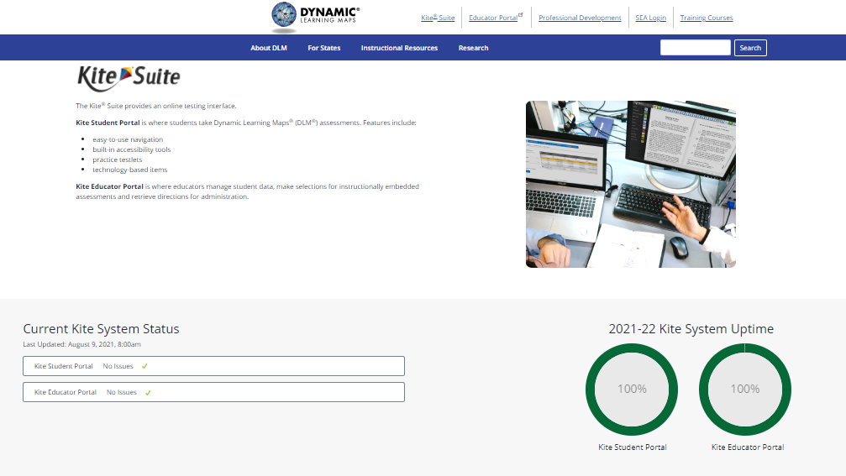
Kite Student Portal
Notes:
To Know: How to access released activities from DESE’s website.
To Do: Show the slide.
To Say: The Kite® Student Portal must be reinstalled before you can access practice activities or released testlets. It is important to note that the Kite® Suite has been updated for the 2021-22 school year. If Kite® Student Portal has previously been installed on computers in your district, it will need to be uninstalled and the new version of Kite® Student Portal will need to be reinstalled. Pages 101-111 of the Test Administration Manual is a Kite® Student Portal User Guide and will be very useful for you.

Slide 104
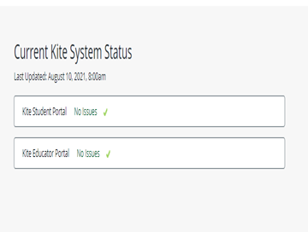
Kite® Suite
Notes:
To Know: Where and how to access Kite® Student Portal and Kite® Educator Portal and the purpose for each.
To Do: Show the slide and share information.
To Say: This slide shows the Kite® Suite/System -DESE uses- status page. This page will always be updated to inform users of any known outages. Please see your technology representative if you experience any problems. Previous versions will need to be uninstalled and the new Kite® Student Portal will need to be reinstalled on all devices used for testing.

Slide 105
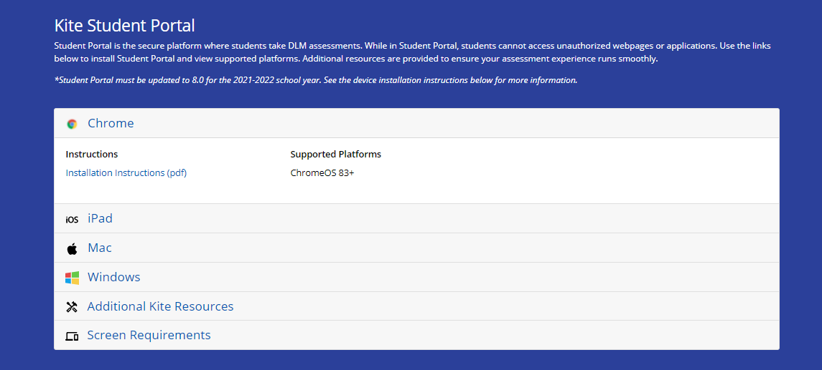
Notes:
To Say: This is a screenshot of what types of computers and web browsers to use.

Slide 106
Kite Student Portal
Use the Practice and Released Items with the students prior to administration of the actual testlets
Kite Student Portal must be installed before teachers can access practice activities or released testlets
IMPORTANT TO NOTE: For this school year, all computers must have Kite Student Portal 8.0
Notes:
To Say: Use the Practice and Released items with the students prior to administration of the actual testlets.
The Kite® Student Portal must be installed before teachers can access practice activities or released testlets.
Student Portal is the secure platform where students take DLM assessments. While in Student Portal, students cannot access unauthorized webpages or applications.

Slide 107
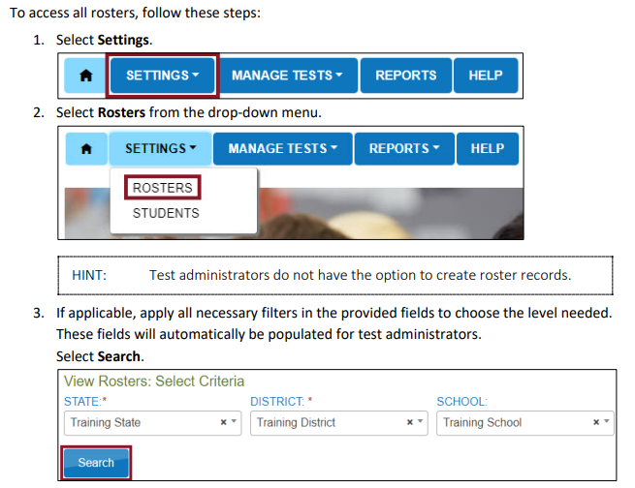
Access to Roster
Notes:
To Say: This is similar to pages 25-29 of the Educator Portal User Guide. You can follow Steps 1-7 to complete the process.

Slide 108
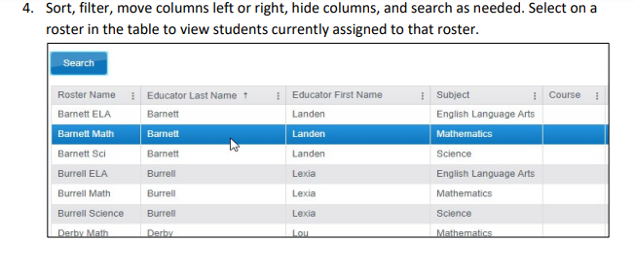
Notes:
To Say: This screenshot shows how the student is in all three content areas for testing.

Slide 109
PNP and First Contact Survey
To be eligible for test assignment, a student must
Be enrolled and rostered and then complete the First Contact Survey
First Contact Survey must be revisited for each student on your roster each year
Notes:
To Say: You will want to review pages 28-41 in the Educator Portal User Guide, as these pages discuss the PNP. Pages 41- 48 of the Educator Portal User Guide discusses the purpose of the First Contact Survey. You will follow the steps discussed on these pages of the Educator Portal User Guide to complete the First Contact Survey. The First Contact Survey must be revisited for each student on your roster each year.

Slide 110
First Contact Survey (FCS) Drives First Testlet
The First Contact Survey (FCS) covers a variety of areas, including communication, academic skills and attention
When completing the First Contact Survey (FCS), educators will need to provide information on special education services, sensory capabilities, motor capabilities, computer access, communication abilities, academic skills, and attention
Notes:
To Know: The purpose of a First Contact Survey
To Do: Show slide and share information. Refer to the Appendix of Test Administrator’s Manual. Have participants tab the pages.
To Say: The First Contact Survey covers a variety of areas, including communication, academic skills and attention. When completing the First Contact Survey, the test administrator will need to provide information on multiple skills as shown on the slide. You can find the full example of the First Contact Survey in Appendix A of the Test Administrators Manual beginning on page 119.

Slide 111
Complete a First Contact Survey (FCS)
The First Contact Survey(FCS) is used in conjunction with the Personal Needs and Preferences (PNP) profile to determine at what linkage level the student initially enters the assessment system
Educator Portal is used to complete a comprehensive questionnaire called the First Contact Survey (FCS)
Notes:
To Know: The reason to use Educator Portal
To Do: Show slide and share information.
To Say: The student’s teacher uses Educator Portal to complete a comprehensive questionnaire called the First Contact Survey (FCS). The First Contact Survey is used in conjunction with the Personal Needs and Preferences (PNP) Profile to determine at what linkage level the student initially enters the assessment system. The First Contact Survey is completed once a year and edited or adjusted as needed throughout the year. Again, you will do this every year.

Slide 112
Personal Needs and Preferences (PNP) Profile
The teacher uses Educator Portal to complete Personal Needs and Preferences Profile (PNP)
The PNP is completed by the test administrator for each MAP-A student
The PNP lists accessibility options that will be used by the student as he/she takes tests administered in Kite® Student Portal
Completing a PNP for each MAP-A student ensures the testlets are personalized and accessible for each student
Notes:
To Know: The purpose of a PNP
To Do: Show the slide and share information.
To Say: The Personal Needs and Preference or PNP is completed by the test administrator/teacher for each MAP-A student. The PNP lists accessibility options that will be used by the student as he/she takes tests administered in Kite® Student Portal. Completing a PNP for each MAP-A student ensures the testlets are personalized and accessible for each student.

Slide 113
Part 6 Instruction and Assessment Planner and Testing
Notes:
To Say: Part 6: Instruction and Assessment Planner and Testing. For this section, you will find having the Educator Portal User Guide handy, beginning on page 56 with Instructionally Embedded Model States.

Slide 114
Educator Portal Sandbox
If you feel comfortable presenting what is in Educator Portal, this might be where you sign in and take them through several tabs

Slide 115
Instruction and Assessment Planner
Notes:
To Know: Be familiar with the new assessment format for the 2021-22 school year.
To Do: Make sure you read the Test Administrator's Manual (TAM) and the Educator Portal Manual.
To Say: The Instruction and Assessment Planner is located in Kite® Educator Portal under the ‘Manage Tests’ tab beginning on page 56.

Slide 116
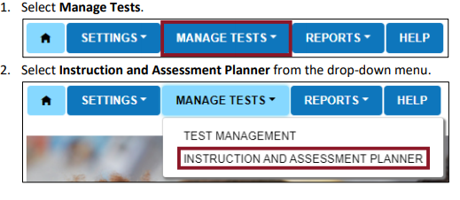
Instruction and Assessment Planner
Notes:
To Know: Page 56 of Educator Portal User Guide
To Say: Please see the Educator Portal User Guide.

Slide 117
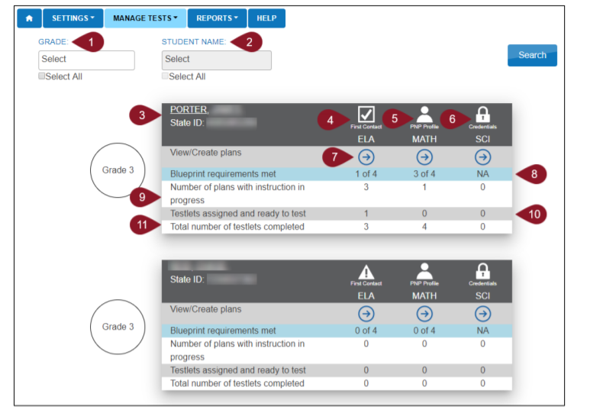
Instruction and Assessment Planner Student Activity Table
Notes:
To Know: Be familiar with the new assessment format for the 2021-22 school year.
To Do: Page 56 of Educator Portal User Guide explains every teardrop red marker.
To Say: When opening the planner, the first screen is the Student Activity Table. This table is where all students rostered to a teacher will appear. The Student Activity Planner provides a quick overview for all rostered students of meeting blueprint requirements, plans for instruction, and testlets assigned during an assessment window. Students are listed numerically by grade level and then alphabetically by default. Page 60 of Educator Portal User Guide explains the Teardrop red markers.

Slide 118
Instruction and Assessment Planner Navigate to Student View Page
Notes:
To Know: Be familiar with the new assessment format for the 2021-22 school year.
To Do: Make sure you have read the TAM.
To Say: This is a view of one student on the Student Activity Table in the planner. To view or create a plan for a subject, click on the arrow below the desired subject. In the example, ELA is the selected subject for the student.

Slide 119
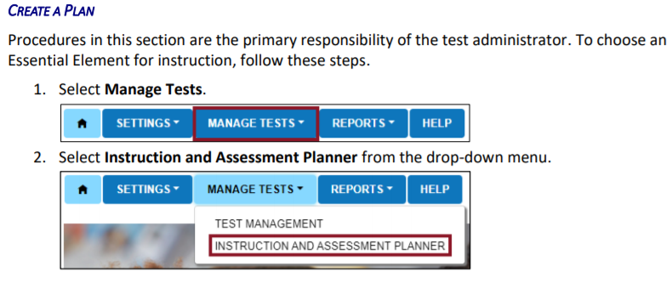
Create a Plan
Notes:
To Say: When you create a plan, first, you will select ‘Manage Tests’ and then ‘Instruction and Assessment Planner’ from the drop-down menu on page 59.

Slide 120
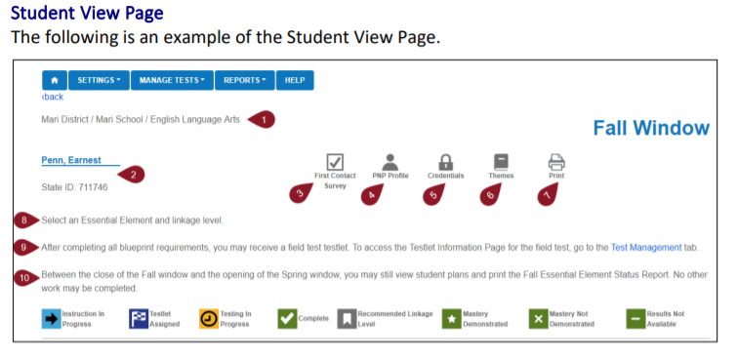
Student View Page
Notes:
To Say: Refer to page 60 of Educator Portal User Guide. The themes icon brings up choices for the teacher. The teacher selects the themes that a student should NOT receive. These themes need only be selected one time for the entire year and will affect each Essential Element during both windows. It will also carry over to the next year. However, a teacher can change the selections at any time. Fall Window is what you need to be sure you are in and Spring Window will appear when you begin in February.

Slide 121
Instruction and Assessment Planner Student View Page - Blueprint
Notes:
To Know: Be familiar with the new assessment format for the 2021-22 school year.
To Do: Make sure you have read the TAM.
To Say: This is a portion of the ELA student view page for a grade 4 student. Notice the similarities to the grade 4 ELA blueprint covered earlier in the presentation. The student view page includes the blueprint requirement ‘Choose at least three Essential Elements in C1.1 Including at least one RL and one RI’.
Along the left-hand side are the Essential Elements in Conceptual Area 1.1. All seven Essential Element options are available, but due to space limitations, are not included in this example. The teacher selected ‘ELA.EE.RI.4.2 which states, ‘Identify the main idea of a text when it is explicitly stated.’ The teacher’s selection is indicated by ‘Instruction in Progress’ for that Essential Element.
The recommended linkage level for the selected Essential Element was Proximal Precursor, as indicated by the flag. In this case, the teacher decided that Initial Precursor would provide the appropriate level of challenge for the student.

Slide 122
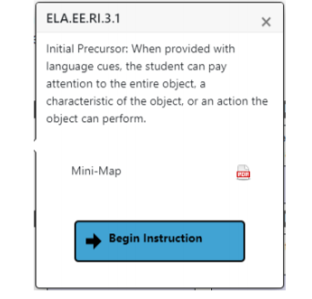
Instruction and Assessment Planner
Notes:
To Know: Be familiar with the new assessment format for the 2021-22 school year.
To Do: Make sure you have read the TAM.
To Say: The teacher has decided to provide instruction on ELA.EE.RI.4.2. Upon clicking on the vertical three dots on the card, a pop out displays the longer definition of the Essential Element. It also displays the Mini-Map icon which the teacher can click to get to the instructional resources. Select “Begin Instruction” for the most appropriately challenging linkage level for the student.

Slide 123
Instruction and Assessment Planner
Notes:
To Know: Be familiar with the new assessment format for the 2021-22 school year.
To Do: Make sure you have read the TAM.
To Say: Once the teacher selects the “Begin Instruction” button, the card displays, “Instruction in Progress”, with the date.

Slide 124
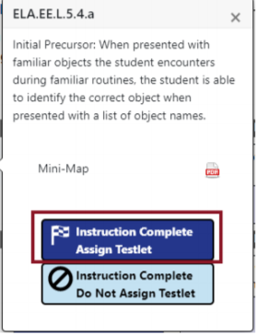
Instruction and Assessment Planner
Notes:
To Know: Be familiar with the new assessment format for the 2021-22 school year.
To Do: Make sure you have read the TAM.
To Say: Once instruction has been provided, the teacher can decide whether to assign the testlet or to not assign the testlet, depending on which button is selected. If the teacher selects “Do not Assign Testlet,” the card reverts back to its original state. It can be chosen again later if so desired. If the teacher wants to proceed with testing the Essential Element at this linkage level, the teacher selects “Instruction Complete Assign Testlet.”

Slide 125
Instruction and Assessment Planner
Notes:
To Know: Be familiar with the new assessment format for the 2021-22 school year.
To Do: Make sure you have read the TAM.
To Say: When the teacher selects “Assign Testlet” a warning message appears, letting the teacher know that assigning the testlet cannot be reversed. The teacher will continue to select to assign the testlet with the date.

Slide 126
Instruction and Assessment Planner
Notes:
To Know: Be familiar with the new assessment format for the 2021-22 school year.
To Do: Make sure you have read the TAM.
To Say: After administering the testlet to the student through KITE® Student Portal, the screen on the ‘Instruction and Assessment Planner’ within the Educator Portal will have a green box indicating, ‘Testlet Complete’. The teacher has now completed one Essential Element as indicated by the green box and a checkmark will appear in the Essential Element card.

Slide 127
Strategies for Meeting Blueprint Requirements
When looking at the blueprint, decide what Essential Elements are required for ALL grades in your classroom
Fall and spring window
Same set of ELA and/or mathematics Essential Elements may be taught and assessed during both the fall and spring windows
Use professional judgment to decide how to create instructional units with the entire class to meet blueprint requirements
Notes:
To Know: Be familiar with the new assessment format for the 2021-22 school year.
To Do: Make sure you have read the TAM.
To Say: If a teacher has more than one grade level in their classroom, there are ways to utilize instruction time so that it meets the need of all students. Essential Elements meeting the blueprint requirements can be thoughtfully and strategically combined in instructional units at the teacher’s discretion and then assessed at the appropriate time following instruction throughout the fall window.
The same set of ELA and/or mathematics Essential Elements taught and assessed during the fall window can be used for the spring window, or other Essential Elements from the blueprint can be chosen based on the teacher’s professional judgment of the student’s academic needs. The student’s progress report may be used at any time within the cycle to evaluate if additional instruction is needed, or if the student is ready to move on to another linkage level or Essential Element.

Slide 128
Instruction and Assessment Planner as a Tool
Combine several Essential Elements into an instructional unit and select them at one time
Select all Essential Elements planned for instruction when the assessment window opens so a student meets blueprint requirements
Print the Student View Page after making selections and create a timeline for instruction and assessment throughout the window in order to meet requirements
Notes:
To Know: Be familiar with the new assessment format for the 2021-22 school year.
To Do: Make sure you have read the TAM.
To Say: To utilize the planner as a planning tool for integrating instruction and assessment, as demonstrated on the Student View Page, the entire blueprint for ELA or mathematics is available. This enables the selection of multiple Essential Elements for instruction and assessment at one time.

Slide 129
Creating an Instructional Unit
Notes:
To Know: Be familiar with the new assessment format for the 2021-22 school year.
To Do: Make sure you have read the TAM.
To Say: Several Essential Elements can be combined into one instructional unit. In this example, four Essential Elements are included in the lesson:
EE.RL.3.1
EE.RL.3.2
EE.RI.3.2
EE.RI.3.3

Slide 130
Creating an Instructional Unit
Notes:
To Know: Be familiar with the new assessment format for the 2021-22 school year.
To Do: Make sure you have read the TAM.
To Say: In this mathematics example, telling time is assessed in both grade 3 and grade 4. While grade 4 extends to telling time using an analog clock, a majority of the teacher’s instruction on telling time can be taught to students in both grade levels

Slide 131
Testing
Notes:
To Say: The next piece is about Testing.

Slide 132
Students are Tested in Two Ways
Direct student interaction with the computer
Teacher administered testlets: Three kinds
Testlets in the lowest Linkage Level with content designed for students who may not yet have symbolic understanding
Some math testlets at higher Linkage Levels, representing the content, making the tasks too abstract
All writing assessments-done during the spring window and teacher assessed
Notes:
To Know: Know two ways students may be tested.
To Do: Show slide and go over information. Emphasize: On educator-administered testlets, teachers can substitute items with things that the student is more familiar with such as balls instead of paper clips.
To Say: Students may be tested two ways: student interaction with the computer or by the teacher. There are three kinds of teacher administered testlets:
Testlets in the lowest linkage levels for students who may or may not have symbolic understanding
some math testlets at higher linkage levels, representing the content, making the tasks too abstract
all writing assessments are completed in the spring window.
You may want to begin exploring ways to administer the testlets if we go to remote learning or if you have a student whose parent has requested remote learning. Students will need to complete the test requirements. NO parent is to administer the testlets.

Slide 133
Testlet Information Page (TIP)
Prior to administering a testlet, the Test Administrator should obtain the Testlet Information Page (TIP) which gives test administration guidelines and materials needed
How to obtain TIPs is described fully in the Test Administration Manual on pages 38-40 for ELA, math and science
Notes:
To Know: How to obtain information about a testlet. Refer to the glossary packet.
To Do: Show the slide and share information.
To Say: The Test Administrator will be provided with a Testlet Information Page (TIP) for each testlet. TIPs are described fully in the Test Administration Manual. During the Instructionally Embedded Fall and Spring Testing Windows, TIPs are acquired in Instructional Tools Interface (ITI). However, during the Spring Summative Testing Window, TIPs are acquired as a PDF in the Test Management Section. Once they are opened and viewed, they are not accessible. It is wise to save the TIPS information or print it.

Slide 134
Test Administration Practices
Test Administrators may need to use their best judgment and be flexible while administering the assessment
Test Administrators may provide additional supports beyond Personal Needs and Preferences Profile (PNP) options
Supports described in the “Practices Allowed” section of the Test Administration Manual and the “Learn about the Accessibility Supports” section of the Accessibility Manual are allowed for testlets unless exceptions are noted in the Testlet Information Page (TIP) on Pages 92-94
Notes:
To Know: Appropriate test administration practices.
To Do: Show slide and go over information.
To Say: Test Administrators may need to use their best judgment and be flexible while administering the assessment. They may provide additional supports beyond PNP options. These are described in the “Practices Allowed” section of the Test Administration Manual and the “Learn about the Accessibility Supports” section of the Accessibility Manual. These supports are allowed for testlets unless exceptions are specifically noted in the Testlet Information Page (TIP).

Slide 135
Remember the Importance of Instruction
Each testlet begins with an engagement activity
ELA - a shared reading or writing activity
Math - gives the context needed
Science - a short story, experiment, video or sets up a context for doing the testlet
*The first portion of every testlet is to ENGAGE the student in the learning
Notes:
To Say: Instructionally embedded assessments look different than other assessments. There is an opportunity for you to engage the student in their learning. For example, in ELA the first reading is a story about camping and you may ask the student, “Have you ever gone camping?” Ask the student throughout the first reading. The second reading is strictly a straight reading.
Engagement and instruction are required prior to the “test mode”. This engagement activity looks different per subject area. As you can see ELA has a shared reading components which can also look very much like the introduction to some science, but math and science ensure the context of the learning is set up prior to test questions.

Slide 136
Shared Reading Strategies
Discuss words – label - point out pictures
Connecting words/pictures to student background
Use objects to help students make connections
Encourage engagement and interaction
Use a “think aloud” to engage processing
Ask questions
Notes:
There is also a vignette that is on the parent’s page that shows one example of what a shared reading could look and sound like. THIS MIGHT BE WHERE YOU PLACE PARTICIPANTS IN A BREAKOUT ROOM AND DISCUSS WHAT TYPE OF SHARED READING OR ENGAGEMENT STRATEGY DID THE TEACHER USE TO INTERACT WITH THE STUDENT AND THE TEXT? BE READY TO SHARE OUT. (Depending on time, this can be optional.)
Grade 3 https://www.dropbox.com/s/yve404q8bjuk39n/Shared%20Reading%20Vignette%20%28Grade%203%29.pdf?dl=0
Grade 4 https://www.dropbox.com/s/6sud4s263mqbm38/Shared%20Reading%20Vignette%20%28Grade%204%29.pdf?dl=0
Grade 5 https://www.dropbox.com/s/4dpvwgaehoaxgnm/Shared%20Reading%20Vignette%20%28Grade%205%29.pdf?dl=0
Grade 7 https://www.dropbox.com/s/lu21u4gt9q06cr8/Shared%20Reading%20Vignette%20%28Grade%207%29.pdf?dl=0
Grade 9-10 https://www.dropbox.com/s/2e05jltroro7bfg/Shared%20Reading%20Vignette%20%28Grade%209-10%29.pdf?dl=0
Grade 11-12 https://www.dropbox.com/s/6gc6wl6vrvffpjb/Shared%20Reading%20Vignette%20%28Grade%2011-12%29.pdf?dl=0

Slide 137
During Testlet, Two Readings of a Text
Notes:
TA Manual on pages 70-71

Slide 138
Shared Reading with Pictures for Matching

Slide 139
After the First Reading
The slide says “This is the end of the story. Now, read the story again and the student will complete some tasks.” That is your signal that you are now going into test mode

Slide 140
Engagement for Math
Designed to activate prior knowledge
Provides a context for the testlet items
No items or required response
Notes:
To Say: Look at the TAM on pages 61-62 and page 82 (Teacher Administered Testlet)

Slide 141
Engagement of Science
Administered at the Initial linkage level
The engagement activity uses either pictures or manipulatives
The student is to explore the materials
Notes:
To Know: Notice Page 61 Samples – many times science will need picture cards printed ahead of time.
To Do: Take time to highlight the information on the bottom of page61 – teacher evaluates the student’s response and chooses the best description of what was observed.
https://dynamiclearningmaps.org/sci_resources DLM website has instructional activities for science resources.

Slide 142
Teacher Administered Writing Testlets
Emergent = early symbolic understanding
Conventional = students can use writing tools
Subject of the writing is decided between teacher and student but relevant and familiar
Writing completed outside of DLM system
PAGES 74-77
Notes:
To Say: Being able to write is essential and should be part of your daily instruction. You should read pages 74-77. Topics to engage them.
Emergent includes
Initial Precursor
Distal Precursor
Based on First Contact and any testlets completed prior
Conventional includes
Proximal Precursor
Target
Successor
Based on First Contact and any testlets completed prior to administration. Conventional Writing is scored by evaluating the product the student completed using rating scales similar to others in the DLM system. Teachers will have students write about something the student knows, or has experienced. Teacher and student can decide.

Slide 143
Engage For Writing
All writing is teacher administered
Focus is on letters, words, and expression of ideas
There are two levels
Emergent
Conventional
Engage by choosing familiar topic

Slide 144
Substitutions Using Key Features
Find things that already exist in the classroom
Familiar to the student
Look at the list for each grade and find objects that can meet multiple purposes (Math Materials list on DESE)
Consider materials for Initial Precursor levels and above
Consider EE Target
Notes:
To Say: Make sure what you substitute are familiar to the student and meet the requirements for what the EE is assessing.

Slide 145
Materials for Test Administration
ELA https://dynamiclearningmaps.org/instructional-resources-ie/english_language_arts/collections
Math https://dynamiclearningmaps.org/instructional-resources-ie/mathematics/collections
Science https://dynamiclearningmaps.org/instructional-resources-ie/science/collections

Slide 146
Transfer Student Information
If a student moves to another building in your district, the assessment coordinator will transfer that student and information
If a student moves into your district from out-of-state that does not use DLM, you must first determine eligibility and then enroll the student as a MAP-A student. Now you will begin the same process as any other student taking the MAP-A in your district
Accountability is the same as any other student
There is NO cutoff date for a transfer of a student
Notes:
To Say: If a student moves to another building in your district, the assessment coordinator will transfer that student and information.
If a student moves into your district from out-of-state that does not use DLM, you must first determine eligibility and then enroll the student as a MAP-A student. Now, you will begin the same process as any other student taking the MAP-A in your district.
Accountability is the same as any other student.
There is NO cutoff date for a transfer of a student.
If you have questions about this, please contact your assessment coordinator and they will contact DESE.

Slide 147
Important Dates for Testing Windows
Fall Window - Required
September 13, 2021-December 17, 2021
Spring Window - Required
February 7, 2022-May 20, 2022
Notes:
To Know: The dates are important for participants to know.
To Do: Show slide
To Say: Remember that the fall window runs from September 13 through December 17, 2021. The spring window runs February 7 through May 20, 2022.
Remember that the IA Planner is closed until Feb. 7, 2022. You will need to pick your EEs again and be sure that your students in grade 5, 8, 11 are rostered to take the science testlets. Science can be found under the Test Management tab.

Slide 148
Summary of What is Found on Educator Portal
Educator Portal houses the following
Kite® Student Portal - Practice Activities and Released Testlets (demo.sue28) and a manual for Practice Activities and Released Testlets
Test Information Page (TIPS) - Teacher side of Kite
Blueprints for ELA, math, and science
Instruction and Assessment Planner
Individual Student Reports
First Contact Survey
Security Agreement
Personal Need and Preferences
Notes:
To Say: This is a revisit of information of where material is housed.
https://dynamiclearningmaps.org/sites/default/files/documents/Manuals_Blueprints/Guide_to_Practice_Activities_and_Released_Testlets.pdf

Slide 149
Technical Assistance from RPDC
Notes:
To Say: On the following slides, your Improvement Consultant and region are provided. Technical Assistance is offered after training such as Reading Strategies, Specially Designed Instruction, Standards Based IEPs, Transition Academy, Progress Monitoring, Accommodations/Modifications, and more. Professional Development can be found on each RPDC website or contact your IC.

Slide 150
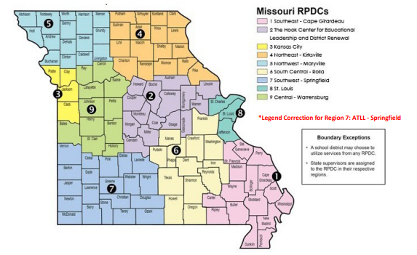
Notes:
To Say: Technical Assistance on Individual Student Report (ISRs) as well as suggestions for additional content strategies can be obtained through your RPDC consultant.

Slide 151
Improvement Consultant Contact Information
Region 1
Region 6
Susan Hekmat srhekmat@semo.edu
Connie Cromwell cromwellco@mst.edu
Region 2
Region 7
Lisa Rapert rapertl@Missouri.edu
Megan Menton MeganMenton@missouristate.edu
Region 3
Region 8
Mary McConnell mcconnellme@umkc.edu
Patti Stenger pstenger@edplus.org
Carrie Turner cturner@umkc.edu
Region 9
Region 4
Mary Beth Scherer mbscherer@ucmo.edu
Susan See ssee@Truman.edu
Region 5
Jane Jackson Jjackso@nwmissouri.edu
Pam Madison pmadison@nwmissouri.edu
Notes:
To Say: Here is a list of Improvement Consultants around the state. ICs can put their information on the next slide.

Slide 152
Questions? Please contact:
Notes:
Consultants should enter their contact information prior to training.

