Slide 1
Finding an Activity to Match the Essential Element You Want to Teach, in the BYOC

Slide 2
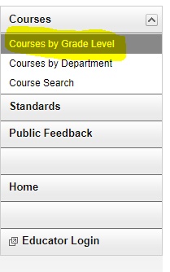
Getting Started
Begin by right clicking on this website and click on “Open Hyperlink:
Courses by Grade Level, BuildYourOwnCurriculum
Choose the course. (by grade level or by department)
For this demonstration we will go to “Courses by Grade Level.

Slide 3
Now you will choose what subject (ELA, Mathematics, Science, Health or Physical Education). Then chose the grade level of the students in your classroom. We will use 3rd grade ELA.

Slide 4
Next you will choose the Unit. We will look at the Unit: Reading Literature.

Slide 5
In this frame, you will see the Conceptual Areas in the Dynamic Learning Map which explains the Topics. We will be looking at the Topic of: Key Ideas and Details.

Slide 6
You will now find all the Essential Elements under that Topic.

Slide 7
To find an Activity to go with the Essential Element you have chosen, go to the bottom of the page where you will find Activity. We will use the Activity: It’s Not Easy Being a Bunny.

Slide 8
Now you have the activity for the Essential Elements listed. Unfortunately all of the Essential Elements do not have Activity Lists at this time.

Slide 9
Activity Details: Continued

Slide 10
FYI
The way you will find the Essential Elements (EE) in the Build Your Own Curriculum (BYOC) is the same way you would find the EE on the Dynamic Learning Maps (DLM).

