Slide 1
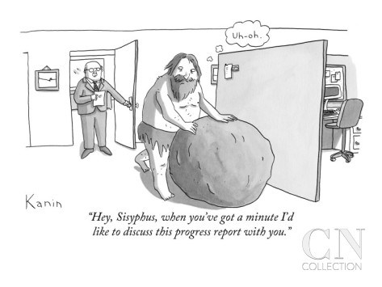
Social Studies 6-12:
Examining Expectations and Implementation
Professional Development Series
July 25, 2016
Hey, Sisyphus, when you get a minute, I’d like to discuss the new social studies standards with you.”

Slide 2
Purpose for today:
Understand the genesis of the 2016 Social Studies expectations.
Understand the key differences between previous and current Social Studies expectations at elementary and secondary levels.
Understand the available DESE resources as you work to translate expectations into curriculum in your district or school.
Understand Social Studies assessment changes tied to 2016 expectations.

Slide 3

What is your POV?
Jot down at least three “I am” statements.
Table intros: introduce yourself to each other with your name and those “I am” statements.
After introductions, find some common element in your lives that links your together. Not that you are secondary educators.
Be ready to share with the full group.

Slide 4
Agenda for today:
Introductions
In the beginning….. and now
Support and Curricular Resources
Quick K-5 overview
Brief break
Close examination of changes in course expectations
Working Lunch
Course changes report-out…questions and ideas
Assessment schedule update
Preview tomorrow

Slide 5
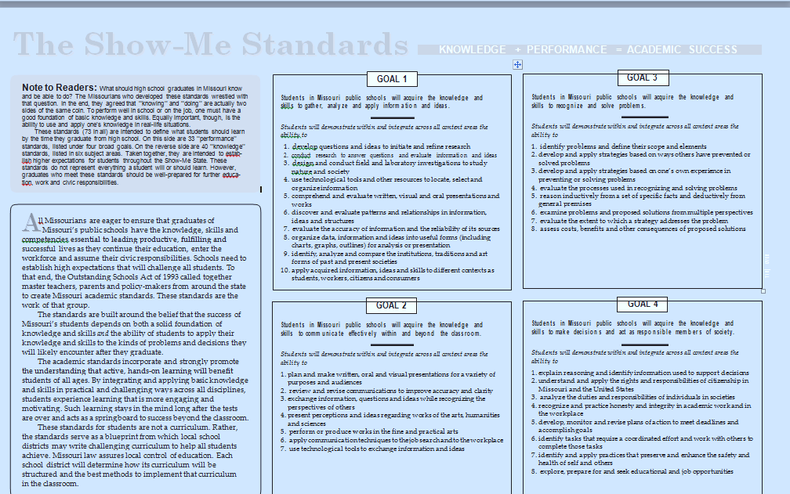
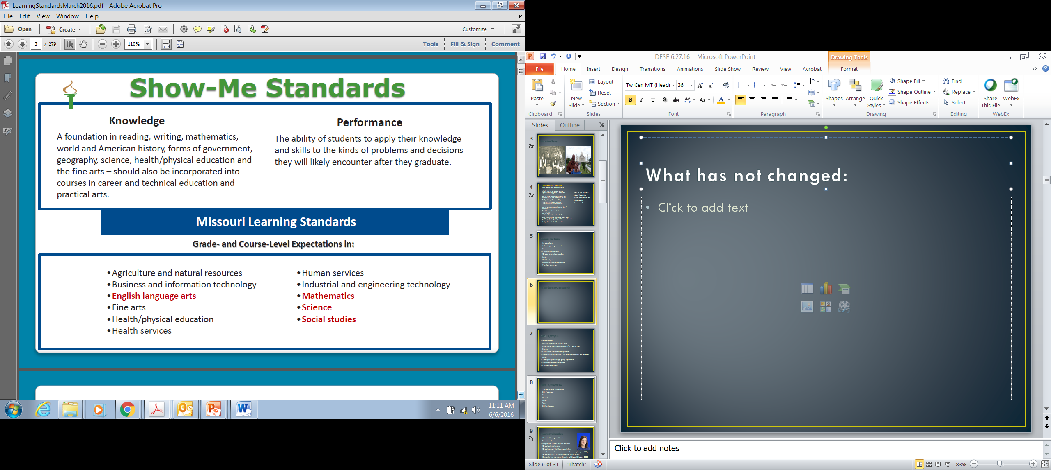
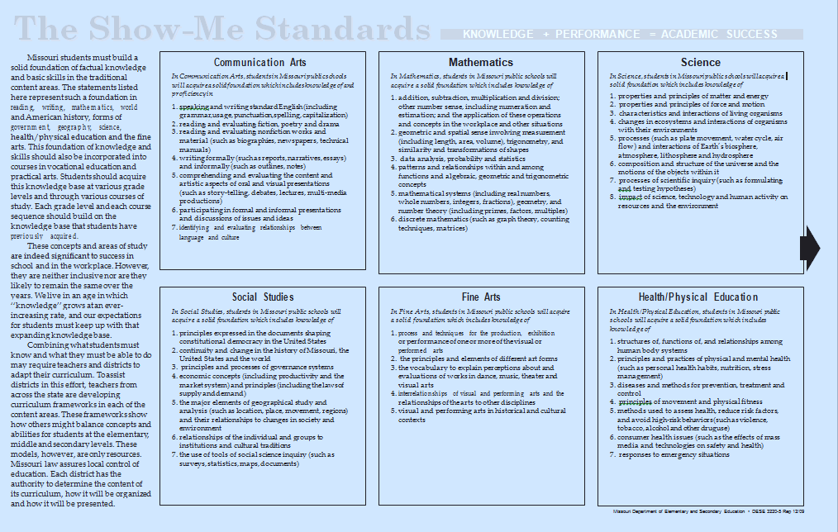
In the beginning…

Slide 6
Show-Me Standards:
Social Studies
In Social Studies, students in Missouri public schools will acquire a solid foundation which includes knowledge of
principles expressed in the documents shaping constitutional democracy in the United States
continuity and change in the history of Missouri, the United States and the world
principles and processes of governance systems
economic concepts (including productivity and the market system) and principles (including the laws of supply and demand)
the major elements of geographical study and analysis (such as location, place, movement, regions) and their relationships to changes in society and environment
relationships of the individual and groups to institutions and cultural traditions
the use of tools of social science inquiry (such as surveys, statistics, maps, documents)

Slide 7
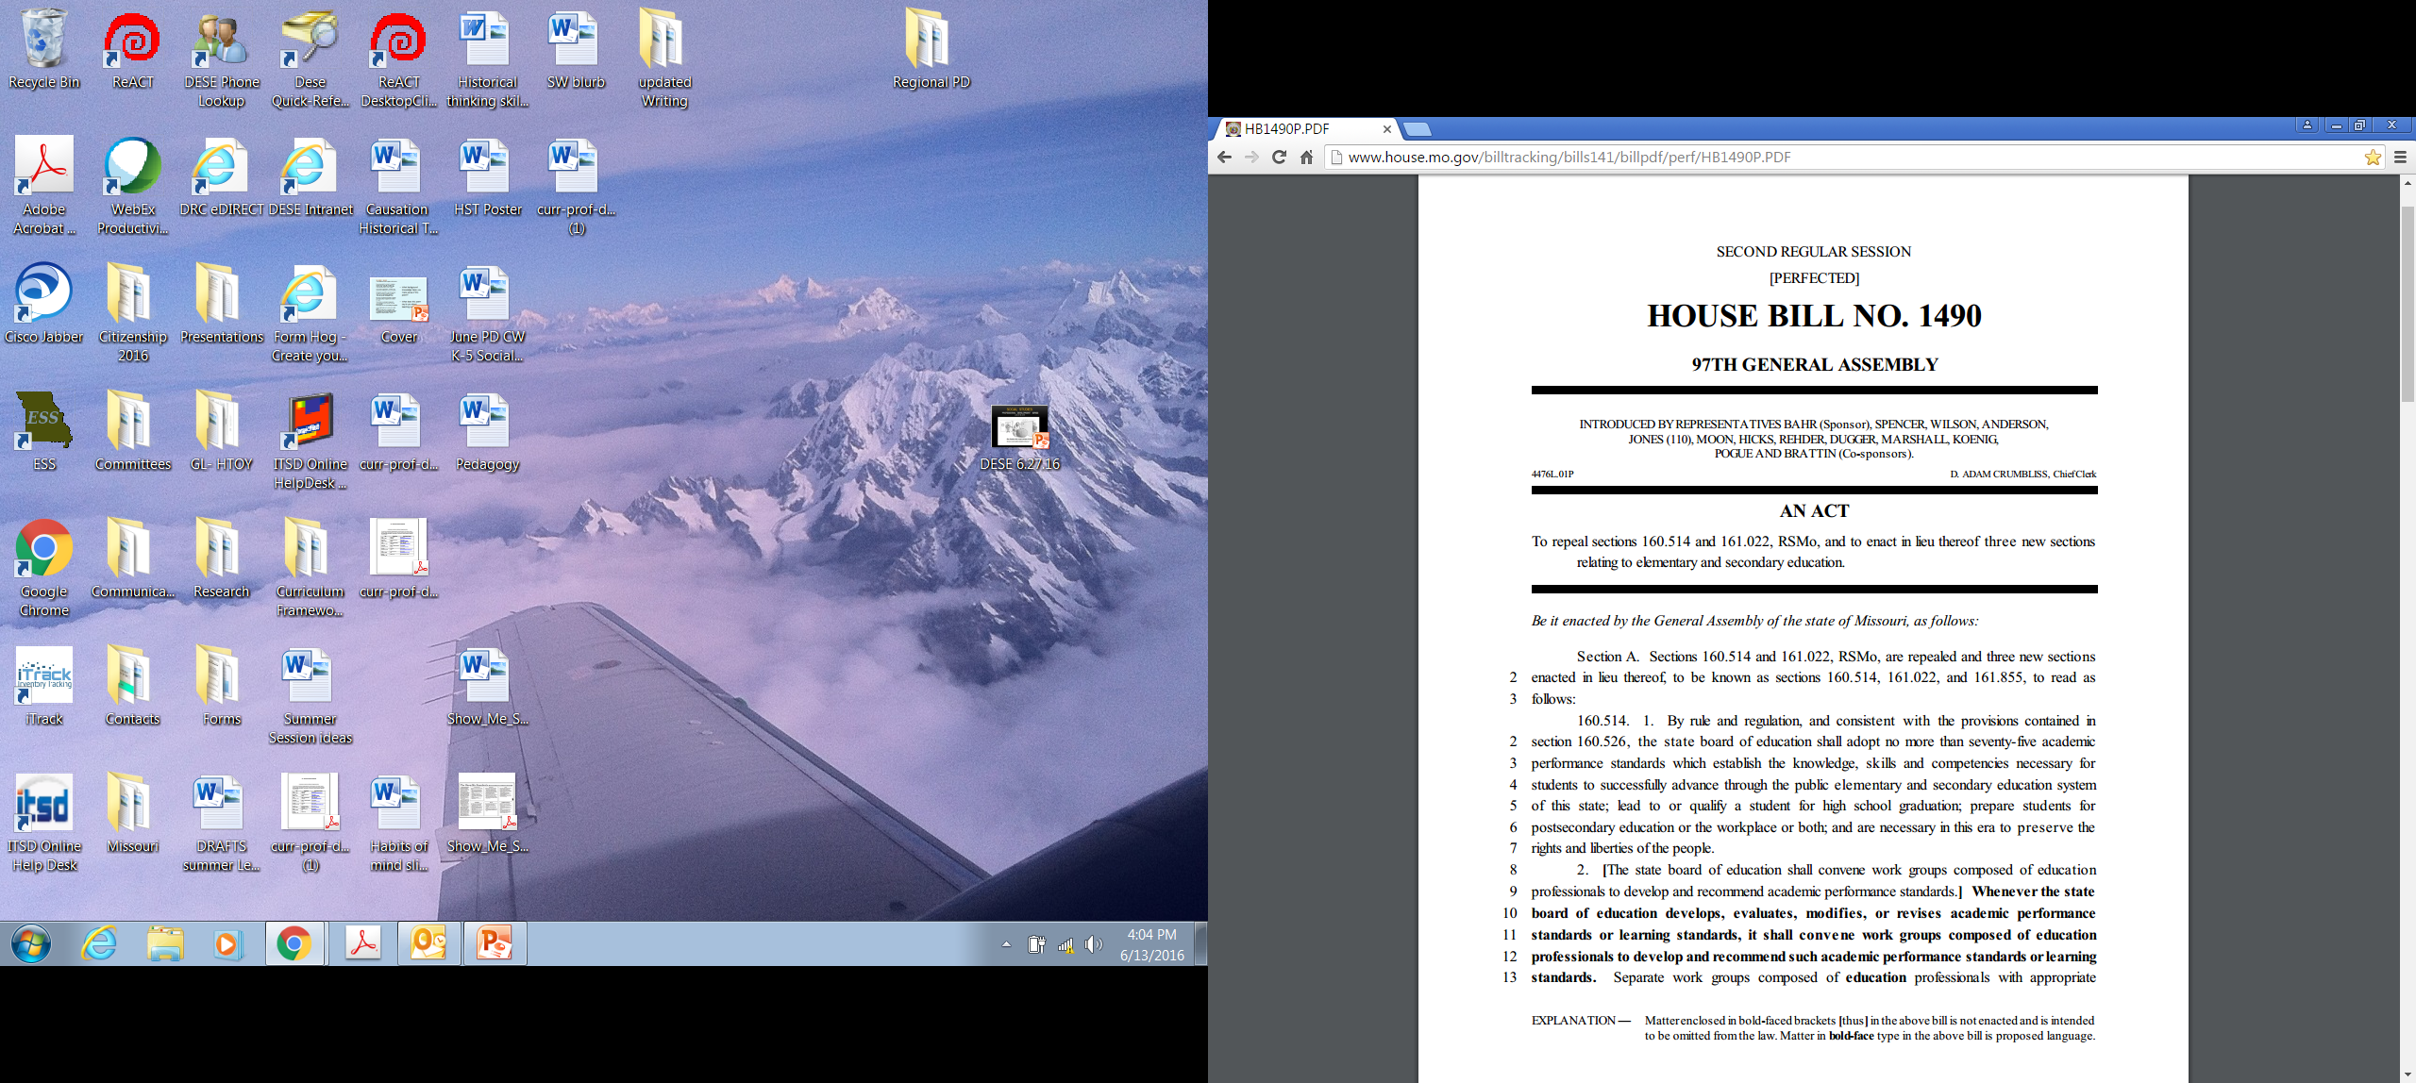
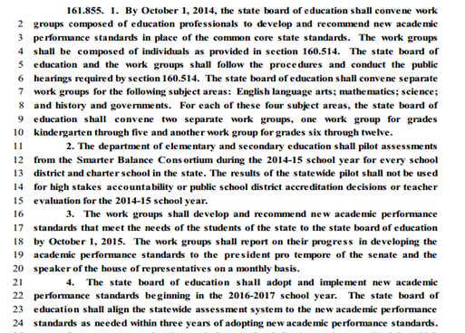
And then in 2014,
HB 1490 was passed by the Missouri legislature and signed into law http://www.house.mo.gov/billtracking/bills141/billpdf/perf/HB1490P.PDF

Slide 8
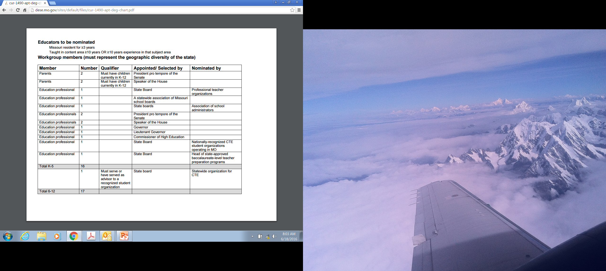
Workgroup participation

Slide 9
Resources available to you as you work in your regions/school districts:
  Teacher-friendly layout
  Glossary
  Curriculum Framework Guide
  Excell format….
  Other needed resources?

Slide 10
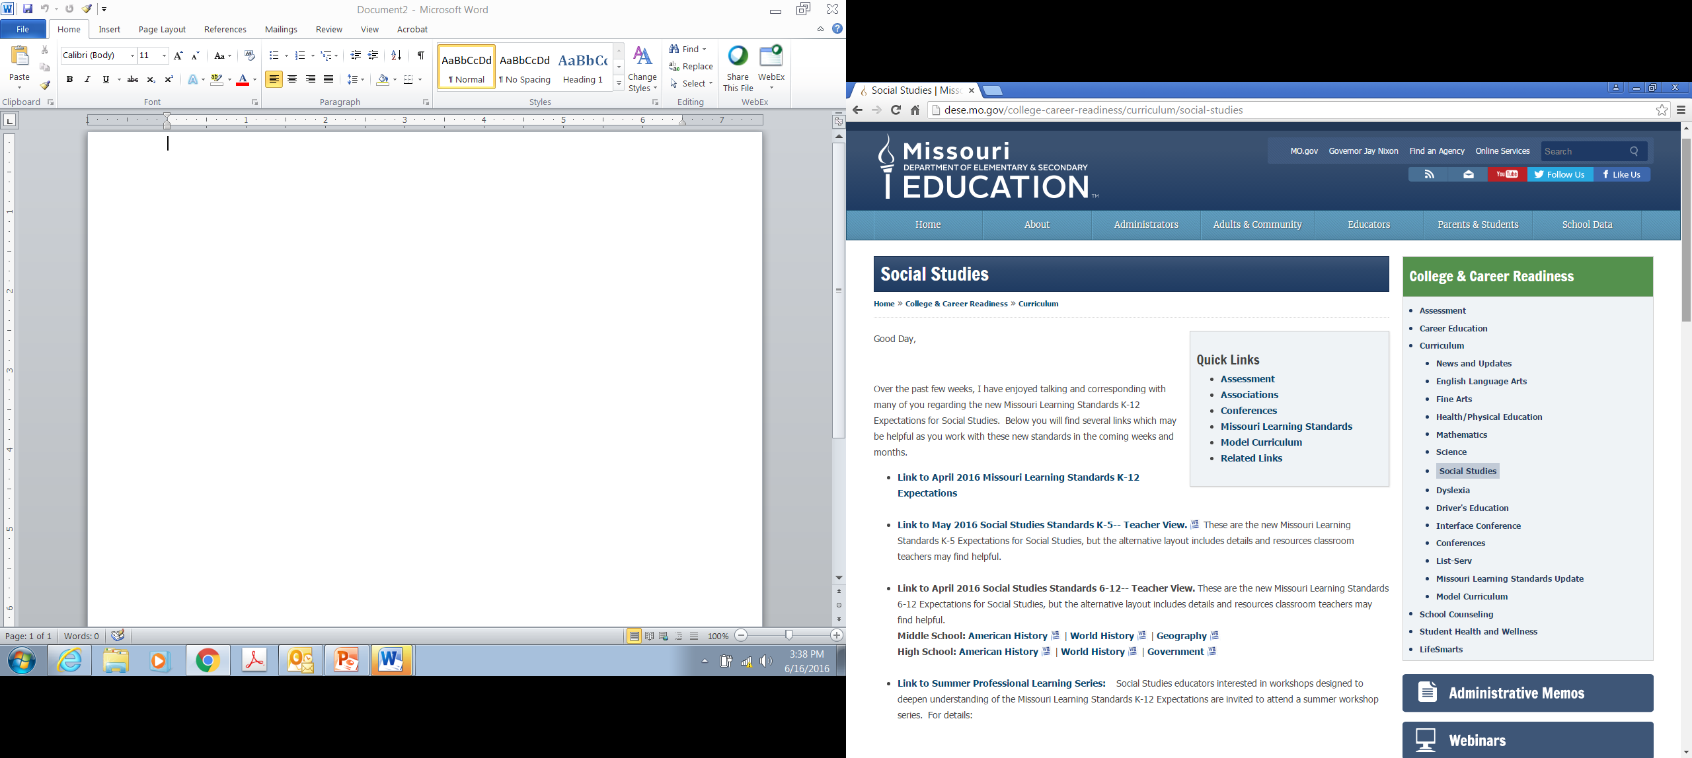
Social Studies DESE PAGE http://dese.mo.gov/college-career-readiness/curriculum/social-studies

Slide 11
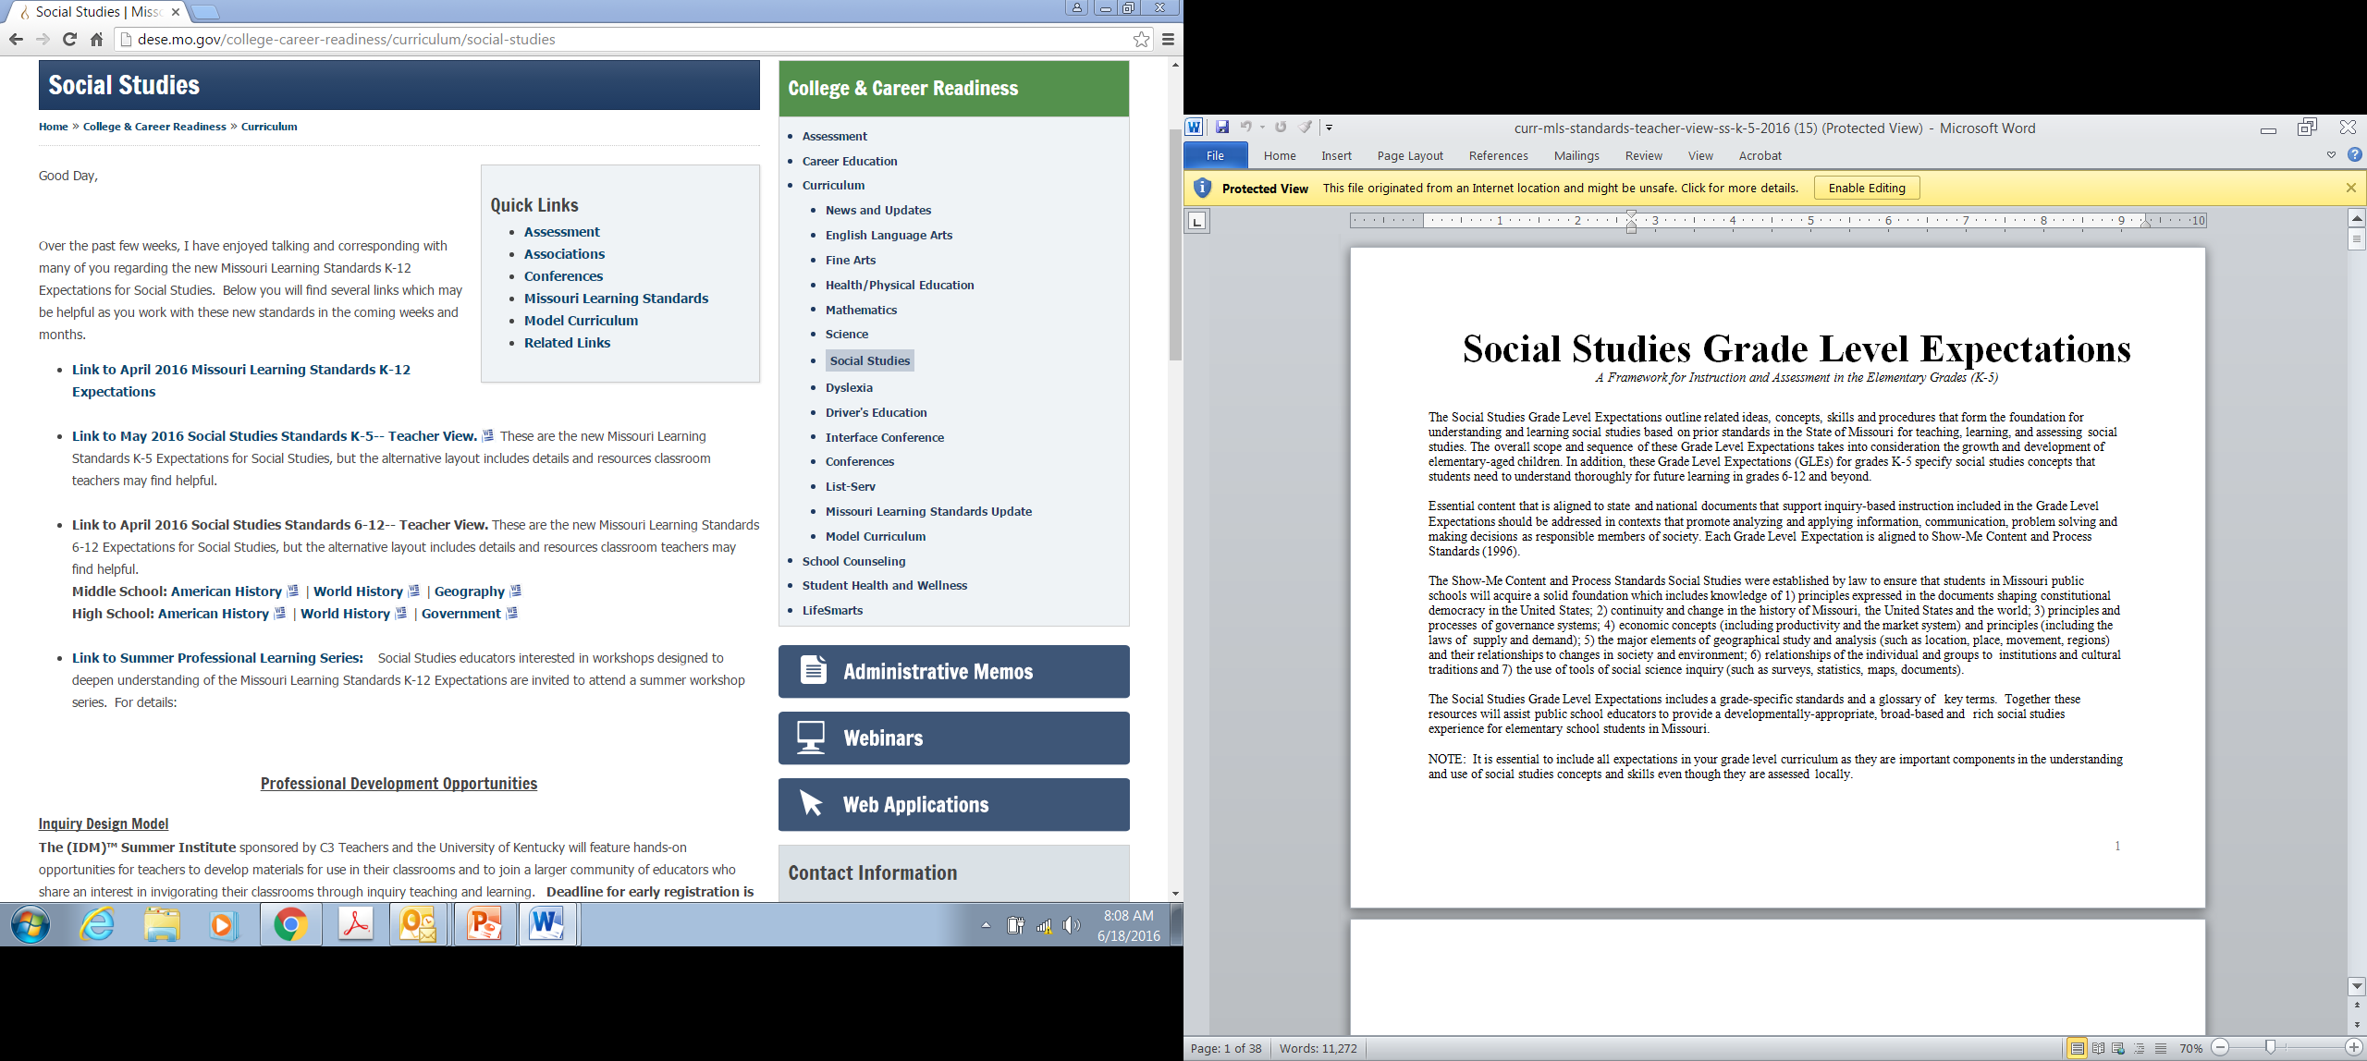
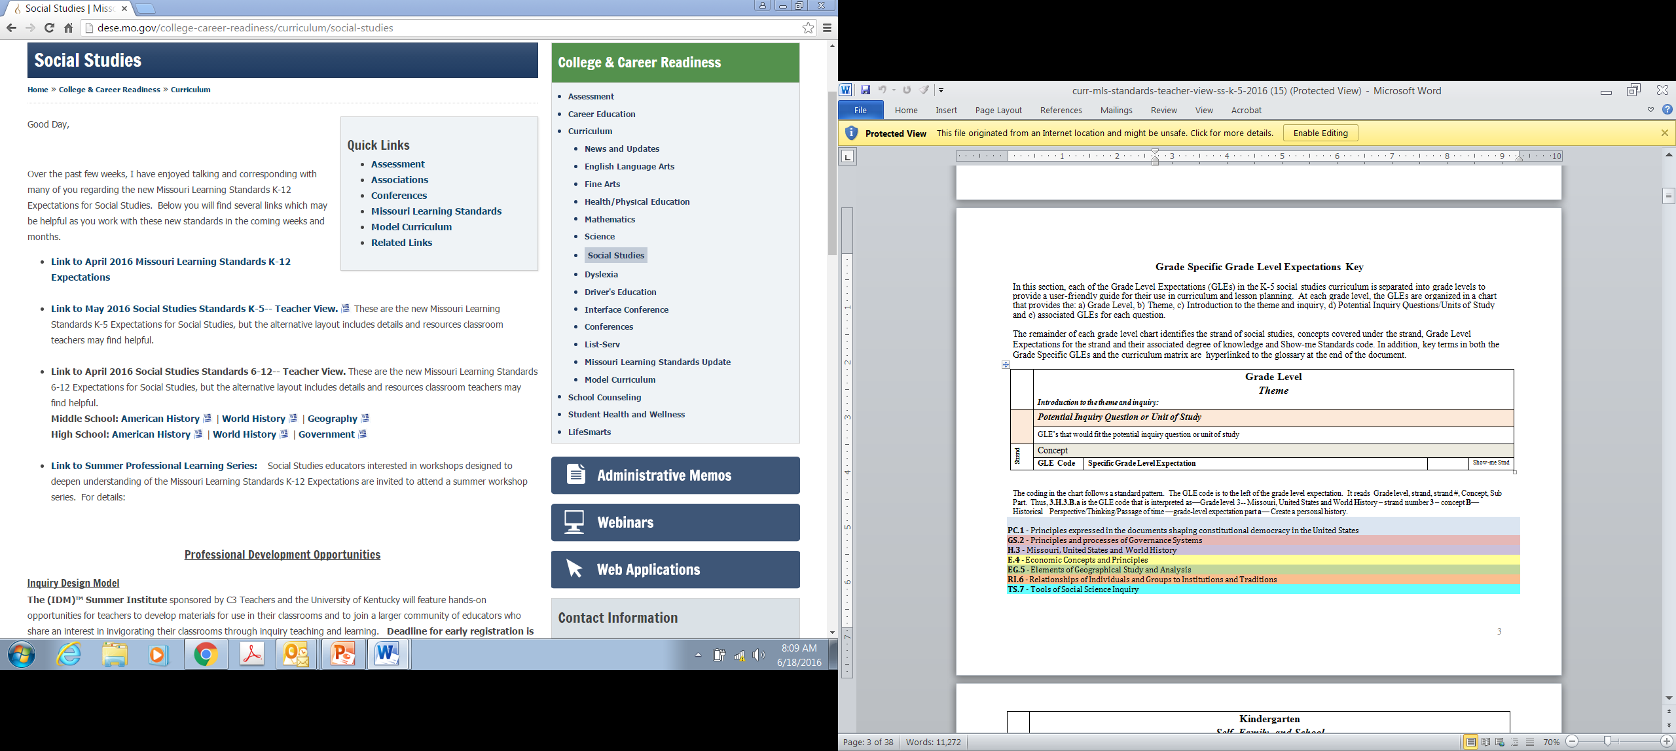
Elementary Teacher -friendly View

Slide 12
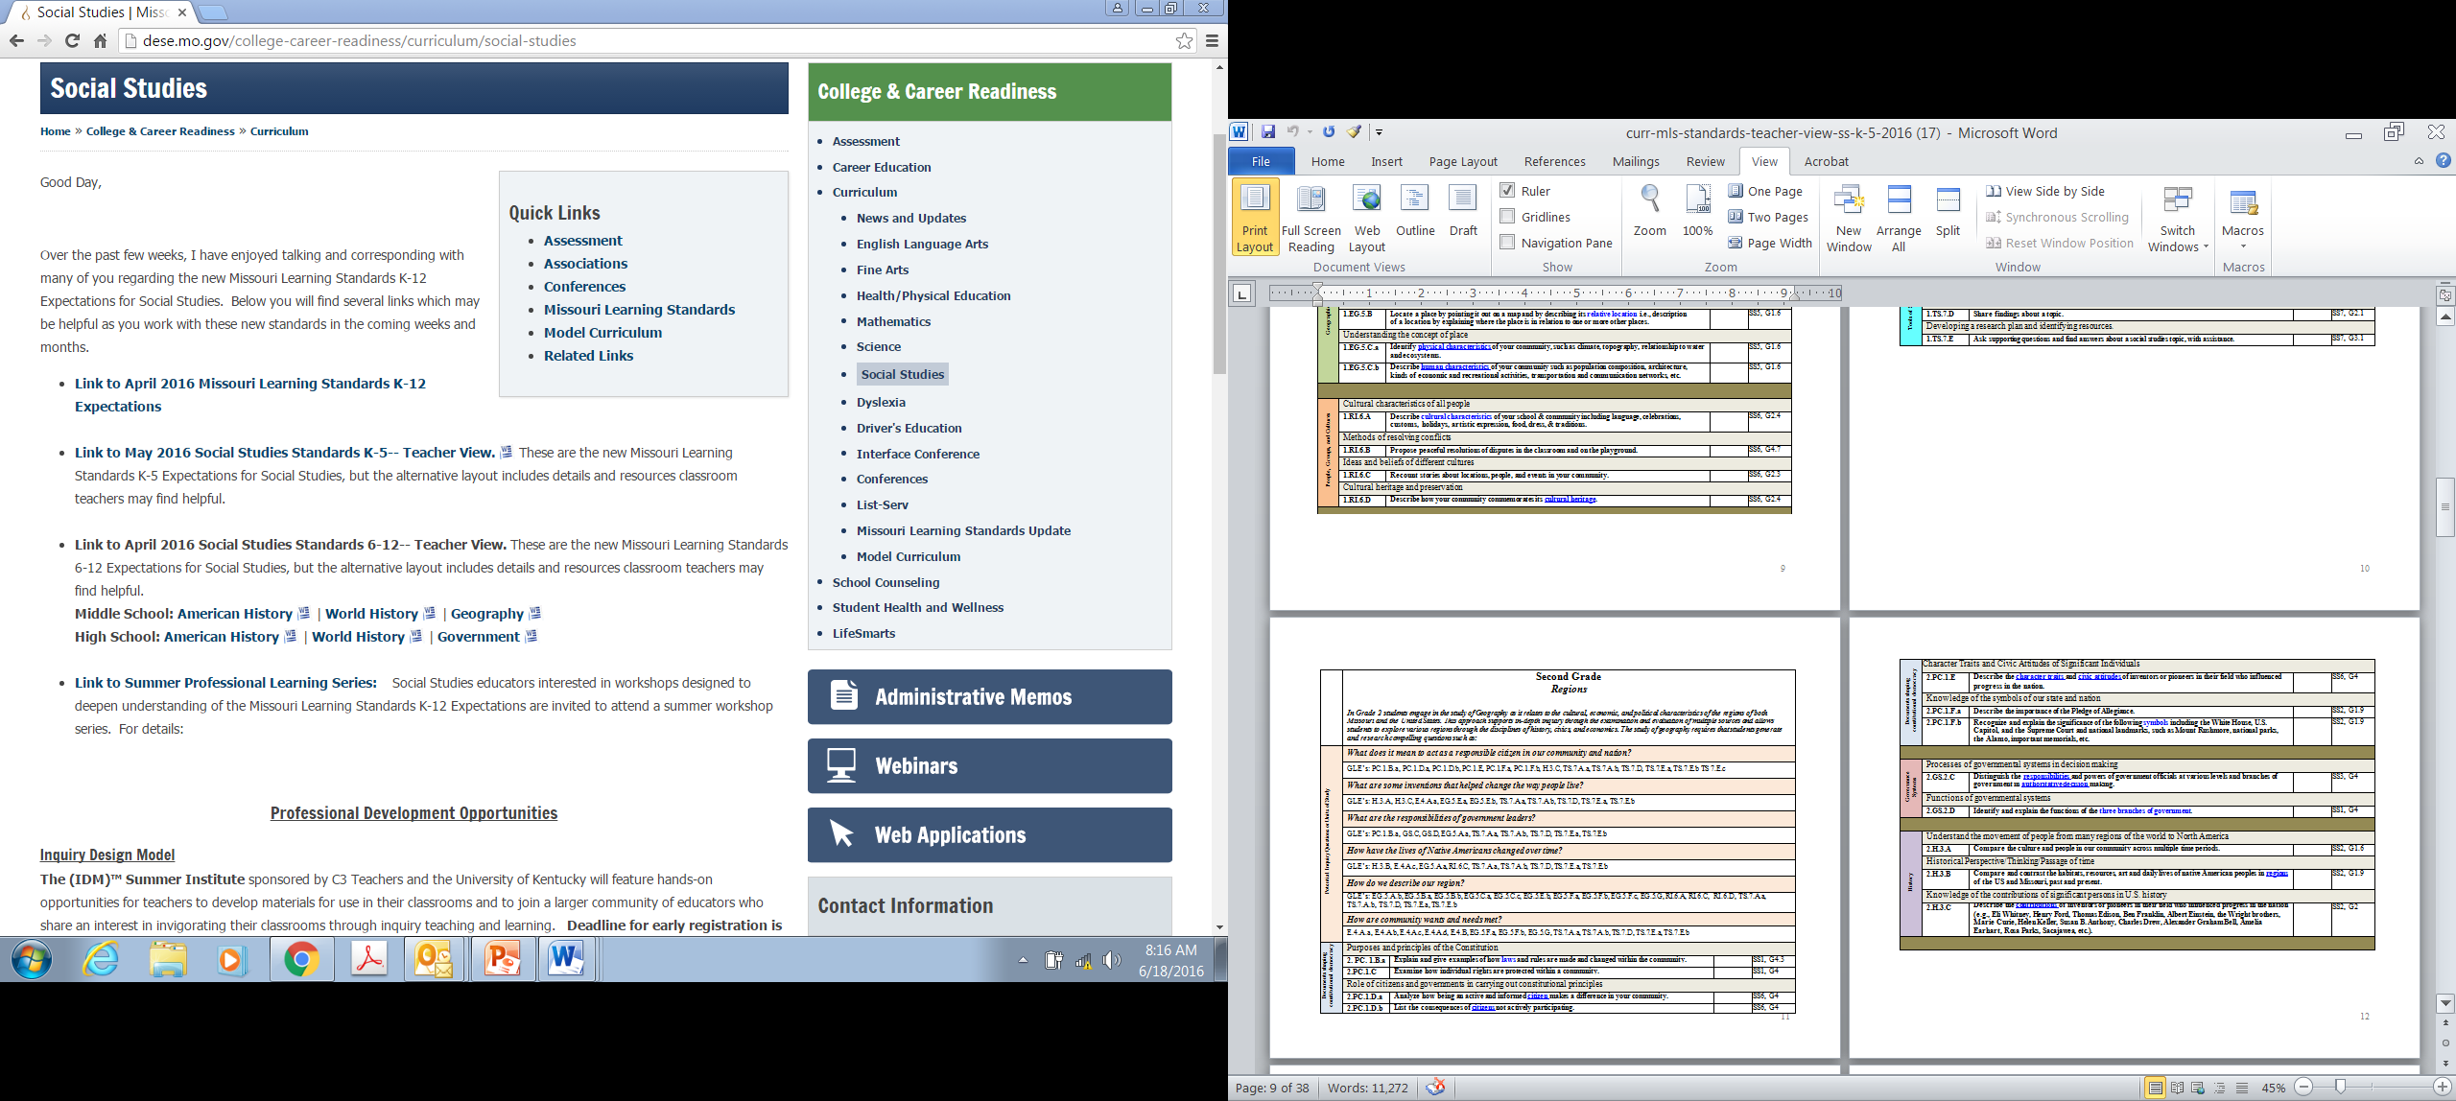

Slide 13
K-5 Overview
Key Changes
Organization:
Themes and Questions
Greater range of social studies disciplines
Focus on social science thinking and on research
Shift of Missouri history content
Expanded opportunity for interdisciplinary integration
K--- Self, Family and School
1--- School and Community
2--- Regions
3--- Missouri Past and Present
4--- Our Nation (to c. 1799)
5--- Our Nation (post c. 1800)

Slide 14
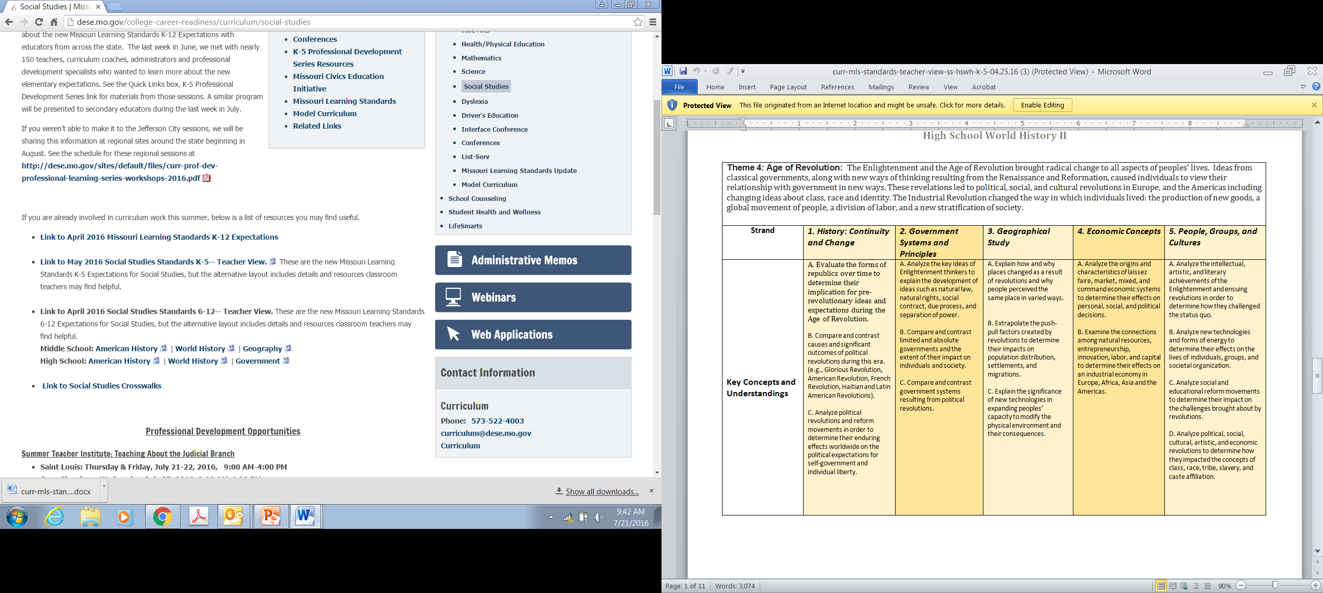
Secondary Teacher-friendly layout

Slide 15
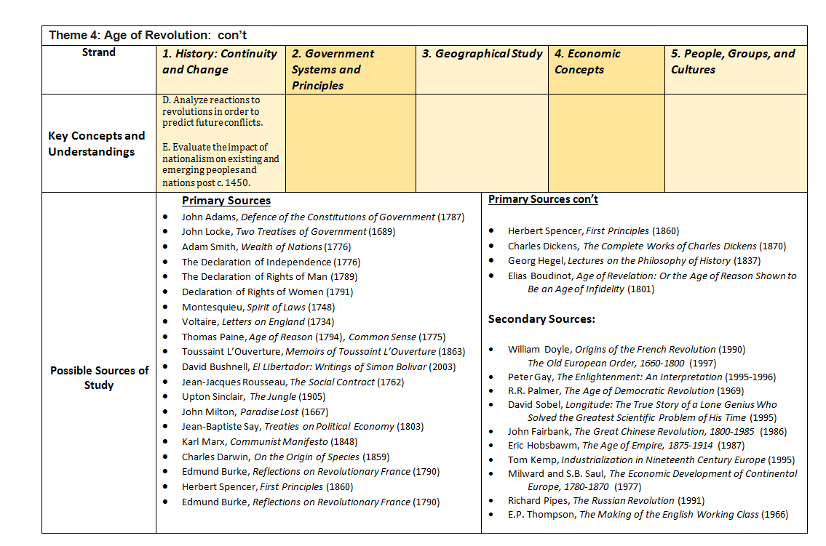
Secondary Teacher-friendly layout

Slide 16
Turn to the classics…
https://www.youtube.com/watch?v=I7LWw_g66SQ

Slide 17
Break….. 10 minutes ☺!
When you return, please sit in course designations and introduce yourselves.
If you do not have a course designation, please sit at a table which is tied to your interests and has open seats.
You will eventually get to hear from all the groups, so don’t worry about missing course specific information.

Slide 18
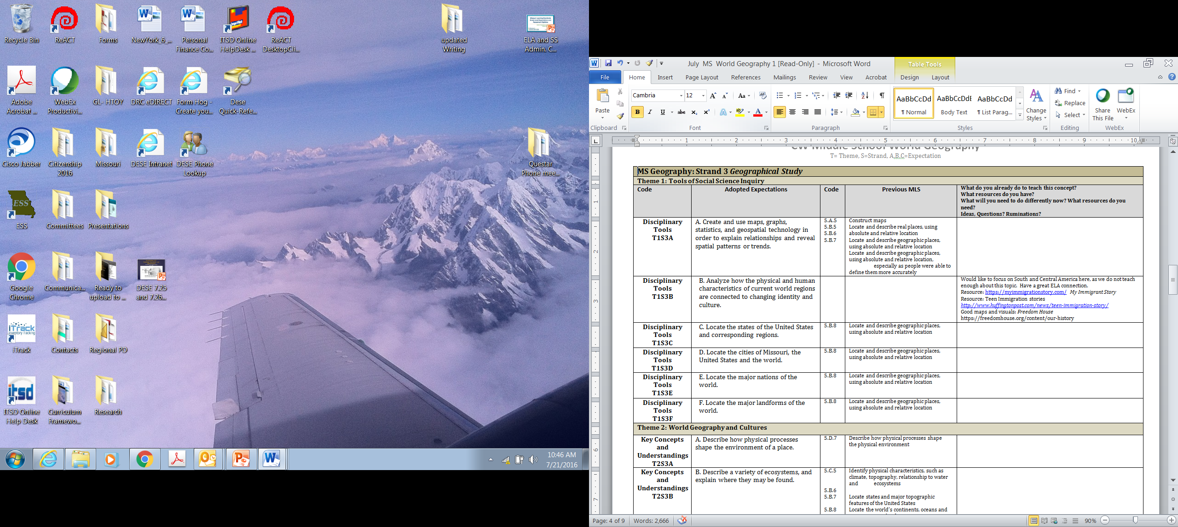
Read through your course level expectations, item by item. In the space provided, respond to the questions at the top of the page and then list any ideas, thoughts or ruminations you feel are important when examining this course level expectation.
Be ready to report out to the larger group later this morning.

Slide 19
In your report-out, be sure you address these questions.
What are the greatest changes/challenges you see in teaching this course under the new Expectations? Cite specific examples and give a whole course analysis as well.
What additional resources will you need to teach this course?
What resources can you suggest to others teaching this course?
What do you think about differently as a result of your group conversation?

Slide 20
Progress Check: Where are we now?
After lunch: Finish course commentary and share responses
Shaun Bates: Director of Assessment: Update
Preview for tomorrow: Focus on pedagogy
How do we teach these expectations in
meaningful, manageable ways?
Nick Kremer, Missouri Writing Project
Reading and Writing through History:
World War II and the Bomb
Tom Tobias, Arts Education Director, DESE
Defining Arts Integration: Reading Portraits as Biography

Slide 21
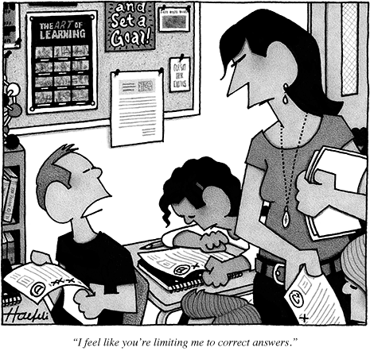
Shaun Bates:
Director of Assessment, DESE

Slide 22
The History Teacher
-from Questions About Angels, by Billy Collins
Trying to protect his students' innocence
he told them the Ice Age was really just
the Chilly Age, a period of a million years
when everyone had to wear sweaters.
And the Stone Age became the Gravel Age,
named after the long driveways of the time.
The Spanish Inquisition was nothing more
than an outbreak of questions such as
"How far is it from here to Madrid?"
"What do you call the matador's hat?"
The War of the Roses took place in a garden,
and the Enola Gay dropped one tiny atom
on Japan.
The children would leave his classroom
for the playground to torment the weak
and the smart,
mussing up their hair and breaking their glasses,
while he gathered up his notes and walked home
past flower beds and white picket fences, wondering if they would believe that soldiers
in the Boer War told long, rambling stories
designed to make the enemy nod off.
How is this poem about teaching social studies?

Slide 23
Contact me with questions or ideas any time: Dixie.Grupe@dese.mo.gov
Share the information you’ve gathered today with your peers
Check the Social Studies DESE page for information and opportunities
Send me your email to add to our informal Wiggio group.
Come back tomorrow!
The Department of Elementary and Secondary Education does not discriminate on the basis of race, color, religion, gender, gender identity, sexual orientation, national origin, age, veteran status, mental or physical disability, or any other basis prohibited by statute in its programs and activities. Inquiries related to department programs and to the location of services, activities, and facilities that are accessible by persons with disabilities may be directed to the Jefferson State Office Building, Director of Civil Rights Compliance and MOA Coordinator (Title VI/Title VII/Title IX/504/ADA/ADAAA/Age Act/GINA/USDA Title VI), 5th Floor, 205 Jefferson Street, P.O. Box 480, Jefferson City, MO 65102-0480; telephone number 573-526-4757 or TTY 800-735-2966; email civilrights@dese.mo.gov

