Slide 1
Social Studies:
Examining Expectations and Implementation
Professional Development Series
June 27, 2016

Slide 2
Purpose for today:
Understand the genesis of the 2016 Social Studies expectations.
Understand the key differences between previous and current Social Studies expectations at grade and cross-grade elementary levels.
Understand the available DESE resources as you work to translate expectations into curriculum in your district or school.
Understand Social Studies assessment changes tied to 2016 expectations.
The Department of Elementary and Secondary Education does not discriminate on the basis of race, color, religion, gender, gender identity, sexual orientation, national origin, age, veteran status, mental or physical disability, or any other basis prohibited by statute in its programs and activities. Inquiries related to department programs and to the location of services, activities, and facilities that are accessible by persons with disabilities may be directed to the Jefferson State Office Building, Director of Civil Rights Compliance and MOA Coordinator (Title VI/Title VII/Title IX/504/ADA/ADAAA/Age Act/GINA/USDA Title VI), 5th Floor, 205 Jefferson Street, P.O. Box 480, Jefferson City, MO 65102-0480; telephone number 573-526-4757 or TTY 800-735-2966; email civilrights@dese.mo.gov

Slide 3
Agenda for today:
Introductions
In the beginning….. and now
Support and Curricular Resources
Brief Break
Dyslexia resources
Grade level close reading
Working Lunch
K-5 Analysis
Assessment schedule update
Preview tomorrow

Slide 4
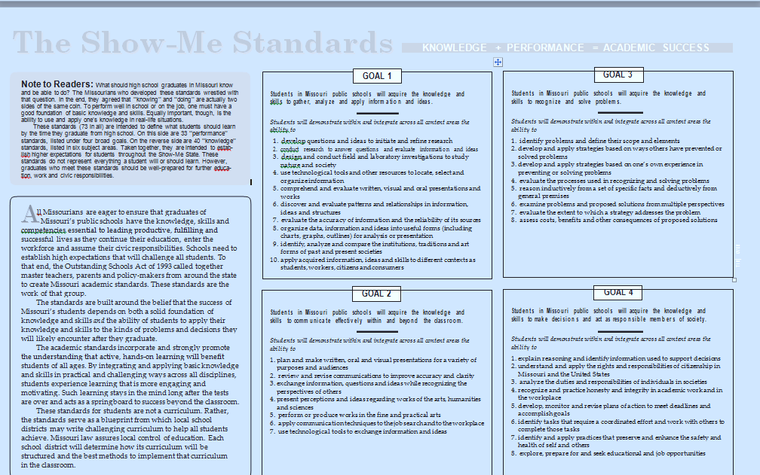
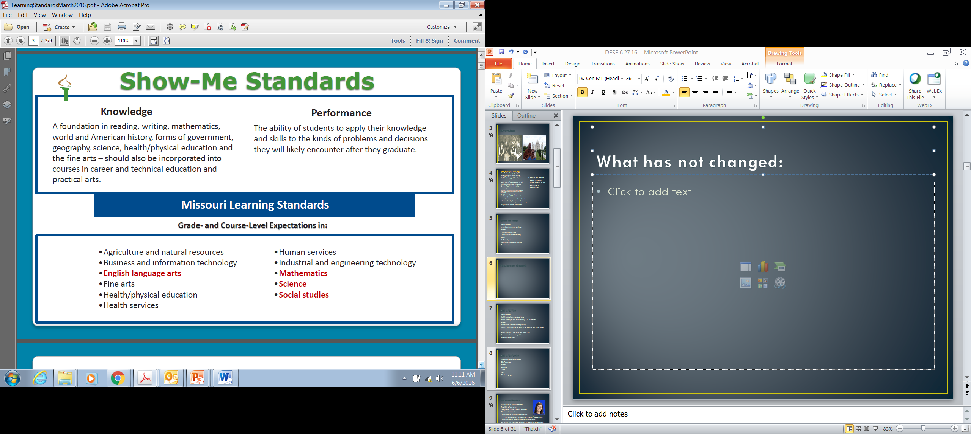
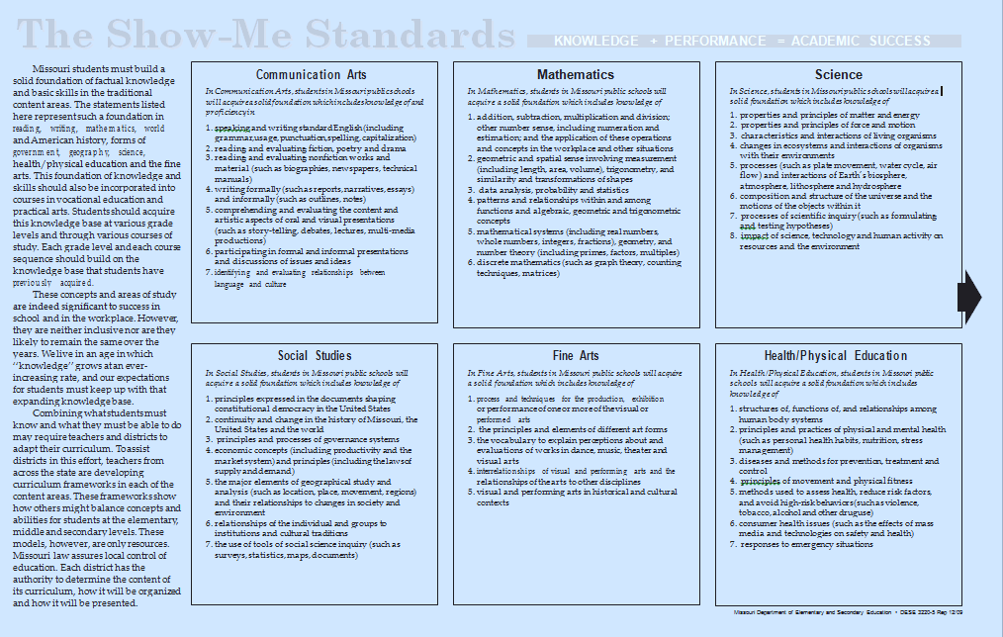
In the beginning…

Slide 5
Show-Me Standards: Social Studies
In Social Studies, students in Missouri public schools will acquire a solid foundation which includes knowledge of
principles expressed in the documents shaping constitutional democracy in the United States
continuity and change in the history of Missouri, the United States and the world
principles and processes of governance systems
economic concepts (including productivity and the market system) and principles (including the laws of supply and demand)
the major elements of geographical study and analysis (such as location, place, movement, regions) and their relationships to changes in society and environment
relationships of the individual and groups to institutions and cultural traditions
the use of tools of social science inquiry (such as surveys, statistics, maps, documents)

Slide 6
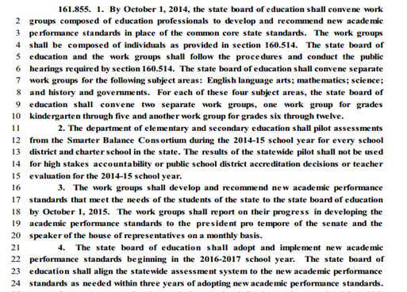
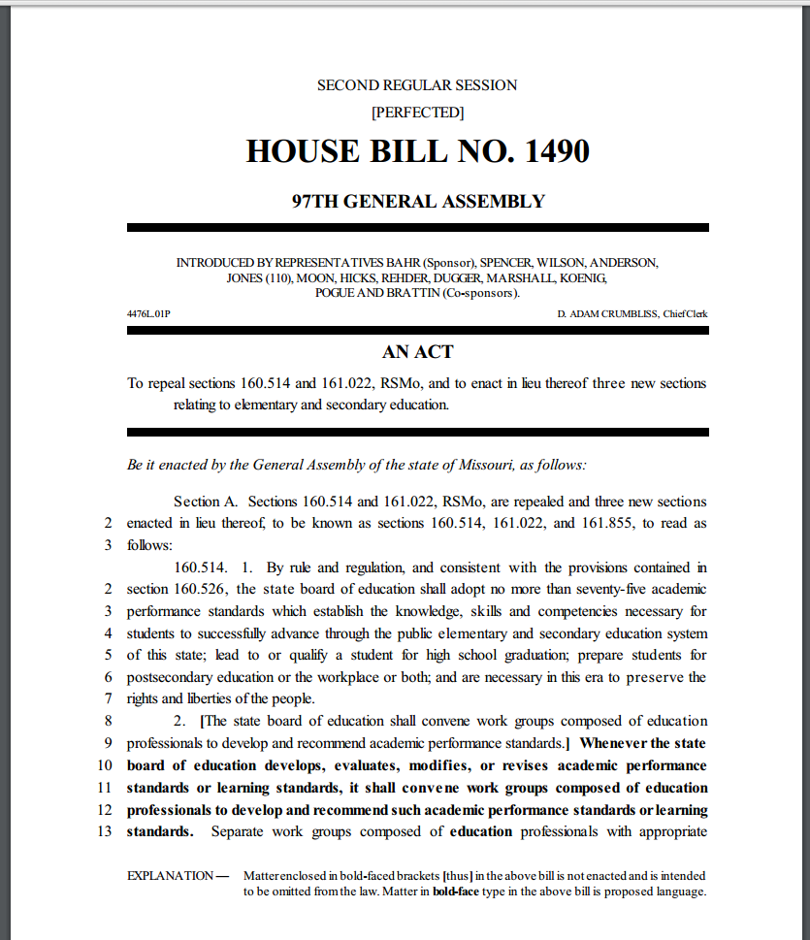
And then in 2014,
HB 1490 was passed by the Missouri legislature and signed into law http://www.house.mo.gov/billtracking/bills141/billpdf/perf/HB1490P.PDF

Slide 7
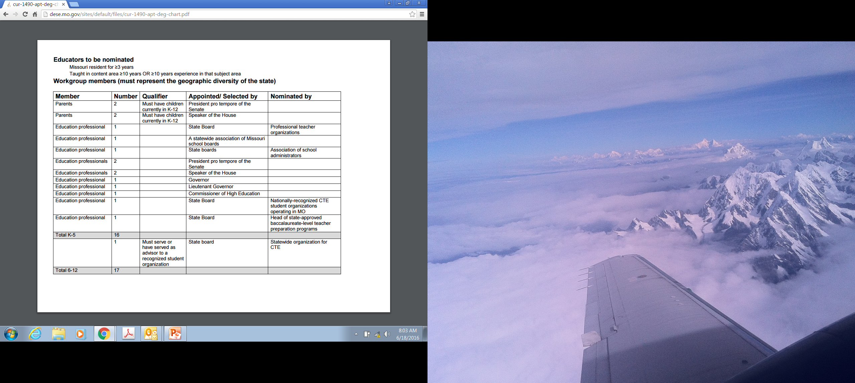
Workgroup participation

Slide 8
Resources available to you as you work in your regions or school districts
  Teacher-friendly layout
  Glossary
  Curriculum Framework Guide
  Excell format….
  Other needed resources?

Slide 9
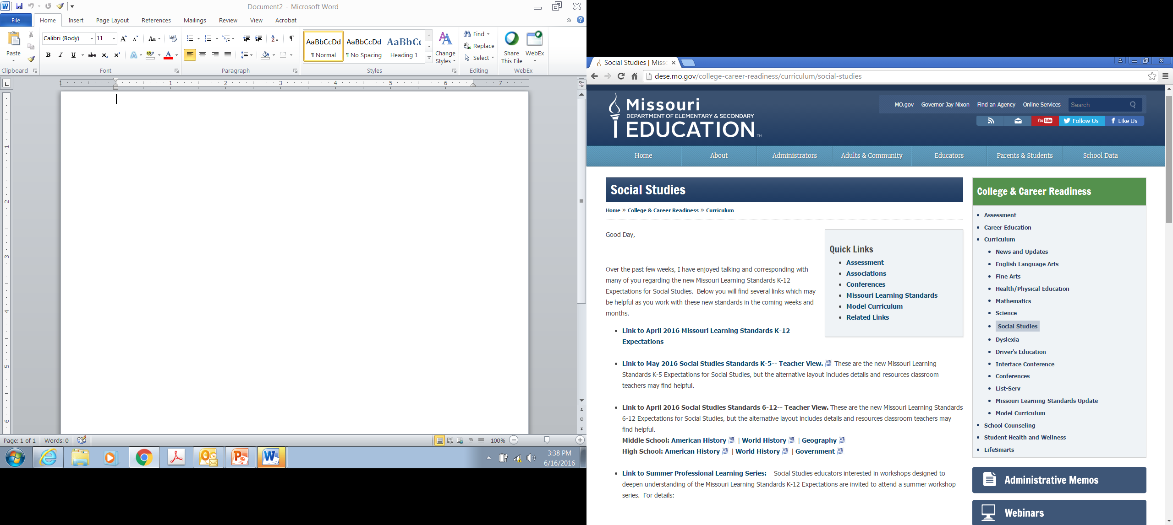
Social Studies DESE PAGE http://dese.mo.gov/college-career-readiness/curriculum/social-studies

Slide 10
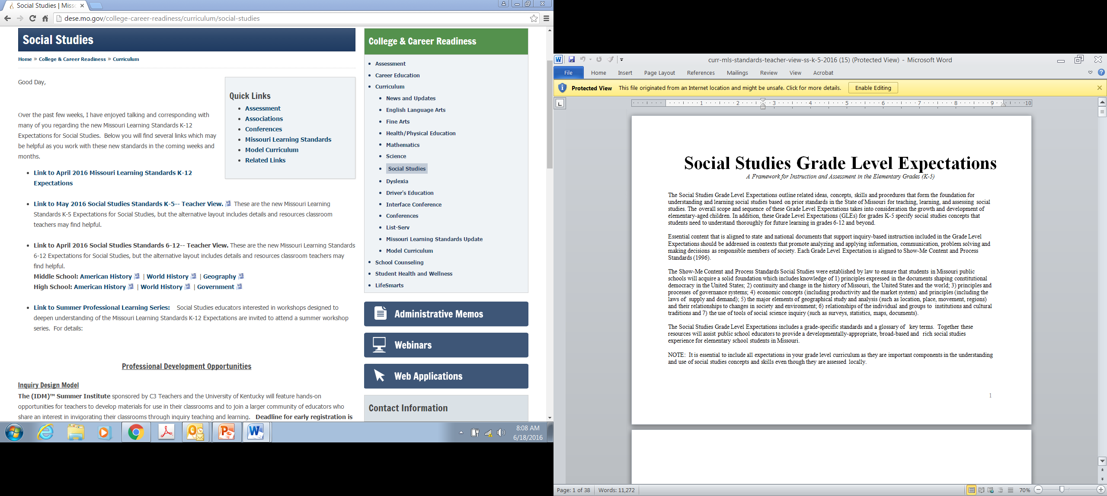
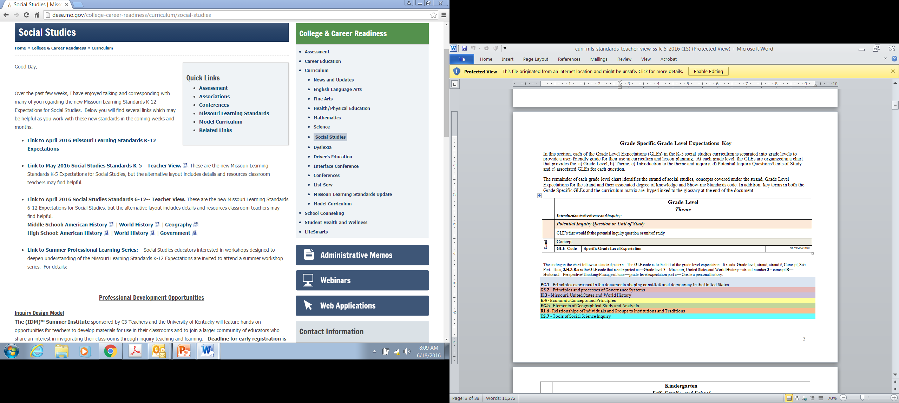

Slide 11
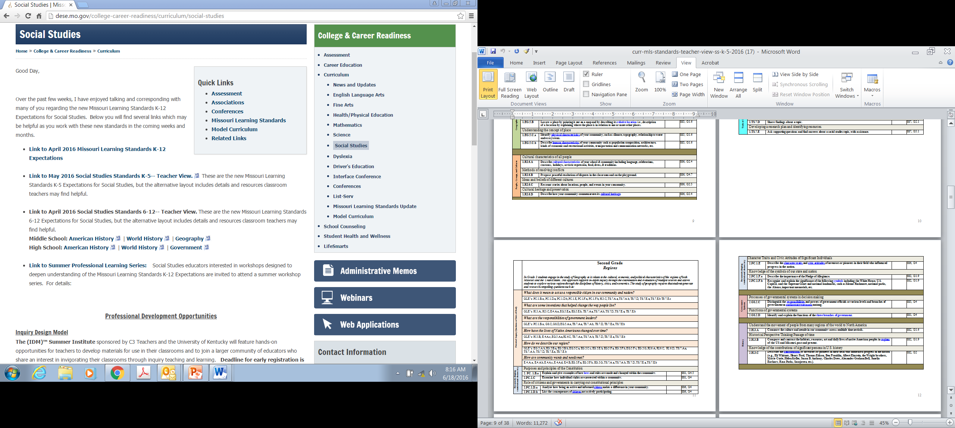

Slide 12
Kim Stuckey
DESE Director, Dyslexia Specialist

Slide 13
Grade level work
Read through your grade level expectations, item by item. In the space provided, respond to the questions at the top of the page and then list any ideas, thoughts or ruminations you feel are important when examining this grade level expectation.
For example:
7. Knowledge of the use of tools of social science inquiry (TS)
A. Identify, select, analyze and evaluate resources to create a product of social science inquiry
2.TS.7.A.a | Describe and analyze primary and secondary social studies’ sources in classroom discussion with guidance and support. | TSSI.7.A TSSI.7.A | Identify and select visual, graphic and auditory aids (graphs and charts) Identify, select and use primary and secondary sources (diaries, letters, people, interviews, journals and photos.
2.TS.7.A.b | Select and use artifacts to share information on social studies’ topics. | TSSI.7.A | Identify and select artifacts (building structures and materials, works of art representative of cultures, fossils, pottery, tools, clothing, musical instruments)
B. Use visual tools to communicate information and ideas
2. TS.7.B. | Use visual tools and informational texts to communicate information. | TSSI.7.A | Identify and select visual, graphic and auditory aids (graphs and charts)
C. Understanding and supporting fact, opinion, bias and point of view in sources.
2.TS.7.C.a | Explain the difference between fact and opinion in social studies’ topics.
2.TS.7.C.b | Explain the concept of point of view in social studies’ topics. |  |  | "The True Story of the Three Little Pigs" by Jon Scieszka. Possible SS topics: Helen Keller vs. Annie Sullivan. Christopher Columbus vs. F&I vs. native Americans.
D. Conducting and presenting research with appropriate resources
2.TS.7.D | Share findings about a topic.

Slide 14
Progress Check: Where are we now?
After Lunch: Finish Grade Level Work and K-5 Analysis
Shaun Bates: Director of Assessment: Update
Preview for tomorrow: Focus on pedagogy
How do we teach these expectations in meaningful,
manageable ways?
Debbie Jameson, ELA Director
Using Literacy Strategies in Social Studies
Tom Tobias, Arts Education Director
Defining Arts Integration: Reading Portraits as Biography

Slide 15
Shaun Bates:
Director of Assessment, DESE

Slide 16
The History Teacher
-from Questions About Angels, by Billy Collins
Trying to protect his students' innocence
he told them the Ice Age was really just
the Chilly Age, a period of a million years
when everyone had to wear sweaters.
And the Stone Age became the Gravel Age,
named after the long driveways of the time.
The Spanish Inquisition was nothing more
than an outbreak of questions such as
"How far is it from here to Madrid?"
"What do you call the matador's hat?"
The War of the Roses took place in a garden,
and the Enola Gay dropped one tiny atom
on Japan.
The children would leave his classroom
for the playground to torment the weak
and the smart,
mussing up their hair and breaking their glasses,
while he gathered up his notes and walked home
past flower beds and white picket fences, wondering if they would believe that soldiers
in the Boer War told long, rambling stories
designed to make the enemy nod off.
How is this poem about teaching social studies in an elementary classroom?

Slide 17
Please:
Contact me with questions or ideas any time: Dixie.Grupe@dese.mo.gov
Share the information you’ve gathered today with your peers
Check the Social Studies DESE page for information and opportunities
Send me your email to add to our informal Wiggio group.
Come back tomorrow!

Slide 18
DESE
Social Studies Professional Development Series
Exploring Instructional Practices in Social Studies
June 28, 2016

Slide 19
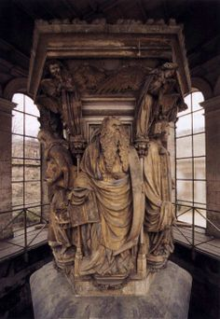
Introductions: Making connections

Slide 20
Social Studies
Professional Development Series: Day 2
Introductions
Social Studies: Giraffes and Elephants
Social Studies: Questions and Answers
Break
Debbie Jameson, ELA Director, and Lisa Scroggs, ELA Assistant Director
Using Literacy Strategies in Social Studies
Working Lunch
Tom Tobias, Arts Education Director-- Defining Arts Integration: Reading Portraits as Biography
SS Pedagogy

Slide 21

Anchor Experiences
What learning experiences can I create to anchor the learning that is to come?
Experiences should be memorable, relevant, and applicable.
Anchor experiences become your shorthand touchstones.

Slide 22
The Elephant and the Giraffe
Giraffe → Bend over, hands clasped in front of you
Elephant → Stand straight, hands clasped above head
Alone → Group together with other people
Group → Move away from others
Sit → Stand up where you are: Small jump in place
Stand → Sit where you are
Against wall → Move to center area
Center of area → Move near a wall

Slide 23
There once was an elephant who had a giraffe as his best friend. Often the elephant would lean against a wall alone and sit, waiting for the giraffe. The elephant’s friend liked to go to the center of an area of grass and stand with the giraffes. Meanwhile, the patient elephant would lean against the wall and sit until the giraffe left the center of the area of grass to come over and lean against the wall to stand by his friend.

Slide 24
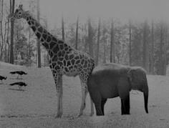
How might you adapt this lesson to teaching social studies in your elementary classroom?
Learning something new
Stretching social studies pedagogy
Scary at first, but got easier with each successive effort
Didn’t get better until I tried it (couldn’t just observe)
Different people mastered at a different pace, but with time and practice everyone could master
Needed multiple opportunities to practice
Used examples from peers with each try to get better
Received feedback from teachers with each try to get better
Scary at first, but got easier with each successive effort
Didn’t get better until I tried it (couldn’t just observe)
Different people embraced at a different pace, but with time and practice everyone embraced
Needed multiple opportunities to practice
Received feedback with each try to get better
Used examples from peers with each try to get better

Slide 25
Social Studies: Questions and Answers Aaronson Model Activity
1 2 3 4 5
5 4 3 2 1
1 2 3 4 5
5 4 3 2 1
1 2 3 4 5
5 4 3 2 1
1 2 3 4 5
5 4 3 2 1

Slide 26

THE VOICE YOU HEAR WHEN YOU READ SILENTLY
is not silent, it is a speaking-
out-loud voice in your head: it is spoken,
a voice is saying it
as you read. It's the writer's words,
of course, in a literary sense
his or her "voice" but the sound
of that voice is the sound of *your* voice.
Not the sound your friends know
or the sound of a tape played back
but your voice
caught in the dark cathedral
of your skull, your voice heard
by an internal ear informed by internal abstracts
and what you know by feeling,
having felt. It is your voice
saying, for example, the word "barn"
that the writer wrote
but the "barn" you say
is a barn you know or knew. The voice
in your head, speaking as you read,
never says anything neutrally- some people
hated the barn they knew,
some people love the barn they know
so you hear the word loaded
and a sensory constellation
is lit: horse-gnawed stalls,
hayloft, black heat tape wrapping
a water pipe, a slippery
spilled *chirr* of oats from a split sack,
the bony, filthy haunches of cows...
And "barn" is only a noun- no verb
or subject has entered into the sentence yet!
the voice you hear when you read to yourself
is the clearest voice: you speak it
speaking to you.
- -----Thomas Lux, The New Yorker, July 14, 1997

Slide 27
Defining Arts Integration:
Reading Portraits as Biography
Tom Tobias, Arts Education Director, DESE

Slide 28
Using Literacy Strategies in
Social Studies
Debbie Jameson, DESE ELA Director
Lisa Scroggs, DESE ELA Assistant Director

Slide 29
Working Lunch
Finish Aaronson report outs
Talk with someone you did not know until today, about how you might use Giraffe and Elephant or Aaronson model in your classroom.

Slide 30
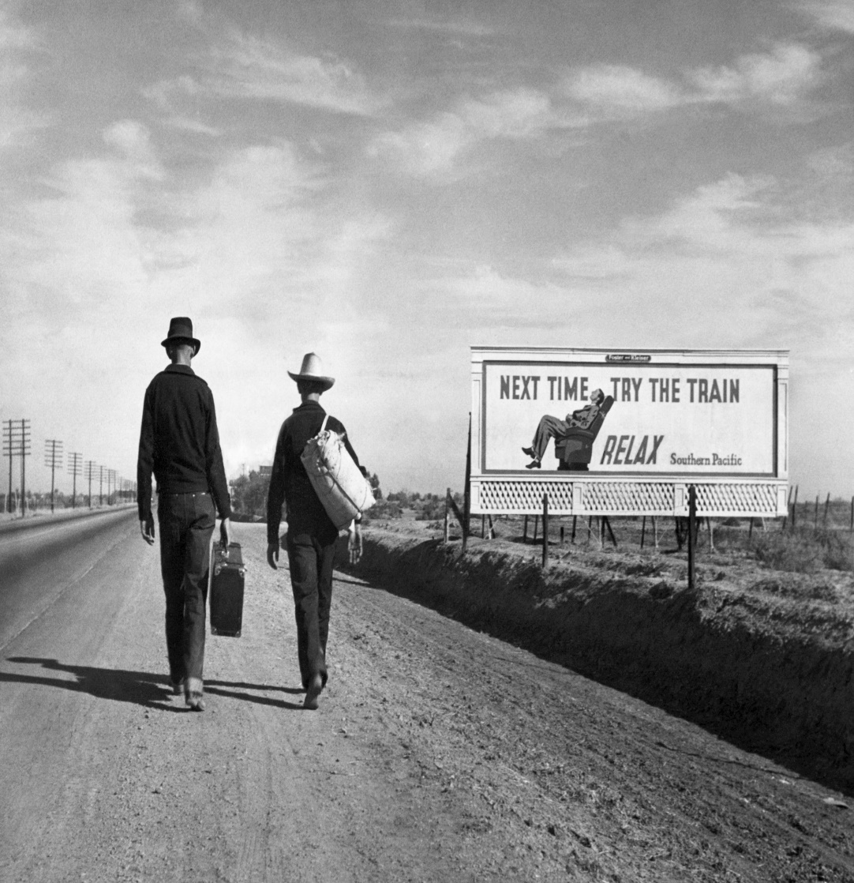
Teaching with images:
Describe who you see in this picture.
Describe the objects in the picture.
Describe the setting of the picture
What clarifying (little) and compelling (big) questions do you have about this picture?
How would you investigate answers to those questions?

Slide 31
Dust Bowl Images
Describe who you see in this picture.
Describe the objects in the picture.
Describe the setting of the picture
What clarifying (little) and compelling (big) questions do you have about this picture?
How would you investigate answers to those questions?
What commonalities exist among these images?
What unique elements do you see?

Slide 32
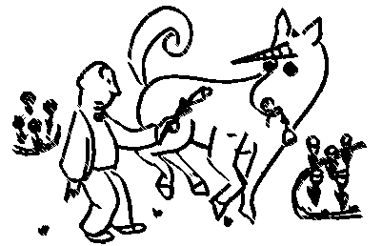
The Unicorn in the Garden
"The unicorn is a mythical beast," she said, and turned her back on him. The man walked slowly downstairs and out into the garden. The unicorn was still there; now he was browsing among the tulips. "Here, unicorn," said the man, and he pulled up a lily and gave it to him. The unicorn ate it gravely. With a high heart, because there was a unicorn in his garden, the man went upstairs and roused his wife again. "The unicorn," he said, "ate a lily." His wife sat up in bed and looked at him coldly. "You are a booby," she said, "and I am going to have you put in the booby-hatch."
The man, who had never liked the words "booby" and "booby-hatch," and who liked them even less on a shining morning when there was a unicorn in the garden, thought for a moment. "We'll see about that," he said. He walked over to the door. "He has a golden horn in the middle of his forehead," he told her. Then he went back to the garden to watch the unicorn; but the unicorn had gone away. The man sat down among the roses and went to sleep.
As soon as the husband had gone out of the house, the wife got up and dressed as fast as she could. She was very excited and there was a gloat in her eye. She telephoned the police and she telephoned a psychiatrist; she told them to hurry to her house and bring a strait-jacket. When the police and the psychiatrist arrived they sat down in chairs and looked at her, with great interest.
"My husband," she said, "saw a unicorn this morning." The police looked at the psychiatrist and the psychiatrist looked at the police. "He told me it ate a lilly," she said. The psychiatrist looked at the police and the police looked at the psychiatrist. "He told me it had a golden horn in the middle of its forehead," she said. At a solemn signal from the psychiatrist, the police leaped from their chairs and seized the wife. They had a hard time subduing her, for she put up a terrific struggle, but they finally subdued her. Just as they got her into the strait-jacket, the husband came back into the house.
"Did you tell your wife you saw a unicorn?" asked the police. "Of course not," said the husband. "The unicorn is a mythical beast." "That's all I wanted to know," said the psychiatrist. "Take her away. I'm sorry, sir, but your wife is as crazy as a jaybird."
So they took her away, cursing and screaming, and shut her up in an institution. The husband smiled, and lived happily ever after.
Once upon a sunny morning a man who sat in a breakfast nook looked up from his scrambled eggs to see a white unicorn with a golden horn quietly cropping the roses in the garden. The man went up to the bedroom where his wife was still asleep and woke her. "There's a unicorn in the garden," he said. "Eating roses." She opened one unfriendly eye and looked at him.
What is the moral of this story?

Slide 33
How might you use this fable or another to teach an anchor concept in your classroom?
Unicorn in the Garden: Anchor Concept:
Historians must be willing to accept ambiguity.
Belling the Cat: Anchor Concept:
Great ideas are not always easily realized
The Crow and the Pitcher: Anchor Concept:
Progress requires creativity, persistence and time.

Slide 34

Education is the most powerful weapon you can use to change the world.
Nelson Mandela
Contact me with questions or ideas any time:
Dixie.Grupe@dese.mo.gov
Check the Social Studies DESE page
Share with your peers
Send me your email to add to our informal Wiggio group.

