Slide 1

Curriculum and Assessment Updates
Chip Sharp
chip.sharp@dese.mo.gov
573-751-1395
Missouri Department of Elementary
and Secondary Education
September 2018

Slide 2
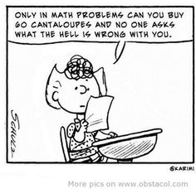
Math Humor?

Slide 3
Lessons Learned during Summer
Number of Questions on the Summative Test
Item Types to highlight

Slide 4
Lessons Learned during Summer
Standard Setting Process (Standard)
  Share Historical Issues and Concerns
  Describe the Process used
  Setting Cut Scores “How much is just enough?”
Basic
Proficient

Slide 5
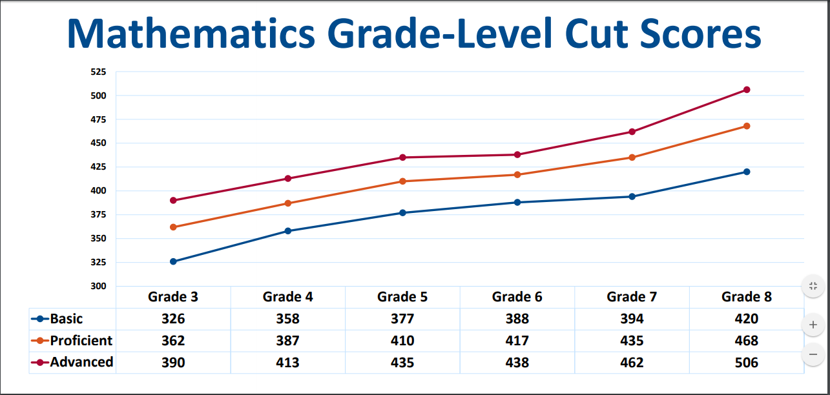
Cut Scores for Grade Level

Slide 6
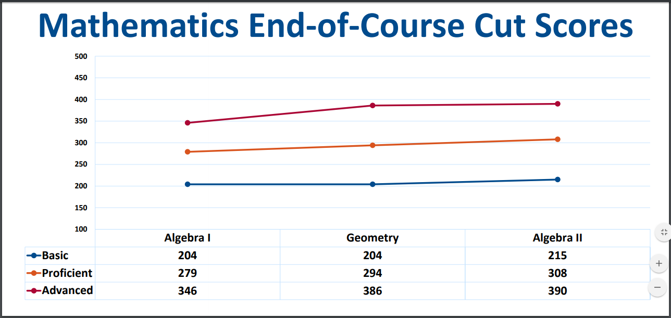
Cut Scores for End Of Course

Slide 7
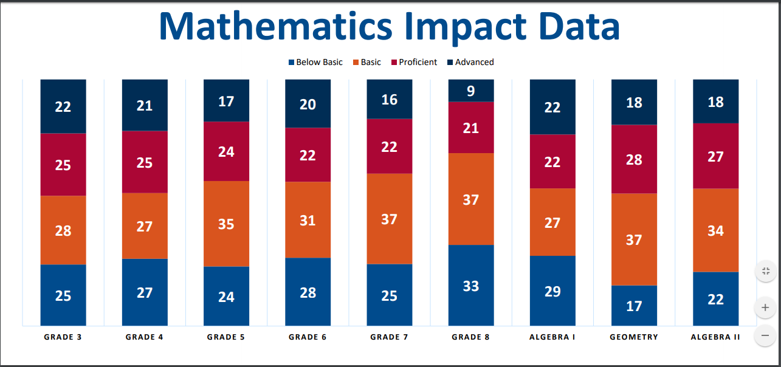
Impact Data of Cut Scores - 2018
These are the cut scores to be used until we redo the MLS per Legislature

Slide 8
Work Continuing to Happen
Item Writing both EOC and GL
CBR for both EOC and GL
July Professional Learning Series
Item Writing Project
chip.sharp@dese.mo.gov

Slide 9
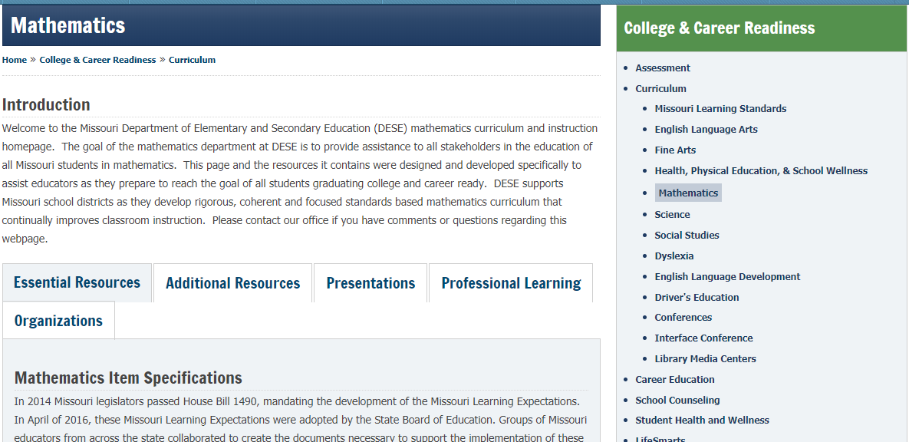
Updated Math Page

Slide 10
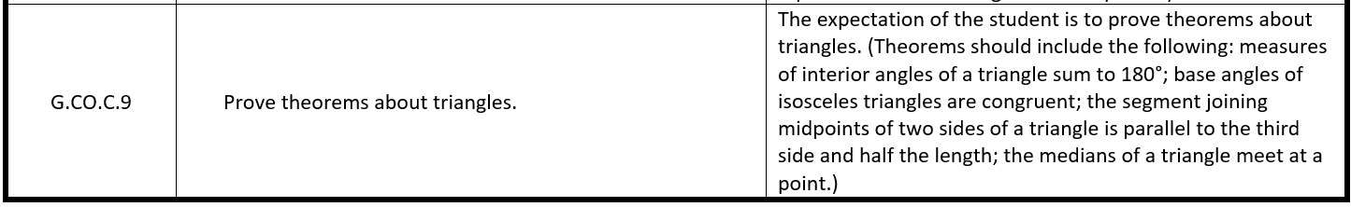
Expanded Expectations

Slide 11
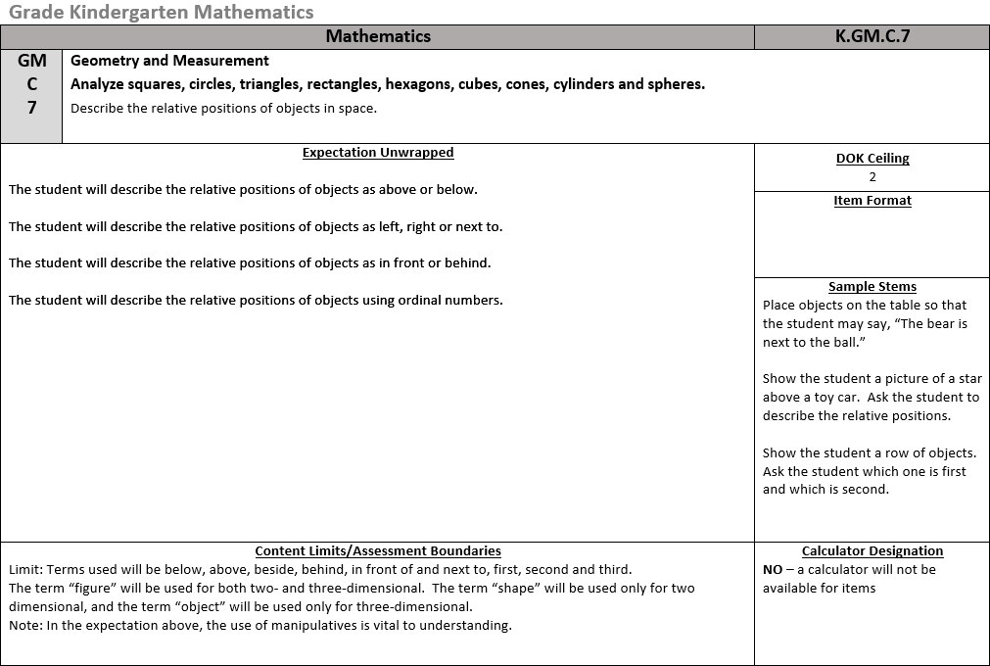
Item Specifications

Slide 12
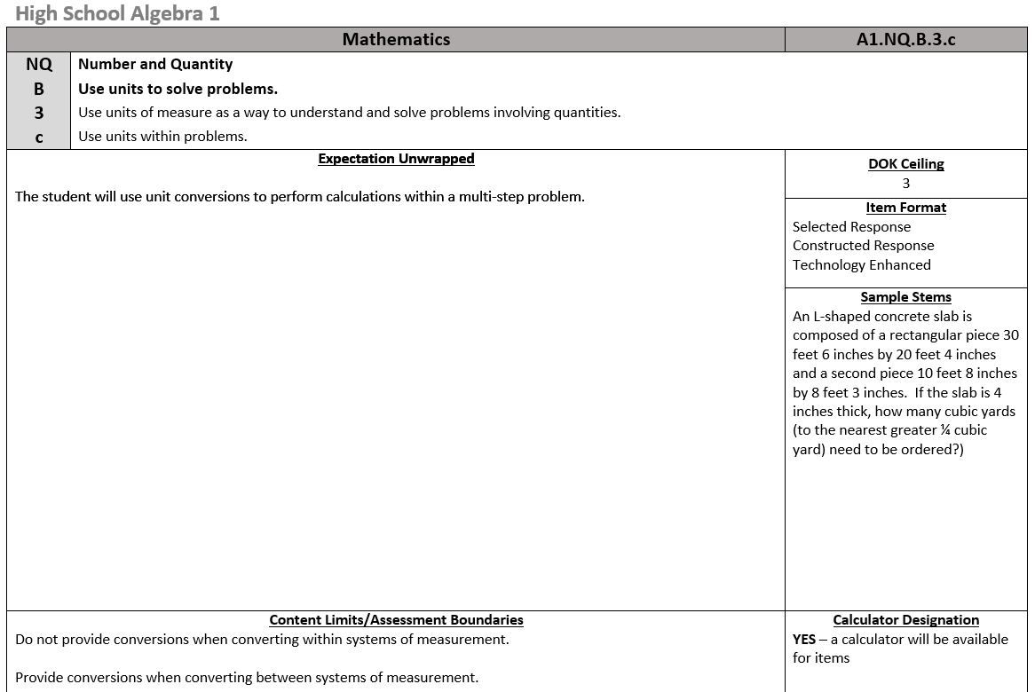
Item Specifications

Slide 13
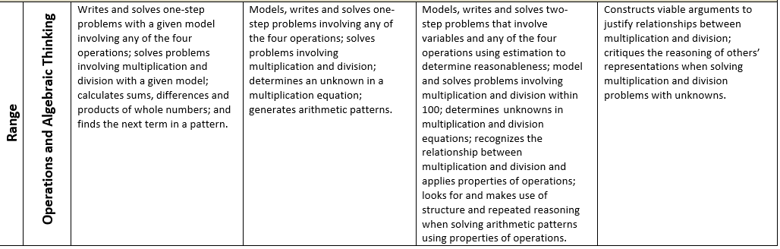
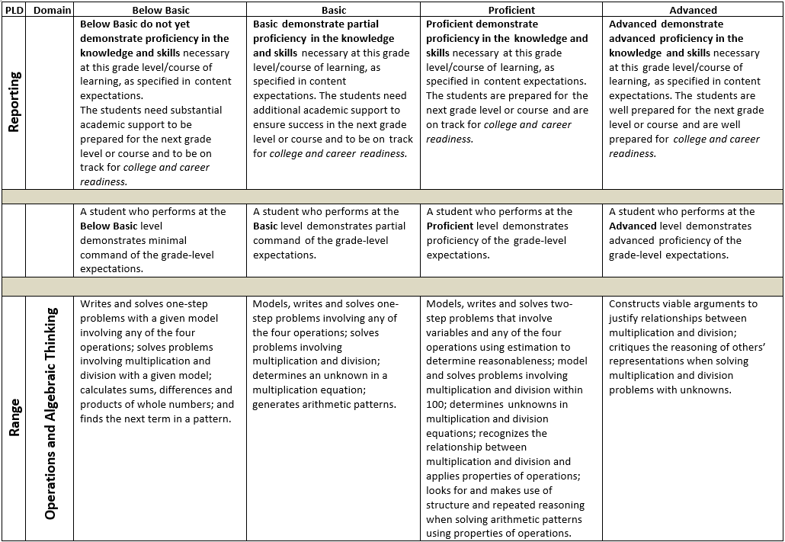
Performance Level Descriptors (PLDs)

Slide 14
Change in Performance Event
Shift in what is coming beginning next year (2019)
What will they look like and when will they be available?

Slide 15
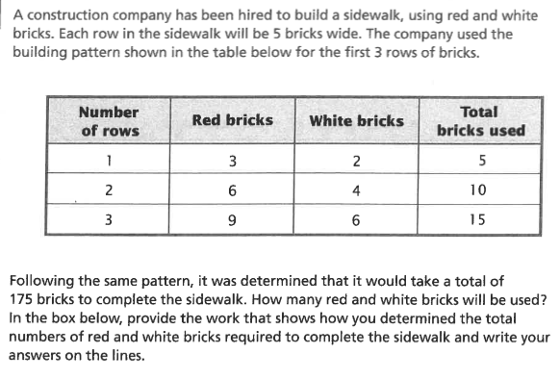
A problem to consider

Slide 16
One of My Favorite Quotes
We don’t have time for _____, we need to teach (cover) all of the standards before MAP test time.
Test prep, district pressure, federal requirements…
I wonder…

Slide 17
Maybe a better question
If you were going to focus on an area, what might you consider using to decide on areas of high importance?

Slide 18
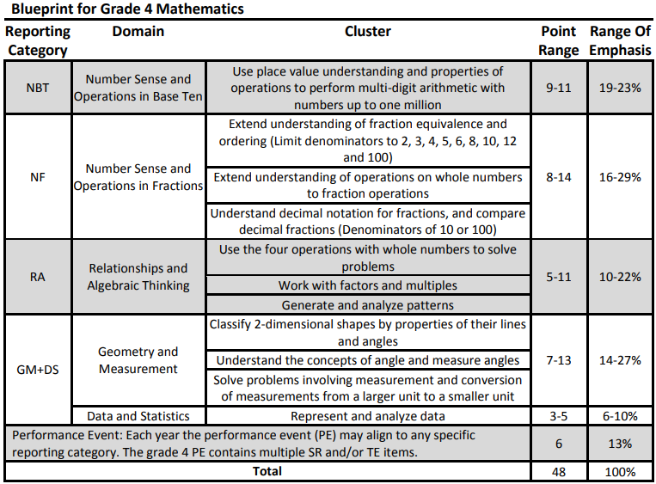
Blueprints

Slide 19
Ideas to consider
Notion of an item being “below basic”, “basic”, “proficient”, or “advanced” (caution with DOK)
Use of resources from DESE to inform practice

Slide 20
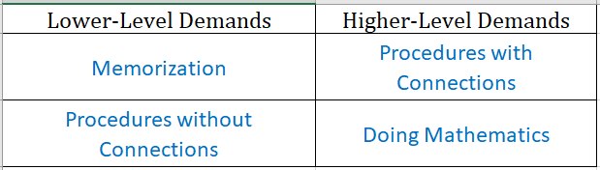
Levels of Cognitive Demand

Slide 21
Practice Form for Spring 2018

Slide 22
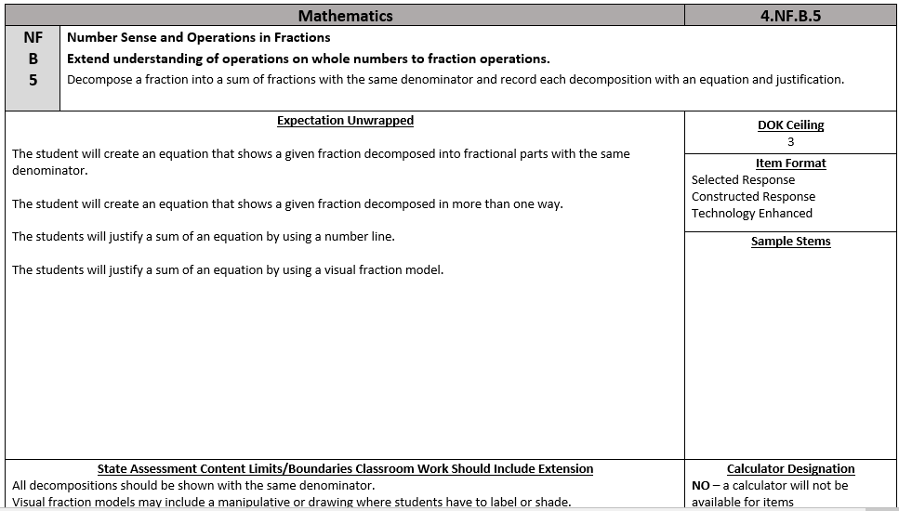
Activity - Item Specifications

Slide 23
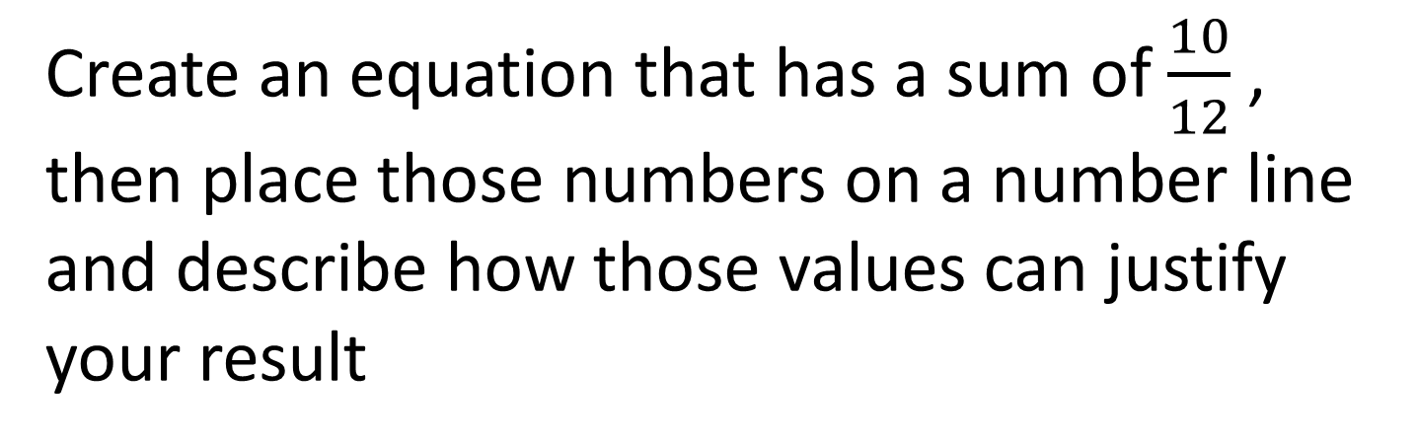
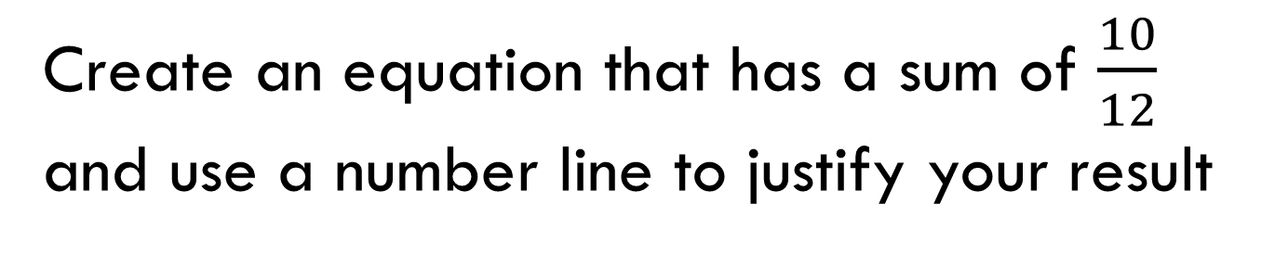
Activity - Item Specifications
Create an equation that has a sum of $\frac{10}{12}$ , then place those numbers on a number line and describe how those values can justify your result
Create an equation that has a sum of $\frac{10}{12}$ and use a number line to justify your result

Slide 24
Mathematics Assessments
Item Types for Math Assessments
  Selected Response
    Multiple Choice, Matching, Multi-Select
  Constructed Response
  Performance Event
  Technology Enhanced
    Drag and Drop, Matching, Graphing
Which are the type of items that create problems for students based on the data?

Slide 25

Assessment Implementation Schedule
22
2016-17 2017-18 2018-19 2019-20
ELA & Math
English Language Arts & Mathematics
Science
Science Field Test
Science
Social Studies
Social Studies Field Test
Social Studies
Personal Finance
Personal Finance
Assessments Aligned to the Previous Expectations
Assessments Aligned to the New Expectations

Slide 26
Assessment Development
Item Writing (Winter 2018)
Rangefinding (Spring 2018)
Content and Bias Review (Summer 2018)
Field Testing (Spring 2019)
Operational (Spring 2018)
Achievement Level Setting (Summer 2018)
Reporting (Fall 2018) Grade 3 through Algebra 2
Item Writing, Content Bias Review and Rangefinding continue into 2018-2019

Slide 27
Building Mathematics Capacity
Promote Mathematics with your Students
Presidential Award for Excellence in Mathematics and Science Teaching (PAEMST)
Elementary Mathematics Specialist (EMS)
Interface
Regional Mathematics Groups
Missouri Council of Teachers of Mathematics (MCTM)
National Council of Teachers of Mathematics (NCTM)
  KC Regional Nov 1-3, 2018
  St Louis Annual Oct 21-24, 2020

Slide 28
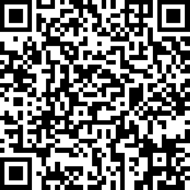
Workshop/Presentation Evaluation
https://www.surveymonkey.com/r/J33C969
Curriculum and Assessment Sections: FY19

Slide 29
Questions?
Chip Sharp
chip.sharp@dese.mo.gov
573-751-1395

Slide 30
Curriculum and Assessment Updates
Chip Sharp
chip.sharp@dese.mo.gov
573-751-1395
Missouri Department of Elementary
and Secondary Education
September 2018

Slide 31
Non-Discrimination Statement
The Department of Elementary and Secondary Education does not discriminate on the basis of race, color, religion, gender, gender identity, sexual orientation, national origin, age, veteran status, mental or physical disability, or any other basis prohibited by statute in its programs and activities. Inquiries related to department programs and to the location of services, activities, and facilities that are accessible by persons with disabilities may be directed to the Jefferson State Office Building, Director of Civil Rights Compliance and MOA Coordinator (Title VI/Title VII/Title IX/504/ADA/ADAAA/Age Act/GINA/USDA Title VI), 5th Floor, 205 Jefferson Street, P.O. Box 480, Jefferson City, MO 65102-0480; telephone number 573-526-4757 or TTY 800-735-2966; email civilrights@dese.mo.gov

