Slide 1

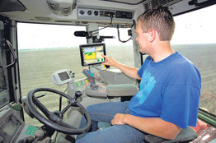
DESE
Update
Dr. Blaine Henningsen
Assistant Commissioner
Office of College and Career Readiness
May 18, 2020

Slide 2
State Board of Education

Slide 3
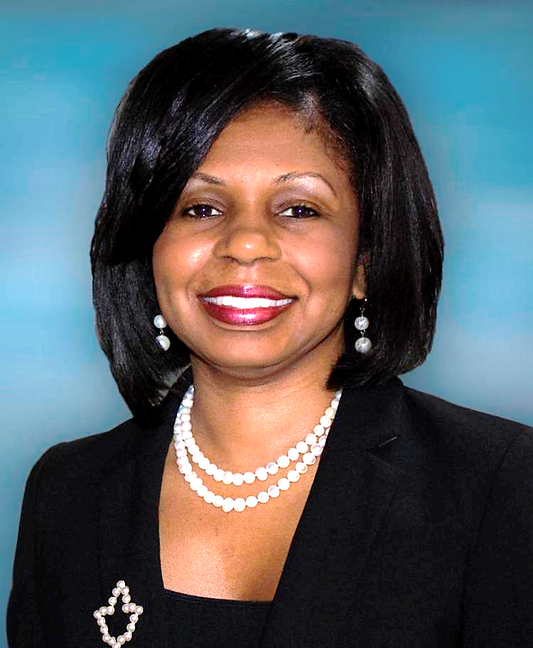
New State Board Member
Pamela Westbrooks-Hodge appointed by Governor Mike Parson
  Board member of the Normandy Schools Collaborative
  Head of Information Systems Audit at Edward Jones Investments
  Formerly held roles in senior governance, risk and compliance for Express Scripts, Anheuser-Busch and Bank of America.
  BS Degree in Finance from NWMSU
  MBA from UMSL

Slide 4
New DESE Staff 7/1/20

Slide 5
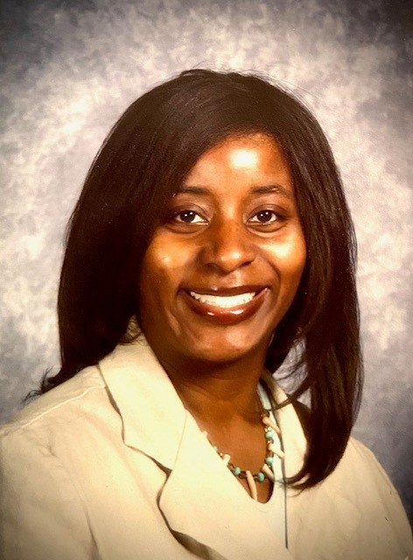
New Deputy Commissioner for Learning Services
Dr. Tracy Hinds – University City Schools
  ELA and Social Studies Coordinator at UCity since 2016
  National Board Certified Teacher
  BS Psychology – DePauw University
  MS Special Education – Fontbonne University
  Specialist Ed Admin – UMSL
  EdD Ed Leadership – UMSL
  Former Special Education teacher in SLPS
  Reading Specialist and facilitated new teacher induction in the Hazelwood School District

Slide 6
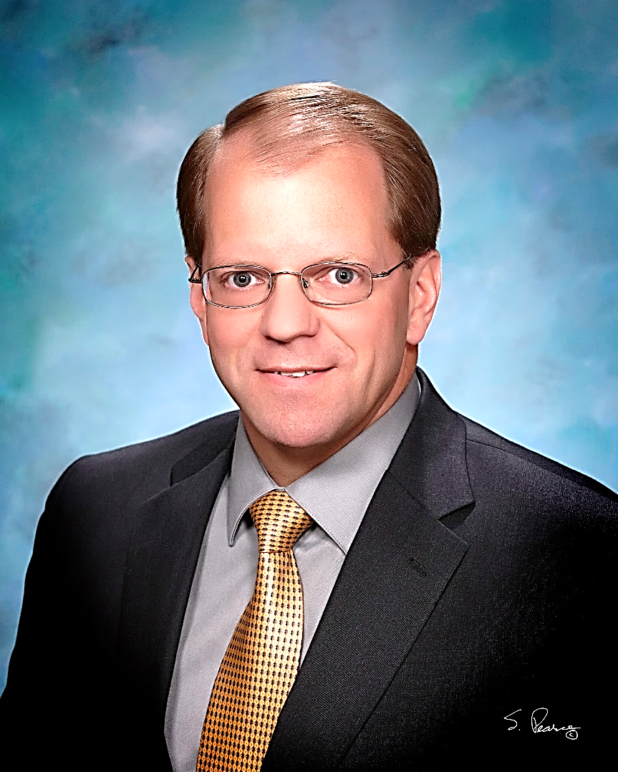
New Deputy Commissioner for Finance
Dr. Kari Monsees – Ray-Pec Superintendent
  Begins June 30, 2020
  Replaces Dr. Roger Dorson
  BS Ed – UCM
  MS Ed Secondary Admin – UCM
  Specialist Ed District Admin – UCM
  EdD Ed Leadership – UMC
  Former CFO in Wentzville School District
  Other experience in:
    Warrensburg, Moniteau County R-1, and Smithton

Slide 7
DESE Priorities - Spring 2020

Slide 8
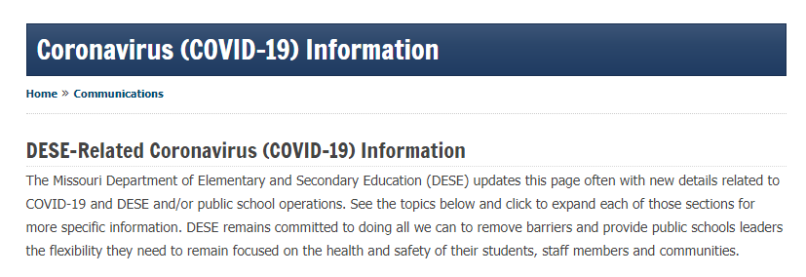
Spring 2020
  https://dese.mo.gov/communications/coronavirus-covid-19-information

Slide 9
Coronavirus (COVID-19) Response
  Canceling Assessments / Obtaining Waivers
  School Buildings Closed
  Taking Care of Students / Parents
    Food Insecurity
    Connectivity
    Social Emotional Support

Slide 10
Coronavirus (COVID-19) Response
  Educating Students
    CTE Supports for Remote Teaching and Learning
    Waiving Accountability Assessments
    Guidance for IRCs and TSAs
    CTSOs
    Recognizing Seniors
    Identifying Learning Loss / Guidance for Acceleration of Recovery

Slide 11
Coronavirus (COVID-19) Response
  Summer Conferences and Trainings
    MOACTE/MCCTA Conference
    CTE Advisory Council Meeting at OTC
    DESE Administrators Conference
    New Teacher Institute
    New Counselor Institute
    CTSOs

Slide 12
Coronavirus (COVID-19) Response
  Summer School
  Re-Entry in Fall
    Start Date
    Social Distancing
      Buses
      Cafeterias
      Classrooms
      Etc.

Slide 13
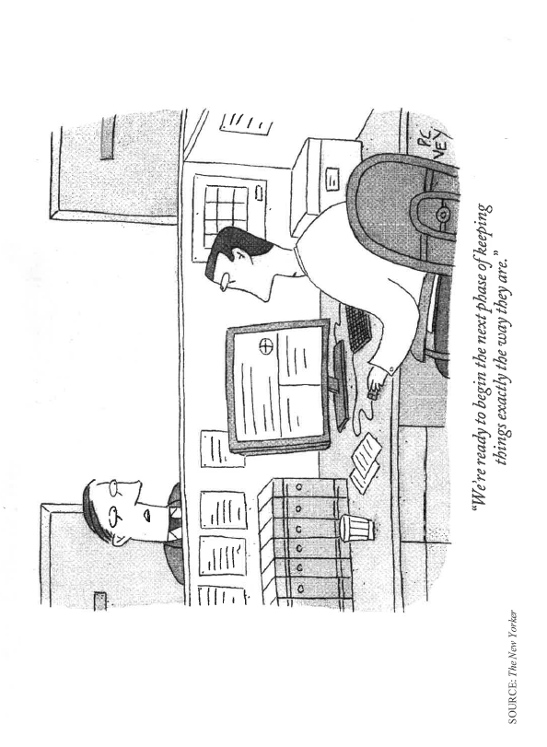
What’s Next?
  We have an

Slide 14
What’s Next?
  “In the middle of difficulty lies opportunity.”
  Albert Einstein

