Slide 1

New Director Boot Camp
Hollie Sheller
Office of College and Career Readiness
February 2021
Notes:
Thank you for being here with us today. My name is Hollie Sheller and I work for the Office of College and Career Readiness. Today I’m going to go over a variety of topics related to Career and Technical Education.

Slide 2
Agenda
Core Data/MOSIS
Layouts, Rules and Excel Templates
Code Sets
Precode Timelines
Data Access and Use Policy
Core Data/MOSIS Manual
User Manager/Login Request Forms
Deadline Calendar Data and Other Important Dates
Perkins Act
Comprehensive Local Needs Assessment
Help Documents
Core Indicators of Performance
Program Management, Accountability & Finance
MCDS Portal
Notes:
I will be presenting information on the following topics. There is a lot of information so I will take it slow.

Slide 3
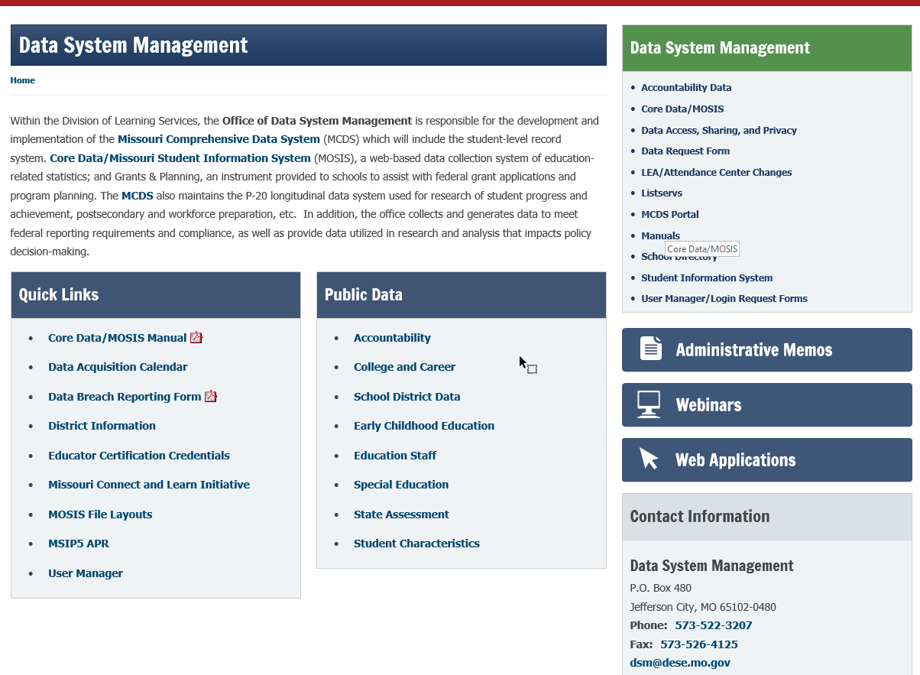
Core Data/MOSIS
Office of Data System Management
https://dese.mo.gov/data-system-management/core-datamosis
Notes:
The Office of Data System Management is responsible for the development and implementation of the Missouri Comprehensive Data System (MCDS). Core Data/Missouri Student Information System (MOSIS), a web-based data collection system of education-related statistics. An instrument provided to schools to assist with federal grant applications and program planning.
The link provided on this slide will take you to the screen as shown. There are many quick links from which to choose that will provide more information. If you select Core Data/MOSIS, the link with the red arrow pointing toward it then you receive some information on how to enter data for your district/students/teachers.

Slide 4
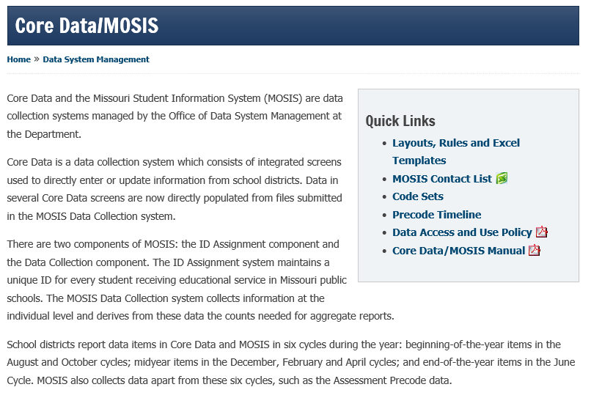
Notes:
This webpage provides quick links such as layouts, rules and Excel templates, Code Sets, and the Core Data/MOSIS Manual to name a few. These are helpful documents that allow proper data entry for your district submissions for each cycle.

Slide 5
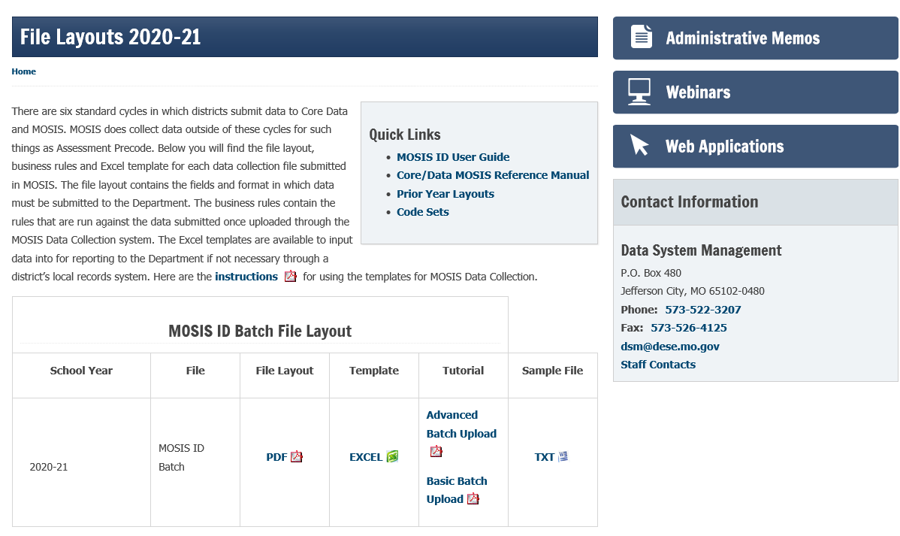
Layouts, Rules and Excel Templates
Notes:
The File Layouts webpage provides information for each cycle of the year. We collect specific information each cycle.

Slide 6
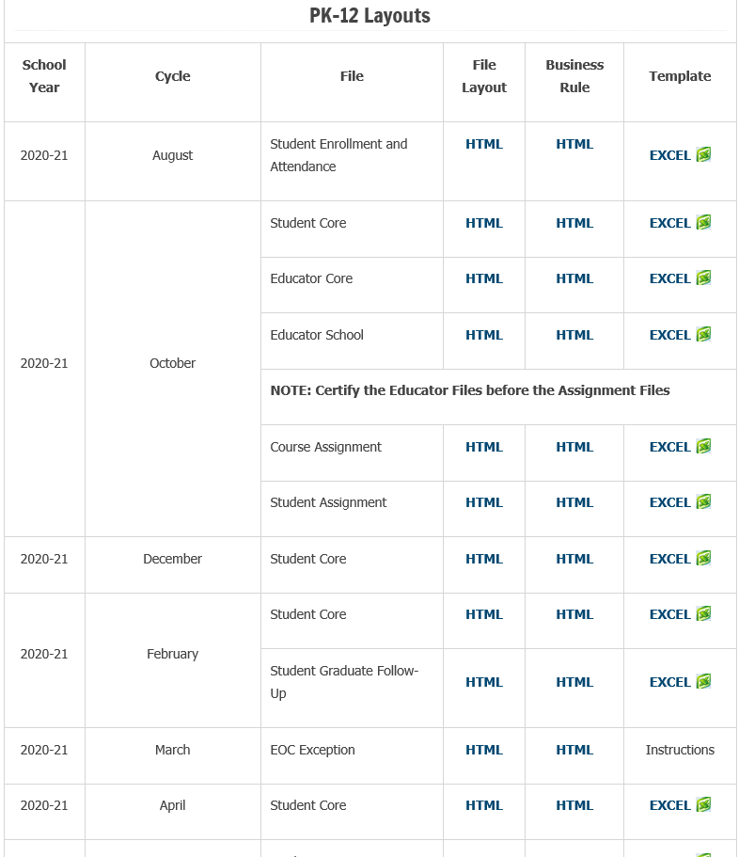
Notes:
As you scroll down the page you’ll see various cycle names and the file name. Since we are currently in the February Cycle lets select the Student Graduate Follow-Up file layout.

Slide 7
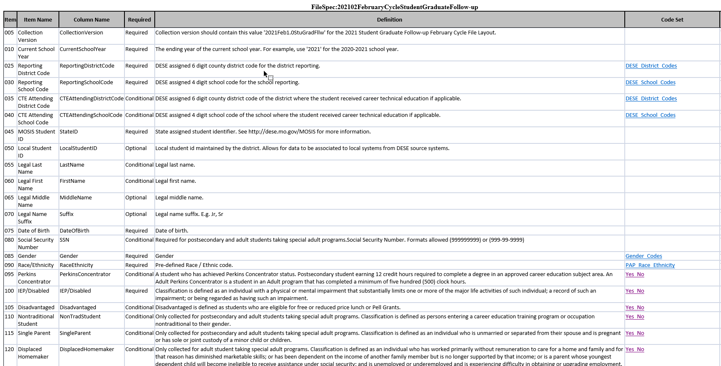
Layouts, Rules and Excel Templates
Notes:
The layout provides the fields that are necessary to complete in the submission as well as a description of the data being collected.

Slide 8
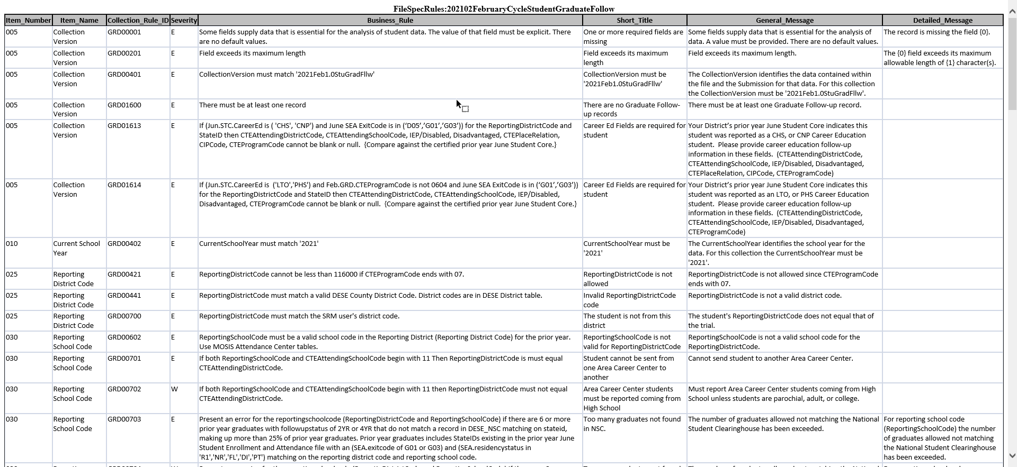
Layouts, Rules and Excel Templates
Notes:
The rules provide a description of the error codes you might receive if data is not properly entered into each cycle. The description provides information on how to fix the error so you may certify your submission.

Slide 9
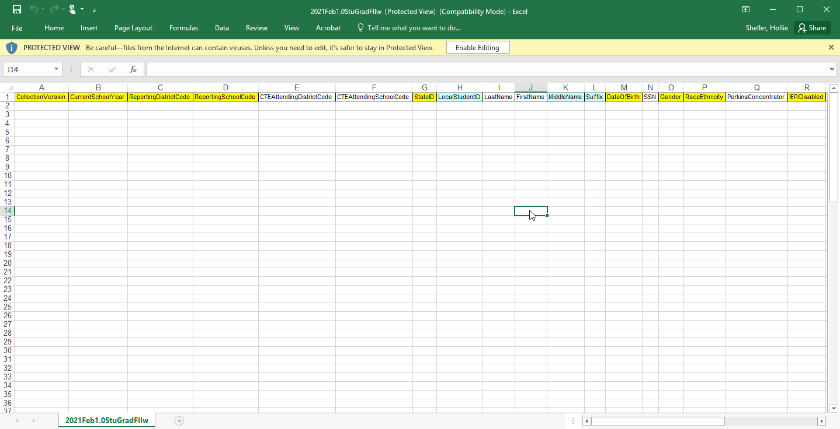
Layouts, Rules and Excel Templates
Notes:
The Excel template may be used to enter the student’s information.

Slide 10
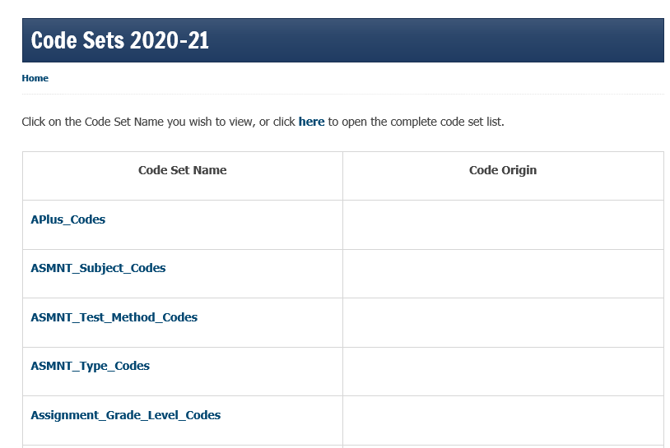
Code Sets
Notes:
Code Sets are specific to each field of data entry. The code set allows you to choose the proper code to enter in a field and may provide a brief description or definition of what the code means.

Slide 11
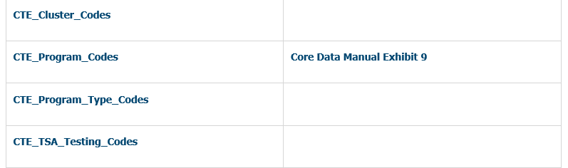
Code Sets
Notes:
For example, if we select CTE_Program_Codes

Slide 12
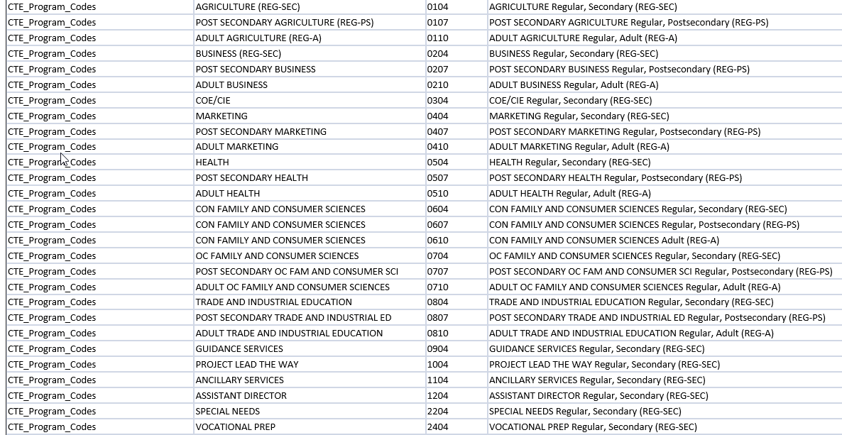
Code Sets
Notes:
These are the CTE_Program_Codes that are available to enter in that data field.

Slide 13
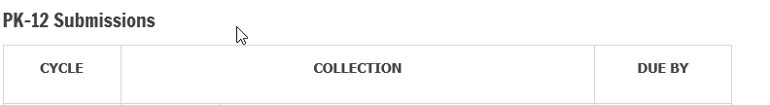
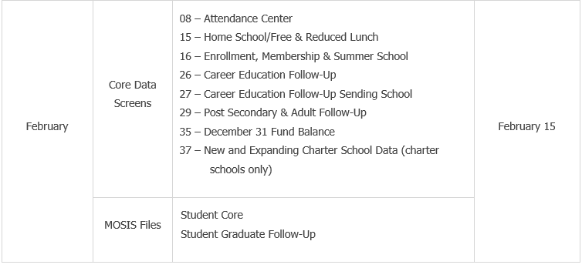
Precode Timeline
Notes:
The precode timeline provides the cycle name, the collection and the due date in which the submission is due. The screen shot I’ve provided on this slide is for February cycle that is due February 15, 2021. You can see there are Core Data Screens and MOSIS files that are due during this submission.

Slide 14
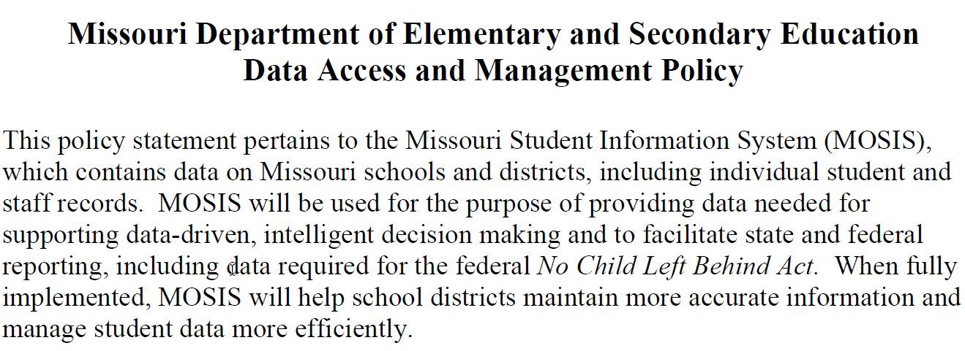
Data Access and Use Policy
https://dese.mo.gov/sites/default/files/MODataAccessandUsePolicy.pdf
Notes:
This policy statement pertains to the Missouri Student Information System (MOSIS), which contains data on Missouri schools and districts, including individual student and staff records. MOSIS will be used for the purpose of providing data needed for supporting data-driven, intelligent decision making and to facilitate state and federal reporting, including data required for the federal No Child Left Behind Act. MOSIS will help school districts maintain more accurate information and manage student data more efficiently.

Slide 15
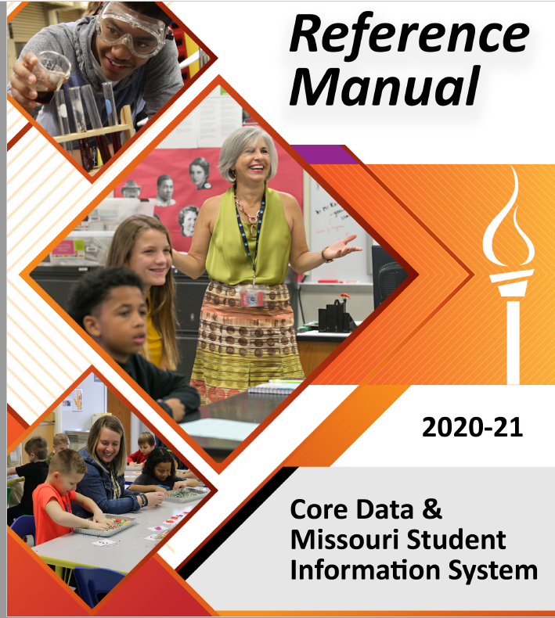
Core Data/MOSIS Manual
https://dese.mo.gov/sites/default/files/CD-MOSIS-Manual.pdf
Notes:
The Core Data/MOSIS Manual reviews the data collection cycles throughout the year as well as exhibits that provide information for each cycle. This information includes racial/ethnic categories, position codes/descriptions, course code and certificate required, and program code just to name a few. This is a helpful document when completing the necessary submissions throughout the year.

Slide 16
User Manager/Login Request Forms
https://dese.mo.gov/data-system-management/user-managerlogin-request-forms
Notes:
The User Manager and Login Request forms are necessary for your district to complete data entry and to view reports. Each district has an assigned user manager that can add/delete/modify users or user roles.

Slide 17
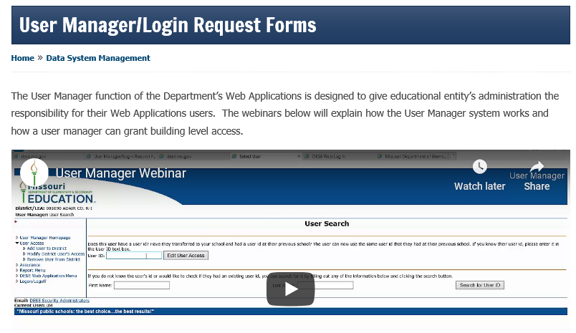
User Manager/Login Request Forms
Notes:
Once you’ve clicked on the link provided in the previous slide it’ll take you to the webpage for User Manager/Login Request Forms.

Slide 18
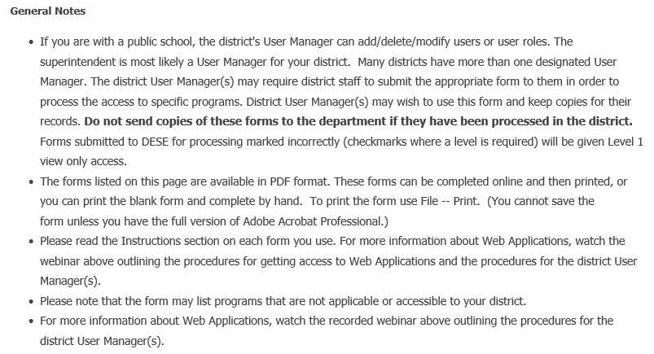
User Manager/Login Request Forms
Notes:
As you scroll through the webpage you’ll notice many notes about the use and purpose of User Manager and links to the appropriate forms to request access or delete access to the Web Applications system.

Slide 19
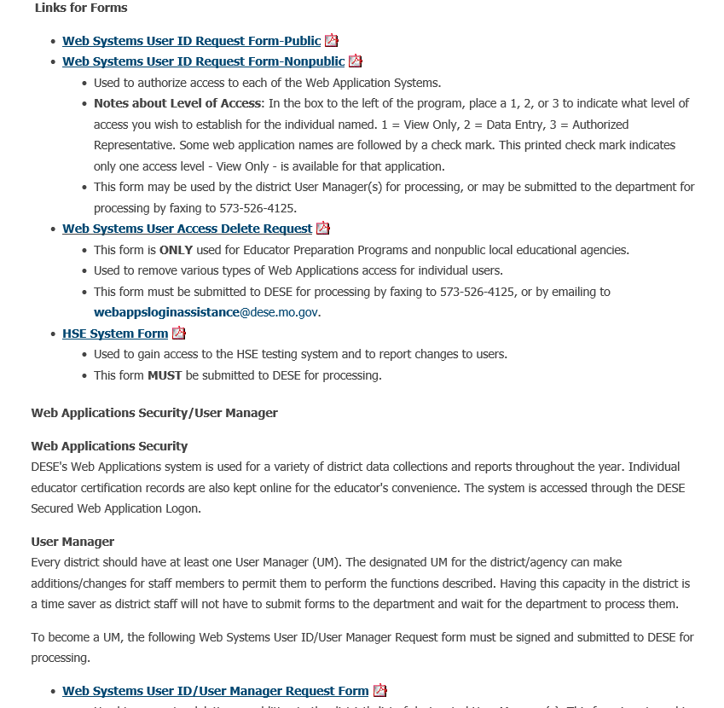
User Manager/Login Request Forms
Notes:
These are some of the forms that are available to request access to Web Applications.

Slide 20
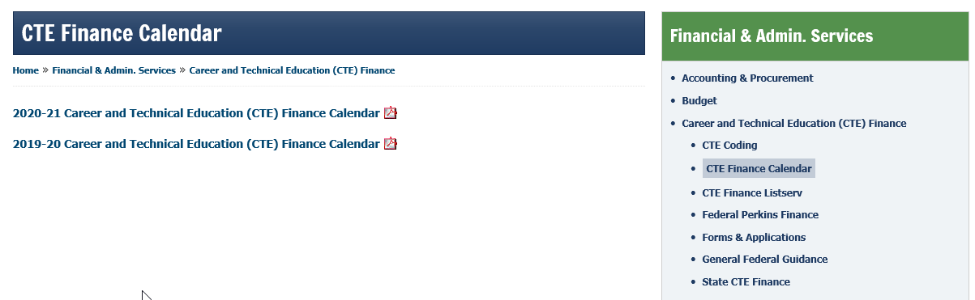
Deadline Calendar Data
https://dese.mo.gov/financial-admin-services/career-and-technical-education-cte-finance/cte-finance-calendar
Notes:
The CTE Finance Calendar provides a list of items such as a grant or application that may be due, the grant year which is it due and the system in which to submit the information.

Slide 21
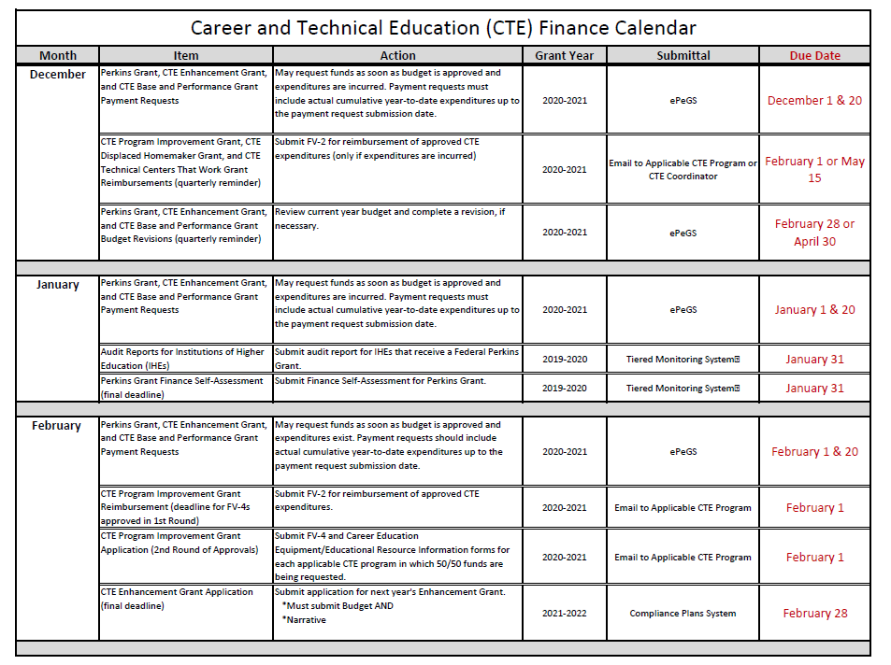
Deadline Calendar Data
Notes:
The CTE Finance Calendar provides a list of items such as a grant or application that may be due, the grant year which is it due and the system in which to submit the information.

Slide 22
Other Important Dates
February 15, 2021
Student Graduate Follow-Up
March 31, 2021
PS/Adult Course Assignment
June 30, 2021
June Student Core and Attendance
June Student Course Completion
June Career Technical Student Organizations (CTSO)
FY2020 Postsecondary/Adult Perkins Core Data
Notes:
The other important dates listed here are related to Core Data/MOSIS reporting and for Perkins reporting. The CTE Certificate will be collected in the June Student Core this year.
Meet all graduation requirements
Qualify as a CTE concentrator
Maintain a 3.0 grade-point average (on a 4.0 scale) in the CTE area of concentration
Pass an approved Technical Skills Assessment and/or earn an approved Industry Recognized Credential or Certificate
Complete at least 50 hours of work-based learning aligned with the CTE area of concentration
Maintain at least a 95 percent attendance record overall for grades 9-12
Demonstrate soft skills/business skills
Achieve a score at or above the state standard on any DESE-approved measure of college and career readiness

Slide 23
Perkins
Comprehensive Local Needs Assessment (CLNA)
Required Every Two Years – Most likely will be conducted in the Fall 2021
CLNA is an opportunity to:
Create programs to ensure access/success for students
Ensure Programs of Study are aligned to workforce needs and economic priorities
Set strategic short- and long-term goals and priorities
Regularly engage in conversation with stakeholders
Notes:
The Comprehensive Local Needs Assessment is one of the most significant changes in Perkins V. The is the foundation for your annual grant application and all uses of Perkins funds must be aligned to the CLNA. The intent is for schools to take an in-depth look at their CTE data and identify areas where improvements can lead to student success.

Slide 24
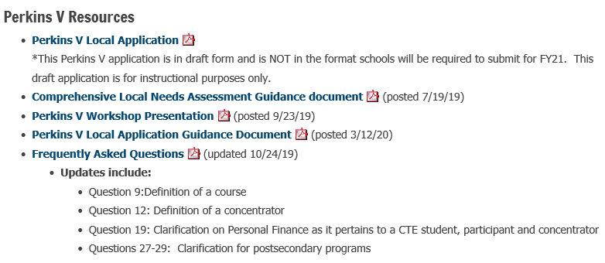
Perkins
Comprehensive Local Needs Assessment (CLNA)
Perkins V Resources: https://dese.mo.gov/college-career-readiness/career-education/perkins-act
Notes:
The link provided on this slide will direct you to a variety of resources for Perkins V including the guidance document for the Comprehensive Local Needs Assessment, the PP presentation for the Perkins V Workshop that Janice and I provided in the fall of 2019 and a frequently asked questions document. I encourage you to review these documents before starting the comprehensive local needs assessment.

Slide 25
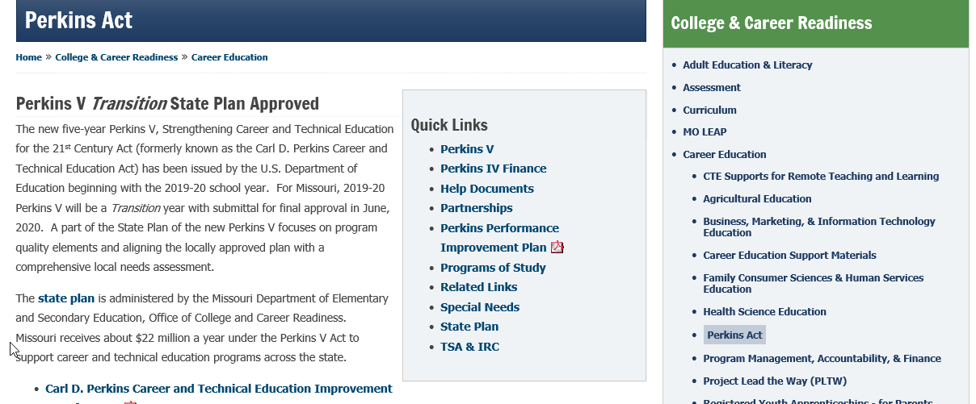
Perkins
Notes:
On the Perkins Act webpage you’ll find several quick links that provide information such as Perkins V, the help documents and the State plan.

Slide 26
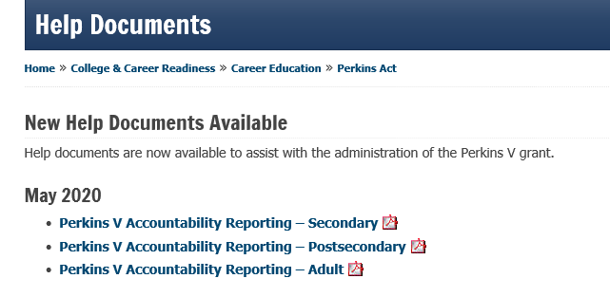
Help Documents
https://dese.mo.gov/college-career-readiness/career-education/perkins-act/help-documents
Notes:
When you select Help Documents you’ll be able to review Perkins V Accountability Reporting PDF that provides information on each of the core indicators of performance and provides a variety of definitions. The core indicator of performance are used and provided in reports on the MCDS portal. The documents for 2021 will be available in May.

Slide 27
Core Indicators of Performance Secondary
1S1 – Four Year Graduation Rate
2S1 – Academic Proficiency in Reading/Language Arts
2S2 – Academic Proficiency in Mathematics
2S3 – Academic Proficiency in Science
3S1 – Post-Program Placement
4S1 – Nontraditional Program Concentration
5S1 – Program Quality – Attained Recognized Postsecondary Credential
Notes:
These are the Core Indicators of Performance for Secondary. We are looking at four year graduation rate, academic proficiency in reading/language arts, mathematics and science, post program placement, non traditional program concentration and program quality – attained recognized postsecondary credential. The formulas for calculating these indicators are included in the help documents for secondary.

Slide 28
Core Indicators of Performance Adult
1A1 – Post-Program Retention and Placement
2A1 – Earned Recognized Postsecondary Credential
3A1 – Non-Traditional Program Concentration
Notes:
These are the Core Indicators of Performance for Adults. Post program retention and placement, earned recognized postsecondary credential and non traditional program concentration. The formulas for calculating these indicators are included in the help documents for adults.

Slide 29
Core Indicators of Performance Postsecondary
1P1 – Post-Program Retention and Placement
2P1 – Earned Recognized Postsecondary Credential
3P1 – Non-Traditional Program Concentration
Notes:
These are the Core Indicators of Performance for postsecondary. Post program retention and placement, earned recognized postsecondary credential and non traditional program concentration. The formulas for calculating these indicators are included in the help documents for postsecondary.

Slide 30
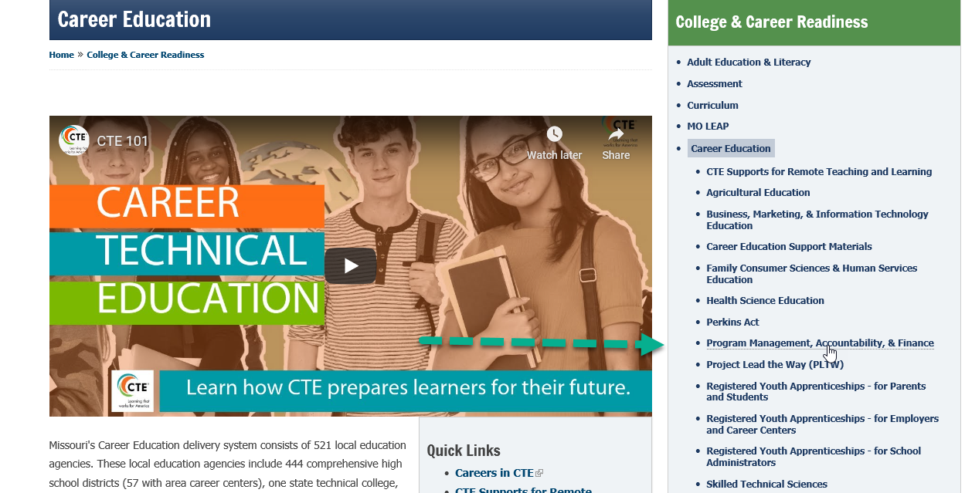
Program Management, Accountability & Finance
https://dese.mo.gov/college-career-readiness/career-education
Notes:
If we go back to the main page for College and Career Education and selection Program Management, Accountability and Finance. We’ll be able to review additional information for CTE.

Slide 31
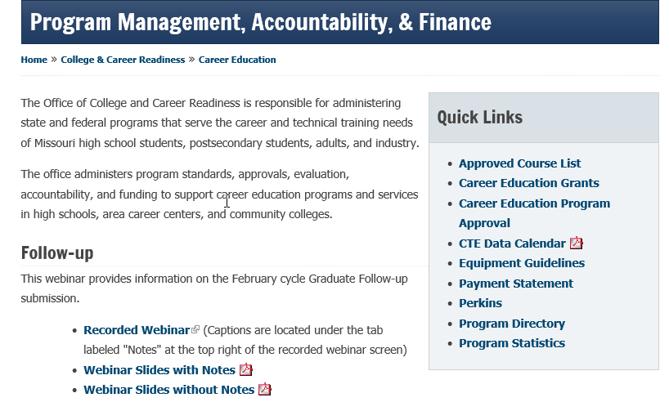
Program Management, Accountability & Finance
Approved Course List
Career Education Program Approval
Program Directory
Notes:
Under quick links you’ll be able to see the approved course list for your district for each year, as well as the process for Career Education Program Approval and the Program Directory for area career centers, community colleges and universities.

Slide 32
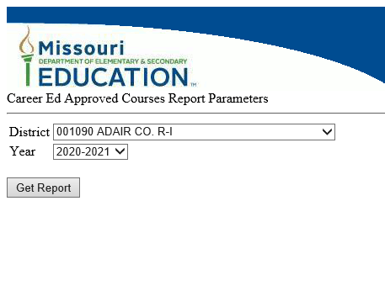
Program Management, Accountability & Finance
Approved Course List
Select District and Year
Select Get Report
Notes:
This is a screen shot of the what the approved course list looks like. At this time you would select the district and year of the report you would like to review and click on get report.

Slide 33
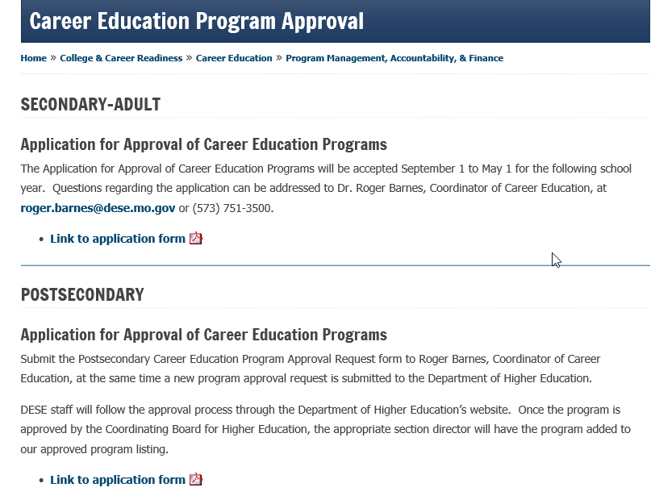
Career Education Program Approval
Notes:
If you want approval for a Career and Technical Education Program then follow the steps listed in the application form provided on the webpage.

Slide 34
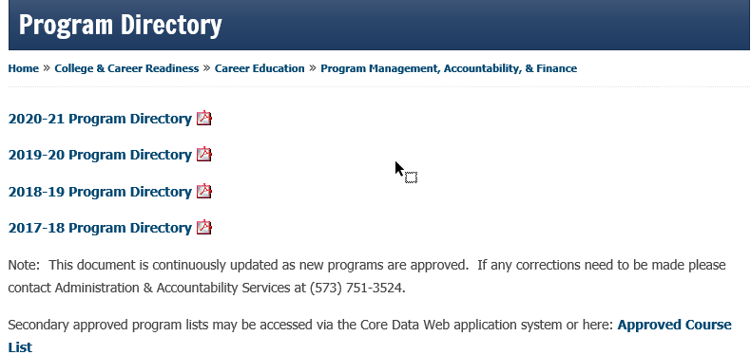
Program Directory
Notes:
The program directory shown here provides a list of approved CTE programs for Postsecondary and Adult programs. This list is updated continuously as new programs are approved.

Slide 35
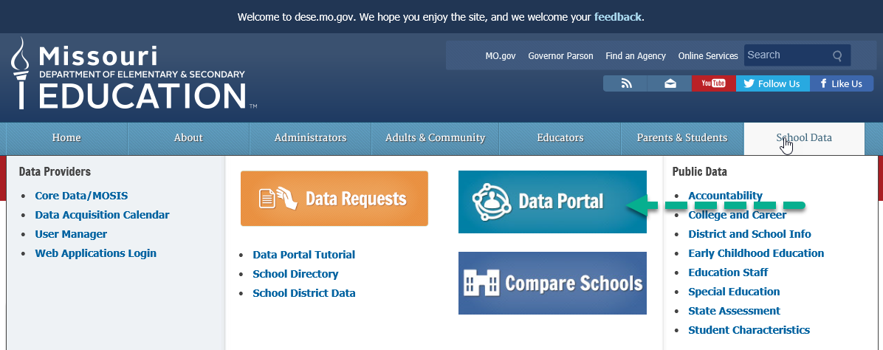
MCDS Portal
https://dese.mo.gov/
Notes:
You’ll be reviewing a variety of reports on the MCDS Portal to complete your comprehensive local needs assessment and reviewing how your CTE programs are doing on the core indicators of performance. You’ll want to be familiar with how to access those reports on the MCDS Portal. To get to the MCDS Portal you’ll want to hover over School Data, Select Data Portal

Slide 36
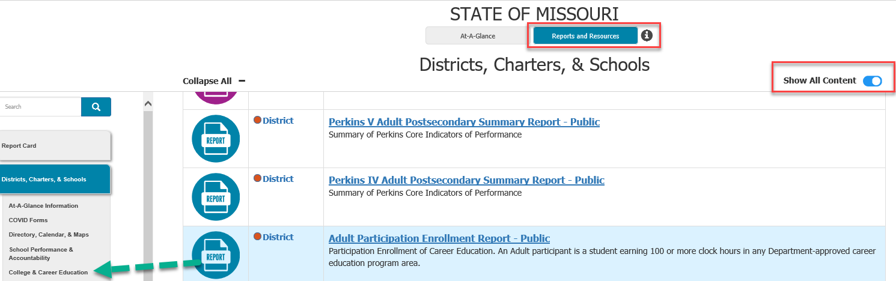
MCDS Portal
Notes:
You’ll come to the main screen and select Reports and Resources, Show All Content, and select College & Career Education.

Slide 37
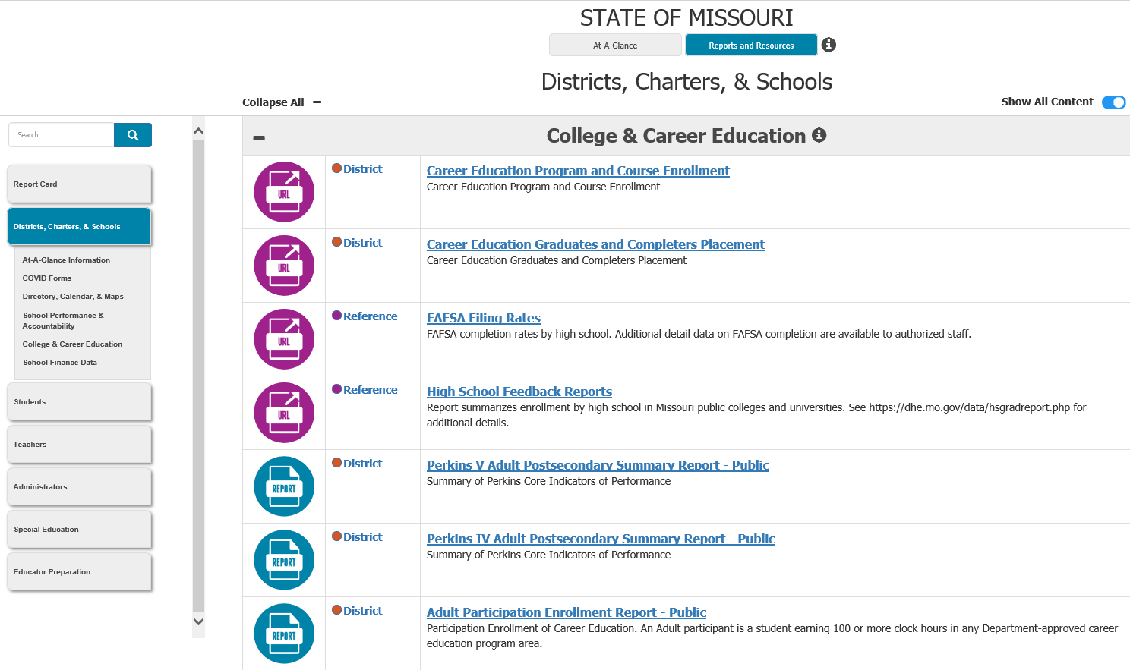
MCDS Portal
Notes:
From there you’ll see a full list of reports. They include historical Perkins IV reports and our new Perkins V reports.

Slide 38
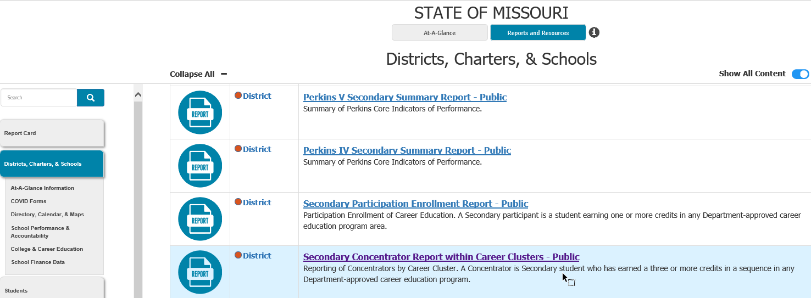
MCDS Portal
Notes:
If we select the Secondary Concentrator Report within Career Clusters you’ll be able to see how many concentrators you have in each career cluster and some characteristics about those students at an aggregate level.

Slide 39
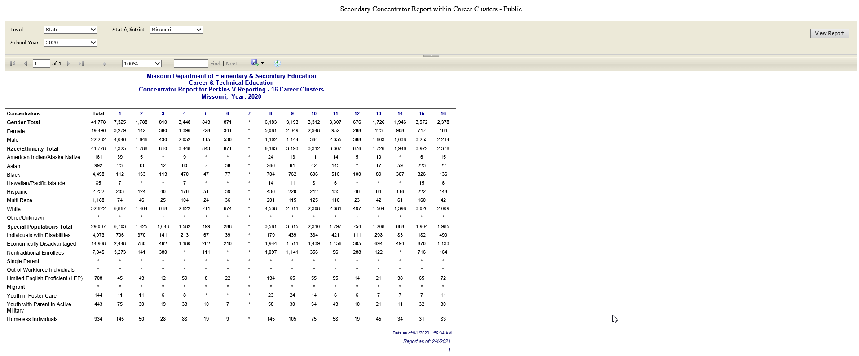
MCDS Portal
Notes:
I’ve chosen the State level, for school year 2020 and the State is Missouri since we’re looking at the State level. If you choose to look at the district level then the State/District would be the district you want to view. These characteristics include gender, race/ethnicity and special populations.

Slide 40
Questions
Thank you!
Contact Information
Hollie Sheller
Hollie.Sheller@dese.mo.gov
573-751-3524

