Slide 1

Providing Evidence of Impact
The Missouri Comprehensive School Counseling Framework
Version 2017
Notes:
Providing evidence of impact through the Missouri Comprehensive School Counseling Framework.

Slide 2
School Counseling History
Then: | “What is a School Counselor?”
Now: | “How are students different because of the school counseling program?”
From: ASCA, schoolcounselor.org, School Counselor Accountability Presentation: Ann F. Cole, Ph.D, Grant Facilitator, Safe and Drug Free Schools, Lee County, FL; Geri McArdle, Ph.D, Associate Professor, Barry Univ.; Madelyn Issacs, Ph.D, Florida Gulf Coast University.
Notes:
Modern-day school counseling has evolved over time, and school counselors today are required to answer very different questions compared to the time when school counseling first began.
In the beginning, the school counseling program was evaluated by task. The answer to the question, “What is a School Counselor?” helped define the counselor role within a school setting. If a school counselor performed his designated job responsibilities, it was assumed he was doing his job.
CLICK
In present day, the success of the school counseling program is determined through task effectiveness. Relevant school data can be used to determine the impact of the program on student outcomes, and thus the question, “How are students different because of the school counseling program?” can be answered.

Slide 3

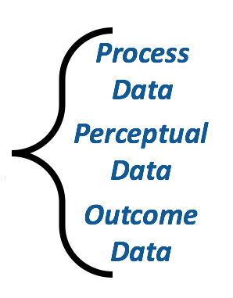



Norman C. Gysbers & Patricia Henderson, “Comprehensive Guidance & Program Evaluation: Program + Personnel = Results, www.counseling.org
Notes:
Program + Personnel = Results is an equation for evaluation first developed by Dr. Norm Gysbers and Patricia Henderson
CLICK
Program consists of the philosophy, mission, vision, structure & procedures
CLICK
Personnel are those highly qualified to carryout the program
CLICK
Results are created when the personnel and program come together.
CLICK
School counselors can show evidence of impact through process, perceptual and outcome data.
When we evaluate the implementation of the program, and the effectiveness of the personnel, we can determine the overall program results and provide evidence of impact.

Slide 4
Evidence of Impact
1.
  To what extent is the school counseling program in place and being implemented?
2.
  Is the program being managed and conducted with fully certified and capable school counseling personnel?
3.
  Is there a plan or system in place to use relevant student data to determine program impact on student outcomes?
Notes:
There are three Questions that help provide Evidence of Impact of School Counseling on Student Outcomes
The first question asked is: To what extent is the school counseling program in place and being implemented ?
The second question asks Is the program being managed and conducted with fully certified and capable school counseling personnel?
And the 3rd ---Is there a plan or system in place to use relevant student data to determine program impact on student outcomes?
During the presentation, we will refer back to these questions as they relate to each component of the equation.

Slide 5
PROGRAM Evaluation
program + personnel = results
Notes:
The first part of providing evidence of impact is program evaluation.

Slide 6
Evidence of Impact
1.
  To what extent is the school counseling program in place and being implemented?
2.
  Is the program being managed and conducted with fully certified and capable school counseling personnel?
3.
  Is there a plan or system in place to use relevant student data to determine program impact on student outcomes?
Notes:
The question asked here to help illustrate Evidence of Impact of School Counseling on Student Outcomes is….
CLICK
To what extent is the school counseling program in place and being implemented ? Research shows that a fully implemented comprehensive school counseling program impacts student achievement, attendance, discipline and relationships.

Slide 7
Written Program
Implemented Program
Program Evaluation
Notes:
School counseling programs are evaluated using two criteria. First there must be a written school counseling program in the school district. Second, the written school counseling program must be implemented in district buildings. Discrepancies between the written program and the implemented program, if present, come into sharp focus as the program evaluation process unfolds.

Slide 8
Program Standards
Acknowledged measures of comparison or the criteria used to judge the adequacy of the nature and structure of the program as well as the degrees to which the program is in place.
Acknowledged measures of comparison or the criteria used to judge the adequacy of the nature and structure of the program as well as the degrees to which the program is in place.
Notes:
To conduct program evaluation, program standards are required. Program standards are acknowledged measures of comparison or the criteria used to judge the adequacy of the nature and structure of the program as well as the degrees to which the program is in place.

Slide 9

MSIP Resource Standards
Certified School Counselors
Desirable Ratio of 1:250
Notes:
In Missouri, program evaluation is conducted using the standards that are found in the Missouri School Improvement Program.
CLICK
The MSIP School Counseling Resource Standard requires state certification for all school counselors
CLICK
and sets a desirable ratio of 1 school counselor for every 250 students.

Slide 10

MSIP Instructional
School Counseling is an essential and fully integrated part of the instructional program.
Developed & Implemented K-12 Comprehensive School Counseling Program in every building
K-12 School Counseling Curriculum is regularly reviewed, revised and delivered
All students participate in the Individual Student Planning process
System Support activities are in place to ensure full implementation, evaluation and improvement of the program
All students have access to Responsive Services
Notes:
The MSIP Instructional Standards require that school counseling is an essential and fully integrated part of a school district’s instructional program. A comprehensive school counseling program which includes a K-12 school counseling curriculum, individual planning, responsive services and system support should be developed and implemented in every school building across the state.

Slide 11
INTERNAL IMPROVEMENT REVIEW
Notes:
The Internal Improvement Review (IIR) is a tool that uses these standards to determine the degree of program implementation. Its purpose is to provide a process for continuous improvement as a school district moves toward full implementation and enhancement of a comprehensive school counseling program.

Slide 12
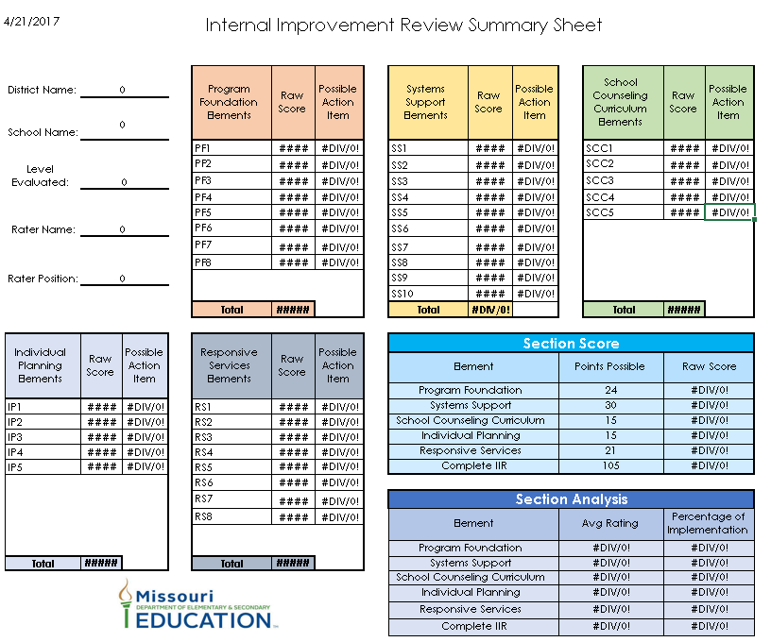
Internal Improvement Review
Document developed by the State of Missouri
Uses MSIP Standards to determine degree of program implementation
Annual review of comprehensive school counseling program
Allows for collaboration between counselors, administrators & stakeholders
Assists to determine action plan for program improvement
Notes:
The Internal Improvement Review or (IIR) was developed by the State of Missouri
CLICK
and uses the MSIP standards to determine the degree of program implementation.
CLICK
It is recommended that the IIR tool be used annually to review and evaluate the comprehensive school counseling program.
CLICK
This tool allows for collaboration between all stakeholders
CLICK
and provides a process for continued program updating and improvement as a school district moves toward full implementation and enhancement of a comprehensive school counseling program.

Slide 13
Time on Task Analysis
Notes:
The Time on Task Analysis is a survey of the school counselors’ time spent on performing the tasks that have been assigned in the program as it currently exists.
The results of this initial analysis will provide baseline data for comparing the time and tasks involved in the current program to the time and tasks chosen for the desired district’s comprehensive school counseling program.

Slide 14
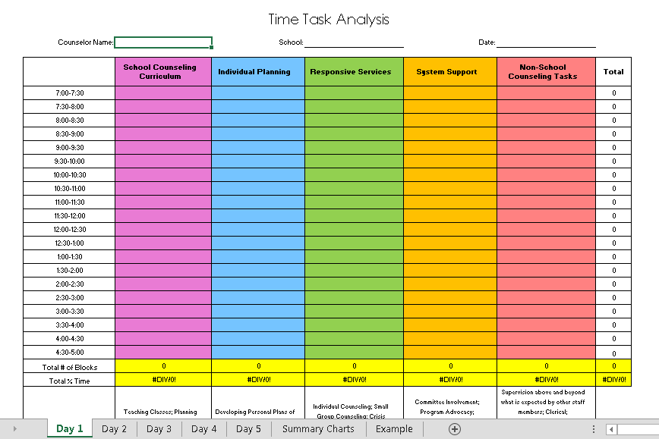
Notes:
Use the Time on Task Analysis form found on the DESE School Counseling website to keep track of the actual time school counselors currently spend in activities in each program component including any non-school counseling time.
All school counselors in the district will select the same ten days spread evenly throughout the school year to conduct the Time on Task Analysis. These ten days should reflect typical days that contain a variety of school counseling program activities within the four components as well as any non-school counseling tasks that may be present.

Slide 15
K-12 Time on Task Analysis
Notes:
Within the Time on Task template, the data will be automatically analyzed and charts will be automatically generated upon entry into the form.
Compare these results with the State’s suggested percentages for each of the four components. Share this data with stakeholders including your school counseling advisory board to see if possible changes should be implemented in your program.

Slide 16
PERSONNEL Evaluation
program + personnel = results
Notes:
The second part of providing evidence of impact is personnel evaluation.

Slide 17
Evidence of Impact
1.
  To what extent is the school counseling program in place and being implemented?
2.
  Is the program being managed and conducted with fully certified and capable school counseling personnel?
3.
  Is there a plan or system in place to use relevant student data to determine program impact on student outcomes?
Notes:
The question asked here to help illustrate Evidence of Impact of School Counseling on Student Outcomes is….
CLICK
Is the program being managed and conducted with fully certified and capable school counseling personnel?

Slide 18
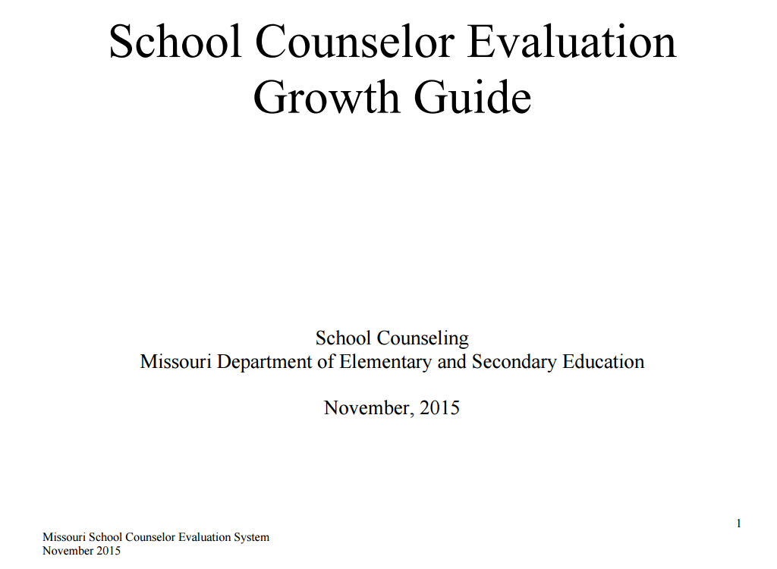
School Counselor Growth Plan
Formative Evaluation
Summative Evaluation
Professional Growth Plan
Notes:
School counseling program personnel evaluation is based directly on the school counselor job description and should have two parts:
CLICK
formative, on-going evaluation
CLICK
and summative or year-end evaluations. The School Counselor Growth Plan identifies the performance areas to be supervised and evaluated in observable and measurable terms. The usefulness of this type of evaluation goes beyond judging past performance. It focuses on actual performance/accomplishments during the evaluation period.
CLICK
Because it is improvement oriented, the personnel evaluation will also target future directions and goals using a professional growth plan.
School counselors should always be evaluated by an evaluation tool that is expressly for school counselors and reflects the scope and practice their work. The evaluation tool should be relevant to the school counselor so their professional growth and development will be enhanced by the evaluation. School counselors should not be evaluated using a teacher evaluation instrument.

Slide 19
School Counseling Standards
1
  Student Development
2
  Program Implementation
3
  Professional Relationships
4
  Leadership & Advocacy
5
  Ethical & Professional Conduct
Notes:
The MO School Counselor Evaluation tool found on the DESE School Counseling website is designed around the following school counseling standards:
CLICK
Student Development
CLICK
Program Implementation
CLICK
Professional Relationships
CLICK
Leadership & Advocacy
CLICK
Ethical & Professional Conduct

Slide 20
RESULTS Evaluation
program + personnel = results
Notes:
The third part of providing evidence of impact is results evaluation.

Slide 21
Evidence of Impact
1.
  To what extent is the school counseling program in place and being implemented?
2.
  Is the program being managed and conducted with fully certified and capable school counseling personnel?
3.
  Is there a plan or system in place to use relevant student data to determine program impact on student outcomes?
Notes:
The question asked in this part of the equation to help illustrate Evidence of Impact of School Counseling on Student Outcomes is….
CLICK
Is there a plan or system in place to use relevant student data to determine program impact on student outcomes?

Slide 22
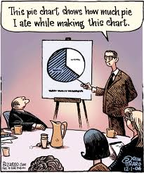
Relevant Student Data
Illustrates Skills, Behaviors & Attitudes
Guides Decisions
Helps Ensure Positive Outcomes
Adapted from Trish Hatch
Notes:
Relevant student data
CLICK
illustrates skills, behaviors and attitudes.
CLICK
It is important because it guides the decision-making process
CLICK
And helps to ensure positive outcomes related to the services provided by the comprehensive school counseling program.

Slide 23



Three Types of Data
Process
Perceptual
Outcome
Notes:
Three types of data should be collected to show evidence of impact:
CLICK
process data
CLICK
perceptual data
CLICK
and outcome data. All three types of data are important in determining the overall effectiveness of the school counseling program and in providing direction for program enhancement.

Slide 24

Process Data
What Was Done for Whom
Notes:
Process data illustrates what was done for whom. This type of data provides evidence that an activity or program was conducted. Process data is an indication that the program is in place and is operating. It provides administrators and school counselors information on the extent that the school counseling program is reaching all students and their parents.

Slide 25
Process Data Examples
Classes
Individual Sessions
Group Sessions
Crisis Sessions
Hotlines
Home Visits
CD Interviews
Testing Coordination
Mental Health Referrals
Personal Plan of Study
Suicide Assessments
Resource Referrals
Notes:
Examples of process data might include
CLICK
# of individual counseling sessions held
CLICK
# of classroom activities conducted and the number of students impacted
CLICK
# of hours of testing coordination
CLICK
or the # of students with a Personal Plan of Study

Slide 26

Process Data
Collection Methods
Notes:
There are various ways available to collect this Process Data. It’s important that no matter which method is used, process data is collected consistently and is an accurate reflection of the services provided.

Slide 27
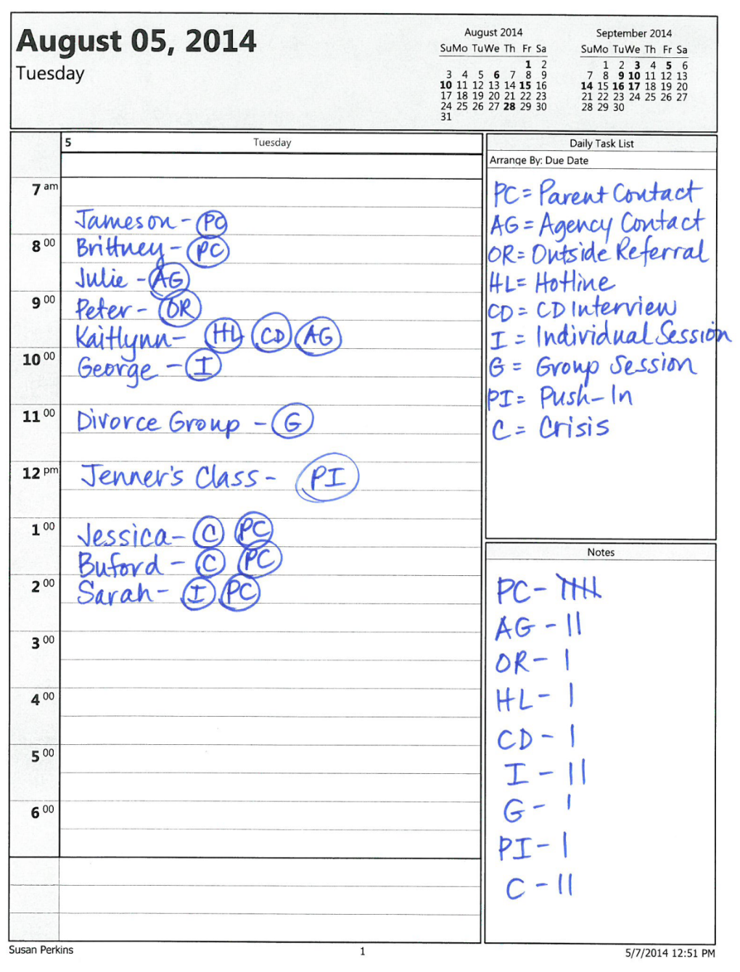
Planner Tally
Decide process data categories
Assign an abbreviation to each category
Record and abbreviate your daily activities
At the end of each day, tally your categories
Tally by week, month and year
Notes:
The simplest way to collect process data is through use of a daily planner or calendar and the use of tally marks. Using this method, the school counselor will keep track of the activities completed, categorize the activities and tally the number of incidents in each category.
CLICK
First and foremost, the school counselor or program coordinator will decide the process data categories to document and track.
CLICK
Secondly, each category should be assigned an abbreviation. For instance, if the school counselor is tracking individual counseling sessions, the abbreviation for that category may be IC for Individual Counseling.
CLICK
Each day, record your daily activities, making sure to assign an abbreviated category to each activity.
CLICK
At the end of each day, tally and record the number of events for each category.
CLICK
Tally events by week, month or by the year to document process data for any given period of time.

Slide 28
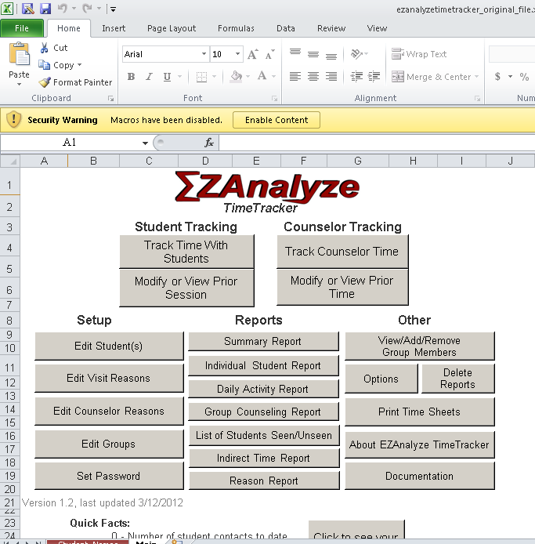
Excel Spreadsheet
Notes:
Another method of process data collection is by use of an Excel spreadsheet
Using formulas, individuals familiar with Excel can create spreadsheets used to track process data. EZ Analyze is a free spreadsheet available for download online which was developed to track school counselor time on task, as well as Process Data.

Slide 29
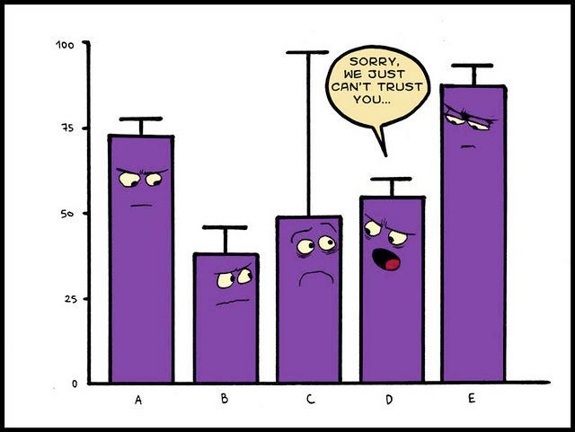
Analyzing Process Data
Notes:
Process data analysis is just as important as the data collection itself. The way the data is compiled can have a profound impact on the overall message. It is necessary to take time to determine the purpose of the process data collection and how it can best be compiled to show evidence of impact.

Slide 30
Process Data Analysis
Totals by Building
Totals by District
Trend Data
Correlate with Other Data
Notes:
Process data can be totaled…
CLICK
By building
CLICK
By district
CLICK
To show trends
CLICK
To correlate and compare with other building, district, state or national data

Slide 31
Totals By Building or District
School | # of Classroom Lessons | # of Individual Counseling Visits | # of Outside Referrals | # of Hotlines
Parkade | 245 | 85 | 23 | 14
Jones | 268 | 112 | 35 | 3
Carlyle | 125 | 234 | 56 | 11
Smith | 202 | 94 | 22 | 5
Notes:
Here is an example of process data totals by building for various categories. From this data, comparisons could be made to district averages, possibly illustrating the need for additional support.

Slide 32

Perceptual Data
What People Think They Know, Believe or Can Do
Notes:
Perceptual data shows what students or parents believe they know or believe they can do. This type of data gives insight into how an activity or program is perceived by the target audience. Perceptual data indicates the perceived effectiveness of the program.

Slide 33
Perceptual Data Collection
Attitudes
Skills
Knowledge
  I believe
  I can
  I know
Notes:
Perceptual data measures the
CLICK
Attitudes
CLICK
Skills
CLICK
And knowledge perceived by the audience

Slide 34
Types of Perceptual Data
Pre-Post
Program Planning Survey
Program/Activity Evaluation
Opinion Survey
Notes:
Examples of perceptual data might include
CLICK
Pre/Post assessments which illustrate knowledge, skills and attitudes
CLICK
Program Planning Survey which indicates student or program needs
CLICK
Program or activity evaluation showing areas of growth related to knowledge, skills or beliefs
CLICK
Or an Opinion Survey showing areas of strength and weakness as perceived by stakeholders.

Slide 35
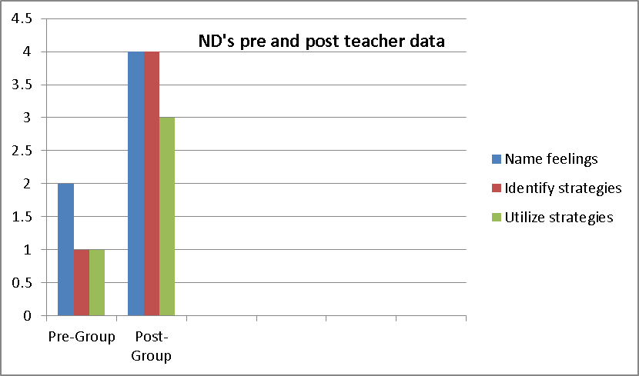
Pre-Post
On a scale of 1-5 (with 5 being strongly agree and 1 being strongly disagree), please rate each of the following statements concerning your student.
My student is able to identify/name his/her feelings/emotions.
1 2 3 4 5
My student is able identify strategies to use to return to a calm state.
1 2 3 4 5
My student is able to utilize strategies to calm when feeling a strong emotion.
1 2 3 4 5
Notes:
This is an example of a Pre/Post Survey used to illustrate student growth within a small group counseling setting. This survey was administered to teachers both before the group began and after the group finished meeting. It is evident by the results of the perceptual survey, the students within the small group setting made a great deal of progress related to the identified criteria.

Slide 36
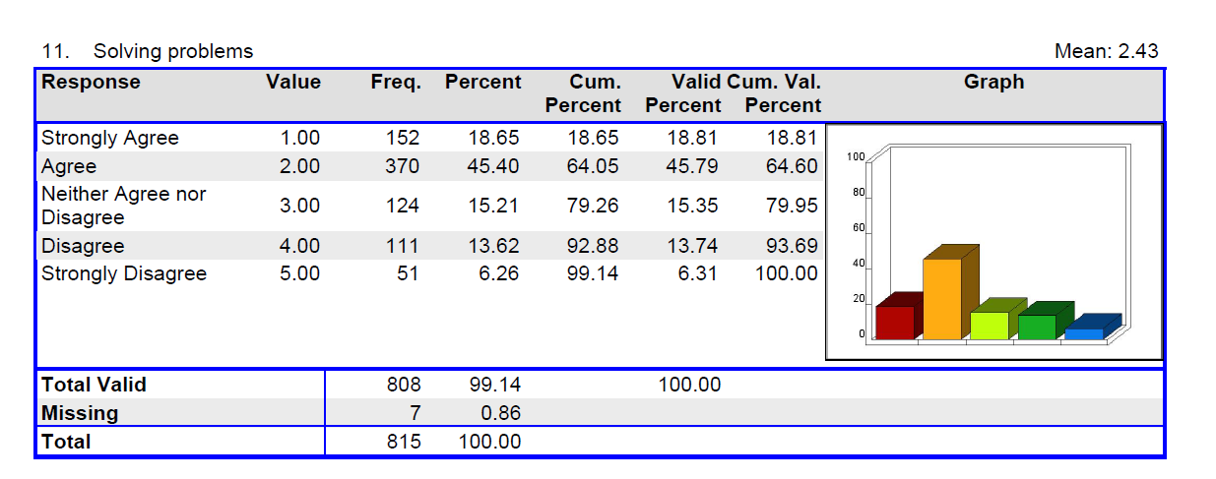
Program Planning Survey
Perception of Parents, Teacher & Students
Result: 3-Year Focus on Developing Problem Solving Skills
Notes:
Program Planning Surveys can assist in soliciting parent, teacher and student feedback related to student needs. The results of this Program Planning Survey illustrated a need developing problem-solving skills at the elementary level, compared to other areas.

Slide 37
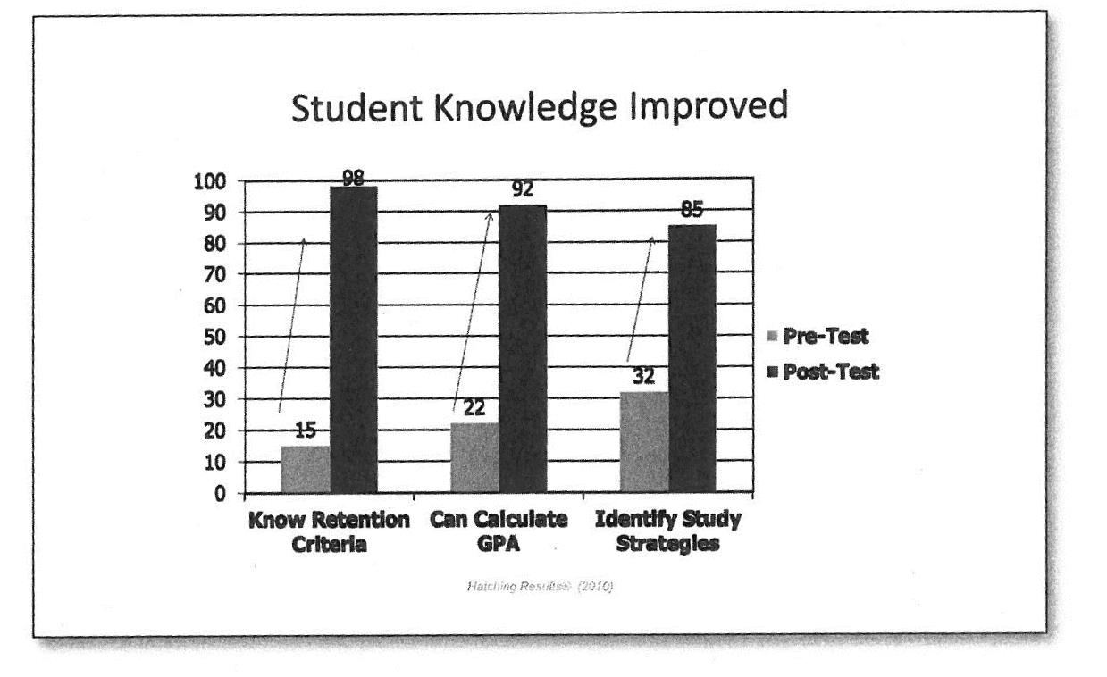
Program/Activity Evaluation
Notes:
This graph shows the results of an activity evaluation. During this activity, students showed great gain in knowledge related to retention criteria, GPA calculation and the identification of study strategies.

Slide 38
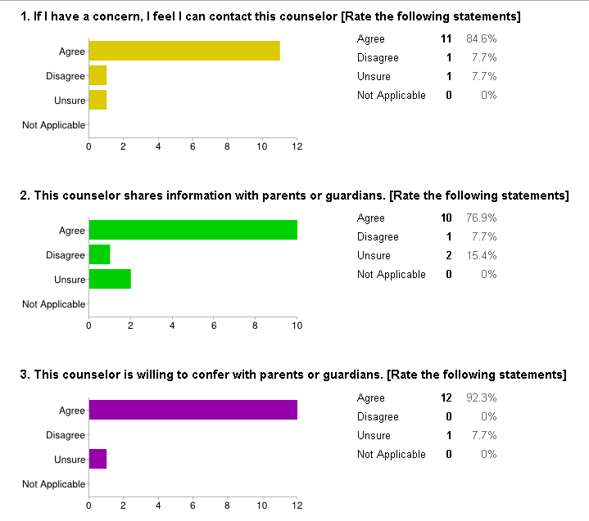
Opinion Survey
Notes:
In order to solicit honest feedback, opinion surveys can be used to gather anonymous perceptual data from parents, teachers and students. Online Google forms can make survey administration and data compilation a fairly seamless process.
.

Slide 39

Outcome Data
So What?
Notes:
Outcome data shows the impact the activity or program had on student performance. This type of data shows the students’ progress toward a target goal.

Slide 40
Outcome Data
Proof the activity changed behavior
Counselor Taught Curriculum
Students Reported Learning
Do students now fight less?
Notes:
Outcome data provides proof the activity changed student behavior.
For example, a school counselor may have delivered a large group curriculum aimed to decrease fighting among students.
CLICK
The process data collected will show the counselor taught the curriculum
CLICK
The perceptual data will hopefully show that the students learned the new attitudes, skills or knowledge
CLICK
The outcome data will help to determine whether students do indeed fight less after having been taught the curriculum.

Slide 41
Three Most Important Outcomes
Attendance
Behavior
Achievement
Connectedness
Notes:
Trish Hatch, author of The Use of Data in School Counseling, will tell you that Attendance, Behavior and Achievement are three of the most important outcomes school counselors can measure.
Attendance can be measured using daily or average attendance rates.
Behavior can be measured using office referrals, suspensions, homework completion and parent involvement
Achievement can be measured using GPA, graduation rates or exam scores
CLICK
Most district goals and improvement plans center around enhancing those three different areas. However, research has suggested that student connectedness also enhances academic success.

Slide 42
Evidence of Impact
Putting It All Together
Notes:
Results evaluation is a process……
A method for showing evidence of impact using process, perceptual, and outcomes data.

Slide 43
Evidence of Impact
1.
To what extent is the school counseling program in place and being implemented?
2.
Is the program being managed and conducted with fully certified and capable school counseling personnel?
3.
Is there a plan or system in place to use relevant student data to determine program impact on student outcomes?
Time
Notes:
Again, there are three Questions that help provide Evidence of Impact of School Counseling on Student Outcomes
To what extent is the school counseling program in place and being implemented ?
Is the program being managed and conducted with fully certified and capable school counseling personnel?
Is there a plan or system in place to use relevant student data to determine program impact on student outcomes?
CLICK
In designing a plan it is also important to consider process, perceptual, and outcome data at different time periods including immediate, intermediate, and long-term time periods.

Slide 44
IDEAS Process
Identify
Describe
Existing Data
Analyze
Summarize
Notes:
The following “IDEAS!” results evaluation model (Lapan, 2005) can be used to conduct a results evaluation. The “IDEAS!” evaluation model consists of the following
1. Identify
2. Describe
3. Existing Data
4. Analyze
5. Summarize
Summarize findings in a brief, written report or presentation. Be clear, concise, and use charts and graphs where appropriate. Be sure to include:
A statement of the problem
What you did in response to this problem (intervention)
What you found out
How results data will be used to improve the intervention
6
Utilize!
Utilize the data to improve the program and communicate to stakeholders about how your comprehensive school counseling program is making a positive difference in the lives of students in your school.
wing steps:

Slide 45

1. Identify Problem or Need
Student Specific
Program Specific
District Specific
Notes:
The first step in evaluating our results is to determine the area of need or problem that needs intervention.
Identify a critical aspect of your job that is important for you to know more about. Pick something that you have some control over and link up with one or more colleagues to work with (counselor, teacher, administrator, advisory board members, etc.). This is your research team.
Results evaluation can help provide information about the effect of our work on students, programming and district-level outcomes.
For example, Julie often gets into arguments with other children. She is angry with life and does not believe she is a worthy person. Julie is disruptive in class, often seeking attention to help her feel better about herself. The problem identified here is student-specific because it relates to Julie’s specific needs.

Slide 46



2. Describe Situation & Action Plan
Students
One, two, three or more
Interventions
Counseling, Lesson, Behavior Plan, Check-In
Measurements
Process, Perceptual, Outcome
Settings
Individual, Group or Classroom
Piers-Harris 2
Office Referrals
Notes:
Describe the situation thoroughly. Every evaluation activity carried out by the school counselor will have 4 components .
The “SIMS” is an easy to remember acronym which consists of Students, Interventions, Measurements and Settings.
CLICK
During Step #1 of the IDEAS process, Julie was identified as a student needing intervention for her behavior. Using SIMS, it was decided that Julie would receive individual counseling sessions where process, perceptual and outcome data would be collected to show the evidence of the school counseling program’s impact.
The process data would consist of
CLICK
8 sessions
CLICK
At 30 minutes each
CLICK
Perceptual data would be collected using the Piers-Harris 2 self-concept scale
CLICK
And outcome data would be collected using the number of office referrals received before and after the intervention

Slide 47
3. Existing Data
Process
Who, what, when, where, how long?
Perceptual
Pre/Post measures, surveys
Outcome
Behavior, attendance, academic
Pre & Post Self-Efficacy
Pre & Post Office Referrals
Notes:
Step #3 is Existing Data—Use existing data that your school is already collecting to show student growth and development. Data collection should not become an additional counselor duty. School districts collect a large amount of data that school counselors can use to develop a results based evaluation plan.
CLICK
In Julie’s case, the school counselor would want to ask Julie to complete
CLICK
both pre and post self-concept scales,
CLICK
as well as office referral numbers both prior to the intervention period and after the intervention period.

Slide 48
4. Analyze Data
Counselor Provided Counseling Sessions
Julie Perceived Improvement
Office Referrals Declined
Process Data | Perceptual Data | Outcome Data
Eight, 30-minute individual counseling sessions | 95% increase in self-efficacy | 78% decrease in office referrals
Notes:
Step #4 requires data analysis. It is very important to analyze the data and decide what the data means. Evidence of impact can be shown by using summary statistics, including mean, standard deviation, percentage, correlation, and T-test. If you are unsure how to analyze the data, ask for help from someone who can look at data with a critical eye.
In Julie’s situation through 8, 30-minute individual counseling sessions, Julie reported a 95% increase in self-efficacy and obtained a 78% decrease in office referrals. The results of this service provided by the comprehensive school counseling program show a tremendous evidence of impact.

Slide 49
5. Summarize
Problem: | Angry, Attention-Seeking & Low Self-Esteem
Evidence of Impact
95%
78%
Individual Counseling Sessions
Notes:
Step 5 requires a summary of the findings. This can be done through a brief, written report or presentation. Be clear, concise, and use charts and graphs where appropriate. Be sure to include:
A statement of the problem
What you did in response to this problem (intervention)
What you found out
How results data will be used to improve the intervention
CLICK
In Julie’s case,
CLICK
the problem was that she was angry, attention-seeking and exhibited a low self-esteem.
CLICK
As an intervention, Julie was provided eight, thirty-minute individual counseling sessions focusing on developing coping and positive self-talk strategies.
CLICK
Julie was administered the Piers-Harris 2 as a pre and post measure.
CLICK
Her pre and post discipline referrals were also tracked. Julie showed remarkable improvement as a result of the individual school counseling intervention.
CLICK
She reported a 95% increase in self-efficacy
CLICK
and a 78% decline in office referrals.
CLICK
It is evident the services provided by the school counseling program had an impact on Julie’s behavior.

Slide 50

6. Utilize….and share with….
Students
Parents
Teachers
Administrators
Other district & community stakeholders
Notes:
The purpose of results evaluation is to show the impact of the district’s school counseling program. This means that the data collected during results evaluation must be used and shared as evidence, not filed away to be forgotten. Reports may be developed to inform various audiences in the district and community. Your results can be used to create two different reports according to your audience: technical report and professional report.
Don’t forget to share these results with all stakeholders including students, parents, teachers, administrators, and other district and community stakeholders

Slide 51

examining your results

Slide 52
Disappointing Results
Look for Trends
Look for Impact
Eliminate Ineffective Interventions
Add Interventions
Adjust Systems
Seek Professional Development
Never Give Up
Notes:
Not all results are celebratory!
Although obtaining disappointing results can be seen as discouraging, any results whether positive or negative can help to better focus the need for program improvement.
The first thing to determine when faced with disappointing results is whether the lack of impact was a consequence of the Program, the Personnel delivering the program or a consequence due to something completely out of the program’s control.
If a lack of results is due to the program or personnel, analyze the results to make appropriate changes. Be sure to:
CLICK
Look for trends
CLICK
Look for impact
CLICK
Eliminate ineffective interventions
CLICK
Add intervention
CLICK
Adjust systems
CLICK
Seek professional development
CLICK
Never give up!
In the end, put a plan of action into place to produce celebratory results.

Slide 53
Connect Positive Results to Research
Fully implemented programs increase achievement & attendance and decrease discipline problems and out-of-school suspensions (Lapan, Gysbers & Kayson, 2006).
Students feel safer in school, earn high grades, understand the relevancy of school, have more positive relationships with teachers and are more satisfied with education in schools with more fully implemented programs (Lapan, Gysbers & Petroski, 2001).
Lower counselor ratios are significantly associated with high graduation rates and lower disciplinary incidents (Lapan, Gysbers & Stanley, 2011).
Lower ratios decrease disciplinary incidents and recurrence of disciplinary problems, especially for low income and minority youth (Carrell & Carrell, 2006).
Indications exist that employing a school counselor is approximately twice as effective as employing an additional teacher (Carrell & Hoekstra, 2011).
Notes:
Connect positive results to what we already know to better strengthen and advocate for a continued and fully implemented comprehensive school counseling program. There is a good amount of research that exists to support the impact of a fully implemented program on achievement, attendance, behavior and positive relationships.

Slide 54
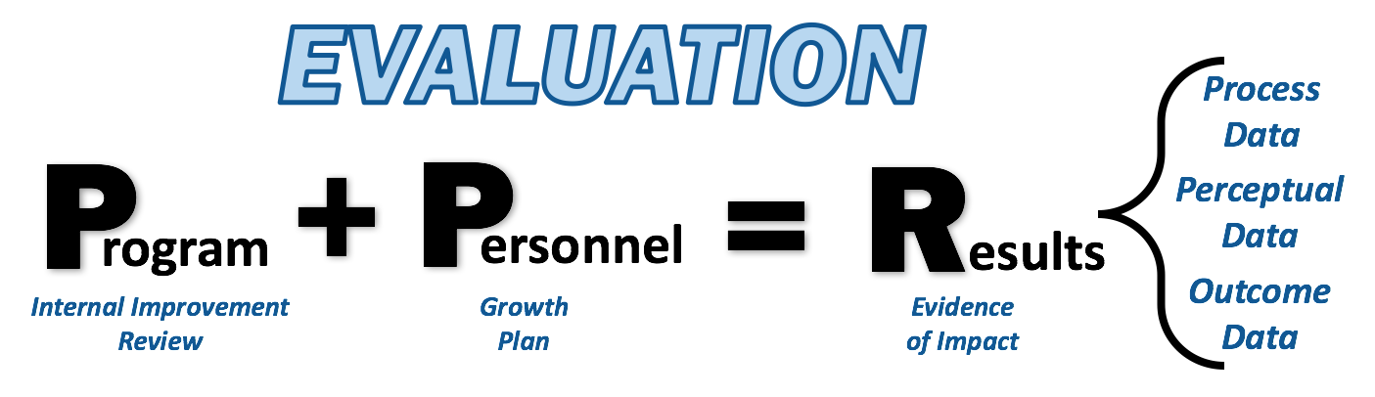
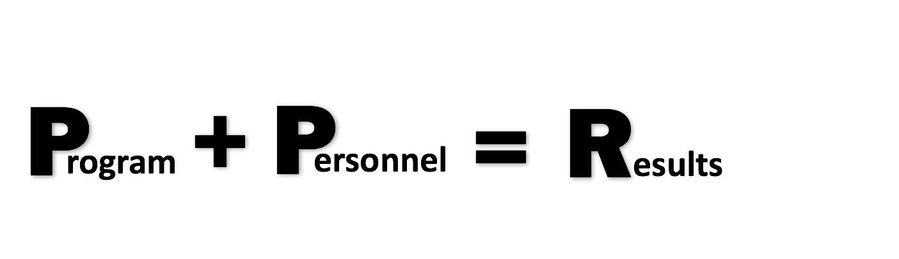
Norman C. Gysbers & Patricia Henderson, “Comprehensive Guidance & Program Evaluation: Program + Personnel = Results, www.counseling.org
Notes:
In summary, when we evaluate the implementation of the program, and the effectiveness of the personnel, we can determine the overall program results.
It is the fully implemented comprehensives school counseling program and the certified and trained school counseling personnel, that when combined, create positive results and impact student achievement and success.

Slide 55
Providing Evidence of Impact
The Missouri Comprehensive School Counseling Framework
Version 2017
Notes:
Program + Personnel = Results
Providing evidence of impact through the Missouri Comprehensive School Counseling Framework.

