Slide 1

Office of educator quality and school counseling
Site Supervisor Training for
School Counselor Candidates
Missouri Department
of Elementary and Secondary Education
Notes:
ADD DESE VIDEO INTRO
Welcome to this special training for site supervisors of school counselor candidates. We appreciate a few moments of your time in describing the approach, assessing the performance, and supporting the growth of your school counselor candidate. We begin this training with opening comments from our Commissioner of Education, Dr. Margie Vandeven…?

Slide 2
Learning Outcomes
Understand the importance and need for statewide consistency in how we grow and develop school counselor candidates.
Understand the importance of meaningful and descriptive feedback in the development of school counselor candidates
Understand and effectively use the School Counselor Candidate Evaluation Growth Guide
Notes:
The important learning outcomes for this training include: creating consistency statewide in growing and developing your school counselor candidate, enhancing your skills to provide meaningful feedback to your candidate, helping your candidate grow and develop to be ready as a first year counselor, and to create a common understanding of the forms and process in assessing your candidate’s progress.

Slide 3
A Site Supervisor…
Successfully implements a comprehensive school counseling program
Addresses academic, social/emotional, and career development of all students
Utilizes tools such as the IIR and Time Task Analysis to advocate for the program
Notes:
As an effective counselor you are already skilled at: successfully implementing a comprehensive school counseling program, addressing academic, social/emotional and career development of all students, you also utilize tools such as the IIR and Time Task Analysis to advocate for your program.
The School Counselor candidate will benefit from the knowledge and expertise you impart on their field experience.

Slide 4
A Site Supervisor…
Introducing school counseling candidate to your school staff
Helping your candidate get familiar with school procedures/policies/culture and climate
Offering sound advice about good practice
Giving guidance on what works, what doesn’t and why
Sharing deep knowledge about students and the school
Modeling professionalism
Notes:
As a site supervisor you will be a valuable resource and serve as a model to your school counseling candidate. Some valuable ways you can help your candidate are:
Introducing your school counselor candidate to your staff
Helping your candidate get familiar with school procedures/policies/culture and climate
Offering sound advice about good practice
Giving guidance on what works, what doesn’t and why
Sharing deep knowledge about students and the school
Modeling professionalism

Slide 5
Essential Skills
School Counselor Candidates apply what they have learned
Notes:
The field experience is an opportunity to demonstrate what has been learned throughout preparation.

Slide 6
Missouri School Counselor Standards and Quality Indicators
(10 Indicators for Intern experience)
Standard 1: Student Development
Standard 4: Leadership and Advocacy
Standard 5: Ethical and Professional Conduct
Standard 2: Program Implementation
Standard 3: Professional Relationships
1:1 Human Growth and Development
1:2 Counseling Theories and Interventions
1:3 Helping Relationships
1:4 Social and Cultural Diversity
1:5 Appraisal of Student Growth and Achievement
1:6 Career Development and Planning
2:1 Structural Components
2:2 Program Components
2:3 Technology
2:4 Program, Personnel, Results Evaluation
3:1 Interpersonal Skills
3:2 Collaboration
3:3 Consultation Theories and Strategies
3:4 School and Community Involvement
4:1 Personal Well-Being
4:2 Leadership and Professionalism
4:3 Student Advocacy
4:4 Program Leadership
4:5 School Culture and Climate
5:1 Ethical Standards
5:2 Professional Standards
5:3 District and School Policies
5:4 Legal Requirements
Notes:
Missouri has 5 School Counselor Standards. These include: Student Development, Program Implementation, Professional Relationships, Leadership and Advocacy, and Ethical and Professional Conduct. Each of the 5 standards are further defined by Quality Indicators. For example, standard 1 has 6 Quality Indicators. Standard 2 has 4 Quality Indicators. These 23 Quality Indicators define the knowledge and skills of an effective school counselor. Certain Quality Indicators shown here in yellow have been found to be particularly important for beginning school counselors. As a site supervisor, you’ll help your school counselor candidate effectively demonstrate competence in these 10 areas.

Slide 7
Promotes mental health and well-being of students
Collaborates to enhance the comprehensive school counseling program
Develops relationships that support mission and improvement plan of the school
Demonstrates leadership, vision, and advocacy for development of everyone in the district
Adheres to current ethical and legal requirements
A School Counselor Candidate…
Notes:
A school counselor candidate is learning how to be an effective school counselor. The skills needed to be effective are defined generally in these 5 areas. From their preparation program your candidate has received basic knowledge and understanding about how these areas define the candidate as an effective school counselor. During the field experience the school counselor candidate now has the opportunity to demonstrate skills in these areas.

Slide 8
Standard 1
Promotes mental
health and well-being
of students
Possible Data Sources for Standard 1
Designs needs based activities across program components
Student portfolios
Opportunities for students to use problem solving and critical thinking
Builds positive relationships with others
Verification of student mastery
Student feedback and reflection
Builds student understanding of self/others utilizing a variety of global perspectives
Notes:
For standard 1, as you school counselor candidate demonstrates the ability to promote mental health you may notice some of these possible data sources. Such as using student portfolios to convey mental health strategies and information, building positive relationships with students and staff or getting student feedback and reflection from classroom lessons. It is important to note this is not an exhaustive list or checklist of strategies your candidate must demonstrate to prove they to promote well-being of students rather it’s a sample of types of data sources that effective counselors use promote mental health and they could be ones you’ll see your candidate use.

Slide 9
Standard 2
Collaborates to enhance the comprehensive school counseling program
Possible Data Sources for Standard 2
Written school counseling program plan
Agenda/meeting notes from program advisory committee
Implements collaborative practices in program planning
Collaborative implementation and analysis of IIR
Strategies to strengthen and sustain positive relationships with key stakeholders
Facilitate partnerships between classes, grades, or whole school and local businesses and community organizations
Student, parent/family, staff and community survey data
Notes:
For Standard 2, as your school counselor candidate demonstrates the ability to enhance the comprehensive school counseling program your candidate may choose to show these artifacts or data sources such as agenda from a program advisory committee, analysis of the IIR, or survey data from students, staff, or families. Again it’s important to note this is not an exhaustive list or a checklist of strategies your candidate must use but rather a sample of some ways effective school counselors can show they understand and can collaborate to improve a comprehensive school counseling program.

Slide 10
Standard 3
Develops relationships that support mission and improvement of the school plan
Possible Data Sources for Standard 3
Maintains individual student records and assessment data
Demonstrates knowledge of student backgrounds/demographics/academic growth/learning profiles
Engages in community activities
Models and/or shares with colleagues
Maintains a calendar of activities
Maintains a list of school community resources
Observation of counselor interactions
Notes:
For standard 3, as your school counseling candidate develops relationships that support the school improvement plan, your candidate may choose to use some of these data sources such as maintaining records and assessment data, engaging in community activities, or keeping a list of school community resources. As already mentioned it is important to note this is not an exhaustive list or a checklist of strategies your candidate must use to show supportive relationships but rather a sample of types of strategies all school counselors use to successfully document supportive relationships.

Slide 11
Standard 4
Demonstrates leadership, vision, and advocacy for everyone in the district
Possible Data Sources for Standard 4
Has an ongoing agenda for professional development
Plans classroom lessons that support positive school culture and climate
Uses the IIR in identifying programmatic strengths and weaknesses
Learns about the culture of the community and joins appropriate committees
Participates in leadership responsibilities of professional organizations
Engages in professional development on school climate
Ties Program goals to school/district improvement goals
Notes:
For standard 4, as your school counseling candidate demonstrates leadership and advocacy, your may notice some of these data sources such as lessons that support positive school culture and climate, participation in leadership of professional organizations, or program goals that are tied to district or school improvement goals. Once again it is important to note this is not an exhaustive list or a checklist of strategies your candidate might use but rather a sample of types of strategies that your candidate might demonstrate while showing the importance of leadership and advocacy.

Slide 12
Standard 5
Adheres to current ethical and legal requirements
Possible Data Sources for Standard 5
Ethical standards are articulated in written Comprehensive School Counseling Plan
Logs document consultations regarding ethical/policy/legal dilemmas
Agendas reflect discussion of ethical responsibilities
Copies of policy revisions
Classroom/small group guidelines are posted
Referral policies and processes are adopted
Membership in professional organizations
Notes:
For Standard 5, as your school counselor candidate adheres to ethical and legal requirements you may notice some of these data sources such as logs documenting consultation regarding ethical dilemmas, guidelines of small groups are posted, and membership of professional organizations. Once again it is important to note this is not an exhaustive list or a checklist of strategies your candidate might use but rather a sample of types of strategies that your candidate might demonstrate while showing the importance of adhering to ethical and legal requirements.

Slide 13
The What and How?
Understanding the Protocol and Forms
Notes:
As a site supervisor you can look to your university supervisor for guidance and support. Collaboration between you and the university supervisor is essential to ensure the success of the school counselor candidate to prepare that person for a seamless transition into school counseling.

Slide 14
Your role as a site supervisor
Provide an independent rating of the 10 Quality Indicators for the School Counselor Candidate
Provide meaningful and descriptive feedback for the candidate
Cooperate with College or University Supervisor
Complete provided formative and summative observation forms on the candidate
Notes:
As a site supervisor you have a very important role. You provide ratings on key indicators of performance. You give valuable feedback that helps your school counselor candidate grow and develop. You model professional collaboration with the university supervisor. And you capture important information on forms that are a necessary component of the candidate’s certification.
This field experience is the last and best method to support the candidate and provide meaningful and descriptive feedback in a focused intentional way to improve school counseling practice. There are forms used to facilitate this process.

Slide 15
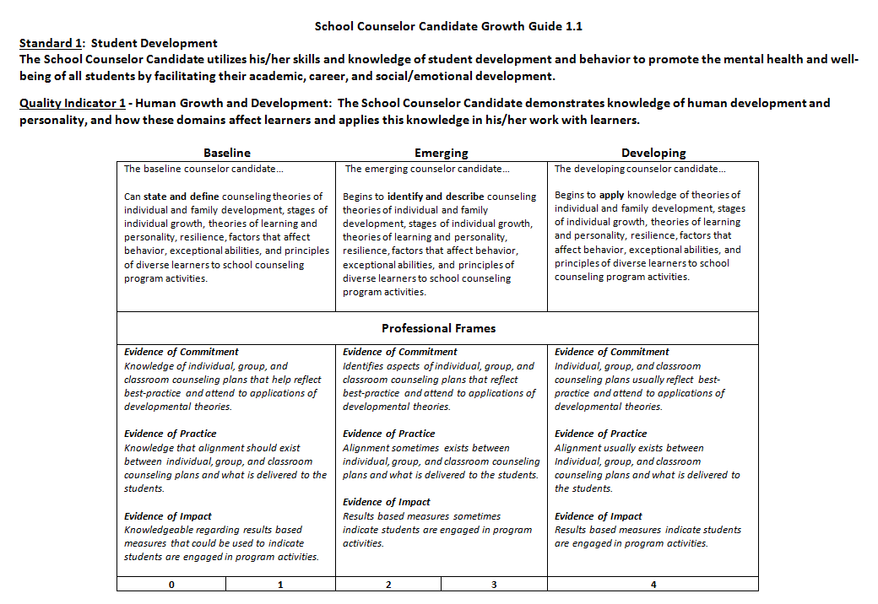
School Counselor Candidate Evaluation Growth Guide
Notes:
The School Counselor Candidate Growth Guide will assist and guide the discussions between you and your candidate. There is a separate rubric for each of the 10 high leverage Quality Indicators, which include the standard, quality indicator, and professional frames. Each standard has a companion document called “Possible Sources of Evidence.” The rubric provides focus for 3 areas of evidence – the first is commitment which is the preparation to provide support, the second is practice which is the actual teaching, and the final one is impact which is student performance data.
All rows on the rubric are important for providing guidance. The top row of descriptors is a general description of performance at each level. These include baseline, emerging, and developing. The second row of professional frame descriptors suggests evidence that performance is occurring. The final row is where ratings can be provided.
This form should be used during observations to take notes, record ratings or performance, and guide feedback.

Slide 16
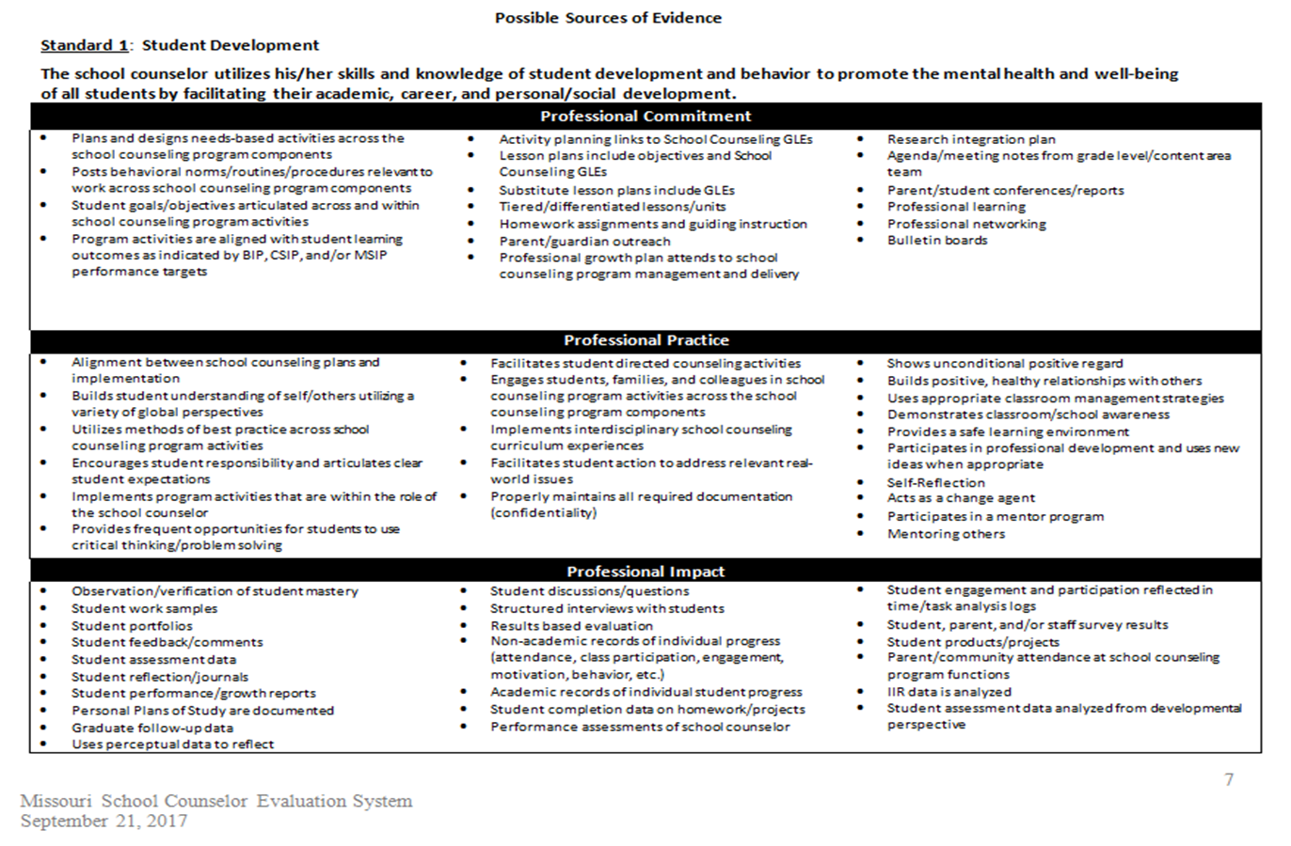
School Counselor Candidate Evaluation Growth Guide
Notes:
Each standard has a companion document called “possible sources of evidence.” Here is the example for Standard 1.

Slide 17
School Counselor Candidate Evaluation Growth Guide
A standard of performance for a defined population
A rating guide for the 10 Quality Indicators to be evaluated
Look at possible observable data
Notes:
The School Counselor Candidate Evaluation Growth Guide is the first step towards consistency statewide. It allows all supervisors, school counselor candidates, and administrators to use common language and share a collective focus.
Keep in mind you do not expect to see everything every time you observe. You might see 5 or 6 of the Quality Indicators at each visit. The important thing is to get a sense of how well the candidate performs in these areas over time.
Also keep in mind that the lists of Possible Sources of Evidence are just that – possible sources. You’ll likely be able to add other things you see that are important data regarding your candidate’s performance for the indicator.

Slide 18
School Counselor Candidate Evaluation Growth Guide
Emphasis on the transition from “knowing to doing”
From School Counselor Candidate to Emerging School Counselor
Notes:
The field experience is a process about growth. It’s a school counselor candidate’s opportunity to apply what’s been learned. Using the Growth Guide and with your support as the site supervisor, the candidate grows or moves along the guide for these important Quality Indicators. It’s critical that the selected 10 Quality Indicators are the focus for observation and feedback between you and your candidate.

Slide 19
School Counselor Candidate Evaluation Growth Guide
O- Baseline:
the School Counselor Candidate did not demonstrate or possess the knowledge.
1 – Baseline:
The School Counselor Candidate possesses the necessary knowledge but cannot apply or demonstrate the performance.
Notes:
To accurately assess the performance of your school counselor candidate using the Growth Guide it’s important to understand the process for scoring performance. This scoring process is a new way of looking at candidates during the field experience. You candidate can receive scores of 0, 1, 2, 3, or 4. A numerical score must also have substantiating feedback in comments to be complete.
A score of 0 – baseline (with substantiating feedback in comments) means the candidate did not demonstrate or possess knowledge for that Quality Indicator.
A score of 1 – baseline (with substantiating feedback in comments) means Candidate possesses the necessary knowledge but cannot apply or demonstrate the performance.
By using effective feedback from you, your candidate can move to the highest level. Remember it’s about growth over the time they are with you.
It’s extremely important during the post observation conversation with your candidate that you help the candidate realize the current level of performance and what can be done to improve performance and move across the rubric. As you do this, you are building and supporting the reflective nature of your candidate. As a school counselor, it take a real commitment to be reflective about your practice. As a site supervisor you can begin to instill in your candidate the importance of this reflective practice.

Slide 20
School Counselor Candidate Evaluation Growth Guide
2 - Emerging:
The School Counselor possesses the necessary knowledge and inconsistently or somewhat effectively demonstrates performance at the Emerging Level.
3 – Emerging:
The School Counselor Candidate possesses the necessary knowledge and consistently and effectively demonstrates performance at the Emerging Level.
Notes:
A score of 2-Emerging (with substantiating feedback in comments) indicates the school counselor candidate has demonstrated the skill on the rubric although performance of it may still be inconsistent and only somewhat effective.
A score of 3-Emerging(with substantiating feedback in comments) indicates the candidate has consistently and effectively demonstrated this particular skill on the rubric. The rubric will guide you to the status of the candidate through observation. Like any rubric, it can’t speak to everything that is going to occur however it does provide guidance for you as the site supervisor to help your candidate improve their performance.

Slide 21
School Counselor Candidate Evaluation Growth Guide
4 – Developing:
The School Counselor Candidate demonstrates consistently at the Emerging level and is beginning to demonstrate at the developing level.
Notes:
A score of 4-developing(with substantiating feedback in comments) indicates the school counselor candidate has demonstrated the skill at the Emerging level and also at the developing level. This score represents the candidate’s ability to demonstrate the skill beyond what’s expected at the emerging level. Ultimately, it’s our hope that all candidates aspire to be a Developing School Counselor but remember that designation is determined by observable evidence and demonstration of the performances articulated in the Quality Indicators.
It’s important to keep in mind the ultimate goal of this entire process is not about receiving scores. It’s to ensure candidates become successful and effective as a first year school counselor.

Slide 22
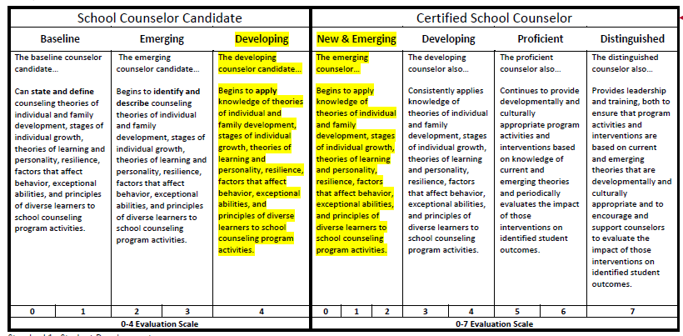
Counselor Continuum
Notes:
The school counselor performance assessment continuum provides a scale which illustrates the growth of a school counselor candidate as he or she develops into a certified, practicing school counselor. This continuum begins with a baseline of zero and continues through the Emerging and Developing levels onto the Distinguished level for a practicing school counselor. Note, the growth level of Developing for the school counselor candidate is identical to the New and Emerging level on the Growth guide for the certified school counselor.

Slide 23
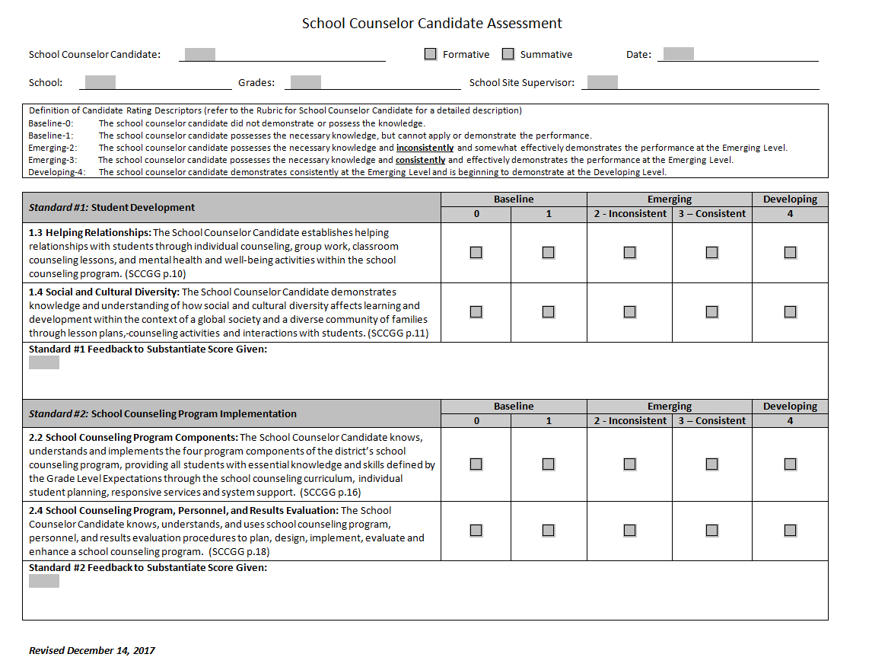
School Counselor Candidate Formative Assessment
Notes:
Data from observations are captured on the School Counselor Candidate Formative Assessment. This form is used to provide feedback on the standards for which candidates are held accountable. It is used each time you observe the practice of your candidate. A new copy of this form should be completed during each observation. Notice the comments portion of this form. Written feedback should be in addition to not instead of verbal feedback.

Slide 24
School Counselor Candidate Formative Assessment
School Counselor Candidate receives feedback throughout the field experience from the Site Supervisor and College or University Supervisor
Each of the 10 Quality Indicators must be assessed at some point during the field experience.
There is a place to note the numerical rating.
Notes:
The School Counselor Candidate will receive feedback throughout the field experience. Some of this is informal and some of it’s formal. Using the formative assessment form, your candidate will receive a numerical rating and feedback from observations you conduct as your candidate performs. Keep in mind that candidates need feedback on all 10 Indicators throughout the field experience.
The College or University Supervisor will be able to assist you on and when and how this form is used?

Slide 25
Standard 1 Feedback Example
Student A builds so many positive relationships with students. For example, she greets students in the hallway, inquires about their feelings if they look upset, and makes sure that they are happy before returning to class. She is in charge of a couple girls groups that focus on self esteem and friendship. She has spent her own money to purchase materials to help the girls create cool down fidgets when they become overwhelmed. She is a non- threatening staff member who is open to all students, and students seek her out.
Notes:
It is critical that the site supervisor and instructor include written feedback for each standard to provide rationale for the School Counselor Candidate growth and development rating. Each part of the assessment process is important and should be based on all data available, including baseline and follow up scores, verbal feedback and other relevant artifacts or examples. Meaningful and specific written feedback should include comments and examples specific to the performance of the School Counselor Candidate.

Slide 26
School Counselor Candidate Summative Assessment
Notes:
The School Counselor Candidate Summative Assessment is the form used at end of the field experience. It’s designed to capture final ratings on the performance of the School Counselor Candidate on the 10 Quality Indicators for which the candidate is held accountable. It’s also used as a place to put final comments on the overall performance of the candidate throughout the field experience. Note signatures are needed by the candidate, and site supervisor.
The University Supervisor is ultimately responsible for the final rating and candidate grade. Each university sets its own policies and procedures on determination of grades and performance ratings. Data from this page is submitted to DESE as part of the candidate’s certification requirements.

Slide 27
School Counselor Candidate Summative Assessment
This form is used by the Site Supervisor at the culmination of the field experience.
All 10 Quality Indicators should be evaluated.
Notes:
The summative form is used by the Site Supervisor at the conclusion of the field experience. All 10 Quality Indicators are addressed on the summative form. The form is also used to capture final feedback on the candidate’s overall performance.

Slide 28
The KEY to Growth and Development
Feedback is the breakfast of champions
~ Ken Blanchard
Notes:
Perhaps the most important role you have as a site supervisor is providing meaningful, timely, actionable feedback to your school counselor candidate.

Slide 29
Feedback
The most powerful single modification that enhances achievement is feedback. The simplest prescription for improving education must be “dollops of feedback.” (Hattie and Timperly 2007)
Notes:
A very strong body of research maintains that in order to grow you have to get feedback. This is true for training dogs, coaching athletes, and raising children and is certainly true for your school counselor candidate as well. Your feedback can help your candidate improve on the skills needed to be a successful first year school counselor.

Slide 30
General Example
School Counselor Performance | Student Response/Source of Evidence | Reflective Questioning
Identify one behavior aligned to this Quality Indicator that will be a focus of your feedback for the School Counseling Candidate. | Connect the School Counselor’s behavior to a specific student response or source of evidence that you observed | Generate 1-2 reflective questions for the School Counselor Candidate to consider.
Notes:
This example provides a strategy for providing effective feedback to your school counselor candidate. Begin by identifying a School Counselor Performance or Event that links directly with one of the Quality Indicators then link the candidate’s performance to a specific response or source of evidence that you observed. Generate a couple of reflective questions to help your candidate begin to think about how performance as a school counselor relates to the school building as a whole.
The use of reflective questions communicates to your candidate the importance and value about being reflective about one’s practice. As a site supervisor this takes a real commitment of your time and attention but it pays off. Effective School Counselors are Reflective School Counselors.

Slide 31
1.4 Social and Cultural Diversity Example
School Counselor Performance | Student Response/Source of Evidence | Reflective Questioning
I noticed how you facilitated the small group revolving around a culturally sensitive issue. | The students responded positively when given the chance to explain each of their own unique perspectives. The students were able to acknowledge a different perspective. | 1) What are some strategies you utilized in this discussion that were beneficial? 2) How did you feel the students responded? Are there any ways you would like to improve student response or engagement?
Notes:
An example for Quality Indicator 1.4 Social and Cultural Diversity would be:
Noting the facilitation of a small group around a culturally sensitive issue.
Observing how student responded positively when given chance to explain their own perspectives. The students also acknowledged another perspective.
You could ask what are some strategies you utilized in this discussion that were beneficial or how did you feel the students responded? Are there any ways you would like to improve student response or engagement?

Slide 32
2.4 School Counseling Program, Personnel, Results Evaluation Example
School Counselor Performance | Student Response/Source of Evidence | Reflective Questioning
I noticed that you collected pre and post perceptual data on the counseling activity you facilitated. | By collecting this data, you were able to identify student growth. | What did you learn from the results? How can you utilize the results to improve future practices?
Notes:
An example of Quality Indicator 2.4 School Counseling Program, Personnel, and Results Evaluation
Notice that the candidate collected pre and post perceptual data of an activity.
By collecting data they were able to identify growth.
Some examples of reflective questions might be: what did you learn from the results? How can you utilize the results to improve future practices?

Slide 33
3.2 Collaboration Example
School Counselor Performance | Student Response/Source of Evidence | Reflective Questioning
I noticed you contributed to the team meeting last week regarding a student. | The intervention you suggested was implemented by the teacher and led to student success. | What was your thinking in providing those particular strategies or resources? What has been your experience with this student which helped you identify this might be a successful intervention?
Notes:
An example of quality indicator 3.2 – collaboration.
You notice your candidate contributed to a team meeting last week regarding a student.
The intervention suggested led to student success.
Questioning “what was your thinking in providing those particular strategies or resources?” or “What has been your experience with this student which helped you identify this might be a successful intervention?” will challenge candidate to reflect about their practice.

Slide 34
4.5 School Climate and Culture Example
School Counselor Performance | Student Response/Source of Evidence | Reflective Questioning
I noticed you were standing in hallways during passing periods. | This resulted in several students stopping to talk to you. | What are some other strategies you might use to promote safety, mutual respect, and a positive school culture and climate? How did you feel this contributed to the positive school culture and climate?
Notes:
An example of quality indicator 4.5 school climate and culture.
You observed the school counselor candidate standing in the hallway during passing periods which resulted in students stopping to talk.
Asking “What are some other strategies you might use to promote safety, mutual respect, and a positive school culture and climate?” will engage candidate in reflecting. Also asking the reflective question “how did you feel this contributed to the positive school culture and climate?”

Slide 35
5.4 Legal Requirements Example
School Counselor Performance | Student Response/Source of Evidence | Reflective Questioning
I noticed in our professional learning session you had some questions about mandated reporting. | Your response indicated you were trying to understand the laws and your obligations in mandated reporting to help keep students safe. | What other professional development opportunities can you seek to better acquaint yourself with legal responsibilities? Explain how school policies or state statutes impact your practice as a school counselor.
Notes:
An example of quality indicator 5.4 legal requirements.
Noticing your candidate had questions about mandated reporting in a PLC session. This indicates they were trying to understand laws to keep students safe.
Great question examples would be: What other professional development opportunities can you seek to better acquaint yourself with legal responsibilities? Explain how school policies or state statutes impact your practice as a school counselor.

Slide 36
Congratulations!
You have completed the School Counseling Site Supervising Training.
Please use this link and email a signed copy to your university supervisor to keep on file!
https://dese.mo.gov/sites/default/files/cnsl-site-supervisor-form.pdf
Notes:
You have completed the School Counseling Site Supervising Training.
Please use this link and email a signed copy to your university supervisor to keep on file!
https://dese.mo.gov/sites/default/files/cnsl-site-supervisor-form.pdf

Slide 37

Questions?
Please contact your College or University Supervisor
or
Educator Preparation in the office of Educator Quality at DESE
573-751-1668
The Department of Elementary and Secondary Education does not discriminate on the basis of race, color, religion, gender, national origin, age, or disability in its programs and activities. Inquiries related to Department programs and to the location of services, activities, and facilities that are accessible by persons with disabilities may be directed to the Jefferson State Office Building, Office of the General Counsel, Coordinator – Civil Rights Compliance (Title VI/Title IX/504/ADA/Age Act), 6th Floor, 205 Jefferson Street, P.O. Box 480, Jefferson City, MO 65102-0480; telephone number 573-526-4757 or TTY 800-735-2966; email civilrights@dese.mo.gov.
Notes:
We hope you found this training helpful for understanding this new process for evaluating and supporting School Counselor Candidates. We hope we have effectively communicated how very important your role is as a site supervisor. We sincerely appreciate your willingness to share your professional expertise and experience with your School Counselor Candidate. You have an essential role in shaping the future of School Counseling in Missouri.
For any additional questions you may have please contact the University Supervisor of your candidate. You’re also welcome to contact Educator Preparation in the office Educator Quality at DESE.
Thank you again and we hope you have a great school year.

