Slide 1
Missouri Comprehensive School Counseling Program
System support

Slide 2
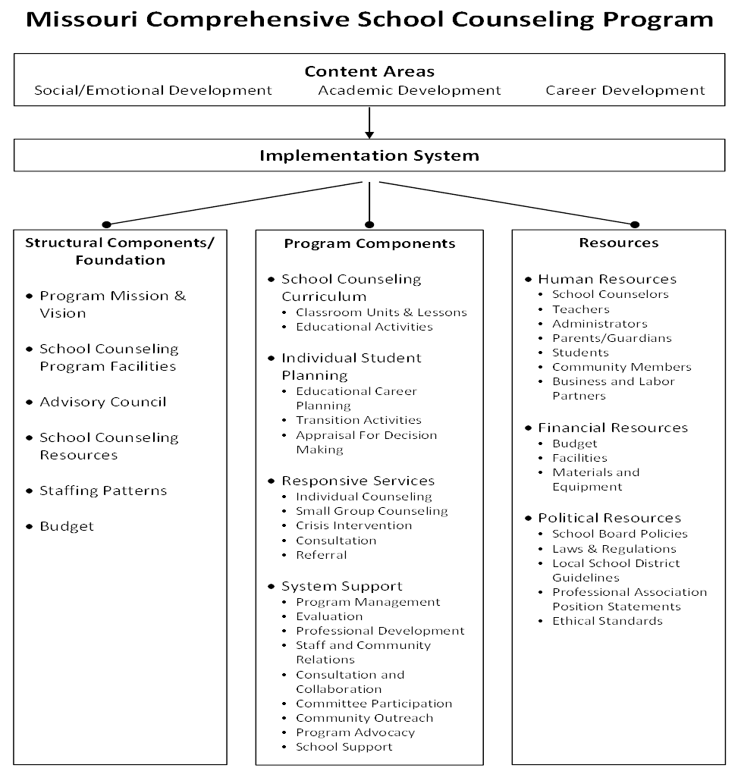

Slide 3
Missouri Comprehensive School Counseling Program
School Counseling Curriculum
Responsive Services
Individual Student Planning
System Support
Notes:
The Missouri Comprehensive School Counseling Program has 4 delivery components: School Counseling Curriculum (a K-12 developmentally sequenced set of classroom activities in the areas of social/emotional, academic, and career development); Responsive Services (meeting with students who have individual needs dealing with social/emotional, academic, or career issues when they arise); Individual Planning (assisting students in academic, college & career planning); and System Support, which will be explained in this presentation.

Slide 4
System Support Definition
The management activities and services required to effectively support a district’s comprehensive school counseling program.
Notes:
System support contains the management activities and services required to effectively support a district’s comprehensive school counseling program. The administration and management activities of a district’s comprehensive school counseling program are located in this component as are activities that support other educational programs.

Slide 5
School Counselor’s Role in
System Support
Program Management
Evaluation
Professional Development
Staff & Community Relations
Consultation & Collaboration
Committee Participation
Community Outreach
Program Advocacy
School Support
Notes:
The system support component is implemented through activities such as program management, evaluation, professional development, staff and community relations, consultation & collaboration, committee participation, community outreach, program advocacy, and school support.

Slide 6
Program Management
Time on Task Analyses
Calendaring
Budgeting
Program Reporting
Prioritizing
Identifying Resources
Notes:
The school counselor plans and manages tasks needed to support activities conducted in the district’s comprehensive school counseling program. Such activities might include: conducting time on task analyses; developing a yearly calendar of activities; developing a yearly budget; writing reports regarding the comprehensive school counseling program; establishing priorities for the year; and identifying resources needed to implement the program.

Slide 7
Program Evaluation
Program Evaluation
To what extent is the program in place?
Personnel Evaluation
To what extent is the program staffed with highly skilled school counselors?
Results Evaluation
To what extent is the program impacting student outcomes?

Slide 8
Professional Development
In-service Training
Professional Organization Meetings
Post-graduate Course Work
Professional Literature Contributions
Notes:
In order to stay current and relevant, the school counselor participates regularly in professional development including, but not limited to, any of the above.

Slide 9
Staff & Community Relations
Newsletters
Local Media
Social Media
School-Community Presentations
Notes:
The school counselor educates and informs the staff and the community about the comprehensive school counseling program through newsletters, local media, and/or school-community presentations.

Slide 10
Receive Feedback
Consultation & Collaboration
Provide Information
Notes:
School counselors consult and collaborate with teachers and other staff members, in addition to parents and community members, in order to provide information and receive feedback on the emerging needs of students.

Slide 11
Committee Participation
Departmental Committees
District Committees
Community Committees
Advisory Boards
Notes:
The school counselor serves on departmental/district committees, community committees, or advisory boards in order to support other programs in the school and community and to advocate for the school counseling program.

Slide 12
Community Outreach
Knowledge of:
Community Resources & Agencies
Periodic Visits to:
Post-secondary Schools & Training Programs
Employment Opportunities
Local Labor Market Information
Local Businesses & Industries
Social Service Agencies
Notes:
School counselors gain knowledge about community resources and agencies, employment opportunities and local labor market information. This may require school counselors to periodically visit postsecondary schools and training programs, local businesses, industries and social service agencies.

Slide 13
Program Advocacy
Share Data
Educate Stakeholders
Promote Activities
Notes:
School counselors promote the activities of the program to various stakeholder groups. They also share data that demonstrates the impact of the program on students and the school community. Additionally, school counselors educate the stakeholder groups on the role of the school counselor and benefits of the school counseling program.

Slide 14
School Support
The school counselor participates in school-related responsibilities equivalent to expectations of all school staff.
Notes:
The school counselor participates in school related responsibilities equivalent to expectations of all school staff.

Slide 15
Missouri Comprehensive School Counseling Program
School Counseling Curriculum
Responsive Services
Individual Student Planning
System Support
Notes:
To briefly review, the Missouri Comprehensive School Counseling Program has 4 delivery components: School Counseling Curriculum (a K-12 developmentally sequenced set of classroom activities in the areas of social/emotional, academic, and career development); Responsive Services (meeting with students who have individual needs dealing with social/emotional, academic, or career issues when they arise); Individual Planning (assisting students in academic, college & career planning); and System Support.

Slide 16

This presentation was brought to you by:
School Counseling Program Writing Team 2017

