Slide 1








direction
coaching
teaching
Mentoring
support
motivation
advice
success
GOALS!

Slide 2
Goal
Goal
Goal
to offer a professional development opportunity to new and returning counselors along with mentors that encourage skill development, collaboration and reflection.
to become familiar with the responsibilities and administrative culture that are inherent in a comprehensive school counseling program.
to support new and returning school counselors in their work with students and to build a network of new and returning school counselors.

Slide 3
Mentor Training
School Counseling Section

Slide 4
Orientation Objectives
Understand the qualities of a positive mentor/mentee relationship
Explore the process of the mentoring program
Provide an overview of the experiences that will be expected to be completed for Year 1to be completed for Year 1

Slide 5
Mentor Qualifications
Preferred practicing school counselor (or related knowledgeable regular direct student contact) with a Missouri school counseling license
Minimum of 3 years of experience
Exhibit enthusiasm and positivity along with commitment to the profession, maintain confidentiality, and be respected by colleagues
Be committed to continuous learning, reflection, and mentoring
Have or hold same or similar job or grade/subject area
Understand broad educational issues
https://dese.mo.gov/sites/default/files/mentoring-standards.pdf
Notes:
Regional Chair can be a mentor for up to 2 mentees.
A mentor can have a max of 2 mentees.

Slide 6
Mentor Responsibilities
Provide support in a variety of ways to mentees
Collaborate with mentee
Schedules regular communication with mentee
Logs communication of contact with mentee
Recognizes mentoring is NOT evaluation! Confidentiality is required between mentor and mentee.

Slide 7
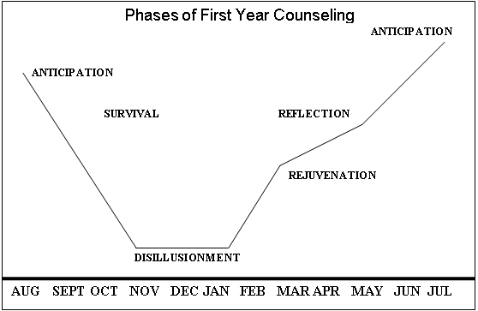
Source: Lipton & Wellman (2003)
PHASES OF FIRST YEAR COUNSELING
The school year has ups and downs! In looking at the Phases of First Year, one can better understand what may be happening at various times throughout the school year. It may offer some insight as to why new counselors may be feeling the way they are. The following chart shows the phases as they occur during the year followed by a description of each phase. It is interesting to talk about these phases and how they change for a more experienced counselor (Lipton & Wellman, 2003).

Slide 8
School Counselors as Adult Learners
Adults are motivated to learn as they experience needs and interests.
Adults orient learning to life.
Experience is the richest resource for adult learning.
Adults have a deep need to be self-directing.
Individual differences between people increase with age*.

Slide 9
Observation Feedback & Training
School Counselor Performance | Student Response/Source of Evidence | Reflective Questioning
The year long calendar presented by the mentee | This shows your dedication to planning as a crucial part of your program. | Do you see certain times you will need more support? How can you plan ahead?
Notes:
CAN WE ADD MORE SPECIFIC EXAMPLES TO MAKE THIS MORE HIGH QUALITY?
DO WE HAVE RESOURCES FOR GIVING FEEDBACK NOT EVALUATIVE!

Slide 10
Time Crunchers (reported by beginning counselors)
After school activities
Non-school counseling responsibilities
Tragic student issues
Faculty and other meetings
Graduate school
Workload
Parent meetings
Paperwork
Maintaining counseling office
Finding resources
Notes:
Mentees – this would be a great place where mentors would be ready and able to answer and help through situations that arise in any of these circumstances
Mentors – these would be more “in the moment” issues that mentees might experience and would like help with.
GUARD your time especially in these situations!

Slide 11
appointments
Biggest Barrier is TIME!!
Use various technology
Plan together
Be creative! Eat lunch or breakfast or meet before or after school.
Remember: Finding time is an expression of commitment!
Notes:
What are some other common problems that might be an issue for mentors/mentees? Are there solutions? – discuss!
Make a calendar PD appointment in calendar – priority!

Slide 12
Overview of Program Expectations

Slide 13
Relationship
Curriculum
Success
collaboration
Integral to increase growth
FIT needs of individual!!
respect
TIME!
Notes:
DESE will not be collecting experiences!
Mentees are encouraged to keep a copy in a “personnel” folder if requested by administration

Slide 14
Mentee
Keep in Prof. Development folder at your district.
Attends in person mentoring training
Logs reflections on topics
Feedback on experiences
Attends in person mentoring training
Logs all contact & submits cc’ing mentee at end of year
Pairs mentors and mentees in region
Conducts mentoring trainings
Communicates with DESE
Certificates upon 2 year completion
Handles contracts with mentors
Submit verification to DESE at end of each year
Addresses grievances Here to clarify ANY questions!! (Amber.Ernst@dese.mo.gov)
Mentee
Mentor
Mentor
Regional Chairs
DESE
DESE

Slide 15
Mentor Logistics
$500 contract encompassing work for the two years per mentee will be issued at the end of year one.
DESE will have contacted you if paired with a mentee and let you know you are paired up with a mentee.

Slide 16
Logs
Contact Logs are available on the DESE Mentoring website.
Can use Google to send spreadsheets to each pair and monitor!
Regional Chairs will Accept all Invites.
Notes:
If you do not have access to Google see it on website
(Add to dedicated Google Folder for easier access)

Slide 17
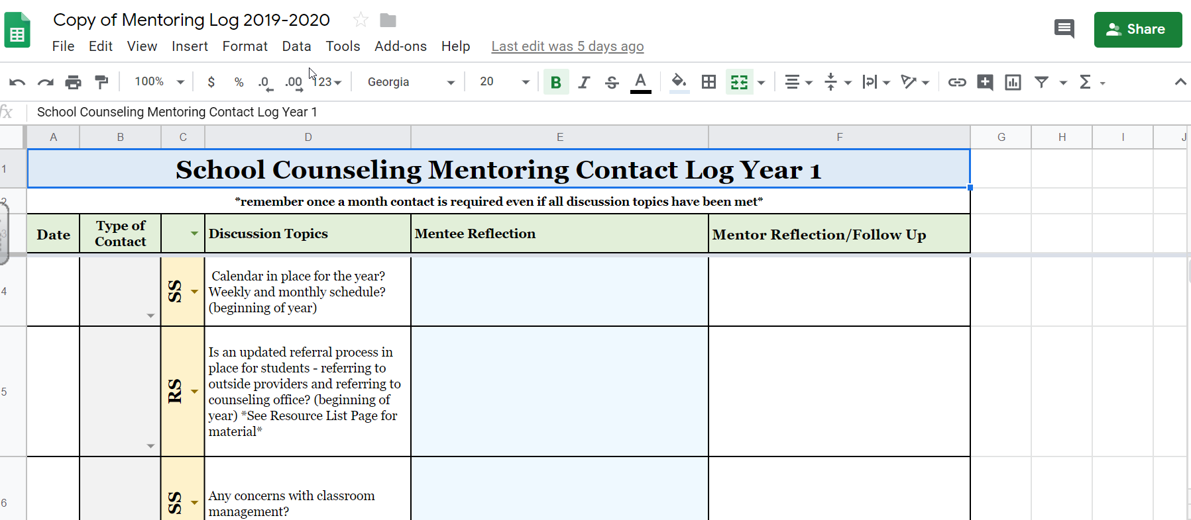
Mentoring Contact Log
Notes:
2 Tabs, Year 1 and Year 2

Slide 18
Certification Upgrade
2 year of mentoring is only ONE component for upgrading certification.
Also needed:
4 years of experience
Professional development (school district defines)
Evaluation (school district defines)

Slide 19
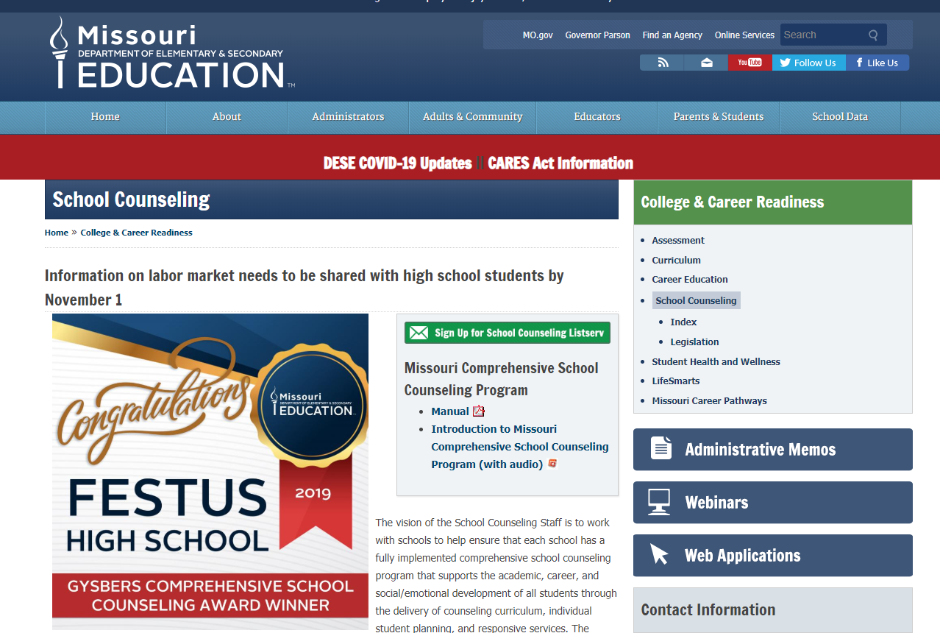
Sign up for the Listserv!
https://dese.mo.gov/college-career-readiness/school-counseling
Use the green button to sign up!

Slide 20

This is all about supporting beginning school counselor successfully! Great partnerships grow confident and capable school counselors!

