Slide 1
ADVISORY COUNCIL MEMBERS
Advisory Council on the Education of Gifted and Talented Children
Dr. Linda Smith, Chair, Clayton
Dr. Steve Coxon, Maryville University
Dr. Rosemary Hodge Graves, North Kansas City
Ms. Sally Holt, Bernie
Dr. Robin Lady, Rockwood
Ms. Lenae Lazzelle, Springfield
Dr. Beth Winton, Columbia
DESE SUPPORT MEMBERS DATA ANALYSIS SUPPORT
Mr. David Welch Dr. Matt Goodman
Ms. Renee Hasty EducationPlus

Slide 2
COUNCIL BACKGROUND
Established in 2013 after passage of State Statute 161.249 by the Missouri legislature
Composed of seven Missouri residents with expertise in gifted education
Members appointed by the Commissioner of Education
Responsible for providing advice “regarding all rules and policies to be adopted by the State Board of Education relating to the education of gifted and talented children” in Missouri.
GOALS OF REPORT
GOAL 1: Create a data-driven understanding of the current status of gifted programs in the state.
GOAL 2: Make recommendations for improvement in Missouri’s efforts related to gifted and talented children.
GOAL 3: Establish a ‘baseline’ for future analyses and recommendations.

Slide 3
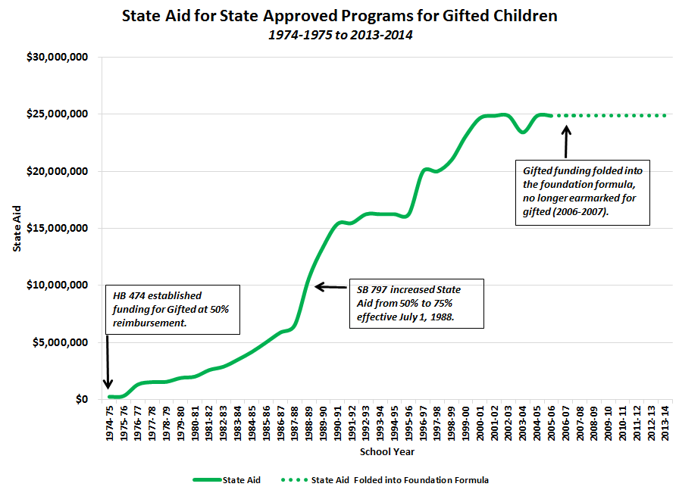

Slide 4
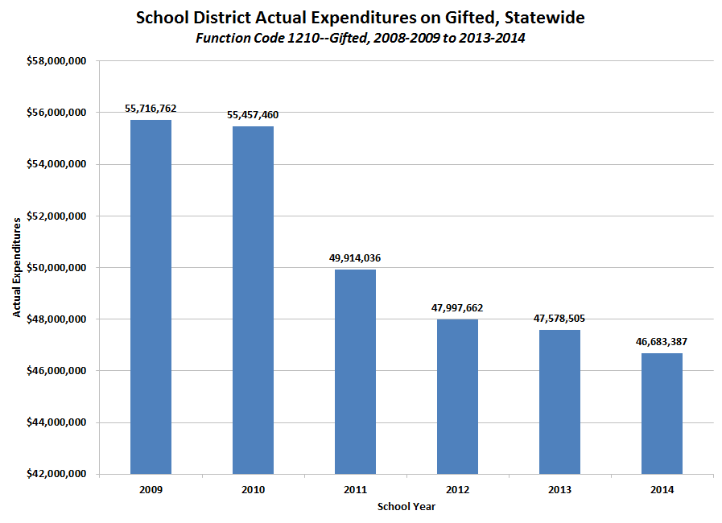

Slide 5
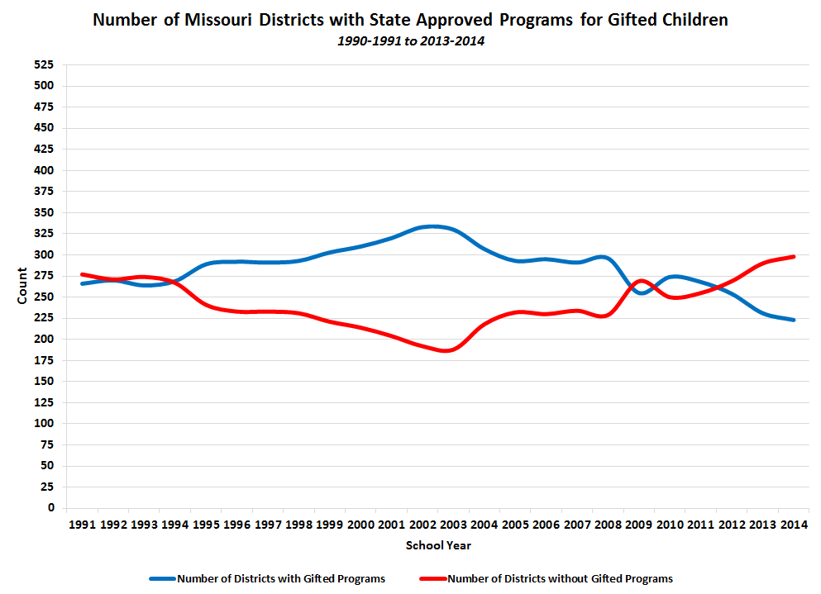

Slide 6
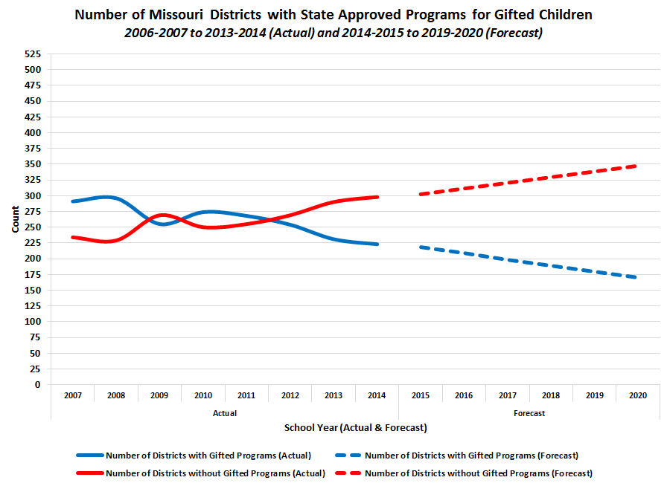

Slide 7
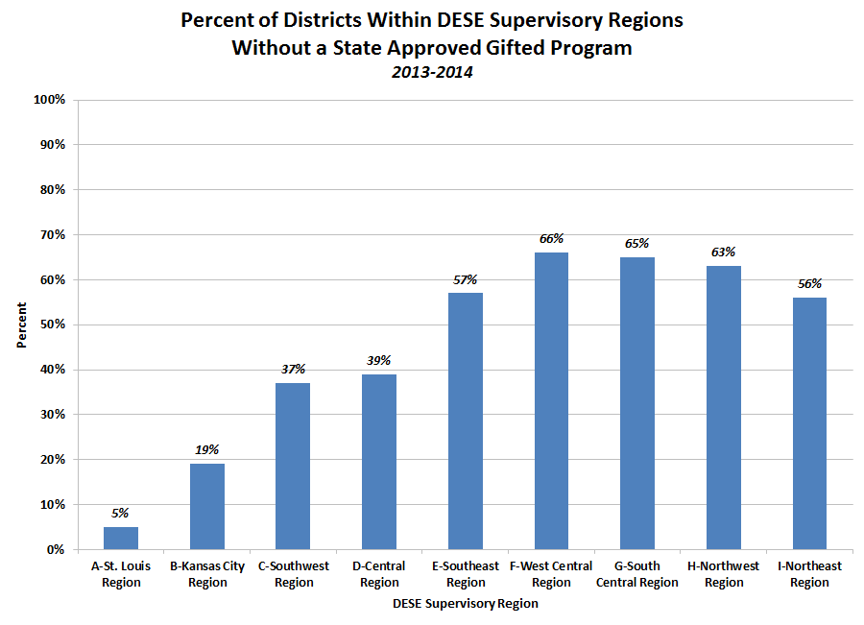

Slide 8
Analysis of Current Gifted Served Compared to 5% and 10% of Student Population
Region | 2014 Missouri Public School Students | 2014 Actual Gifted Students Identified and Served | 2014 Current Percent of Students Identified and Served | 5% |  |  | 10%
 |  |  |  | Students Identified and Served | Additional Students to Reach 5% | Percent Increase to Reach 5% | Students Identified and Served | Additional Students to Reach 10% | Percent Increase to Reach 10%
A-St. Louis | 265,211 | 19,252 | 7.3% | 13,261 |  |  | 26,521 | 7,269 | 38%
B-Kansas City | 175,034 | 7,568 | 4.3% | 8,752 | 1,184 | 16% | 17,503 | 9,935 | 131%
C-Southwest | 141,931 | 4,845 | 3.4% | 7,097 | 2,252 | 47% | 14,193 | 9,348 | 193%
D-Central | 79,368 | 3,643 | 4.6% | 3,968 | 325 | 9% | 7,937 | 4,294 | 118%
E-Southeast | 65,584 | 1,503 | 2.3% | 3,279 | 1,776 | 118% | 6,558 | 5,055 | 336%
F-West Central | 38,241 | 703 | 1.8% | 1,912 | 1,209 | 172% | 3,824 | 3,121 | 444%
G-South Central | 57,345 | 1,534 | 2.7% | 2,867 | 1,333 | 87% | 5,735 | 4,201 | 274%
H-Northwest | 34,007 | 876 | 2.6% | 1,700 | 824 | 94% | 3,401 | 2,525 | 288%
I-Northeast | 28,555 | 842 | 2.9% | 1,428 | 586 | 70% | 2,856 | 2,014 | 239%
MISSOURI TOTAL | 885,276 | 40,766 | 4.6% | 44,264 | 9,489 | 23% | 88,528 | 47,762 | 117%

Slide 9
In comparison with border states, only Missouri and Illinois do not have a gifted mandate or earmarked funds for gifted programming. In Iowa and Oklahoma, gifted programming is mandated and fully funded by the state. In Kansas, Arkansas, Tennessee and Kentucky, gifted programming is mandated and partially funded by the state. In Nebraska, gifted programming is not mandated but has funds available for gifted programming.
Of the “Top 10 by 20” DESE comparison states, seven have a mandate for gifted programming. Those states are Connecticut, Maine, Minnesota, Montana, New Jersey, Virginia and Wisconsin. Only Massachusetts, New York and Vermont have no mandate. Five of the states have partial funding for gifted programming. Those states are Maine, Minnesota, New Jersey, Virginia and Wisconsin.
COMPARISON STATES

Slide 10
RECOMMENDATIONS
The report concludes with 10 recommendations for action, grouped into five broad areas:
Reporting data on gifted students and programs
Identification of gifted students
Programming for gifted students
Educator preparation and professional development
Requiring and funding gifted education
Report Pages: 37-43
Format: Problem – Recommendation – Rationale

Slide 11
www.dese.mo.gov/gifted-advisory-council

