Slide 1
S.M.A.R.T. Goals
DESE Zoom November 4, 2021
The Why, What and How

Slide 2
Training Agenda
Before we begin: Definitions and reminders
Why: The case for SMART goals
What: Unpacking the required components of a SMART goal
How: Step by step recipe for SMART goal development
Review of the S.M.A.R.T. Goal Rubric

Slide 3
SMART Goals: Common Vocabulary
SMART Goals: Annual IEP goals that are written in a manner so they are specific, measurable, attainable, results oriented and timebound.
SMART acronym does not appear in IDEA but does appear in Missouri State Plan for Special Education (Regulation IV) and in Missouri Compliance Standards and Indicators (200.810)

Slide 4
IDEA’s Exact Words
§ 300.320 Definition of individualized education program.
(2) (i) A statement of measurable annual goals, including academic and functional goals designed to -
(A) Meet the child's needs that result from the child's disability to enable the child to be involved in and make progress in the general education curriculum; and
(B) Meet each of the child's other educational needs that result from the child's disability;
(ii) For children with disabilities who take alternate assessments aligned to alternate academic achievement standards, a description of benchmarks or short-term objectives;

Slide 5
SMART Goals: A Few Reminders
Present level of academic and functional performance statement (PLAAFP) provides the foundation for SMART goal development
The quality and appropriateness of SMART goals is directly linked to the quality and appropriateness of PLAFFP statement in IEP
  A well written PLAAFP = SMART goals that provide FAPE and educational benefit
  A poorly written PLAAFP = SMART goals that will most likely not provide FAPE or provide educational benefit
The foundation for the PLAAFP is the evaluation report
  Poorly written evaluation report=> weak PLAFFP=> “non” SMART goals
  Comprehensive evaluation report =>data rich, comprehensive PLAAFP=> SMART Goals
Remember the Golden Thread

Slide 6
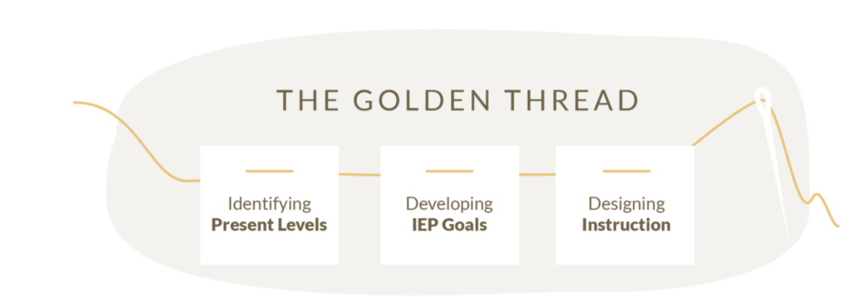
Golden Thread
Evaluation Report: Eligibility Determination Data

Slide 7
Why: The Case For SMART Goals

Slide 8
Endrew F. Standard
Endrew F. clarified the substantive standard for determining whether a child’s IEP – the centerpiece of each child’s entitlement to FAPE under the IDEA – is sufficient to confer educational benefit on a child with a disability.
The Supreme Court determined that, “[t]o meet its substantive obligation under the IDEA, a school must offer an IEP [individualized education program] that is reasonably calculated to enable a child to make progress appropriate in light of the child’s circumstances.”
The Court additionally emphasized the requirement that “every child should have the chance to meet challenging objectives.”

Slide 9
Endrew F Standard (Cont.)
The IEP must include annual goals that aim to improve educational results and functional performance for each child with a disability.
Each child with a disability must be offered an IEP that is designed to provide access to instructional strategies and curricula aligned to both challenging State academic content standards and ambitious goals, based on the unique circumstances of that child.
The IEP must be developed in a way that ensures that children with disabilities have the chance to meet challenging objectives, as reflected in the child’s IEP goals.
Each child’s IEP must include, among other information, an accurate statement of the child's present levels of academic achievement and functional performance and measurable annual goals, including academic and functional goals. This information must include how the child's disability affects the child's involvement and progress in the general education curriculum.
The IEP Team’s effectiveness in gathering and interpreting this information will ensure that, in establishing IEP goals, the child has the opportunity to meet challenging objectives.

Slide 10
Endrew F. Standard (Cont.)
ED wrote that, so that the Endrew F. standard is met for each individual child with a disability, districts must implement policies, procedures, and practices related to:
  1) identifying present levels of academic achievement and functional performance;
  2) the setting of measurable annual goals, including academic and functional goals; and
  3) how a child's progress toward meeting annual goals will be measured and reported.
In Questions and Answers on Endrew F. v. Douglas County School District. Re-1, 71 IDELR 68 (EDU 2017)

Slide 11
Top 10 Indicators Out of Compliance
SMART goal indicators consistently rank among in the top 10 indicators out of compliance during DESE’s cyclical monitoring
200.810 A statement of measurable annual goals, including academic and functional goals
  The IEP includes goals that:
  200.810.a.Demonstrate consistency with the content of the present level of performance.
  200.810.b.Are written in terms that are:
    200.810.b.(1) Specific to a particular skill or behavior to be achieved,
    200.810.b.(2) Measurable
    200.810.b.(3) Attainable (can reasonably be accomplished within the duration of the IEP)
    200.810.b.(4) Results oriented, and
    200.810.b.(5) Time-bound (generally happen within one(1)year)
  .200.810.c.Enable the child to be involved in the general education curriculum, as appropriate (for preschool children, participation in appropriate activities)
  200.810.d.Address the child’s other educational needs resulting from her/his disability.
  200.810.e.Are present for each special education and related service (N/A for transportation as a related service)
  200.810.f.For children taking alternate assessments, description of benchmarks or short-term objectives aligned to alternate achievement standards.
  NOTE: Measurable means written in terms that includes the skill or behavior and the level of attainment that will be achieved

Slide 12
What: Unpacking the SMART Goal Components

Slide 13
In general, SMART Goals are:
  Linked to the PLAAFP & Evaluation Report
  Instructionally relevant
  Address both academic and functional needs of the student
  Written in terms parents and educators can understand.
  Support participation & progress in the general education curriculum.
  Align and support with post secondary goals

Slide 14
Standards and Indicators
200.810 A statement of measurable annual goals, including academic and functional goals
  The IEP includes goals that:
  200.810.a.Demonstrate consistency with the content of the present level of performance.
  200.810.b.Are written in terms that are:
    200.810.b.(1) Specific to a particular skill or behavior to be achieved,
    200.810.b.(2) Measurable
    200.810.b.(3) Attainable (can reasonably be accomplished within the duration of the IEP)
    200.810.b.(4) Results oriented, and
    200.810.b.(5) Time-bound (generally happen within one(1)year)
  .200.810.c.Enable the child to be involved in the general education curriculum, as appropriate (for preschool children, participation in appropriate activities)
  200.810.d.Address the child’s other educational needs resulting from her/his disability.
  200.810.e.Are present for each special education and related service (N/A for transportation as a related service)
  200.810.f.For children taking alternate assessments, description of benchmarks or short-term objectives aligned to alternate achievement standards.
  NOTE: Measurable means written in terms that includes the skill or behavior and the level of attainment that will be achieved

Slide 15
200.810.a
200.810.a.Demonstrate consistency with the content of the present level of performance
  Goals address specific skills or behaviors noted in the PLAAFP as a disability related need of the child based on their unique circumstances and individualized needs
  A goal is not necessary to address each specific skill or behavior noted in the PLAAFP, but there should be a goal to address each area of disability related need
    Example: If student is SLD in reading comprehension and math calculation, it is expected that there would be at least one goal for each area of disability related need, ie no less than one goal that addresses reading comprehension and no less than one goal that addresses math calculation

Slide 16
200.810.b
  200.810.b.Are written in terms that are:
    200.810.b.(1) Specific to a particular skill or behavior to be achieved,
    200.810.b.(2) Measurable
    200.810.b.(3) Attainable (can reasonably be accomplished within the duration of the IEP)
    200.810.b.(4) Results oriented, and
    200.810.b.(5) Time-bound (generally happen within one(1)year)

Slide 17
200.810.b (1)
  200.810.b.(1) Specific to a particular skill or behavior to be achieved,
  Answers the questions
    “What do we want the student to do?”
    “What specific skills will the student need to do to accomplish the goal?”
  Key word “specific”
  Describes the precise skill or behavior we want the student to do
  Uses an action verb
    Avoid using vague open ended verbs such as know, understand, appreciate, learn, remember or comprehend
  Skill or behavior must be able to be observed and measured
Reference: ModelTeaching.com

Slide 18
Specific Examples
Specific: Non-examples**
  “Increase his Aimsweb reading score to a 334”
  “Decrease inappropriate behavior”
  “Make and maintain passing grades”
  “complete grade level writing assignments”
Specific: Examples**
  “Increase his ability to decode words containing long vowel patterns”
  “ Decrease incidents of biting when she is asked to transition to a nonpreferred activity”
  “Increase the accuracy of his note taking skills when using a 3 column note taking graphic organizer”
  “Increase her sentence composition skills by constructing grammatically correct sentences over given topic”
  ** These are not complete goals

Slide 19
200.810.b (2)
200.810.b.(2) Measurable
  Answers the questions:
    “How are we measuring the skill/behavior?”
    “To what degree or mastery level should the student be able to perform skill/behavior?”
    “Would a stranger be able to determine what the goal is measuring, how it is being measured and when the goal would be considered mastered?”
  Describes the quantity, quality, and/or time measurement for mastery of the behavior or skill
  Teams need to determine measurement tool while developing the goal

Slide 20
Measurable Examples
Measurable: Non-examples
  “Increase reading decoding”
  “ Will obtain a passing score”
  “Will stay on task”
Measurable: Examples
  “Will increase his ability to decode long vowel sounds from 60% accuracy to 95% accuracy 4/5 data collection days”
  “Will compute 15/20 single digit multiplication facts accurately on teacher created weekly fact assessments on 15/15 assessments given this semester”
  “will increase his time on task during preferred activities (independent reading and computer time) from his current baseline of 5 minutes to 7 minutes, as measured by teacher observations during 4/5 data collection periods.”

Slide 21
200.810.b (3)
200.810.b.(3) Attainable (can reasonably be accomplished within the duration of the IEP)
  Answers the questions:
    “Given what we know of student’s current performance and past rate of progress, what skills/behaviors would be reasonably calculated to be attainable during this IEP cycle? And to what degree of mastery?”
    “ Based on student’s current functioning, is it reasonable to expect the student to attain this goal within this IEP cycle?
  Use data in PLAAFP, including parent input to guide discussion regarding attainability of goal
Be careful not to set the bar too low; have high expectations for success, yet base those expectations on student data

Slide 22
200.810.b(4)
200.810.b.(4) Results oriented
This component goes hand in hand with “measurable” and “specific” components
Answers the questions:
  “What is the end result we expect to see when this goal is mastered?”
  “What specifically will the student need to do to accomplish the goal?”
  “What is the level of educational benefit that we expect to see when this student masters the goal?”
  “ How will mastery be measured?”
  “What condition needs to be present in order for student to achieve goal?”
How to Recognize SMART IEP Goals | Individualized Education Program | Understood - For learning and thinking differences

Slide 23
200.810.b (5)
200.810.b.(5) Time-bound (generally happen within one(1)year)
Generally, it is assumed goal will be addressed and mastered within one annual IEP cycle, unless another timeframe is specifically stated in goal
Goals can be created for less than one year (i.e for a semester or quarter) if team determines that is most appropriate timeframe to address goal
  Must be clearly stated in goal if using another timeframe other than the IEP cycle
  Example: “During first semester of the 2021-2022 school year, Student will….”
  Example: “…this goal will be addressed during the third and fourth quarters of student’s 4th grade year.”

Slide 24
Let’s Review A SMART Goal
Over the course of the IEP cycle, when given a teacher created text passage of 100 words at the 2.0 reading grade level, Student will orally read aloud the text passage with 95% or greater accuracy on 4/5 data collection days each quarter. Student’s current baseline is 70% accuracy on 2.0 grade level passage of 100 words.
Specific Skill: Orally read aloud
Measurable: 95% or greater accuracy on teacher created 100 word passage, on 4/5 data collection days each quarter
Attainable: Current baseline 70% accuracy, rate of improvement noted in PLAAFP indicated 2.0 words per week improvement goal is reasonable based on past performance
Results oriented: when given 2.0 grade level text passage of 100 words student will read with 95%+ accuracy
Time-bound: Over the course of the IEP cycle

Slide 25
200.810.c
200.810.c.Enable the child to be involved in the general education curriculum, as appropriate (for preschool children, participation in appropriate activities)
  Link goals to skills necessary for student to be involved in and make progress in the general education curriculum
  Aligned to grade level standards (Missouri Learning Standards or Essential Elements)
  Examine student’s current functioning and the expectations for student’s age/grade/courses then create goals that develop skills and behaviors necessary for the student to make progress towards age/grade/course level expectations
  Academic and functional goals may be necessary for the child to be involved in the general education curriculum

Slide 26
Connecting to the Standards
  “To help make certain that children with disabilities are held to high expectations and have meaningful access to a State’s academic content standards, we write to clarify that an individualized education program (IEP) for an eligible child with a disability under the Individuals with Disabilities Education Act (IDEA) must be aligned with the State’s academic content standards for the grade in which the child is enrolled.”
  “IEP goals must be aligned with grade-level content standards for all children with disabilities.”
  Add statement about uniqueness of needs
Taken from the OSEP Guidance Letter on FAPE, November 16, 2015; https://sites.ed.gov/idea/files/idea/policy/speced/guid/idea/memosdcltrs/guidance-on-fape-11-17-2015.pdf

Slide 27
Missouri Learning Standards and Essential Elements are KEY!
For academic standards the Missouri Learning Standards (MLS) or Essential Elements (EE) should be used to develop goals.
MLS:
https://dese.mo.gov/college-career-readiness/curriculum/missouri-learning-standards
EE:
https://dese.mo.gov/college-career-readiness/assessment/map-a
Notes:
Every state has academic standards that describe what students are to know and to do in each core area in every grade. Those standards are the framework for teaching. In Missouri, we have the Missouri Learning Standards. The MAP Test is based on the Missouri Learning Standards. Using the MLS to develop IEP goals helps us move our students toward achieving grade level academic standards. It also helps provide them access to the general education curriculum and be better prepared for the MAP test.
For our students who have more significant cognitive disabilities and take the MAP-A, the essential elements serve as curriculum. The Essential Elements are used to develop IEP goals. The Essential Elements are based on the Missouri Learning Standards, just at a lower level.

Slide 28
Links to Assist with Standards Based Goals
  Priority Standards
  https://dese.mo.gov/college-career-readiness/curriculum/academic-standards/priority-standards
  Assessment Resources
  ELA https://dese.mo.gov/college-career-readiness/curriculum/english-language-arts
  Math https://dese.mo.gov/college-career-readiness/curriculum/mathematics
Notes:
When we are looking at Standards Based Goals it is important to understand that there are priority standards that can assist us with identifying what key concepts are most important for the student to utilize such as the priority standards and assessment resources for both ELA and Math.

Slide 29

200.810.d
200.810.d.Address the child’s other educational needs resulting from her/his disability.
Notes:
Goals should address academic and functional needs that are a result of the unique disability related needs

Slide 30
200.810.e
200.810.e. Are present for each special education and related service (N/A for transportation as a related service)
  Each IEP goal should have at least one corresponding service
  Having goals without related programming indicates that the district is not providing FAPE
  Related services are required to have goals if the student receives instruction during the provision of the related service
Notes:
Example: If transportation is only necessary to enable the student to attend school and is not intended to increase the student’s skills. (OSEP 1994, Letter to Hayden, 22 IDELR 501)
We had a conversation around this indicator on when goals are appropriate for related services and are not appropriate. There may be specific situations where a goal may not be appropriate because no specialized instruction is taking place such as health or nurse services, and transportation. No instruction = no goal

Slide 31
200.810.f
  200.810.f.For children taking alternate assessments, description of benchmarks or short-term objectives aligned to alternate achievement standards.
    MAP A eligible students are required to have benchmarks of short-term objectives for each annual goal, including related services goals
Notes:
Students who have the most significant cognitive disabilities demonstrate smaller increments of progress therefore benchmarks or short-term objectives are required to paint a clear picture of progress towards the annual goal.

Slide 32
Short-Term Objectives Vs. Benchmarks
Short Term Objective | Benchmark
Measurable intermediate steps | Major milestones
Break down skills described in annual goal to discrete components | Describe the progress the child is expected to make within specified segments of time
Notes:
Short Term Objectives are your stair steps they break down skills described in an annual goal to distinct components.
Where as
Benchmarks are your major milestones they describe the progress the child is expected to make within a specific amount of time going- the progression of 30%- 60% over time

Slide 33
Short Term Objectives Example
By the end of the IEP cycle, when presented with a 100 word 1.0 grade level passage, David will orally read the passage with 95% or greater accuracy on 4/4 consecutive data collection days, as measured teacher created oral reading probes
By October, when given a list of 20 unfamiliar words that contain short-vowel sounds, David will decode them with 95% accuracy on each of 5 trials.
By November, when given 20 unfamiliar words that contain long-vowel sounds, David will decode them with 95% accuracy on each of 5 trials.
By January, David will correctly pronounce 20 words with 95% accuracy on each of 5 trials to demonstrate understanding of the rule that where one vowel follows another, the first vowel is pronounced with a long sound and the second vowel is silent (ordeal, coast).
By April, David will correctly separate 20 words by syllables with 95% accuracy on each of 5 trials to demonstrate understanding of the rule that each syllable in a word must contain a vowel (les-son).

Slide 34
Benchmark Examples
By the end of the IEP cycle, when presented with a 100 word 1.0 grade level passage, David will orally read the passage with 95% or greater accuracy on 4/4 consecutive data collection days, as measured teacher created oral reading probes
By the end of first quarter David will orally read a 100 word Kdg level passage with 95% accuracy on 4/4 data collection days as measured by teacher created oral reading probes.
By end of second quarter David will orally read a 100 word 1.0 grade level passage with 80% accuracy on 2/4 data collection days as measured by teacher created oral reading probes.
By end of third quarter, David will orally read a 100 word 1.0 grade level passage with 95% accuracy on 3 / 4 data collection days as measured by teacher created oral reading probes.

Slide 35
How To Create SMART Goals
Step by Step Recipe for Creating SMART Goals

Slide 36
SMART Goals
Remember “BCCT” to “B” Compliant
Behavior
Condition
Criteria
Time-bound
Behavior: | Criteria:
Condition: | Time-bound:
Notes:
Read Slide

Slide 37
BCCT Goal Formula
Who
Student
Behavior
Will do What
Time Frame
In what length of time
Conditions
Under What Conditions
Criteria
To what level or degree
Notes:
Read Slide

Slide 38
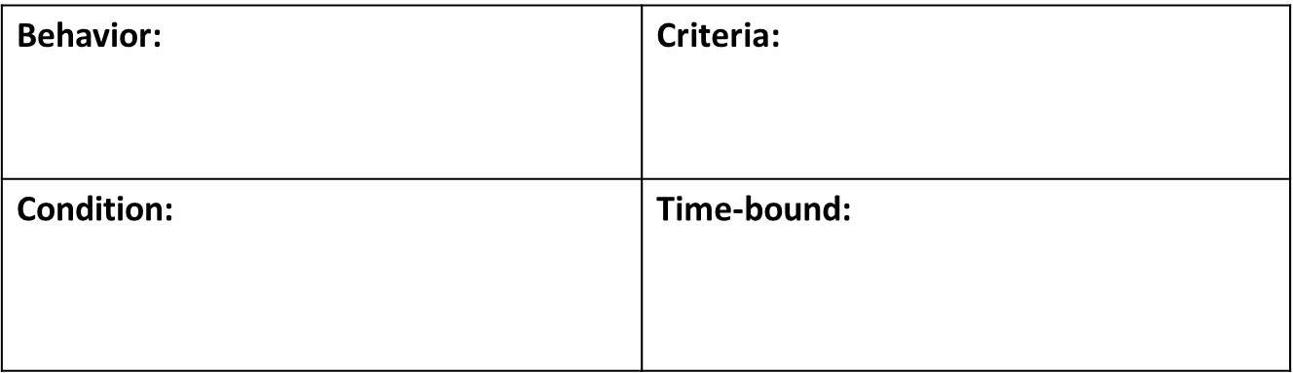
BCCT SMART Goal Example
During the course of this IEP, Amy will answer comprehension questions when reading 3rd grade level text from a baseline of 40% accuracy to 70% accuracy on 3 of 4 trials.
Answer comprehension questions
From a baseline of 40% accuracy to 70% accuracy 3 out of 4 trials
When given a 3rd grade level text
During course of IEP
Notes:
Behavior- What will they do?
Condition- Under what condition?
Criteria- What level or degree
Time frame- in what length of time?

Slide 39
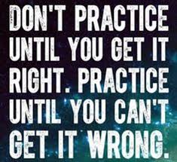
Let’s Practice
Annual Goal:
When given a nonpreferred task (independent math assignment or journal writing assignment), Student will start working on task within 1 minute of teacher prompt as measured by teacher observation 4/5 data collection days per month.
Notes:
Break this goal down into BCCT components
What is the behavior? They will do what?
What is the condition? Under what condition?
What is the criteria? To what level or degree ?
What is the time? What is the length of time?
Behavior: Start working on task
Condition: When given a non preferred task
Criteria: Within 1 minute of teacher prompt 4/5 data collection days
Time-based- duration of IEP (implied)

Slide 40
Answer
When given a nonpreferred task (independent math assignment or journal writing assignment), Student will start working on task within 1 minute of teacher prompt as measured by teacher observation 4/5 data collection days per month. Current baseline: student starts work on tasks greater than 3 min after teacher prompting
Within 1 minute of teacher prompt, on 4/5 data collection days
Start working on task
When given a nonpreferred task
IEP cycle (implied)

Slide 41
  How many SMART goals do we need to create per IEP?
    It depends on the unique needs of the student. Court rulings and state administrative decisions indicate that an IEP should have at least one annual goal for each area of need. See, e.g., A.D. v. Creative Minds Int'l Pub. Charter Sch., 77 IDELR 163 (D.D.C. 2020) (holding that a public charter school violated the IDEA by failing to include math goals in a fourth-grader's IEP despite her documented struggles in math).
      Retrieved 10/21 from SpecialEdConnections: Focus on Quality not Quantity of IEP Goals
Notes:
As special education consultant Carol Kosnitsky noted, however, that may not be adequate for some students with disabilities. Some students may need more than one goal per area of need. According to Kosnitsky, "less may be more" when deciding the number and type of goals to include in a student's IEP. She recommended that the team members consider the following question: "Which skill(s) and behavior(s) are most essential for the student to acquire now to have the most impact on the student's trajectory next year?” "The very idea that a pre-determined number of goals would appropriately apply to a group as diverse as those students with IEPs is antithetical to the whole idea of an Individualized Education Program," she said.
Retrieved 10/21 from SpecialEdConnections: Focus on Quality not Quantity of IEP Goals,

Slide 42
  Can we write broad generalized goals, such as “student will use study skills”?
    The description of annual goals should be specific enough to allow the district to determine whether the student made progress and also make clear which specific skills will be required in order to achieve those goals. 64 Fed. Reg. 12,471 (1999). See D.S. and A.S. v. Bayonne Bd. of Educ., 54 IDELR 141 (3d Cir. 2010)
    The IEP team must write IEP goals in a way that allows for an objective measurement of the child's progress toward achieving the annual goals.
    Use the stranger test
      Retrieved 10/21 from SpecialEdConnections:Smart Starts IEP Goals
Notes:
In Mason City Community School District, 46 IDELR 148 (SEA IA 2006), the administrative law judge suggested that a properly written IEP goal will pass the "stranger test." That is, a person unfamiliar with the student's IEP would be able to implement the goal, assess the student's progress on the goal, and determine whether the student's progress was satisfactory.

Slide 43
  Can IEP goals be recycled each year?
  If a student's annual IEP goals appear substantially similar or the same year-to-year, that's a red flag that the student may not be receiving FAPE. See, e.g. Damarcus S. v. District of Columbia, 67 IDELR 239 (D.D.C. 2016) (The fact that an IEP team repeated a District of Columbia student's goals across multiple IEPs was a good indication that the IEPs weren't designed to produce progress.).
  BUT- The parents of a child with ADHD and specific learning disabilities could not convince the 3d Circuit that the repetition of their daughter's annual goals in two successive IEPs established a denial of FAPE. Noting that the student's baseline performance improved during that time, the 3d Circuit held that the student made progress that was appropriate in light of her circumstances. see K.D. v. Downington Area Sch. Dist., 72 IDELR 261 (3d Cir. 2018)
    Retrieved 10/21 from SpecialEdConnections:Smart Starts IEP Goals

Slide 44
SMART Goal Resources
LRP SpecialEdConnections: Smart Starts Annual Goals
Parentcenterhub.org: https://www.parentcenterhub.org/iepgoals/
Understood.org : https://www.understood.org/articles/en/how-to-tell-if-your-childs-iep-goals-are-smart

Slide 45
S.M.A.R.T. Goal Rubric
PDF Link: https://dese.mo.gov/media/pdf/smart-goal-rubric-pdf
Word Link found under Topic Resources: https://dese.mo.gov/special-education/effective-practices/special-education-directors
Notes:
This is located on the special education directors resource page as well as within the presentation. Please utilize this rubric with your staff in training them on SMART Goals. This would be a great SMART goal fidelity check to ensure our annual goals are within compliance.

Slide 46
Definitions:
READING -
Basic Reading skills include phonemic awareness, sight word recognition, phonic and word analysis, Essential skills include identification of individual sounds, and the ability to manipulate them. Identification of printed letters, and sounds associated with letters, and decoding of written language.
Reading Comprehension: ability to process text, understand its meaning, and integrate what the reader already knows. Skills within reading comprehension include fact/opinion, prediction of outcomes, sequencing, evaluate, main idea, cause/effect, basic recall of details, stating inferential and literal facts.
Reading Fluency: ability to read like you speak. Accuracy rate, proper expression, speed.
Notes:
Explain the reasoning behind why we put the definitions on the rubric.
Sometimes we may see a reading comprehension goal that is written but the student is really SLD basic reading skills and therefore the goal does not align to the service being provided. It is important that our special education case managers take time to look at these definitions and discuss what goals would be appropriate for the student to work on within the eligibility category.

Slide 47
Definitions, continued
WRITTEN EXPRESSION:
Highly complex, cognitive, self-directed process, including planning, translating (drafting), review and revising.
Skills include: grammar, composition, organization of writing, ideas, voice, word choice, sentence fluency, spelling, punctuation, sentence and paragraph structures, types of writing (entertainment, factual, biography), editing, and revisions.
MATHEMATICS:
Math Calculation: count, objects, compute simple math facts and operations. Skills: basic addition, subtraction, multiplication, division facts; step-by-step processes with 1,2,3 digits…
Math Problem Solving: examining questions to find the key ideas choosing appropriate strategy, doing the math facts, finding the answer and rechecking. Skills: interpreting charts/graphs, money, multiple step word problems, higher thinking math, algebra, geometry.

Slide 48
Definitions, Continued
BEHAVIOR/SOCIAL SKILLS:
SKILLS used daily to interact and communicate appropriately with others, includes verbal and nonverbal communication, body language, facial expressions, gestures.
Skills: show empathy, group activities, solve own problems, conflict resolution, relationship management, respect, active listening, and effective communication.

Slide 49
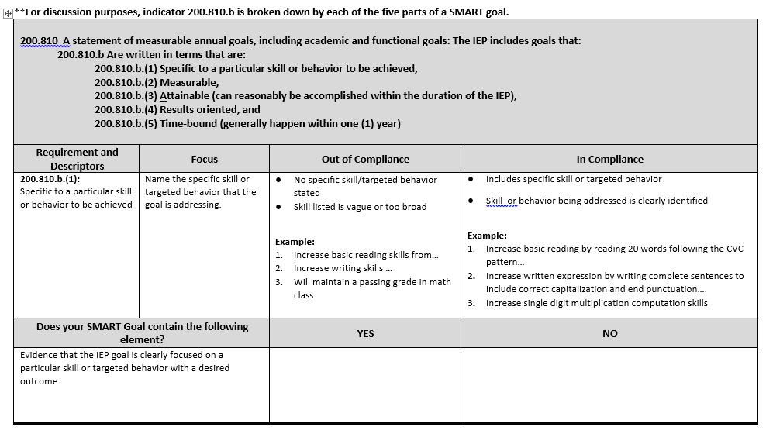
Notes:
On the first page of the rubric it focuses on Indicator 200.810.b (1) making sure the particular skill or behavior to be achieved is specific. This document provide information on what the main focus of the indicator is ( naming the specific skill or targeted behavior that the goal is addressing). It also provides you with examples of non-compliance and what it looks like to be within compliance.
*Non-Compliance would be when a specific skill or behavior is not listed or is vague and broad. For example when we say “Johnny will increase math calculation skills during the duration of the IEP”... I would want to know what is the specific skill that we are working on within math calculation to increase his level of knowledge...
Compliant Example: “Johnny will increase single digit multiplication computation skills ....”
When looking at your goals if you have focused on a particular skill or target behavior you will check yes ( you want all yes to be in compliance). If you check no, then we may need to reconvene and discuss revisions to the goal.

Slide 50
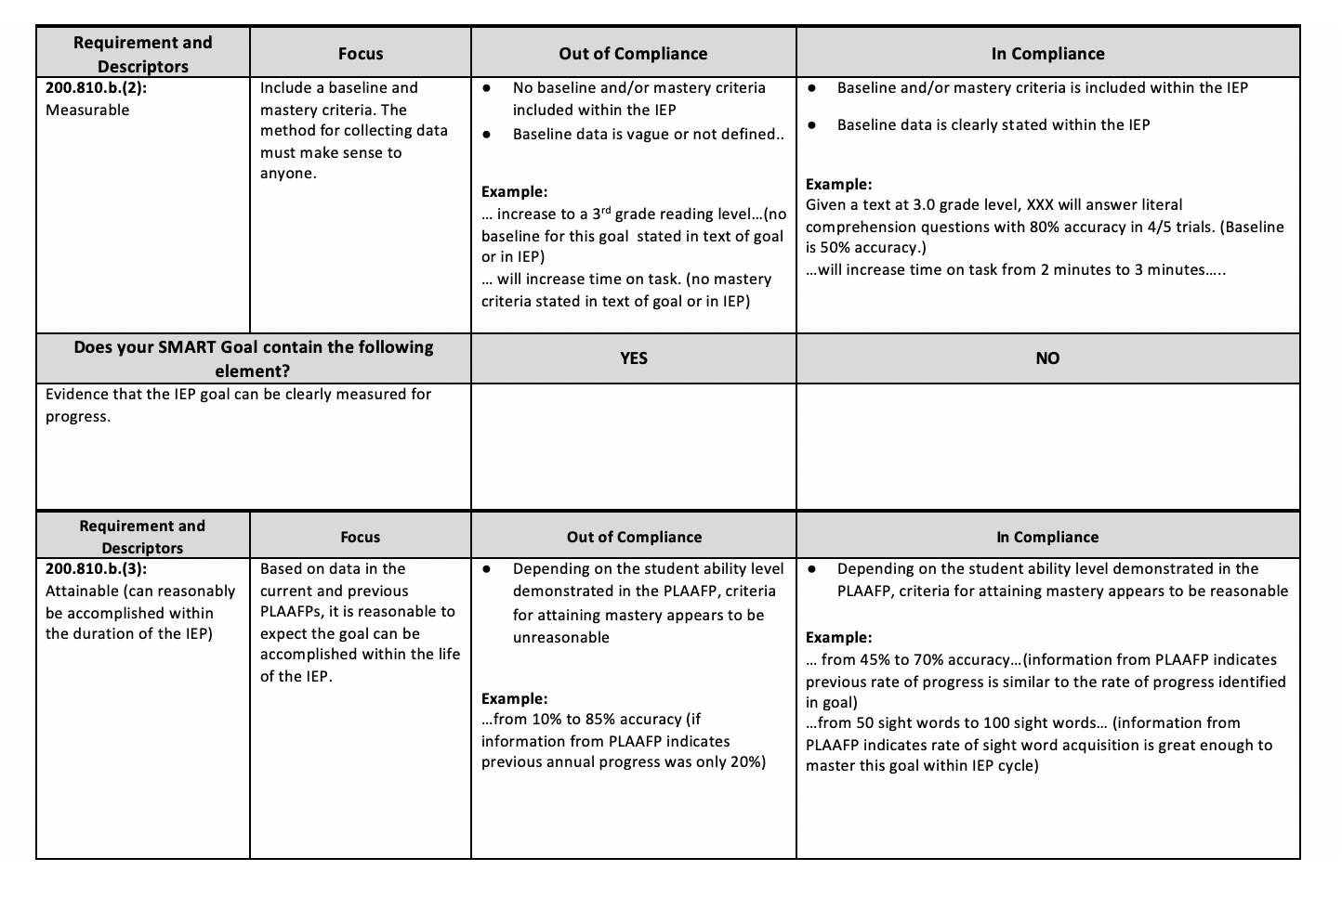
Notes:
Pg 2. goes into whether a goal is measurable. Our focus is including that we have baseline and mastery criteria. We are also looking for the method for collecting data that makes sense to all (stranger/ breath test). If there is no baseline data or the baseline data is too vague then it is out of compliance.
We also will mark whether or not the goal is attainable. In this section we are looking to determine whether the goal is based on data from the current and previous PLAAFP. You need to ask yourself, can this goal be reasonably accomplished within the duration of the IEP year. If the students ability level demonstrated within the PLAAFP is unreasonable (data demonstrated in previous annual progress shows student only making 20-30 % gains per year) for the goal, this would be considered out of compliance going from 0-90%.
Once again for both of these sections you will need to ask your self if your goal contains the criteria set forth in the rubric for measurement and attainability . If you mark yes- your in compliance!

Slide 51
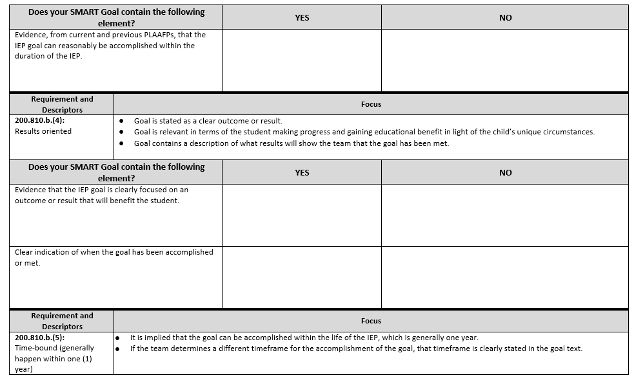
Notes:
Pg 3 and 4 deals with goals being results oriented, the focus is to ensure that the goal has a clear outcome or result. We want to make sure that goal is relevant in terms of the student making progress and gaining educational benefit in light of the child’s circumstances. Goals should contain a description of what results will show the team that the goal has been met.
Time bound- usually is within one IEP year. If the team determines another timeframe is more appropriate it needs to be stated.

Slide 52
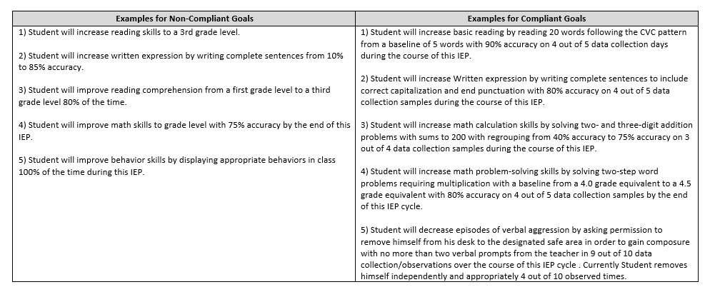

Slide 53
In Summary
Top 10 out of Compliance List (annually)
Present level of academic and functional performance statement (PLAAFP) provides the foundation for SMART goal development
Address both academic and functional needs of the student
Written in terms parents and educators can understand.
Support participation & progress in the general education curriculum.
Align and support with post secondary goals

Slide 54
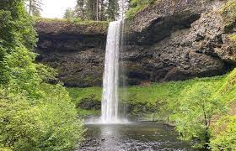
Waterfall in the Chat
DO NOT write until I say “GO!”
In the chat, write one thing you need to focus on to increase compliance within the 200.810 Indicators for SMART Goals
I am going to give you 30 seconds to write but do not hit enter until I say GO

Slide 55

Questions?
Notes:
On behalf of our compliance consultants and DESE supervisors, Julie and I want to thank you for joining us today. We appreciate all the work you are doing with your staff to ensure that we are writing high quality IEPs and in particular SMART Goals. We know your time is extremely valuable and we want to thank you for spending it with us.

Slide 56
Please Contact your Special Education Compliance Consultants for Further Questions
Region 1: Tiffiney Smith tdsmith@semo.edu
Region 2: Lynn Lynch lynchly@missouri.edu
Region 3: Bailey Tennesen tennesenb@umkc.edu
Region 4: Joetta Walter jwalter@Truman.edu
Region 5: Lauren Struthers laurens@nwmissouri.edu
Region 6: Leasa Day ldnd3@mst.edu
Region 7: Amy Phipps amyphipps@missouristate.edu
Region 8: Jeanne Rothermel jrothermel@edplus.org
Region 9: Julie Harris jharris@ucmo.edu
Notes:
If you have any further questions, please contact your local RPDC Compliance Consultant. We want to help you make this year run as smooth as possible. All of the ladies are extremely knowledgeable and can’t wait to hear from you!
Thank you for your time

Slide 57
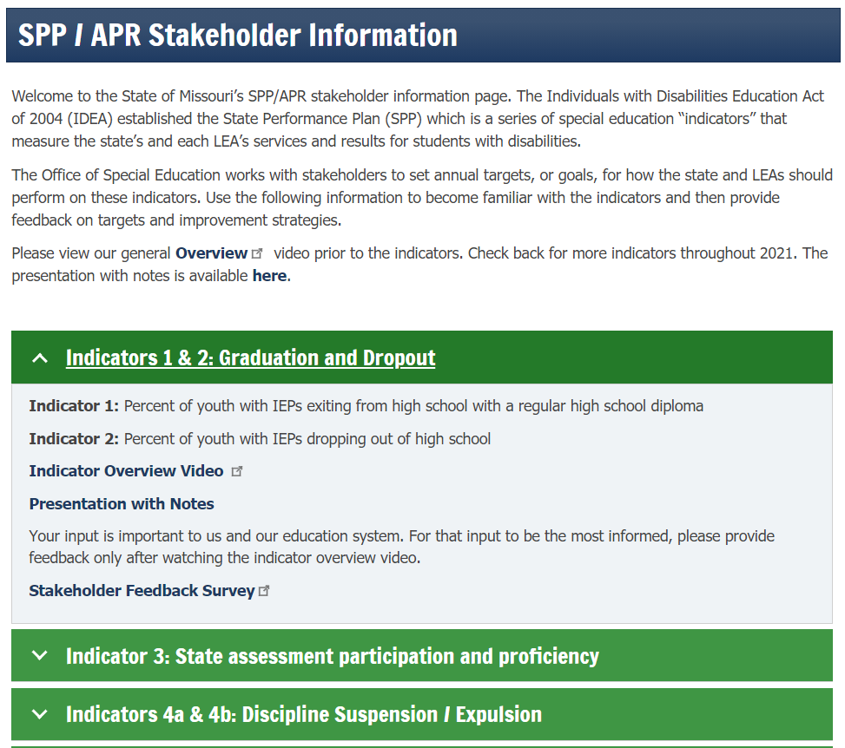
SPP/APR Stakeholder Information
Web page
  Short videos
  Presentation with notes
  Feedback surveys
https://dese.mo.gov/spp-apr-stakeholder-information
Notes:
State Performance Plan- is required by IDEA and is a set of performance indicators established by OSEP that every state must address. States must set annual targets for six years and these targets apply to state and every local school district.
In February 2022 we will set targets for the next 6 years. Surveys are one way we are gathering input from stakeholders. We are encouraging everyone to check out an indicator or two and to please share this webpage with parents.
The feedback surveys include three questions: What is happening that is making a positive difference for this indicator now? These are practices or activities that we would want to promote or expand. What is making a negative difference now? These are practices we may want to discourage or find alternatives for. Lastly what is not happening that could make a positive difference? These could be simple solutions or complex systems. All together these three questions will enable state and local school districts to meet the targets that we are setting.
We need a diverse group of stakeholders and want to get as much input as we can ☺
Contact Mary Corey with data for further questions.

