Slide 1
Missouri Connections for Teachers Regional Professional Development Center

Slide 2
Notes:
Need to activate poll – open full slide show – upper Rt. Corner – second tab (Activate) Can clear prior results from this point also Poll Title: Whose responsibility is it to teach college and career readiness? https://www.polleverywhere.com/multiple_choice_polls/BTc9KgK2esab4qZ
The Question aligns with our purpose for teachers – to connect the relevance of their content to career exploration.
Will show the results as the responses are entered – Will reference the results during the training

Slide 3
Purpose for Training
Educational Shift Towards Career Development
Facilitate students opportunity to explore and engage in education and career planning through classroom lessons.
Discover Relevance
Develop a plan to incorporate Missouri Connections
Notes:
Career Development is the responsibility of everyone within the school community.
Reference results from survey
Consider during this training – your specific content area and how you can implement MC into your lessons.
Generate questions for us.
What additional support or information would you like to see ( repeat at the end of session)

Slide 4
Questions to Consider (Partner Share)
Why is it important for you to help students prepare for post-graduation?
Whose responsibility is career education?
How can your students explore career options in your content area?
What would you like for students to “take away” from career exploration?
Notes:
School is a collective effort- all are responsible
Shoulder Partner/Table Talk
About 2-3 minutes to partner share – informal discussion

Slide 5
Missouri Connections as an Instructional Resource
By incorporating Missouri Connections in your content area it…
Exposes students to career exploration
Builds content relevance with students
Promotes awareness of college and career readiness
Notes:
Builds Capacity – Both Teachers and Students
Knowledge
Research
Collaboration

Slide 6
Notes:
Provide teachers with a full page chart for their reference. 11x17 placemat
Breakdown Career Path, Cluster, and Pathway- Short reference to each part; want to begin building capacity to see relationship to their content
Knowledge and Skill (employability skills)– In the Center– Important for all Career Paths
Ask teachers to consider which career cluster(s) their content aligns with – Move to next slide

Slide 7
Partner Share
Which Career Clusters align with your content?
Examples?
Who is responsible for Career Development?
Notes:
Using the placemat – partner share (3-5 minutes, pending discussion)
Ask for a couple partner volunteers to share their Content Area and what they see as aligned Career Clusters
Refer back to survey results –
depending on the initial results – we can connect Relevance to Career Development

Slide 8
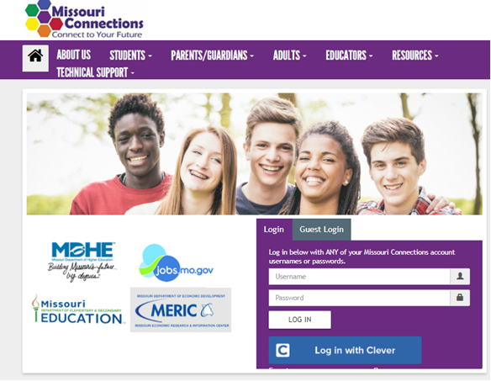
www.missouriconnections.org
Notes:
Pre set up with Counselor –teacher logins; arrange for icon upload – Direct Teachers to login
missouriconnections.org
HYPER link to login page
Introduce Clever – as option for schools. School Counselors can learn more about this option and how to implement this login process
Advantage – provides a quick, easy login process for teachers and students. Minimizes delays during instruction; reflects the importance and value of MC.
Encourage teachers to create a quick link to this page or open the window prior to the lesson they intend to use it. This will reduce any frustration or delays during instruction

Slide 9
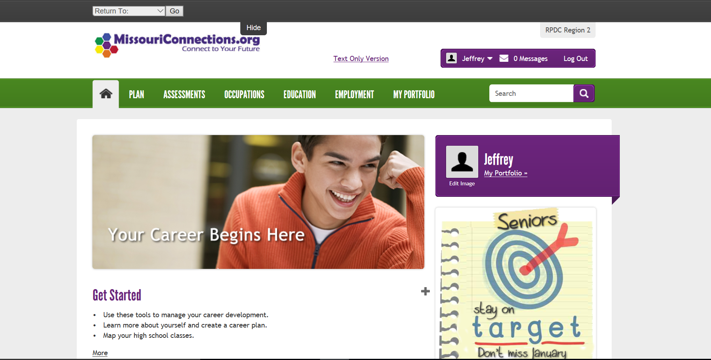
Notes:
Arrow points to Occupations tab- this is where you will want to go
Introduce Occupations tab, but also show the resources available under the other tabs.
Occupations – go to Career Clusters – This is the first method to use this tab – point out the ICON KEY
Click on Health Services – open up Dermatology (example)
Review At a Glance
Show them the Topic column. - Click Skills and Abilities; reference this as employability skills for success
Next click Athletic Trainer – reference/show the video - Important for teachers to see how videos can extend their students learning
Next – Use the Search Tab – Type Biology; show the occupations that are identified - Open any.
Next type Agriculture – review occupations – open up Sales and Marketing – Review the Knowledge section.

Slide 10
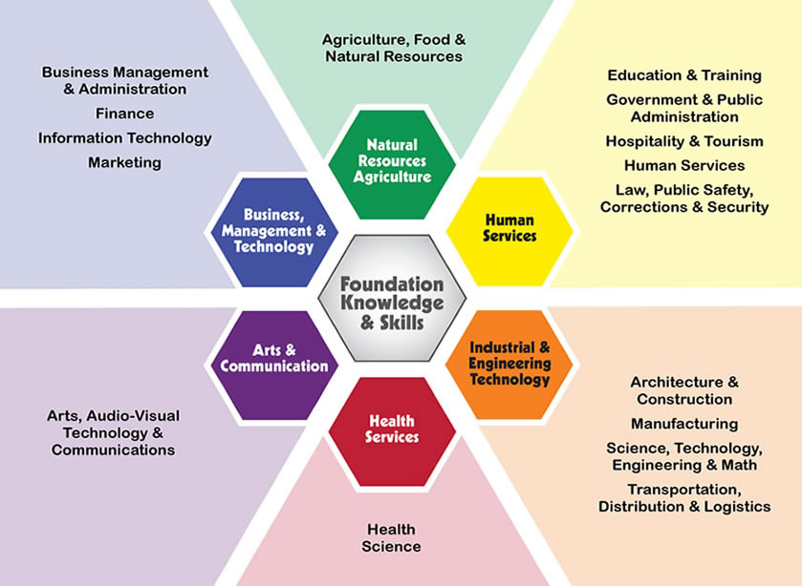
Notes:
We will use online to guide presentation - Click the Career Cluster Tab ( this picture will come up)
Click on Hospitality and Tourism – click on pathways – scroll down to show occupations
Refer back to partner activity – ask group to look at one career pathway to see how connected to their content
Explore additional pathways to see the depth of this instructional tool. (Length of time allotted - TBD)

Slide 11
Expl ration
Purpose for Exploring…
To determine ways to incorporate careers into a lesson using Missouri Connections.
What is your one lesson within a unit you can incorporate career exploration?
Notes:
Where is your one lesson within a unit that you can align career exploration?
Identify the unit lesson that you will implement Missouri Connections into instruction

Slide 12
What will it take to make this a collective commitment for you?
What is the importance of Missouri Connections?
Sustainability
Notes:
Sustainability is key – it requires commitment and belief in the system- embedded in practice.
Reflect back to the purpose of the training – Importance of MC

